Slide 1
Project 1 ELF, Program loading

Slide 2
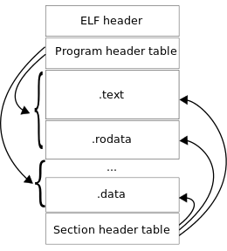
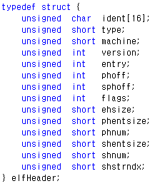
elf.c
Parameter
Char *exeFileData : executable file을 read한 버퍼
struct elfHeader : GeekOS의 ELF Header 구조체
Struct programHeader : GeekOS의 Program Header 구조체
struct Exe_format : GeekOS에서 Program을 Load하기 위한 Segment 정보를 포함하는 구조체
EXE_MAX_SEGMENTS : GeekOS의 최대 Segment 개수(3)
exeFileData(buffer)
Exe_format
Int Parsr_ELF_Executable (char *exeFileData, ulong_t exeFileLength, struct Exe_Format *exeFormat)
1.
Elfhdr = (elfHeader*) exeFileData ;
2.
If(elfhdr -> phnum <= EXE_MAX_SEGMENT)
exeFormat -> numSegments = elfhdr -> phnum;
exeFormat -> entryAddr = elfhdr -> entry;
3.
for( i=0; i < elfhdr->phnum; i++)
programhdr = (programHeader *)(exeFileData + elfhdr->phoff + (i * elfhdr->phentsize));
exeFormat->segmentList[i].offsetInfile = programgdr->offset;

Slide 3
userseg.c
User process 시작주소
복사
exeFileData(buffer)
Exe_format
주소참조
복사
command
DEFAULT_USER_STACK_SIZE
Total size
int Load_User_Program(char *exeFileData, ulong_t exeFileLength, struct Exe_Format *exeFormat, const char *command, struct User_Context **pUserContext)
각각의 Segment( Text, Data)들의 정보를 담은 struct Exe_format을 이용
Segment가 시작하는 memory 주소, segment 크기, Stack Size들을 산술하여 stack 시작주소, command 시작주소를 정함
Process가 가지는 memory영역의 size를 계산 → Process memory 할당
Process memory의 시작주소를 기준으로 각 Segment들을 Process의 memory에 Loading (memcpy)

Slide 4
userseg.c
1 ~ 3
User process 시작주소
Exe_format
주소참조
복사
DEFAULT_USER_STACK_SIZE
command
Total size
for( i=0; i < exeFormat->numSegments; i++)
struct Exe_Segment *segment = &(exeFormat->segmentList[i]);
tmp = segment->startAddress + segment->sizeInMenory;
if(maxsegsize <= tmp)
meaxsegsize = tmp;
argvaddr = stackvaddr + DEFAULT_USER_STACK_SIZE;
Get_Argument_Block_Size(); : 결과값 argblocksize
totvaddrsize = argvaddr + Round_Up_To_Page(argblocksize)
stackvaddr = Round_Up_To_Page(maxsegsize);
Project 2

Slide 5
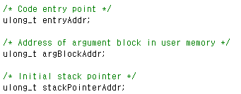
userseg.c
4
User process 시작주소
복사
exeFileData(buffer)
복사
command
DEFAULT_USER_STACK_SIZE
Total size
stackvaddr
argvaddr
for( i=0; i < exeFormat->numSegments; i++)
struct Exe_Segment *segment = &(exeFormat->segmentList[i]);
memcpy(
(*pUserContext)->memory) + (segment->startAddress),
exeFileData + (segment->offsetInFile),
Segmet->lengthInFile);
(*pUserContext) -> entryAddr = exeFormat -> entryAddr;
Dest
src
len
Format_Argument_Block((*pUserContext->memory + argvaddr, numarg, argvaddr, command);

Slide 6
Project 2 User context

Slide 7
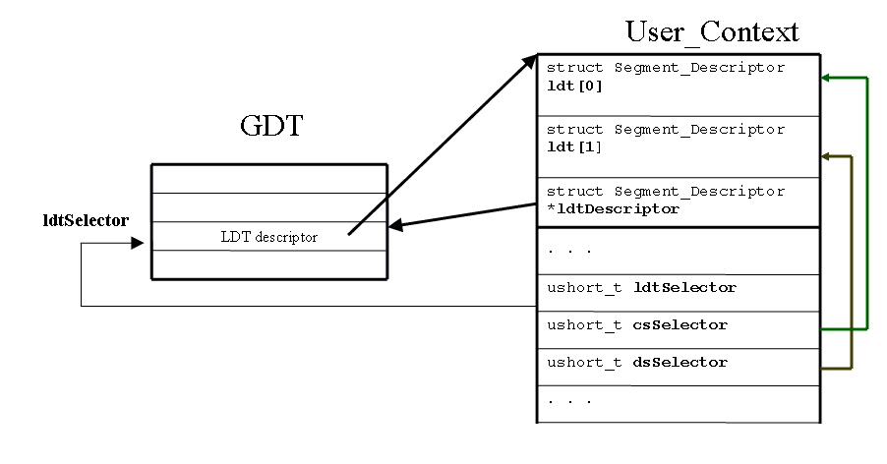
userseg2.c
struct User_Context* Create_User_Context (ulong_t size)

Slide 8
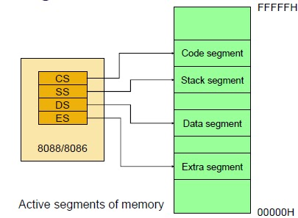
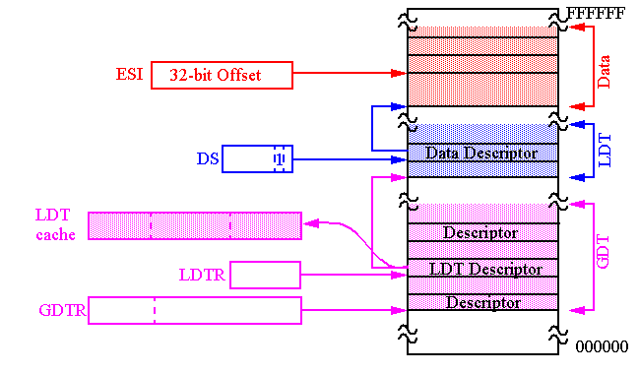
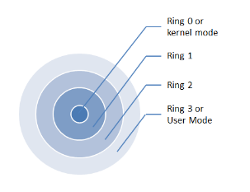
User context Descriptor Table - LDT
Local Descriptor Table : Process에 대한 Segment Descriptor들을 보관
LDTR을 통해 접근, Context Switching과 관련성이 있음
LDT의 위치를 나타내는 Segment Descriptor를 GDT 내부에 저장한 뒤, 해당 Index를 LDTR Register에 넣어주면 CPU는 LDT를 읽어들여 Process의 Segment들에 대한 정보에 접근가능
32bit 이상의 OS에서 Segment Register에는 Segment에 관한 LDT의 Descriptor Number가 들어가게 되어 Segment Selector라는 명칭으로 바뀌게 된다

Slide 9
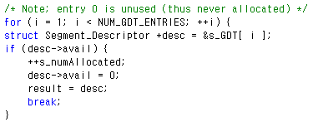
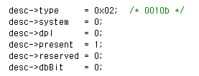
userseg2.c
struct User_Context* Create_User_Context (ulong_t size)
pUserContext = (struct pUserContext*) Malloc( sizeof(struct User_Context) );
pUserContext -> memory = (char*) Malloc (size);
pUsetContext -> size = size;
pUserContext -> ldtDescriptor = Allocate_Segment_Descriptor();
Init_LDT_Descriptor(pUserContext->ldtDescriptor, pUserContext->ldt, NUM_USER_LDT_ENTRIES);

Slide 10
userseg2.c
struct User_Context* Create_User_Context (ulong_t size)
Init_Code_Segment_Descriptor( ~ );
Init_Data_Segment_Descriptor( ~ );
pUserContext->ldtSelector = Selector( ~ );
pUserContext->csSelector = Selector( ~ );
pUserContext->dsSelector = Selector( ~ );
pUserContext->refCount = 0;

Slide 11
Project 3 EDF-Scheduling

Slide 12
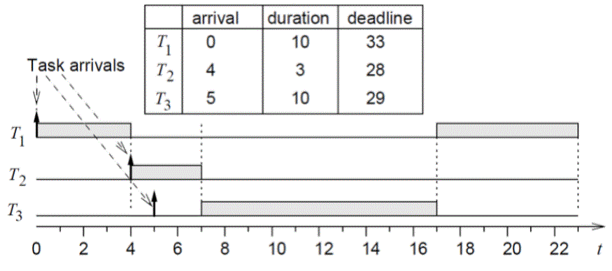
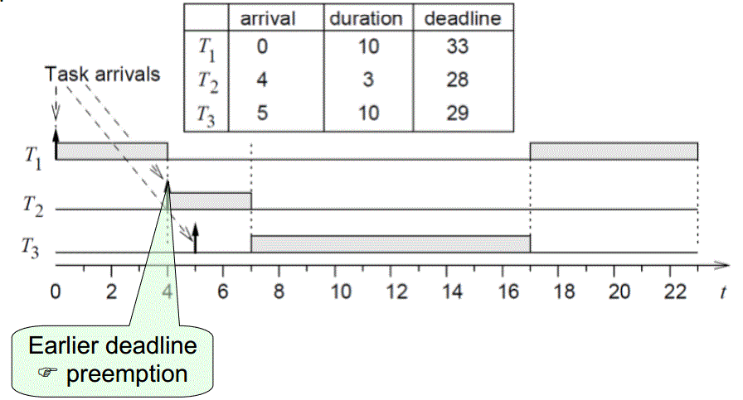
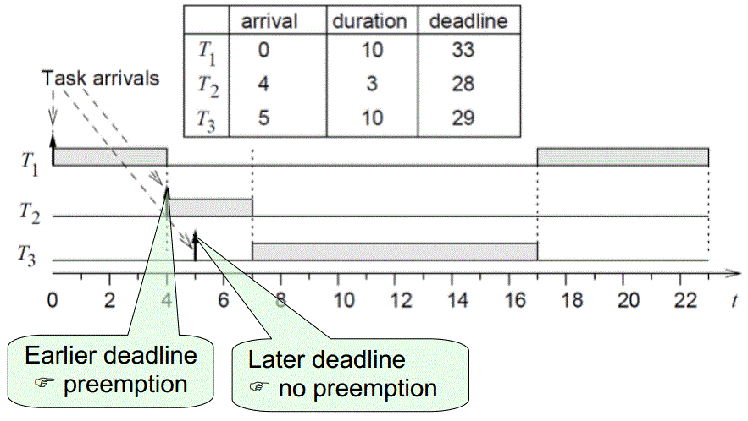
timer.c
User thread
- EDF
Dead line - 20
Dead line - 15
1
1
2
2
Kernel thread
- Round Robin
static void Timer_Interrupt_Handler(struct Interrupt_State* state)
if(policy == 2 && spawned)
{
g_needReschedule = true;
}

Slide 13
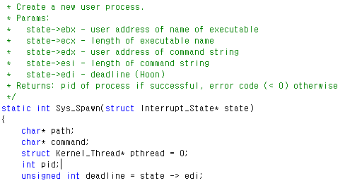
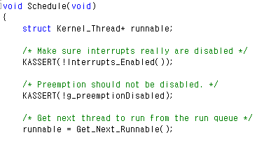
kthread.c

Slide 14
kthread.c
User thread
- EDF
Dead line - 20
Dead line - 15
1
1
2
2
Kernel thread
- Round Robin
struct Kernel_Thread* Get_Next_Runnable(void)
struct Kernel_Thread* Find_Best(struct Thread_Queue* queue)
case 2: // EDF
if(spawned || K_or_U_sched)
{
best = Find_Best_User(&s_runQueue[0]);
spawned = 0;
K_or_U_sched = 0;
}
else if(!K_or_U_sched)
{
best = Find_Best(&s_runQueue[0]);
K_or_U_sched = 1;
}
if(best != 0)
Remove_Thread(&s_runQueue[0], best);
break;
if(policy == 2)
{
while (kthread != 0) {
if ((best == 0 && kthread -> K_or_U) || (kthread -> K_or_U && kthread->priority > best->priority))
best = kthread;
kthread = Get_Next_In_Thread_Queue(kthread);
}
struct Kernel_Thread* Find_Best_User(struct Thread_Queue* queue)
struct Kernel_Thread *kthread = queue->head, *best = 0;
while (kthread != 0) {
if ((best == 0 && kthread -> K_or_U == 0) || (kthread -> K_or_U == 0 && kthread->deadline < best->deadline))
best = kthread;
kthread = Get_Next_In_Thread_Queue(kthread);
}
if(!best)
best = Find_Best(queue);
return best;

Slide 15
Project 4 Semaphore

Slide 16
Semaphore
Sys_CreateSemaphore()
Sys_P()
인자로 받은 Semaphore ID로 해당
Semaphore를 검색
해당 Semaphore의 count값을 조회하여
thread가 wait 또는 임계영역 자원획득 허가를 판단
Sys_V()

Slide 17
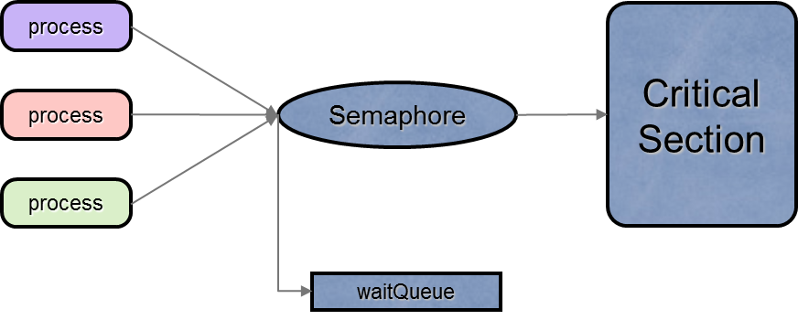
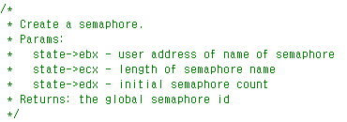
syscall.c
static int Sys_CreateSemaphore(struct Interrupt_State* state)
char sem_name[25];
int length = state->ecx;
Copy_From_User(sem_name, state->ebx, length);
else
for(i=0 ; i<NUM_SEMAPHORE; i++)
{
if(strcmp(sem_name,sem[i]->sem_name)==0)
return i;
if(sem == NULL)
sem = (struct semaphore**)Malloc(NUM_SEMAPHORE * sizeof(struct semaphore*));
for(i=0; i<NUM_SEMAPHORE; i++)
{
sem[i] = (struct semaphore*)Malloc(sizeof(struct semaphore));
sem[i] 초기화
Clear_Thread_Queue( (sem[i] waitqueue) );
}
for(i=0 ; i<NUM_SEMAPHORE; i++)
if(sem[i]->avail)
{
sem[i]->count = state -> edx;
sem[i]->avail = 0;
memcpy(sem[i]->sem_name,sem_name,length+1);
return i;
}

Slide 18
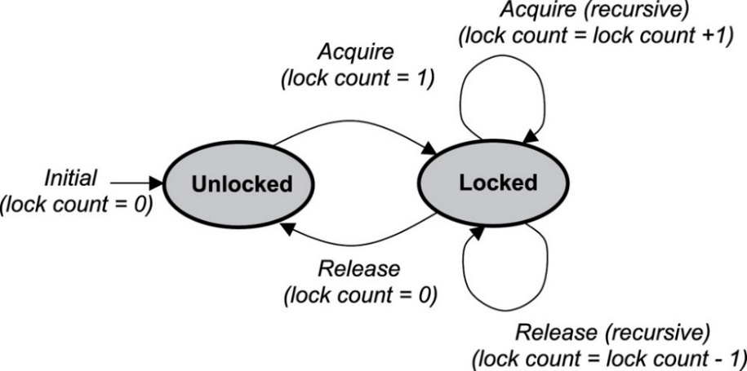
syscall.c
static int Sys_P(struct Interrupt_State* state)
static int Sys_V(struct Interrupt_State* state)
int sem_id = state -> ebx;
if(sem[sem_id]->count <= 0)
Wait;
else
sem[sem_id]->count--;
int sem_id = state -> ebx;
if(!Is_Thread_Queue_Empty(&(sem[sem_id]->waitQueue)))
Wake_Up
else
sem[sem_id]->count++;

Slide 19
syscall.c
static int Sys_DestroySemaphore(struct Interrupt_State* state)
int sem_id = state->ebx;
if(sem[sem_id]->avail == 0)
{
return -1;
}
else
{
sem[sem_id]->count = 0;
sem[sem_id]->avail = 1;
Clear_Thread_Queue;
}

Slide 20
Project 제출
제출
제출기한 : 기말고사 1주 후
제출방법 : Geek-OS 압축파일+소스 설명을 포함한 Report
Email제출
질문사항
Email 또는 자연과학관 515호

