Slide 1
Sparrow Distributed, Low Latency Scheduling
72130310 임규찬

Slide 2
목차
Abstract
Introduction
Design Goals
Sample-Based Scheduling for Parallel Jobs
Implements

Slide 3
Abstract
Large-scale data analytics frameworks are shifting
Shorter task durations
Larger degrees of parallelism to provide low latency
Paper demonstrate that a decentralized, ran-domized sampling approach
Provides near-optimal performance avoid throughput
Availability limitations of a centralized design
Sparrow, on a 110-machine cluster demonstrate performs within 12% of ideal scheduler

Slide 4
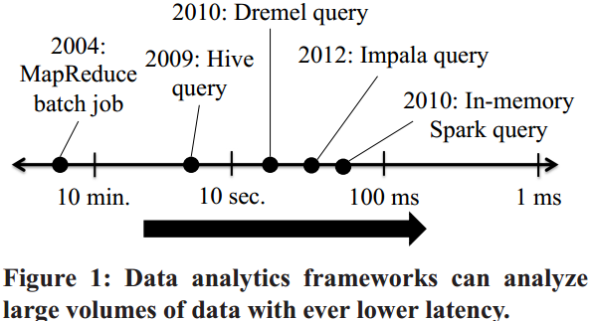
Introduction
Today’s data analytics clusters are running ever shorter and higher-fanout jobs
Expect this trend will enable powerful new application

Slide 5
Introduction
Jobs composed of short, sub-second tasks present difficult scheduling challenge
Frameworks targeting low latency
Long-running batch jobs into a large number of tasks, a technique that improves fairness and mitigates stragglers
These requirements differ from traditional workloads

Slide 6
Introduction
Explores opposite extreme in the design space
Propose scheduling from a set of machines that operate autonomously and without centralized or logically centralized state
Decentralized design offers attractive scaling and availability properties
System can support more requests by adding schedulers

Slide 7
Introduction
Sparrow?
Stateless distributed scheduler that adapts the power of two choices technique
Proposes scheduling each task by probing two random servers and placing the task on the server with fewer queued task
Have three techniques to make the power of two choices effective in a cluster running parallel jobs.
Batch sampling
Late binding
Policies and constraints

Slide 8
Introduction - Batch Sampling
‘power of two choices’ perform poorly for parallel jobs
Job response time is sensitive to tail task wait time
Batch sampling solve this problem
Applying the recently developed multiple choices approach to the domain of parallel job scheduling
Batch sampling places the m tasks in a job on the least loaded of d *m randomly selected worker

Slide 9
Introduction - Late Binding
‘power of two choices’ suffers from two remaining performance problems
Server queue length is poor indicator wait time
Multiple schedulers sampling in parallel may experience race conditions
Late binding avoids these problems
Delaying assignment of tasks to worker machines until workers are ready to run the task, and reduce median job response time by as much as 45%

Slide 10
Introduction - Policies and Constraints
Sparrow uses multiple queues on worker
To enforce global policies
Supports the per-job and per-task placement constraints needed by analytics frameworks.
Neither policy enforcement nor constraint handling are addressed is simpler theoretical models, but both play an important role in real clusters

Slide 11
Design Goals
This paper focuses on fine-grained task scheduling for low-latency applications
Sparrow need only send a short task descriptions
Sparrow assumes that long-running executor process is already running on each worker for each framework.
Sparrow makes approximations
When scheduling and trades off many of the complex features supported by sophisticated, centralized schedulers in order to provide higher scheduling throughput and lower latency.

Slide 12
Design Goals
Sparrow does not allow certain types of placement constraints
Does not perform bin packing
Does not support gang scheduling
Sparrow supports a small set of features
Can be easily scaled
Minimizes latency
Keeps the design of the system simple

Slide 13
Sample-Based Scheduling for Parallel Jobs
Traditional task scheduler maintains a complete view of which tasks are running on which worker machine
uses this view to assign incoming tasks to available works
Sparrow takes a radically different approach
Schedulers operate in parallel
Schedulers do not maintain any state about cluster load

Slide 14
Sample-Based Scheduling for Parallel Jobs - Terminology and job model
Worker machines
Composing cluster, Execute tasks
Schedulers
Assign tasks to worker machines
Wait time
Describe the time from when a task is submitted to scheduler until when the task begins executing
Service time
Describe the time from when a task begins executing

Slide 15
Sample-Based Scheduling for Parallel Jobs - Terminology and job model
Job Response Time
Describes the time from when the job is submitted to the scheduler until the last task finishes executing
Delay
Describe the total delay within a job due to both scheduling and queueing

Slide 16
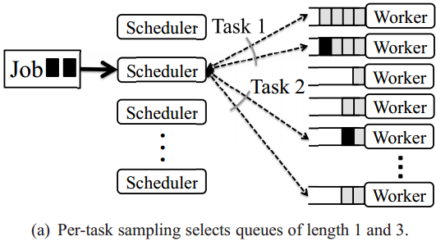
Sample-Based Scheduling for Parallel Jobs - Per-task sampling
The scheduler randomly selects two worker machines for each task and sends to lightweight RPC a probe to each.
Improves performance compared to random placement

Slide 17
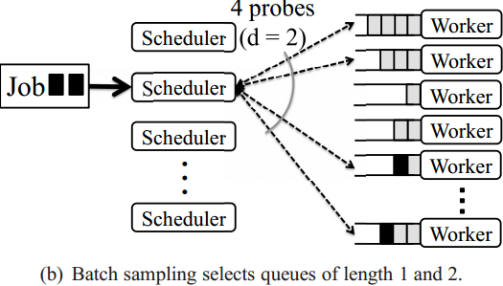
Sample-Based Scheduling for Parallel Jobs - Batch Sampling
Improves on per-task sampling by sharing information across all of the probes for a particular job

Slide 18
Sample-Based Scheduling for Parallel Jobs - Problems with sample-based scheduling
Sample-based techniques perform poorly at High load
Schedulers place tasks based on the queue length
Suffers from a race condition where multiple schedulers concurrently place tasks on a worker tha appears lightly loded.

Slide 19
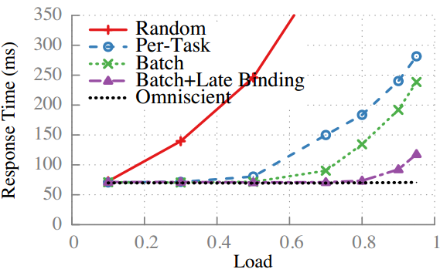
Sample-Based Scheduling for Parallel Jobs - Late Binding
Solve the aforementioned problems
Workers do not reply immediately to probes
Instead place a reservation for the task at the end of an internal work queue

Slide 20
Sample-Based Scheduling for Parallel Jobs - Proactive Cancellation
Using simulation, Proactive cancellation deduces median response time by 6% at 95% Cluster load
Helps more when the ratio of network delay to task duration increases.
Will become more important as task durations decrease

Slide 21
Scheduling Policies and constraints
Sparrow aims to support a small but useful set of policies within its decentralized framework
Two types of popular scheduler policies
Handling placement constraints
Resource allocation policies

Slide 22
Scheduling Policies and constraints - Handling placement constraints
Handles two types of constraints
Per-job/Per-task constraints
Per-job constraints are trivially handled at a Sparrow scheduler

Slide 23
Scheduling Policies and constraints - Resource allocation policies
Sparrow supports two types of policies
Strict priorities
Weighted fair sharing
Many cluster sharing policies reduce to using strict priorities
Sparrow can also enforce weighted fair shares.

Slide 24
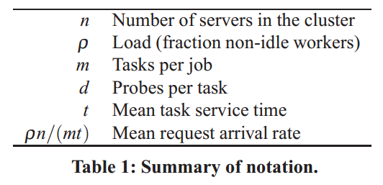
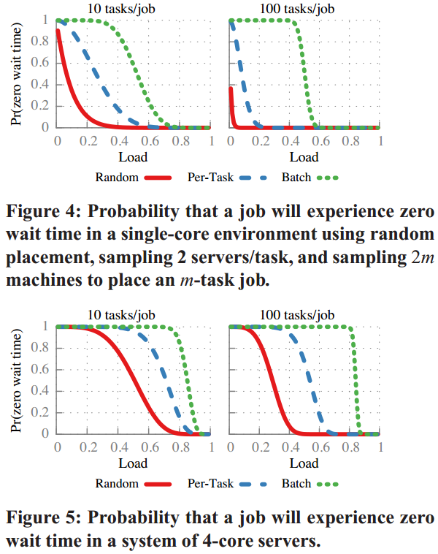
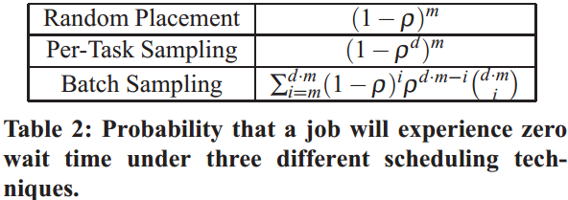
Analysis

Slide 25
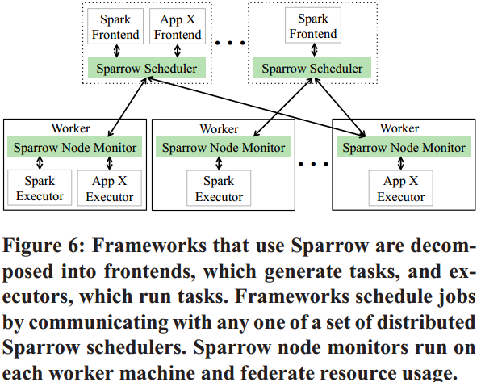
Implementation
Sparrow schedules from a distributed set of schedulers that are each responsible for assigning task to workers

Slide 26
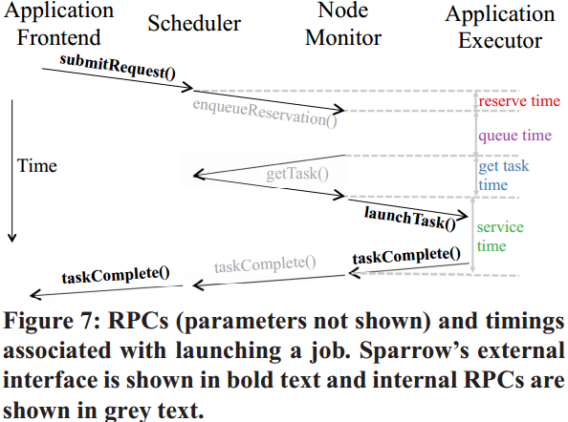
Implementation
Schedulers expose a service that allows frameworks to submit job scheduling requests using Thrift remote procedure call.

Slide 27
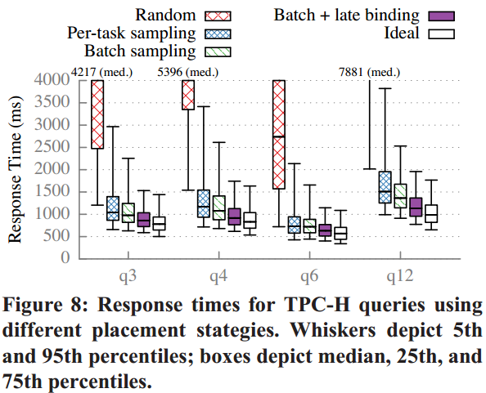
Experimental Evaluation -Performance of TPC-H workload

Slide 28
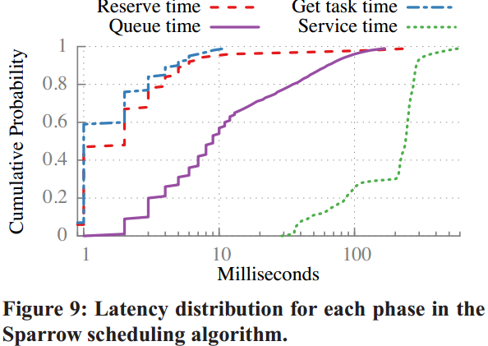
Experimental Evaluation - Deconstructing performance

Slide 29
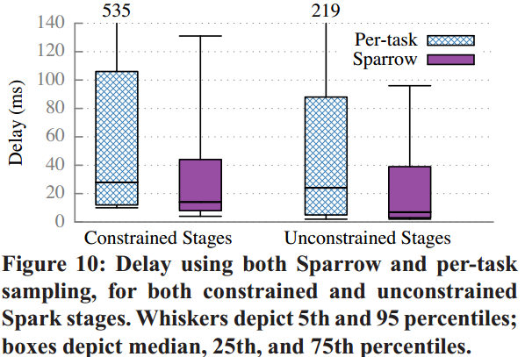
Experimental Evaluation -How do task constraints affect performance?

Slide 30
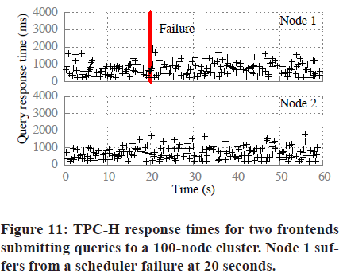
Experimental Evaluation -How do scheduler failures impact job response time?
Sparrow provides automatic failover between schedulers

Slide 31
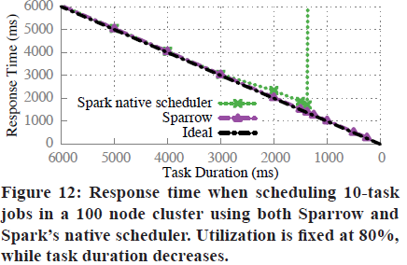
Experimental Evaluation -How does Sparrow compare to Spark’s native, centralized scheduler?

Slide 32
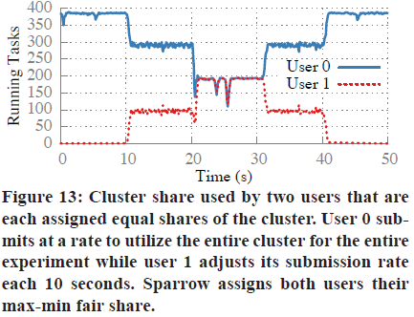
Experimental Evaluation -How well can Sparrow’s distributed fairness enforcement maintain fair shares?

