Slide 1
Analyzing Inter-Application Communication
In Android
MobiSys '11 Proceedings of the 9th international conference
on Mobile systems, applications, and services
2015. 4. 28
박 종 혁
pjh61014@dankook.ac.kr
컴퓨터 보안 및 운영체제 연구실

Slide 2
Contents
Introduction
Android Overview
Intent-Based Attack Surface
Comdroid
Evaluation
Conclusion
References

Slide 3
Introduction
Android’s message passing system Can become an attack surface if used incorrectly
Intent
Intents can be used for both intra and inter Application communication
Comdroid
A tool analyzes Android applications to detect potential instance of vulnerabilities
Personal data loss, corruption, phishing

Slide 4
Android Overview
Android’s security model differs significantly from the standard desktop security model
The Complexity of Android’s message passing system implies it has the largest attack surface
This paper do not consider attacks on the OS
Just focus on securing applications from each other

Slide 5
Android Overview
Intents
Provides a sophisticated message passing system
System broadcast Intents
Only can be sent by the OS
Intent
Intent
Start Activity()
OnCreate()
Activity A
Android
System
Activity B
1
2
3

Slide 6
Android Overview
Kind of Intent
Explicit Intent
specifies that it should be delivered to a particular application specified by the Intent
Implicit Intent
requests delivery to any application that supports a desired operation.
Intent B
Activity B
Activity A
Intent C
Activity C
Intent Filter
Filter through Action
Intent B
Intent B
Activity B
Activity A
Intent C
Activity F
Intent Filter

Slide 7
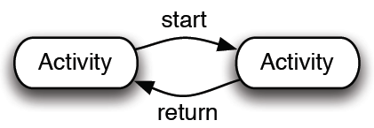
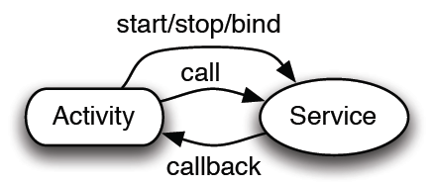
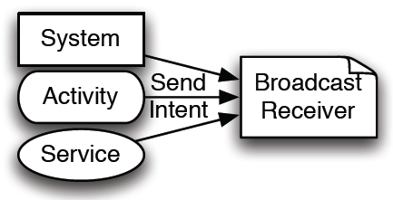
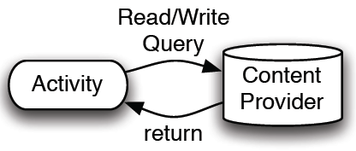
Android Overview
Activity
Display on screen
Service
Background process
Broadcast Receiver
Asynchronous event notification
Broadcast Intent
Normal, Ordered, Sticky
Content Provider
Share data between applications
Use URI (Uniform Resource Identifier)

Slide 8
Android Overview
A sender can assign any action, type, or category

Slide 9
Android Overview
Component Declaration
AndroidManifest.xml
To receive Intents
Service and Activity must be declared in the manifest
Broadcast Receivers can be declared at runtime or in the manifest
Exported Components
EXPORTED flag (in AndroidManifest.xml)
Includes at least one Intent filter
Intent filter
Action, category, data, extra data…

Slide 10
Android Overview
Permission
Normal
permissions are granted automatically.
Dangerous
permissions can be granted by the user during installation.
Signature
permissions are only granted if the requesting application is signed by the same developer that defined the permission.
SignatureOrSystem
m permissions are granted if the application meets the Signature requirement or if the application is installed in the system applications folder.

Slide 11
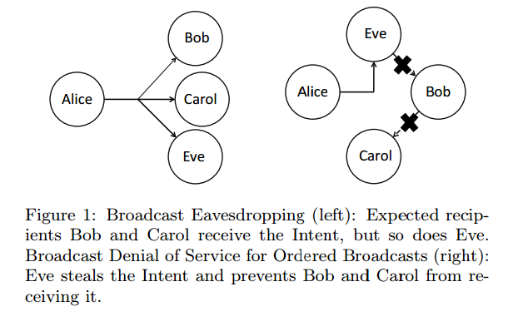
INTENT-BASED ATTACK SURFACES
Broadcast Theft
A malicious Broadcast Receiver
could eavesdrop on all public broadcasts from all applications
by creating an Intent filter that lists all possible actions, data, and categories.Dangerous

Slide 12
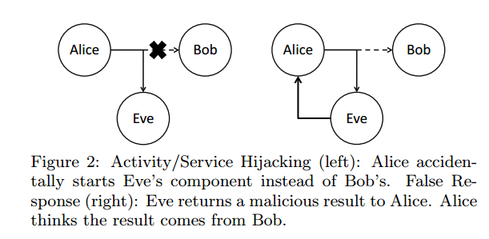
INTENT-BASED ATTACK SURFACES
Activity Hijacking
a malicious Activity is launched in place of the intended Activity.
the malicious Activity could read the data in the Intent and then immediately relay it to a legitimate Activity.
Service Hijacking
occurs when a malicious Service intercepts an Intent meant for a legitimate
initiating application establishes a connection with a malicious Service instead of the one it wanted.

Slide 13
INTENT-BASED ATTACK SURFACES
Malicious Broadcast Injection
If an exported Broadcast Receiver blindly trusts an incoming broadcast Intent
inappropriate action or operate on malicious data from the broadcast Intent.
Malicious Activity Launch
Exported Activities can be launched by other applications with either explicit or implicit
Malicious Service Launch
If a Service is exported and not protected with strong permissions
then any application can start and bind to the Service

Slide 15
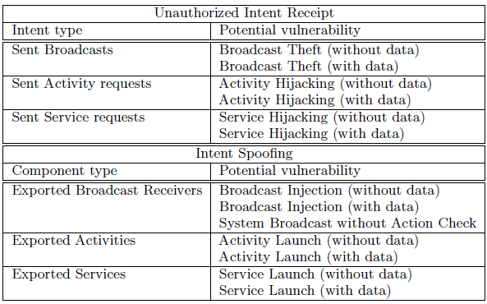
ComDroid
Disassemble application DEX files using Dedexer tool
Parses the disassembled output and logs potential component and Intent vulnerabilities

Slide 16
ComDroid
Permission
Normal and Dangerous
Intent Analysis
Intents, IntentFilters, registers, sinks (e.g., sendBroadcast(), startActivity(), etc.) and components
Component Analysis
Public or not?
Main, launching Activity is public but is less likely to be attackable
With data / without data

Slide 17
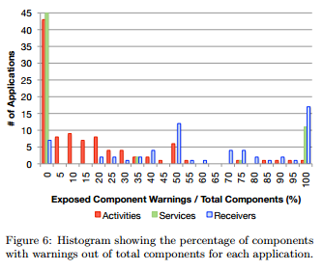
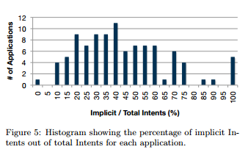
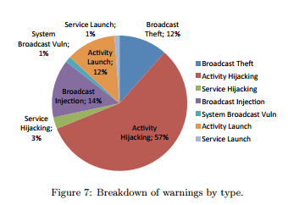
Evaluation
Automated Analysis
False negatives
Pending Intent
Future work

Slide 18
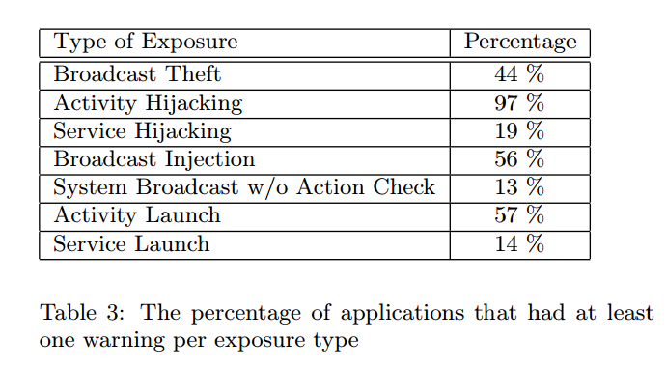
Evaluation
Automated Analysis
Do not distinguish between paths through if and switch statements

Slide 19
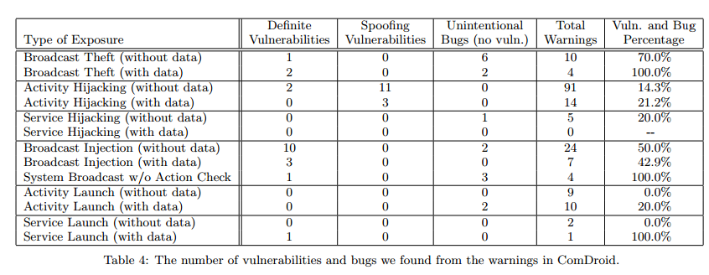
Evaluation
Manual Analysis

