Slide 1
Data Retention in MLC NAND Flash Memory: Characterization, Optimization, and Recovery
Yu Cai, Yixin Luo, Erich F. Haratsch*, Ken Mai, Onur Mutlu
Canegie Mellon University, LSI Corporation*
Daeyeon Son
2015.5.12

Slide 2
Introduction
Typical Retention in NAND Flash Memory error occurs due to the leakage of electrons stored in the Floating Gate.
This paper focuses on the problem of dealing retention age varies depending on the distribution of the Threshold voltage in MLC NAND flash chip for 2y-nm.
Using Retention Optimized Reading according to each of the State Voltage Retention State check in real time, and allows to modify the Voltage is maintained at the optimal level.
Using the Data Retention Failure Recovery allows to recover for the Error has occurred Cell.

Slide 3
Reviewer’s History..
- Arrhenius’s Law -

Slide 4
Why do we think it is difficult..?!
The answer is very simple because we need to learn about the NAND Flash Memory..
Speaker
‘Dyson’
Retention Optimized Reading (ROR)
Retention Failure Recovery (RFR)
NAND Flash Memory..?!
Hardware Structure
How to identify the ‘0’ and ‘1’
Threshold Voltage
SLC, MLC, TLC..?!
Single Level Cell
Multi Level Cell
Triple Level Cell
Hot Issues in This Paper
Tunneling Effect
Trap-Assisted Tunneling
Charge De-Trapping
Retention Age in Each State
Read Latency
Error Correction Latency

Slide 5
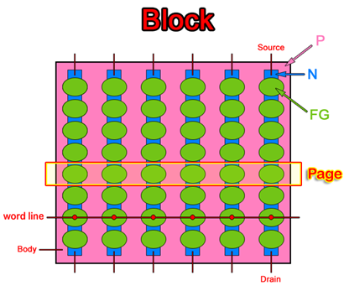
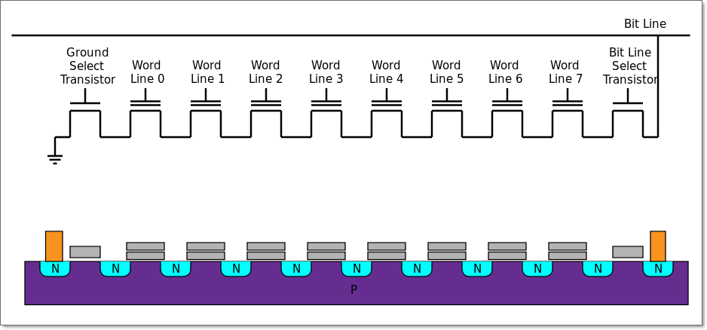
NAND Flash Memory
NAND Flash Memory is non-volatile storage.
Memory structure is configured by bit line and word line.
(bit line)

Slide 6
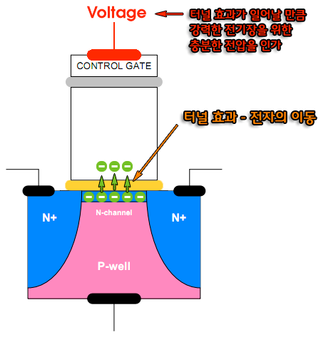
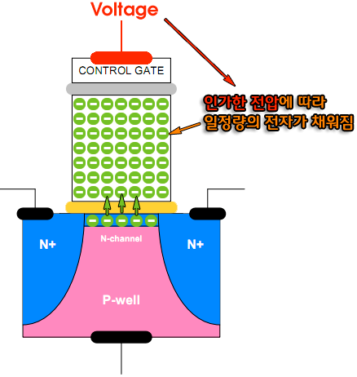
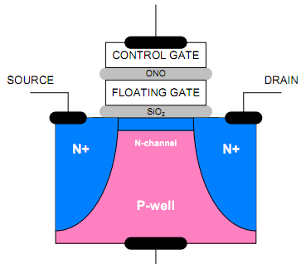
NAND Flash Memory
NAND Flash Memory Cell separation between 0 and 1 rely on the charge on Floating Gate is filled by a current that is sent from a Drain to Source.
‘Program’ operation is called that inserting electric charge from substrate to the floating gate.

Slide 7
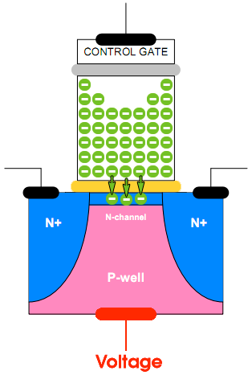
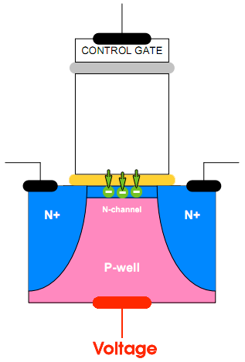
NAND Flash Memory
If voltage send to P-well, electric charge within floating gate is forced out to N-channel.
‘Erase’ operation is called that removing electric charge from the floating gate to substrate.

Slide 8
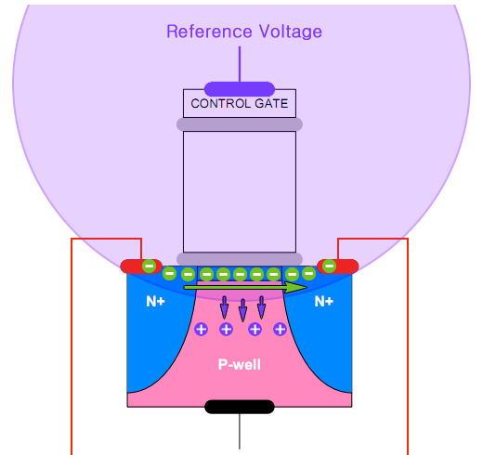
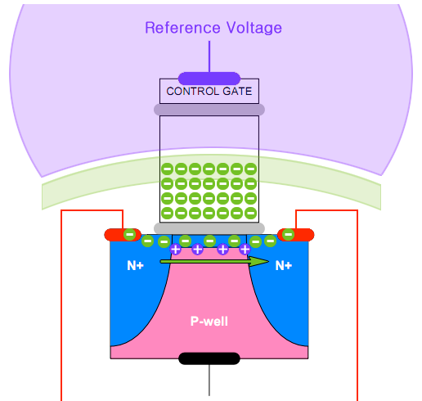
NAND Flash Memory
‘Read’ operation that is identify reference voltage on control gate is affected by intrinsic electric field which is made by electric charge in floating gate.

Slide 9
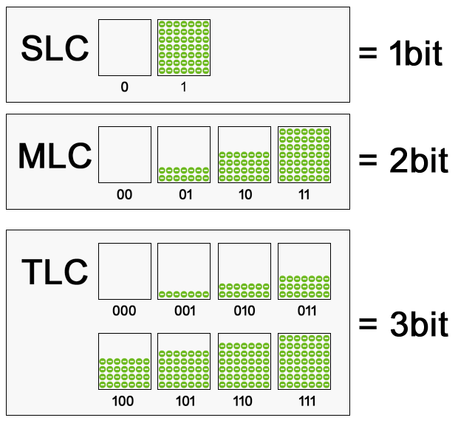
NAND Flash Memory
SLC : Single-Level Cell
1, 0
MLC : Multi-Level Cell
11, 10, 00, 01
TLC : Triple-Level Cell
… … … …
… … … …
More More~

Slide 10
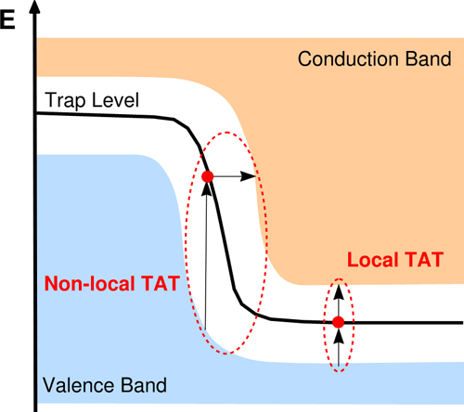
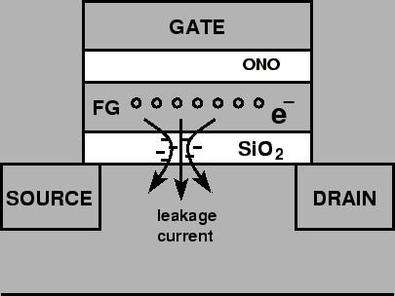
Hot Issues in This Paper
Trap-Assisted Tunneling Effect
‘TAT effect’ is proceed by increase P/E cycles and electric charge gets in the tunnel oxide between floating gate and substrate.
As long as the retention age, electric charge will be remained more than the previous state.
And, Electric charge in the tunnel oxide is related with ‘Stress Induced Leakage Current(SILC)’.
Electric charge in the floating gate are faster removed through ‘SILC’ by TAT effect on tunnel oxide.

Slide 11
Hot Issues in This Paper
Trap-Assisted Tunneling Effect
What is the origin of the 'TAT Effect'?
Basically, Threshold voltage of a flash cell is calculated that above formula.
And, We can find that threshold voltage is directly affected by the amount of the charge($Q_{FG}$) that is programmed on the floating gate.
Tunneling current in a flash cell is calculated that above formula.
The tunneling current ($J_{FN}$) exponentially correlates with the oxide electric field strength ($E_{ox}$).
Oxide electric field strength is calculated that above formula.
As a result, We can find that Tunneling current($J_{FN}$) is totally affected by the amount of the charge ($Q_{FG}$).
$$V_{th}=V_{thi}+\left(−Q_{FG}\right)/C_{pp}$$
(1)
$$J_{FN}=α_{FN}E_{ox}^{2}∙e^{−β_{FN}/E_{ox}}$$
(2)
$$E_{ox}=\left\{C_{ono}/\left(C_{ono}+C_{ox}\right)\right\}∙\left(V_{th}−V_{thi}\right)/T_{ox}$$
(3)
$$(−Q_{FG})∝V_{th}∝E_{ox}∝J_{FN}$$

Slide 12
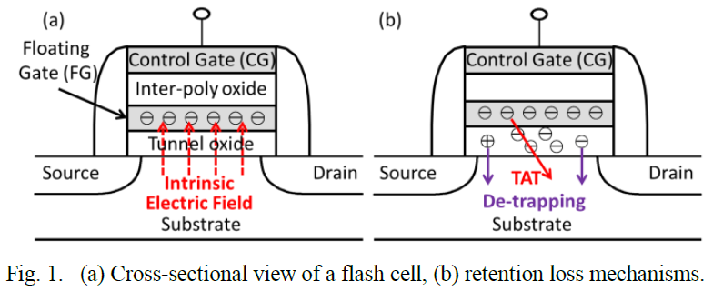
Hot Issues in This Paper
Charge De-Trapping
The electric charge trapped in the tunnel oxide can also be spontaneously de-trapped over time.
The electric charge is mainly configured by electrons.
But, The electric charge trapped in the tunnel can be inserted by holes that affected by higher threshold voltage on the control gate.
Over time, the charge can be brought out to the substrate.

Slide 13
Hot Issues in This Paper
Charge De-Trapping
Why would we should to watch with interest this phenomenon?
In TAT effect section, we saw the threshold voltage formula on the control gate like that.
And, Charge de-trapping phenomenon can trap the electric charge into the tunnel oxide. so that can be brought out the charge to the substrate.
This means that processing step about ‘Charge de-trapping’ can affect to change the leaking speed about electric charge($−Q_{FG}$) in the tunnel oxide.
And, Threshold voltage in the control gate for read the state on a flash cell can change in real-time.
Because, Decreasing and Increasing the threshold voltage of a flash cell is depending on the polarity of the de-trapped charge.
$$V_{th}=V_{thi}+\left(−Q_{FG}\right)/C_{pp}$$
(1)
Ohm’s law : $V=IR$

Slide 14
Hot Issues in This Paper
Retention Loss Problem
In generally, Amount of the electric charge is fixed by threshold voltage in the control gate on initial time to running the programmed on flash memory.
But, We saw truth that amount of the electric charge can changed by ‘TAT Effect’ and ‘Charge De-Trapping’. It called the ‘Retention Loss’.
This reason is mainly in accordance with the supply of a constant voltage over long time for save data.
Pika..?!
Supplying the voltage is the cause of the all problem about retention.

Slide 15
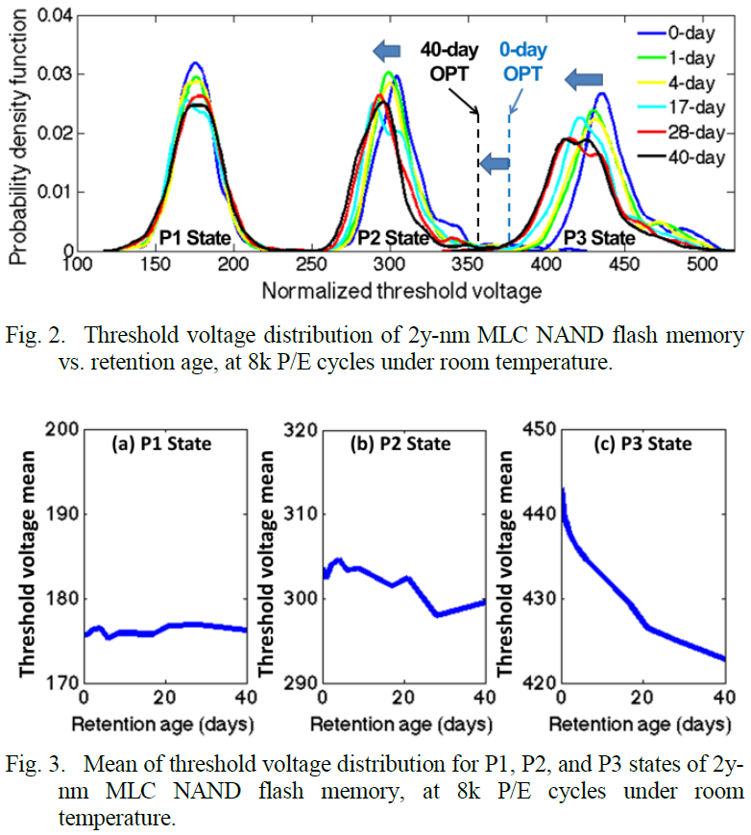
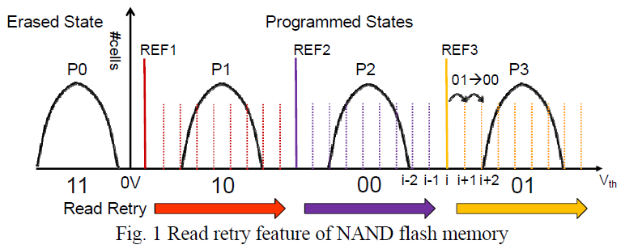
Hot Issues in This Paper
Retention Loss Problem
How to find the reason about ‘retention loss’?
In figure 2 and figure 3 the paper, It can find shifting to left the distribution of threshold voltage about each state in a flash cell.
Threshold voltage mean of each state are increasingly inclined.
Ref) Y. Cai et al., “Threshold Voltage Distribution in MLC NAND Flash Memory: Characterization, Analysis, and Modeling”, DATE 2013, pp. 2.

Slide 16
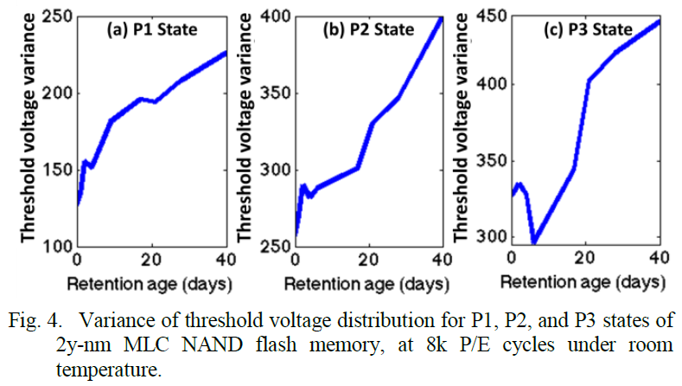
Hot Issues in This Paper
Retention Loss Problem
How to find the reason about ‘retention loss’?
In figure 4, It can find the increasing about threshold voltage variance in each state by retention age(time) for a long time.
Finally, We gets about hint for information on the retention loss the electric charge from the floating gate to the substrate. (Into Fig 2, Fig 3, Fig 4)

Slide 17
Step 1 : Characterization
Characterization on section 3.2 in the paper
Finding 1 : The threshold voltage distributions of the P2 and P3 states systematically shift to lower voltages with retention age.
$∆P1<∆P2<∆P3$
Finding 2 : The threshold voltage distribution of each state becomes wider with higher retention age.
$∆P1<∆P2<∆P3$
Finding 3 : The threshold voltage distribution of a higher-voltage state shifts faster than that of a lower-voltage state.
In page 11, We prove the correlation using formula between intrinsic electric field and threshold voltage in a flash cell.
1st Theorem in the paper
All findings are related on the ‘TAT’ and ‘charge de-trapping’.
Retention loss problem is related on the ‘TAT’ and ‘charge de-trapping’.

Slide 18
Hot Issues in This Paper
Optimal Read Reference Voltage (OPT)
There exists an optimal read reference voltage that achieves the minimal raw bit error rate(RBER) between every two neighboring states.
When random data is programmed to cells, OPT lies at the intersection of neighboring threshold voltage distributions.
Ref) Y. Cai et al., “Threshold Voltage Distribution in MLC NAND Flash Memory: Characterization, Analysis, and Modeling”, DATE 2013, pp. 2.

Slide 19
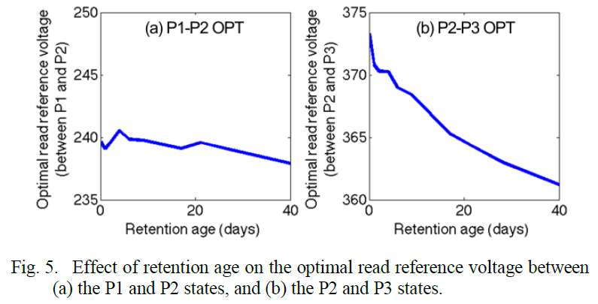
Hot Issues in This Paper
Optimal Read Reference Voltage (OPT)
Is there a relation about between ‘OPT’ and ‘Retention age’?
In figure 5, ‘OPT’ in each state on 40 days are more shifter than 0 days to left.
This result is similarly with mean of threshold voltage distributions in each state on a flash cell.

Slide 20
Step 1 : Characterization
Characterization on section 3.3 in the paper
Finding 4 : Both P1-P2 OPT and P2-P3 OPT become smaller over retention age.
$∆(P2−P1)<∆(P3−P2)$
Finding 5 : P2-P3 OPT changes more significantly over retention age than P1-P2 OPT.
$∆(P2−P1)<∆(P3−P2)$
2nd Theorem in the paper
Changing the ‘OPT’ is related over the retention age.

Slide 21
Hot Issues in This Paper
RBER for Suboptimal Read Reference Voltages.
The flash controller uses a fixed read reference voltage for the entire flash memory, and is unaware of the distribution distortion caused by retention age.
But, It can’t apply to entire block in the flash memory.
First, the retention age of an individual block varies over time due to both environmental factors that might change rapidly.
Second, different blocks are likely to be programmed at different times, and thus are likely to have different retention ages.
Every retention threshold voltages on each blocks in the flash memory are different.
Suspects
Victims
Factor
Diversity
Environments
Voltage

Slide 22
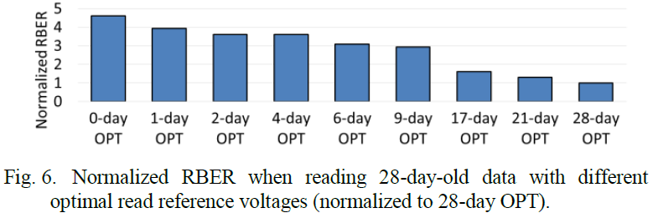
Hot Issues in This Paper
RBER for Suboptimal Read Reference Voltages.
In figure 6, ‘RBER’ according to the ‘OPT’ is becoming increasingly stable over the time.
Fig. 6 shows the RBER obtained when reading the 28-day-old data with different OPTs, normalized to the RBER obtained when reading the data with the 28-day OPT.

Slide 23
Step 1 : Characterization
Characterization on section 3.4 in the paper
Finding 6 : The optimal read reference voltage corresponding to one retention age is suboptimal for reading data with a different retention age.
Finding 7 : RBER becomes lower when the retention age for which the used read reference voltage is optimized becomes closer to the actual retention age of the data.
3rd Theorem in the paper
Optimal read reference voltage for reduce RBER is stable in progress gradually as a long time.

Slide 24
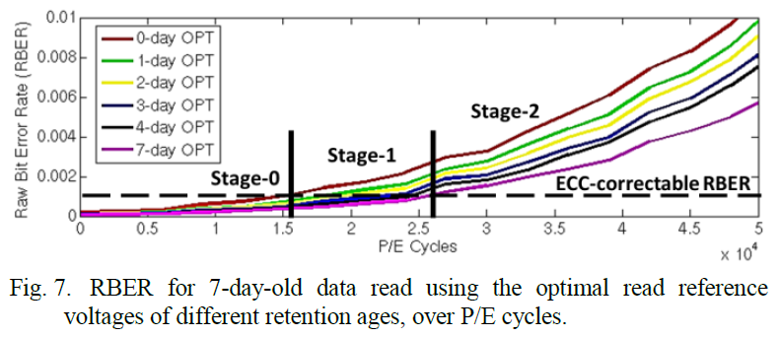
Hot Issues in This Paper
Lifetime vs. RBER
In figure 7, There are distinct stage on RBER state for check to allow limitation range in OPT.
Finding 8 : The P/E-cycle lifetime of flash memory can be extended if the optimal read reference voltage that corresponds to the retention age of the data is used.
Minimum
Limit
(0-day)
Maximum
Limit
(7-day)
0.001
($10^{−3}$)
All OPT are safe
Some OPT are dangerous
All OPT are dangerous

Slide 25
Step 1 : Characterization
Conclusions for theorems
1st Theorem : Retention loss problem is related on the ‘TAT’ and ‘charge de-trapping’. (Finding 1, 2, 3)
2nd Theorem : Changing the ‘OPT’ is related by the retention age. (Finding 4, 5)
3rd Theorem : Optimal read reference voltage for reduce RBER is stable in progress gradually as a long time. (Finding 6, 7)
4th Theorem : Lifetime on P/E cycle of the flash memory can be improved over the time by using the ‘OPT’ in daily. (Finding 8)
It must get the threshold voltage for everything
about retention problem.

Slide 26
Step 1 : Characterization
Threshold voltage on flash memory cell is very important for retention loss problem and OPT, lifetime.
How to retention the threshold voltage in flash memory cells exactly and periodically?
Speaker
‘Dyson’
Threshold Voltage

Slide 27
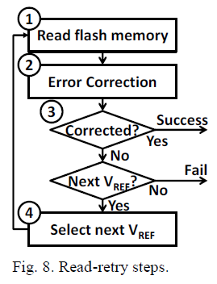
Step 2 : Optimization
Retention Optimized Reading (ROR)
Observation 1 : Flash read latency can be reduced by minimizing the number of read retries.
Read Latency
$$T_{read}=\sum_{i=1}^{N}{\left(T_{ECC}^{(i)}+T_{flash}\right)}$$
(4)
①
Time to read the data
(Constant)
②
Error Correction Latency
(Variable)

Slide 28
Step 2 : Optimization
Retention Optimized Reading (ROR)
Observation 2 : The number of read-retries can be reduced by using a closer-to-optimal starting read reference voltage.
It really needs the exactly starting read reference voltage for minimum control count. (for observation 1)
Minimum Control Count
$$N=(V_{start}−V_{correctable})/∆V$$
(5)
Starting Read Reference Voltage
(★ ★ ★)
Maximum Read Reference Voltage in Allowed Range
Minimal Step Size for decrease in each time

Slide 29
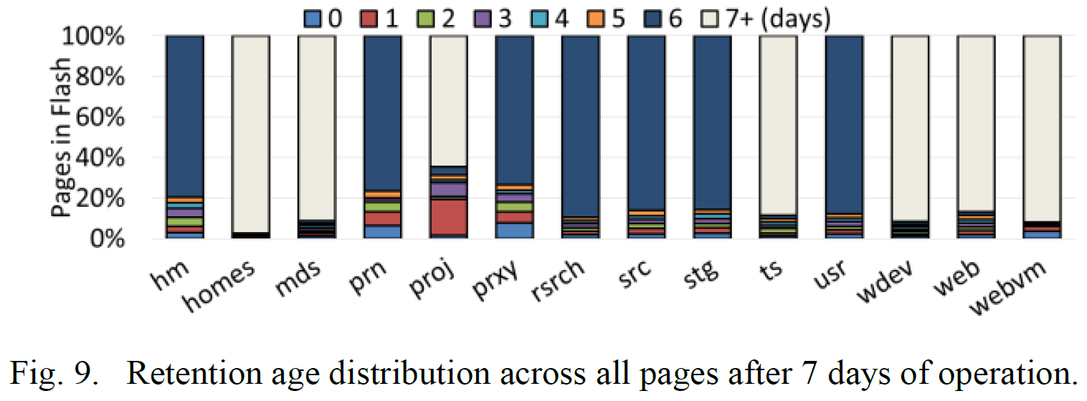
Step 2 : Optimization
Retention Optimized Reading (ROR)
Observation 3 : The optimal read reference voltages of pages in the same block are close, while those of pages in different blocks are not.
Workloads : FIU, MSR-Cambridge

Slide 30
Step 2 : Optimization
Retention Optimized Reading (ROR)
Observation 4 : The optimal read reference voltage of pages in a block is upper-bounded by the optimal read reference voltage of the last-programmed page.
Small threshold voltage differences between ‘Page 0’ and ‘Page 255’
Block
……
Page 0
Page 1
Page 2
Page 3
Page 254
Page 255
Maximum retention age < 1 day
★
Contents of page 6 in this paper

Slide 31
Step 2 : Optimization
Retention Optimized Reading (ROR)
Online pre-optimization algorithm
Initialization
→ The flash controller first reads page 255 with any default read reference voltage.
Try with a lower/higher read reference voltage
→ Find the optimal read reference voltage on the lowest RBER.
Record the optimal read reference voltage.
→ Apply the recorded OPT to target block.

Slide 32
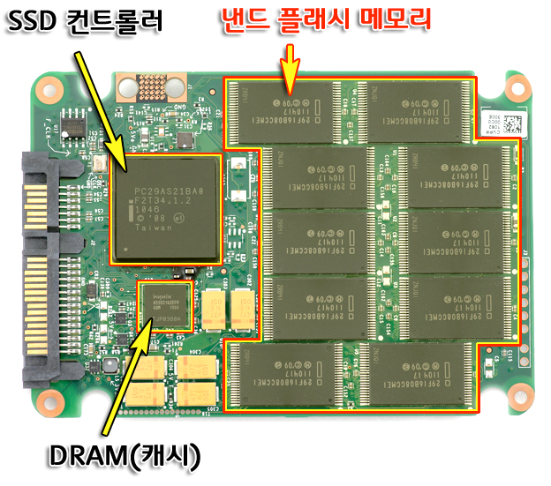
Step 2 : Optimization
Retention Optimized Reading (ROR)
Improved read-retry technique
It needs to fast access for checking about OPT and RBER.
$$T_{read}=\sum_{i=1}^{N}{\left(T_{ECC}^{(i)}+T_{flash}\right)}$$
(4)
$$N=(V_{start}−V_{correctable})/∆V$$
(5)
Contents of page 8 in this paper

Slide 33
Step 2 : Optimization
Retention Optimized Reading (ROR)
Minimizing the Error Correction Latency
Syndrome calculation
Berlekamp-Massey algorithm
Chien search
ECC latency
$$T_{BCH}^{dec}=T_{syndrome}+N×T_{Berlekamp}+\left(k/m\right)×T_{Chien}$$
(6)
Number of raw bit errors
Chien search time
$$\left(E+e\right)/2$$
ROR → $\left(RBER∝\left(T_{BCH}^{dec}≈T_{ECC}^{(i)}\right)∝T_{read}\right)$

Slide 34
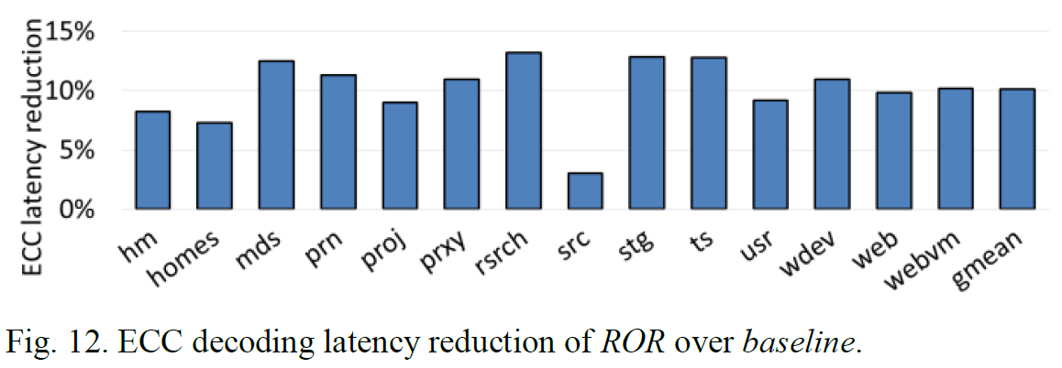
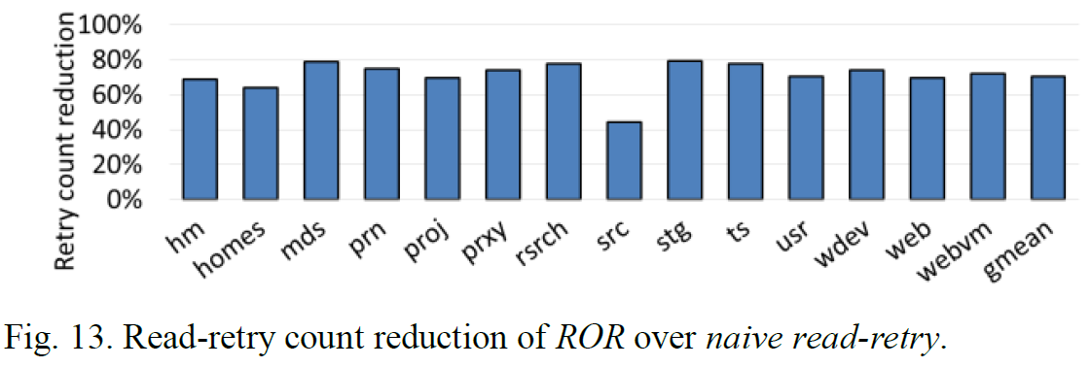
Step 2 : Optimization
Retention Optimized Reading (ROR)
Evaluation
$$T_{read}=\sum_{i=1}^{N}{\left(T_{ECC}^{(i)}+T_{flash}\right)}$$
$$T_{read}=\sum_{i=1}^{N}{\left(T_{ECC}^{(i)}+T_{flash}\right)}$$
Stage 0
Stage 1
ROR reduces the ECC decoding latency by 10.1%
ROR reduces the overall read latency by 70.4%

Slide 35
Step 3 : Recovery
Retention Failure Recovery (RFR)
To avoid data loss resulting from retention failure, It propose an offline technique, RFR, to reduce RBER and increase the chances of successful recovery of data after a retention failure happens.
Arrhenius Law
ex) Temperature ↑ = Retention Age ↑
$$Aging Factor=\frac{t_{1}}{t_{2}}=\exp\left[\left(\frac{E_{a}}{k}\right)×\left(\frac{1}{T_{1}}−\frac{1}{T_{2}}\right)\right]$$
(8)

Slide 36
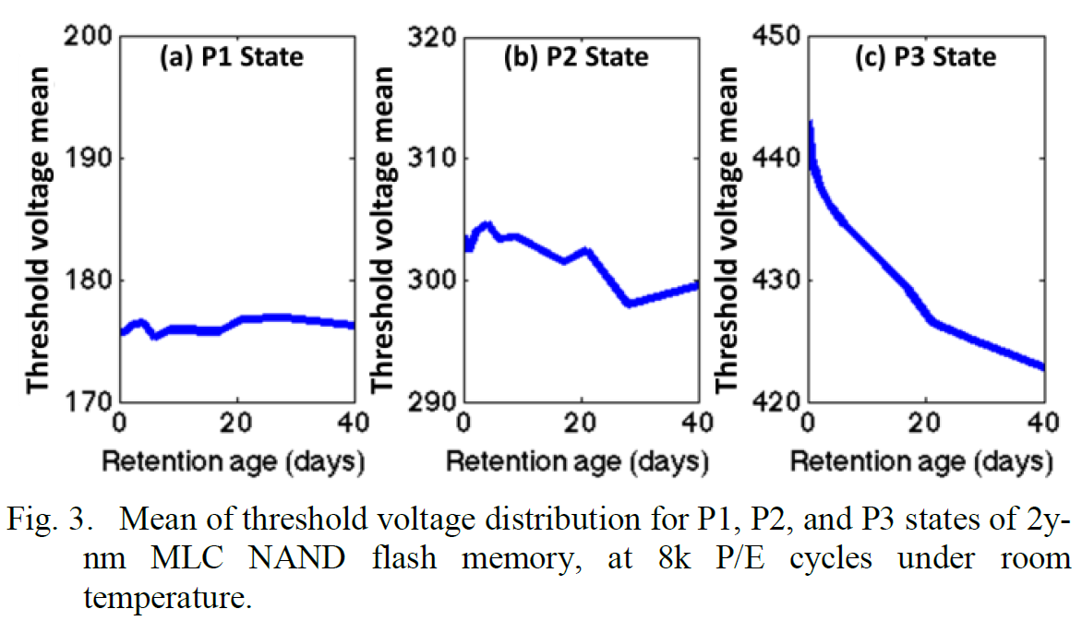
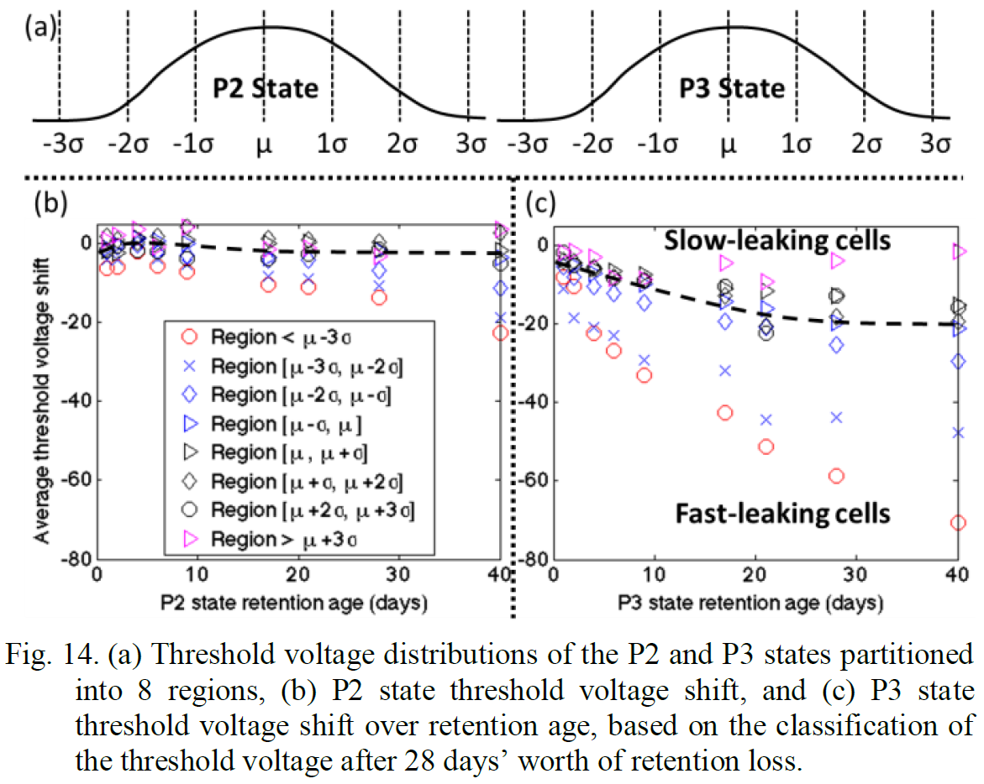
Step 3 : Recovery
Retention Failure Recovery (RFR)
Fast- and Slow- Leaking Cells
Leaking the electric charge is related on the retention age in a flash cell.
It can find the fast/slow leaking cells to using the statistics about mean of leaking speed in flash memory cells.
Graphs are divided by 8 regions in P2, P3 state.

Slide 37
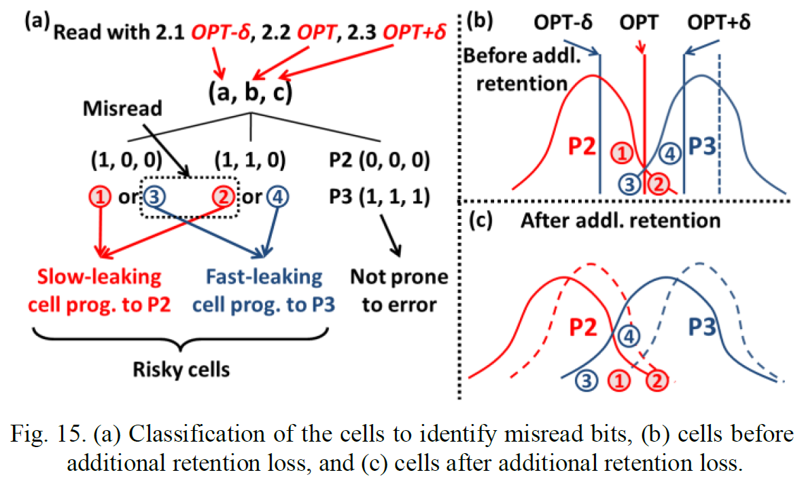
Step 3 : Recovery
Retention Failure Recovery (RFR)
Retention Failure Recovery Mechanism
Identify data with a retention failure. (Using the ROR)
Identify risky cells using three read operations.
Identify fast- and slow-leaking cells.
Selective bit flipping.

Slide 38
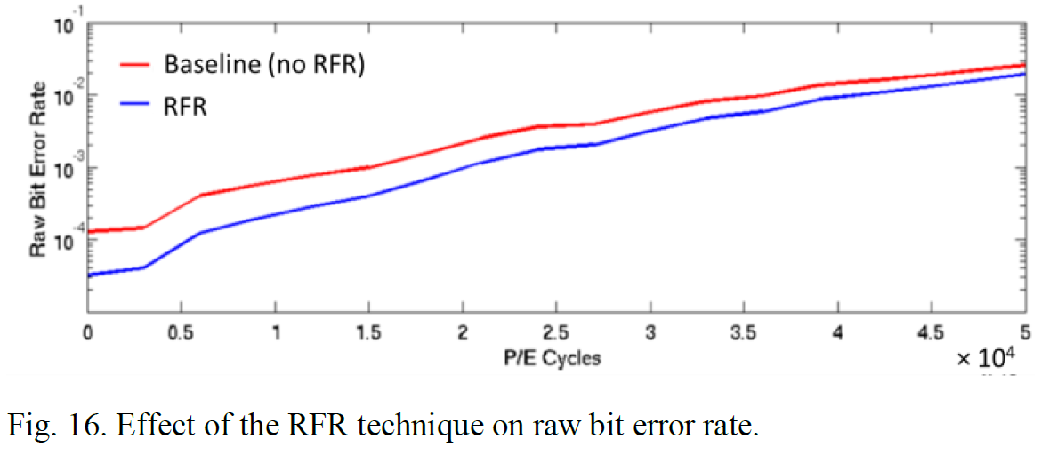
Step 3 : Recovery
Retention Failure Recovery (RFR)
Evaluation
Fig. 16 shows that RFR reduces RBER by 50%, averaged across all P/E cycles.

Slide 39
Conclusion
Retention Optimized Reading (ROR) improves reliability, lifetime, and performance of MLC NAND flash memory.
This paper demonstrate significant benefits with ROR in terms of reduced RBER, extended flash lifetime, and reduction in flash read latency.
Retention Failure Recovery (RFR) recovers data with uncorrectable errors by identifying and probabilistically correcting flash cells with retention errors.
This paper demonstrated large raw bit error rate reductions with RFR.

Slide 40
References
http://cappleblog.co.kr/582, “SSD 의 이해 - 낸드 플래시 메모리의 구조와 SLC, MLC, TLC 방식의 차이”
Y. Cai et al., “Error Patterns in MLC NAND Flash Memory: Measurement, Characterization and Analysis”, DATE 2012.
N. Mielke et al., “Bit Error Rate in NAND Flash Memories”, IRPS 2008.
Y. Cai et al., “Program Interference in MLC NAND Flash Memory: Characterization, Modeling, and Mitigation”, ICCD 2013.
Y. Cai et al., “Neighbor-cell Assisted Error Correction for MLC NAND Flash Memories”, SIGMETRICS 2014.
Y. Cai et al., “Threshold Voltage Distribution in MLC NAND Flash Memory: Characterization, Analysis, and Modeling”, DATE 2013.
J. E. Brewer and M. Gill, “Nonvolatile Memory Technologies with Emphasis on Flash: A Comprehensive Guide to Understanding and Using NVM Devices”, IEEE Press Series on Microelectronic Systems, WILEY Press 2007.
Y. Cai et al., “FPGA-Based Solid-State Drive Prototyping Platform”, FCCM 2011.
Y. Lee et al., “6.4Gb/s Multi-Threaded BCH Encoder and Decoder for Multi-Channel SSD Controllers”, ISSCC 2012.
C.L.Chen, “High-Speed Decoding of BCH Codes”, IEEE Transactions on Information Theory 1979.

