Slide 1
Iridis-pi : a low-cost, compact demonstration cluster
윤 준 기

Slide 2
Index
03
System description
.
05
Conclusion
01
Background
.
04
Performance results
02
Introduction

Slide 3
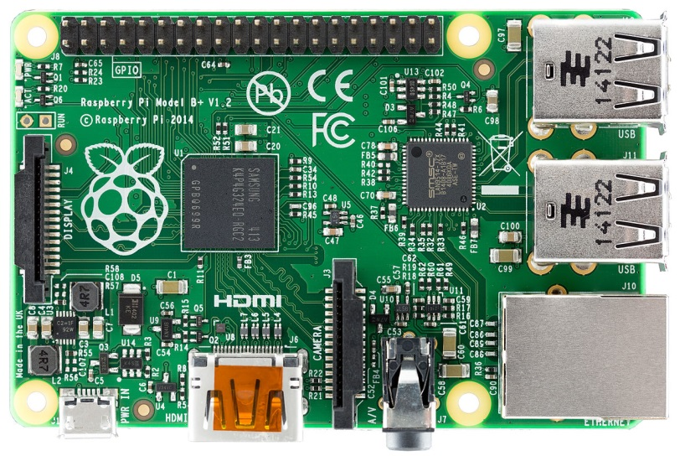
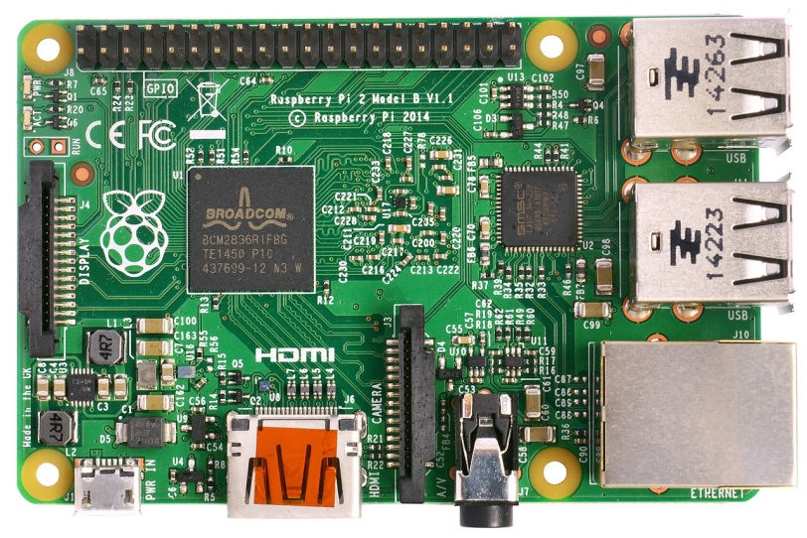
About Raspberry Pi
The Raspberry Pi is a series of credit card-sized single-board computers developed in the UK by the Raspberry Pi Foundation with the intention of promoting the teaching of basic computer science in schools.
Raspberry Pi 2 B
They feature a Broadcom BCM2835 system-on-chip, which integrates a 700 MHz ARM1176JZF-S RISC processor, 256 MiB RAM (current Model B production models have been upgraded to 512 MiB), a Broadcom VideoCore IV GPU with HDMI and composite output, a DSP for audio, and a single USB controller.
This is wired up to an SMSC 9512 USB 2.0 hub and 10/100 Mbit s−1 Ethernet adaptor, which exposes two USB 2.0 and one Ethernet ports externally.
Local storage is provided via an SD (secure digital) card slot on board, and there are various low-level interfaces including I2C and SPI busses, a UART and eight GPIO pins.
Grapic
Low cost
Operating system
The Raspberry Pi primarily uses Linux-kernel-based operating systems.
Notes:
라즈베리 파이(영어: Raspberry Pi)는 영국의 라즈베리 파이 재단이 학교에서 기초 컴퓨터 과학 교육을 증진시키기 위해 만든 싱글 보드 컴퓨터이다. 라즈베리 파이는 그래픽 성능이 뛰어나면서도 저렴한 가격

Slide 4
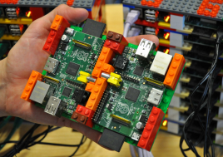
Introduction
The present work
Very compact overall size
Light weight
,
Low-power ARM processors
Low-power flash based local storage
Many supercomputing
applications are built
Low-cost
Commodity Ethernet
interconnects
System
Educational purposes
Military and in-vehicle systems
Ambient cooling
Passive
Demonstration

Slide 5
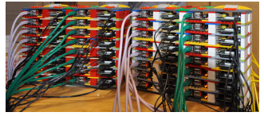
System description
2.1 Hardware
The “Iridis-Pi” system consists of 64 Raspberry Pi Model B nodes4 , which are credit card sized single board computers.
The “Iridis-Pi” nodes are housed in a chassis built from Lego, and interconnected via commodity Etherne.
Installed a Kingston 16 GB SDHC flash memory card in each node, with a specified write speed of up to 15 MB s−1.
We powered the nodes using individual commodity, off the shelf, 5 V DC power supplies connected to the micro USB power sockets on the nodes.
The Raspberry Pi uses the first ARM-based multimedia system-ona-chip (SoC) with fully-functional, vendor-provided, fully open-source drivers, although some code that runs on the GPU remains closed-source.

Slide 6
System description
2.2 Software
It run the Raspbian operating system5, an optimised version of the Debian GNU/Linux distribution for the Raspberry Pi.
We prepared one SD card using an image downloaded from the Raspberry Pi Foundation, and
customised this by compiling our benchmarks and associated software.
2) We cloned this, our ‘master’ image, to the SD cards of the other nodes.
3) We have subsequently upgraded to the latest release and noted a small performance increase on LINPACK performance when using the default system clock speed settings.

Slide 7
System description
2.2 Software
The benchmarks in this paper required additional software to be installed.
Benchmark
LINPACK
HPL
iperf and the NetPIPE
DD
To assess the numerical compute power of the nodes and the cluster, we employed the well-known LINPACK benchmark for single-node performance.
the HPL (High-Performance LINPACK) benchmark to measure the throughput of the cluster as a whole.
Network bandwidth and latency measurements were performed using iperf and the NetPIPE performance evaluator.
We tested the raw IO throughput using DD and the cluster throughput using Hadoop.

Slide 8
System description
Cost
The total cost of the system excluding network switches was below £2500.
Power
We measured the current drawn from the mains with the cluster idle (the current drawn by the switches was not included in this measurement) as 810 mA, which corresponds to 194 VA with a 240 V mains supply.
Physical enclosure
The Lego design for the rack consisted of 2 blocks of 8 layers each containing 4 Raspberry Pi computers to give a total of 64 housed together.

Slide 9
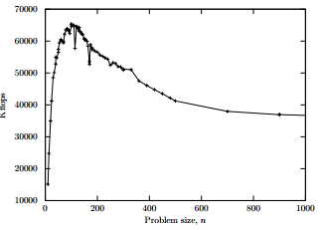
Performance results
3.1 Single node compute
We benchmarked the nodes of the cluster by running the LINPACK benchmark, both in single and double precision modes.
Benchmark
This benchmark aims to assess the computer’s ability to solve real-world problems by solving a dense n × n system of linear equations, Ax = b, on a single node.
We compiled the benchmark with optimisations, and ran it for n = 200 in both double and single precision on the individual nodes of the “Iridis-Pi” system.
Single precision performance : 55571 kflop s−1
A standard deviation : 304 kflop s−1
double precision performance : 41078 kflop s−1 A standard deviation 1077 kflop s−1.

Slide 10
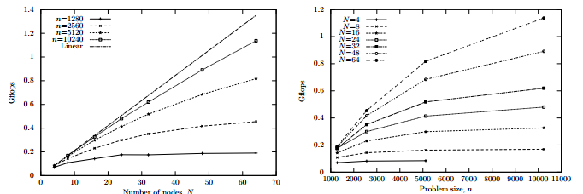
Performance results
3.2 Cluster compute
problem sizes n
numbers of nodes N

Slide 11
Performance results
3.3 Network
We used the nodes’ on-board 100 Mbit s−1 network interface (which is part of the SMSC 9512 USB hub and Ethernet adaptor, and therefore communicates to the processor over USB 2.0) for our cluster’s inter-node communications.
We now present the results we obtained from assessing the available bandwidth and latency using these interfaces.
We considered three scenarios.
firstly, picking two physical nodes, we measured the bandwidth between them as a function of the size of the message passed between the nodes in a “ping pong” style test.
secondly as a function of the number of TCP connections made in parallel.
Finally, we nominated one physical node a ‘server’ and measured the bandwidth that it afforded to various numbers N of ‘client’ nodes that connected to it.

Slide 12
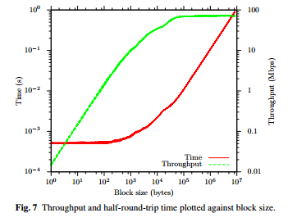
Performance results
3.3.1 Effects of data block size
Benchmark
We nominated one node as our ‘reference’ node, and used the NetPIPE software to investigate the effect of block size on throughput and round-trip time between this reference node and the other nodes in the system.
A round trip consists of the ‘reference’ node sending, then receiving, a block of some size c, whilst the ‘other’ node receives, then sends blocks of size c.
Our recorded times are the half-round-trip times, i.e. they represent the time taken to send or receive a block of a given size.

Slide 13
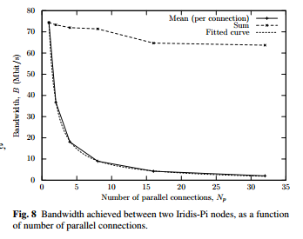
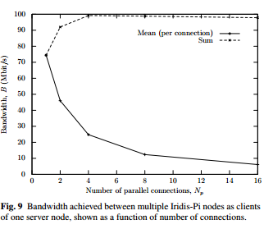
Performance results
3.3.2 Multiple connections between one client and one server

Slide 14
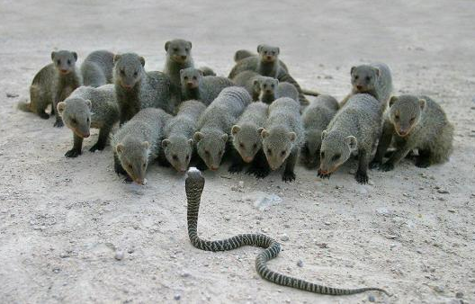
Conclusion

Slide 15
Thanks

