Slide 1
Analyzing and Comparing the Protection Quality of Security Enhanced Operating Systems
May 26
Younsik Jeong
Ph.D. Student

Slide 2
Contents
Abstract
Introduction
Background
Overview of approach
Tool(VulSAN)
Comparing SELinux with AppArmor
Conclusion

Slide 3
Funny
Not justice but definition

Slide 4
Abstract
Problem
Host compromise is a serious computer security problem
To mitigation problem(or to better protect hosts)
SELinux and AppArmor have been introduced
So, Authors propose an approach to analyze and compare the quality of protection offered by these different MAC systems
Introduce the notion of vulnerability surfaces under attack scenarios as the measurement of protection quality, and implement a tool called VulSAN for computing such vulnerability surfaces
We apply our approach to compare SELinux and AppArmor policies in several Linux distributions and discuss the results
Notes:
Host compromise : 호스트를 위험에 빠뜨리는
네트웍 보안 쪽에서 종종 사용되는 용어 주로 호스트에 대한 제어권을 공격자가 얻는 공격을 말함

Slide 5
The Model of Penetration

Slide 6
Introduction (1/2)
Host compromise is one of the most serious computer security problems
key reason why hosts can be easily compromised is that the Discretionary Access Control (DAC) mechanism in today’s operating systems is vulnerable to Trojan horses and the exploitation of buggy software
In the past decade
A number of efforts aiming at adding some form of Mandatory Access Control (MAC) to Commercial-Off-The-Shelf (COTS) operating systems
Low Water-Mark Access Control(LOMAC), SELinux, AppArmor, Usable Mandatory Integrity Protection(UMIP)
SELinux is supported a number of Linux distribution, including Fedora, Debian, Gentoo, EnGarde, Ubuntu
AppArmor is supported in Linux distribution, including SUSE, PLD, Pardus Linux, Annvix, Ubuntu, Mandriva
It would be very useful for an administrator to know:
What kinds of attacks are prevented by the MAC system my host is using?
What does it take for an attacker to penetrate the defense of the system, e.g., to install a rootkit on my host?

Slide 7
Introduction (2/2)
We
develop a tool called Vulnerability Surface ANalyzer (VulSAN) for answering these questions
analyze the QoP by measuring the vulnerability surface for attack scenarios
※ Attack scenarios
Remote to full control → a remote attacker wants to fully control the system
Remote to leaving(plant) a Trojan
local to full control
have applied VulSAN to analyze the QoP of several Linux distributions with SELinux and AppArmor
we find that AppArmor offers significantly smaller vulnerability surface, while the SELinux policy with Ubuntu 8.04 offers only slightly smaller vulnerability surface compared with the case when no MAC is used (using DAC)
When no MAC is used, the system has seven length-1 attack paths in the scenario when a remote attacker wants to install a rootkit
They correspond to the seven network-facing daemon programs running as root, namely apache2, cupsd, nmbd, rpc.mountd, smbd, sshd, and vsftpd
SELinux policy confines only cupsd

Slide 8
Background and related work (1/3)
SELinux has been integrated into Linux Kernel since 2.6. In SELinux, every process has a domain and every object has a type
Objects are categorized into object security classes, such as files, folders, sockets, etc.
A set of operations are defined over each object security class (e.g., read, write, execute, lock, create, rename, etc. for a file)
AppArmor is an access control system that confines the access permissions on a per program basis
It confines programs that are likely to be attacked, e.g., server programs that face network and setuid root programs
For every protected program, AppArmor defines a program profile
profile is a list of permitted accesses, including file accesses and capabilities
Profiles of all protected programs constitute an AppArmor policy
If a program does not have a profile, it is by default not confined. If a program has a profile, it only has permissions specified in the profile

Slide 9
Background and related work (2/3)
Previous approaches for analyzing SELinux security policies include Gokyo, SLAT, PAL, APOL, SELAC, NETRA, and PALMS
Gokyo
identifies a set of domains and types as the implicit Trusted Computing Base (TCB) of a SELinux policy. Integrity of the TCB holds if no type in it can be written by a domain outside the TCB
PALMS
is a tool for analyzing SELinux MLS policy, and was used to verify that the SELinux MLS reference policy satisfies the simple security property and the *-property defined by Bell and LaPadula

Slide 10
Background and related work (3/3)
Our work is different in the following ways
VulSAN supports analyzing AppArmor in addition to SELinux
VulSAN utilizes the current system state (such as which files exist in the system) as well as DAC policies (such as which users can write to a file according to the DAC permission bits) in addition to the MAC policies
our goal, which is to compute the vulnerability surface under different attack scenarios, is different from that of existing tools

Slide 11
Overview of Approach
First of all, we define the QoP(Quality of Protection)
Our approach generates all possible attack paths that can lead an attacker to control of the system
We analyze the QoP under multiple attack scenarios
Each attack scenario has two aspects
objective of the attacker (e.g., load a kernel module or plant a Trojan horse)
initial resources the attacker has (e.g., can connect to the machine from network, or has a local account)
Our approach consists of following steps:
Establish a running server as the analysis target
Translate policy rules and system state information into Prolog facts
Encode what the attacker can do to break into a system and escalate privileges in one or more steps → create a system rule
Encode an attack scenario into a query, and use the query to generate the host attack graph
Analyze the host attack graph
Describe how an attacker exploits a program
to cause state transition under the MAC system

Slide 12
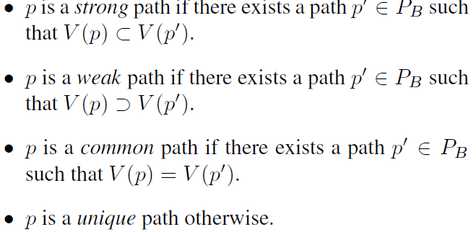
Overview of Approach
Vulnerability surface ≒ set of all minimal attack path
Each path includes the programs(nodes in graph) that must be exploited to realize the attack objective
we compare two protection systems A and B under the same attack scenario, we first generate the sets of all minimal attack paths of the two protection systems, called P_{A} and P_{B}
Ex. A strong path p of system A suggests that, if the attacker compromises the same programs in p under system B, she will need to compromise more programs to achieve the attack objective in B.
※ PA has higher QoP than PB when all
minimal attack paths for PA are either
common paths or weak paths
※ V (p) represents the set of edge labels along the path

Slide 13
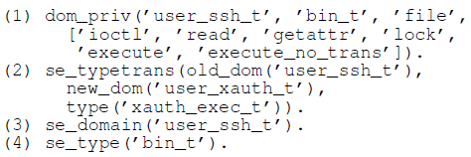
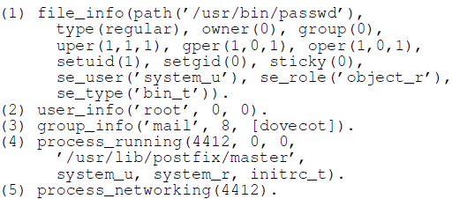
VulSAN (Vulnerability Surface ANalyzer)
Fact Collector, Host Attack Graph Generator, Attack Path Analyzer
Fact Collector
Take System state and security policy → information as facts in Prolog
Consider system facts that are relevant to our security analysis
Irrelevant information like CPU/memory consumption is not considered
Parser for
SELinux policy is based on the tool checkpolicy
AppArmor policy is based on apparmor_parser
Sample facts of SELinux Policy
Sample facts of system state
Sample facts of AppArmor Policy
https://www.suse.com/documentation/apparmor/book_apparmor21_admin/data/bx5bmkc.html

Slide 14
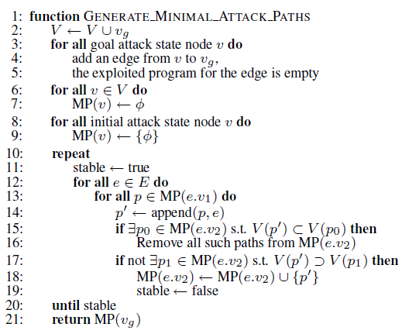
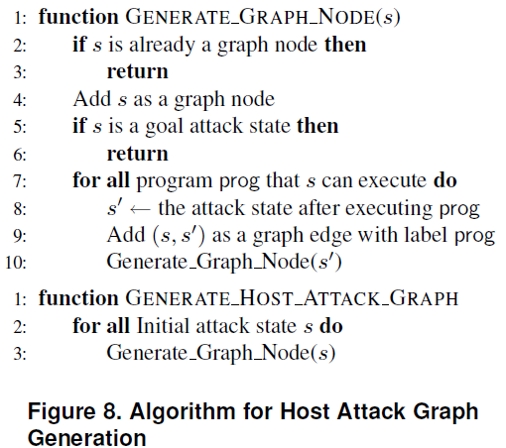
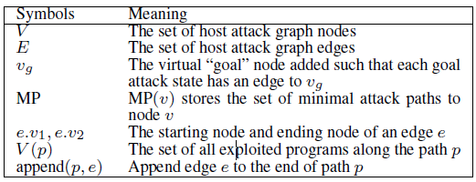
Host Attack Graph Generator & Analyzer
Takes system facts(library of system rules, attack scenario) → host attack graph
We are interested in all the potential attack states that might be controlled by an attacker

Slide 15
Host attack graph & minimal attack path
(Minimal) Attack paths that are not superset of other attack paths

Slide 16
Comparing SELinux with AppArmor
3 scenarios
Remote attacker install a rootkit
Remote attacker plant a Trojan horse
Strong Trojan - attacker can create an executable in a folder on the executable search path or user’s home directory
Weak Trojan - the attacker can create an executable in any folder such that a normal user process can execute
Local attacker to install a rootkit

Slide 17
Define the State & sample penetration
At process level
Attributes relevant to access control decisions
SELinux: proc(uid, gid, domain)
AppArmor: proc(uid, gid, profile)

Slide 18
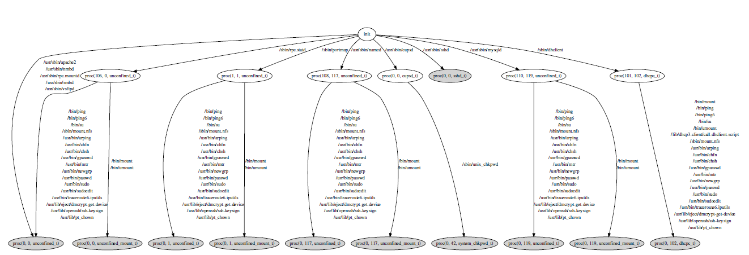
SELinux vs. AppArmor vs. DAC only on Ubuntu 8.04
Attacker has network access to the host, and the objective is to install a rootkit via loading a kernel module
AppArmor has the smallest vulnerability surface
Node = attack state
The minimal attack paths that SELinux has but AppArmor doesn’t have
(1) Some programs are running in the unconfined t domain under this version of SELinux policy, while AppArmor has profiles for them; these include, e.g., nmbd, (2) Some programs are confined by SELinux domains, but the confinements are not as tight as corresponding AppArmor profiles. e.g., cupsd
Host attack graph for remote attacker to install a rootkit(Ubuntu 8.04 with SELinux)

Slide 19
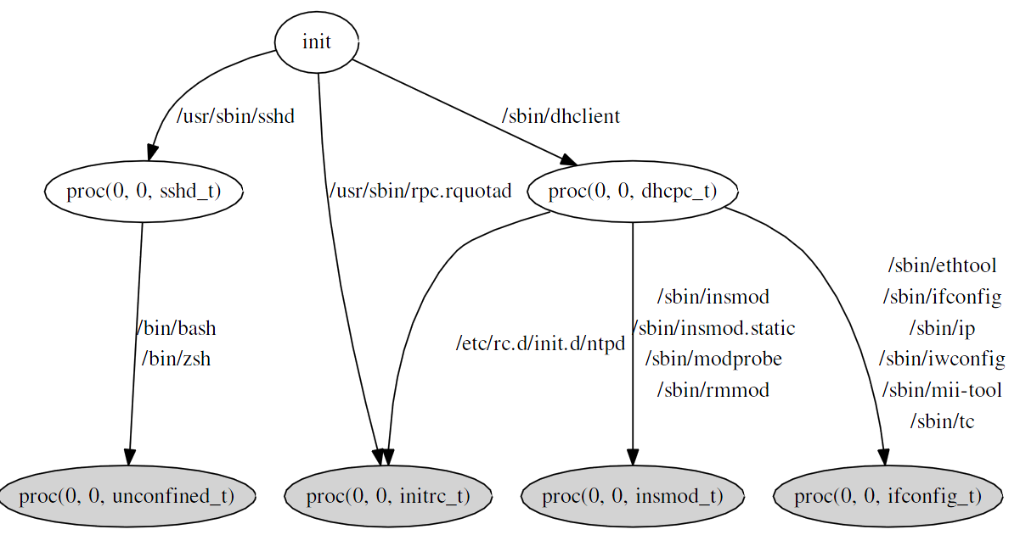
SELinux vs. AppArmor
Unique attack paths of SELinux
Privileged programs run under unconfined_t:nmbd, smbd, vsftpd, portmap, and rpc.statd
Confinement not as tight as AppArmor: cupsd and dhclient
Setuid confinement: ping, passwd
Conclusion –with data
In this configuration, AppArmor provides better protection
Host attack graph for remote attacker to install a rootkit(Fedora 8 with SELinux)

Slide 20
Conclusion
Introduce the notion of vulnerability surfaces under attack scenarios as the measurement of the QoP offered by MAC policies in operating systems
Implement VulSAN for computing vulnerability surfaces for Linux systems with SELinux or AppArmor
Analyze and compare SELinux and AppArmor in several recent Linux distributions, and show tightening opportunities

Slide 21
Ref.
SUSE, File Permission Access Modes, https://www.suse.com/documentation/apparmor/book_apparmor21_admin/data/bx5bmkc.html
SELinux, Policies and modules, http://equivocation.org/node/13
AppArmor, Example profile, https://wiki.ubuntu.com/AppArmor
Presented paper, https://www.isoc.org/isoc/conferences/ndss/09/proceedings.shtml

Slide 22
Thank You !

