Slide 1
Addressing Shared Resource Contention in Multicore Processors via Scheduling
오명훈
snt2426@gmail.com

Slide 2
Index
Introduction
Classification Schemes
Factors Causing Performance Degradation
Scheduling Algorithms
Evaluation on Real Systems

Slide 3
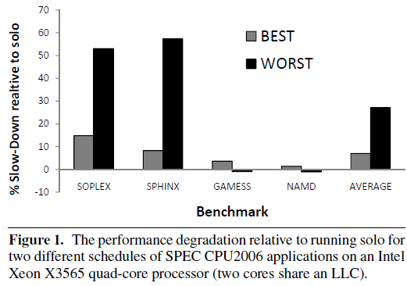
Introduction
Figure 1 shows the performance degradation that occurs due to sharing an LLC with another application, relative to running solo (contention free).

Slide 4
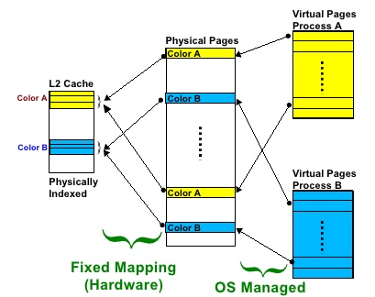
References
Previous : Cache Partitioning, Page coloring
non-trivial changes, copying of physical memory, addressing only shared cache

Slide 5
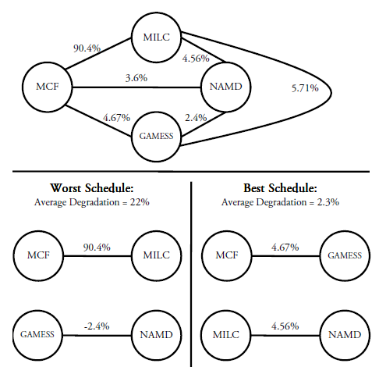
Classification Schemes
Contention Aware Scheduling = Scheduling Policy + Classification Scheme
Offline Perfect Scheduling Policy proposed by jiang
SDC
vs
Animal Classes
vs
Miss rate
vs
Pain
methodology : the best case vs evaluated classification schemes
(estimated best schedule)

Slide 6
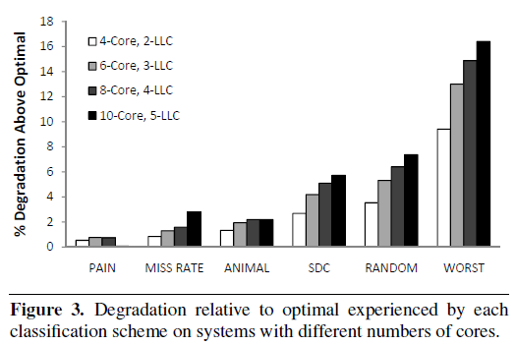
Classification Schemes
Reason : no account miss rate
Based on stack distance profiles (pin tool)
Other resources : contention for memory controller, memory bus, resources involved in prefetching

Slide 7
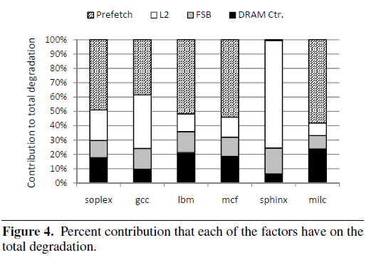
Factors Causing Performance Degradation
Cache contention is by far not the dominant cause of performance degradation
Miss rate turned out to be an excellent heuristic for contention

Slide 8
Factors Causing Performance Degradation
We assumed that the dominant cause of performance degradation is contention for the space in the shared cache. (ex : cache partitioning, page coloring)

Slide 9
Scheduling Algorithms
Miss rate classification schemes + Centralized Sort scheduling policy
very easy to obtain online via hardware perf counters
sort APP by miss rate → distribute APP across cores
User level scheduler (Using affinity interfaces provided by Linux)
→ SIMPLE
DI (Distributed Intensity) scheduler
Estimate the the miss rate based on the stack-distance-profiles – Offline
2. DIO (DI Online) scheduler
Miss rate measured online → more resilient to APP

Slide 10
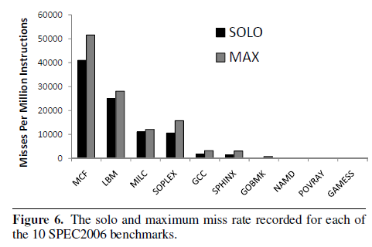
Scheduling Algorithms
Why DI use miss rates
Why DI should work is that miss rates of applications are relatively stable

Slide 11
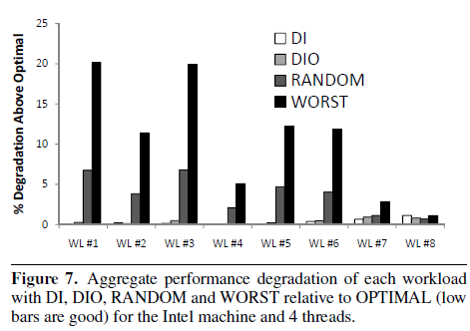
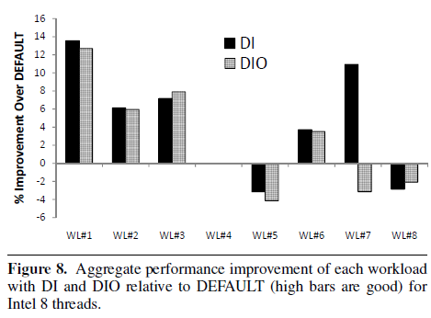
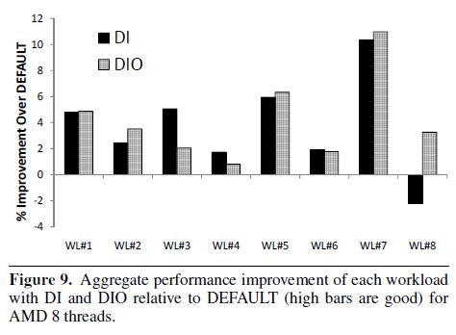
Evaluation on Real Systems
Measure the aggregate workload completion time of each
DI, DIO perform better than RANDOM
and are with in 2% if OPTIMAL
In former case : 13%↑
Isolated case : 4%↓
The biggest advantage of DI and DIO is stable results → avoid worst case

Slide 12
Evaluation on Real Systems
Average : DEFAULT < DIO or DEFAULT > DIO
-> DEFAULT is able to perform well on average
Individual : DIO > DEFAULT

Slide 13
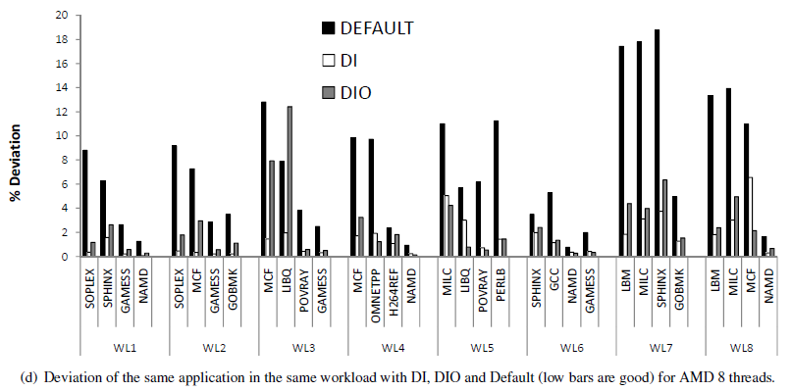
Evaluation on Real Systems
Deviation of execution time of consecutive runs of the same APP in the same workload
DIO < DI < DEFAULT

Slide 14
References
http://www.slideshare.net/davidkftam/rapidmrcpresentation
M. K. Qureshi and Y. N. Patt. Utility-based cache partitioning: A lowoverhead, high-performance, runtime mechanism to partition shared caches. In MICRO 39: roceedings of the 39th Annual IEEE/ACM International Symposium on Microarchitecture, pages 423–432, 2006.
S. Cho and L. Jin. Managing Distributed, Shared L2 Caches through OS-Level Page Allocation. In MICRO 39: Proceedings of the 39th Annual IEEE/ACM International Symposium on Microarchitecture, pages 455–468, 2006.

