Slide 1
Read Disturb Errors in MLC NAND Flash Memory: Characterization, Mitigation, and Recovery
Yu Cai, Yixin Luo, Saugata Ghose, Erich F. Haratsch*, Ken Mai, Onur Mutlu
Carnegie Mellon University, *Seagate Technology
Daeyeon Son
2015.10.27

Slide 2
Introduction
Read disturb error is related on the difference between read voltage to selected word line and other masked word lines.
The value of LSB, MSB can be set in same bit line and it saves to LSB, MSB buffer.
In same block, the values of specific voltage to bit line can occur error to read the LSB, MSB pages.
Pass-though voltage on flash cell in masked word lines is same and changing about voltage can affect to read values of cells.

Slide 3
LSB, MSB
LSB
Least Significant Bit
Change Region : P1 → P2
MSB
Most Significant Bit
Change Region : ER → P1, P2 → P3
LSB
ex) 1 0
MSB
Threshold voltage
Pass-through voltage

Slide 4
LSB, MSB
Tutorial of the calculation in LSB, MSB
The process of calculation with LSB and MSB is very important for ‘Figure 9’ in this paper.
ex) 1 0
1 1
0 1
0 0
ex) 0 1
1 1
0 1
0 1
ex) 1 0
1 0
1 0
1 1
0 0
0 1
1 0

Slide 5
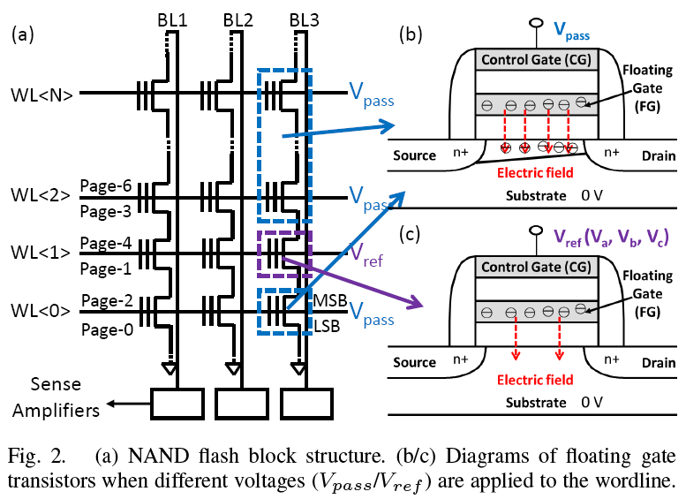
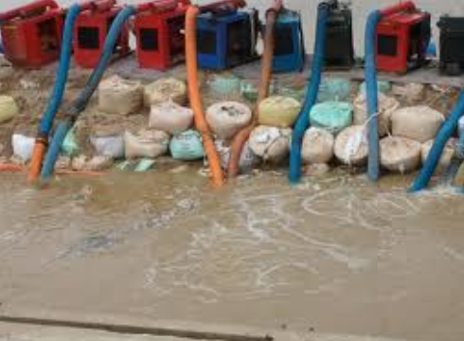
Read Disturb
In read operation, the phenomenon of read disturb is affected by pass-through voltage of other masked word lines.
Stable
Voltage
(Weak Programming for Retention)
Selected
Line
(Real Programming for Injection)
Flexible
Voltage

Slide 6
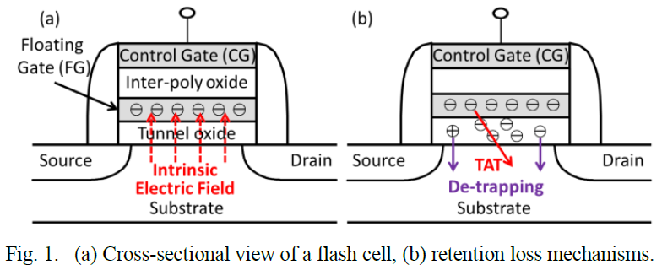
Fowler-Nordheim Tunneling
The amount of charge stored in the FG determines the threshold voltage of the transistor.
FN Tunneling is effect by electron injected in oxide between floating gate in cell and substrate on word line.
Material-Specific Constants
Current Density
$$J_{FN}=α_{FN}E_{ox}^{2}e^{{−β_{FN}}/{E_{ox}}}$$
(1)
Electric Field in Oxide
Ref) Yu Cai, et al. "Data retention in MLC NAND flash memory: Characterization, optimization, and recovery." High Performance Computer Architecture (HPCA), 2015 IEEE 21st International Symposium on. IEEE, 2015.

Slide 7
Read Disturb Characterization
The mean of voltage affected by read disturb can shift to direction on other state in cell.
Probability density function of threshold voltage is changed on graph of all state by read disturb.

Slide 8
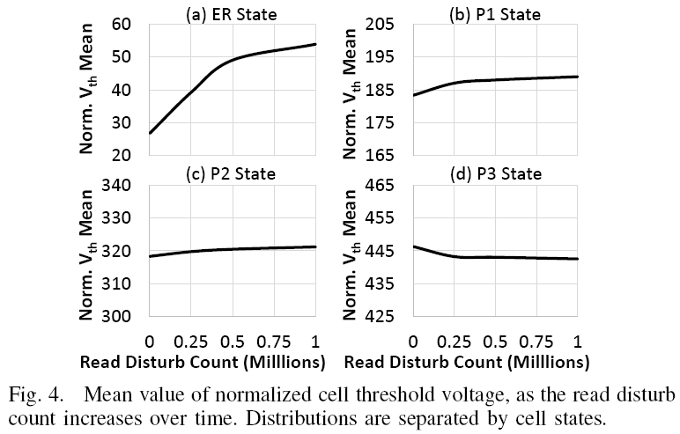
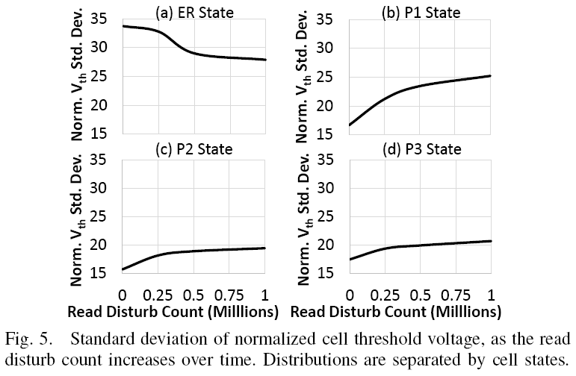
Read Disturb Characterization
Through increase count of read disturb, mean of threshold voltage is increased, except for state of ‘P3’.
The standard deviation of threshold voltage is increased, except for state of ‘ER’. (It’s not important in paper)
Deviation of threshold voltage on state of ‘P3’ is ‘Key point’ in this paper.

Slide 9
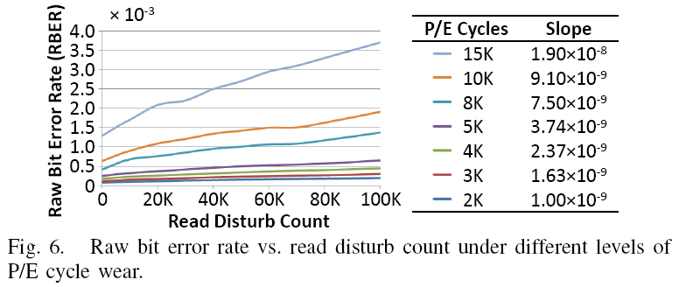
Read Disturb Characterization
It can observe that the effects of read disturb are greater for cells that have experienced a larger number of P/E cycles.
Graph shows that correlation between read disturb count and raw bit error rate in same block.
The result is that slope of graph is increased by count of P/E cycles on cells.
(++++)
(+++)
(++)
(+)

Slide 10
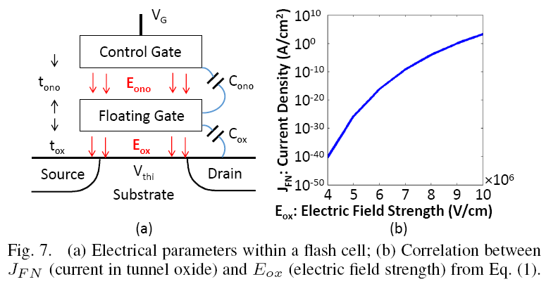
Read Disturb Characterization
Correlation between $E_{ox}$ and $J_{FN}$
The current density between floating gate and substrate can be calculated by formula (1).
The electric field with insulator and oxide under floating gate can be calculated by formula (2).
If current density is increased, leaking effect on oxide will be larger than state of small voltage on control gate.
It results that $V_{pass}$ should be small beside the state on $V_{th}$ of value in cell. ($V_{G}=V_{pass}$)
$$E_{ox}=\frac{C_{ono}}{C_{ono}+C_{ox}}×\left[\left(V_{G}−V_{thi}\right)−V_{th}\right]×\frac{1}{t_{ox}}$$
(2)
$$J_{FN}=α_{FN}E_{ox}^{2}e^{{−β_{FN}}/{E_{ox}}}$$
(1)

Slide 11
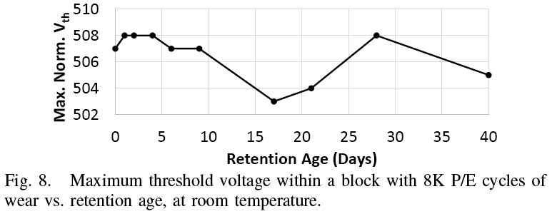
Read Disturb Characterization
The retention voltage in cell will be reduced to left direction during a long time through many phenomenon.
It may be applied the single pass-through voltage to entire cell in same block.
But, while performs the wear leveling in cell, voltage to floating gate will be refreshed for retention about electron.
Twist~ Twist~
Scheme in paper must be implemented to efficiently manage for each word line.

Slide 12
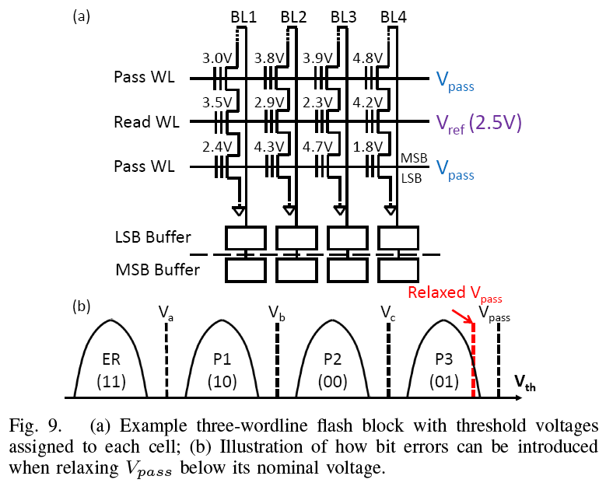
Read Disturb Characterization
Effect of Pass-Through Voltage on Raw Bit Error rate
Example 1 : Normal situation (for $V_{pass}$)
Are you ready to calculate..?!
BL1
BL2
BL3
BL4
Pass WL
1
1
1
1
$$V_{pass} (5V)$$
Read WL
0
0
1
0
$$V_{ref} (2.5V)$$
Pass WL
1
1
1
1
$$V_{pass} (5V)$$
LSB Buffer
0
0
1
0
MSB Buffer

Slide 13
Read Disturb Characterization
Effect of Pass-Through Voltage on Raw Bit Error rate
Example 2 : Read disturb situation (for Relaxed $V_{pass}$)
Can you find the difference..?!
BL1
BL2
BL3
BL4
Pass WL
1
1
1
0
$$V_{pass} (4.6V)$$
Read WL
0
0
1
0
$$V_{ref} (2.5V)$$
Pass WL
1
1
0
1
$$V_{pass} (4.6V)$$
LSB Buffer
0
0
0
0
MSB Buffer
Pass-through voltage is an important factor of setting the ‘LSB’ and ‘MSB’. (^^)

Slide 14
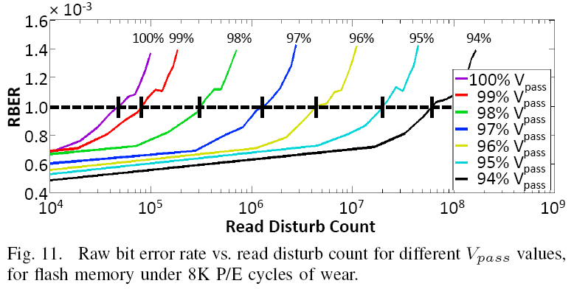
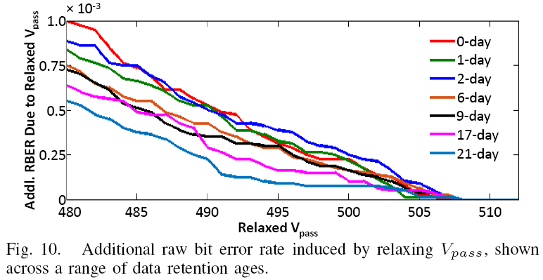
Read Disturb Characterization
It has tradeoff between ‘Retention Age’ and ‘RBER’ through Relaxed ‘$V_{pass}$’ because threshold voltage will be moved to low value.
‘$V_{pass}−V_{th}$’ will be increased from retention age during a long time.
But, if ‘$V_{pass}$’ is higher than other value then ‘RBER’ will be increased.
It needs to control the value about ‘$V_{pass}$’ through ‘$V_{th}$’ for predict the low ‘RBER’.

Slide 15
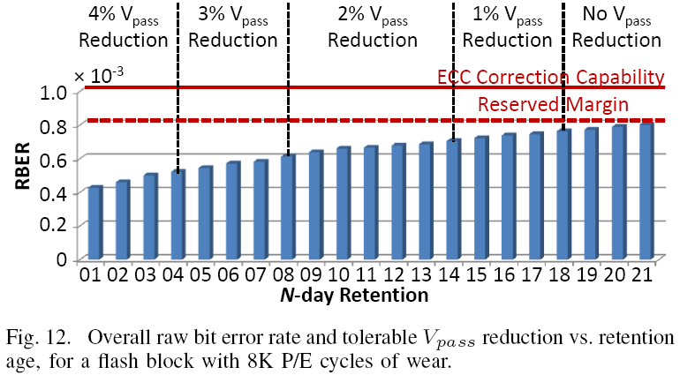
Read Disturb Characterization
‘$V_{pass}−V_{th}$’ must be smaller to decrease on raw bit error rate of cell.
But, if ‘$V_{pass}$’ increase with retention time then it will occur the boost of ‘RBER’.
The capability of ‘ECC’ is limited by reserved margin to protect for variation in the distribution of errors.

Slide 16
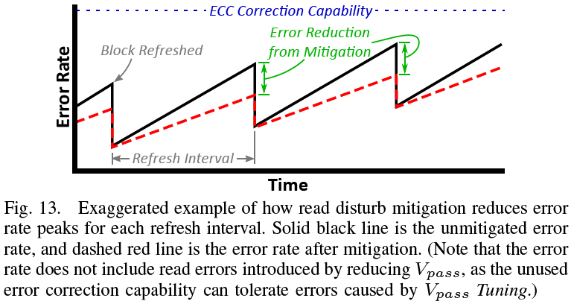
Pass-Through Voltage Tuning
It can be controlled through mitigation about error reduction to approach slowly to reserved margin on ‘ECC’.
The main key point is time of arrival to limited capability of ‘ECC’, because if error rate will be larger than reserved margin then there is not methodology to correct the error by reliability of data in cell.
The mission in paper is that set methodology to maintain for relative value of ‘$V_{pass}$’.

Slide 17
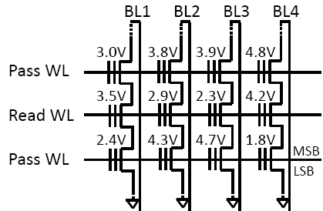
Pass-Through Voltage Tuning
Mechanism
Preliminary-Phase 1 : Collecting the ‘Maximum Estimated Error’ for page in same block (once a day)
Preliminary-Phase 2 : Calculating the margin of ‘ECC’ to can be used to correct the error in cell ($M=\left(1−0.2\right)×C−MEE$)

Slide 18
Pass-Through Voltage Tuning
Mechanism
Phase 1 : Aggressively reduce $V_{pass}$ to $V_{pass}−∆$, where $∆$ is the smallest resolution by which $V_{pass}$ can change.
$$V_{pass}$$
$$V_{pass}$$
$$V_{pass}$$
$$V_{pass}$$
$$3×∆$$
$$2×∆$$
$$∆$$
P3
(01)
$$V_{th}$$

Slide 19
Pass-Through Voltage Tuning
Mechanism
Phase 2 : Apply the new $V_{pass}$ to all wordlines in the block.
BL1
BL2
BL3
BL4
Case 1) $N≤M$
WL
1
1
0
1
Go to ‘Phase 1’
WL
0
0
1
0
WL
1
0
1
1
Case 2) $N>M$
Go to ‘Phase 3’
Count the number of 0’s read from the page

Slide 20
Pass-Through Voltage Tuning
Mechanism
Phase 3 : Increase $V_{pass}$ to $V_{pass}+∆$, and verify that the introduced read errors can be corrected by ECC.
Fallback Mechanism
If $V_{pass}$ exceeds the reserved margin of ECC, then it just set to default pass-through voltage.
$$V_{pass}$$
$$V_{pass}$$
$$V_{pass}$$
$$V_{pass}$$
$$∆$$
$$2×∆$$
$$3×∆$$
P3
(01)
$$V_{th}$$
$$N>M$$
$$N>M$$
$$N>M$$
$$N≤M$$
(X)
(X)
(X)
(O)

Slide 21
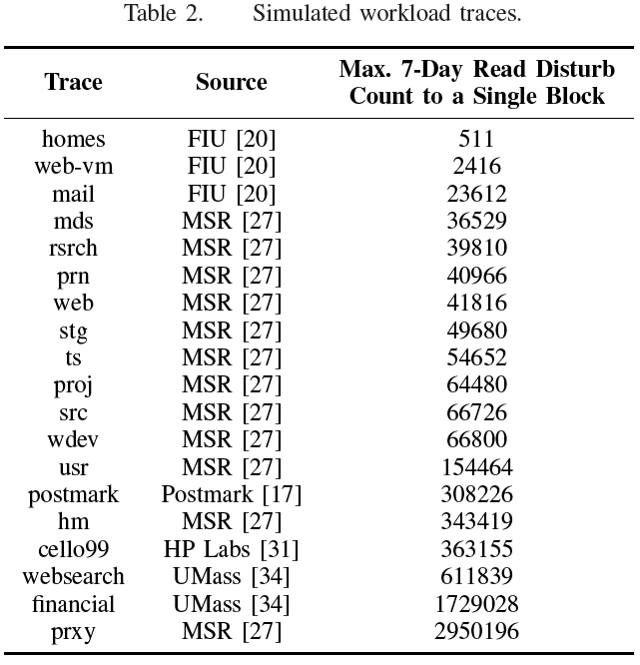
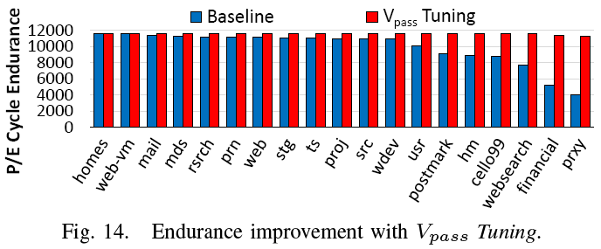
Pass-Through Voltage Tuning
Evaluation
In workload traces, it shows that increased the P/E cycle endurance in order of count of the read disturb by pass-through voltage tuning.
The gap between baseline and $V_{pass}$ tuning will increase more and more by count of read disturb in cell.

Slide 22
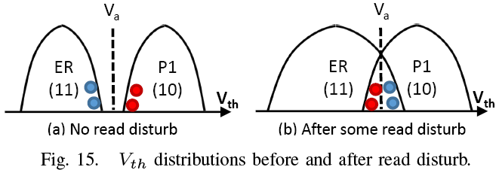
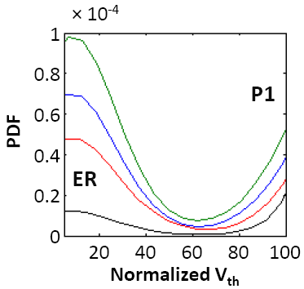
Read Disturb Oriented Error Recovery
If read disturb is more occurred to cells, it may show that probability density functions about state of ‘ER’ and ‘P1’ will cross to opposite area in threshold voltage.
It needs to repair this error because uncorrectable flash error is the most critical type of error.
This scheme is called the ‘Read Disturb Recovery’ (RDR).
$$V_{a}$$

Slide 23
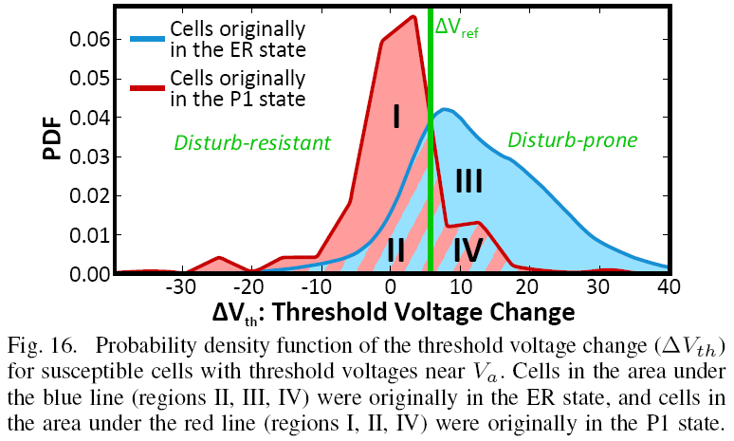
Read Disturb Oriented Error Recovery
Correction
In figure 16, state of ‘2,3,4’ that is called the ‘ER’ state will translate to ‘P1’ state by ‘RDR’.
In figure 16, state of ‘1,2,4’ that is called the ‘P1’ state will translate to ‘ER’ state by ‘RDR’.
So, state of ‘2,4’ that is called the area of overlapping will be recovered by ‘ECC’ automatically.

Slide 24
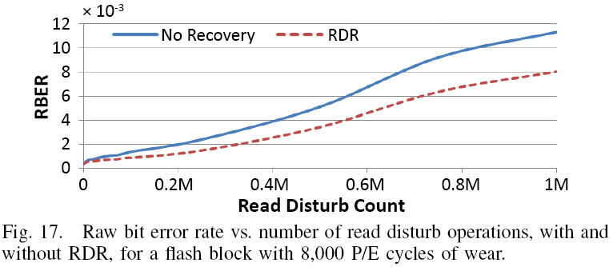
Read Disturb Oriented Error Recovery
Evaluation
When RDR is applied, the reduction in overall RBER grows with the read disturb count, from a few percent for low read disturb counts up to 36% for 1 million read disturb operations.

Slide 25
Conclusion
This paper provides the first detailed experimental characterization of read disturb errors for 2Y-nm MLC NAND flash memory chips.
Authors propose a mitigation mechanism, called $V_{pass}$ Tuning, which dynamically adjusts the pass-through voltage for each flash block online to minimize read disturb errors.
And, an error recovery mechanism, called Read Disturb Recovery, which exploits the differences in susceptibility of different cells to read disturb, to probabilistically correct read disturb errors.

Slide 26
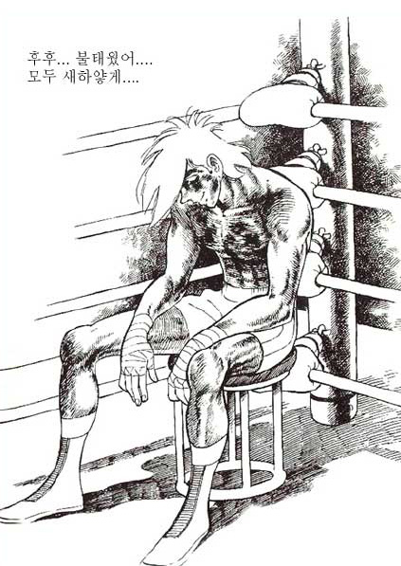
Q & A
손대연 (1986~2015)
‘논문 읽다가 연구실에서 잠들다’
(그러다 또 깨어나서 세미나를 준비하겠지..)

