Slide 1
Special Korea Telecom
-시각 장애인을 위한 스마트 장갑-
조장 : 임재환(32092011)
조원 : 노우철(32091958)
전민우(32092018)
이경수(32101531)
Notes:
뭐 꾸밀꺼없나…?

Slide 2
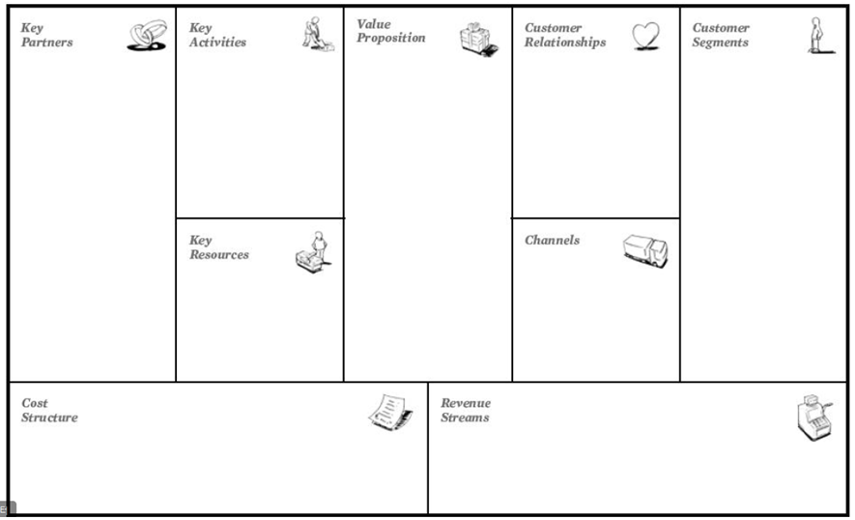
- olleh GiGa IoTMaker
- The disabled
- People
- The disabled using IoT Home Services
- WiseHand Motion, It is convenient.
- Easy to control
- Simplicity
- Comfortable
- Speakable
- Handy
- Flexible
Disabled People
of IOT Home
Service user
- Disabled people
- KT’s Customers
Developer’s experience of an arduino or raspberry
- medical market
- home shopping
Manufactoring
Marketing and Sale
- KaKaoPay
- PayNow
- Naver Pay

Slide 3
IoT Service Ideas!
Motions!
Lock!
# 서비스 구성 요소
Arduino
가속도 센서
자이로 센서
Wifi 모듈
진동 센서
장갑
Lock!
Call

