Slide 1
COCO
&
JAMES
DKU.SOWFTWARE.COCO
DKU.SOWFTWARE.JAMES

Slide 2
CONTENT
1
2
3
INTEREST
INTRODUCTION
HUMOR

Slide 3
INTEREST
1
Internet Of Thins
2
Big Data
3
Machine Learning

Slide 4
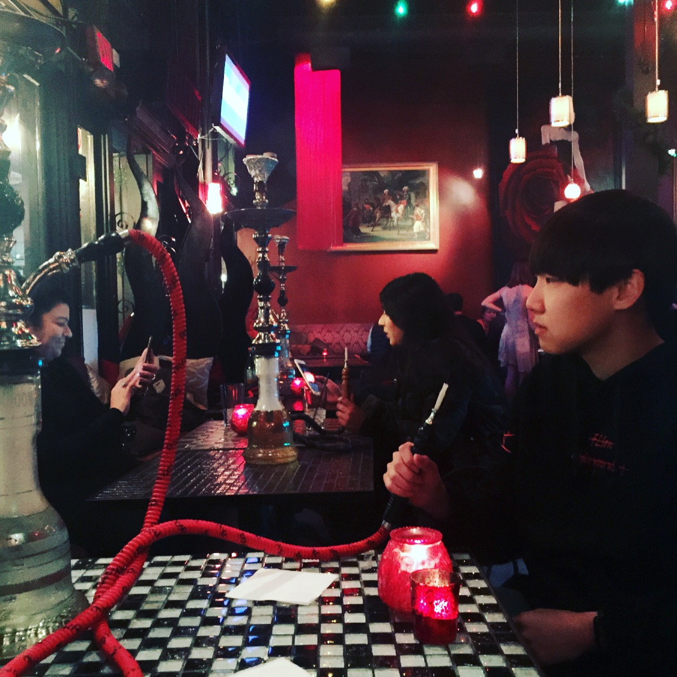
INTRODUCTION
NAME : KIM JUNHO (COCO)
INTEREST : SECURITY, IOT, MACHINE LEARNING, DSP
PROJECT : NOTHING
FUTURE : BUILDING OWNER

Slide 5
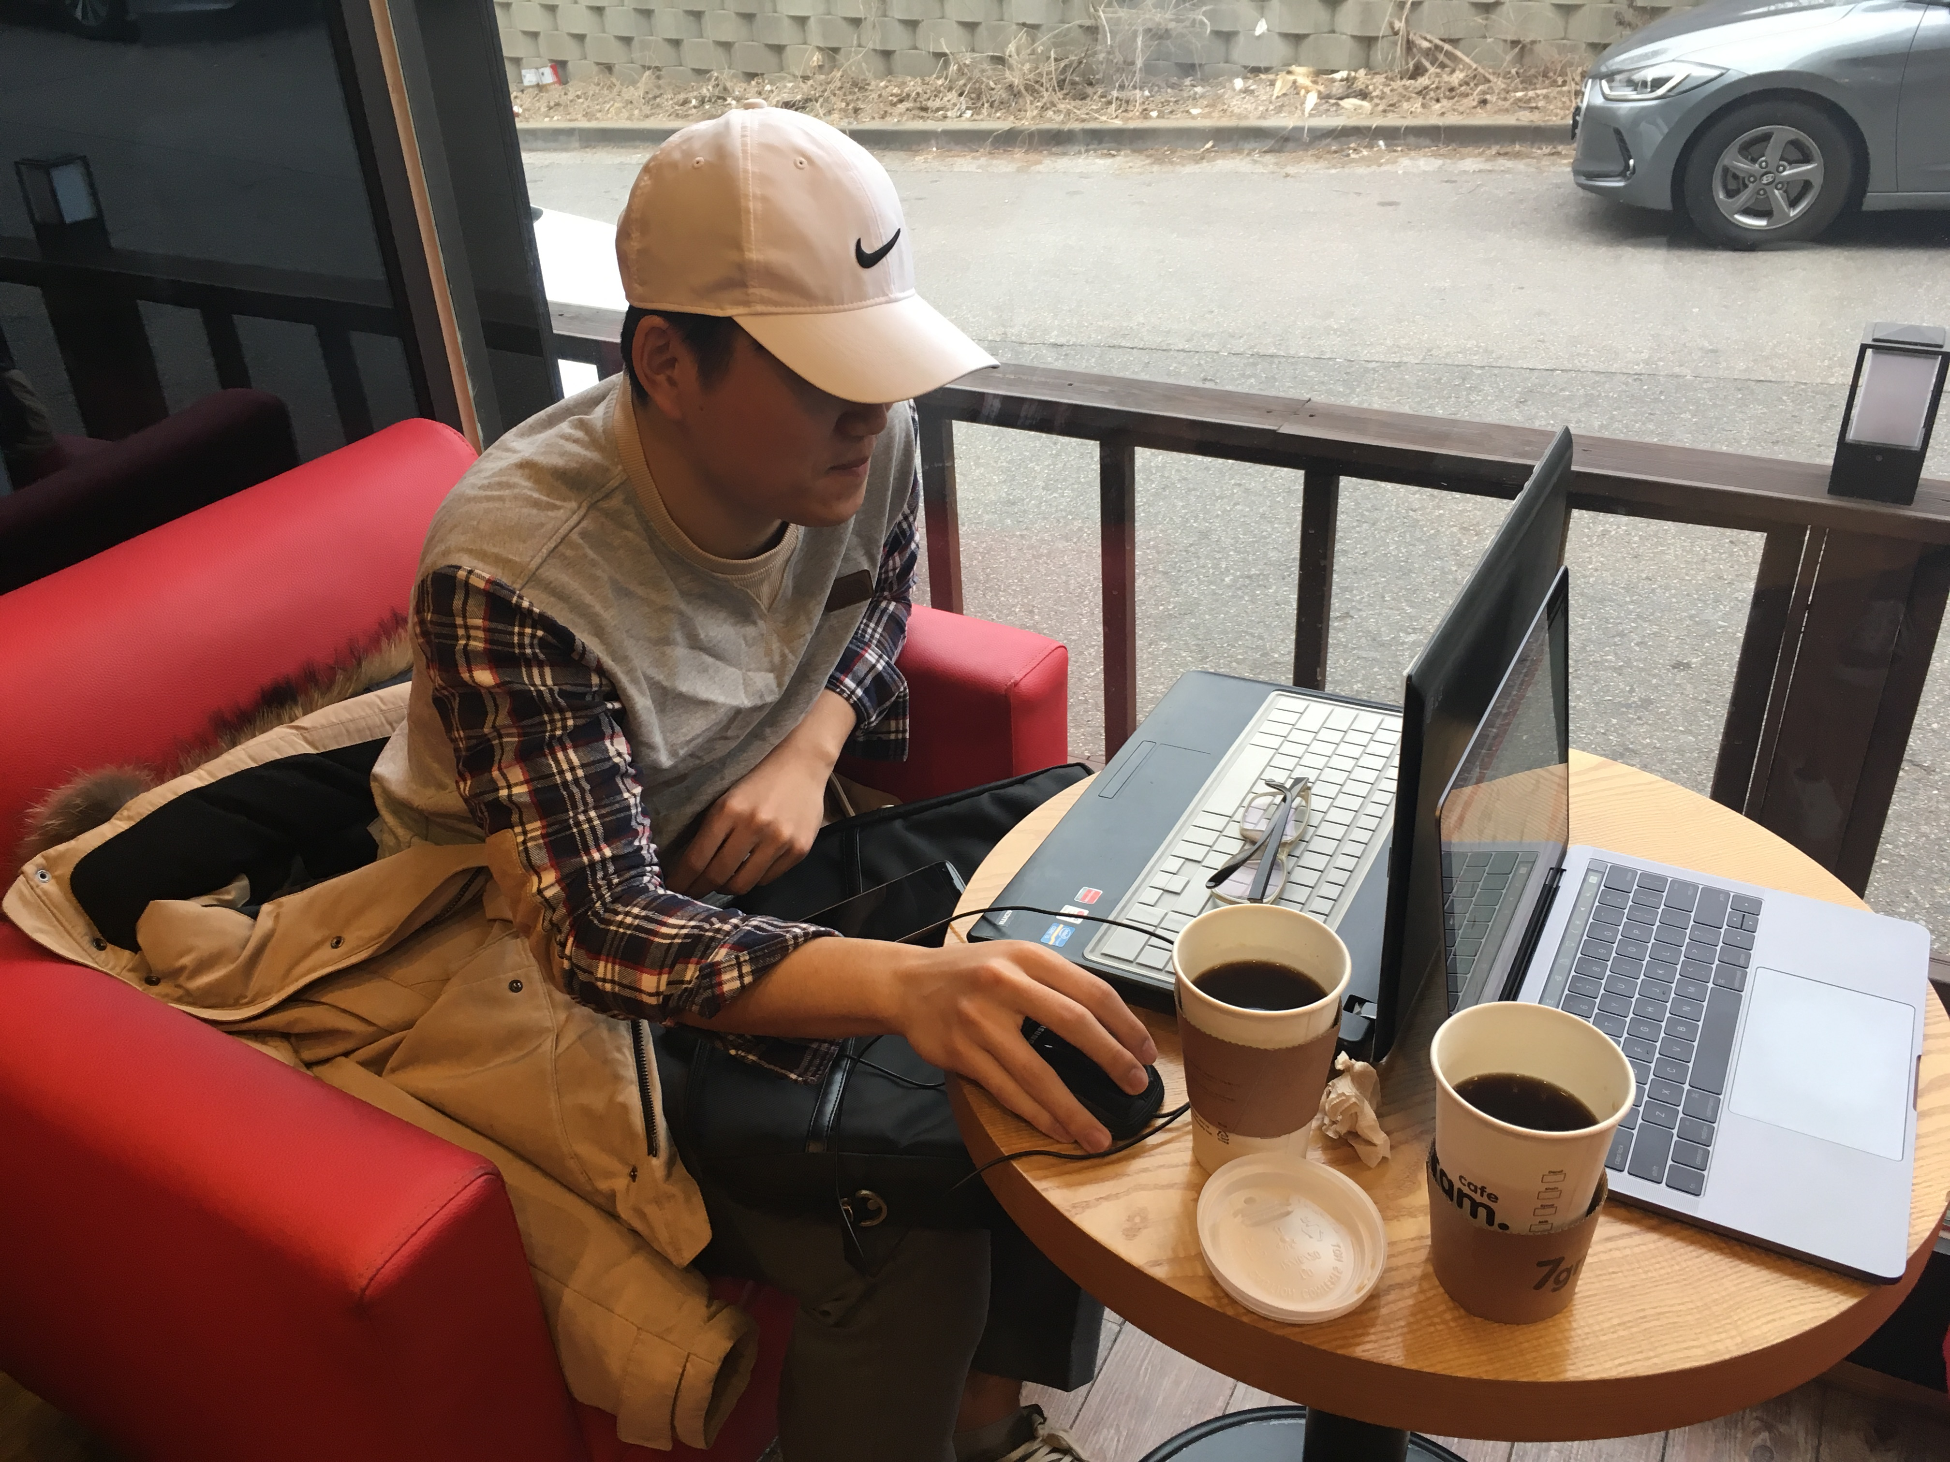
INTRODUCTION
NAME : LEE JE HEON (JAMES)
INTEREST : IOT, MACHINE LEARNING
PROJECT : NOTHING
FUTURE : YOUNG & RICH

Slide 6
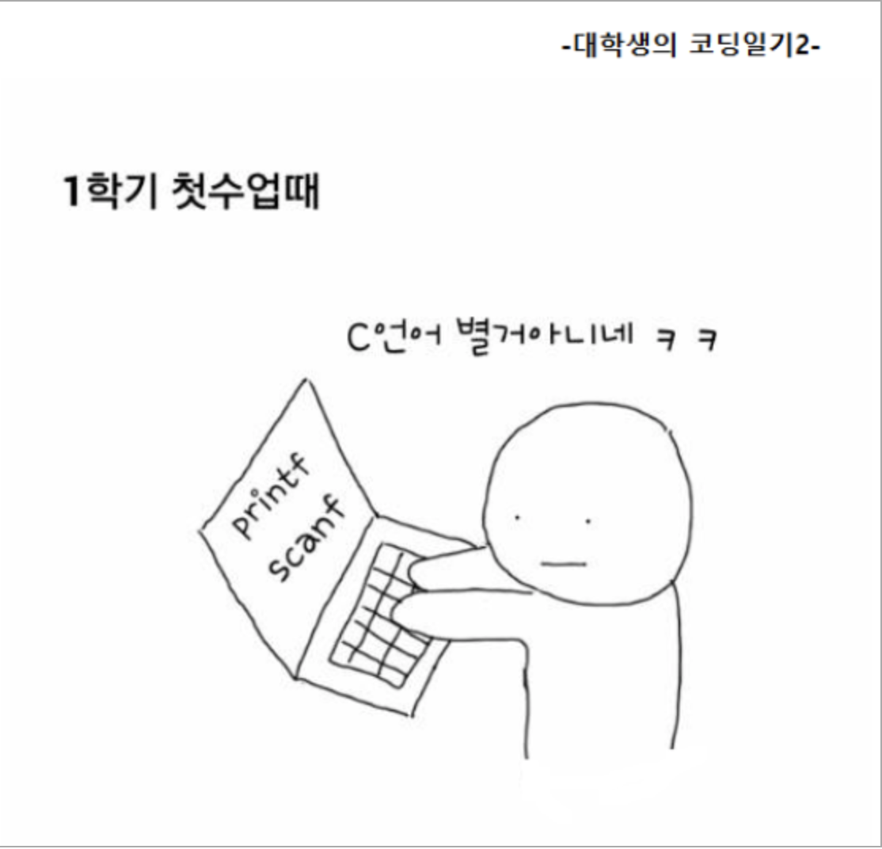
HUMOR

Slide 7
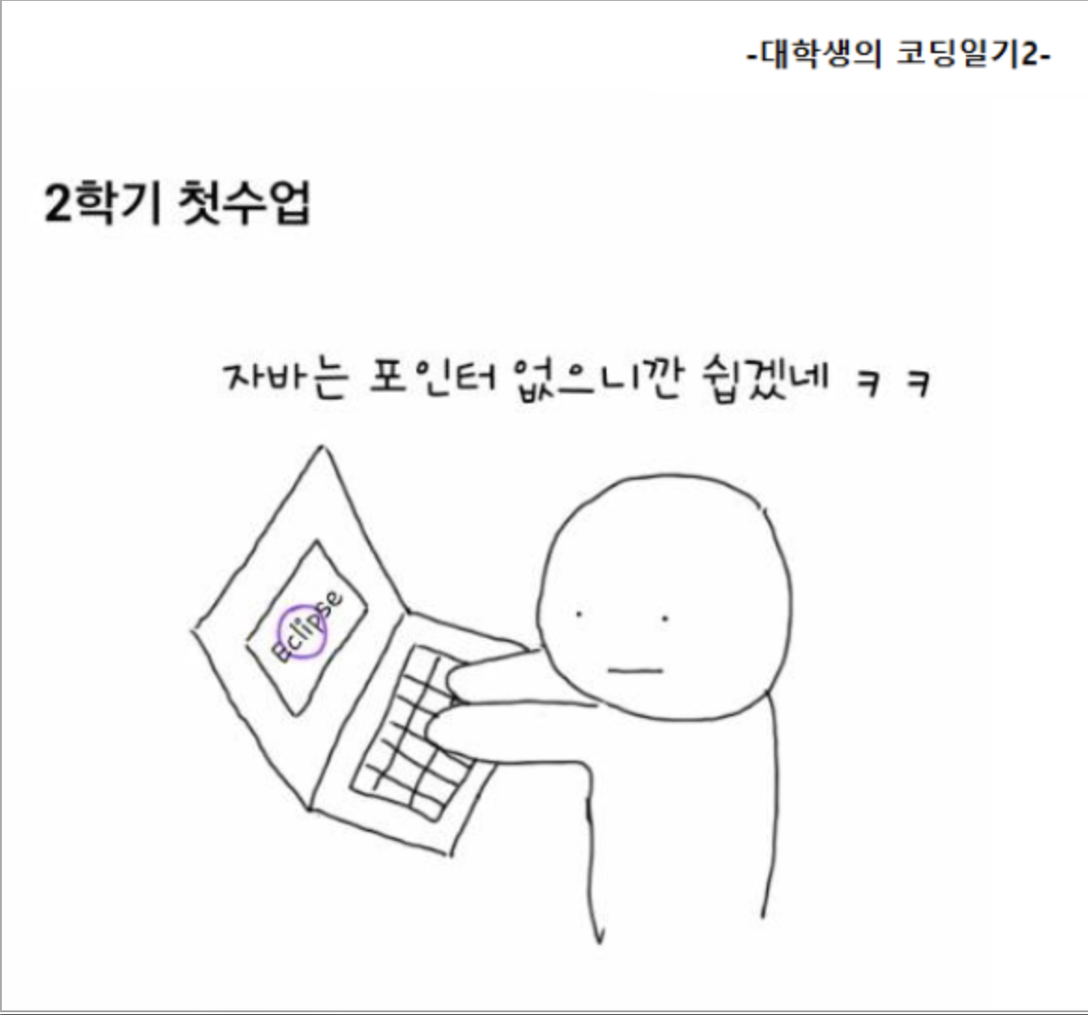
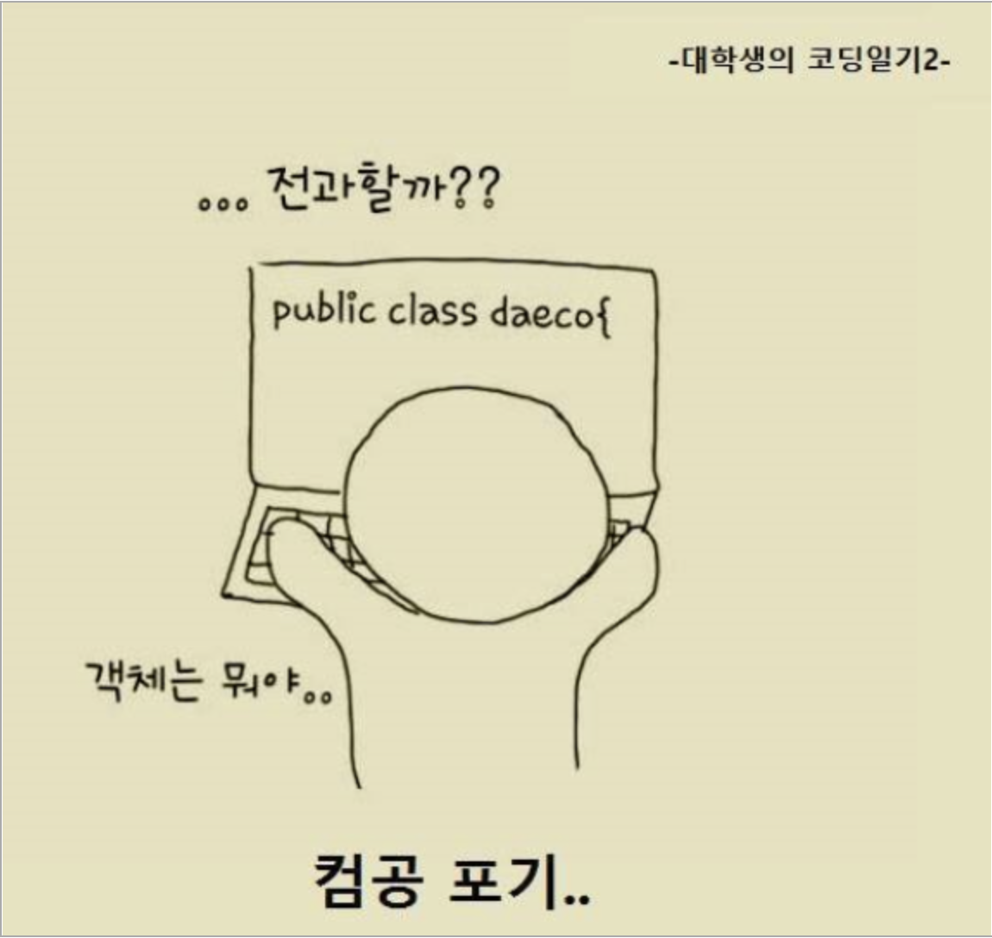
HUMOR

Slide 8
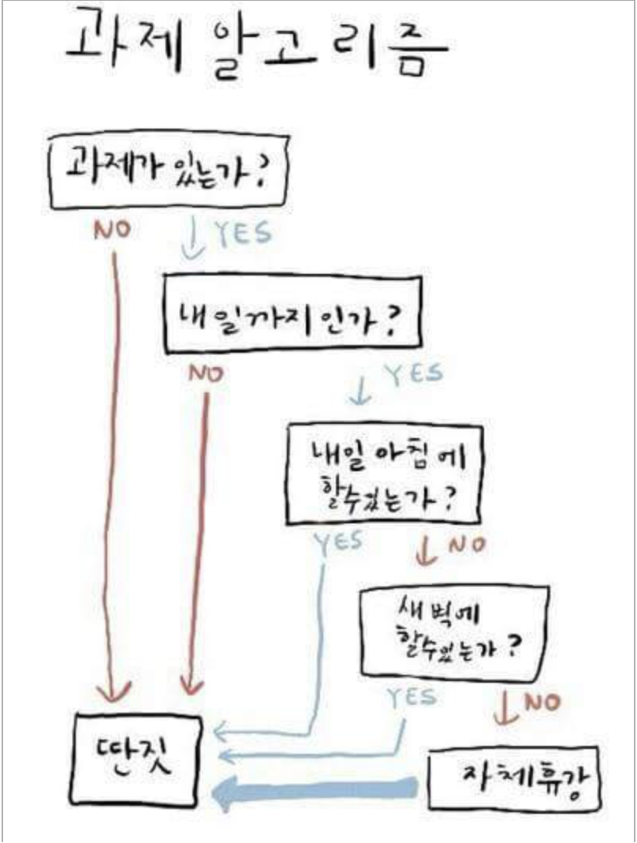
HUMOR

Slide 9
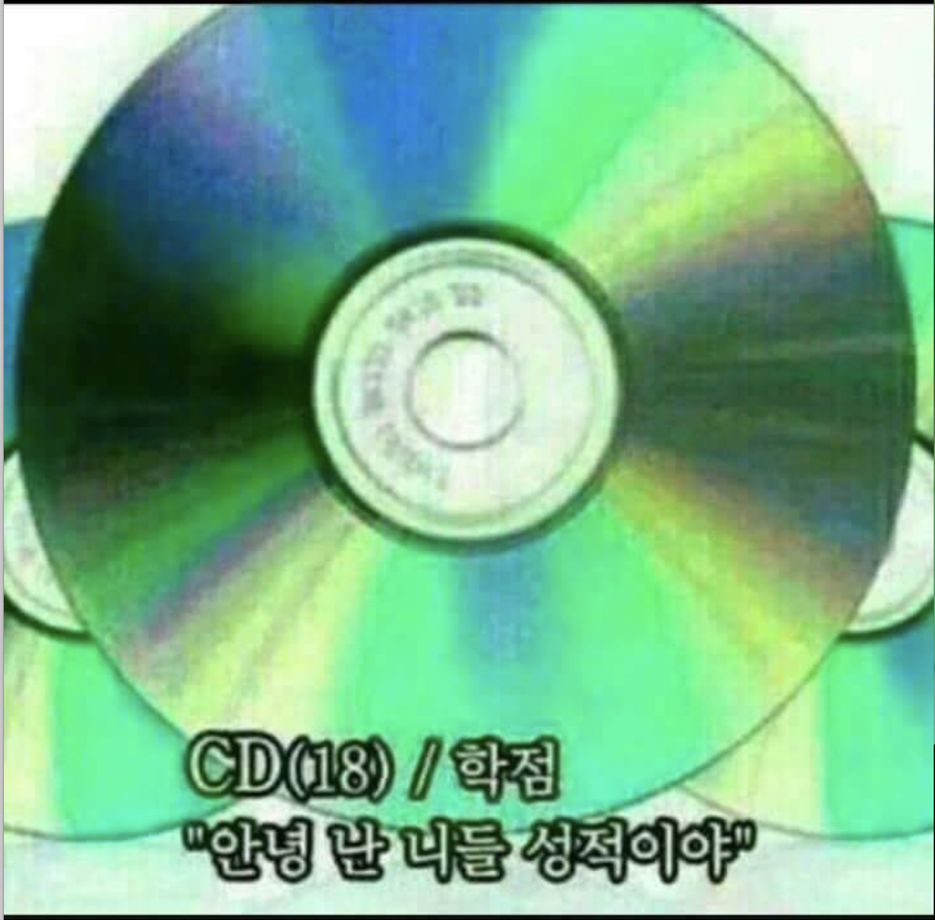
HUMOR

Slide 10
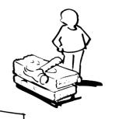
Business Model Canvas -
Key Partners Intel 하드웨어 제조업체 | Key Activities 제품관리 | Value Propositions 최소의 가격으로 귀중품을 보호, 간단 편리한 사용법 |  | Customer Relationships A/S =>불량품만 교환 및 환불 | Customer Segments 귀중품을 자주 분실하는 사람
 | Key Resources 하드웨어 설계, 유통, |  |  | Channels Online, 오프라인 매장(?)
Cost Structure Fixed cost |  |  | Revenue Streams 판매 수익

