Slide 1
COCO & JAMES
PROPOSAL

Slide 2
Wait! Did you check your pocket?
I think you forgot your wallet or your cell phone!
Notes:
Miss your things?

Slide 3
BUT!! Don’t worry about it!
COCO & JAMES can help you!

Slide 4
OUTPUT
Cell Phone
Wallet
COCO & JAMES
Key
Notes:
Simple Information

Slide 5
DESIGN
Buzzer
GPS
Bluetooth
Battery
COCO & JAMES
Raspberry pi
Notes:
Hardware Design

Slide 6
SCENARIO
Where is my things?
Wallet
1. Wallet
2. Key
Find
Notes:
Software Design

Slide 7
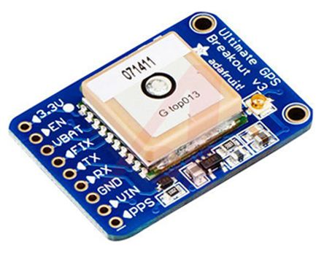
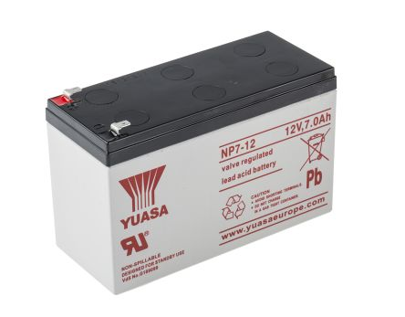
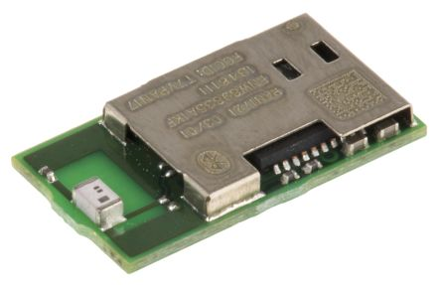
COMPONENTS
RS Pro 12V dc Buzzer
ADAFRUIT INDUSTRIES 746 GPS Module
Yuasa NP7-12 Lead Acid Battery
Panasonic PAN1721-TI Bluetooth Chip 4.0
Raspberry pi
Notes:
Require Item
RS Pro 12V dc Buzzer, 85dB Continuous
ADAFRUIT INDUSTRIES 746 GPS Module
Panasonic PAN1721-TI Bluetooth Chip 4.0
Yuasa NP7-12 Lead Acid Battery

Slide 8
ROLE
COCO
JAMES
Design software
Design hardware
Making a application
Making a presentation
Announce our project
Design software
Design hardware
Making a application
Making a document
Announce our project

Slide 9
Sun
Mon
Tue
Wed
Thu
Fri
Sat
2. 26
27
28
3.1
2
3
4
5
6
7
8
9
10
11
12
13
14
15
16
17
18
Making Team
Brainstorming
19
20
21
22
23
24
25
Brainstorming
Writing Document
26
27
28
29
30
31
4.1
Writing Document
Design Software
2
3
4
5
6
7
8
Design Software
Notes:
Schedule

Slide 10
Sun
Mon
Tue
Wed
Thu
Fri
Sat
4.9
10
11
12
13
14
15
Design Software
Implementation Software
16
17
18
19
20
21
22
Implementation Software
23
24
25
26
27
28
29
Implementation Software
Design & Making Hardware
30
5.1
2
3
4
5
6
Design & Making Hardware
7
8
9
10
11
12
13
Design & Making Hardware
14
15
16
17
18
19
20
Design & Making Hardware

Slide 11
Sun
Mon
Tue
Wed
Thu
Fri
Sat
5. 21
22
23
24
25
26
27
Design & Making Hardware
28
29
30
31
6.1
2
3
Design & Making Hardware
Develop Application & Debugging
4
5
6
7
8
9
10
Develop Application & Debugging
11
12
13
14
15
16
17
Develop Application & Debugging
The Last Announcement
18
19
20
21
22
23
24
25
26
27
28
29
30
7.1

Slide 12
Question & Answer

