Slide 1
The UNIX Time Sharing System
Ritchie, Dennis M., and Ken Thompson. "The UNIX time‐sharing system." Bell System Technical Journal 57.6 (1978): 1905-1929.
2019.09.16
Presentation by Sion Lee
sioni322@naver.com

Slide 2
Introduction
Hardware and Software Environment
The File System
Implementation of the File System
Processes and Images
The Shell
Traps
Perspective & Statistics

Slide 3
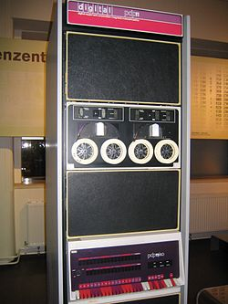
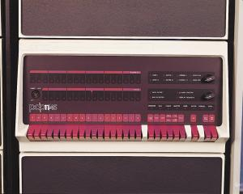
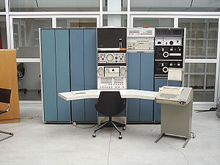
1. Introduction
Three version of UNIX
Earliest version: PDP-7, PDP-9
Second version: PDP-11/40, PDP-11/45
<PDP-7>
<PDP-11/40>
<PDP-11/45>
Notes:
PDP-7: https://en.wikipedia.org/wiki/PDP-7
PDP-11/40: https://ko.wikipedia.org/wiki/PDP-11
PDP-11/45: http://gunkies.org/wiki/File:PDP11-45.jpg

Slide 4
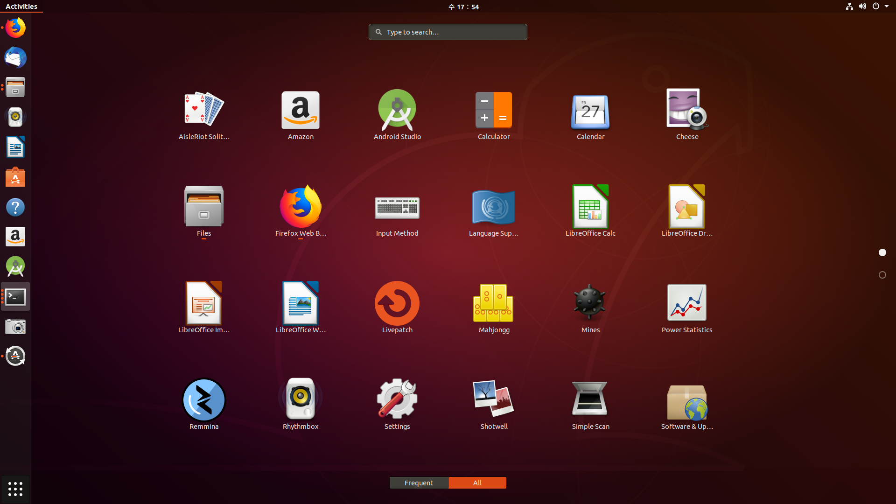
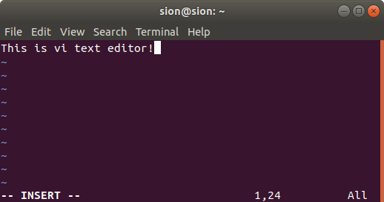
1. Introduction
Earliest version of UNIX
Preparation & formatting patent applications, processing of trouble data, and recording & checking telephone service order
Second version of UNIX
Low cost in equipment and human effort
Major programs
Assembler, text editor, linking loader, symbolic debugger, compiler, etc
Other maintenance, utility, recreation, novelty programs
<vi text editor>
<application programs in UNIX>

Slide 5
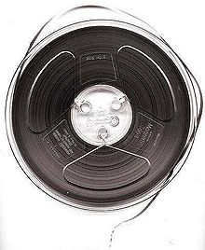
2. Hardware and Software Environment
PDP-11/45
16 bit computer
144KB of core memory ➔ UNIX 42KB
Disk
1MB fixed-head disk (file system storage and swapping)
2.5MB moving-head disk drives x 4
40MB moving-head disk drive
Paper tape, magnetic tape, etc
Console typewriter interface, Picturephone interface
<Paper tape>
<Magnetic tape>
Notes:
Paper tape: https://en.wikipedia.org/wiki/Punched_tape
Magnetic tape: https://ko.wikipedia.org/wiki/자기_테이프

Slide 6
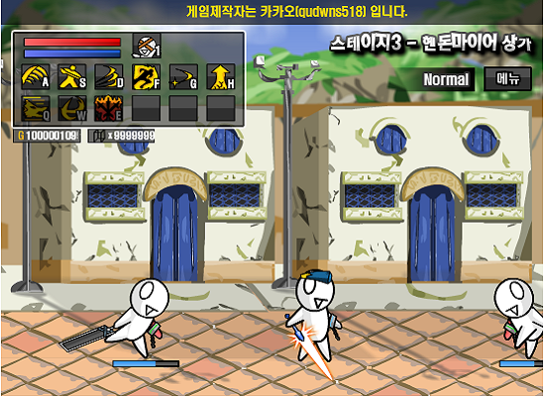
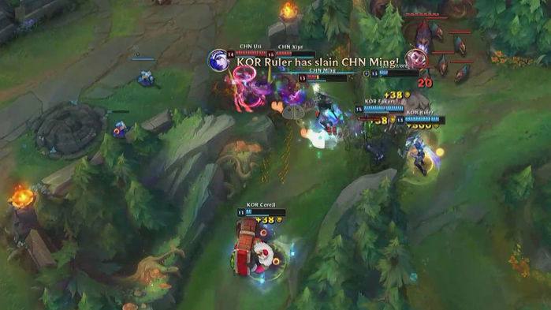
2. Hardware and Software Environment
The UNIX software
Written in C language
Quite big size ➔ for device drivers, I/O buffers, system tables
Easier to understand and modify
Multiprogramming, reentrant code
Interactive OS
Notes:
레바의모험: https://www.google.com/search?q=%EB%A0%88%EB%B0%94%EC%9D%98+%EB%AA%A8%ED%97%98&sxsrf=ACYBGNQ5Z83fDIubi1YOd6vkKpZVoikdbw:1568557036456&source=lnms&tbm=isch&sa=X&ved=0ahUKEwiq5N6ngtPkAhXNG6YKHY3sA0YQ_AUIESgB&biw=1600&bih=778&dpr=1.2
리그오브레전드: https://www.google.com/search?biw=1600&bih=778&tbm=isch&sxsrf=ACYBGNSbaqpkRyN8t00TMBnMq0LwRX2hcg%3A1568557050813&sa=1&ei=-kd-Xb6oMcqQr7wPu4Sj-AU&q=%EB%A6%AC%EA%B7%B8%EC%98%A4%EB%B8%8C%EB%A0%88%EC%A0%84%EB%93%9C+%ED%8E%98%EC%9D%B4%EC%BB%A4&oq=%EB%A6%AC%EA%B7%B8%EC%98%A4%EB%B8%8C%EB%A0%88%EC%A0%84%EB%93%9C+%ED%8E%98%EC%9D%B4%EC%BB%A4&gs_l=img.3...2312.4550..4745...1.0..2.222.2875.8j16j1......0....1..gws-wiz-img.......0j0i24.RC6nbPpv_Qs&ved=0ahUKEwi-jcuugtPkAhVKyIsBHTvCCF8Q4dUDCAY&uact=5

Slide 7
3. The File System
Ordinary File
No particular structure
String of characters
Directory
Provide the mapping between the names of files and the files themselves
Behaves like ordinary file
Hierarchical structure
Cannot be written on by unprivileged programs
“root” directory ➔ ‘/’
Every directory has two subdirectories ➔ ‘.’, ‘..’
<subdirectories of root>

Slide 8
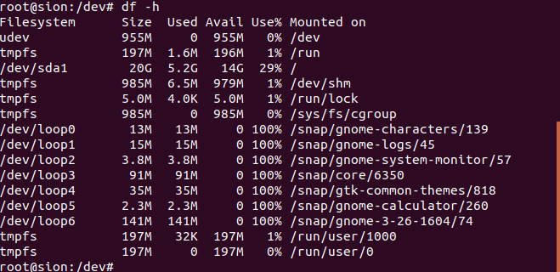
3. The File System
Special File
Request read & write of the associated device
Reside in /dev directory
Three advantages
File and device I/O are similar
File and device name have the same syntax and meaning
Same protection mechanism as regular files
Mount
Replace a leaf of the hierarchy tree by a whole new subtree
No link may exist between one file system hierarchy and another
<special files and mount list>

Slide 9
3. The File System
Protection
Protect file with owner and seven protection bits
Set-user-ID feature
Available without administrative intervention
Super-user
r | w | e | r | w | e
owner
other users
set-user-ID
<seven protection bits>

Slide 10
3. The File System
I/O calls
Open (create)
Read
Write
Seek
Another I/O calls
Close a file, get the status of a file, change the protection mode or owner, create a directory, etc
filep = open(name, flag);
n = read(filep, buffer, count);
n = write(filep, buffer, count);
location = seek(filep, base, offset);

Slide 11
4. Implementation of the File System
file descriptor table
system table(i-list)
inode-table
file
fd | i-num
3 | 7
… | …
i-num | device | r/w ptr | inode #
… | … |  | …
7 | … | … | 10
inode # | owner | protect bit | …
… | … | … | …
10 | Sion | 1111001 | …
open

Slide 12
4. Implementation of the File System
Each block is 512B
inode → eight device address for each file
Small files(nonspecial) : direct address
Large files(nonspecial): indirect address
Special files: last seven device addresses are immaterial & device address indicates device name
Buffering mechanism for I/O
i-list
Simple way to the protection, addressing, accessing, checking consistency

Slide 13
5. Processes and Images
Image: computer execution environment
Three logical segments
Process: execution of an image
processid = fork(label);
filep = pipe();
execute(file, arg 1, arg 2, …, arg n);
processid = wait();
exit(status);

Slide 14
6. The Shell
Shell: command line interpreter
All of the shell commands are in /bin directory
Standard I/O
file descriptor 0: standard reading
file descriptor 1: standard writing
Redirection
a>b: place output on b
a<b: take input from b
Filter
|: execute all the commands simultaneously and deliver to the standard input of the next command in the sequence
<redirection>

Slide 15
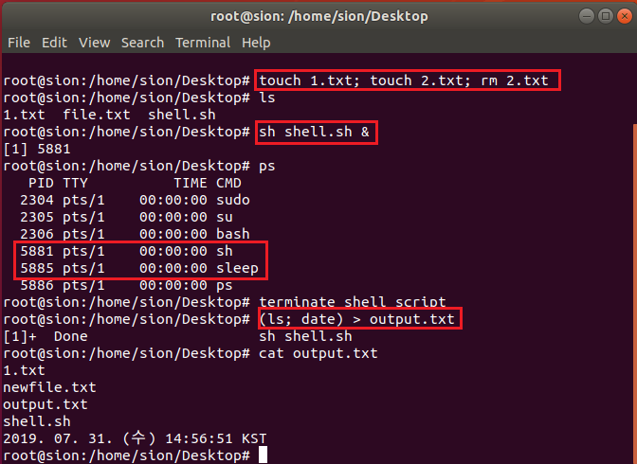
6. The Shell
Command Separator
Semicolon(;)
Ampersand(&)
Parentheses( ‘(‘, ‘)’ )
Command File
Shell is itself a command
<command file>
<command separators>

Slide 16
6. The Shell
Implementation of the Shell
Write command & input enter
Read and analyze command
Internal processing?
fork()
n
y
Processing
inside the shell
execute()
Termination of child process
Success

Slide 17
6. The Shell
Initialization
Create a process
Execute init
Open the typewriters for I/O
Wait until users log-in
init changes to the user’s default current directory, sets the process’s user ID, performs an execute of the Shell

Slide 18
7. Traps
Program faults ➔ trap
Interrupt signal
“delete” character
Cause the program to cease execution
Quit signal
Force a core image to be produced
<SIgnals>

Slide 19
8. Perspective & Statistics
Consideration
They designed the system to make it easy to write, test, and run programs (interactive use)
There have always been fairly severe size constraints on the system and its software
Nearly from the start, the system was able to, and did, maintain itself
Convenience
Easy “access method”
No control blocks
Process control scheme
Command interface

Slide 20
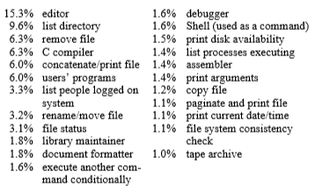
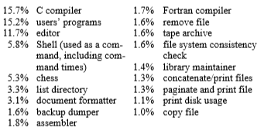
8. Perspective & Statistics
<Command CPU Usage>
<Command Access>

Slide 21
Thank you
2019.09.16
Presentation by Sion Lee
sioni322@naver.com

