Slide 1
W03 paper #2
Flash-Friendly
고급운영체제론 수업
발표일: 2019.09.23

Slide 2
Before we get started
플래쉬/NAND 특성
블록을 지우기 전에 새로 쓸 수 없다.
“block erase before write” (덮어쓰기 x)
기록 회수에 제한이 있다.
예: 써지는데, 전원 off/on 이후 리셋된다
Wear leveling 필수
블록단위로만 재기록할 수 있다.
NOR: 블록단위 지우기(1로 쓰기) 이후 셀단위 쓰기(0으로 쓰기) 가능
NAND: 블록단위로만 쓰기 가능
1셀은 1 bit(SLC), 2 bit (MLC), 3 bit(TLC), …
1블록은 128kB 혹은 그 이상
디스크 조각모음 필요 없음
WE NEED TO KNOW FLASH H/W
OR IT WILL BE MESSED UP
SO, KNOW YOUR FLASH

Slide 3
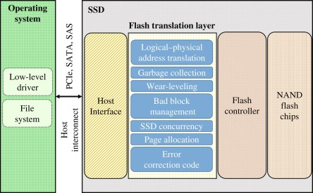
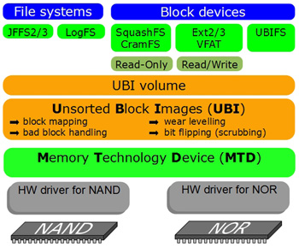
Before we get started
FTL(Flash Translation Layer) was introduced for device abstraction
Example device: eMMC, UFS, SSD, …
Still, random writes cause SSD performance degradation
Especially in apps using SQLite such as facebook
FTL layer in SSD
UBI and UBIFS (without FTL)

Slide 4
Introduction
Random writes is bad to flash storage device(common in facebook app)
Free space fragmentation -> sustained random write performance degrades -> lifetime reduced
Sequential write oriented file systems
Log-structured file systems, copy-on-write file systems [27, 26]
Still sub-optimal in terms of performance and device lifetime
Contribution
Design and implementation of a new file system to fully leverage and optimize the usage of NAND flash solution (with block interface[1])
Performance comparison with Linux file system (EXT4, Btrfs, Nilfs2) - Mobile system and server system

Slide 5
Key Design Considerations
Flash-friendly on-disk layout
Cost-effective index structure
Multi-head logging
Adaptive logging
fsync acceleration with roll-forward recovery

Slide 6
Flash-friendly on-disk layout
6 areas: SB, CP, SIT, NAT, SSA, Main Area
Flash Awareness
All the FS metadata are located together for locality
Start address of main area is aligned to the zone size,
File system cleaning is done in a unit of section (FTL’s GC unit)
Cleaning Cost Reduction
Multi-head logging for hot/cold data separation

Slide 7
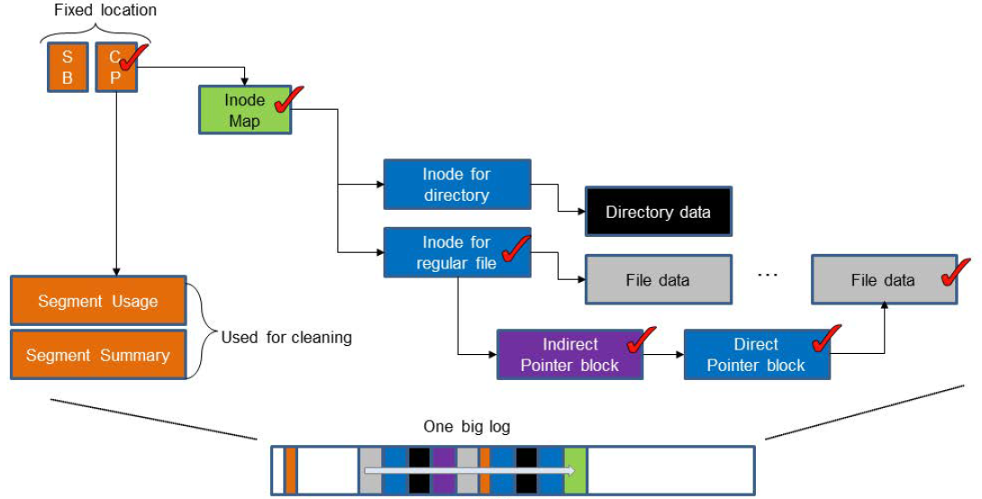
LFS Index Structure (for comparison)
Update propagation issue: wandering tree (Update propagation)
One big log

Slide 8
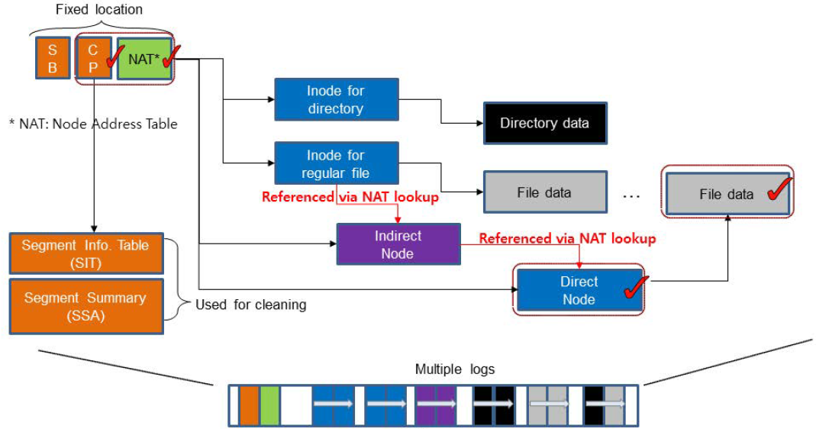
F2FS Index Structure
Restrained update propagation: node address translation method
Use unique node ID as an index to get physical locations of all node blocks
No update propagation!
Multi-head log

Slide 9
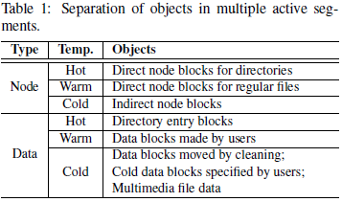
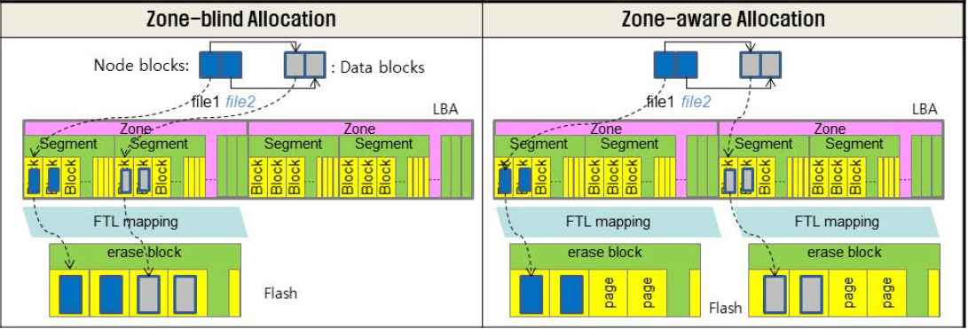
Multi-head Logging
Data temperature classification
Node > data
Direct node > indirect node
Directory > user file
Separation of multi-head logs in NAND flash
Zone-aware log allocation for set-associative
Multi-stream interface

Slide 10
Cleaning
Cleaning is done in section unit.
Section to be aligned with FTL’s GC unit
Cleaning procedure
Victim selection: get a victim section through referencing Segment Info Table(SIT) - Greedy algorithm for foreground cleaning job - Cost-benefit algorithm for background cleaning job
Valid block check: load parent index structures of there-in data identified from Segment Summary Area(SSA)
Migration: move valid blocks by checking there cross-reference
Mark victim section as “pre-free” - Pre-free sections are freed after the next checkpoint is made

Slide 11
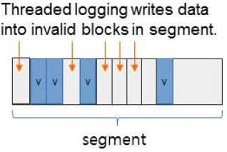
Adaptive Logging
To reduce cleaning cost at highly aged conditions, F2FS changes write policy dynamically
Append logging(logging to clean segments)
Need cleaning operations if there is no free segment
Cleaning causes mostly random read and sequential writes
Threaded logging¹ (logging to dirty segments)
Reuse invalid blocks in dirty segments
No need cleaning
Cause random writes
Node is always written with append logging policy
1. Y. Oh, E. Kim, J. Choi, D. Lee, and S. H. Noh, Optimization of LFS with slack space recycling and lazy block indirect update in Proceedings of the Annual Haifa Experimental Systems Conference, page 2, 2010

Slide 12
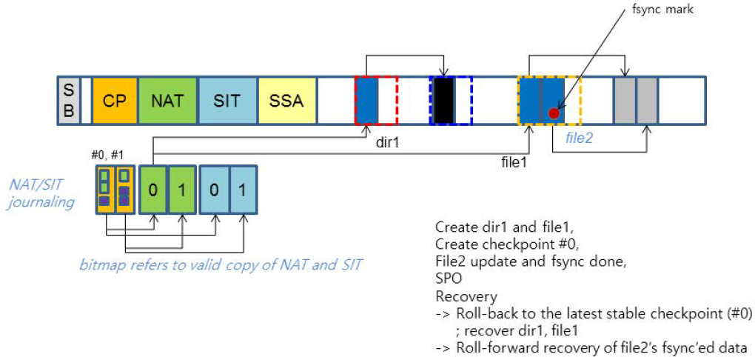
Sudden Power Off Recovery (1/2)
Checkpoint and rollback
Maintains Shadow copy of checkpoints, NAT, SIT blocks
Recovers the latest checkpoint
Keeps NAT/SIT journal in checkpoint to avoid NAT, SIT writes

Slide 13
Sudden Power Off Recovery (2/2)
Fsync handling
On fsync, checkpoint is not necessary.
Direct node blocks are written with fsync mark.
Roll-forward recovery procedure
Search marked direct node blocks
Per marked node block, identify old and new data blocks by checking the differen between the current and previous node block.
Update SIT; invalidate old data blocks
Replay new data blocks writes; update NAT, SIT accordingly
Create checkpoint

Slide 14
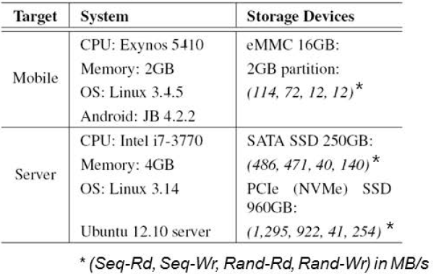
Evaluation
Experimental Setup
Mobile and server systems
Performance comparison with EXT4, btrfs, nilfs2

Slide 15
Mobile Benchmark
In F2FS, more than 90% of writes are sequential
F2FS reduces write amount per fsync by using roll-forward recovery
If checkpoint is done per fsync, write amount in SQLite insert test is 73% more than EXT4, and normalized performance is 0.88.
Btrfs and nilfs2 performed poor than EXT4.
Btrfs: heavy indexing overheads, Nilfs2: periodic data flush
For lozone-RW, Btrfs, Nilfs2 write 15%, 41% more I/Os than EXT4, respectively.
For lozone-RR, Btrfs has 50% more I/Os than other file systems.

Slide 16
Server Benchmark
Performance gain of F2FS over EXT4 is more on SATA SSD than on PCIe SSD
Varmail: 2.5x on the SATA SSD and 1.8x on the PCIe SSD
Oltp: 16% on the SATA SSD and 13% on the PCIe SSD
Discard size matters in SATA SSD due to interface overhead
When using small discard (256kB) for F2FS, fileserver performance is degraded by 18%.

Slide 17
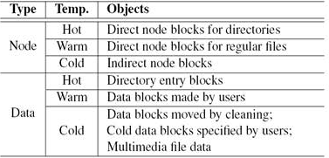
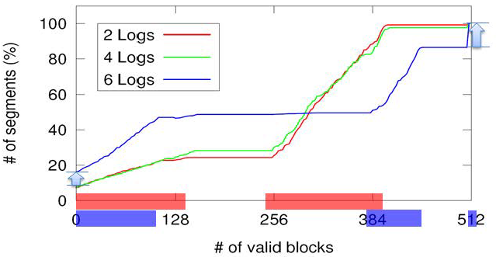
Multi-head Logging
Using more logs gives better hot and cold data separation.
2 logs: node, data
4 logs: hot node, warm/cold node, hot data, warm/cold data
Test condition:
Run two workloads simultaneously:
1. Varmail(10,000 files in 100 dirs., total writes 6.5 GB)
2. Copying jpg files (500kB, 5,000files, 2.5GB) → considered as cold

Slide 18
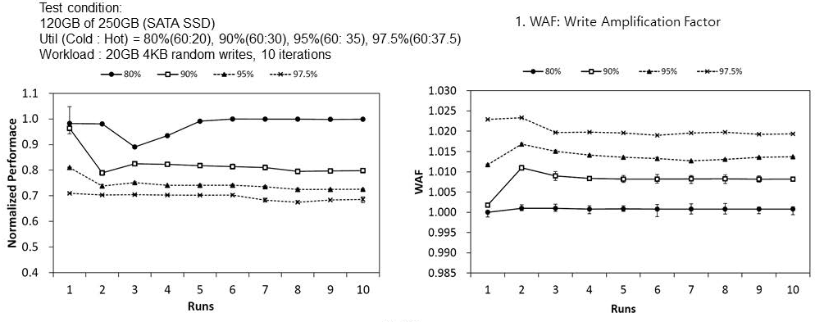
Cleaning Cost Analysis
Under high utilization, F2FS uses adaptive logging to restrain FS cleaning cost
Only node segment cleaning is done.
Even in 97.5% util., WAF¹ is less than 1.025.
Without adaptive logging, WAF¹ goes up to more than 3.

Slide 19
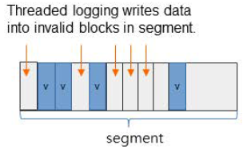
Adaptive Logging Performance
Adaptive logging gives graceful performance degradation under highly aged volume conditions
Fileserver test on SATA SSD (94% util.)
Sustained performance improvement: 2x/3x over EXT4/btrfs.
Iozone test on eMMC (100% util.)
Sustained performance is similar to EXT4.

Slide 20
Conclusion
F2FS features
Flash friendly on-disk layout -> align FS GC unit with FTL GC unit,
Cost effective index structure -> restrain write propagation,
Multi-head logging -> cleaning cost reduction,
Adaptive logging -> graceful performance degradation in aged condition,
Roll-forward recovery -> fsync acceleration.
F2FS shows performance gain over other Linux file systems.
3.1x(iozone) and 2x(SQLite) speedup over EXT4,
2.5x(SATA SSD) and 1.8x(PCIe SSD) speedup over EXT4 (varmail)
F2FS is publicly available, included in Linux mainline kernel since Linux 3.8.

Slide 21
References
[27] M. Rosenblum and J. K. Ousterhout.
The design and implementation of a log-structured file system.
ACM Transactions on Computer Systems (TOCS), 10(1):26–52, 1992.
-> still has update propagation problem
[26] O. Rodeh, J. Bacik, and C. Mason.
Btrfs: The linux b-tree filesystem.
ACM Transactions on Storage (TOS), 9(3):9, 2013.
[1] Thomas Gleixner and Artem Bityutskiy.
Unsorted block image file system.
http://www.linux-mtd.infradead.org/doc/ubifs.html, 2006
-> file system for raw-flash devices
(Experimental Papers)
Tristan Lelong.
File system considerations for embedded devices
ELC2015, 03/25/15
-> performance comparison of various file systems
Bianca Schroeder, Raghav Lagisetty and Arif Merchant.
Flash Reliability in Production: The Expected and the Unexpected
FAST ’16
-> SSD reliability assessment in Google IDC for 6 years

