Slide 1
W06 paper #1
Xen and the Art of Virtualization
Paul Barham(MS), Boris Dragovic, Keir Fraser, Steven Hand, Tim Harris,
Alex Ho, Rolf Neugebauer(Intel), Ian Pratt, Andrew Warﬁeld,
University of Cambridge Computer Laboratory
-> cited over 1,600
19th ACM Symposium on Operating Systems Principles
(SOSP 2003)
고급운영체제론 수업
발표일: 2019.10.14

Slide 2
Contents
Introduction – Virtualization Overview
Xen Overview
Virtual Machine Interface
Cost of Porting
Control and Management
Xen Design in detail
Control transfer: Hypercalls and Events
Data transfer: I/O Rings
Subsystem Virtualization
Binding a New Domain
Evaluation
Related Works
Future Work and Conclusion
Legend
Blue – pros, goods
Red – cons, bads

Slide 3
1. Introduction – Why Virtualization?
Virtualization in the Enterprise
Consolidate under-utilized servers to reduce CapEx and OpEx
Avoid downtime with VM Relocation
Dynamically re-balance workload to guarantee application SLAs
Enforce security policy
X
X
X

Slide 4
1. Introduction – Full Virtualization
Present the illusion of many small Virtual Machines to run multiple instances of different Operating Systems concurrently
Virtual Machine exactly like physical machine
Pros
Can run unmodiﬁed OSes in VM
Cons
Performance
Uncooperative hardware
Solution: binary rewriting
Examples
VM/370, VMware, Disco

Slide 5
1. Introduction – Para-virtualization
Present an idealized VM abstraction to guest OSes
Differs from underlying hardware interface
Pros
Can deal with difﬁculties to virtualize architectures
Exposing both a virtual and real interface leads to potential performance enhancements
Cons
Must port existing OSes to run on paravirtualized host
Example
Denali
(*) this paper was an enhanced version of Denali, but much more successful
- citation index of [Xen] is 1600 while [Denali] is 230
Also, [Xen] was successful in terms of commercial impact[Citrix].

Slide 6
1. Introduction
Single OS image: Ensim, Vservers, CKRM, Virtuozo, Zones, Docker
Group user processes into resource containers
Hard to get strong isolation (treated as a process/task)
Full virtualization: VMware, VirtualPC, QEMU, VirtualBox
Run multiple unmodified guest OSes
Hard to efficiently virtualize x86
Para-virtualization: UML, Xen
Run multiple guest OSes ported to special arch
Arch Xen/x86 is very close to normal x86

Slide 7
2. Xen Overview - Features
Execution performance is close to native
Provides an environment to execute up to 100 VM instances simultaneously
Attempts to minimize overhead associated with virtualization
Secure isolation between VMs
Resource control and QoS
Only guest kernel needs to be ported
All user-level apps and libraries run unmodified
XenoLinux - Port of Linux 2.4 and family OSes(Linux 2.6, NetBSD, FreeBSD, Plan9)
XenoXP - Port of Windows XP (in development as of 2003)
Supports the same hardware as Linux x86
Live Relocation of VMs between Xen nodes

Slide 8
2. Xen Overview - Paravirtualization
Xen extensions to x86 arch
Like x86, but replaces privileged instructions with Xen hypercalls
Avoids binary rewriting
Minimize number of privilege transitions into Xen
Modifications relatively simple and self-contained
For Linux 2.6, only arch-dep files modified (but still needs modification)
Modify kernel to understand virtualized env.
Wall-clock time vs. virtual processor time
Desire both types of alarm timer
Expose real resource availability
Enables OS to optimize its own behavior
MMU virtualization: direct vs. shadow mode

Slide 9
2. Xen Overview - I/O Architecture
Xen IO-Spaces delegate guest OSes protected access to specified h/w devices
Virtual PCI configuration space
Virtual interrupts
Devices are virtualized and exported to other VMs via Device Channels
Safe asynchronous shared memory transport
‘Backend’ drivers export to ‘frontend’ drivers
Net: use normal bridging, routing, iptables
Block: export any blk dev e.g. sda4,loop0,vg3

Slide 10
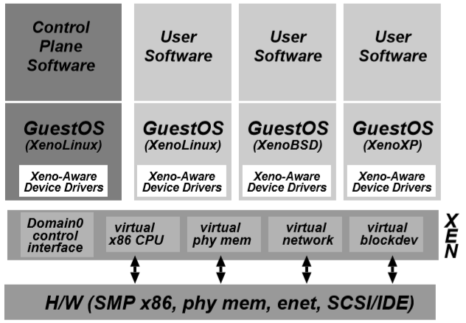
2. Xen Overview - Architecture (2.0)

Slide 11
2. Xen Overview - Architecture (2.0)
VM0
VM1
VM2
VM3
Device
Manager &
Control s/w
Unmodified
User
Software
Unmodified
User
Software
Unmodified
User
Software
GuestOS
(XenoLinux)
GuestOS
(XenoLinux)
GuestOS
(XenoXP)
GuestOS
(XenoBSD)
Back-End
Back-End
Native
Device
Driver
Native
Device
Driver
Front-End
Device Drivers
Front-End
Device Drivers
Control IF
Safe HW IF
Event Channel
Virtual CPU
Virtual MMU
Xen Virtual Machine Monitor
Hardware (SMP, MMU, physical memory, Ethernet, SCSI/IDE)

Slide 12
2.1 Xen Overview – Virtual Machine Interface
CPU
Memory
Device I/O

Slide 13
2.1 Xen Overview – Virtualized CPU
CPU Execution
Non-Privileged Instructions can run directly on “bare hardware” (AKA. bare metal)
Privileged operations must be marshaled by Xen
Privilege Levels
x86 has four privileged levels (rings) 0-3 (0=more … 3=less)
Xen runs at ring0, Guest OS at ring1, apps at ring3
Exception Handling
Guest provides virtual IDT
Most ISRs same as on real x86 hardware, page-fault is special case
Interrupts and Events
Handled via “event channels,” Xen upcalls into guest
Maskable, analogous to disabling interrupts
‘Fast’ exception handler for Guest OS system-calls

Slide 14
2.1 Xen Overview – Memory Management
Page Tables
Guests responsible for managing their own page tables
Updates to page tables must go through Xen, and can be batched
Page frames contain reference count and type
Translation Lookaside Buffer
x86’s hardware managed TLB complicates virtualization
Xen mapped to the top 64MB of each address space, saves TLB ﬂushes
Segmentation
Handled in a similar manner as page tables
Physical Memory
Most Operating Systems expect contiguous memory addresses
Illusion of contiguous physical memory provided by physical hardware map
Exposing both hardware and physical memory addresses provides area for optimization
Cache locality

Slide 15
2.1/3.3 MMU Virtualization : Shadow-Mode
guest reads
Virtual → Pseudo-physical
guest writes
Guest OS
Accessed &
Updates
dirty bits
Virtual → Machine
VMM
Hardware
MMU

Slide 16
2.1 Xen Overview – Device I/O
Xen exposes a set of clean and simple device abstractions
I/O data transferred between guest and Xen via aync I/O Rings
Network Device
VFR - Virtual Firewall-Router
VIF - Virtual Network Interface
Disks
VBD - Virtual Block Devices Cache locality

Slide 17
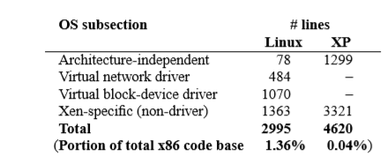
2.2 Xen Overview – The Cost of Porting an OS
Porting an OS to Xen
Only architecture-dependent part is modified
Porting Linux is rather simple due to virtual I/O drivers
Porting WinXP is rather complex, including architecture independent parts, PTEs, legacy 16bit support codes.

Slide 18
2.3 Xen Overview – Control & Management
Domain0
Created at Xen boot-time
Has access to Xen’s control interface
Hosts application-level management software
Provides separation of policy and mechanism
Control Transfer
Hypercalls (rather than system calls which are slow)
Events - Lightweight notiﬁcation

Slide 19
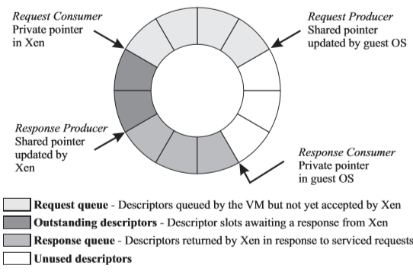
2.3 Xen Overview – Control & Management
Data Transfer
I/O Rings
Mechanism to allow efﬁcient moving of data vertically through system
Based around two pairs of producer-consumer pointers

Slide 20
4. Evaluation
Compare Linux to different Virtualization tecnhiques
XenoLinux compared against
Linux, VMWare, User-Mode Linux
Benchmarks
SPEC: CPU intensive
Linux build: 7% of time spent in kernel
OSDB-IR/OLTP: OS intensive, many domain transitions (many page faults?)
Dbench: ﬁlesystem intensive
SPEC WEB99: good overall measure

Slide 21
4.1 Evaluation - System Performance
1.1
1.0
0.9
0.8
0.7
0.6
0.5
0.4
0.3
0.2
0.1
0.0
L
X
V
U
L
X
V
U
L
X
V
U
L
X
V
U
SPEC INT2000 (score)
Linux build time (s)
OSDB-OLTP (tup/s)
SPEC WEB99 (score)
Benchmark suite running on Linux (L), Xen (X), VMware Workstation (V), and UML (U)

Slide 22
4.2 Evaluation - Network Performance
Smaller packet size shows performance degradation due to header overhead
1.1
1.0
0.9
0.8
0.7
0.6
0.5
0.4
0.3
0.2
0.1
0.0
L
X
V
U
L
X
V
U
L
X
V
U
L
X
V
U
Tx, MTU 1500 (Mbps)
Rx, MTU 1500 (Mbps)
Tx, MTU 500 (Mbps)
Rx, MTU 500 (Mbps)
TCP bandwidth on Linux (L), Xen (X), VMWare Workstation (V), and UML (U)

Slide 23
4.3/4.5 Evaluation – Concurrent VMs, Scalability
Run up to 100 VMs concurrently
Only a loss of 7.5% throughput compared to Linux
1000
800
600
400
200
0
L
X
L
X
L
X
L
X
2
4
8
16
Simultaneous SPEC WEB99 Instances on Linux (L) and Xen(X)

Slide 24
Scalability
Scalability principally limited by Application resource requirements
Several 10’s of VMs on server-class machines
Balloon driver used to control domain memory usage by returning pages to Xen
Normal OS paging mechanisms can deflate quiescent domains to <4MB
Xen per-guest memory usage <32KB
Additional multiplexing overhead negligible

Slide 25
6.2 Conclusions
Xen provides excellent platform for deploying a wide variety of differing applications
Xen provides necessary protection and performance isolation
Paravirtualization provides near native performance
Xen is a complete and robust GPL VMM
http://xensource.com
http://xen.sf.net
http://www.xen.org

Slide 26
7. References
[43] A. Whitaker, M. Shaw, and S. D. Gribble.
Denali: Lightweight Virtual Machines for Distributed and Networked Applications.
Technical Report 02-02-01, University of Washington, 2002.
-> 본 논문은 Denali의 단점을 보완
[3] G. Banga, P. Druschel, and J. C. Mogul.
Resource containers: A new facility for resource management in server systems.
In Proceedings of OSDI 1999, pages 45–58, Feb. 1999.
[32] S. Oikawa and R. Rajkumar. Portable RK
A portable resource kernel for guaranteed and enforced timing behavior.
In Proceedings of the IEEE Real Time Technology and Applications Symposium, pages111–120, June 1999
[23] M. F. Kaashoek and et al.
Application performance and flexibility on Exokernel systems.
In Proceedings of the 16th ACM SIGOPS, vol 31(5) of ACM OS Review, pages 52–65, Oct. 1997.
-> Exokernel의 lightweight resource switching 개념 활용
https://www.citrix.com/blogs/2016/08/24/10-years-of-xenserver/
Written 10 years after first release of XenEnterprise 3.0 based on Xen hypervisor 3.0.0 at 2006
https://www.cnet.com/news/citrix-to-buy-virtualization-company-xensource-for-500-million/
Citrix acquired XenSource at $500 mil. in 2007
3 major player: Citrix – combination of young blood and old money
market darling VMware
the (potential) threat of Microsoft's Viridian(Hyper-V)

Slide 27
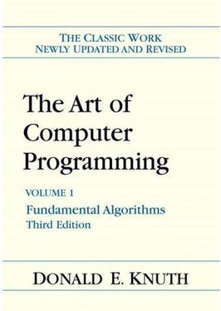
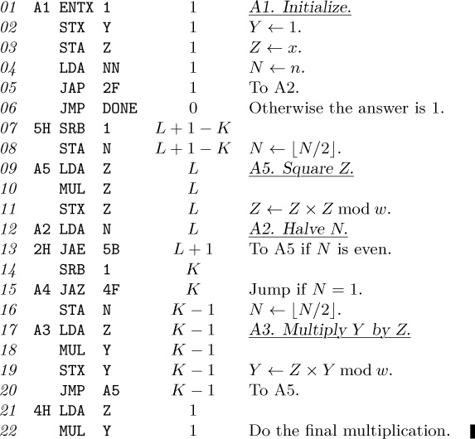
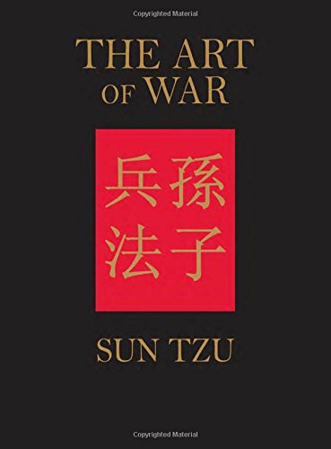
Fun Part
The title “The Art of …” of this paper might come from
“The Art of Computer Programming” by Donald E. Knuth, 1968
.. and this book is still being cited

