Slide 1
WiscKey : Separating Keys from Values in SSD-conscious Storage
Lanyue Lu, Thanumalayan Sankaranarayana Pillai,
Andrea C. Arpaci-Dusseau, Remzi H. Arpaci-Dusseau
2019. 10. 28
Presentation by Jeeweon, Lee
leejeeweon93@gmail.com

Slide 2
t
Problem
Key-Value Separation
Challenges
Evaluations
Conclusions

Slide 3
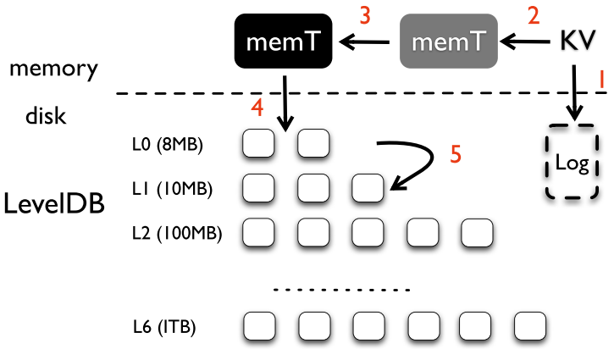
1. Problem
LSM-trees : Insertion
write sequentially
sorting and garbage collection are coupled
immutable

Slide 4
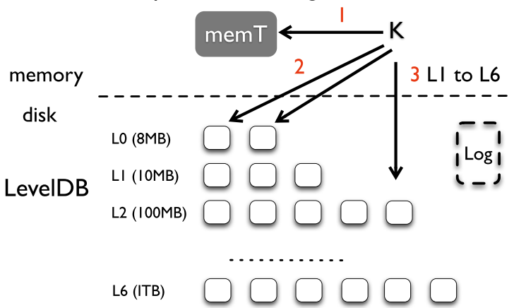
1. Problem
LSM-trees : Lookup
travel many levels for a large LSM-tree

Slide 5
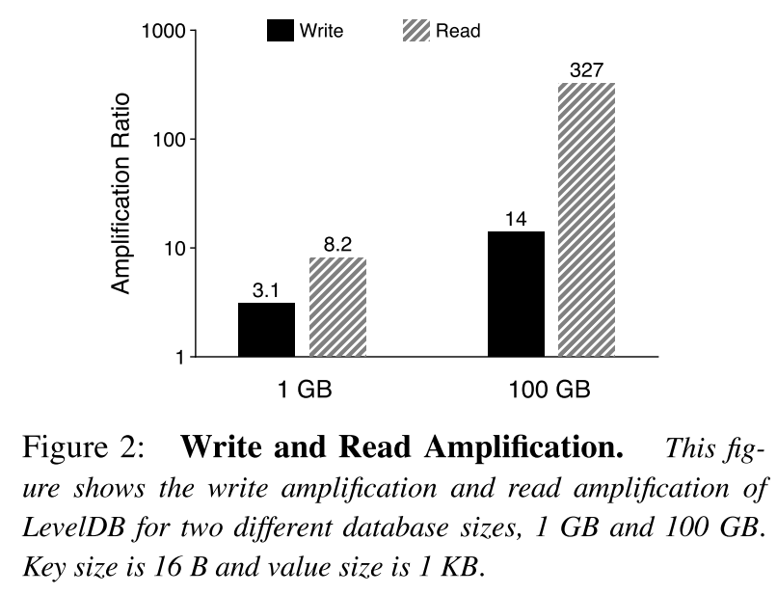
1. Problem
Problem 1
Write Amplification
&
Read Amplification
Write 시 Compaction 과 Garbage Collection 같이
-> Write Amplification
-> SSD 성능 / 수명 감소
Read 시 L0 ~ L6 검사
-> Read Amplification

Slide 6
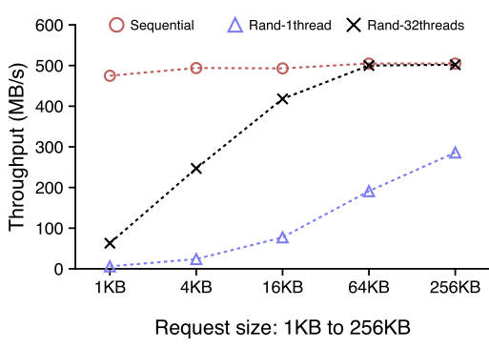
1. Problem
Problem 2
Read 시 parallel utilization 활용 못함

Slide 7
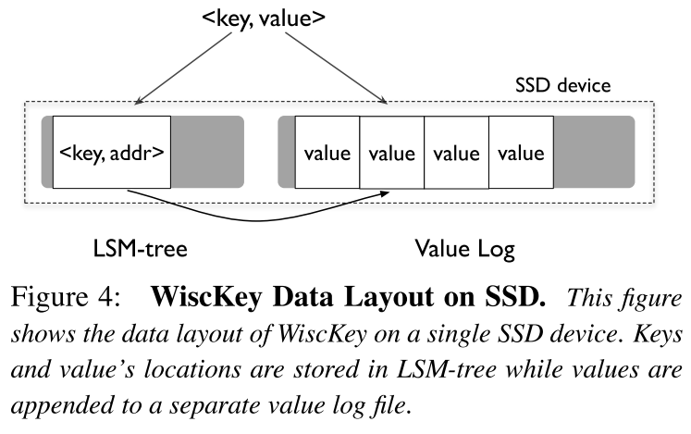
2. Key-Value Separation
Main idea
오직 key 만을 정렬
정렬과 garbage collection 작업 분리

Slide 8
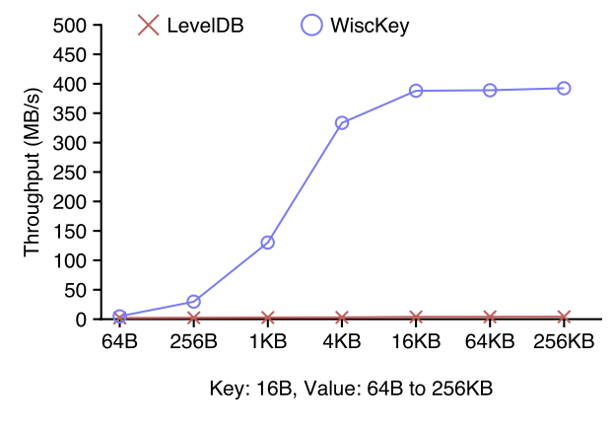
2. Key-Value Separation
Random Load
LevelDB’s throughput range
2 MB/s (64-B) ~ 4.1 MB/s (256-KB)
LevelDB의 compaction
-> 많은 비율의 device bandwidth 소모, slows down foreground writes
Wisckey의 compaction
-> small overhead

Slide 9
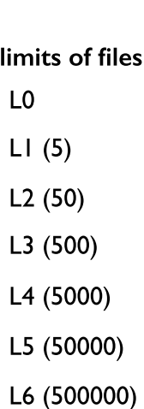
2. Key-Value Separation
Number of files
Small LSM-tree :
less compaction
fewer levels to search
better caching
Large LSM-tree :
Intensive compaction
-반복되는 reads/writes
-stall foreground I/O
Many levels
-travel several levels for each look up

Slide 10
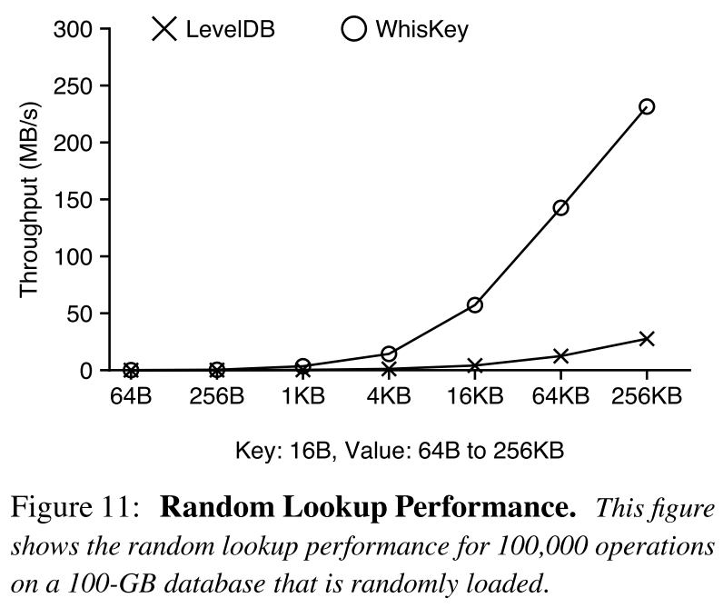
2. Key-Value Separation
Random Lookup
Large read amplification in LevelDB
Smaller LSM-tree in WiscKey leads to better lookup performance (1.6x ~ 14x)

Slide 11
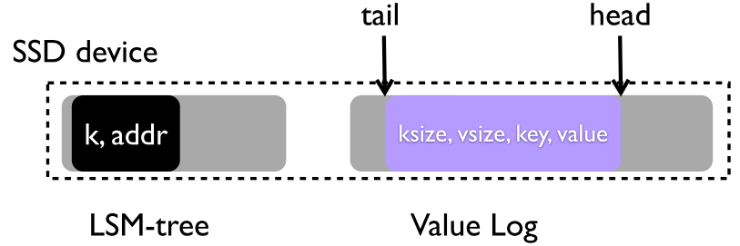
3. Challenges
Garbage Collection
head : 항상 새로운 값이 들어오는 vLog의 끝
tail : garbage collection 시작 될때
마다 공간 확보 시작

Slide 12
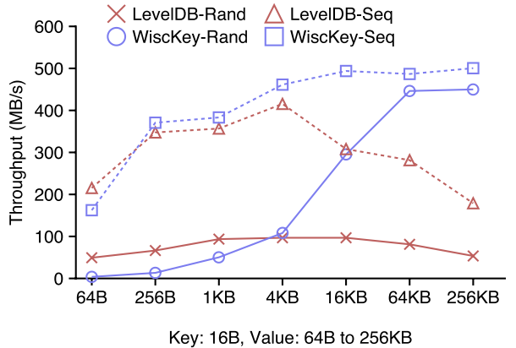
3. Challenges
Parallel Range Query

Slide 13
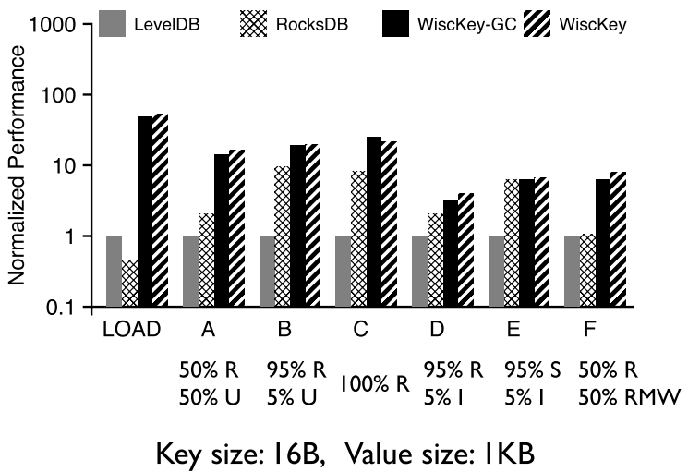
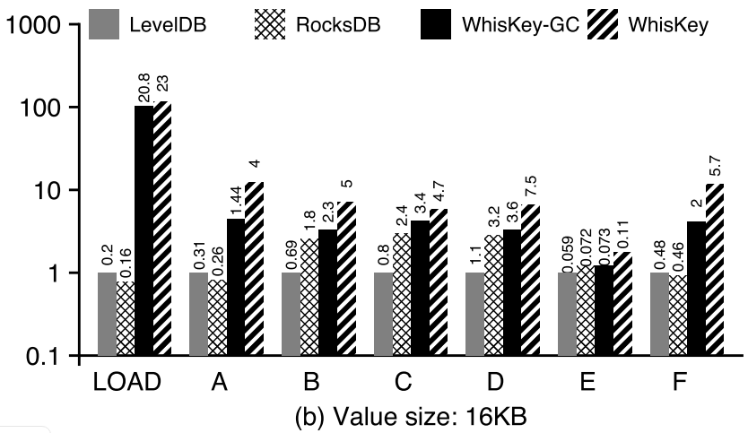
4. Evaluation
YCSB Benchmarks

Slide 14
5. Conclusion
WiscKey : LSM-tree 기반의 key-value store
-decouple sorting and garbage collection by separating keys from values
-SSD-conscious designs

Slide 15
WiscKey : Separating Keys from Values in SSD-conscious Storage
Lanyue Lu, Thanumalayan Sankaranarayana Pillai,
Andrea C. Arpaci-Dusseau, Remzi H. Arpaci-Dusseau
Thank You!
2019. 10. 28
Presentation by Jeeweon, Lee
leejeeweon93@gmail.com

