Slide 1
DistCache: Provable Load Balancing for Large-Scale Storage Systems with Distributed Caching
Zaoxing Liu and Zhihao Bai, Zhenming Liu, Xiaozhou Li, Changhoon Kim,; Vladimir Braverman and Xin Jin,; Ion Stoica,
Johns Hopkins University, College of William and Mary, Celer Network, Barefoot Networks, Johns Hopkins University, UC Berkeley
FAST’19
2019. 12. 02
Presentation by Choi, Gunhee
choi_gunhee@dankook.ac.kr

Slide 2
Large-Scale Storage System
Load Balancing with Cache
DistCache
Evaluations
Conclusions

Slide 3
1. Large-Scale Storage System
https://www.google.com/url?sa=i&source=images&cd=&cad=rja&uact=8&ved=2ahUKEwjaue3E8JXmAhVqHKYKHVIECeMQjhx6BAgBEAI&url=https%3A%2F%2Fwww.absolutdata.com%2Fblog%2Ffive-things-to-know-about-big-data-storage%2F&psig=AOvVaw1vhegQgf53Yr79Mn8Ny9Xl&ust=1575338724081399
https://www.cisco.com/c/dam/en/us/solutions/collateral/service-provider/global-cloud-index-gci/white-paper-c11-738085.docx/_jcr_content/renditions/white-paper-c11-738085_0.jpg

Slide 4
2. Load Balancing with Cache
Overload

Slide 5
2. Load Balancing with Cache
Cache
Load Balancing

Slide 6
2. Load Balancing with Cache
Cache
Load Balancing
Prior work : Fast, Small Cache
→ One big cache is not Scalable.

Slide 7
2. Load Balancing with Cache
Cache
Load Balancing
Prior work : Fast, Small Cache
→ One big cache is not Scalable.

Slide 8
2. Load Balancing with Cache
Cache
Cache
Cache

Slide 9
2. Load Balancing with Cache
Load balance
Cache
Load balance
Load Imbalance
Cache
Load balance
Cache

Slide 10
2. Load Balancing with Cache
Load balance
Cache
Cache
Load balance
Cache
Cache
Load balance
Cache
Cache

Slide 11
2. Load Balancing with Cache
Challenge #1
Cache-Partition
Load balance
Cache
Cache
Load balance
Cache
Cache
Load balance
Cache
Cache

Slide 12
2. Load Balancing with Cache
Challenge #2
Cache-Replication
Load balance
Cache
Cache
Load balance
Big Cost
Cache
Cache
Load balance
Cache
Cache

Slide 13
3. DistCache
Key Idea
Cache allocation with independent hash functions
Query routing with the power-of-two-choices
Cache size and multi-layer hierarchical caching

Slide 14
3. DistCache
#1 Cache allocation with independent hash functions
Load balance
Cache
Cache
Load balance
Cache
Cache
Load balance
Cache
Cache

Slide 15
3. DistCache
#2 Query routing with the power-of-two-choices
Load balance
1
Cache
Cache
Load balance
Cache
Cache
Load balance
2
Cache
Cache

Slide 16
3. DistCache
#3 Cache size and multi-layer hierarchical caching
Load balance
1
Cache
Cache
Cache
Load balance
2
Cache
Cache
Cache
3
Load balance
Cache
Cache
Cache

Slide 17
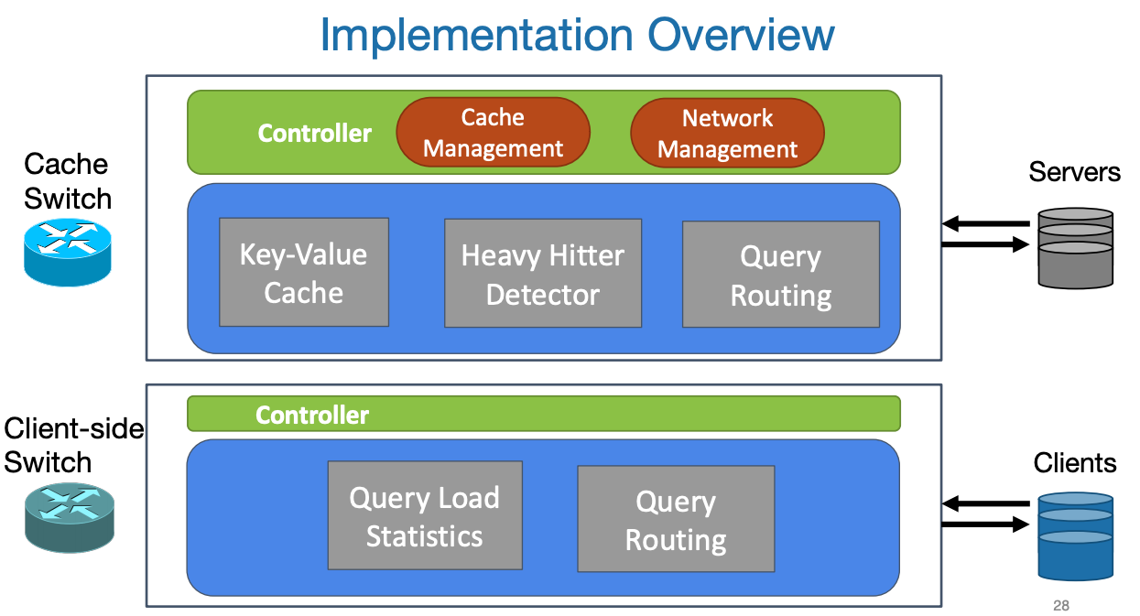
4. Evaluations
https://www.usenix.org/sites/default/files/conference/protected-files/fast19_slides_liu.pdf

Slide 18
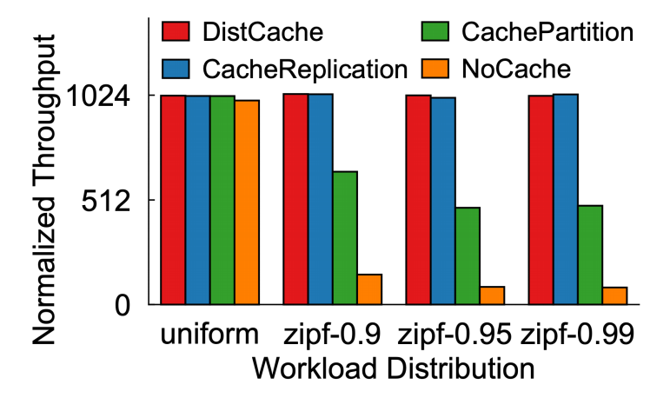
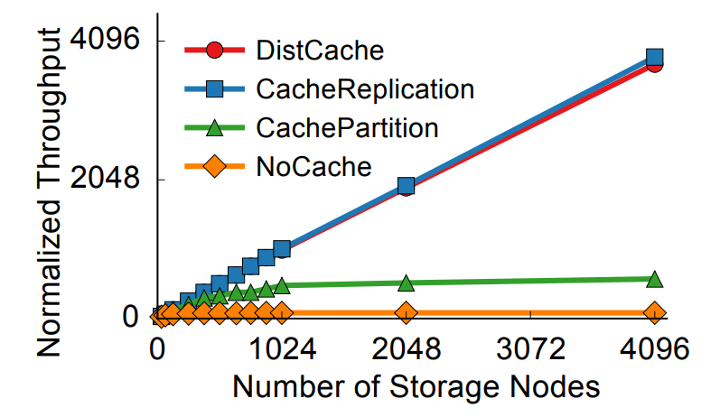
4. Evaluations

Slide 19
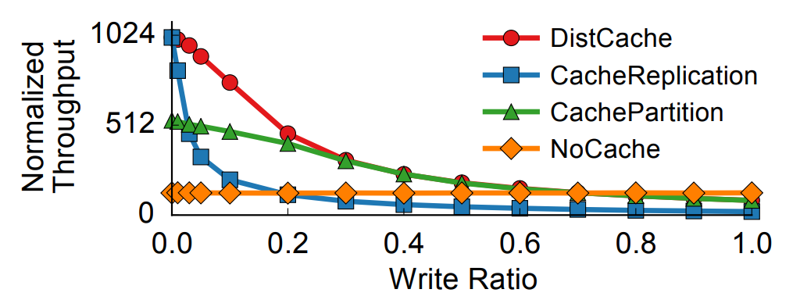
4. Evaluations

Slide 20
5. Conclusions
DistCache is a general distributed caching mechanism to ensure load balancing crossing many storage clusters.
DistCache requires simple primitives (independent hashing, power-of-two-choices routing).
DistCache provides near-perfect throughput with rigorous theoretical guarantees.

Slide 21
DistCache: Provable Load Balancing for Large-Scale Storage Systems with Distributed Caching
Zaoxing Liu and Zhihao Bai, Zhenming Liu, Xiaozhou Li, Changhoon Kim,; Vladimir Braverman and Xin Jin,; Ion Stoica,
Johns Hopkins University, College of William and Mary, Celer Network, Barefoot Networks, Johns Hopkins University, UC Berkeley
FAST’19
Thank You!
2019. 12. 02
Presentation by Choi, Gunhee
choi_gunhee@dankook.ac.kr

