Slide 1
DFTL: A Flash Translation Layer Employing Demand-based Selective Caching of Page-level Address Mappings
A. Gupta, Y. Kim, B. Urgaonkar
Vol. 37. No. 1. ACM, 2009, ASPLOS’09
2020. 03. 23
Presentation by Lee, Jeyeon
2reenact@dankook.ac.kr

Slide 2
Introduction
Background
Design of DFTL
Experimental Result
Conclusion

Slide 3
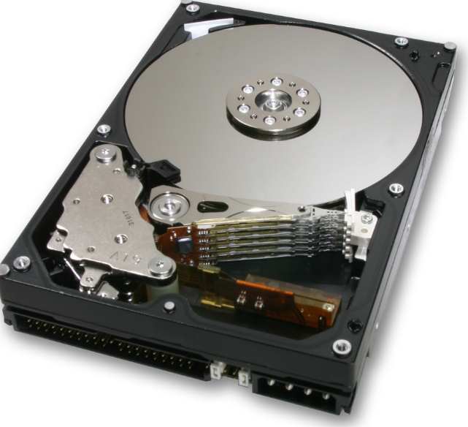
1. Introduction

Slide 4
1. Introduction
Shortcomings of hard disk

Slide 5
1. Introduction
Shortcomings of hard disk
Slow for random accesses

Slide 6
1. Introduction
Shortcomings of hard disk
Slow for random accesses

Slide 7
1. Introduction
Shortcomings of hard disk
Slow for random accesses
Unpredictable latencies

Slide 8
1. Introduction
Shortcomings of hard disk
Slow for random accesses
Unpredictable latencies
Power consumption

Slide 9
1. Introduction
Shortcomings of hard disk
Slow for random accesses
Unpredictable latencies
Power consumption
Noisy

Slide 10
1. Introduction
Shortcomings of hard disk
Slow for random accesses
Unpredictable latencies
Power consumption
Noisy
…

Slide 11
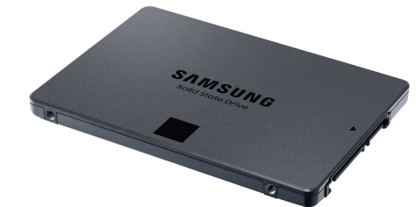
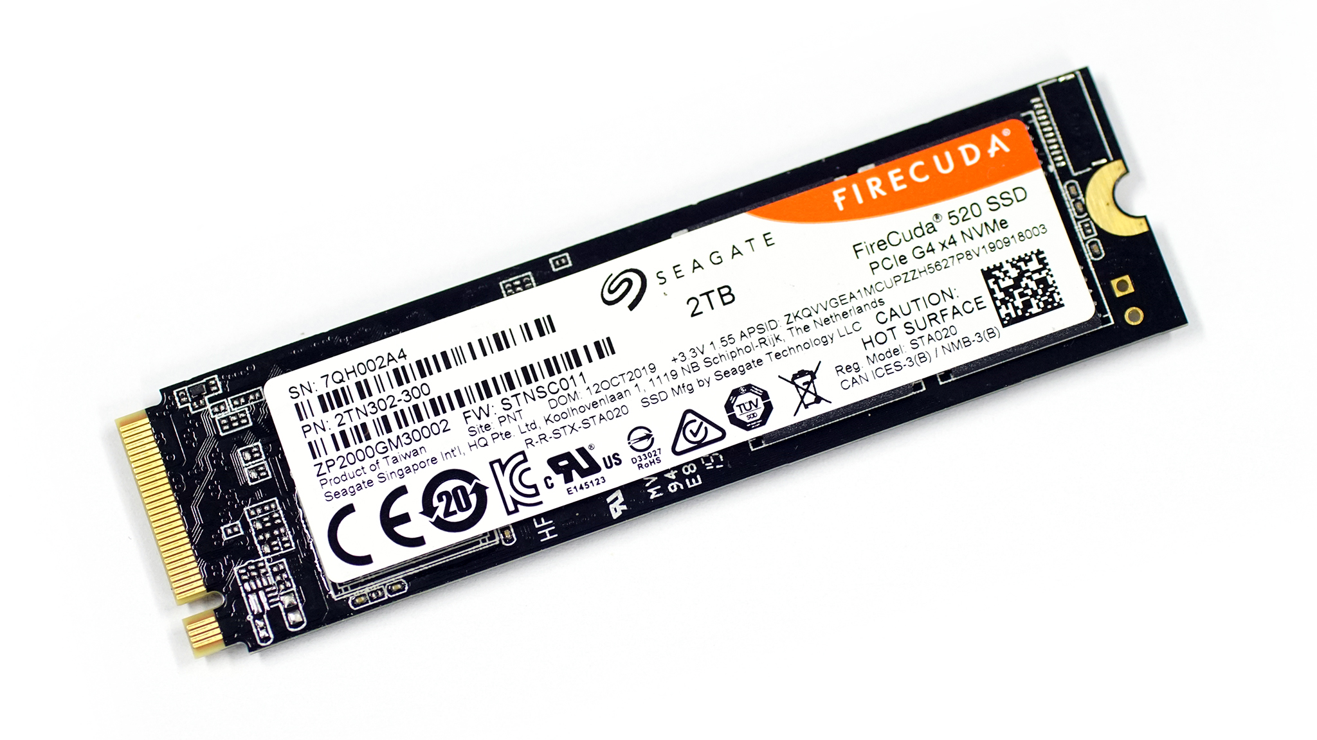
1. Introduction

Slide 12
1. Introduction
Solid State Drive
Fast for random accesses
Predictable latencies
Low power consumption
Lack of noise
…

Slide 13
1. Introduction
Solid State Drive
Fast for random accesses
Predictable latencies
Low power consumption
Lack of noise
…
Drawback

Slide 14
1. Introduction
Solid State Drive
Fast for random accesses
Predictable latencies
Low power consumption
Lack of noise
…
Drawback
Erase before write

Slide 15
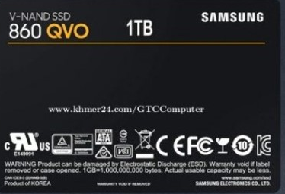
1. Introduction
Solid State Drive
Fast for random accesses
Predictable latencies
Low power consumption
Lack of noise
…
Drawback
Erase before write
SSD

Slide 16
1. Introduction
Solid State Drive
Fast for random accesses
Predictable latencies
Low power consumption
Lack of noise
…
Drawback
Erase before write
Block
Die
SSD

Slide 17
1. Introduction
Page
Solid State Drive
Fast for random accesses
Predictable latencies
Low power consumption
Lack of noise
…
Drawback
Erase before write
Block
$≈$ 128KB
Die
SSD

Slide 18
1. Introduction
Page
$≈$ 2KB
Solid State Drive
Fast for random accesses
Predictable latencies
Low power consumption
Lack of noise
…
Drawback
Erase before write
Block
$≈$ 128KB
Die
SSD

Slide 19
1. Introduction
Page
$≈$ 2KB
Solid State Drive
Fast for random accesses
Predictable latencies
Low power consumption
Lack of noise
…
Drawback
Erase before write
Block
$≈$ 128KB
Die
→ Flash Translation Layer
SSD

Slide 20
1. Introduction
Solid State Drive
Flash Translation Layer
Out-of-place update

Slide 21
1. Introduction
Solid State Drive
Flash Translation Layer
Out-of-place update

Slide 22
1. Introduction
Solid State Drive
Flash Translation Layer
Out-of-place update
A 0
B 0
C 0

Slide 23
1. Introduction
Solid State Drive
Flash Translation Layer
Out-of-place update
A 1
B 0
C 0

Slide 24
1. Introduction
Solid State Drive
Flash Translation Layer
Out-of-place update
A 0
B 0
C 0

Slide 25
1. Introduction
Solid State Drive
Flash Translation Layer
Out-of-place update
A 0
B 0
C 0
A 1

Slide 26
1. Introduction
Solid State Drive
Flash Translation Layer
Out-of-place update
A 0
B 0
C 0
A 1

Slide 27
1. Introduction
Solid State Drive
Flash Translation Layer
Out-of-place update
A 0
B 0
C 0
A 1
B 1

Slide 28
1. Introduction
Solid State Drive
Flash Translation Layer
Out-of-place update
A 0
C 0
B 0
A 1
C 0
B 1
A 1
B 1

Slide 29
1. Introduction
Solid State Drive
Flash Translation Layer
Out-of-place update
A 0
C 0
B 0
A 1
C 0
B 1
A 1
C 1
B 1

Slide 30
1. Introduction
Solid State Drive
Flash Translation Layer
Out-of-place update
C 0
A 1
B 1
C 1

Slide 31
1. Introduction
Solid State Drive
Flash Translation Layer
Out-of-place update
Garbage Cleaning

Slide 32
1. Introduction
Solid State Drive
Flash Translation Layer
Out-of-place update
Garbage Cleaning
Mapping table

Slide 33
1. Introduction
Solid State Drive
Flash Translation Layer
Out-of-place update
Garbage Cleaning
Mapping table
Page level mapping
Block level mapping

Slide 34
1. Introduction
Solid State Drive
Flash Translation Layer
Out-of-place update
Garbage Cleaning
Mapping table in SRAM
Page level mapping
Block level mapping

Slide 35
1. Introduction
Solid State Drive
Flash Translation Layer
Out-of-place update
Garbage Cleaning
Mapping table in SRAM
Page level mapping
Block level mapping
Hybrid

Slide 36
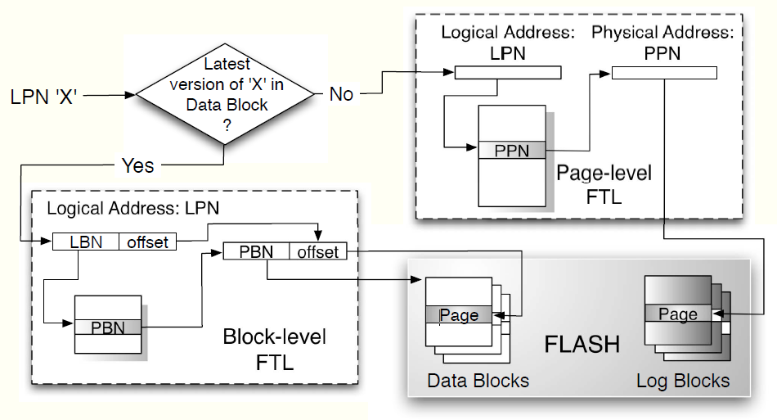
2. Background
Hybrid FTL

Slide 37
2. Background
Hybrid FTL
Data Blocks
Log/Update Blocks

Slide 38
2. Background
Hybrid FTL
Data Blocks : block-level mapping
Log/Update Blocks : page-level

Slide 39
2. Background
Hybrid FTL
Data Blocks : block-level mapping
Log/Update Blocks : page-level
Garbage Collection

Slide 40
2. Background
Hybrid FTL
Data Blocks : block-level mapping
Log/Update Blocks : page-level
Garbage Collection
Switch merge
Partial merge
Full merge

Slide 41
2. Background
Hybrid FTL
Data Blocks : block-level mapping
Log/Update Blocks : page-level
Garbage Collection
Switch merge
Partial merge
Full merge

Slide 42
2. Background
Hybrid FTL
Data Blocks : block-level mapping
Log/Update Blocks : page-level
Garbage Collection
Switch merge
Partial merge
Full merge

Slide 43
2. Background
Hybrid FTL
Data Blocks : block-level mapping
Log/Update Blocks : page-level
Garbage Collection
Switch merge
Partial merge
Full merge

Slide 44
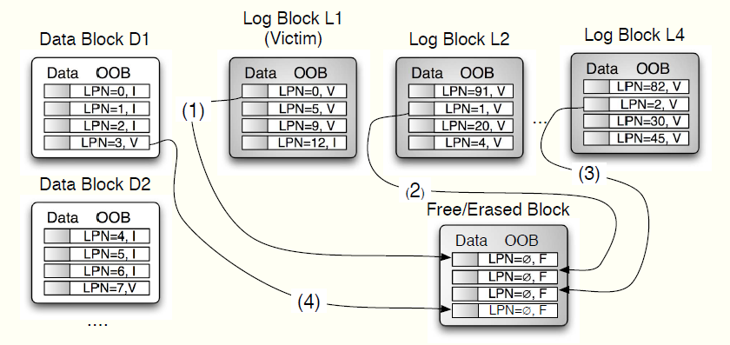
2. Background
Hybrid FTL
Data Blocks : block-level mapping
Log/Update Blocks : page-level
Garbage Collection
Switch merge
Partial merge
Full merge

Slide 45
2. Background
Hybrid FTL
Data Blocks : block-level mapping
Log/Update Blocks : page-level
Garbage Collection
Switch merge
Partial merge
Full merge
Block Associative Sector Translation
Fully Associative Sector Translation
SuperBlock FTL
Locality-Aware Sector Translation

Slide 46
2. Background
Block level?
Page level?

Slide 47
2. Background
Hybrid !!!!

Slide 48
2. Background
Hybrid !!!!....?

Slide 49
2. Background
DFTL !!!!

Slide 50
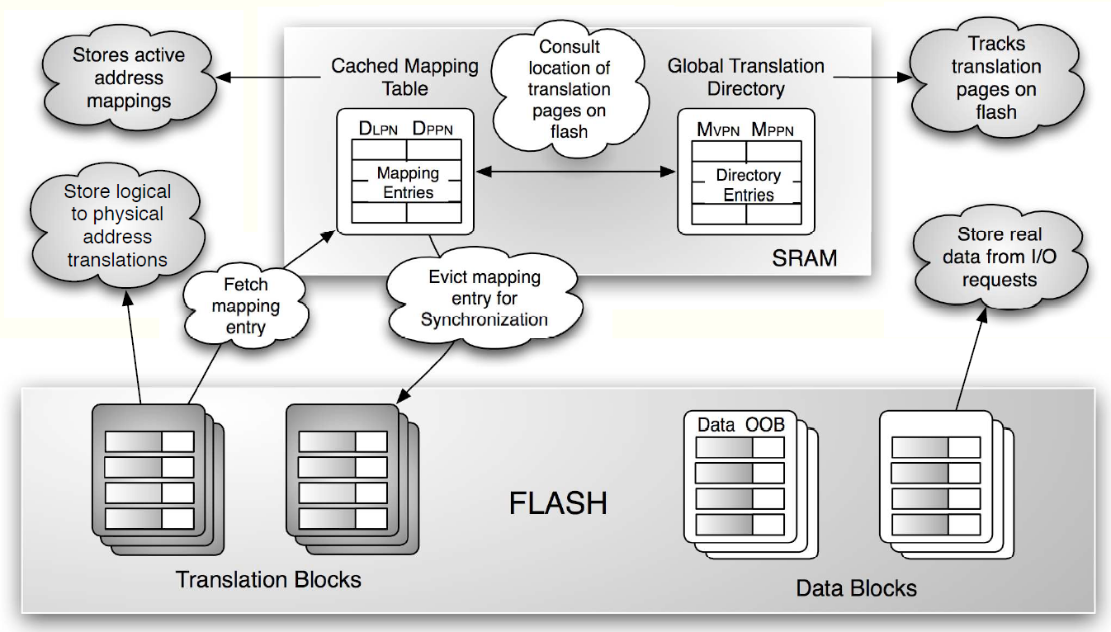
3. Design of DFTL
DFTL : Demand-based Page-mapped FTL

Slide 51
3. Design of DFTL
DFTL : Demand-based Page-mapped FTL
Page-level mapping

Slide 52
3. Design of DFTL
DFTL : Demand-based Page-mapped FTL
Page-level mapping table in Flash

Slide 53
3. Design of DFTL
DFTL : Demand-based Page-mapped FTL
Page-level mapping table in Flash
Update SRAM depends on workload

Slide 54
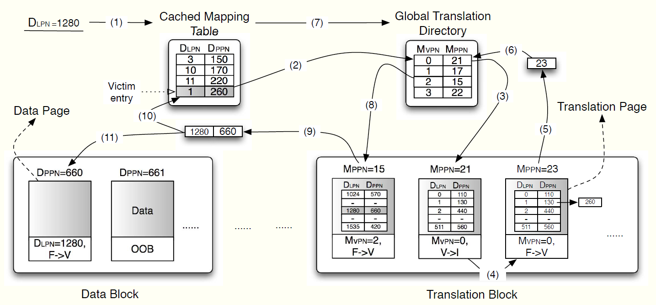
3. Design of DFTL
DFTL : Demand-based Page-mapped FTL
Page-level mapping table in Flash
Update SRAM depends on workload

Slide 55
3. Design of DFTL
DFTL : Demand-based Page-mapped FTL
Page-level mapping table in Flash
Update SRAM depends on workload
Garbage Collection – watermark GCthreshold

Slide 56
3. Design of DFTL
DFTL : Demand-based Page-mapped FTL
Page-level mapping table in Flash
Update SRAM depends on workload
Garbage Collection – watermark GCthreshold
Translation block
Data block

Slide 57
3. Design of DFTL
DFTL : Demand-based Page-mapped FTL
Page-level mapping table in Flash
Update SRAM depends on workload
Garbage Collection – watermark GCthreshold
Translation block : copy valid pages, update GTD
Data block

Slide 58
3. Design of DFTL
DFTL : Demand-based Page-mapped FTL
Page-level mapping table in Flash
Update SRAM depends on workload
Garbage Collection – watermark GCthreshold
Translation block : copy valid pages, update GTD
Data block : copy valid pages

Slide 59
3. Design of DFTL
DFTL : Demand-based Page-mapped FTL
Page-level mapping table in Flash
Update SRAM depends on workload
Garbage Collection – watermark GCthreshold
Translation block : copy valid pages, update GTD
Data block : copy valid pages, update translation block, CMT

Slide 60
3. Design of DFTL
DFTL : Demand-based Page-mapped FTL
Page-level mapping table in Flash
Update SRAM depends on workload
Garbage Collection – watermark GCthreshold
Translation block : copy valid pages, update GTD
Data block : copy valid pages, update CMT (lazy copy translation pages)

Slide 61
4. Experimental Results

Slide 62
4. Experimental Results

Slide 63
4. Experimental Results

Slide 64
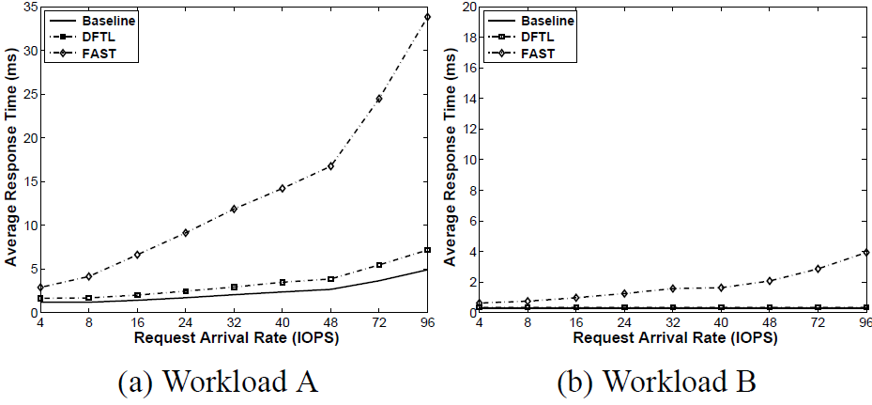
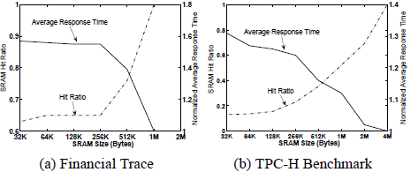
4. Experimental Results

Slide 65
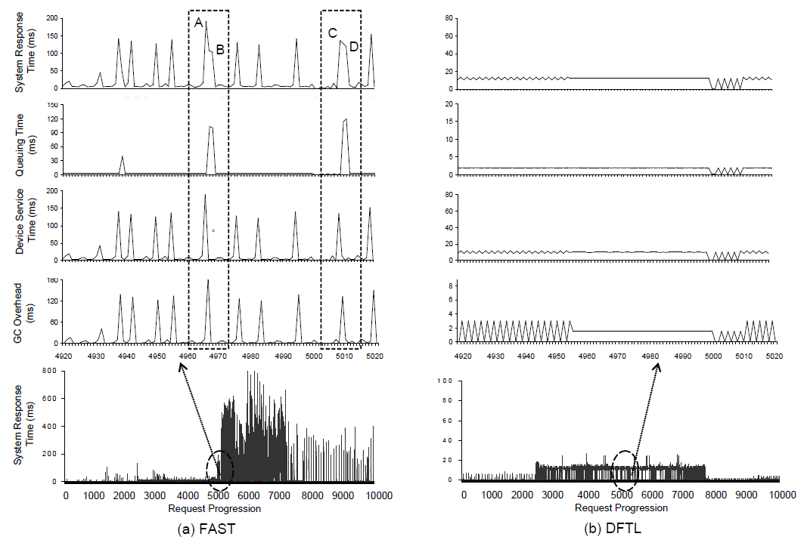
4. Experimental Results

Slide 66
5. Conclusion
The FTL is one of the core engines in flash-based SSDs
But it’s also one of the important causes of poor performance
Expensive Full Merge involves the largest overhead.
Demand-based Page-level Mappings makes possible always full merge

Slide 67
DFTL: A Flash Translation Layer Employing Demand-based Selective Caching of Page-level Address Mappings
A. Gupta, Y. Kim, B. Urgaonkar
Vol. 37. No. 1. ACM, 2009, ASPLOS’09
Thank You!
2020. 03. 23
Presentation by Lee, Jeyeon
2reenact@dankook.ac.kr

