Slide 1
Bigtable A Distributed Storage System for Structured Data
소프트웨어학
백영윤

Slide 2
INDEX
What is the Bigtable?
Data Model
Building Blocks
Implementation Refinements
Performance Evaluation
Real Applications

Slide 3
What is the Bigtable?
Big table?
NO!!!
Bigtable!

Slide 4
What is the Bigtable
Bigtable
Spares, distributed, persistent multi dimensional sorted map.
Map is indexed by a row key, column key, and a time stamp
Each value in the map is an uninterpreted array of bytes.
Row
Row key
Column Families
Time stamp

Slide 5
Data Model
Rows
The row keys in a table are arbitrary string
Bigtable maintains data in lexicographic order by row key.
Each value in the map is an uninterpreted array of bytes.
Column Families
Column keys are grouped into sets called column families
A column key is named using the following syntax family:qulifier
Timestamps
Multiple versions are indexed by timestamp.

Slide 6
Data Model
Row key
Time Stamp
Column Family
“contents:”
Column Family
“anchor:”
Column
“anchor:cnnsi.com”
“anchor:my.look.ca”
Row key
Column key
Row
“com.cnn.www”
t3
“<html>…”
Structured
data
“com.cnn.www”
t5
“<html>…”
“com.cnn.www”
t6
“<html>…”
“com.cnn.www”
t8
“CNN”
Column
Family
Time stamp
“com.cnn.www”
t9
“CNN.com”

Slide 7
Building Blocks
Chubby
Master
Master
Overall integration
Tablet Server
tablet management
Client
Data read & write
SSTable
Table for read-only searches
Tablet is composed of multiple SSTables
Chubby
Highly-available and persistent distributed lock service
GFS
Tablet Server
Tablet Server
Commit Log
Tablet Server
tablet
memtable
index
SSTable
index
SSTable
Client
index
tablet
memtable
SSTable
tablet
memtable

Slide 8
Building Blocks
Chubby
Cell
Chubby
File System
Lock Service
Event notification
Replica
Tablet Server
Replica
Tablet Server
Client
Master
Tablet Server
Client
Replica
Tablet Server
Replica
Tablet Server

Slide 9
Implementation
“com.cnn.www”
t3
“<html>…”
“com.cnn.www”
t5
“<html>…”
“com.cnn.www”
t6
“<html>…”
…
increase
“com.cnn.www”
t8
“CNN”
“com.cnn.www”
t9
“CNN.com”
…
increase
tablet
tablet
“com.cnn.www”
t3
“<html>…”
“com.cnn.www”
t8
“CNN”
“com.cnn.www”
t5
“<html>…”
“com.cnn.www”
t9
“CNN.com”
“com.cnn.www”
t6
“<html>…”

Slide 10
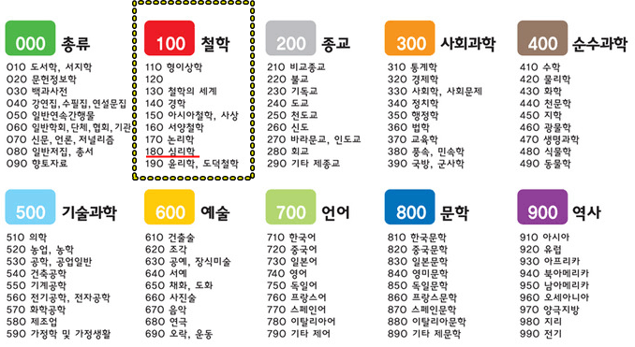
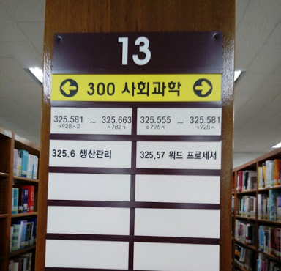
Implementation

Slide 11
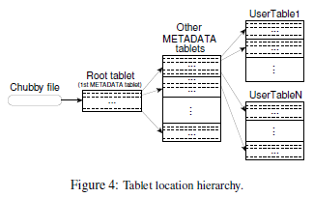
Implementation
Tablet Location
Three-level hierarchy analogous to that of a B+tree
Root tablet
- Metadata tablet management, Search starting point
METADATA tablet
- User Tablet Management,
User Tablet
- Data
Table 1
Table 11
news
Table 11
news
Economy.com
culture
Table 12
Table 12
culture
Asia.com
Chubby
“com.cnn.www”
Table 1
Table 2
….
“com.cnn.image.www”
Table 2
block
Root Tablet
data
data
Metadata Tablet
User Tablet

Slide 12
Implementation
Tablet Assignment
Each tablet is assigned to one tablet server at a time
tablet server malfunction
- Assign a tablet to another server
Chubby
Master
GFS
Tablet Server
Tablet Server
Tablet Server
tablet
memtable
tablet
memtable
tablet
memtable

Slide 13
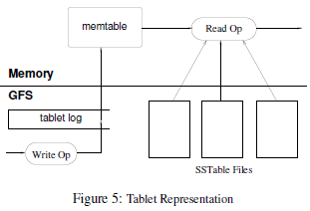
Implementation
Tablet Serving
Recently committed ones are stored in memory in a sorted buffer
Older updates are stored in a sequence of SSTables
Chubby
Master
GFS
Tablet Server
Tablet Server
Commit Log
Tablet Server
tablet
memtable
index
SSTable
index
SSTable
tablet
memtable
index
SSTable
tablet
memtable

Slide 14
Implementation
Client
Tablet Serving
Write
- Add what to write to the commit log
- Update Memtable
- Passing results to the client
Read
- Search key in Memtable
- If there is recent data, return to client
- If present in SSTable, receive from GFS and return
GFS
Tablet Server
1. Create Log
Commit Log
2. Writing
memtable
memtable
1. Check memtable
Tablet Server
SSTable
2. reading
Client

Slide 15
Implementation
Client
Compaction
Minor Compaction
- When the Memtable grows, it is recorded in a new SSTable.
- Only recent Memtable updates are recorded
- Deleting the contents of the Commit log
Major Compaction
- Reading efficiency decreases as SStable increases
- Disk waste
- Working to bring SSTable together
GFS
Tablet Server
Commit Log
memtable
Minor Compaction
SSTable
memtable
Tablet Server
SSTable
SSTable
SSTable
SSTable
Client
Major Compaction

Slide 16
Refinements
Locality Groups
Column family likely to be used at the same time
- Group by locality groups
Data Compression
Automatic compression and decompression by locality group
Cash for read performance
Data is present in the memory of the tablet server
Reduced communication with GFS
Bloom filters

Slide 17
Refinements
Commit-log implementation
Large write batch processing
Speeding up tablet recovery
reducing the amount of uncompacted state in the tablet server's commit log
Exploiting immutability

Slide 18
Performance Evaluation
Bigtable cluster with N tablet servers
The table shows the number of operations per second per tablet server
The graph shows the aggregate number of operations per second

Slide 19
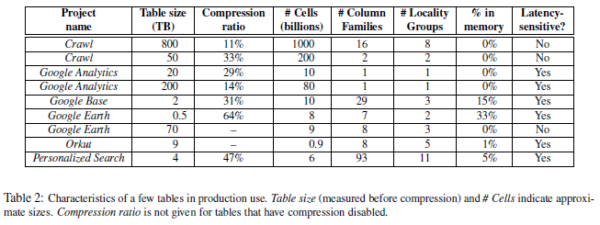
Real Applications

