Slide 1
Analysis and Evolution of Journaling File Systems
V. Prabhakaran et al.
USENIX ATC, 2005
2020. 04. 13
Presentation by Lee, Sounghyoun
leesh812@dankook.ac.kr

Slide 2
Introduction
SBA
STA
Analysis of FS with SBA
Conclusion

Slide 3

1. Introduction
Google Finance
1. Introduction
Analysis and Evolution of Journaling File Systems

Slide 4
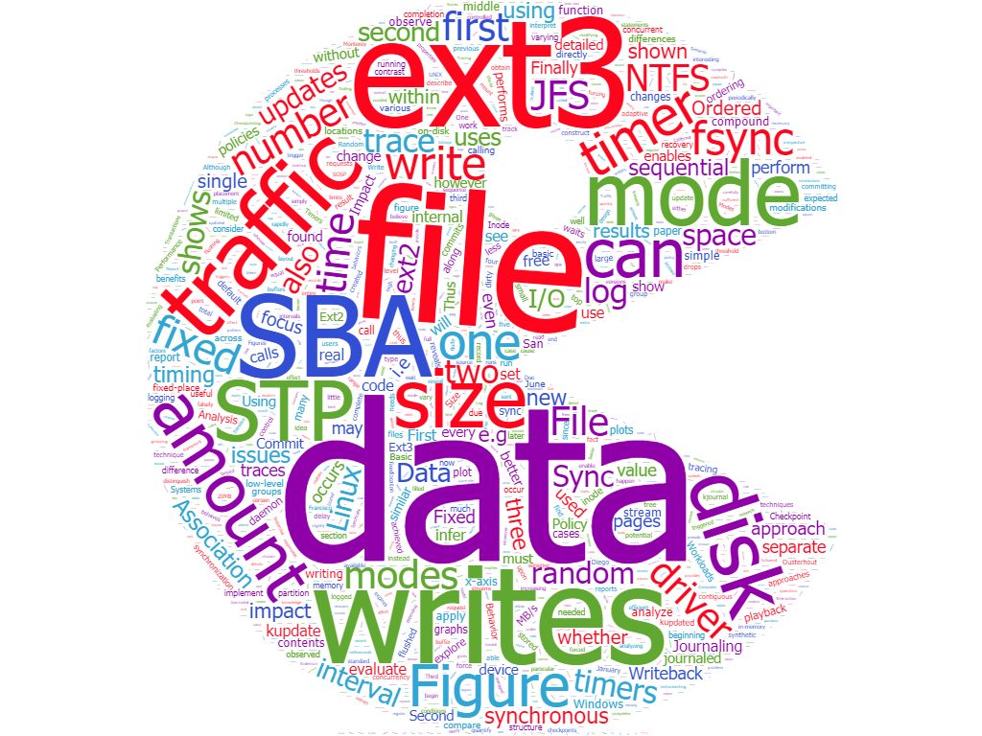
1. Introduction
Google Finance
Journaling File System

Slide 5

1. Introduction
Underlying reasons
User level programs
Google Finance
File system performance
- It is difficult to discover the underlying reasons for
the observed performance with this approach.

Slide 6
1. Introduction
Semantic Block-level Analysis (SBA)
Read
Write
Request below the file system
Targeted synthetic workload
Block-level tracing semantic info

Slide 7
1. Introduction
Semantic Block-level analysis (SBA)
Read
Write
Request below the file system
Targeted synthetic workload
Block-level tracing semantic info
But does not reveal whether the change is worth implementing.

Slide 8

1. Introduction
Semantic Trace Playback(STP)
- STP enables us to rapidly suggest and evaluate file system
STP
Performance

Slide 9

2. SBA
Google Finance
2. SBA
1. Introduction
Analysis and Evolution of Journaling File Systems
Linux Block IO: Introducing Multi-queue SSD Access on Multi-core Systems

Slide 10
2. SBA
Traditional Block-level Analysis
- synthetic or real workloads and measures the resulting file system performance
- collects traces to understand how file systems are used
Semantic Block-level Analysis (SBA)
- Why a given workload behaves as it does.
Ex) Block number of each block that is read or written
> sequential or random
> timing information
Google Finance
Combination

Slide 11
2. SBA
Traditional Block-level Analysis
- synthetic or real workloads and measures the resulting file system performance
- collects traces to understand how file systems are used
Semantic Block-level Analysis (SBA)
- Why a given workload behaves as it does.
Ex) Block number of each block that is read or written
> sequential or random
> timing information
Kernel
Google Finance
Combination
SBA
Request
Respense
Device

Slide 12

3. STA
3. STA
Analysis and Evolution of Journaling File Systems

Slide 13
3. STA
Semantic Trace Playback(STA)
- User-level Process
- Multiful thread > Concurrency
STA Requirement
- observe any file-system level operations
- observe application-level calls to fsync
Google Finance

Slide 14
3. STA
Semantic Trace Playback(STA)
- User-level Process
- Multiful thread > Concurrency
STA Requirement
- observe any file-system level operations
- observe application-level calls to fsync
Google Finance
SBA + STA

Slide 15



3. STA
Semantic Trace Playback(STA)
- User-level Process
- Multiful thread > Concurrency
STA Requirement
- observe any file-system level operations
- observe application-level calls to fsync
Google Finance
SBA + STA
+

Slide 16

4. Analysis of FS with SBA
4. Analysis of FS with SBA
Analysis and Evolution of Journaling File Systems

Slide 17
4. Analysis of FS with SBA
Ext3 Three Analysis
1. Basic behavior and three journaling mod
2. Isolate the factors that control when data is committed to the journal
3. Isolate the factors that control when data is checkpointed to its fixed-place location
Google Finance

Slide 18
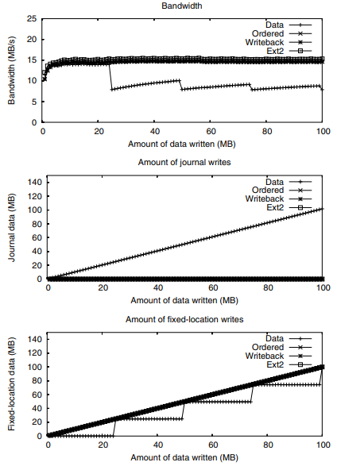
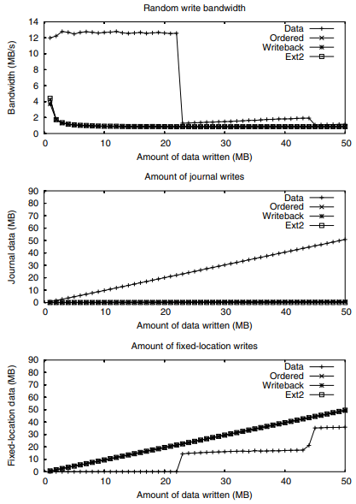
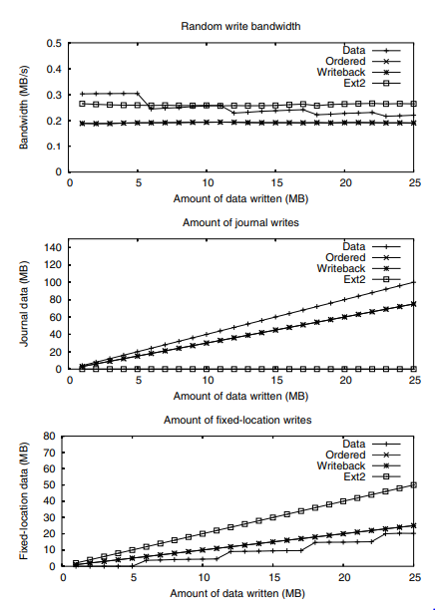
4. Analysis of FS with SBA
Basic Behavior: Modes and Workload
Google Finance

Slide 19
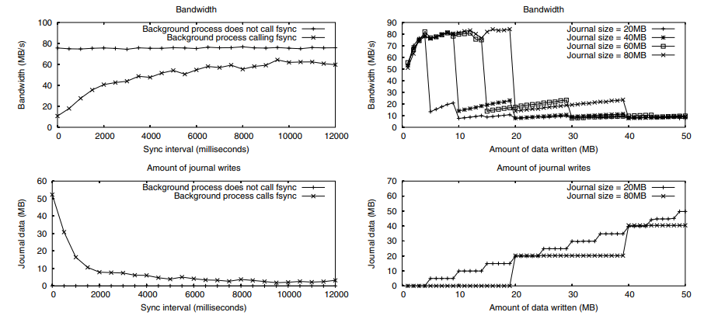
4. Analysis of FS with SBA
Impact of Journal Size on Commit Policy
Google Finance

Slide 20
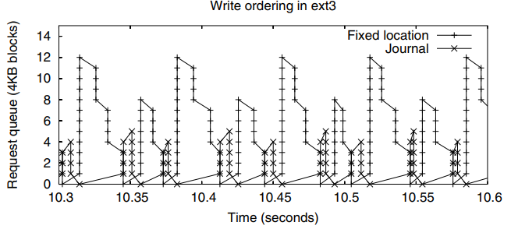
4. Analysis of FS with SBA
Journal and fixed data
Google Finance

Slide 21
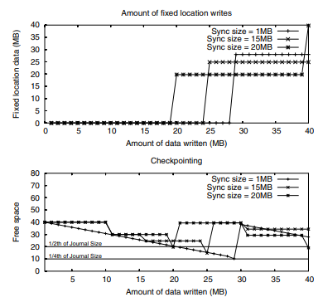
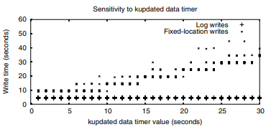
4. Analysis of FS with SBA
Ceckpointing and Timers
Google Finance

Slide 22
4. Analysis of FS with SBA
Ext3 summary
1. The journaling mode that delivers the best performance depends strongly on the workload.
2. performance for asynchronous traffic when combined with synchronous traffic.
3. falsely limited parallelism can harm performance.
4. increasing the I/O load.
Google Finance

Slide 23
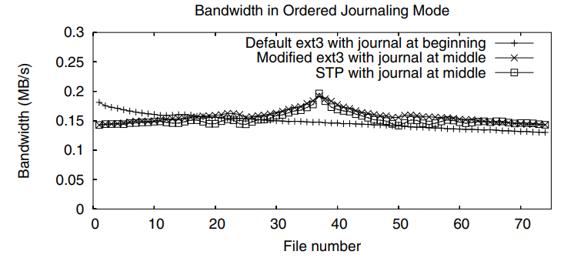
4. Analysis of FS with SBA
Evolving ext3 with STP
Google Finance

Slide 24
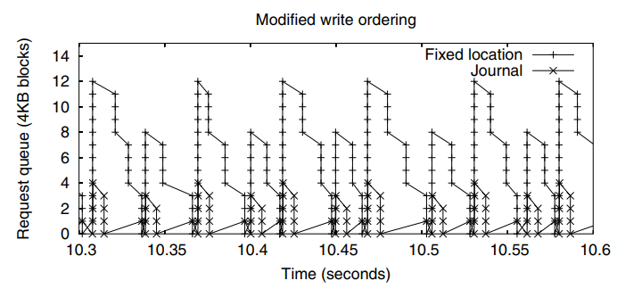
4. Analysis of FS with SBA
Evolving ext3 with STP
Google Finance

Slide 25
4. Analysis of FS with SBA
Three differences of ResierFS
1. On-disk structures
2. The format of the journal is slightly different.
3. Slightly in their journal contents.
Google Finance

Slide 26
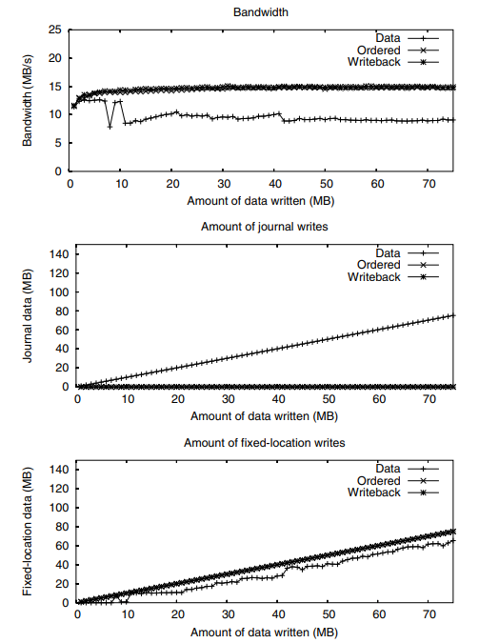
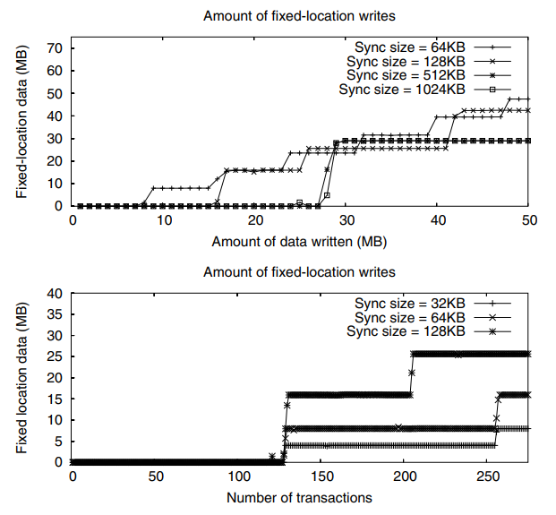
4. Analysis of FS with SBA
Basic Behavior for Sequential Workloads
Google Finance

Slide 27
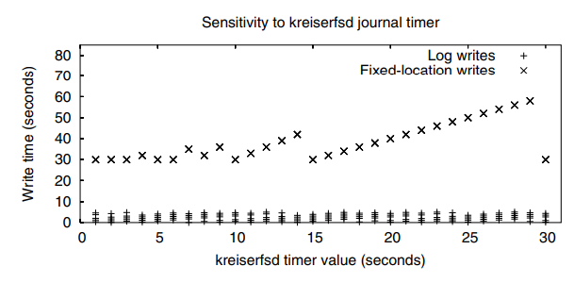
4. Analysis of FS with SBA
Impact of Timers
Google Finance

Slide 28
4. Analysis of FS with SBA
ResiserFS bug
Sync call returns before any of the data is written
2. When a file block is overwritten in writeback mode, its stat information is not updated (inode)
3. When committing old transactions, dirty data is not always flushed
4. Dirty data is not flushed
Google Finance

Slide 29
4. Analysis of FS with SBA
IBM Journaled File System
JFS uses ordered journaling mode.
JFS does logging at the record level.
No commit timers in JFS and the fixedlocation writes happen whenever the kupdate daemon’s timer expires
Window NTFS
Every object in NTFS is a file.
NTFS waits until the data block writes to the fixed-location
Google Finance

Slide 30

5. Conclusion
5. Conclusion
Analysis and Evolution of Journaling File Systems

Slide 31
5. Conclusion
Conclusion
  - Leverage SBA to understand the semantic behavior of a journaling FS
  - Leverage STP to predict the effect of algorithmic changes to a journaling FS
Google Finance

Slide 32
Analysis and Evolution of Journaling File Systems
V. Prabhakaran et al.
USENIX ATC, 2005
Thank you!
2020. 04. 13
Presentation by Lee, Sounghyoun
leesh812@dankook.ac.kr

