Slide 1
Cognitive SSD: A Deep Learning Engine for In-Storage Data Retrieval
S. Liang et al.
Usenix ’19, ATC, 2019
2020. 05. 11
Presentation by Shin Hojin
ghwls03s@gmail.com

Slide 2
Reference
Introduction
Background
Cognitive SSD System
DLG-x Accelerator
Evaluation
Conclusion

Slide 3
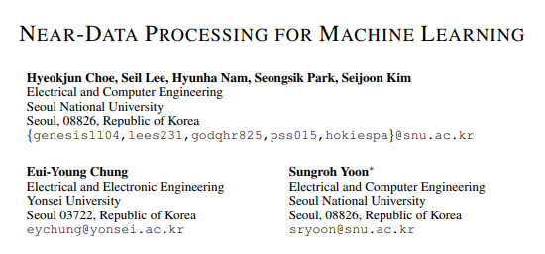
1. Reference

Slide 4
2. Introduction
Structured Data
Unstructured Data

Slide 5
2. Introduction
Unstructured Data
This data occupies to 80% of storage capacity in data centers
It leads to intensive retrieval requests issued by users
Challenge to processing throughput and power consumption
Reduce the total cost of ownership (TCO) of datacenters
80%

Slide 6
2. Introduction
CPU, GPU and Computing based Architecture
Request
Application
VFS/File system
I/O scheduler
Block IO layer
DRAM, Cache
Device Driver
Storage Device
HDD, NAND Flash

Slide 7
2. Introduction
Massive data movement incurs energy and latency overhead -> compact stroage
Providing a high accuracy, low latency, energy efficient query mechanism
Energy-efficient deep learning based data processing
Enable developers to customize the data retrieval system for different dataset
Requsets
CPU
DRAM
DLG-x
Cognitive
SSD
Results

Slide 8
3. Background
Content Based Unstructured Data Retrieval System
Feature representation
Database indexing
Data Preprocessing
Feature Mapping
Feature Matching
Ranking
Retrieval Request
Deep Hashing
Hash
Layer
0
1
0
0
1
0
1
0
1
Fully
Connected Layer
Pooling Layer
Graph
Search
Convolution
Layer

Slide 9
3. Background
Content Based Unstructured Data Retrieval System
Feature representation
Database indexing
Data Preprocessing
Feature Mapping
Feature Matching
Ranking
Retrieval Request
Deep Hashing
Hash
Layer
0
1
0
0
1
0
1
0
1
Fully
Connected Layer
Pooling Layer
Graph
Search
Convolution
Layer
Simplify the software stack
-> DLG-x

Slide 10
3. Background
Near-data processing shorten data path
Internal bandwidth of SSD > External SSD bandwidth (x16)
Controller
Request
DLG-x
NAND
Flash
CPU
DRAM

Slide 11
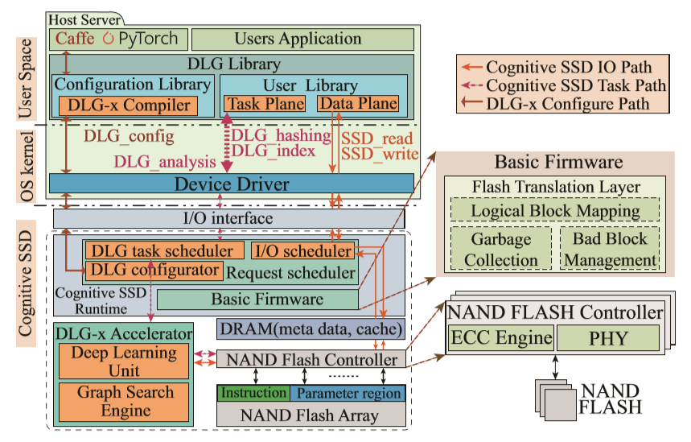
3. Cognitive SSD System

Slide 12
3. Cognitive SSD System

Slide 13
3. Cognitive SSD System
Configuration library
Deep Learning Framework
Provides a DLG-x compiler compatible with popular deep learning framework (caffe)
Generate corresponding DLG-x instruction offline
Updated instruction maintain until a model change command (DLG_config) is issued
Caffe PyTorch
Configuration library
DLG-x Compiler
DLG_config

Slide 14
3. Cognitive SSD System
User library
User Library
SSD_write/read
Operate directly on the physical address bypassing FTL
Users can use addresses to direct the operands in other APIs
Task Plane
Data Plane
DLG_hashing
SSD_write
DLG_hashing/index/analysis
Using the C0h, C1h, C2h commads of NVMe I/O protocol
DLG_index
SSD_read
DLG_analysis
Device Driver

Slide 15
3. Cognitive SSD System
User library
User Library
DLG_hashing
Extract the condensed feature of input data and map it into the hash or semantic space
Useful for other analysis functions
Task Plane
Data Plane
DLG_hashing
SSD_write
DLG_index
SSD_read
DLG_analysis
Device Driver

Slide 16
3. Cognitive SSD System
User library
User Library
DLG_index
Abstracted from the graph search function
Includes an extended parameters: T
T : number of search results
Task Plane
Data Plane
DLG_hashing
SSD_write
DLG_index
SSD_read
DLG_analysis
Device Driver

Slide 17
3. Cognitive SSD System
User library
User Library
DLG_analysis
Allows users to analyze the input data
Use processing of ability of DNN
Include reserved field for user-defined functions
Task Plane
Data Plane
DLG_hashing
SSD_write
DLG_index
SSD_read
DLG_analysis
Device Driver

Slide 18
4. DLG-x Accelerator
The Architecture of DLG-x accelerator
NAND
Flash
Neural Processing Engine
Weight
Buffer-0
Neural Processing Engine
InOut
Buffer-0
Controller
Convolution
Pooling
Activation
Convolution
Pooling
Activation
NAND
Flash
Controller
Weight
Buffer-1
InOut
Buffer-1
Neural Processing Engine
NAND
Flash
Controller
Instruction
Queue
Vertex
Detector
Vertex
Arbitrator
Address
Generator

Slide 19
4. DLG-x Accelerator
I/O Path in Cognitive SSD
Parameters
FCL
FCL
FCL
FCL
FCL
FCL
Channel-0
Channel-1
Channel-2
Channel-0
Channel-1 Channel-2

Slide 20
4. DLG-x Accelerator
Improve throughput
Page
Page
Block
Page Register
Cache Register
Flash Controller
Read command
Page
Page
Block
Page Register
Cache Register
Flash Controller
Read page cache command

Slide 21
4. DLG-x Accelerator
NSG(Navigating Spreading-out Graph) Algorithm
Online stage: graph search
Offline stage: K-NN graph construction
Neural
Processing
Engine
Data entry
K-NN graph
Vertex
Neighbors

Slide 22
4. DLG-x Accelerator
Data Layout for fast In-SSD NSG search
V 0 V 3 V 2
V 3
V 2 V 3 V 4
Neighbors of Vertex 0
Neighbors of neighbors of vertex 0
V 3
V 0 V 2
V 1 V 5
V 2 V 3 V 4
V 0
V 2
V 2
Page 0
V 3
V 4
V 5
V 2
V 0
V 2
V 1 V 5
V 2 V 3
V 5 V 1 V 0
Reduce flash access
V 3
V 2
Page 1
V 4
V 1 V 0
Read Vertex 0
Read Vertex 3
Read Vertex 2
Read Page 0
Read Page 1
Read Page 0
Read Vertex 0
Read Vertex 3
Read Vertex 2
Read Page 0

Slide 23
4. DLG-x Accelerator
Data Flow
Deploy deep learning mode and graph parameter
Inject image data
User image request
Data Plane
Caffe, PyTorch
Task Plane
Deep Learning
Unit
Task scheduler
I/O scheduler
DLG-compiler
Graph Search
Unit
DLG-x
accelerator
NAND Flash

Slide 24
5. Evaluation
Hardware Implementation
 | CPU | DRAM | SSD | GPU | FPGA
B-CPU | 2*Xeon E5-2630 | 32GB | 4* 1TB PCIe SSD | - | -
B-GPU | 2*Xeon E5-2630 | 32GB | 4* 1TB PCIe SSD | NVIDIA GTX 1080Ti | -
B-FPGA | 2*Xeon E5-2630 | 32GB | 4* 1TB PCIe SSD | - | ZC706 Board
B-DLG-x | 2*Xeon E5-2630 | 32GB | 4* 1TB PCIe SSD | - | ZC706 Board
Cognitive SSD + CPU | 2*Xeon E5-2630 | 32GB | 3* 1TB PCIe SSD | - | OpenSSD
Cognitive SSD | ARM Dual Cortex A9 | 2GB | 1TB NAND flash | - | OpenSSD

Slide 25
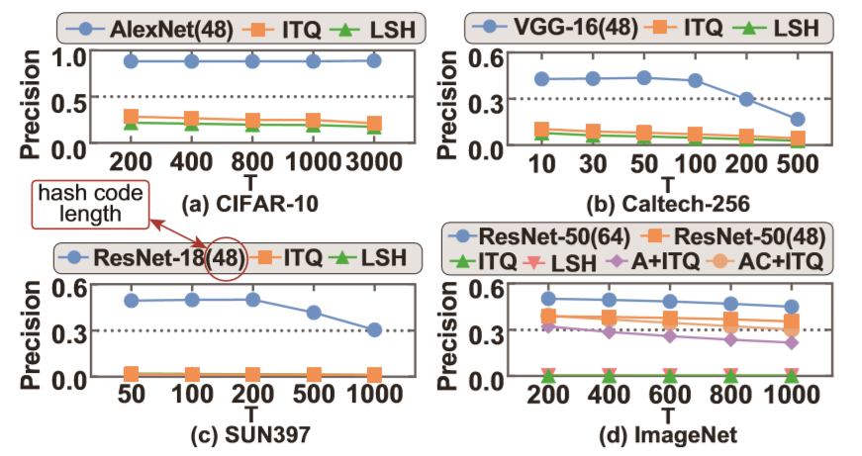
5. Evaluation
Evaluation of DLG algorithm
Dataset
Dataset | Total | Train/Validate | Labels
CIFAR-10 | 60000 | 50000/10000 | 10
Caltech256 | 29780 | 26790/2990 | 256
SUN397 | 108754 | 98049/10705 | 397
ImageNet | 1331167 | 1281167/50000 | 1000
ITQ = Iterative Quantization
LSH = Locality Sensitive Hashing

Slide 26
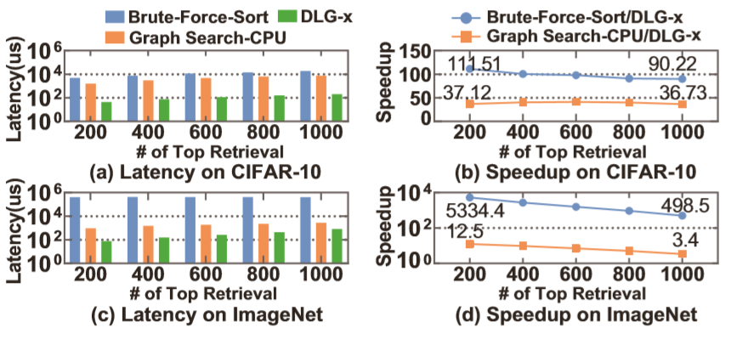
5. Evaluation
Evaluation of DLG-x
Model | - | Latency(ms) | Power(w)
Hash AlexNet | DLG-x | 38 | 9.1
 | CPU | 114 | 186
 | GPU | 1.83 | 164
Hash ResNet-18 | DLG-x | 94 | 9.4
 | CPU | 121 | 185
 | GPU | 7.13 | 112

Slide 27
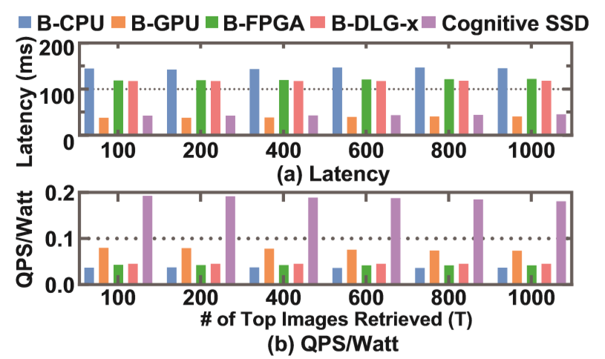
5. Evaluation
Evaluation of Cognitive SSD system
QPS = Queries Per Second

Slide 28
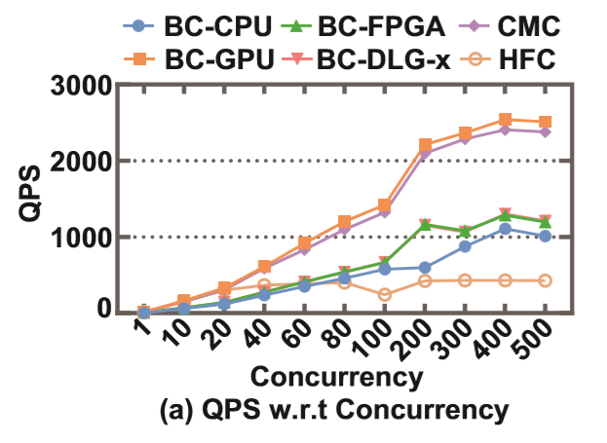
5. Evaluation
Evaluation of Cognitive SSD Cluster

Slide 29
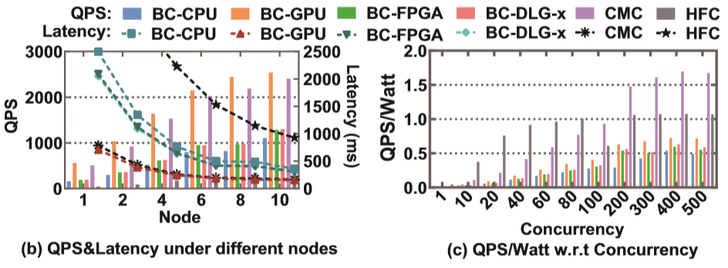
5. Evaluation
Evaluation of Cognitive SSD Cluster

Slide 30
6. Conclusion
Cognitive SSD provides a more power-efficient solution for unstructured data retrieval
The DLC-x accelerator integrates deep learning and graph search into one chip and directly accesses data from NAND flash without crossing multiple memory hierarchies
FPGA-based prototype evaluations show that Cognitive SSD outperforms other solutions on power-efficiency

Slide 31
Cognitive SSD: A Deep Learning Engine for In-Storage Data Retrieval
S. Liang et al.
Usenix ’19, ATC, 2019
Thank you!
2020. 05. 11
Presentation by Shin Hojin
ghwls03s@gmail.com

