Slide 1
Characterizing, Modeling, and Benchmarking RocksDB Key-Value Workloads at Facebook
February 25–27, 2020

Slide 2
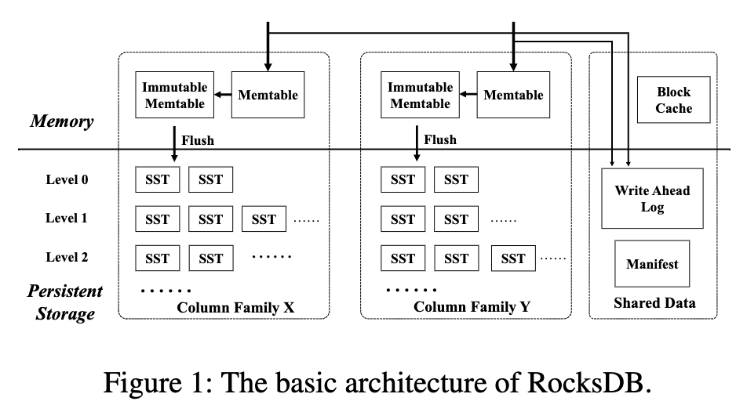
ROCKS DB
Derived from LevelDB
Alibaba/Yahoo/LinkedIn

Slide 3
ROCKS DB at FACEBOOK
Zippy DB
UDB
UP2X

Slide 4
UDB
User layer query
10.2billion query/14days
SQL query -> RocksDB query
UDB

Slide 5
Metadata for photos, other objects
Mapped directly to RocksDB
420Million / day
Zippy DB

Slide 6
Used AI/ML
Merge operation for updates
111Million / day
UP2X

Slide 7
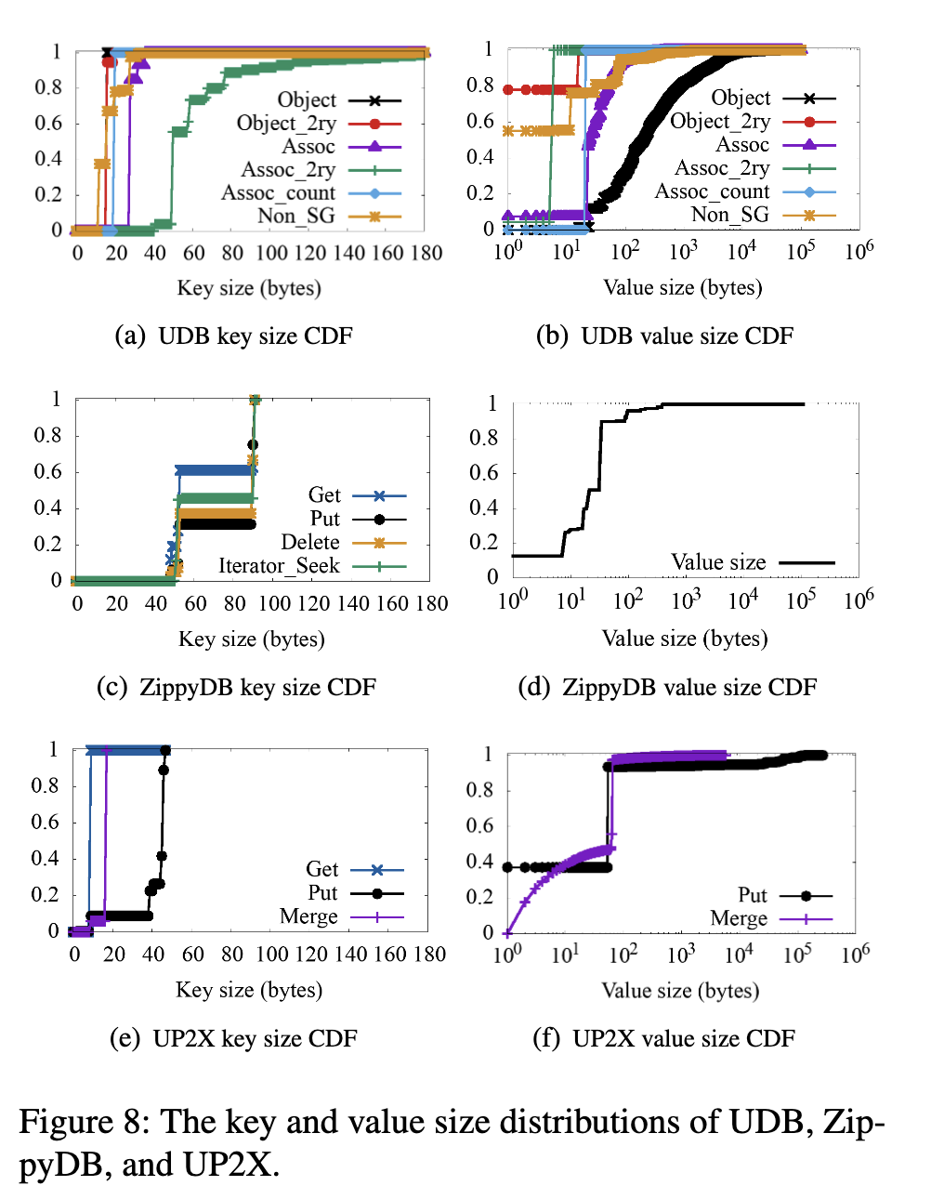

Slide 8
UDB
Zippy DB
UP2X

Slide 9
UDB
UP2X
Face
book
Zippy DB

