Slide 1
A Study of SSD Reliability in Large Scale Enterprise Storage Deployments
Stathis Maneas, Kaveh Mahdaviani, Tim Emami, Bianca Schroeder
18th USENIX Conference on File and Storage Technologies (FAST’20). 2020.
2020. 06. 01
Presentation by Choi, Gunhee
choi_gunhee@dankook.ac.kr

Slide 2
What is SSD?
Distributed Storage?
Large Scale Storage?
Statistics
Reasons for replacements
Factors impacting replacement rates
Conclusions

Slide 3
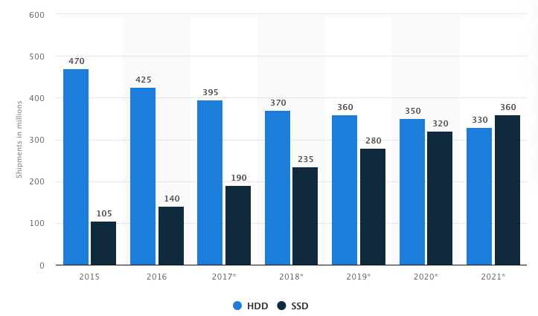
1. What is SSD?
https://www.statista.com/statistics/285474/hdds-and-ssds-in-pcs-global-shipments-2012-2017/

Slide 4


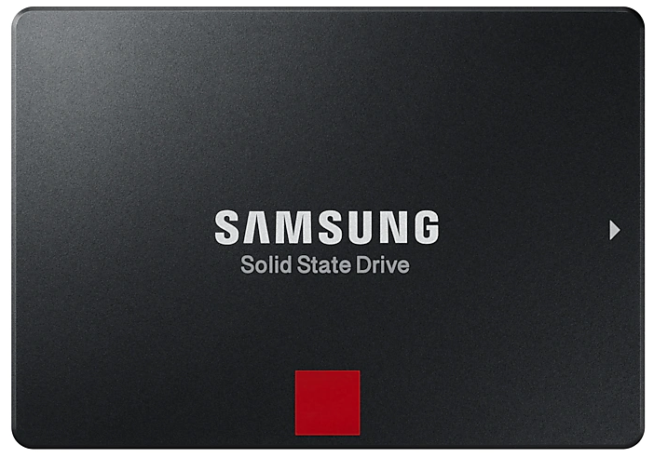
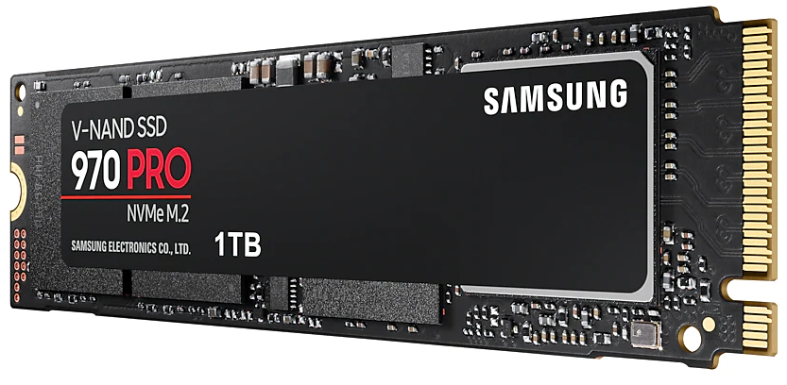
1. What is SSD?
Price per capacity
Reliability
20TB
64GB

Slide 5
1. What is SSD?
Lithography
https://terms.naver.com/entry.nhn?docId=754457&cid=42341&categoryId=42341
https://www.skcareersjournal.com/194

Slide 6
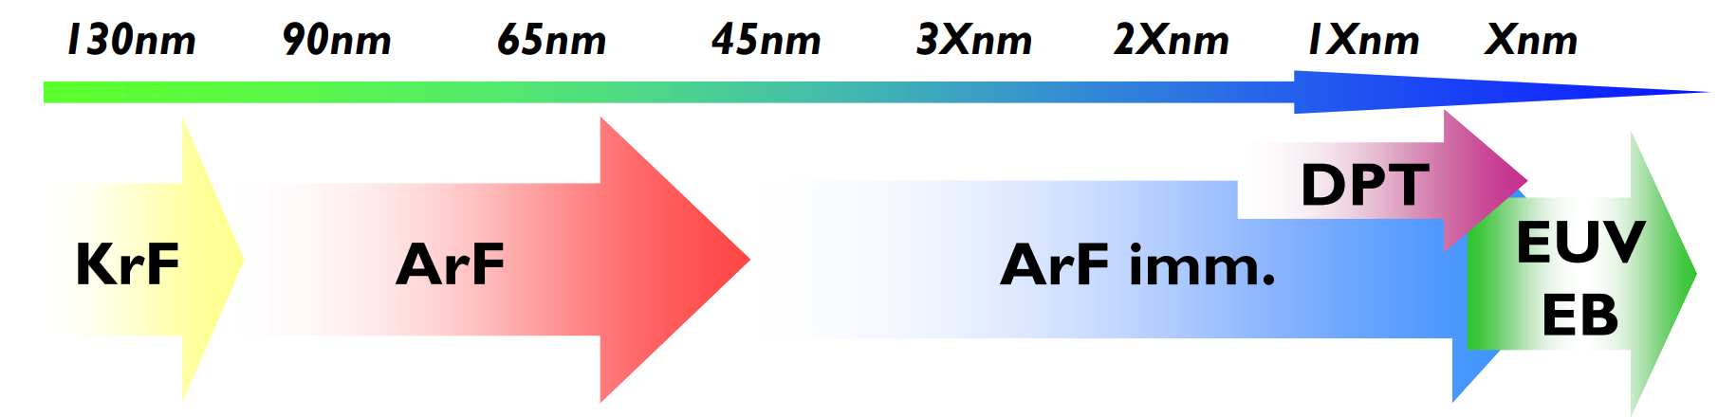
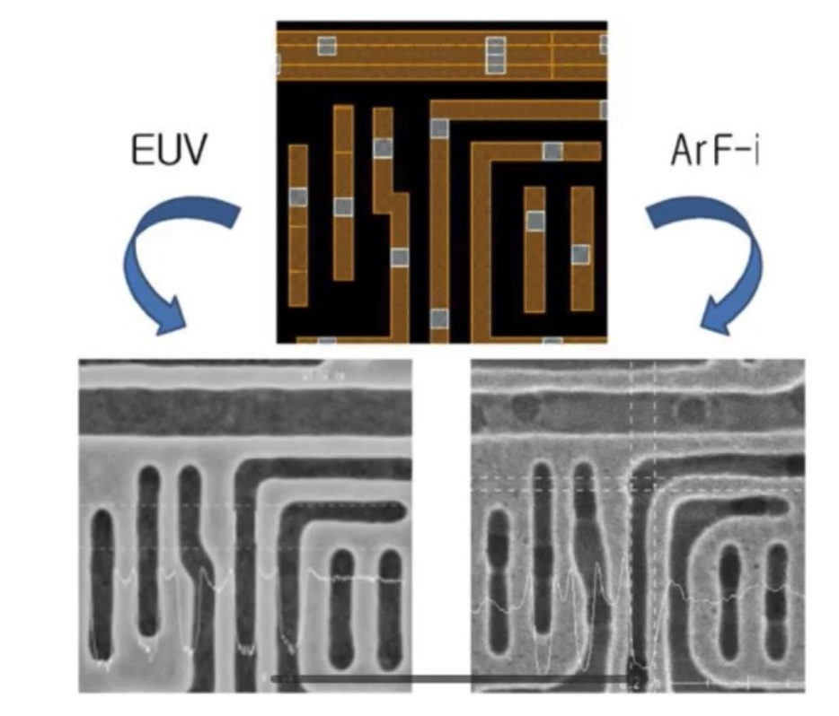
1. What is SSD?
Lithography
extreme ultraviolet
Argon fluoride
http://euvlsymposium.lbl.gov/pdf/2014/a6eb9ce6470a4a448160d68ca3e2ca0d.pdf

Slide 7
1. What is SSD?
Terms
OP area (Over Provisioning area)
eMLC (Enterprise Multi Level Cell)
GC (Garbage Collection)
FTL (Flash Translation Layer)

Slide 8
2. Distributed Storage? Large Scale Storage?
Server
Block
Block
Block
Parity
Block
Block
Block
Parity
Block
Block
Block
Parity
Block
Block
Block
Parity
Distributed Storage
Large Scale Storage

Slide 9
2. Distributed Storage? Large Scale Storage?
Distributed Storage
Large Scale Storage

Slide 10
2. Distributed Storage? Large Scale Storage?
Distributed Storage
Large Scale Storage
Critical gaps
There are no studies that focus on enterprise storage systems.
Realistic failure models
So, This paper presents the result s from out analysis with a focus to close the gaps in existing work.

Slide 11
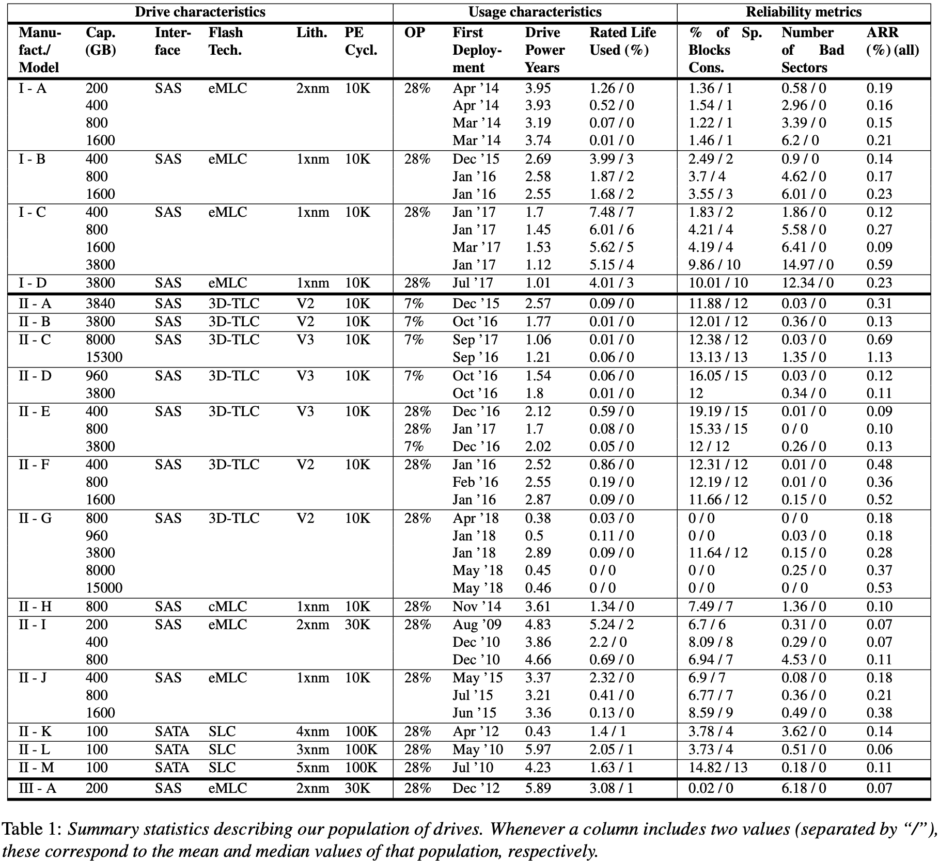
3. Statistics
30 month
1.4 million
Model 18
Capacity 12
Flash technology 4

Slide 12
3. Statistics
Percentage of spare blocks Consumed
Number of bad sectors
Annual Replacement Rate(ARR)
# of device failures
ARR =
# of device years

Slide 13
3. Statistics
MAX ARR : 1.13, MIN ARR : 0.07
but, this lower than data center drives.
(Google : 1~2.5%)

Slide 14
3. Statistics
MAX ARR : 1.13, MIN ARR : 0.07
but, this lower than data center drives.
(Google : 1~2.5%)
Even for drive models,
ARR can vary dramatically

Slide 15
3. Statistics
MAX ARR : 1.13, MIN ARR : 0.07
but, this lower than data center drives.
(Google : 1~2.5%)
Even for drive models,
ARR can vary dramatically
The spare area reserved for bad blocks
Average : less than 15%
in 99th and 99.9th : 17 ~ 33%
The typical drive remains far from
ever reaching PE cycle limit
in 2~3 years : 2~3%
in 99th and 99.9th : 15%, 33%

Slide 16
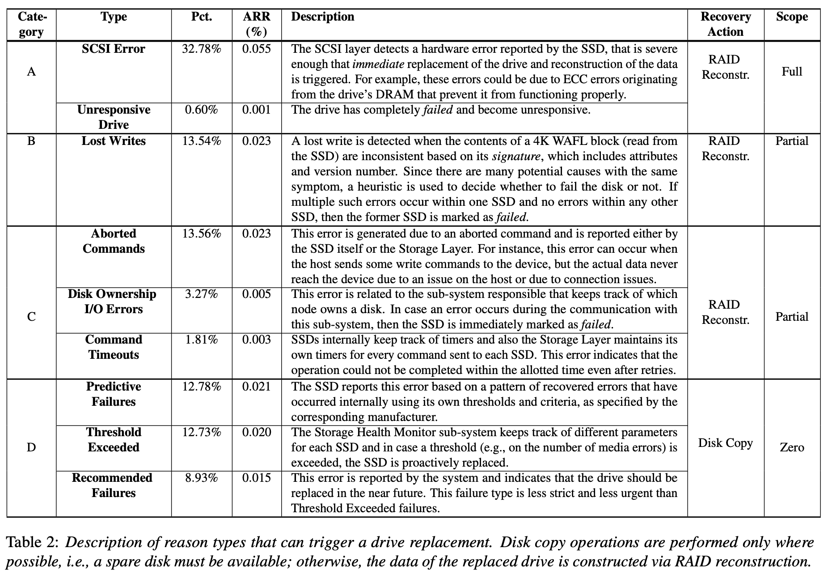
4. Reasons for replacements
Category D
Inside drive
Higher level in the system
Predict future drive failure
Example
Timeout
SMART statistics

Slide 17
4. Reasons for replacements
Category A
Occupies the most part
Completely unresponsive
SCSI layer detect a problem
Need RAID reconstruction
Example
SCSI error
Unresponsive drive

Slide 18
4. Reasons for replacements
Category B
Not perform the write at all
Wrote it to a wrong location
Corrupted the write
Firmware bug
Example
Lost writes

Slide 19
4. Reasons for replacements
Category C
Aborted commands
Commands timed out
Need RAID reconstruction
Example
Aborted Commands
Command Timeouts
Disk Ownership I/O Errors

Slide 20

4. Reasons for replacements
Most of them are predictable errors
and can be recovered.

Slide 21
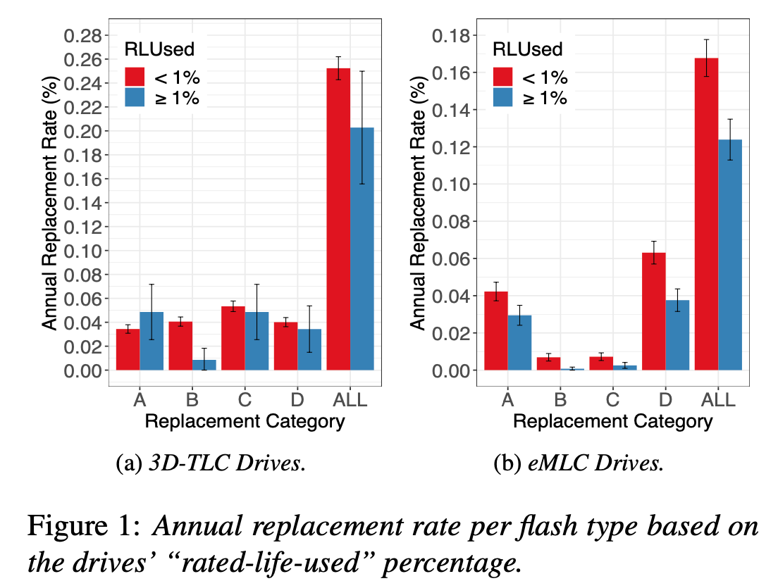
5. Factors impacting replacement rates

Slide 22
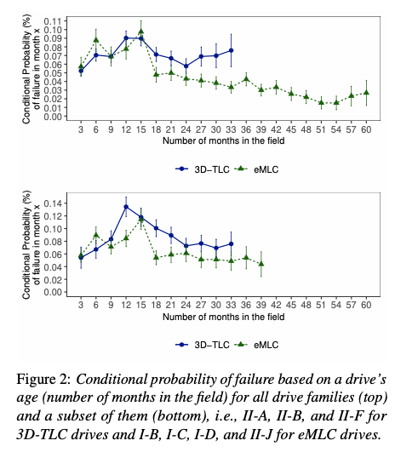
5. Factors impacting replacement rates
That means that,
given typical drive lifetimes of 5 years,
drives spend 20-40% of their life in infant mortality.

Slide 23
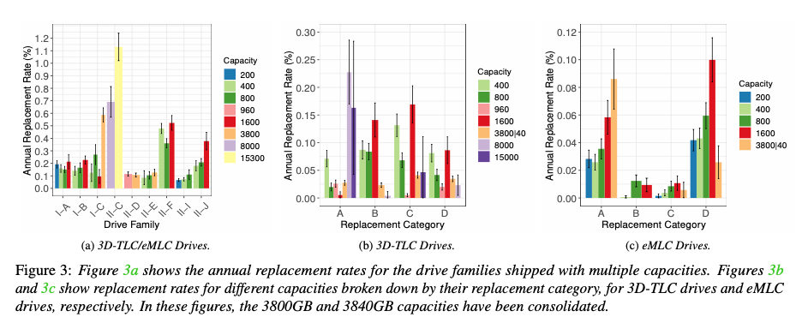
5. Factors impacting replacement rates
The larger the capacity, the higher the replacement rate.

Slide 24
5. Factors impacting replacement rates
The larger the capacity, the higher the replacement rate.
However, it may be a large FTL problem of DRAM rather than a flash technology problem.

Slide 25
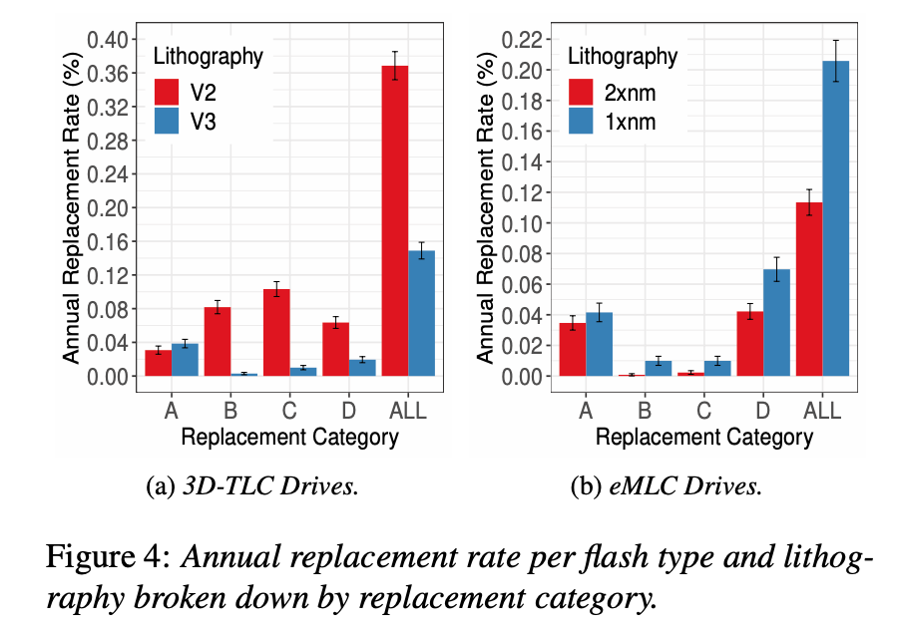
5. Factors impacting replacement rates
In contrast to previous work,
higher density drives do not always see higher replacement rates.

Slide 26
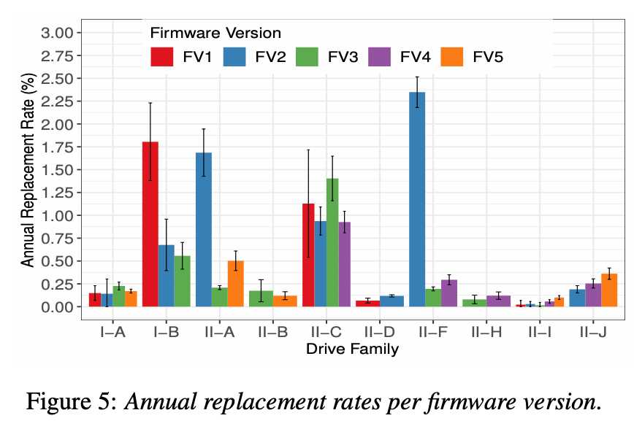
5. Factors impacting replacement rates
Earlier firmware versions can be correlated with significantly higher replacement rates,
emphasizing the importance of firmware updates.

Slide 27
5. Factors impacting replacement rates
New Bug
Earlier firmware versions can be correlated with significantly higher replacement rates,
emphasizing the importance of firmware updates.

Slide 28
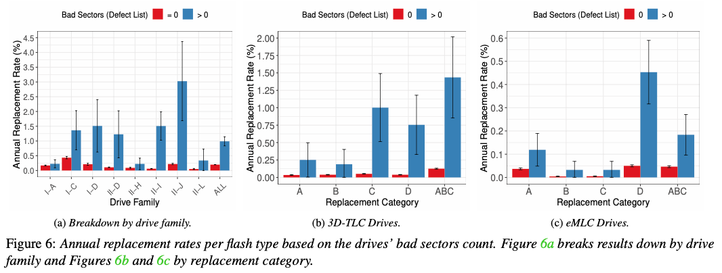
5. Factors impacting replacement rates
SSDs with a non-empty defect list have a higher chance of getting replaced,
not only due to predictive failures, but also due to other replacement reasons as well.

Slide 29
5. Factors impacting replacement rates
we observe similar correlations with the number of consumed spare blocks.

Slide 30
5. Factors impacting replacement rates
we observe similar correlations with the number of consumed spare blocks.
SSDs that make greater use of their overprovisioned space are quite likely to be replaced in the future.

Slide 31
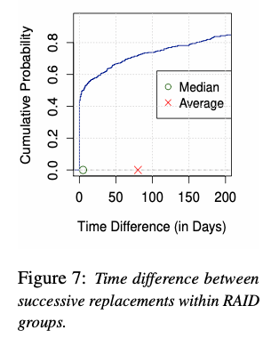
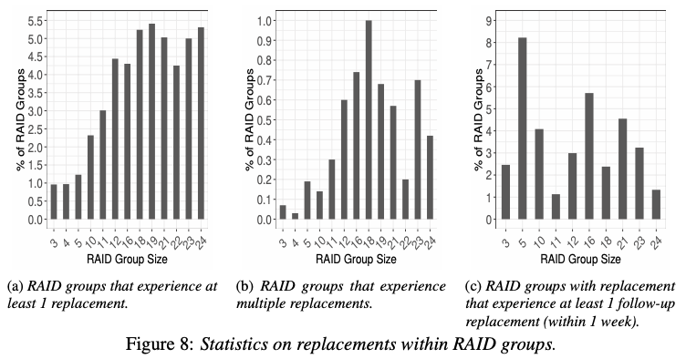
5. Factors impacting replacement rates
0.0504 %
9.39 %
The reason seems to be that the likelihood of a follow-up failure after a first failure is not correlated with RAID group size.
More 180 time

Slide 32
5. Factors impacting replacement rates
0.0504 %
9.39 %
The reason seems to be that the likelihood of a follow-up failure after a first failure is not correlated with RAID group size.
More 180 time

Slide 33
6. Conclusions
Many aspects different from expectations:
A long period of infant mortality!
Higher densities not always experience higher replacement rates.
SLC not generally more reliable than MLC.
Firmware versions can have a significant impact on replacements
Temporally correlated failures within the same RAID group
No evidence that follow-up failures are correlated with RAID group size.

Slide 34
A Study of SSD Reliability in Large Scale Enterprise Storage Deployments
Stathis Maneas, Kaveh Mahdaviani, Tim Emami, Bianca Schroeder
18th USENIX Conference on File and Storage Technologies (FAST’20). 2020.
Thank You!
2020. 06. 01
Presentation by Choi, Gunhee
choi_gunhee@dankook.ac.kr

