Slide 1
GIFT: A Coupon Based Throttle-and-Reward Mechanism for Fair and Efficient I/O Bandwidth Management on Parallel Storage Systems
Tirthak Patel, Rohan Garg, Devesh Tiwari
18th USENIX Conference on File and Storage Technologies (FAST’20). 2020.
2020. 06. 08
Presentation by Choi, Gunhee
choi_gunhee@dankook.ac.kr

Slide 2
Data-intensive Parallel Application
What is Problems?
GIFT
Evaluation
Conclusions

Slide 3
1. Data-intensive Parallel Application

Slide 4
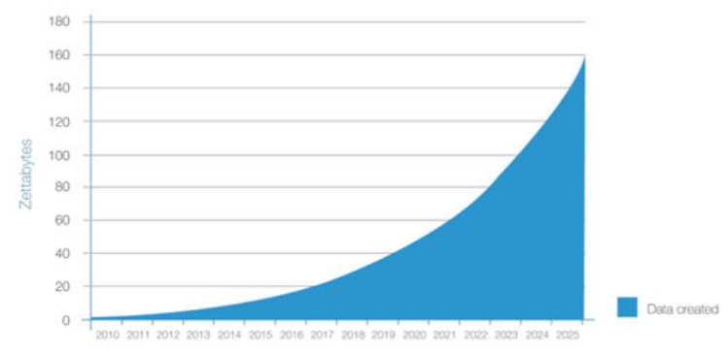
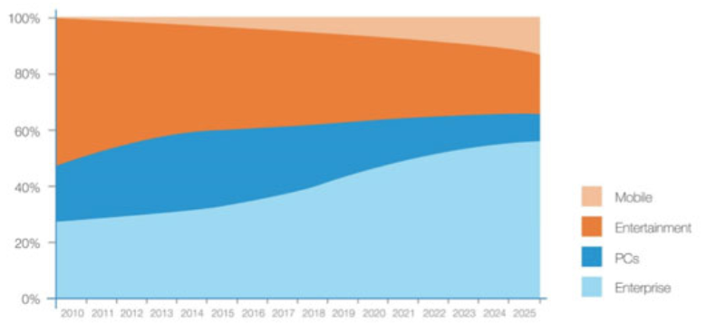
1. Data-intensive Parallel Application
Data growth
Main data storage location
https://www.bodnara.co.kr/bbs/article.html?num=142029

Slide 5
1. Data-intensive Parallel Application
MPI processes

Slide 6
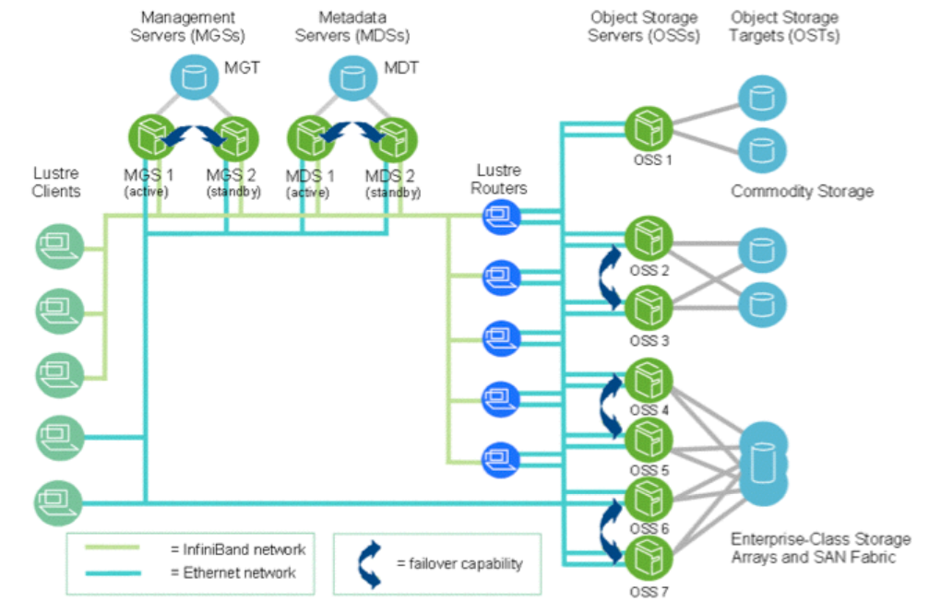
1. Data-intensive Parallel Application
Lustre File System

Slide 7
2. What is Problems?
What is Problems?

Slide 8
2. What is Problems?
MPI processes
Side-effect : need for synchronous I/O progress

Slide 9
2. What is Problems?
Storage System
Bandwidth contend
Lustre File System

Slide 10
2. What is Problems?
Storage System
Bandwidth contend
Lustre File System

Slide 11
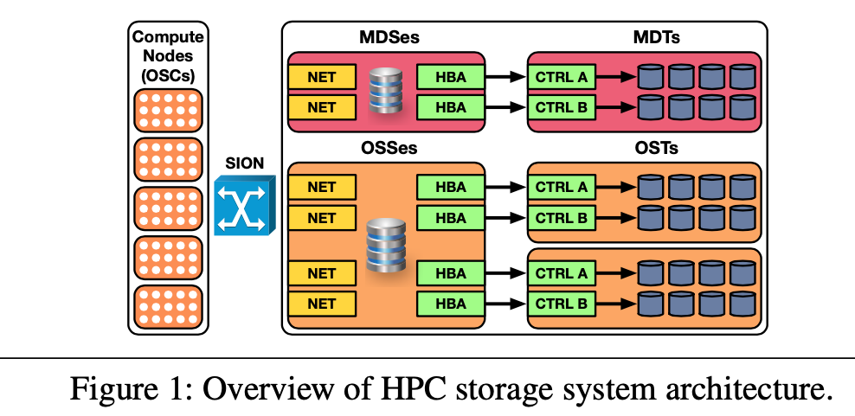
2. What is Problems?
Storage System
Bandwidth contend
Lustre File System

Slide 12
2. What is Problems?

Slide 13
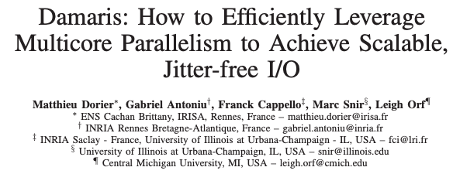
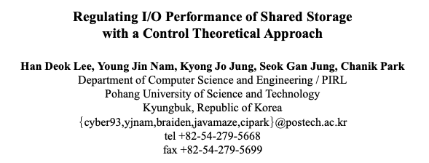
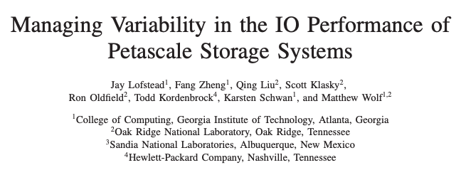
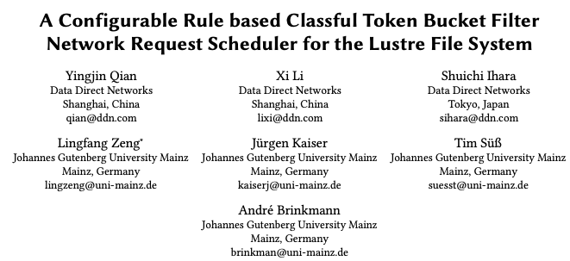
2. What is Problems?
I/O bottlenecks
Application-level
techniques
Server-side solutions

Slide 14
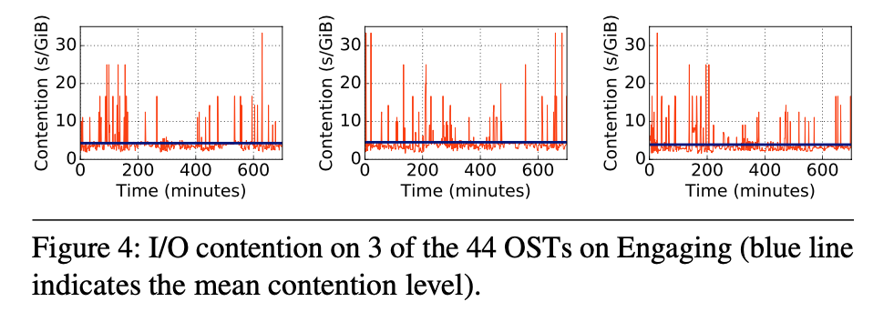
2. What is Problems?
Results of this simple experiment show
that the degree of contention is different on each OST and varies over time

Slide 15
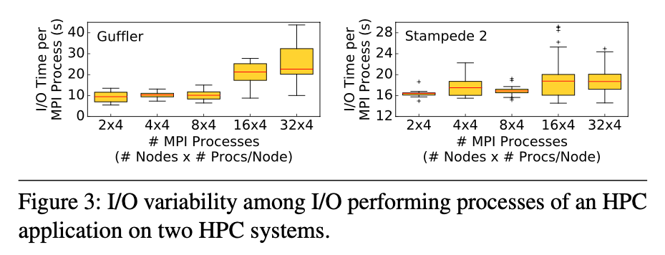
2. What is Problems?
I/O time of different MPI processes can vary significantly across runs and the number of nodes

Slide 16
2. What is Problems?
I/O time of different MPI processes can vary significantly across runs and the number of nodes
Because non-synchronous I/O

Slide 17
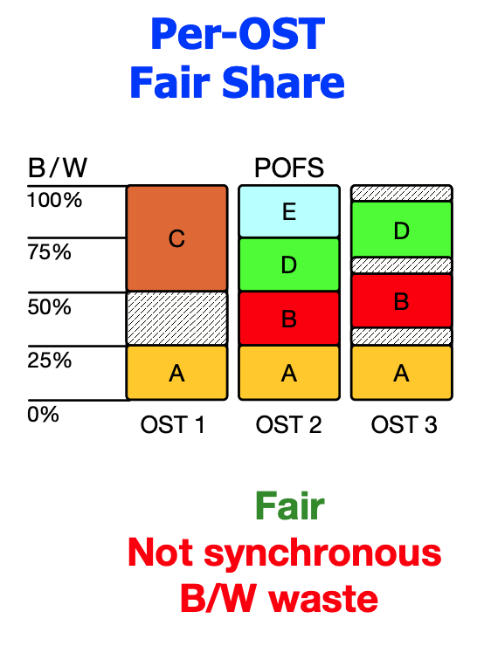
2. What is Problems?

Slide 18
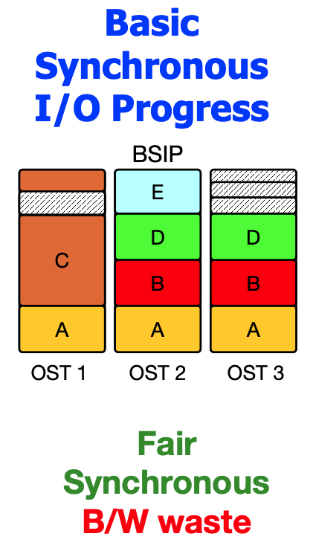
2. What is Problems?

Slide 19
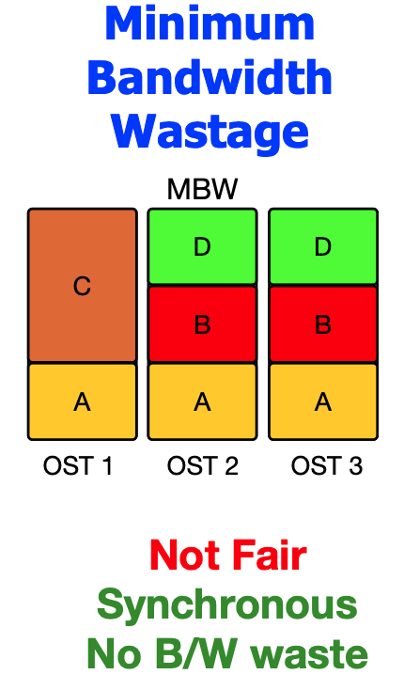
2. What is Problems?

Slide 20
3. GIFT
GIFT

Slide 21
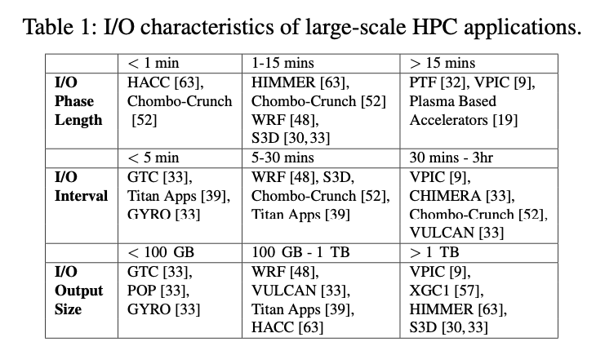
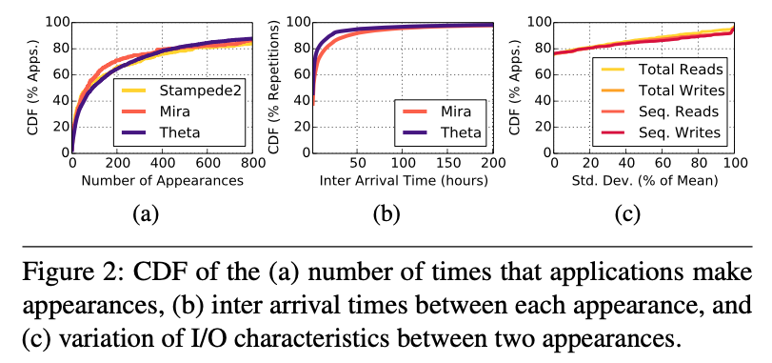
3. GIFT
Long term
Repetitive runs
Low-periodicity
Predictable I/O

Slide 22
3. GIFT
Long term
Repetitive runs
Low-periodicity
Predictable I/O
non-synchronous I/O

Slide 23
3. GIFT
Long term
instant
Repetitive runs
Low-periodicity
Predictable I/O
non-synchronous I/O

Slide 24
3. GIFT
Long term
instant
Repetitive runs
Predictable
I/O Phase
Low-periodicity
Predictable I/O
non-synchronous I/O

Slide 25
3. GIFT
Long term
instant
Repetitive runs
Predictable
I/O Phase
Low-periodicity
Predictable I/O
Bandwidth
waste
non-synchronous I/O

Slide 26
3. GIFT

Slide 27
3. GIFT

Slide 28
3. GIFT
Optimal Bandwidth Allocation
Should not be less than the initial allocation.
The maximum allocation size of the bandwidth is overall, but the OST is calculated first.

Slide 29
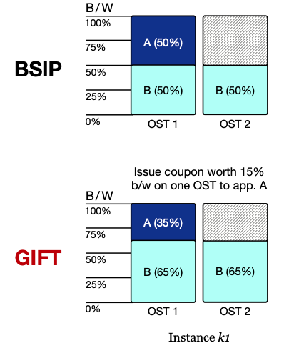
3. GIFT

Slide 30
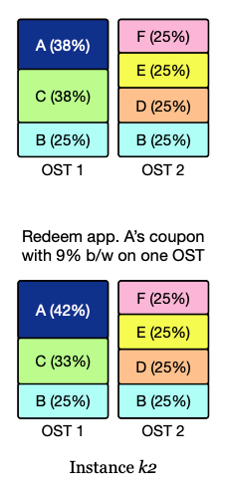
3. GIFT

Slide 31
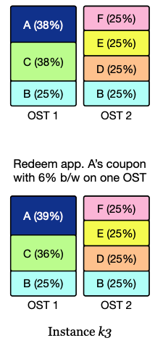
3. GIFT

Slide 32
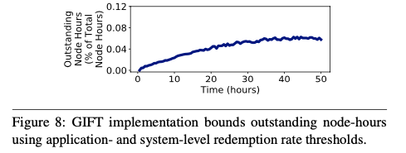
4. Evaluation
Performance improvement
Not fair
Additional offer time less than 0.12
But,
system throughput increased by 2%

Slide 33
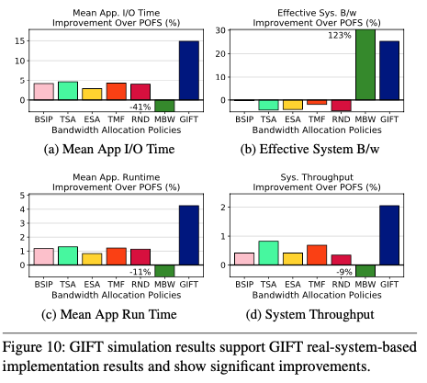
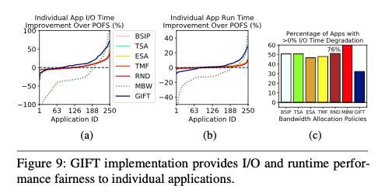
4. Evaluation
Relatively fair

Slide 34
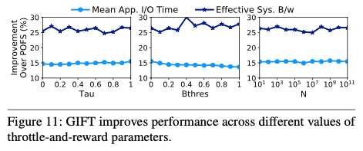
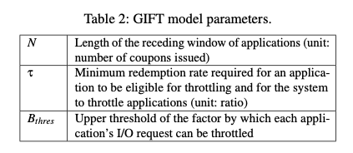
4. Evaluation
I/O time is expected to improve as $τ$increases
$B_{thres}$ has a great influence on B/W, but I/O time decreases
$N$ has good stability

Slide 35
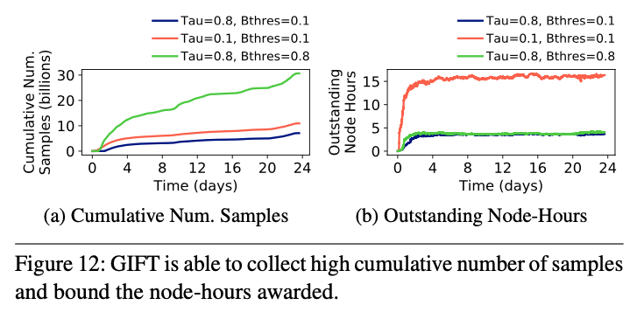
4. Evaluation
less than 20 hours at any instance,
although the corresponding 2% improvement in system throughput translates to
a gain of more than 5,800 node-hours

Slide 36
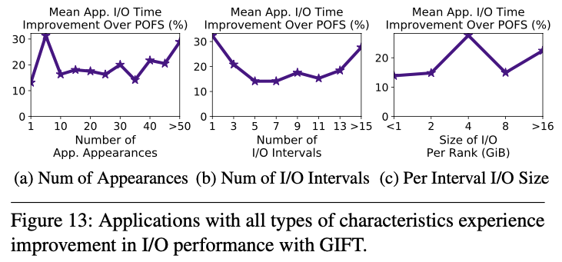
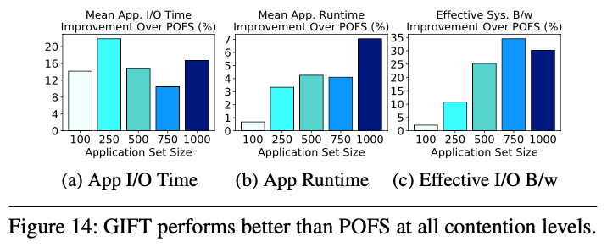
4. Evaluation
Mean application I/O time by up to 16%
Mean application run time by up to 7%
Mean effective system bandwidth by up to 30%
SSDs have the same results.

Slide 37
6. Conclusions
Improving effective system I/O bandwidth
Providing fairness among applications
Ensuring synchronous I/O progress
GIFT
17% in mean effective system I/O bandwidth
10% in the mean application I/O time
https://github.com/GoodwillComputingLab/GIFT.

Slide 38
GIFT: A Coupon Based Throttle-and-Reward Mechanism for Fair and Efficient I/O Bandwidth Management on Parallel Storage Systems
Tirthak Patel, Rohan Garg, Devesh Tiwari
18th USENIX Conference on File and Storage Technologies (FAST’20). 2020.
Thank You!
2020. 06. 08
Presentation by Choi, Gunhee
choi_gunhee@dankook.ac.kr

