Slide 1
Hailstorm: Disaggregated Compute and Storage for Distributed LSM-based Databases
L. Bindschaedler et al.,
ASPLOS, 2020
2020. 06. 08
Presentation by Lee, Jeyeon
2reenact@dankook.ac.kr

Slide 2
Introduction
Background
The Hailstorm Design
Evaluation
Conclusion

Slide 3
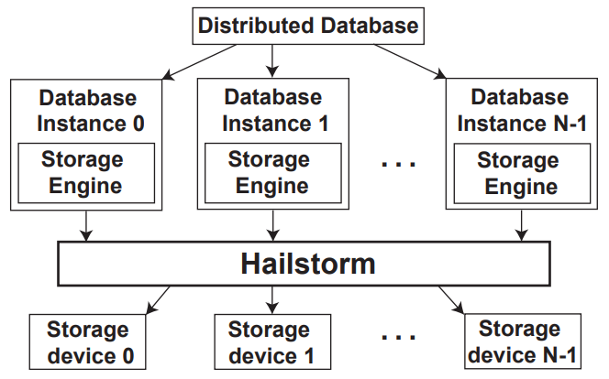
1. Introduction
Hailstorm a lightweight distributed filesystem
Disaggregate compute and storage allowing each to be load balanced
Higher throughput
Better resource utilization

Slide 4
2. Background
Issues and Challenges
Skew in Distribute Databases
Compaction in LSM KV Stores

Slide 5
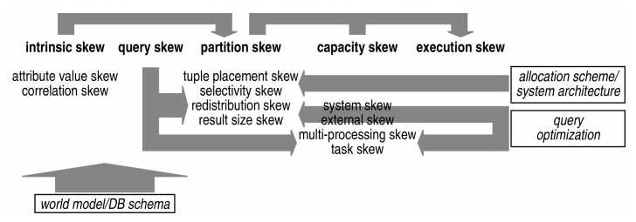
2. Background
Issues and Challenges
Skew in Distribute Databases
Skew occurs naturally in many distributed workloads
Some keys are more popular than others
Sharding inevitably leads to data imbalance
Can be mitigated using resharding which is high cost
rebalancing data is costly as it triggers additional compaction, flushing, and GC
Compaction in LSM KV Stores
“A Classification of Skew Effects in Parallel Database Systems.”
- Holger Märtens. 2001. In European Conference on Parallel Processing. Springer.

Slide 6
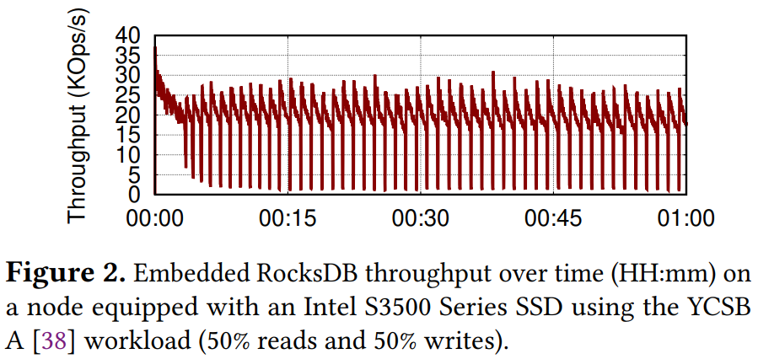
2. Background
Issues and Challenges
Skew in Distribute Databases
Skew occurs naturally in many distributed workloads
Can be mitigated using resharding which is high cost
Compaction in LSM KV Stores
typically expensive operations in terms of both CPU and I/O

Slide 7
2. Background
Issues and Challenges
Skew in Distribute Databases
Skew occurs naturally in many distributed workloads
Can be mitigated using resharding which is high cost
Compaction in LSM KV Stores
typically expensive operations in terms of both CPU and I/O
In Mongo DB

Slide 8
3. The Hailstorm Design
The Hailstorm
Resource disaggregation
disaggregate compute from storage
enabling each resource to be scaled and load balanced
Storage pooling
pools together all storage devices within a rack
Fine-grained spreading of data
splitting data into small blocks
spreading them uniformly across all storage devices
Compaction offloading

Slide 9
3. The Hailstorm Design
Distributed Database
Instance 0
Instance 1
Instance N
Storage
Engine
Storage
Engine
Storage
Engine
Local Storage
Local Storage
Local Storage

Slide 10
3. The Hailstorm Design
Distributed Database
Instance 0
Instance 1
Instance N
Storage
Engine
Storage
Engine
Storage
Engine
Hailstorm
Local Storage
Local Storage
Local Storage

Slide 11
3. The Hailstorm Design
Distributed Database
Instance 0
Instance 1
Instance N
Storage
Engine
Storage
Engine
Storage
Engine
Hailstorm
Storage pooling
Local Storage
Local Storage
Local Storage

Slide 12
3. The Hailstorm Design
Distributed Database
Instance 0
Instance 1
Instance N
Storage
Engine
Storage
Engine
Storage
Engine
Fine-grained
spreading of data
Hailstorm
Local Storage
Local Storage
Local Storage

Slide 13
3. The Hailstorm Design
Distributed Database
Instance 0
Instance 1
Instance N
Storage
Engine
Storage
Engine
Storage
Engine
Hailstorm
Local Storage
Local Storage
Local Storage

Slide 14
3. The Hailstorm Design
Distributed Database
Instance 0
Instance 1
Instance N
Storage
Engine
Storage
Engine
Storage
Engine
Hailstorm
Local Storage
Local Storage
Local Storage

Slide 15
3. The Hailstorm Design
Distributed Database
Instance 0
Instance 1
Instance N
Compaction
Storage
Engine
Storage
Engine
Storage
Engine
Hailstorm
Local Storage
Local Storage
Local Storage

Slide 16
3. The Hailstorm Design
Distributed Database
Instance 0
Instance 1
Instance N
Compaction
Storage
Engine
Storage
Engine
Storage
Engine
Hailstorm
Local Storage
Local Storage
Local Storage

Slide 17
3. The Hailstorm Design
Distributed Database
Compaction offloading
Instance 0
Instance 1
Instance N
Storage
Engine
Storage
Engine
Storage
Engine
Hailstorm
Local Storage
Local Storage
Local Storage

Slide 18
4. Evaluation
Environment
18 dedicated 16 core machines
2 CPU sockets with Xeon E5-2630v3
128 GB of DDR3 ECC
Intel S3500 SSD
read : 420 MB/s
write : 320 MB/s
Rocks DB + Hailstorm

Slide 19
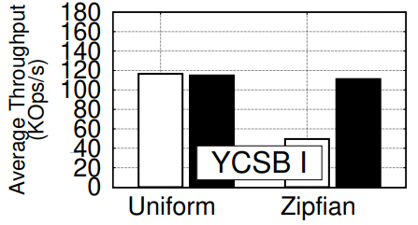
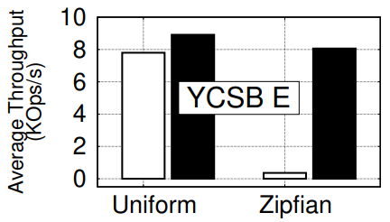
4. Evaluation
MongoDB vs Hailstorm
Write intensive
Read intensive

Slide 20
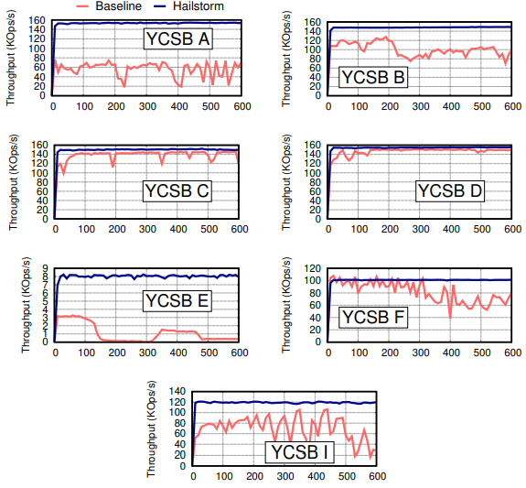
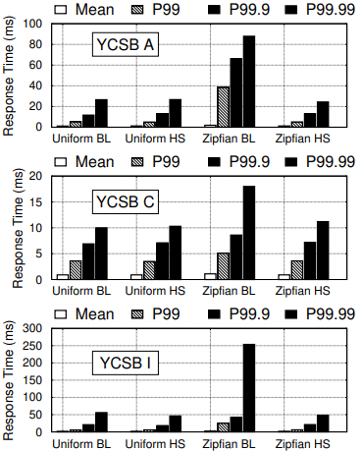
4. Evaluation
MongoDB vs Hailstorm

Slide 21
5. Conclusion
Hailstorm improves load balance in LSM-based databases
Compute and storage disaggregation
Fine-grained storage pooling
Compaction offloading
Higher throughput and resource utilization
Works with existing databases

Slide 22
Hailstorm: Disaggregated Compute and Storage for Distributed LSM-based Databases
L. Bindschaedler et al.,
ASPLOS, 2020
Thank you
2020. 06. 08
Presentation by Lee, Jeyeon
2reenact@dankook.ac.kr

