Slide 1
W14 paper #3
Moving Beyond End-to-End Path Information
to Optimize CDN Performance
Rupa Krishnan§ Harsha V. Madhyastha‡ Sridhar Srinivasan§ Sushant Jain§
Arvind Krishnamurthy£ Thomas Anderson£ Jie Gao†
§ Google Inc. ‡ University of California, San Diego £ University of Washington † Stony Brook University
{rupak,sridhars,sushantj}@google.com, harsha@cs.ucsd.edu
{arvind,tom}@cs.washington,edu, jgao@cs.sunysb.edu
ACM Internet Measurement Conference 2009
(ACM IMC 2009)
모바일빅데이터 수업
발표자: 홍승표
발표일: 2020.6.15

Slide 2
0. References
Real Reference
[1] Akamai, Inc. home page. http://www.akamai.com.
130 개국 23만대 이상 서버로 cache 서비스
Recent Approaches

Slide 3
0. Abstract
What is CDN? (Contents-Delivery Network)
CDN is a Contents-Delivery Network with
Short RTT
Core Network/Transport Network Offload
CDN is applicable for 80~85% internet traffic
IPTV, YouTube, Netflix …

Slide 4
0. Abstract
Abstract
Topology
Which server to subscribe?
Shortest RTT?
Sample RTT Check
\ Server Client | 로컬 서버 211.188.145.xxx | AWS Seoul ec2-54-180-99-252.ap | AWS N.Virginia ec2-18-212-35-30...
S10 5G단말 LTE망 | 54.851 ms | 59.063 ms | 294.355 ms
S10 5G단말 5G망 | 45.528 ms | 49.063 ms | 436.710 ms
2020년에도
지구반대편까지 가기에는
지연시간이 크다
Key Result
‘Short RTT’ scheme does NOT always works.
Queueing delay and other aspects need to be taken into account

Slide 5
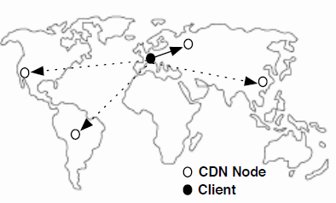
I. Introduction
Google CDN
Latency-based Redirection
“Proximity” first
Adding new node to reduce RTT
But it does not reduce the worst case RTT
A deeper look
RTT Analysis from clients of 170 prefixes worldwide
Optimization of routing path
Optimization of queueing delay
WhyHigh tool
CDN performance assessment system
Identification of clients with poor performance
Classification according to path
Information Gathering
Routing tables(BGP table), Router locations, RTT logs, Traffic volume(Netflow log)
Active measure: traceroute, ping

Slide 6
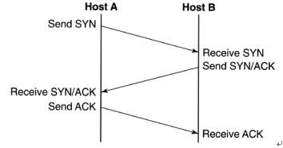
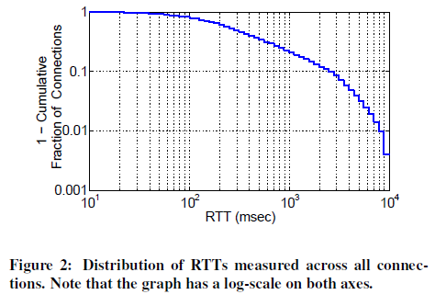
II. Overview
Measurement Goals
Efficacy of latency-based redirection
Identify cause of poor RTT
Detect instances of poor RTT
Measurement Dataset
Google CDN 13 nodes
170k network prefixs
RTT measurement with TCP SYN/ACK or SYN/ACK/ACK
40% 이상의 client는 400m초과하는 지연시간
The RTT will be
measured

Slide 7
III. Understanding Path Latency
Overall RTT
40% 이상의 client는 400m초과
RTT delay breakdown
TCP layer delay
Transmission delay
Client node에서 전송로(wire)로 보낼때까지의 지연시간
Propagation delay
전송로 구간에서의 지연시간(물리적인 거리와 다를수있음)
Queueing delay
Routing/forwarding 지연시간
40% 이상의 client는 400m초과하는 지연시간

Slide 8
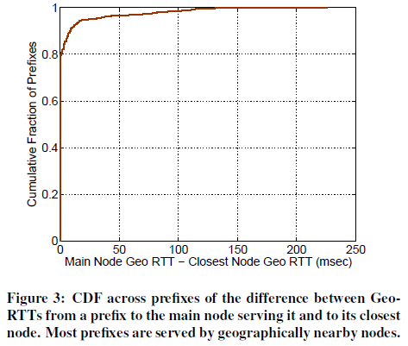
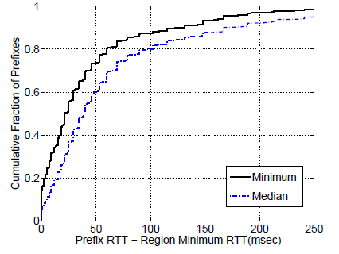
III. Understanding Path Latency
Geo-RTT
항상 가까운 node로 redirection되는 않음
20%는 보다 먼곳으로 redirection
일시적인 load 상황, DNS 서버 등이 원인
Distribution of RTT, Compared to Min value

Slide 9
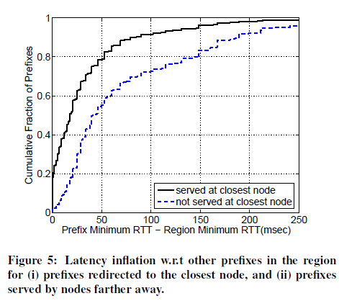
III. Understanding Path Latency
Latency Inflation
Due to (not proper) redirection to far nodes
Summary
Latency inflation due to
Inefficient routes to new nodes ( active < 1 year)
Queueing

Slide 10
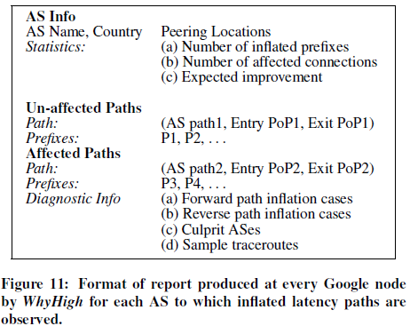
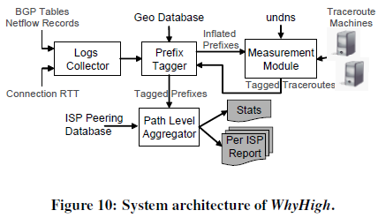
IV. WhyHigh
A SYSTEM FOR DIAGNOSING LATENCY INFLATION
A deeper look
RTT Analysis from clients of 170 prefixes worldwide
Identification of clients with poor performance
Classification according to path
Information Gathering
Routing tables(BGP table), Router locations(Geo Database), RTT logs, Traffic volume(Netflow log)
Active measure: traceroute, ping

Slide 11
IV. WhyHigh
Root cause of latency inflation
Lack of peering
Limited of bandwidth capacity
Route misconfiguration – such as asymmetric bandwidth
Traffic Engineering

Slide 12
V. Result
Case 1. No peering, and all AS paths are long
필리핀의 특정 ISP에서 300ms 이상의 지연발생(최소지연은 200ms)
부하분산을 위해 prefix 별로 AS path 분산
하지만 최종목적지(US) 까지의 direct path가 부족하여 우회로 인한 지연 발생
Case 2. No peering, and shorter path on less specific prefix
일부 traffic만 최적의 경로로 전달되며, 나머지는 비효율적으로 우회하여 전송됨
Case 3: Peering, but longer paths on more specific prefixes
Traffic is not routed direct peer AS
Case 4: Peering, but inflated reverse path
Forward 4 hops vs reverse 8 hops

Slide 13
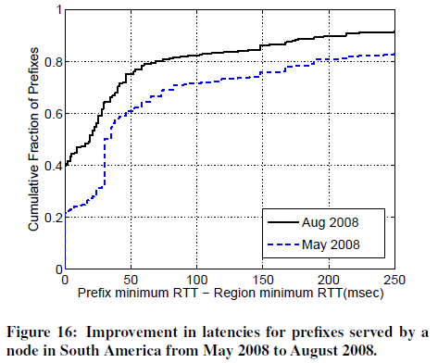
V. Result
Summary
RTT 와 routing 정보 분석으로
특히 Peering AS 부족으로 인한 지연에 집중하여 routing 및 peering 개선하여
50ms 이상인 prefix 비율을 40%→ 22% 로 개선

Slide 14
Appendix B. Terminology
From BGPeep: An IP-Space Centered View for Internet Routing Data
Peering
Peering is the arrangement of traffic exchange between Internet service providers (ISPs). Larger ISPs with their own backbone networks agree to allow traffic from other large ISPs in exchange for traffic on their backbones. They also exchange traffic with smaller ISPs so that they can reach regional end points. Essentially, this is how a number of individual network owners put the Internet together. To do this, network owners and access providers, the ISPs, work out agreements that describe the terms and conditions to which both are subject. Bilateral peering is an agreement between two parties. Multilateral peering is an agreement between more than two parties.

Slide 15
Appendix B
Google CDN (YouTube)
(bottleneck in IX)
Netflix CDN
(no bottleneck)

