Slide 1
Lecture Note 0: Course Introduction
February 25, 2020
Jongmoo Choi
Dept. of software
Dankook University
http://embedded.dankook.ac.kr/~choijm

Slide 2
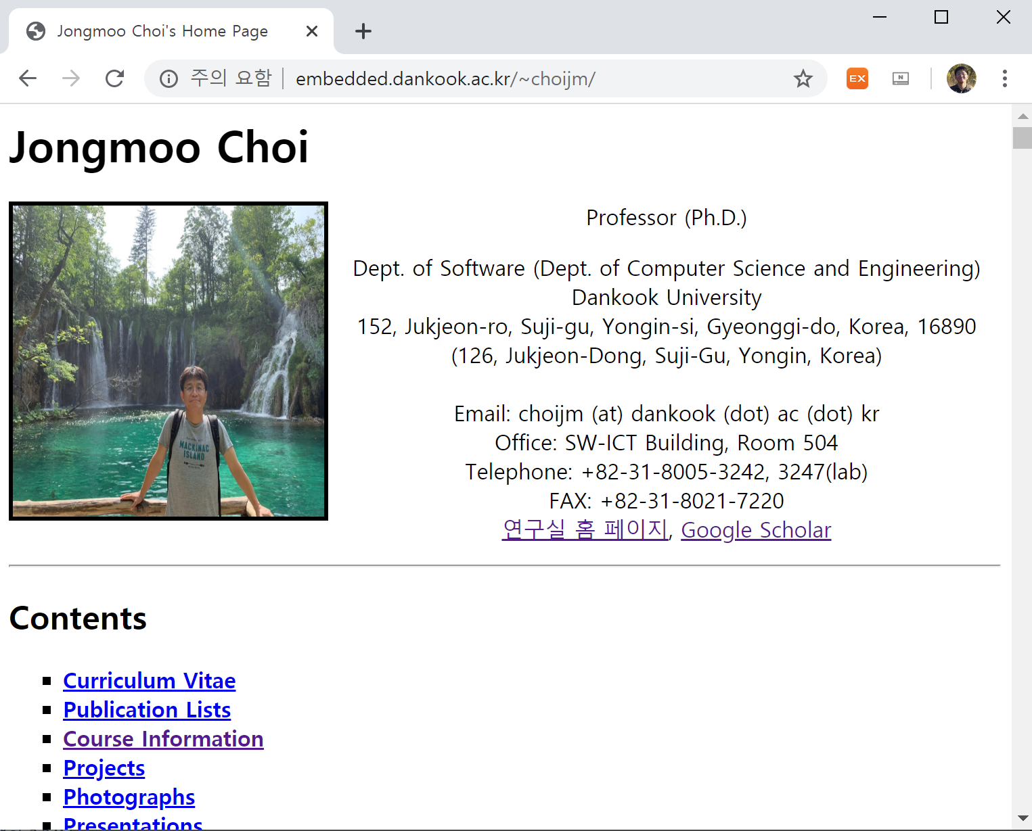
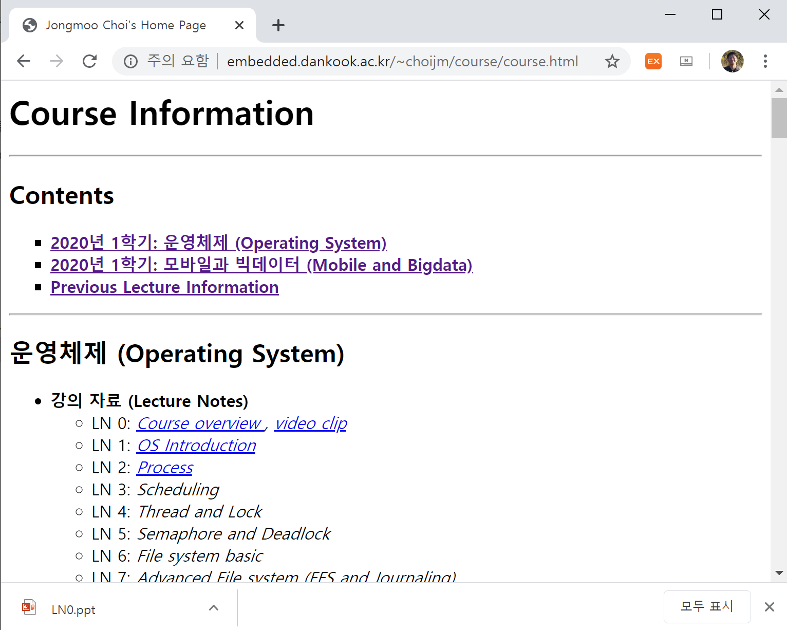
How to get the Lecture note?
Lecture site

Slide 3
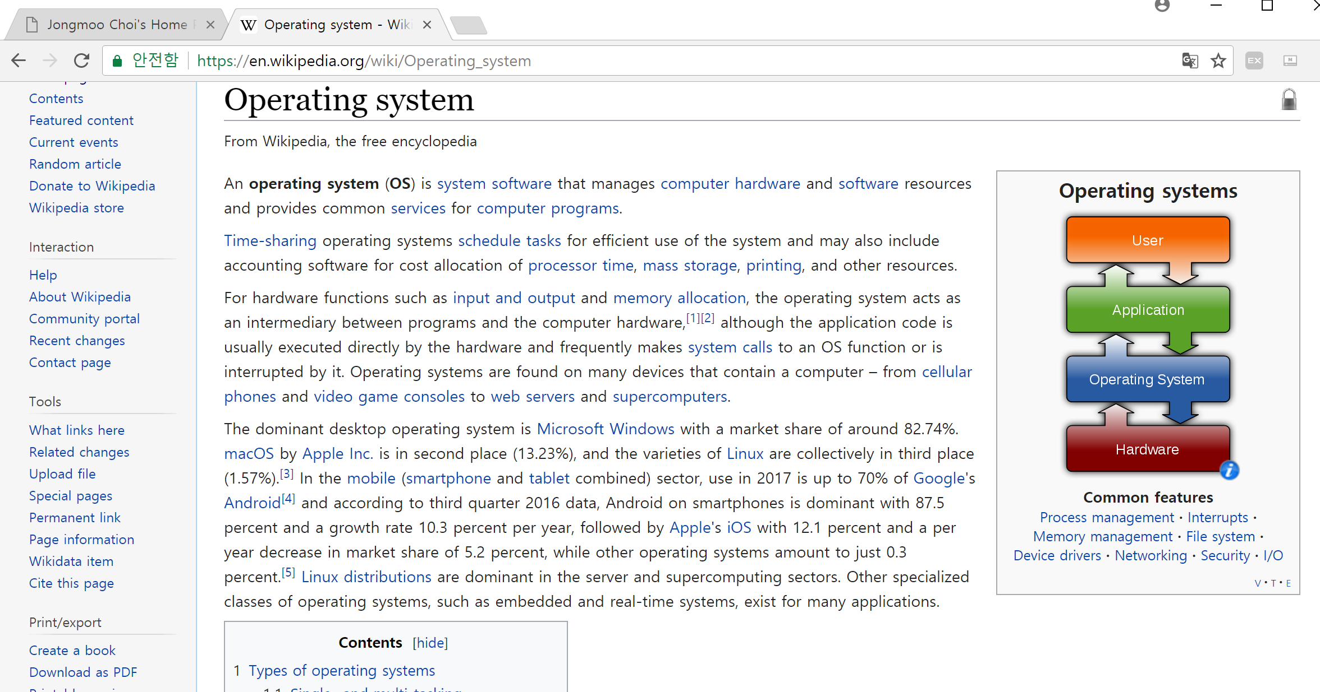
What is Operating System?
Definition (from wikipedia.org)

Slide 4
Course Objectives
Understand the definition, role and goal of OS
Resource manager, computing environments, …
Know the existing operating systems
UNIX, Windows, Apple OS X, Linux, Android, iOS, WebOS, Mach, …
Learn the internal structure of OS
Process, Virtual memory, File system, Driver, Protocol, Interrupt, …
Comprehend the policies and mechanisms used by OS
CPU scheduling, Demand paging, LRU, inode, System call, …
Grasp the idea of abstraction
Hiding, Illusion, Interface, Layered architecture, …
Demonstrate what we have learned
Personal/Team project

Slide 5
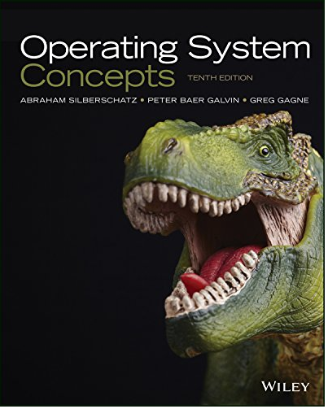
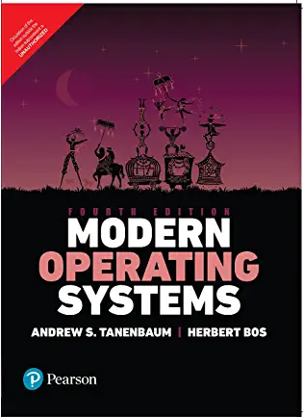
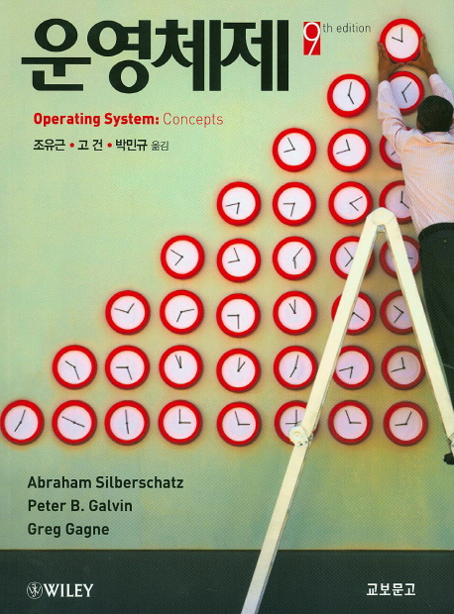
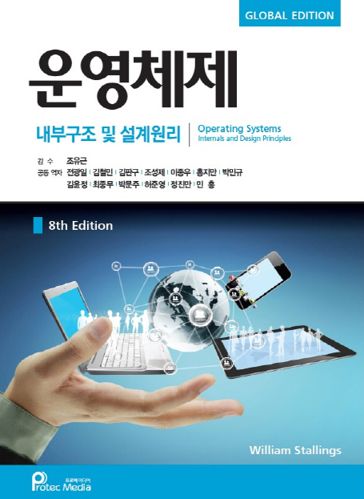
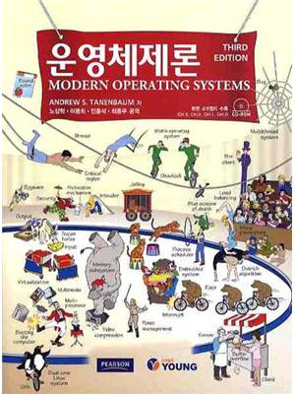
Traditional Textbook
Three representative textbooks for operating system course
Operating Systems Concepts (10th edition), by A. Silberschatz, P. Galvin and G. Gagne
Operating Systems: Internals and Design Principles (9th edition), by W. Stalling
Modern Operating Systems (5th edition), by A. Tanenbaum and H. Bos

Slide 6
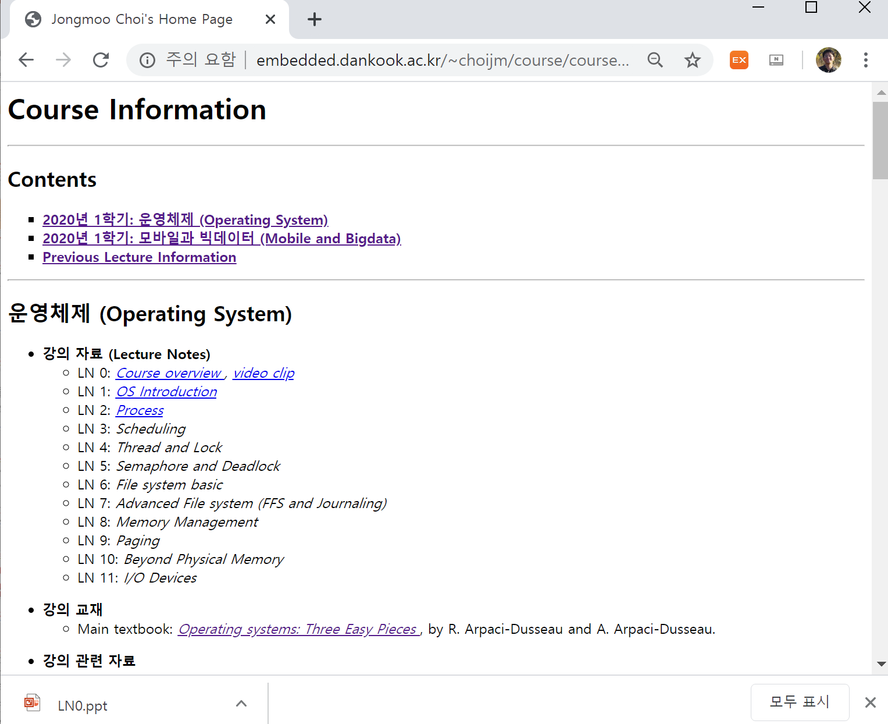
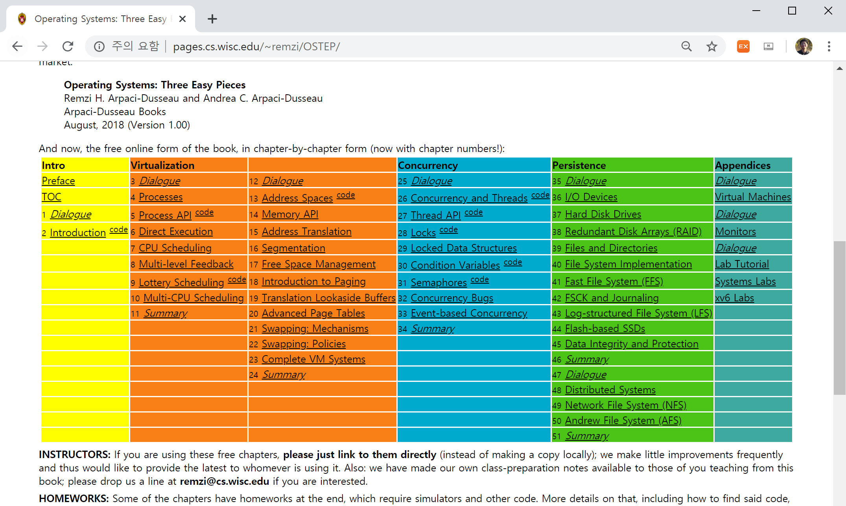
Textbook in this course
Remzi’s OSTEP (OS Three Easy Pieces)
http://pages.cs.wisc.edu/~remzi/OSTEP/

Slide 7
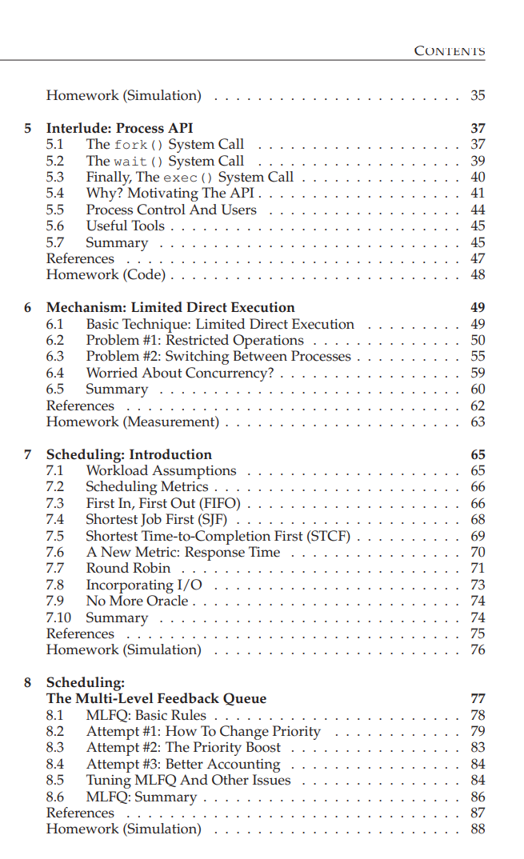
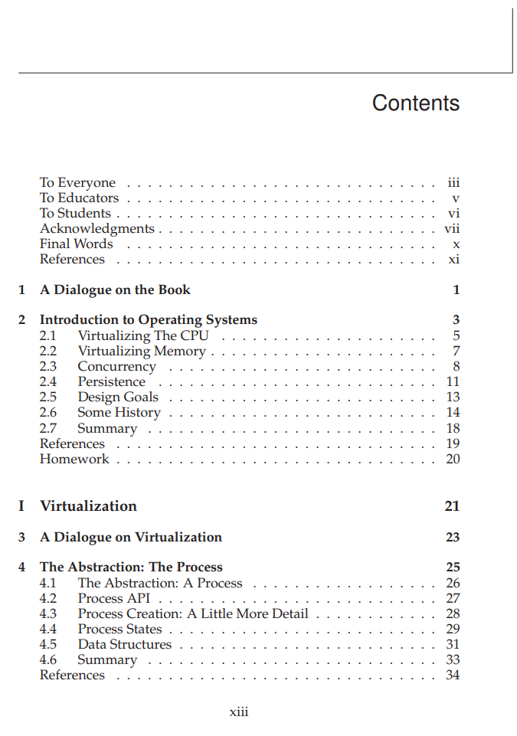
Textbook in this course
TOC (Table of Contents) of OSTEP

Slide 8
Reference
Linux Kernel Internals (리눅스 커널 내부 구조)
1장. 리눅스 소개
2장. 리눅스 커널 구조
3장. 태스크 관리
4장. 메모리 관리
5장. 파일시스템과 가상 파일시스템
6장. 인터럽트와 트랩 그리고 시스템 호출
7장. 리눅스 모듈 프로그래밍
8장. 디바이스 드라이버
9장. 네트워킹
10장. 운영체제 관련 실습
부록1. 리눅스와 가상화 그리고 XEN
부록2. MTD와 YAFFS

Slide 9
Teaching Method
Mainly Lecturing
Discussion (Q&A) during the course is quite important
Homework
Personal assignment
2 or 3 times
Team project: 2 members per team
Lab1: scheduling
Lab2: concurrency
Lab3: file system
Grading
Mid. exam(30%) + Final exam(30%) + Team project(15% for team eval. + 15% for personal eval.) + Discussion/Attendance (10%)
Absence more than 5 times or Exam. score below 20 or No team project ➔ F
Roughly, 20% students are expected to get the A grade.
Notes:
Development Environment:
- https://webnautes.tistory.com/448
- https://webnautes.tistory.com/1198

Slide 10
Discussion
Any questions? Send an email to me: choijm@dankook.ac.kr
Simple question to take attendance: find out a philosopher in the chap. 1 of the OSTEP (Dialogue) and send his name to me using email (Until 6 PM, March 18th)

Slide 11
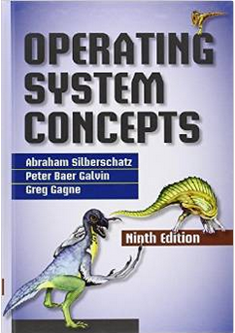
Reference
Operating Systems Concepts
Chapter 1: Introduction
Chapter 2: Operating System Structure
Chapter 3: Processes
Chapter 4: Threads
Chapter 5: Process Synchronization
Chapter 6: CPU Scheduling
Chapter 7: Deadlocks
Chapter 8: Main Memory
Chapter 9: Virtual Memory
Chapter 10: Mass-Storage Structure
Chapter 11: File System Interface
Chapter 12: File System Implementation
Chapter 13: I/O Systems
Chapter 14: Protection
Chapter 15: Security
Chapter 16: Virtual machine
Chapter 17: Distributed Systems
Chapter 18: The Linux System
Chapter 19: Windows 7
Chapter 20: Influential OSes
Appendix: Mach, BSD

Slide 12
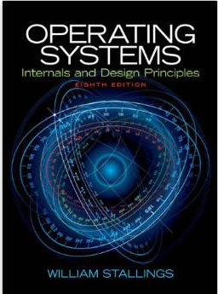
Reference
Operating Systems: Internals and Design Principles
Chapter 1. Computer system overview
Chapter 2. Operating system overview
Chapter 3. Process description and control
Chapter 4. Threads
Chapter 5. Concurrency: Mutual exclusion & synchronization
Chapter 6. Concurrency: Deadlock & Starvation
Chapter 7. Memory management
Chapter 8. Virtual memory
Chapter 9. Uniprocessor scheduling
Chapter 10. Multiprocessor and RT scheduling
Chapter 11. I/O management and disk scheduling
Chapter 12. File management
Chapter 13. Embedded operating system
Chapter 14. Virtual machine
Chapter 15. Operating system security
Chapter 16. Distributed processing, Client/Server, and Cluster
Appendix and Online chapter

Slide 13
Reference
Modern Operating Systems
Chapter 1. Introduction
Chapter 2. Process and Thread
Chapter 3. Memory Management
Chapter 4. File Systems
Chapter 5. Input/Output
Chapter 6. Deadlocks
Chapter 7. Virtualization and Cloud
Chapter 8. Multiple Processor Systems
Chapter 9. Security
Chapter 10. Case Study 1: UNIX, Linux, & Android
Chapter 11. Case Study 2: Windows 8
Chapter 13. Operating System Design
Chapter 14. Reading List and Bibliography

