Slide 1
Lecture Note 1: OS Introduction
March 1, 2020
Jongmoo Choi
Dept. of software
Dankook University
http://embedded.dankook.ac.kr/~choijm
(This slide is made by Jongmoo Choi. Please let him know when you want to distribute this slide)

Slide 2
Contents
From Chap 1~2 of the OSTEP
Chap 1. A Dialogue on the Book
Chap 2. Introduction to Operating System
Virtualizing the CPU
Virtualizing Memory
Concurrency
Persistence
Design Goals
Some History
References

Slide 3
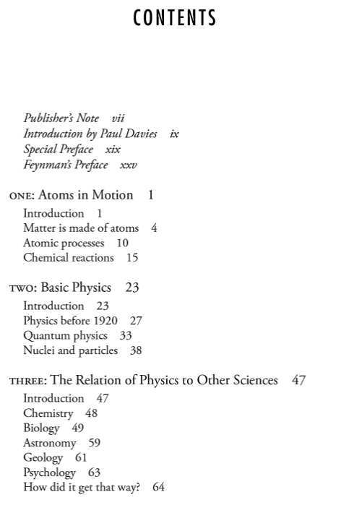
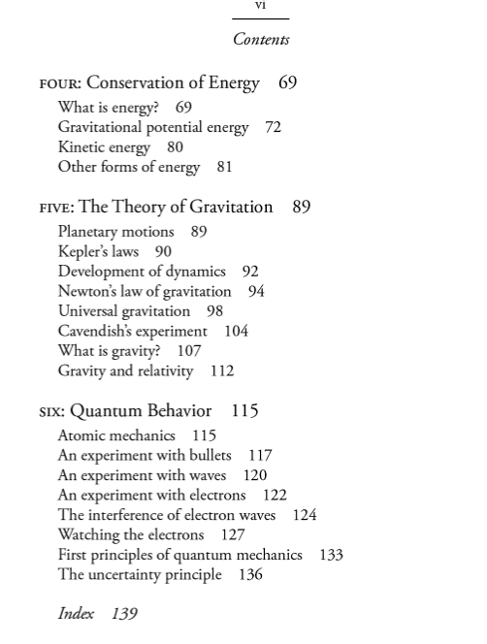
Chap 1. A Dialog on the Book
OSTEP
Operating Systems: Three Easy Pieces
Homage to the Feynman’s famous “Six Easy Pieces on Physics”
OS is about half as hard as Physics: from Six to Three Pieces
(Source: https://www.amazon.com/Six-Easy-Pieces-Essentials-Explained/dp/0465025277)

Slide 4
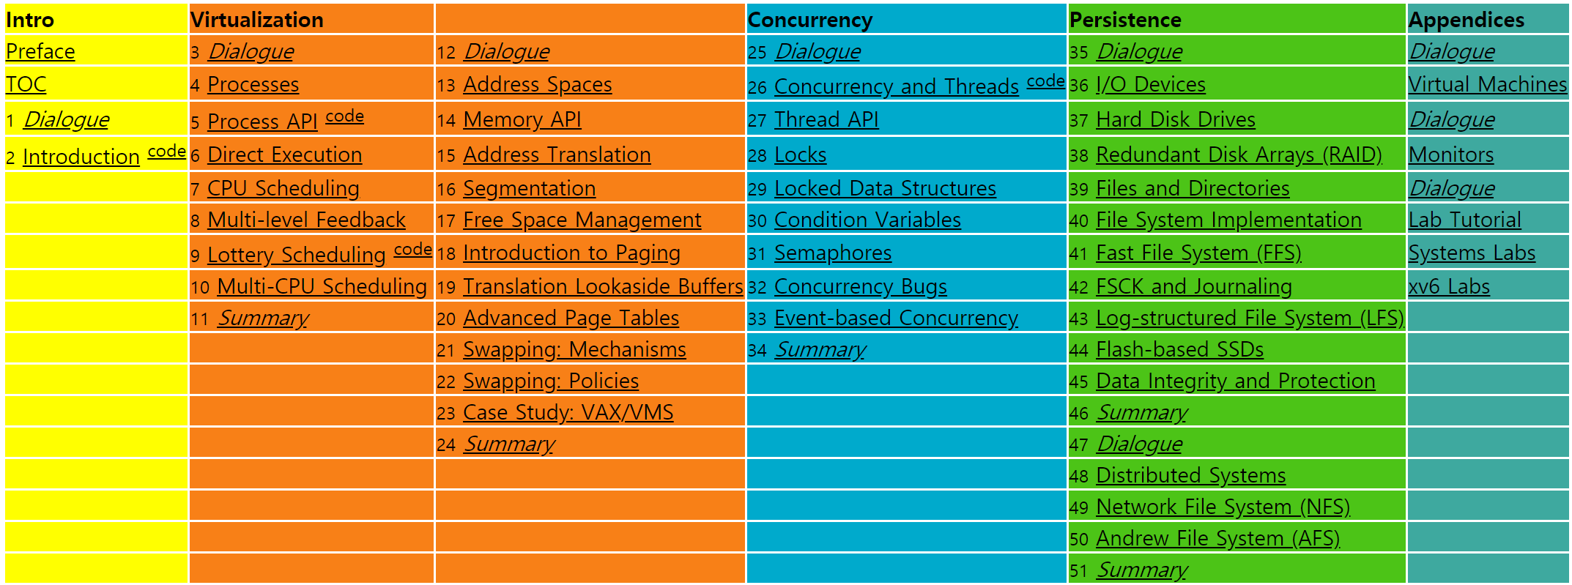
Chap 1. A Dialog on the Book
OSTEP
What are Three Pieces: Virtualization, Concurrency, Persistence
(Source: http://pages.cs.wisc.edu/~remzi/OSTEP/)

Slide 5
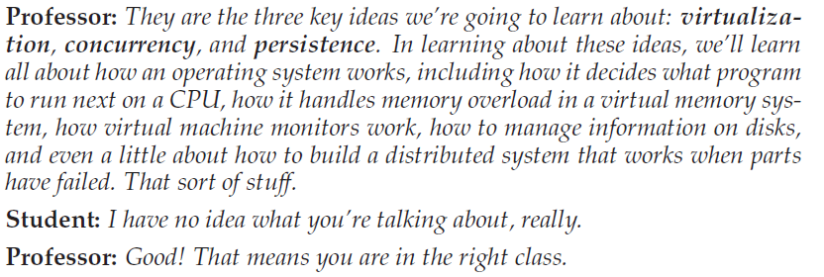
Chap 1. A Dialog on the Book
OSTEP
What to study?
How to study?

Slide 6
Chap 2. Introduction to Operating Systems
2.1 Virtualizing CPU
2.2 Virtualizing Memory
2.3 Concurrency
2.4 Persistence
2.5 Design Goals
2.6 Some history
2.7 Summary
References

Slide 7
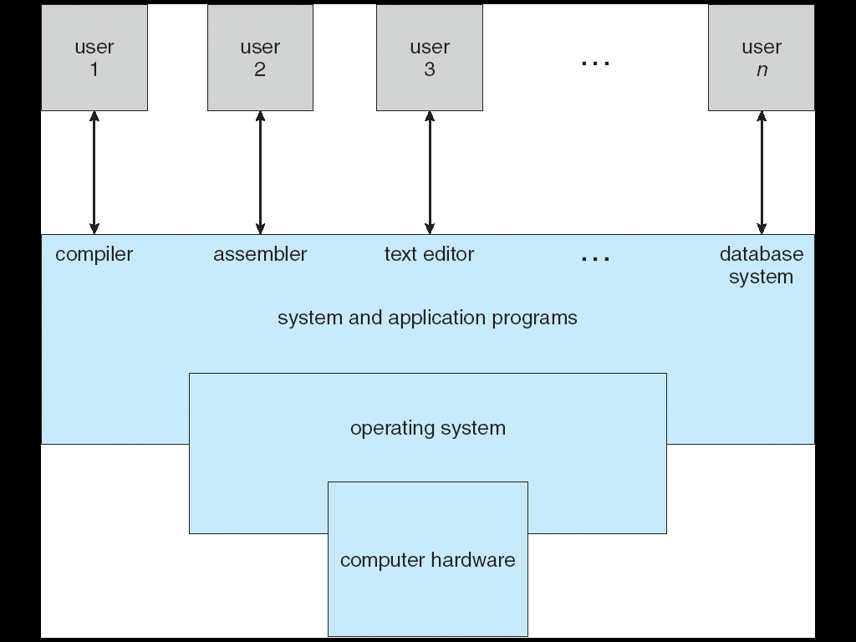
Introduction
Layered structure of a computer system
(Source: A. Silberschatz, “Operating system Concept”)

Slide 8
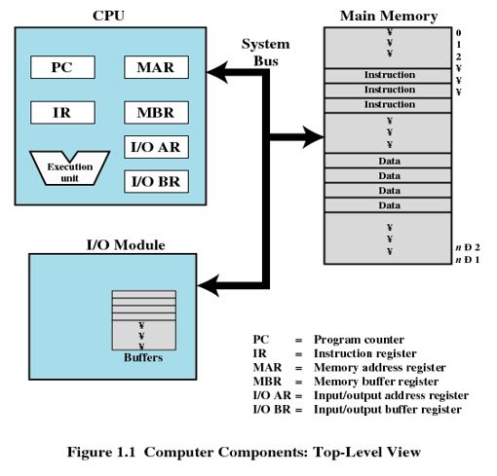
Introduction
What happens when a program runs?
1. Simple view about running a program
(Source: W. Stalling, “Operating Systems: Internals and Design Principles”)

Slide 9
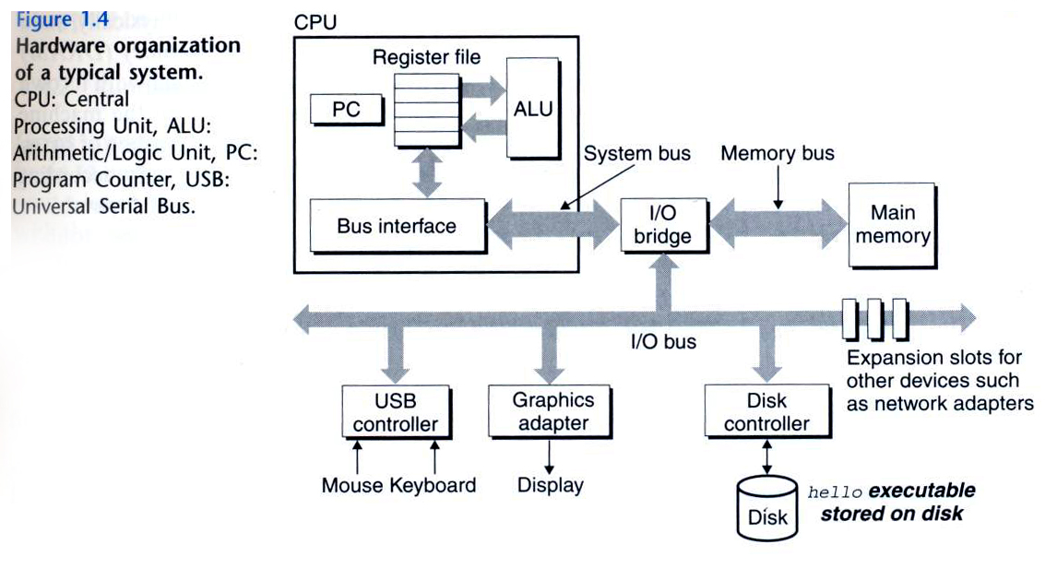
Introduction
What happens when a program runs?
2. A lot of stuff for running a program
Loading, memory management, scheduling, context switching, I/O processing, file management, IPC, …
Operating system: 1) make it easy to run programs, 2) operate a system correctly and efficiently
(Source: computer systems: a programmer perspective)

Slide 10
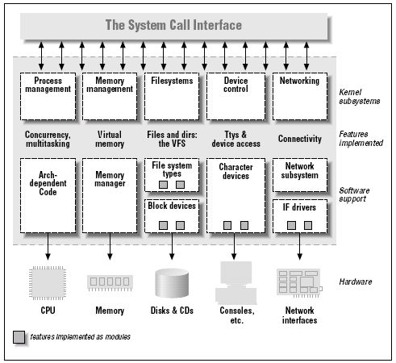
Introduction
Definition of operating system
Resource manager
Physical resources: CPU (core), DRAM, Disk, Flash, KBD, Network, …
Virtual resources: Process, Thread, Virtual memory, Page, File, Directory, Driver, Protocol, Access control, Security, …
Virtualization (Abstraction)
Transform a physical resource into a more general, powerful, and easy-to-use virtual form
(Source: Linux Device Driver, O’Reilly)

Slide 11
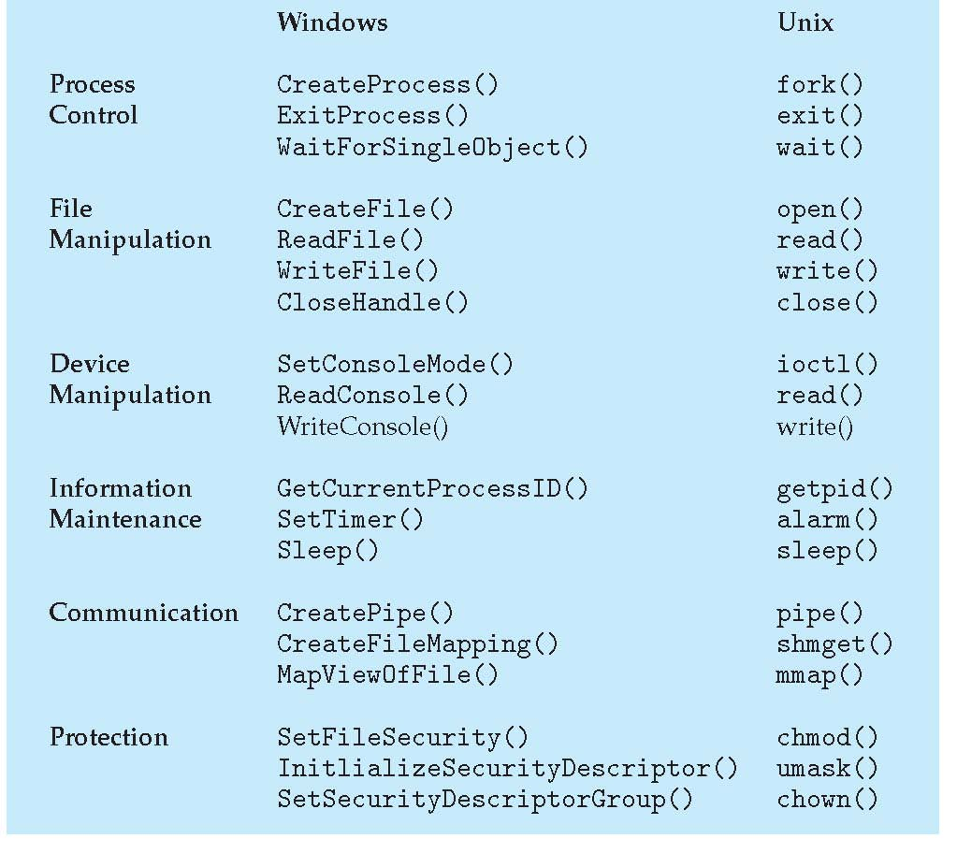
Introduction
System call
Interfaces (APIs) provided by OS
(Source: A. Silberschatz, “Operating system Concept”)

Slide 12
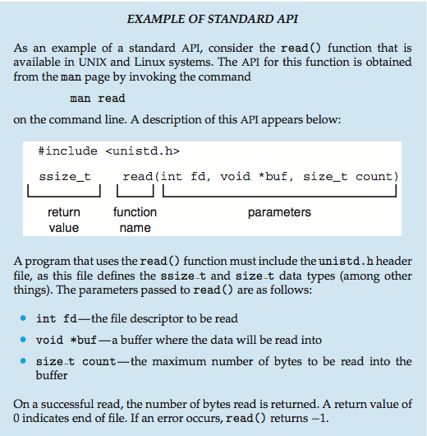
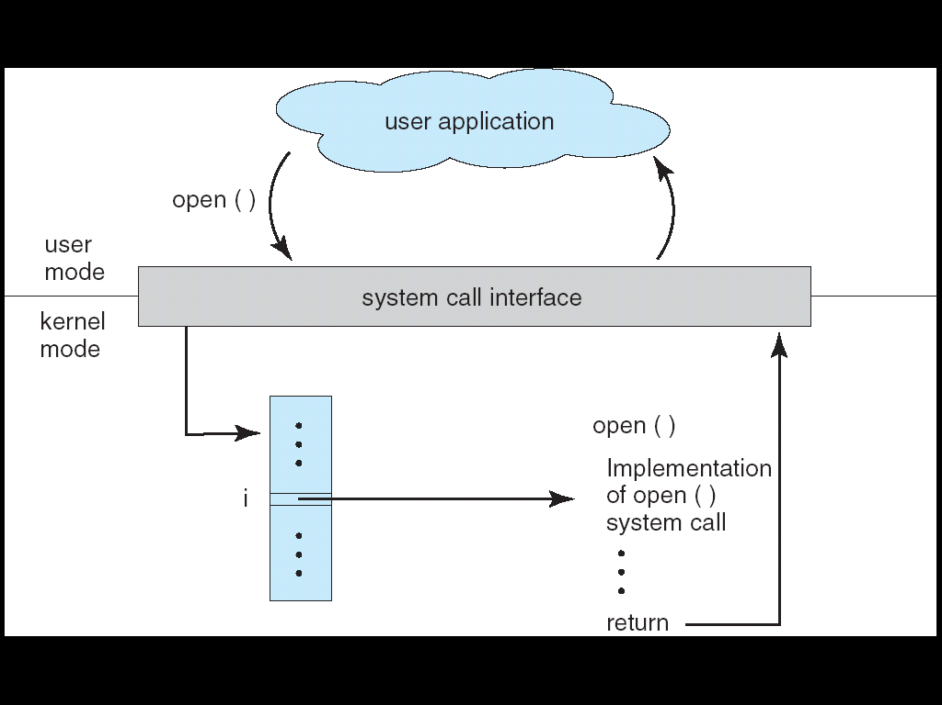
Introduction
System call
Standard (e.g.. POSIX, Win32, …)
Mode switch (user mode, kernel mode)
(Source: A. Silberschatz, “Operating system Concept”)

Slide 13
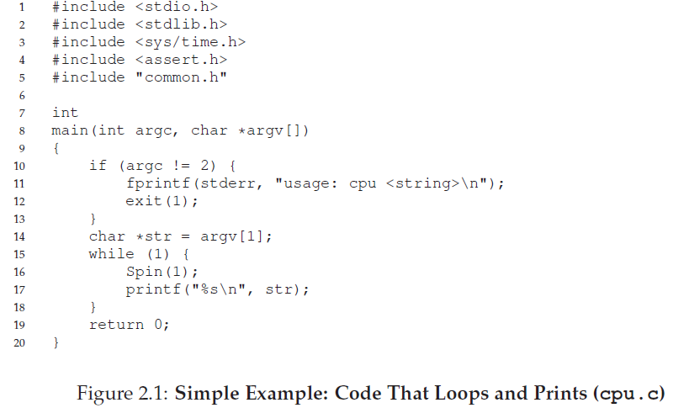
2.1 Virtualizing CPU
A program for the discussion of virtualizing CPU
call Spin (busy waiting and return when it has run for a second)
print out a string passed in on the command line

Slide 14
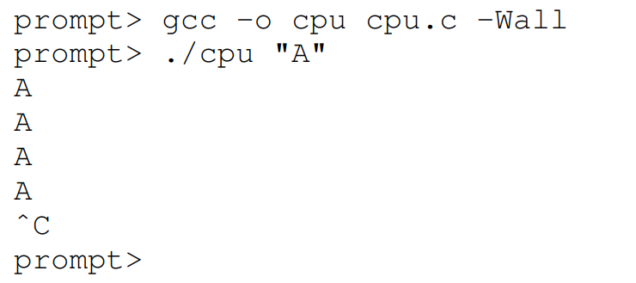
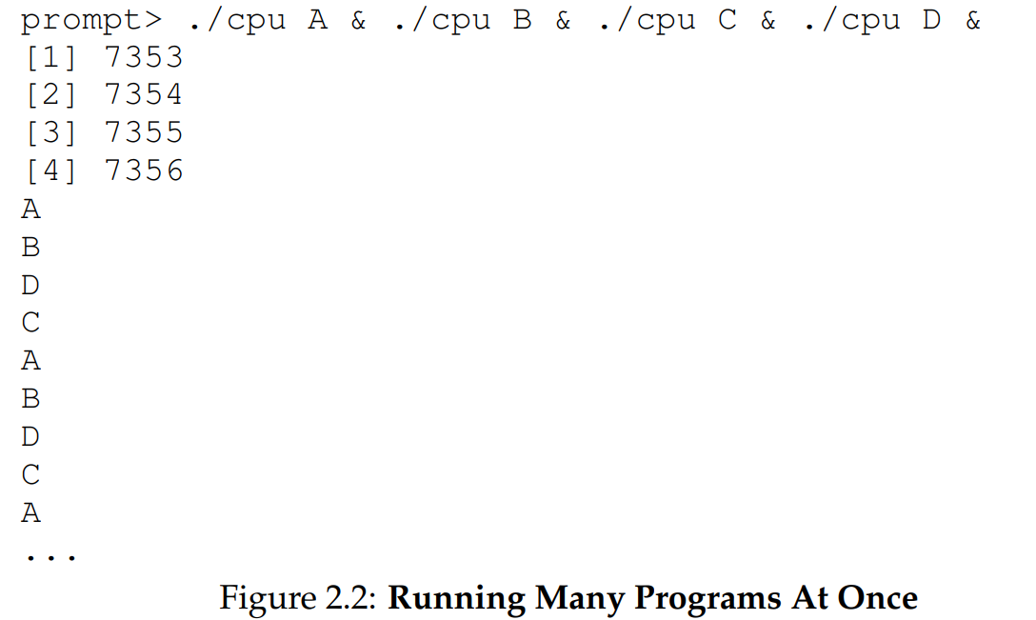
2.1 Virtualizing CPU
Execute the CPU program
Execute the program in parallel
 Process, Scheduling, …
Notes:
gcc –w: disable all warning messages
gcc –Wall: enable all warning messages

Slide 15
2.1 Virtualizing CPU
Issues for Virtualizing CPU
How to run a new program? ➔ process
How to make a new process? ➔ fork()
How to stop a process? ➔ exit()
How to execute a new process? ➔ exec()
How to block a process? ➔ sleep(), pause(), lock(), …
How to select a process to run next? ➔ scheduling
How to run multiple processes? ➔ context switch
How to manage multiple cores (CPUs)? ➔ multi-processor scheduling, cache affinity, load balancing
How to communicate among processes? ➔ IPC (Inter-Process Communication), socket
How to notify an event to a process? ➔ signal (e.g. ^C)
…
 Illusion: A process has its own CPU even though there are less CPUs than processes

Slide 16
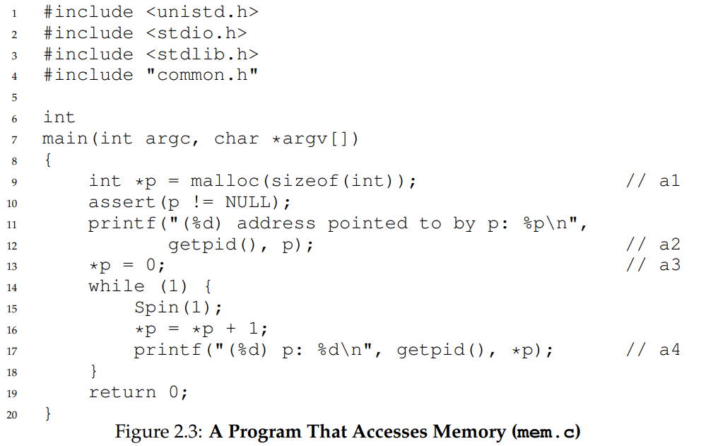
2.2 Virtualizing Memory
Memory
Can be considered as an array of bytes
Another program example
Allocate a portion of memory and access it

Slide 17
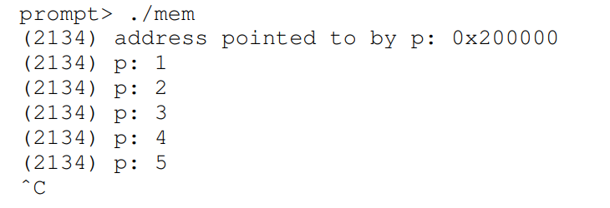
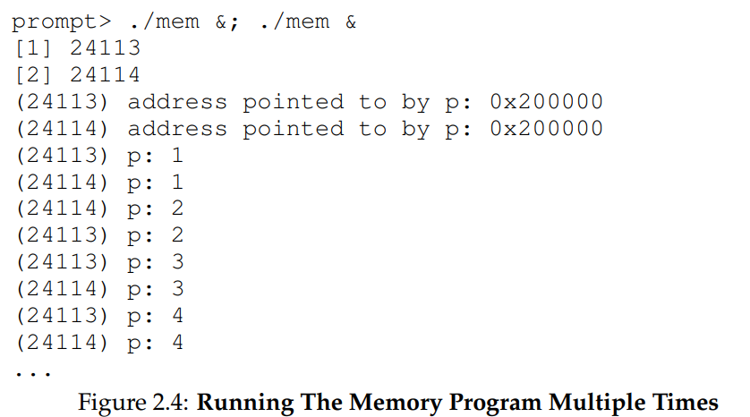
2.2 Virtualizing Memory
Execute the Mem program
Execute the program in parallel
 Same address but independent
Notes:
2134: PID

Slide 18
2.2 Virtualizing Memory
Issues for Virtualizing Memory
How to manage the address space of a process? ➔ text, data, stack, heap, …
How to allocate memory to a process? ➔ malloc(), calloc(), brk(), …
How to deallocate memory from a process? ➔ free()
How to manage free space? ➔ buddy, slab, …
How to protect memory among processes? ➔ virtual memory
How to implement virtual memory? ➔ page, segment
How to reduce the overhead of virtual memory? ➔ TLB
How to share memory among processes? ➔ shared memory
How to exploit memory to hide the storage latency? ➔ page cache, buffer cache, …
How to manage NUMA? ➔ local/remote memory
…
Any questions? Send an email to me: choijm@dankook.ac.kr
Simple question to take attendance: Explain why the title of our main text include “three easy pieces”? (Hint: see page 3 in this slide, until 6 PM, March 19th)
 Illusion: A process has its own unlimited and independent memory even though several processes are sharing limited memory in reality

Slide 19
2.3 Concurrency
Background: how to create a new scheduling entity?
Two programming model: process and thread
Key difference: data sharing
// fork example (Refer to the Chapter 5 in OSTEP)
// by J. Choi (choijm@dku.edu)
#include <stdio.h>
#include <stdlib.h>
int a = 10;
void *func()
{
a++;
printf("pid = %d\n", getpid());
}
int main()
{
int pid;
if ((pid = fork()) == 0) { //need exception handle
func();
exit(0);
}
wait();
printf("a = %d by pid = %d\n", a, getpid());
}
// thread example (Refer to the Chapter 27 in OSTEP)
// by J. Choi (choijm@dku.edu)
#include <stdio.h>
#include <stdlib.h>
int a = 10;
void *func()
{
a++;
printf("pid = %d\n", getpid());
}
int main()
{
int p_thread;
if ((pthread_create(&p_thread, NULL, func, (void *)NULL)) < 0) {
exit(0);
}
pthread_join(p_thread, (void *)NULL);
printf("a = %d by pid = %d\n", a, getpid());
}
(Source: System programming lecture note)

Slide 20
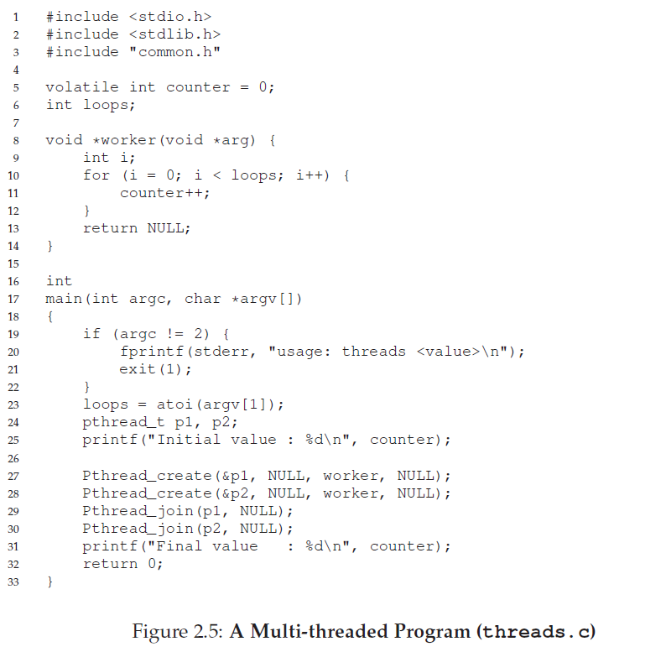
2.3 Concurrency
Concurrency
Problems arise when working on many things simultaneously on the same data
A program for discussing concurrency
Notes:
pthread_create(): pthread library for creating thread
Pthread_create(): the wrapper version of the standard pthread_create() with error handling.
atoi(): 10진 정수 문자열을 정수로 변환

Slide 21
2.3 Concurrency
Execute the multi-thread program
Programing model
thread model: share data section (a.k.a data segment)
process model: independent, need explicit IPC for sharing
Reason for the odd results for the large loop
Lack of atomicity, scheduling effect, … ➔ need concurrency control

Slide 22
2.3 Concurrency
Issues for Concurrency
How to support concurrency correctly? ➔ lock(), semaphore()
How to implement atomicity in hardware? ➔ test_and_set(), swap()
What is the semaphore?
What is the monitor?
How to solve the traditional concurrent problems such as producer-consumer, readers-writers and dining philosophers?
What is a deadlock?
How to deal with the deadlock?
How to handle the timing bug?
What is the asynchronous I/Os?
…
 Illusion: Multiple processes run in a cooperative manner on shared resources even though they actually race with each other on the resources

Slide 23
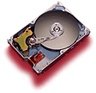
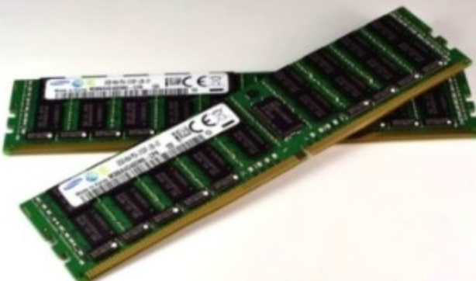
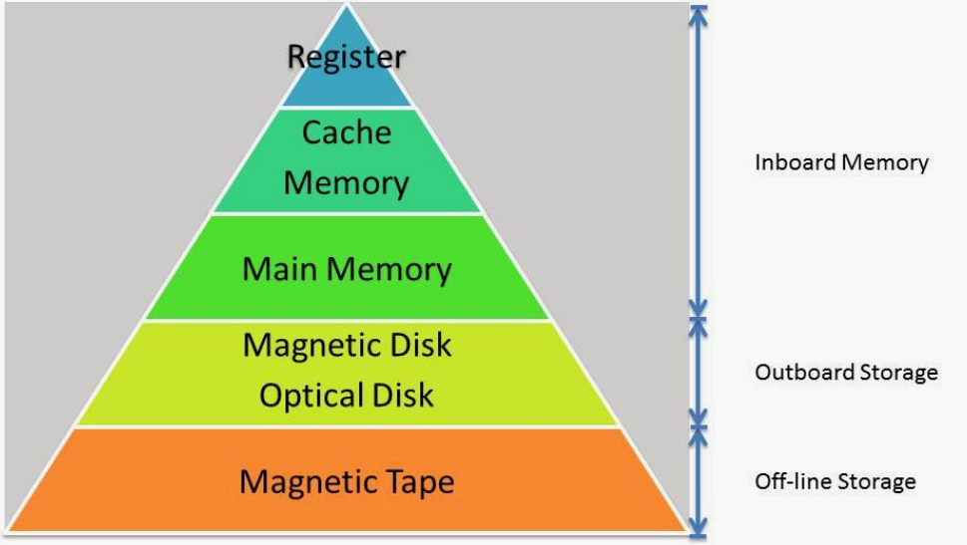
2.4 Persistence
Background: DRAM vs. Disk
VS
Capacity, Speed, Cost, …
Access granularity: Byte vs. Sector
Durability: Volatile vs. Non-volatile
(Source: Google Image)

Slide 24
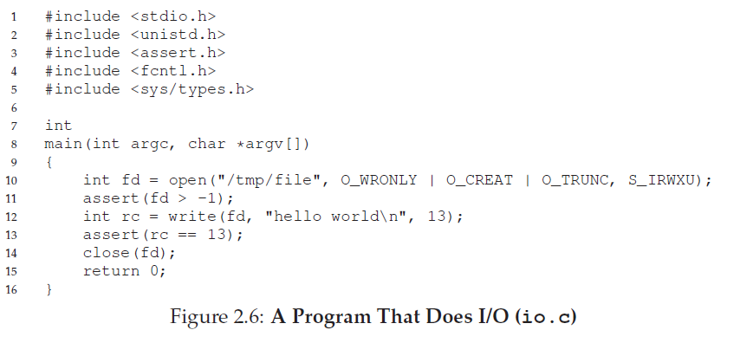
2.4 Persistence
Persistence
Users want to maintain data permanently (durability)
DRAM is volatile, requiring write data into storage (disk, SSD) explicitly
A program for discussing persistence
Use the notion of a file (not handle disk directly)

Slide 25
2.4 Persistence
Issues for Persistence
How to access a file? ➔ open(), read(), write(), …
How to manage a file? ➔ inode, FAT, …
How to manipulate a directory?
How to design a file system? ➔ UFS, LFS, Ext2/3/4, FAT, F2FS, NFS, AFS, …
How to find a data in a disk?
How to improve performance in a file system? ➔ cache, delayed write, …
How to handle a fault in a file system? ➔ journaling, copy-on-write
What is a role of a disk device driver?
What are the internals of a disk and SSD?
What is the RAID?
 Illusion: Data is always maintained in a reliable non-volatile area while it is often kept in a volatile DRAM (for performance reason) and storage is broken from time to time.

Slide 26
2.5 Design Goals
Abstraction
Focusing on relevant issues only while hiding details
E.g. Car, File system, Make a program without thinking of logic gates
“Abstraction is fundamental to everything we do in computer science” by Remzi
Performance
Minimize the overhead of the OS (both time and space)
Protection
Isolate processes from one another
Access control, security, …
Reliability
Fault-tolerant
Others
Depend on the area where OS is employed
Real time, Energy-efficiency, Mobility, Load balancing, Autonomous, …

Slide 27
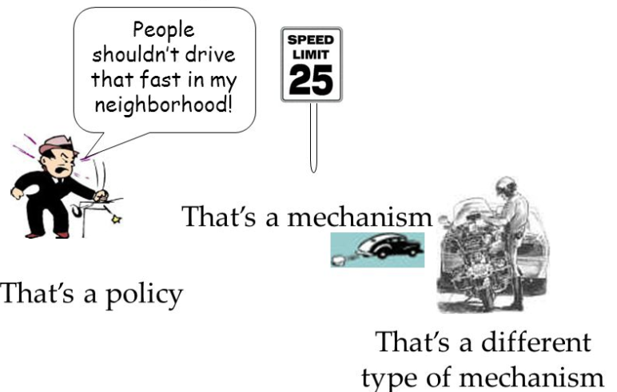
2.5 Design Goals
Separation of Policy and Mechanism
Policy: Which (or What) to do?
e.g.) Which process should run next?
Mechanism: How to do?
e.g.) Multiple processes are managed by a scheduling queue or RB-tree
(Source: Security Principles and Policies CS 236 On-Line MS Program Networks and Systems Security, Peter Reiher, Spring, 2008)

Slide 28
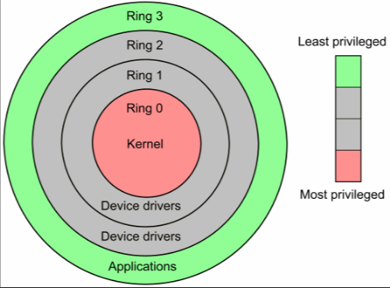
2.6 Some History
Early Operating Systems: Just libraries
Commonly-used functions such as low-level I/Os (e.g. MS-DOS)
Batch processing
a number of jobs were set up and then run all together (Not interactive)
Beyond Libraries: Protection
Require OS to be treated differently than user applications
Separation user/kernel mode, system call
Use trap (special hardware instruction) to switch into the kernel mode
Transfer control to a pre-specific trap handler (system_call handler)
(Source: Google Image)
(Source: A. Silberschatz, “Operating system Concept”)
Notes:
MS-DOS: Microsoft Disk Operating System

Slide 29
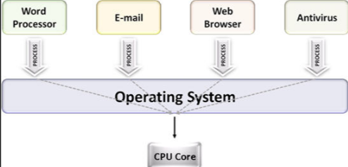
2.6 Some History
The Era of Multiprogramming (c.f. multitasking)
Definition: OS load a number of applications into memory and switch them rapidly
Reason: Advanced hardware ➔ Want to utilize machine resources better ➔ Multiple users share a system (workstation, minicomputer) ➔ multiprogramming
Especially important due to the slow I/O devices ➔ while doing I/O, switch CPU to another process ➔ enhancing CPU utilization
Memory protection and concurrency become quite important ➔ UNIX
(Source: Google Image)
Notes:
MS-DOS: Microsoft Disk Operating System

Slide 30
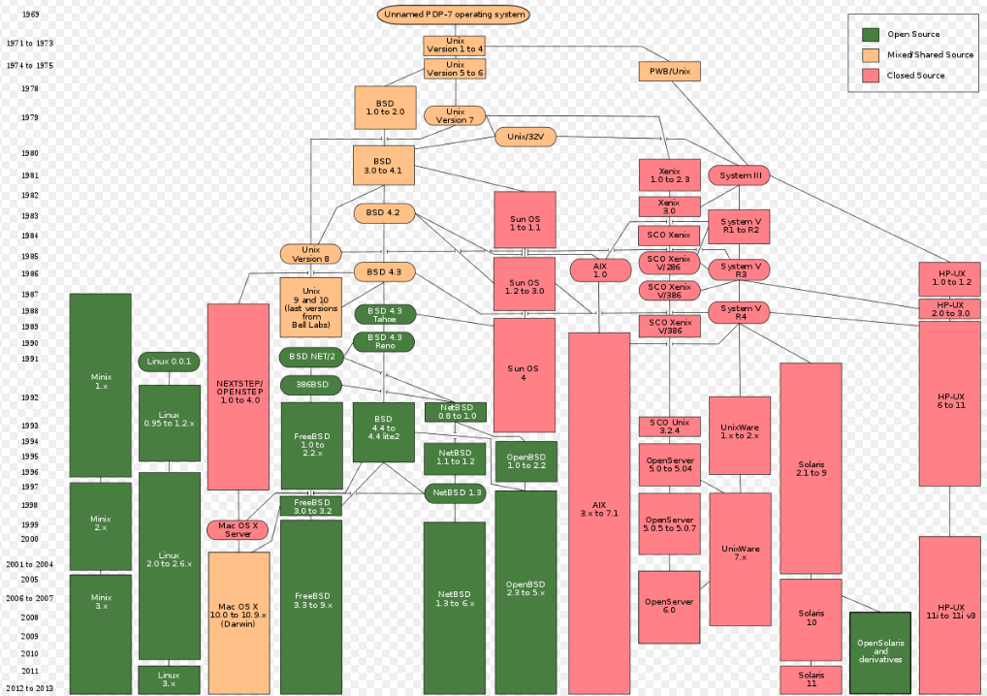
2.6 Some History
The Era of Multiprogramming (c.f. multitasking)
UNIX
By Ken Thompson and Dennis Ritche (Bell Labs), Influenced by Multics
C language based, excellent features such as shell, pipe, inode, small, everything is a file, …
Influence OSes such as BSD, SUNOS, AIX, HPUX, Nextstep and Linux
(Source: Wikipedia)
Notes:
MS-DOS: Microsoft Disk Operating System

Slide 31
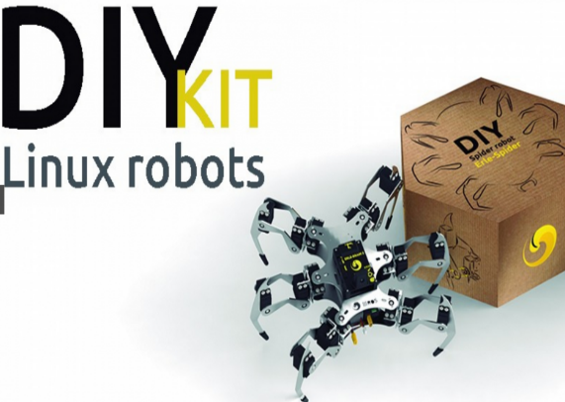
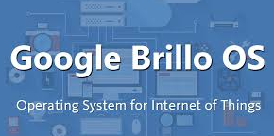
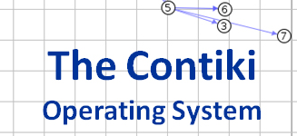
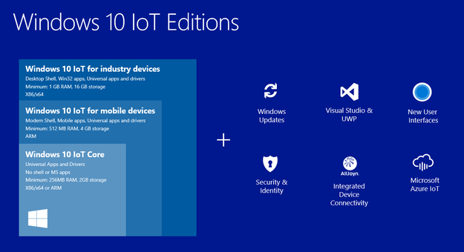
2.6 Some History
The Modern Era
PC
MS Windows, Mac OS X, Linux, …
Smartphone
Android, iOS, Windows Mobile, …
IoT
What is the next?
Notes:
MS-DOS: Microsoft Disk Operating System

Slide 32
2.7 Summary
OS
Resource manager (Efficiency)
Make systems easy to use (Convenience)
Cover in this book
Virtualization, Concurrency, Persistence
Not being covered
Network, Security, Graphics
There are several excellent courses for them
Homework 1: summarize the chap 2 of the OSTEP
Requirement: 1) personal, 2) 3~5 pages for summary, 3) 1 page for the goal you want to study
Due: until the same day of the next week
Bonus: Snapshot of the results of example programs in a Linux system
Any questions? Send an email to me: choijm@dankook.ac.kr
Simple question to take attendance: Explain the differences between interrupt and trap which was discussed in page 28 (until 6 PM, March 24th)

Slide 33
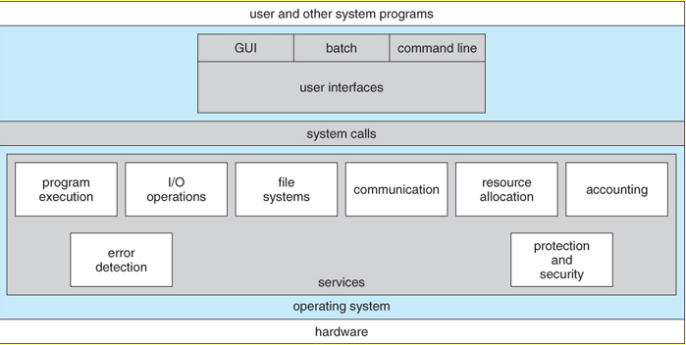
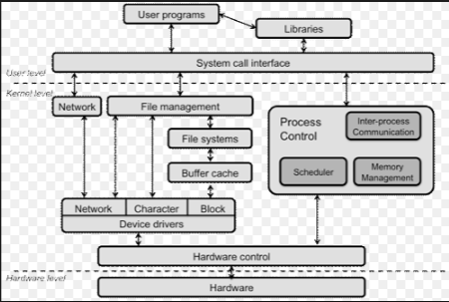
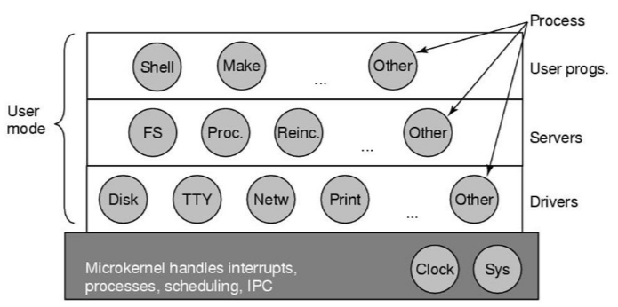
Appendix
OS structure in General
(Source: Operating System Concepts)
(Source: https://www.cs.rutgers.edu/~pxk/416/notes/03-concepts.html)
(Source: Linux Device Driver)
(Source: Modern Operating System)
Notes:
3개의 piece 이름은?
왜 3개인가?
공자의 말은?

Slide 34
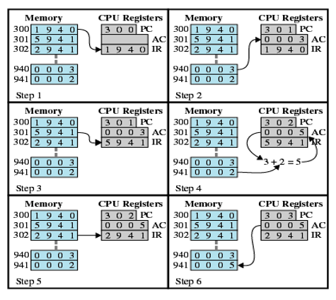
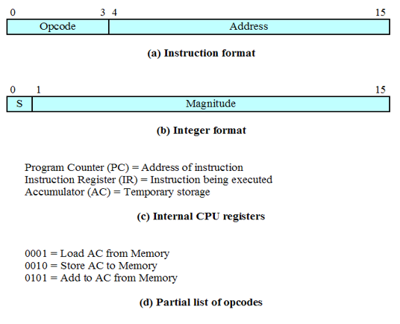
Appendix
What happens when a program runs?
Details: execute instructions
Fetch and Execute
<Instruction cycle>
<Hypothetical machine>
<Run example>
(Source: W. Stalling, “Operating Systems: Internals and Design Principles”)
Notes:
EAX: extended accumulator register

