Slide 1
Lecture Note 2: Processes
March 11, 2020
Jongmoo Choi
Dept. of software
Dankook University
http://embedded.dankook.ac.kr/~choijm
(This slide is made by Jongmoo Choi. Please let him know when you want to distribute this slide)

Slide 2
Contents
From Chap 3~6 of the OSTEP
Chap 3. A Dialogue on Virtualization
Chap 4. The abstraction: The Process
Process, Process API, Process States and Data Structure
Chap 5. Interlude: Process API
System calls: fork(), wait(), exec(), kill() , …
Chap 6. Mechanism: Limited Direct Execution
Basic Technique: Limited Direct Execution
Switch between Modes
Switch between Processes

Slide 3
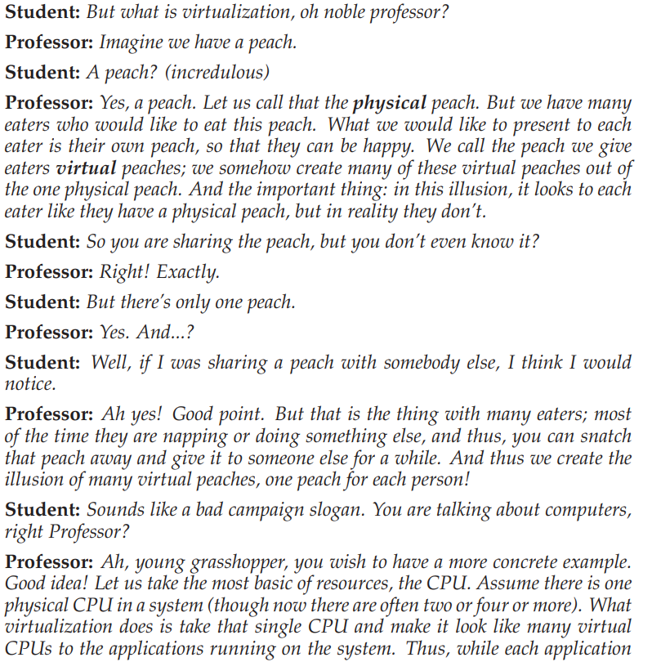
Chap 3. A Dialogue on Virtualization
Virtualization
…

Slide 4
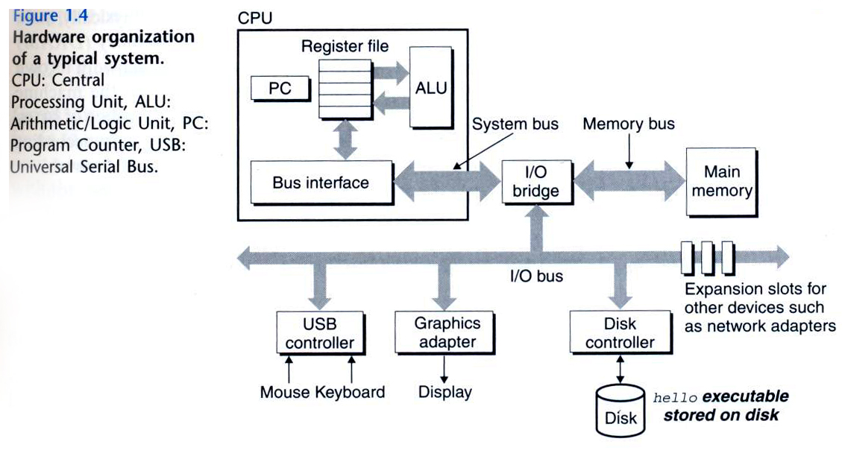
Chap 4. The Abstraction: The Process
Process definition
A running program, scheduling entity
c.f.) program: a lifeless thing, sit on the disk and waiting to spring into action
Run on memory and CPU
There exist multiple processes (e.g. browser, editor, player, and so on)
Each process has its own memory (address space), virtual CPU, state, …
Process (task)
program
(Source: computer systems: a programmer perspective)

Slide 5
Chap 4. The Abstraction: The Process
How to virtualize CPU? Time sharing on multiple processes
Mechanism
context switch: an ability to stop running one program and start running another on a given CPU
Policy
scheduling policy: based on historical information or workload knowledge or performance metric.
CPU1
 Time sharing vs. Space sharing

Slide 6
4.1 Process
Process structure
Need resources to run:
CPU
Registers such as PC, SP, ..
Memory (address space)
Text: program codes
Data: global variables
Stack: local variables, parameters, …
Heap: allocated dynamically
I/O information
Opened files (including devices)
cf.) program
Passive entity
A file containing instructions stored on disk (executable file or binary)
Execute a program twice ➔ result in creating two processes (from one program) ➔ text is equivalent while others (data, stack) vary (1-to-n)
(Source: A. Silberschatz, “Operating system Concept”)

Slide 7
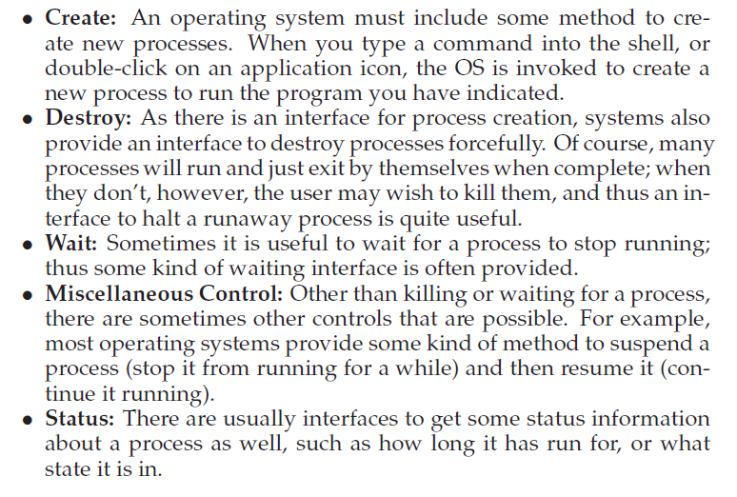
4.2 Process API
Basic APIs for a process
 Refer to chapter 5 in OSTEP

Slide 8
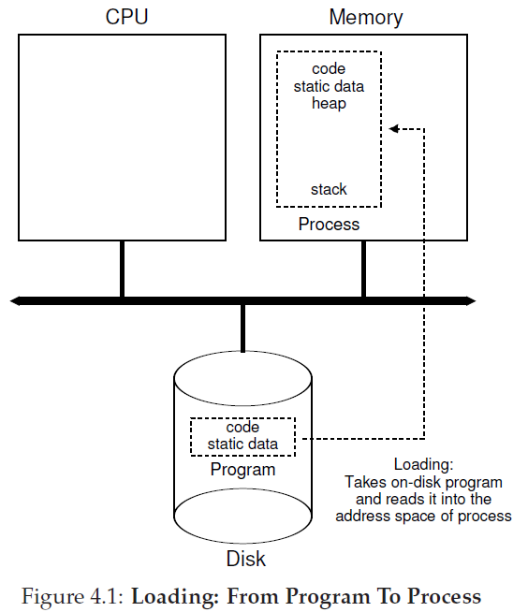
4.3 Process Creation: A Little More Detail
How to start a program
Load
Bring code and static data into the address space
Based on executable format (e.g. ELF, PE, BSD, …)
Eagerly vs. Lazily (paging, swapping)
Dynamic allocation
Stack
Initialize parameters (argc, argv)
Heap if necessary
Initialization
file descriptors (0, 1, 2)
I/O or signal related structure
Jump to the entry point: main()

Slide 9
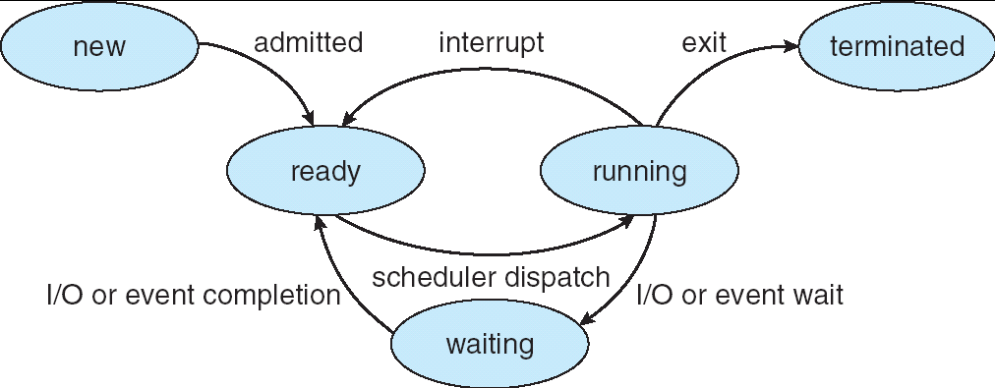
4.4 Process States
State and transition
State
new(created, embryo), ready, running, waiting(blocked), terminated (zombie)
Transition
admitted, dispatch (schedule), timeout (preemptive, descheduled), wait (sleep, I/O initiate), wakeup (I/O done), exit
suspend and resume: to Disk (swap) or to RAM
timeout
dispatch
(Source: A. Silberschatz, “Operating system Concept”)

Slide 10
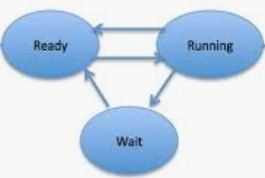
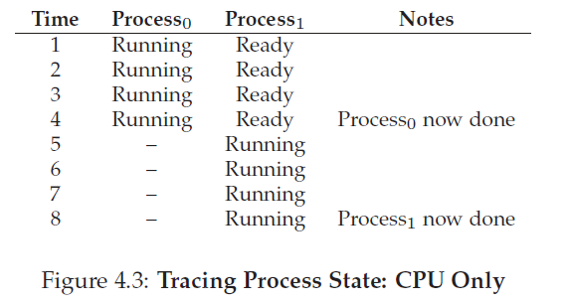
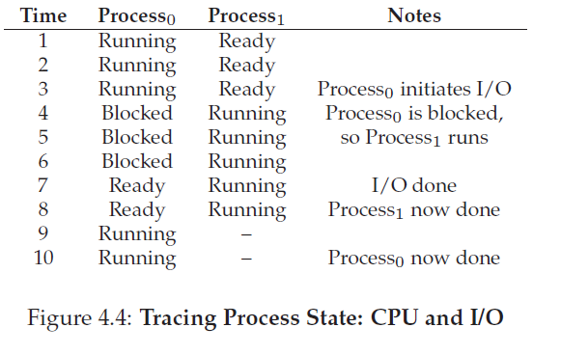
4.4 Process States
Example
Used resources: CPU only ➔ Figure 4.3
Used resources: CPU and I/O ➔ Figure 4.4
Note: I/O usually takes quite longer than CPU
 At the end of time 6 in Figure 4.4, OS can decide to 1) continue running the process1 or 2) switch back to process 0. Which one is better? Discuss tradeoff.

Slide 11
4.5 Data Structure
PCB (Process Control Block)
Information associated with each process
Process state
Process ID (pid)
Program counter, CPU registers
Used during context switch
Architecture dependent
CPU scheduling information
Memory-management information
Opened files
I/O status information
Accounting information
Managed in the kernel’s data segment
(Source: A. Silberschatz, “Operating system Concept”)

Slide 12
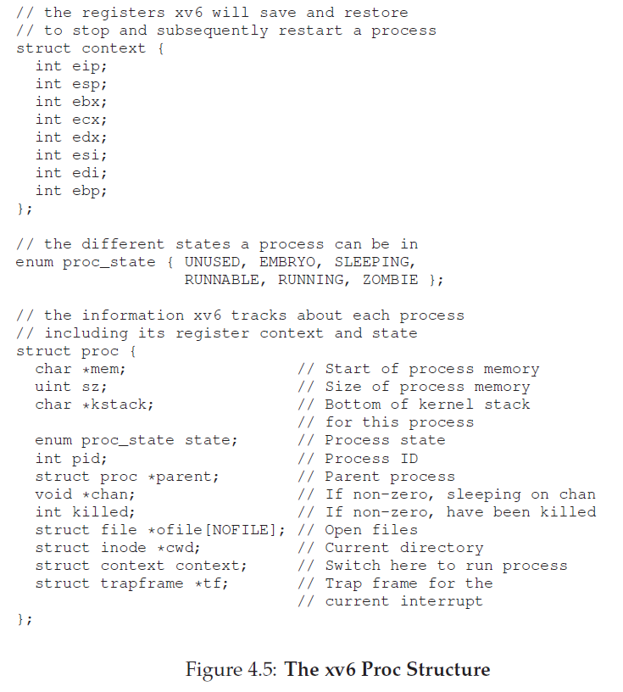
4.5 Data Structure
Implementation example
OS is a program, implementing a process using data structure (e.g. struct proc and struct context)
All “proc” structures are manipulated using a list

Slide 13
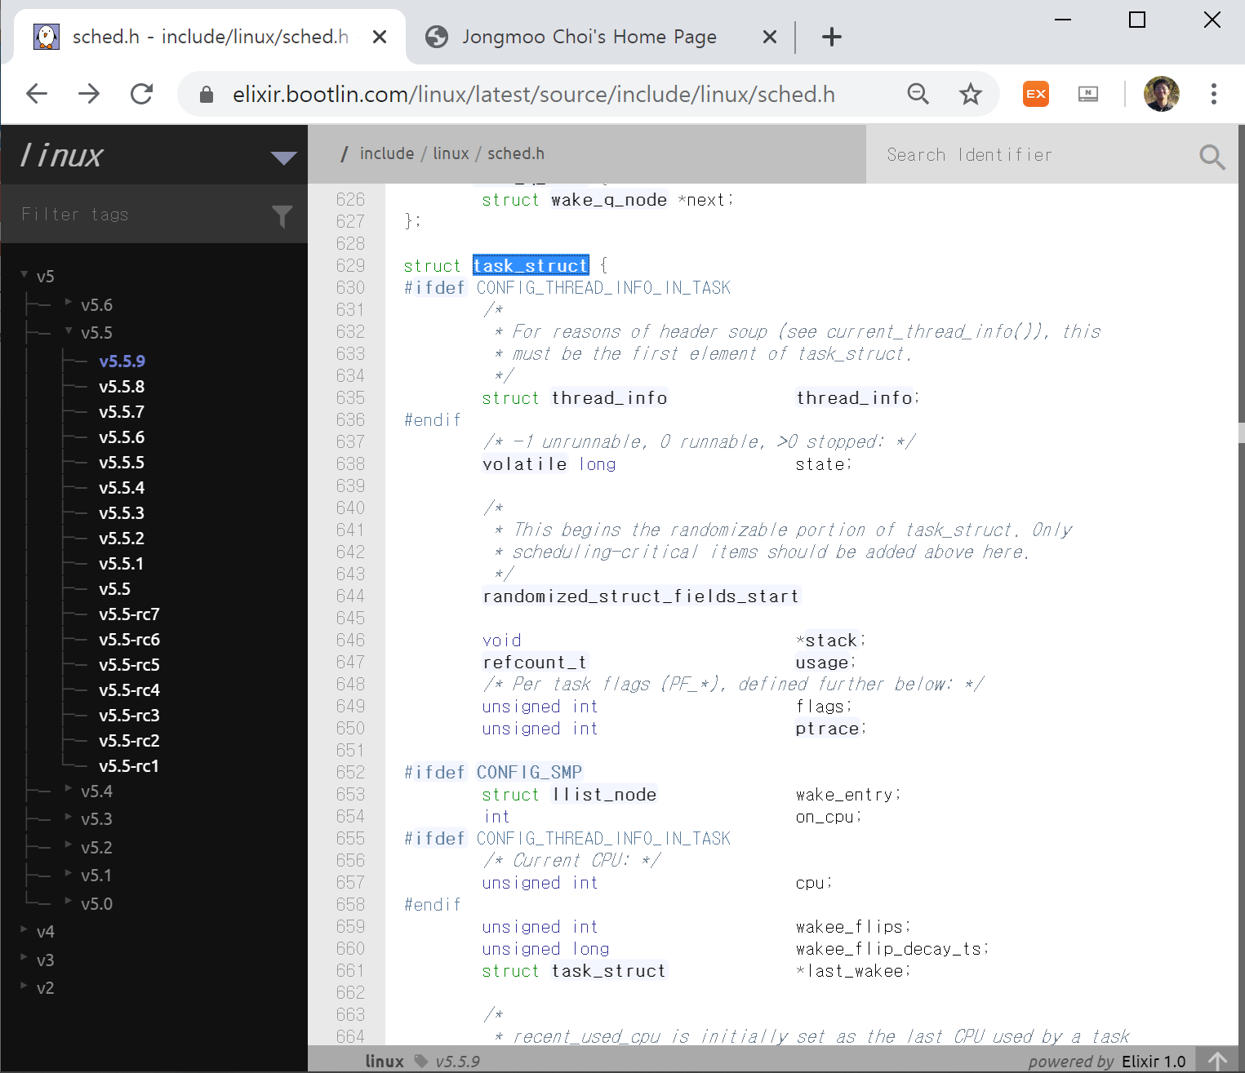
4.5 Data Structure (Optional)
PCB in real OS (task structure in Linux)
<https://elixir.bootlin.com/linux/latest/source/include/linux/sched.h >

Slide 14
4.5 Data Structure (Optional)
PCB in real OS (task structure in Linux)
rlim
task_struct
mm_struct
vm_area_struct
fd
pid
mm
files
signals
sem
thread
name
…
vm_end
files_struct
map_count
vm_start
pgd
vm_flag
…
fs_struct
vm_file
vm_offset
vm_ops
vm_next
text
mode
link
time
…
direct
indirect
signal_struct
mmap
sem_list
inode
thread_struct
vm_area_struct
vm_end
data
eip
eflags
eax
ebx
…
esp
ss
…
sched_entity
31 11 0
vm_start
vm_flag
…
:
PFN
vm_file
vm_offset
vm_ops
vm_next
:
stack
page directory
thread
a.out
CPU
(Source: 리눅스 커널 내부구조)

Slide 15
Chap 5. Interlude: Process API
Comments for Interlude by Remzi
Notes:
Interlude: cover more practical aspect

Slide 16
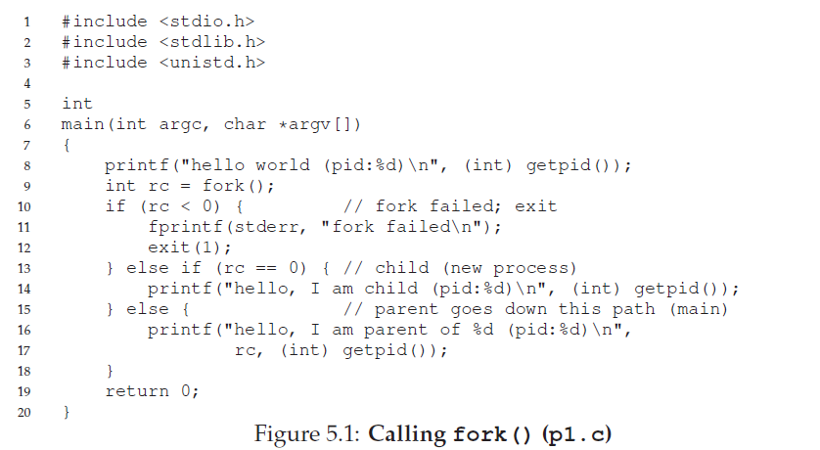
5.1 fork() system call
fork()
Create a new process: parent, child
Return two values: one for parent and the other for child
Non-determinism: not decide which one run first.

Slide 17
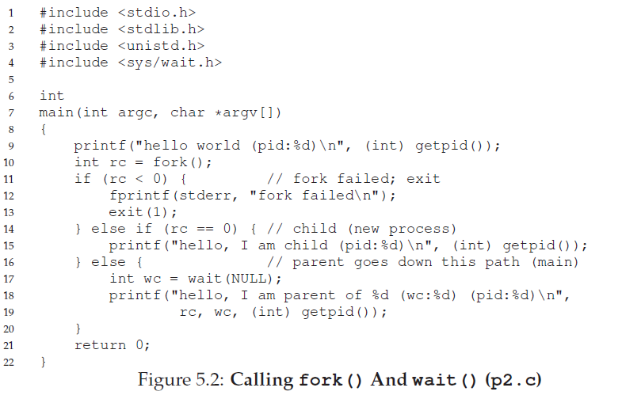
5.2 wait() system call
wait()
Block a calling process until one of its children finishes
Now, deterministic ➔ synchronization

Slide 18
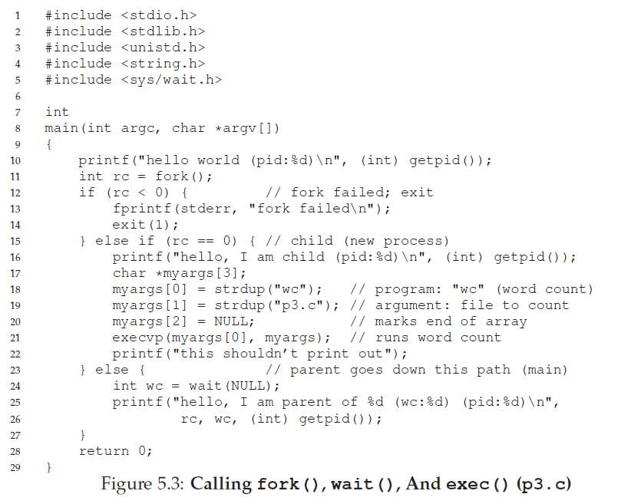
5.3 exec() system call
exec()
Load and overwrite code and static data, re-initialize stack and heap, and execute it (never return) ➔ refer to 8 page
6 variations: execl, execlp, execle, execv, execvp, execve
 Comments from Remzi: Do it on a Linux system. “Type in the code and run it is better for understanding”
Notes:
strdup(): duplicate a string, returns a pointer to a new string which is a duplicate of the string s.
alloca(): The alloca() function allocates size bytes of space in the stack frame of the caller. This temporary space is automatically freed when the function that called alloca() returns to its caller.

Slide 19
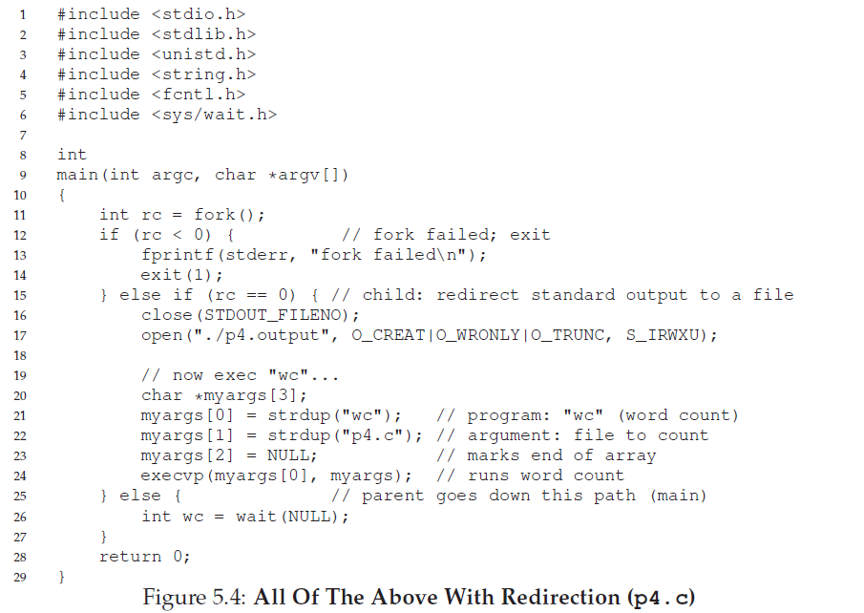
5.4 Why? Motivating the API (optional)
Why separate fork() from exec()?
Modular approach of UNIX (especially for shell)
Notes:
- cf: system()

Slide 20
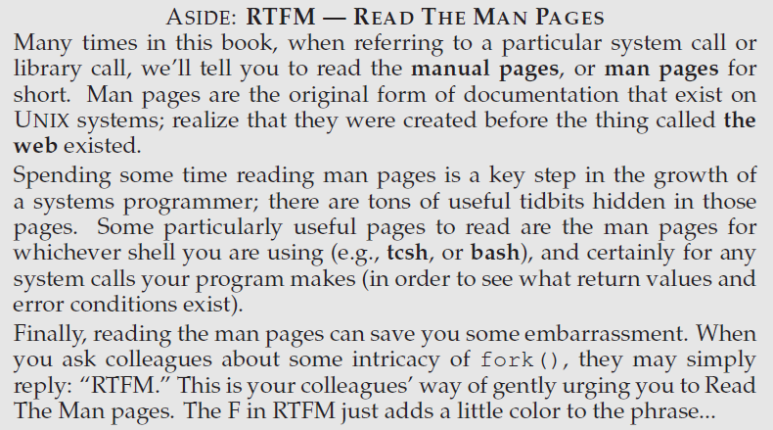
5.5 Other parts of the API
Other APIs
getpid(): get process id
kill(): send a signal to a process
signal(): register a signal catch function
scheduling related
…
Command and tool
ps, top, perf, …
read the man pages for commands and tools
Any questions? Send an email to me: choijm@dankook.ac.kr
Simple question to take attendance: Explain which process you prefer to schedule when there are two processes, browser and synchronizer (backup apps) in page 5 (until 6 PM, March 26th)
Interactive Q&A announcement
- March 31th(Tuesday) at class time (10:30 am for Section 2, 2:30 pm for Section 3)
- Zoom Meeting ID: 240-964-9989
Notes:
Ps: Process Status
top allows you display of process statistics continuously until stopped vs. ps which gives you a single snapshot.

Slide 21
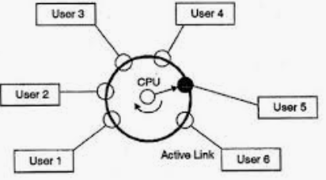
Chap 6. Mechanism: Limited Direct Execution
Time sharing
Key technique for virtualizing CPU
Issues
Performance: how to minimize the virtualization overhead?
Control: how to run processes while retaining control over the CPU?
(Source: Google image. Users can be replaced with programs or processes)

Slide 22
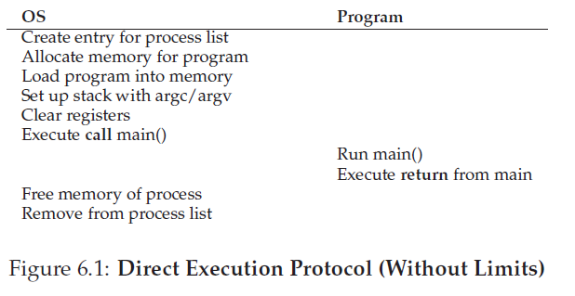
6.1 Basic Technique: Limited Direct Execution
Performance-oriented ➔ Direct execution
Run the program directly on the CPU
Efficient but not controllable
 See 8 page in LN2
 Control is particularly important to OS. Without control, a process could run forever, monopolizing resources.

Slide 23
6.2 Problem #1: Restricted Operation
Control mechanism 1: Restrict operations
Operations that should run indirectly (in a privileged mode)
Gain more system resources such as CPU and memory
Issue an I/O request directly to a disk
Through a well defined APIs (system call)
E.g.) fork(), nice(), malloc(), open(), read(), write(), …
Mechanism: User mode vs. Kernel mode
User mode: do privileged operation ➔ cause exception and killed
Kernel mode: do privileged operation ➔ allowed
Mode switch: using trap instruction, two stacks (user and kernel stack)
(Source: A. Silberschatz, “Operating system Concept”)
Notes:
도서관 비유
책을 꺼내서 읽고 돌려 두는 것은 direct execution
대출하거나 공간을 예약하는 것은 사서를 통해 ➔ restricted operations

Slide 24
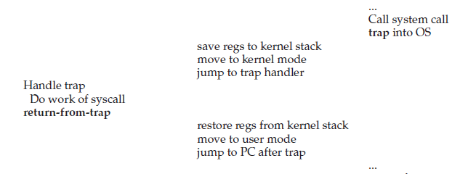
6.2 Problem #1: Restricted Operation
0
1
2
..
80
divide_by_zero()
How to handle trap in OS?
Using trap table (a.k.a interrupt vector table)
Trap table consists of a set of trap handlers
Trap (interrupt) handler: a routine that deals with a trap in OS
system call handler, div_by_zero handler, segment fault handler, page fault handler, and hardware interrupt hander (disk, KBD, timer, …)
Initialized at boot time
E.g.: System call processing
System call (e.g. fork()) ➔ trap ➔ save context and switch stack ➔ jump to the trap handler ➔ eventually in kernel mode
Return from system call ➔ switch stack and restore context ➔ jump to the next instruction of the system call ➔ user mode
page_fault()
segment_fault()
…
system_call()
trap table

Slide 25
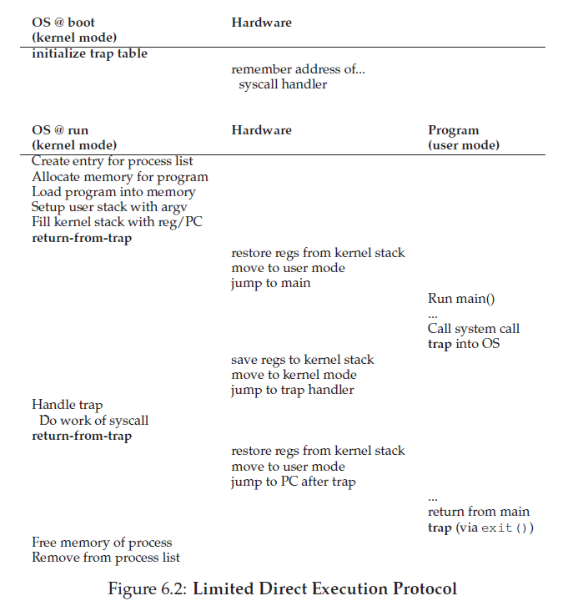
6.2 Problem #1: Restricted Operation
Global view
Initialize
(Boot)
Process
create
Trap
(syscall)
Process
destroy

Slide 26
6.2 Problem #1: Restricted Operation (optional)
System call Implementation: Linux case study
Kernel
user task
ENTRY(system_call) /* arch/i386/kernel/entry.S */
SAVE_ALL
….
call *SYMBOL_NAME(sys_call_table)(,%eax,4)
….
ret_from_sys_call (schedule, signal, bh_active,
nested interrupt handling)
main()
{
….
fork();
}
Trap Table
(IVT, IDT)
0x0
divide_error()
debug()
nmi()
….
libc.a
….
fork()
{
….
movl 2, %eax
int $0x80
….
}
….
sys_call_table
sys_exit()
sys_fork()
sys_read ()
sys_write ()
….
1
0x80
system_call()
….
2
sys_fork()
/* arch/i386/kernel/process.c */
/* kernel/fork.c */
3
4
(Source: 리눅스 커널 내부구조, 6장 )
 Note: This mechanism is a little different in 64bit CPU, but the concept is the same

Slide 27
6.3 Problem #2: Switching between Processes
Control mechanism 2: Context switch with Timer interrupt
Time sharing: Process A ➔ Process B ➔ Process A ➔ ….
By the way, how can OS regain control of the CPU so that it can switch between processes?
Two approach
A cooperative approach: exploiting system calls
Processes use a system call ➔ control transfer to OS ➔ do scheduling (and switching)
A process causes exception (e.g. page fault or divide by zero ) ➔ transfer control to OS
A process that seldom uses a system call ➔ invoke an yield() system call explicitly
No method for a process that does an infinite loop
A Non-cooperative approach: using timer interrupt
Notes:
도서관 비유 (again)
책을 꺼내서 읽고 돌려 두는 것은 계속하는데, 대출이나 예약은 안함 ➔ 사서를 만나지 않음
이 상황에서 사서는 어떻게 제어를 획득? ➔ 문닫을 시간 (timer)

Slide 28
6.3 Problem #2: Switching between Processes
A Non-cooperative approach: using timer interrupt
Interrupt: a mechanism that a device notify an event to OS
Interrupt happens ➔ current running process is halted ➔ a related interrupt hander is invoked via interrupt table ➔ transfer control to OS
Timer interrupt (like a heart in human)
A timer device raises an interrupt every milliseconds (programmable) ➔ a timer interrupt handler ➔ do scheduling (and switching) if necessary
Context switch
Context: information of a process needed when it is re-scheduled later ➔ hardware registers
Context save and restore
E.g. 1) Process A ➔ Process B: save the context of the process A and restore the context of process B. 2) later Process B ➔ Process A: save the context of the process B and restore the saved context of process A
Where to save: proc structure in general

Slide 29
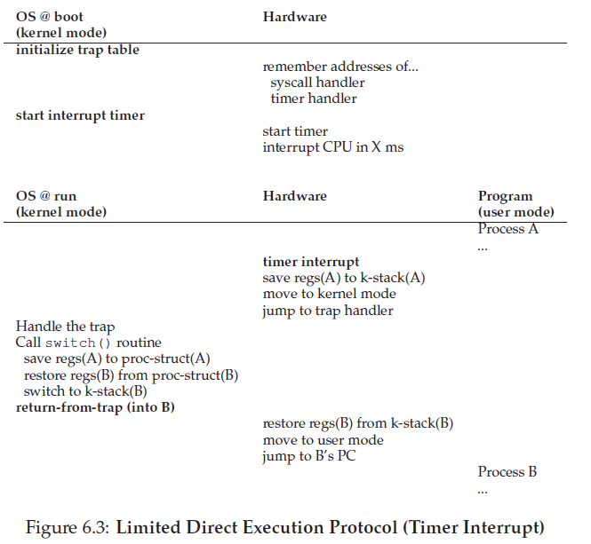
6.3 Problem #2: Switching between Processes
Context switch: global view
Initialize
(Boot)
Interrupt
(timer)
Scheduling
and Context Switch
Return from
Interrupt

Slide 30
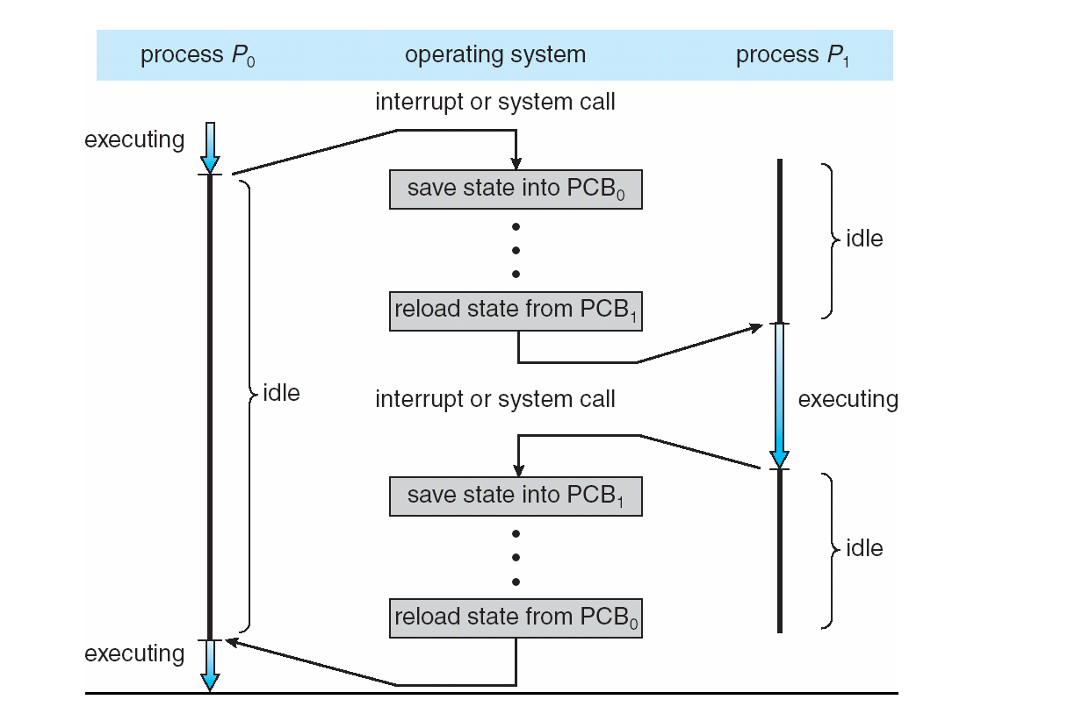
6.3 Problem #2: Switching between Processes
Context switch
Memorize the last state of a process when it is preempted
Context save (state save): storing CPU registers into PCB (in memory)
Context restore (state restore): loading PCB into CPU registers
Context-switch time is overhead (the system does no useful work while switching) ➔ utilizing hardware support (hyper-threading)
(Source: A. Silberschatz, “Operating system Concept”)
Notes:
책에 비유
읽다가 중단하면 무엇을 기억? 다음에 읽을 페이지
프로그램에서는? 다음에 수행할 명령어 ➔PC 등의 레지스터

Slide 31
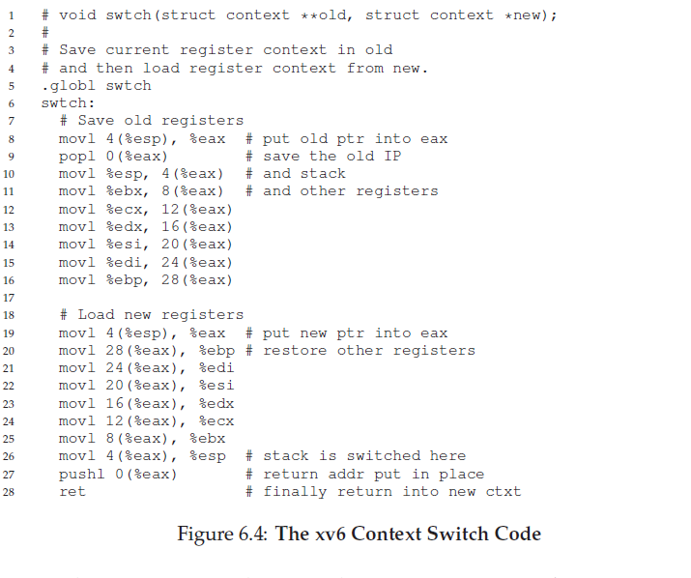
6.3 Problem #2: Switching between Processes
Context switch: pseudo code
Notes:
Indeed, context save is the sequence of saving CPU registers

Slide 32
6.4 Worried about concurrency?
Some issues
What happens when you are handling one interrupt and another one occurs?
What happen when, during a system call, a timer interrupt occurs?
Some solutions
Disable interrupt (note: disable interrupt too long is dangerous)
Priority
Locking mechanism
➔ actually Concurrency issue

Slide 33
Summary
Process (Chapter 4)
Process definition
Process state
Process management (PCB, struct proc, struct task)
Process manipulation (Chapter 5)
fork(), wait(), exec(), kill() , …
Mechanism (Chapter 6)
Limited Direct Execution: 1) Mode switch, 2) Context switch
Performance: system call ➔ 4 us, context switch ➔ 6 us on P6 CPU
Suggestion:
check the questions in Chap. 5 (homework) and 6 (measurement homework)
Exercise them on a Linux server

Slide 34
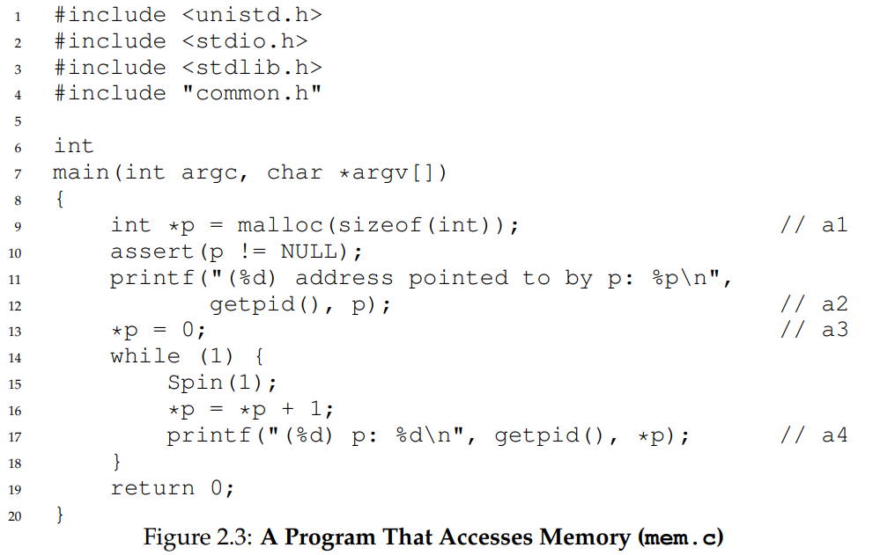
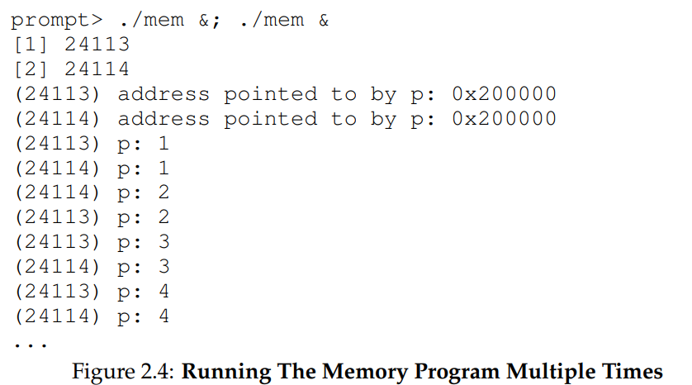
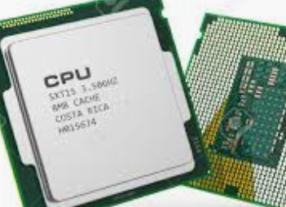
Appendix
Answers for questions commonly asked by students
Q1: same address in the two processes?
Q2: why not 1➔ 2 ➔ 3 ➔ 4 ➔ ….
Key concept: Program ➔ CPU using Compiler and OS
(Source: Chapter 2 in OSTEP)
int a, b;
…
main()
{
int c, d
…
}
stack
c
d
772
data
b
a
100
text
a
b
main
0
OS (loading)
568
Compiler
OS
int a, b;
…
main()
{
int c, d
…
}
stack
c
d
772
OS (schedule)
a
b
240
data
B
a
100
text
main
0
Program
Binary (virtual address)
DRAM (physical address)
CPU

Slide 35
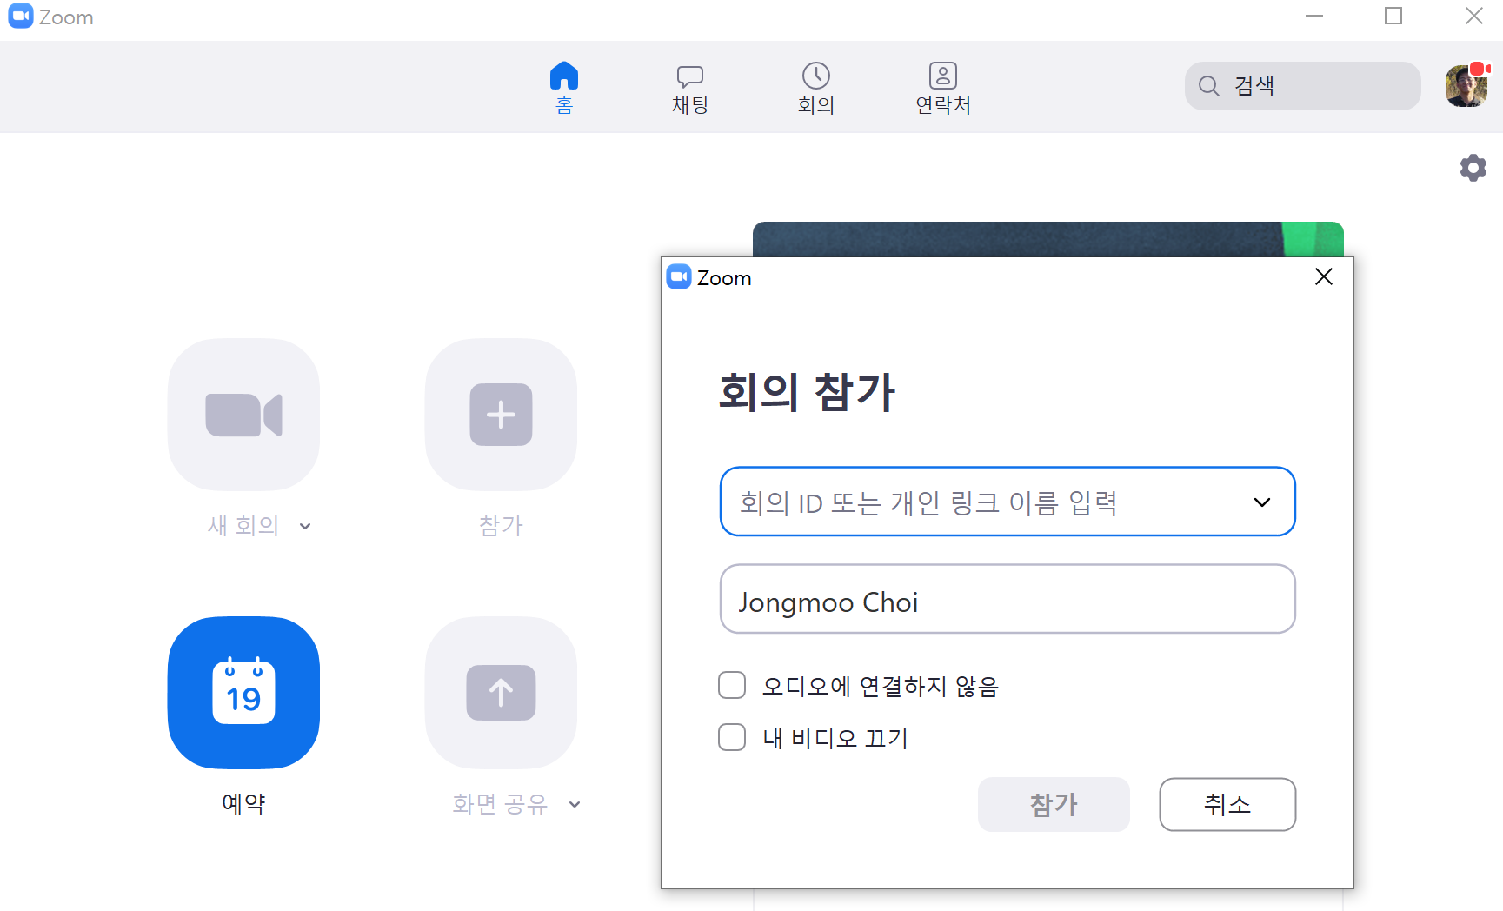
Appendix
Any questions? Send an email to me: choijm@dankook.ac.kr
5th Simple question to take attendance: Explain the similarity between “context switch” and “kakao talk with multiple chatting room concurrently” (until 6 PM, April first)
Interactive Q&A announcement
- March 31th(Tuesday) at class time (10:30 am for Section 2, 2:30 pm for Section 3)
- Zoom Meeting ID: 240-964-9989

