Slide 1
Lecture Note 7. Advanced File System
May 10, 2020
Jongmoo Choi
Dept. of software
Dankook University
http://embedded.dankook.ac.kr/~choijm
(This slide is made by Jongmoo Choi. Please let him know when you want to distribute this slide)

Slide 2
Contents
From Chap 41~45 of the OSTEP
Chap 41. Locality and the Fast File System
Performance requirement
Storage-aware performance enhancement
Chap 42. Crash Consistency: FSCK and Journaling
Consistency requirement
Journaling mechanism
Chap 43. Log-structured File Systems
Chap 44. Flash-based SSDs
Chap 45. Data Integrity and Protection
Chap 46. Summary
Summary. Features of Various FS: Ext2/3/4, FAT, Flash FS and Lab3

Slide 3
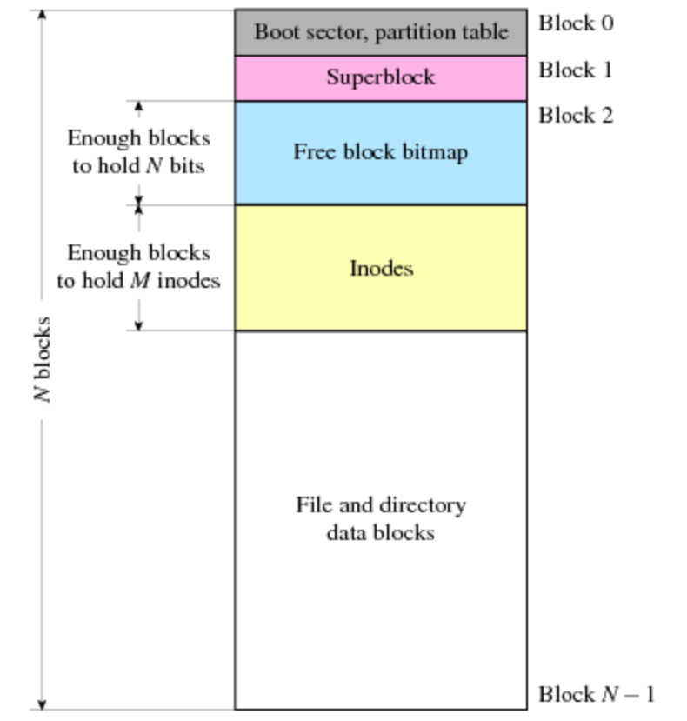
Chap. 41 Locality and The Fast File System
UFS (Unix File System)
Layout
Boot sector
Superblock: how big FS is, how many inodes, where is inode, …
Bitmap + Inode + User data
➔ Simple and easy-to-use
Access method
Inode access, data access alternately
Look good, but consider disk geometry (see chapter 37) and multiple I/Os per a write (see chapter 40)
Concerns: 1) Long seek time, 2) Consistency
Performance issue ➔ this chapter
Consistency issue ➔ next chapter

Slide 4
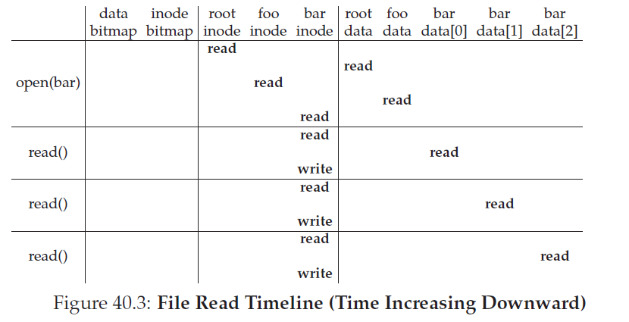
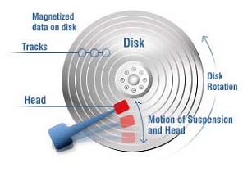
41.1 Poor Performance
UFS (also our VSFS)
Poor performance
1) Inode and User data are located in different tracks 2) A file is fragmented as time goes (external fragmentation) ➔ long seek
How to overcome this problem?

Slide 5
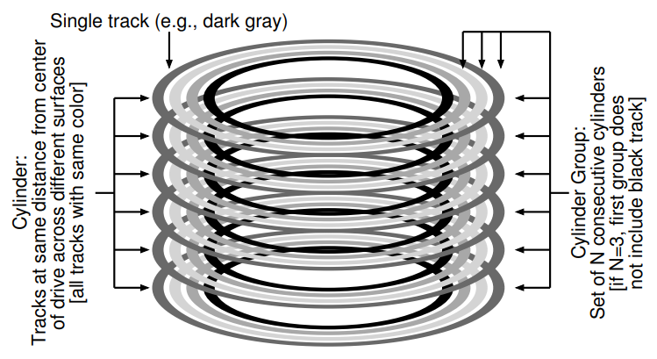
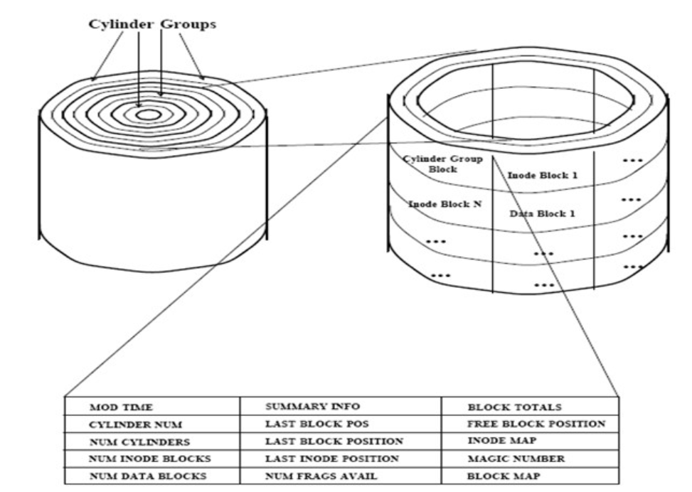
41.2 FFS: Disk Awareness
New proposal: FFS (Fast File System from BSD OS)
Place inodes and user data blocks as close as possible
Disk-awareness
Data in the same cylinder ➔ no seek distance (or closer cylinder ➔ less seek distance)
Cylinder group is defined as a set of cylinders where a file’s content (both inode and data blocks) can be allocated together
This idea is also used in Ext2/3/4 File system
(Source: https://slideplayer.com/slide/8117044/)

Slide 6
41.3 Organizing Structure: The Cylinder Group
FFS in detail
Partition(or a disk): divided into a number of cylinder groups
Cylinder group
N consecutive cylinders
Structure of each cylinder group
Superblock (duplication for reliability)
Per-group bitmap, inode and data blocks
Management
Allocate an inode and data at the same group: e.g. Inode and data blocks for file A in Group 0, those for file B in group 1, … ➔ Small seek distance
Ext2: similar approach called block group
Feature of FFS: Different internal implementation, but same external interfaces

Slide 7
41.4 Policies: How to Allocate Files and Directories
Allocation in FFS
Idea: keep related stuff together
Data and related inode, file and its related directory, …
Allocation issue
E.g.) Create a file A, which group does it allocate?
E.g.) Create a directory B, which group does it allocate?
Allocation rules
Rule 1. Directory: place it into a cylinder group with a high number of free inodes (a low number of allocated directories)
To balance directories across groups
Rule 2. File: 1) put files in the cylinder group of the directory they are in, 2) allocate data blocks of a file in the same group as its inode
To allocate inode, data blocks and directory as close as possible ➔ name space locality

Slide 8
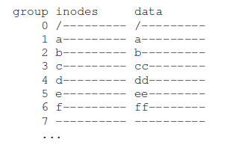
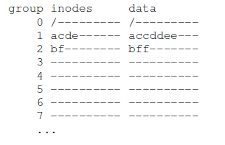
41.4 Policies: How to Allocate Files and Directories
Allocation in FFS
Allocation rules (cont’)
E.g.) create three directories (/, /a, /b) and four files (/a/c /a/d, /a/e, /b/f)
Assumption: 1) Directory: 1 block for data, 2) file: 2 blocks for data
➔ FFS allocates three directories at different group (rule 1, load balancing), allocate files in the same directory (rule 2, namespace locality)
Analysis
“ls –l” in the “a” directory
Within one group in FFS allocation vs Access 4 groups in even allocation
User usage pattern: strong namespace locality
(Even allocation)
(FFS allocation)
Simple question to take attendance: 1) Read page 2 in Chap. 41 of OSTEP and explain why fragmentation (external fragmentation) happens and what is the benefit of defragmentation tool? 2) What is the merit and demerit when we set the disk block size as 4KB instead 512B? (see page 2 and 10 in Chap. 41) (until 6 PM, May 21th)
Notes:
FFS allocation
Create directory in the least used cylinder: 0 for /, 1 for /a and 2 for /b
Create files on the same cylinder where its directory is in: 1 for c, d, e and 2 for f
Even allocation
Spread inodes across groups
Comparison: “ls –l in /a” ➔ seek one group in FFS (or two when we consider ..) vs four groups in Even allocation (or five when we consider ..)

Slide 9
41.6 The Large-File Exception
How to handle a large file for allocation in FFS?
Large file ➔ fill up a cylinder group with its own data ➔ undesirable with the consideration of the namespace locality
Rule 3. For a large file
Allocate a limited number of blocks (called as chunks) in a group. Then, go to another group and allocate a limited number of blocks there. Then, move another one. …
Pros) locality among files, Cons) locality in a file
E.g.): 1) file /a: 30 blocks, 2) limited number of blocks in a group: 5
(FFS allocation)
(Without Rule 3)

Slide 10
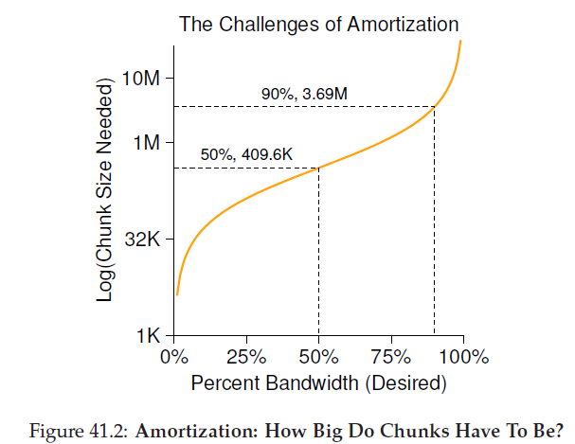
41.6 The Large-File Exception
How to handle a large file for allocation in FFS?
Analysis of Rule 3
How much is the seek overhead for accessing a large file?
Seek and Transfer alternatively due to the Rule 3 in FFS
Example
Assumption: Seek=10ms, Bandwidth = 40MB/s
Example 1) limited number of blocks (chunks) in a group = 4MB
Transfer time: 4MB / (40MB/s) = 100ms vs. seek time = 10ms ➔ 90%(100 / 110) bandwidth is used for data transfer
Example 2) limited number of blocks (chunks) in a group = 400KB
Transfer time: 0.4MB / (40MB/s) = 10ms vs. seek time = 10ms ➔ 50%(10 / 20) bandwidth is used for data transfer
➔ Large chunks can amortize the seek overhead
Notes:
Fig. 41.2
Assume that seek time = 10ms, Data transfer = 40MB/s
만일 4MB라면 100ms를 전송에 사용할 수 있음. Seek time이 10ms인 것으로 고려하면 100/110 즉 대략 90% 정도의 대역폭 사용
FFS가 한 실린더에서 다른 실린더로 옮겨서 파일 할당할 때 한 실린더에 할당하는 데이터가 400KB 이상이라면 50%
Amortize: 분할 상환

Slide 11
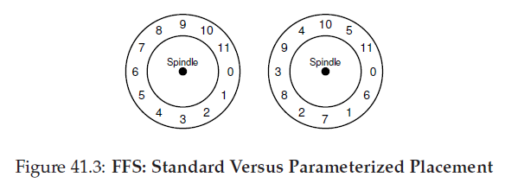
41.7 A Few Other Things about FFS
Another features in FFS
Larger disk block size: 512B (sector) in UFS ➔ 4KB (disk block) in FFS
Pros) Larger size ➔ Less seek and more transfer ➔ Higher Bandwidth usage in disk
Cons) Internal fragmentation
Waste space (e.g. half when a file is 2KB)
Sub-blocks (fragment) allocation
Parameterization
Sequential block requests: 1, 2, 3, …., (request 1, transfer, request 2, transfer, …) ➔ But when the request 2 is arrived in disk, the head has already passed the location of 2 ➔ solution: parameterized placement
c.f) Modern disk: use track buffer
Others: Symbolic link (link across multiple file systems), atomic rename(), long file name, …
Notes:
Sequential

Slide 12
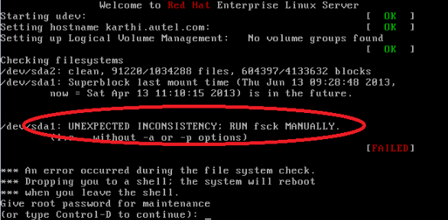
Chap. 42 Crash Consistency: FSCK and Journaling
Non-volatility: no-free lunch
Can retain data while power-off
But, requires maintaining file system consistency
Consistency definition
Changes in a file system are guaranteed from a valid state to another valid state
E.g.) inconsistent state: bitmap says that a block is free even though it is used by a file
What happen if, right in the middle of creating a file, a system loses power?
Solutions
FSCK (File System Check)
Journaling: employed many file systems such as Ext3/4, JFS, …
Others: Soft update, COW, Integrity checking, Optimistic, …

Slide 13
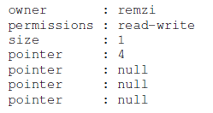
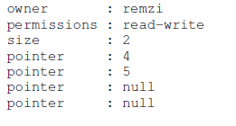
42.1 A Detailed Example
Example
Simple FS: 8 inodes, 8 disk blocks, i-bitmap, d-bitmap
One file: size=4KB, owner =Remzi
Modify the file: appending, size=8KB
Note that we need to change three locations ➔ need three writes

Slide 14
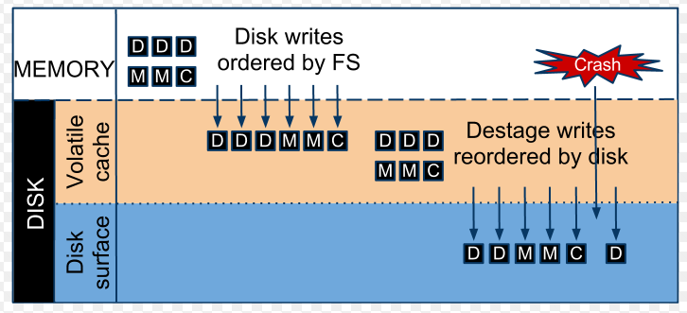
42.1 A Detailed Example
Crash scenario
Three writes: Db, I[v2], B[v2]
Delayed write using cache (or queuing) ➔ Unexpected power loss or system crash ➔ Some writes can be done while others are not.
Db only is written to disk: no problem
B[v2] only is written to disk: space leak
I[v2] only is written to disk: 1) garbage read, 2) inconsistency: inode vs. bitmap
Db and B[v2] are written to disk (except I[v2]): inconsistency
Db and I[v2] are written to disk (except B[v2]): inconsistency
I[v2] and B[v2] are written to disk (except Db): Garbage read
Need consistency: write all modifications or nothing (a kind of atomicity)

Slide 15
42.2 Solution #1: The File System Checker
Traditional solution: fsck (file system checker)
Consist of several passes
Superblock: metadata for FS, usually sanity check
Free blocks: check all inodes and their used blocks. If there is an inconsistent case in bitmaps, correct it (usually follow inode info.)
Inode state: validity check in each inode. reclaim wrong inodes
Inode links: link counts check by scanning the entire directory tree. Move the missed file (there is an inode but no directory entry points it) into the lost+found directory
Duplicate pointers: find blocks which are pointed by two or more inodes
Bad blocks: pointer that points outside its valid ranges
Directory checks: fs-specific knowledge based directory check (e.g. “.” and “..” are the first entries
Issue: too slow
Remzi says that “the fsck looks like that, even though you drop the key in your bedroom, you start a search-the-entire-house-for-key algorithm, scanning from the basement, kitchen, and every room.”
15
Notes:
Sanity check: such as making sure the file system size is not negative (or greater than the number of blocks allocated), magic number
Inode state: Each inode is checked for corruption or other problems. For example, fsck makes sure that each allocated inode has a valid type field (e.g., regular file, directory, symbolic link, etc.). If there are problems with the inode fields that are not easily fixed, the inode is considered suspect and cleared by fsck; the inode bitmap is correspondingly updated.

Slide 16
42.3 Solution #2: Journaling (or WAL)
Journaling
A Kind of WAL (Write-ahead logging)
Key idea: When updating disks, before overwriting the structure in place, first write down a little note to somewhere in a well-known location, describing what you are about to do.
Crash occur ➔ The note can say what you intended ➔ redo or undo
Journaling FS
Linux Ext3/4, IBM JFS, SGI XFS, NTFS, Reiserfs, …
Features of Ext3 file system
Integrate journaling into ext2 file system
Three types: 1) journal (data journal), 2) ordered (metadata journal, ordered, default), 3) writeback (metadata journal, non-ordered)
(Ext2 disk layout, like FFS)
(Ext3 disk layout: Ext2 + Journaling )
16
Notes:
Ext3: introduced in 2001
WAL: Write-Ahead-Logging

Slide 17
42.3 Solution #2: Journaling (or WAL)
Data Journaling
Assume we want to do three writes (I[v2], B[v2], and Db)
Before writing them to their final locations, we first write them to the log ➔ step 1: journaling.
TxB: Transaction begin, include Tid and writes information
Log
Physical logging: same contents to the final locations
Logical logging: intent (save space, but more complex)
TxE: End with Tid
After making this transaction safe on disk, we are ready to update the original data ➔ step 2: checkpointing
Recovery (fault handling)
In the case of failures btw journaling and checkpointing, we can replay journal (redo) ➔ can go into the next consistent state
In the case of failures btw TxB and TxE, we can remove journal (undo) ➔ can stay in the previous consistent state
17
Notes:
Conclusion ➔ 2 steps: 1) Journal write, and 2) Checkpoint

Slide 18
42.3 Solution #2: Journaling (or WAL)
How to reduce journaling overhead? ➔ 1. performance
For journaling, we need to write a set of blocks
e.g. TxB, i[v2], B[v2], Db, TxE
Approach 1: issue all writes at once
Unsafe, might be loss some requests
Transaction looks valid (it has begin and end). Thus, replaying journal leads wrong data to be updated.
Approach 2: issue each request at a time, wait for each to complete, then issuing the next (e.g. fsync() at each write)
Too slow
Approach 3: employ commit
Separate TxE from all other writes (e.g. fsync() before TxE)
Recovery: 1) not committed ➔ undo, 2) committed, but not in the original locations ➔ redo logging
Approach 4: issue all writes at once and apply checksum using all contents in the journal (integrity example)
18

Slide 19
42.3 Solution #2: Journaling (or WAL)
How to reduce journaling overhead? ➔ 2. write volume
Data journaling writes data twice, which increases I/O traffic (reducing performance), especially painful for sequential writes
Metadata Journaling
Journal Metadata Only
User data is not written to the journal (I and B, except D)
Question?
Does the writing order btw user data and journal become matter? ➔ Yes, writing journal before user data causes problems (garbage read)
Conclusion: ordered journaling
1) Data write ➔ 2) Journal metadata write ➔ 3) Journal commit ➔ 4) Checkpoint ➔ 5) Free
Real world
Ext3: support both ordered and writeback(non-ordered)
Windows NTFS and SGI’s XFS use non-ordered metadata journaling
19

Slide 20
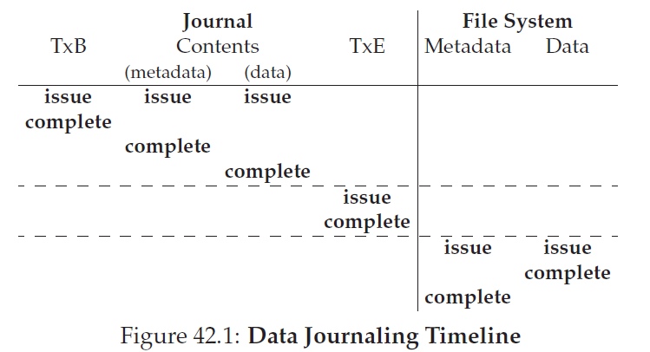
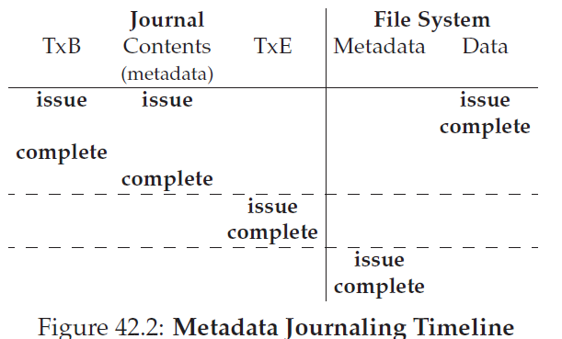
42.3 Solution #2: Journaling (or WAL)
Timeline
Data journaling vs. Metadata Journaling
Horizontal dashed line is “write barrier”
Note that, in this figure, the order btw Data and Journaling is not guaranteed in the metadata journaling timeline (writeback mode in the ext3.)
20

Slide 21
42.4 Solution #3: Other Approaches (Optional)
Alternatives
fsck: A lazy approach
Journaling: An active approach
Ext3, Reiserfs, IBM’s JFS, …
Soft update
Suggested by G. Ganger and Y. Patt
Carefully order all writes so that on-disk structures are never left in an inconsistent state (e.g. data block is always written before its inode)
Soft update is not easy to implement since it requires intricate knowledge about file system (On contrary, journaling can be implemented with relatively little knowledge about FS)
COW (Copy on Write)
Used in Btrfs and Sun’s ZFS
Optimistic crash consistency
Enhance performance by issuing as many writes to disk as possible
Exploit checksum as well as a few other techniques
Simple question to take attendance: 1) Explain the definition of consistency. 2) Discuss an example that occur inconsistency while you create a new file into a directory (hint: You have already seen one example in page 14, please give me another example using the words “space leak, garbage read, duplicate pointers and dangling reference”. (until 6 PM, May 27th)
21

Slide 22
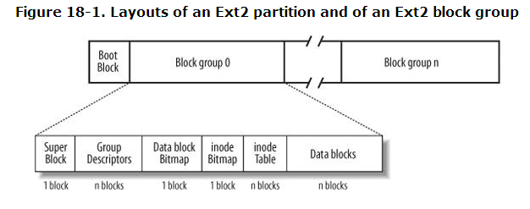
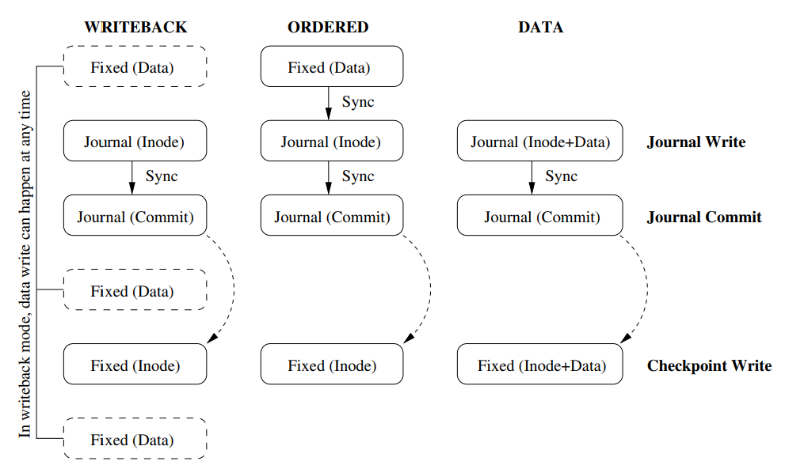
Summary: Ext2/3/4 File System
Ext2
Reference: R. Card, T. Ts’o and S. Tweedie, “Design and Implementation of the second extended FS”, http://e2fsprogs.sourceforge.net/ext2intro.html
Performance enhancement: 1) cylinder group, 2) pre-allocation: usually 8 adjacent blocks, 3) Read-ahead during sequential reads
Ext3
Ext2 + Journaling
Use a block group (or groups) for journaling
Three types: 1) data journal, 2) ordered, 3) writeback
Other BGs for data
BGs for journal
Other BGs for data
22
Notes:
Theodore Ts’o

Slide 23
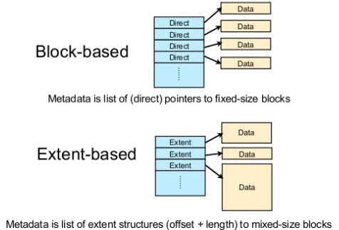
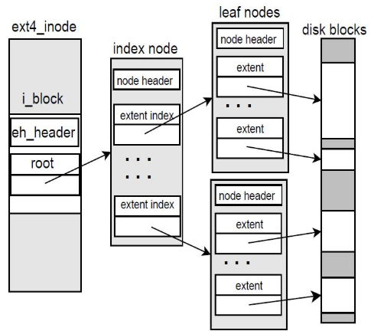
Summary: Ext2/3/4 File System
Ext4
Ext3 + Larger file system capacity with 64-bit
Supports huge file size (e.g. 16TB) and file system (e.g. 2^64 blocks)
Directory can contain up to 64,000 subdirs
Extent-based mapping
Extent: Variable size (c.f. Inode: fixed size (4KB))
E.g. Contiguous 16KB ➔ need one mapping vs need 4 mappings
Ext4, BtrFS, ZFS, NTFS, XFS, …
Need split/merge in a tree structure (extent tree)
Hash based directory entries management
(Source: https://www.slideshare.net/relling/s8-filesystemslisa13,
https://blog.naver.com/PostView.nhn?blogId=jalhaja0&logNo=221536636378)
23

Slide 24
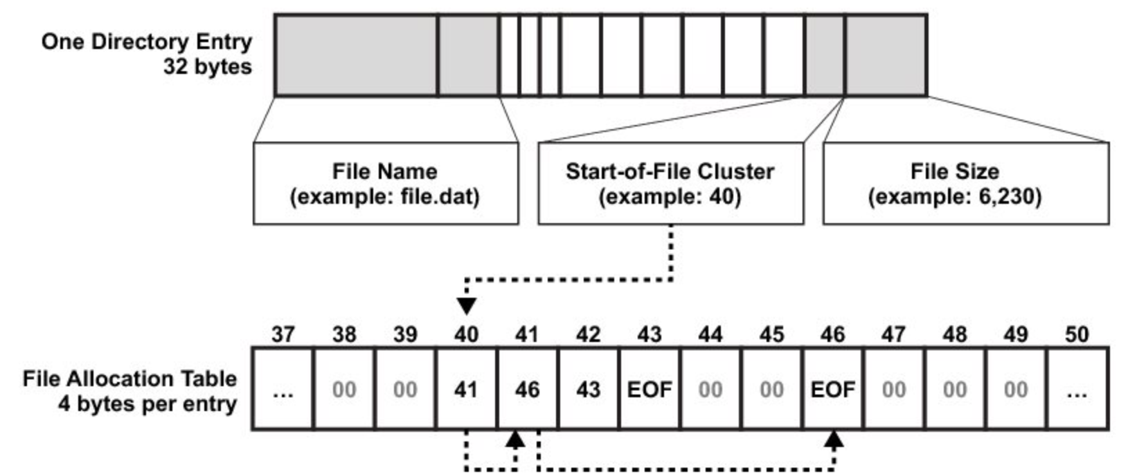
Summary: FAT File System
Why?
Large vs Small storage (USB, Memory card, IoT device)
Space for Metadata is quite expensive
Solution: FAT file system
Originated by Microsoft
Idea: Bitmap, Inode ➔ FAT (File Allocation Table)
No per file metadata (no inode), FAT for all files (one in a file system)
1) link for next block, 2) Used for used/free
Directory entry: point to the first index for FAT
Metadata (size, time, permission, ..) in directory entry
24
Notes:
FAT12: 1977, MS disk basic
FAT16: 1987, MS-DOS
FAT32: 1996, Win95
ExFAT: 2006, Windows CE, larger file
c.f.) vFAT: long file name

Slide 25
Summary: FAT File System
Example
Layout assumption
1 block for Boot Sector, 2 blocks FAT, 1 block for root directory
Working scenario (same as 41 page in LN 6)
When we create a new file (named hello.c whose size is 7KB) in a root directory?
Then, we compile it? (a.out whose size is 15KB)
Res | Res | Res | 0xFF | 0x05 | 0xFF | 0x07 | 0x08
0x09 | 0xFF | 0x00 | 0x00 | 0x00 | 0x00 | 0x00 | 0x00
0x00 | 0x00 | 0x00 | 0x00 | 0x00 | 0x00 | 0x00 | 0x00
0x00 | 0x00 | 0x00 | 0x00 | 0x00 | 0x00 | 0x00 | 0x00
.: 3
..: 3
hello.c:4
a.out: 6
Res | Res | Res | 0xFF | 0x00 | 0x00 | 0x00 | 0x00
0x00 | 0x00 | 0x00 | 0x00 | 0x00 | 0x00 | 0x00 | 0x00
0x00 | 0x00 | 0x00 | 0x00 | 0x00 | 0x00 | 0x00 | 0x00
0x00 | 0x00 | 0x00 | 0x00 | 0x00 | 0x00 | 0x00 | 0x00
.: 3
..: 3
B
FAT
R
hello.c
a.out
a.out
#include <stdio.h>
int main() …
457f 464c 0102 0001
0000 …
25

Slide 26
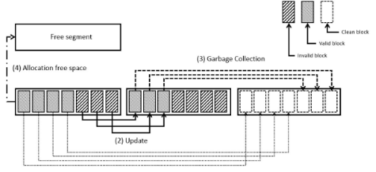
Summary: LFS
Why?
How to reduce seek distance (or seek distance)?
Allocate related data as close as possible: FFS, Ext2, …
But, eventually fragmentation occurs
E.g.) create a file 1 in a dir1, and a file 2 in a dir 2 ➔ 8 random writes in FFS
LFS (Log-Structured File System)
write data sequentially in new place (log) instead of original place (out-place update vs in-place update)
Need to add new mapping information (inode map)
E.g.) create a file 1 in a dir1, and a file 2 in a dir 2 ➔ 8+1 sequential writes in LFS
Original data ➔ invalidate
Need garbage collection for reclaiming invalidated data
UFS
LFS
(Source: https://work.tinou.com/2012/03/log-structured-file-system-for-dummies.html,
https://deepai.org/publication/ssdfs-towards-lfs-flash-friendly-file-system-without-gc-operation)
26

Slide 27
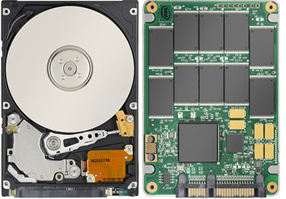
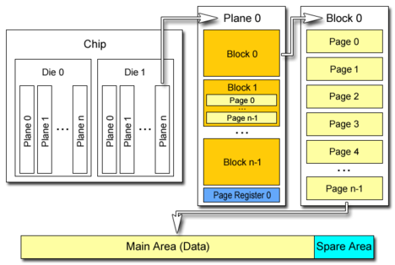
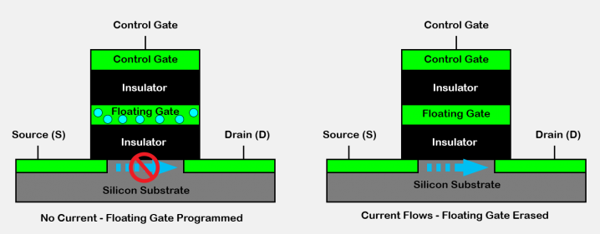
Summary: Flash-aware File System
Why?
Disk vs. Flash memory
Same: non-volatile
Different: 1) need erase operation in flash, 2) read/write: small unit (4/8KB, usually called page), erase unit: large unit (512KB called block), 3) performance, mechanical, price, shock resistance, …
<Read/Write>
<Read/Write + Erase>
<What is erase?>
<page vs. block >
27
Notes:
left: after programmed
Right: after erased

Slide 28
Summary: Flash-aware File System
Solution
Out place update (not in place update)
Allocate new disk blocks (erased) and write them
Reclaim the old invalidated disk blocks
Example
A file whose size is 15KB ➔ 4 data blocks
Assume that disk blocks 1, 4, 7 and 8 are allocated for the file
A user modify the file ranging from 0 to 10KB
In place update ➔ write on the already allocated blocks
Out place update ➔ allocate new blocks and write on them
1
9
1
1
1
9
9
1
9
4
10
4
4
10
4
10
4
10
<inode>
<inode>
<inode>
<inode>
7
11
7
7
7
11
11
7
11
8
<after update 1,4,7>
8
8
<after update 1,4,7>
8
<data blocks>
<data blocks>
<data blocks>
<data blocks>
<In place update>
<Out place update>
28

Slide 29
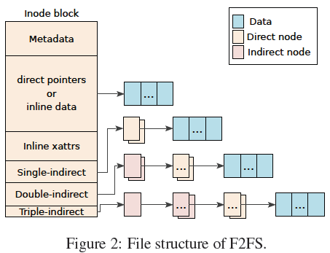
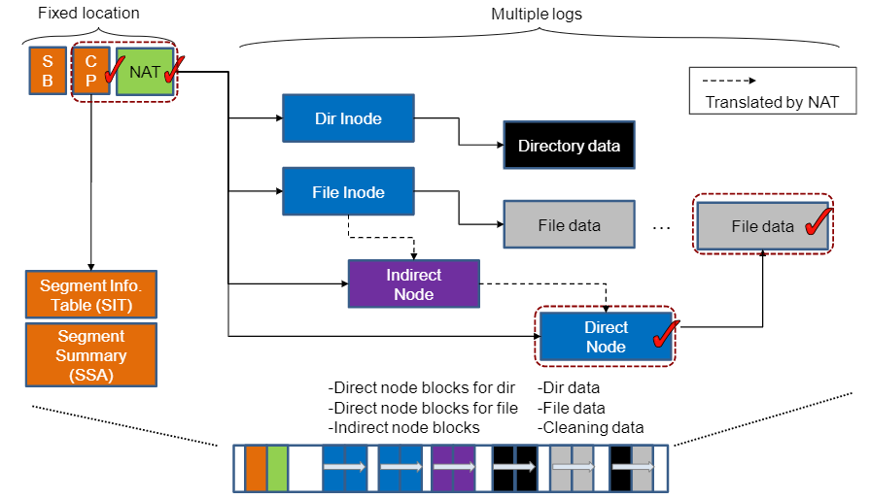
Summary: Flash-aware File System
Example
F2FS: Flash Friendly FS by Samsung
Key idea
Use inode (like FFS) and Out-place update (like LFS)
Make new mapping in an inode and Invalidate old data (Translation)
Garbage collection to reclaim invalidated blocks
New features
1) Multiple logging: for hot/cold separation, 2) NAT: to prevent wandering tree problem, 3) GC Optimization (Fore vs background, greedy vs cost-benefit)
Note: General FS (e.g. Ext4) + FTL (Flash Translation Layer)
FTL: Abstract flash memory like disks ➔ See Chapter 44 in OSTEP
(Source: F2FS, FAST’15)
29

Slide 30
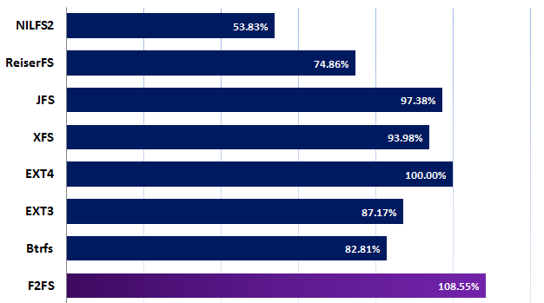
Summary
File basic
Layout: superblock, bitmap, inode, data blocks
Access methods: open(), read(), write(), …
Optimization
Performance: FFS, Ext2, …
A watershed moment in file system research
Storage-awareness, simple but effective techniques
Consistency: Ext3/4, JFS, …
Change from valid state to another valid state
Journaling: Performance and Reliability tradeoff
Others
LFS, F2FS: for Flash memory (or for sequential access)
FAT: for small storage
(Source: https://www3.cs.stonybrook.edu/~porter/courses/cse506/f14/slides/ext4.pdf)
30

Slide 31
Lab3 : Ext2 Analysis
Lab3: Analyze Ext2 file system internal (a kind of digital forensic^^)
What we need to do
1. create ramdisk
2. make Ext2 file system on ramdisk
3. mount the Ext2 file system
4. run the script on the mount directory ➔ will generate file hierarchy
5. find a file assigned to you (or find two files assigned to each team)
Assigned files: last three digits of a student number ➔ directory + file name
(e.g. *****236 ➔ directory name is 2, file name is 36)
6. dump ramdisk, examine or make a program that parsing Ext2
Superblock ➔ Group descriptor ➔ root inode ➔ root data ➔ dir. inode ➔ dir. data ….
Requirement: 1) report (discussion, analysis results and snapshots) ➔ email to professor and TA
Environment: See Lab. 3 in the lecture site
Due: 6pm, June 10th, Wednesday (2 weeks later.)
Bonus
Print the team members (name and student id) while mounting Ext2
Ext2 source modification + make + module insert (e.g. insmod) + mkfs + mount
Simple question to take attendance: FTL (Flash Translation Layer) is a SW layer that abstracts flash memory like disks. Three key roles of FTL are 1) address translation, 2) garbage collection and 3) wear-leveling. Explain these roles. (until 6 PM, May 28th)
Interactive Q&A announcement
- June 2nd (Tuesday) at class time (10:30 am for Section 2, 2:30 pm for Section 3)
- Zoom Meeting ID: 375-898-1997 (PW: To be announced)
31

Slide 32
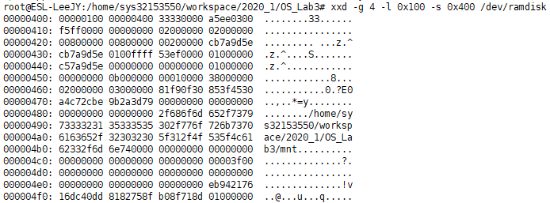
Appendix 1: Lab3 details
Main steps
https://drive.google.com/file/d/1Cg9HJNeYNSZOvYaIxqPv4aQOxreu4zA5/view in https://github.com/DKU-Embedded-Lab/2020_DKU_OS
(make a ramdisk)
(mkfs and mount)
(make file hierarchy by running script)
(Explore file system layout)
32

Slide 33
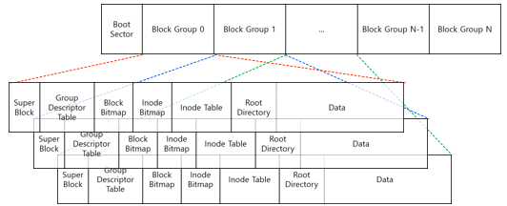
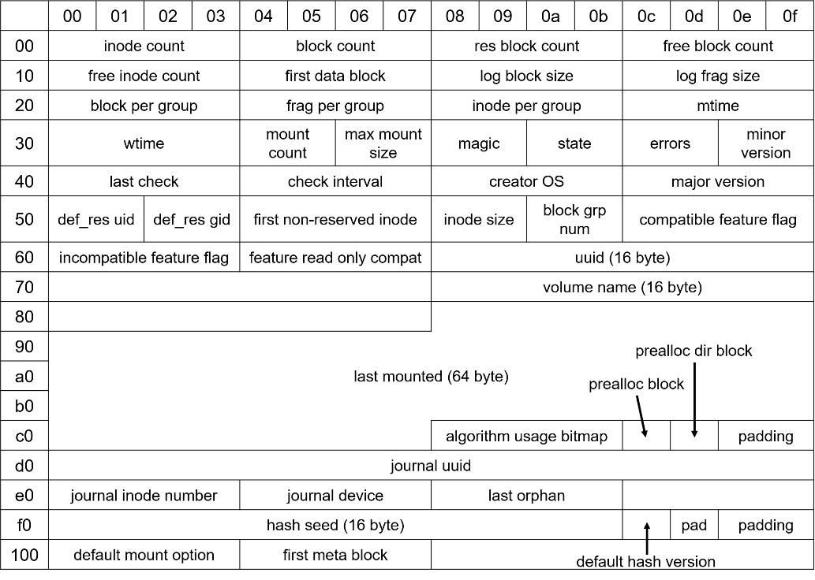
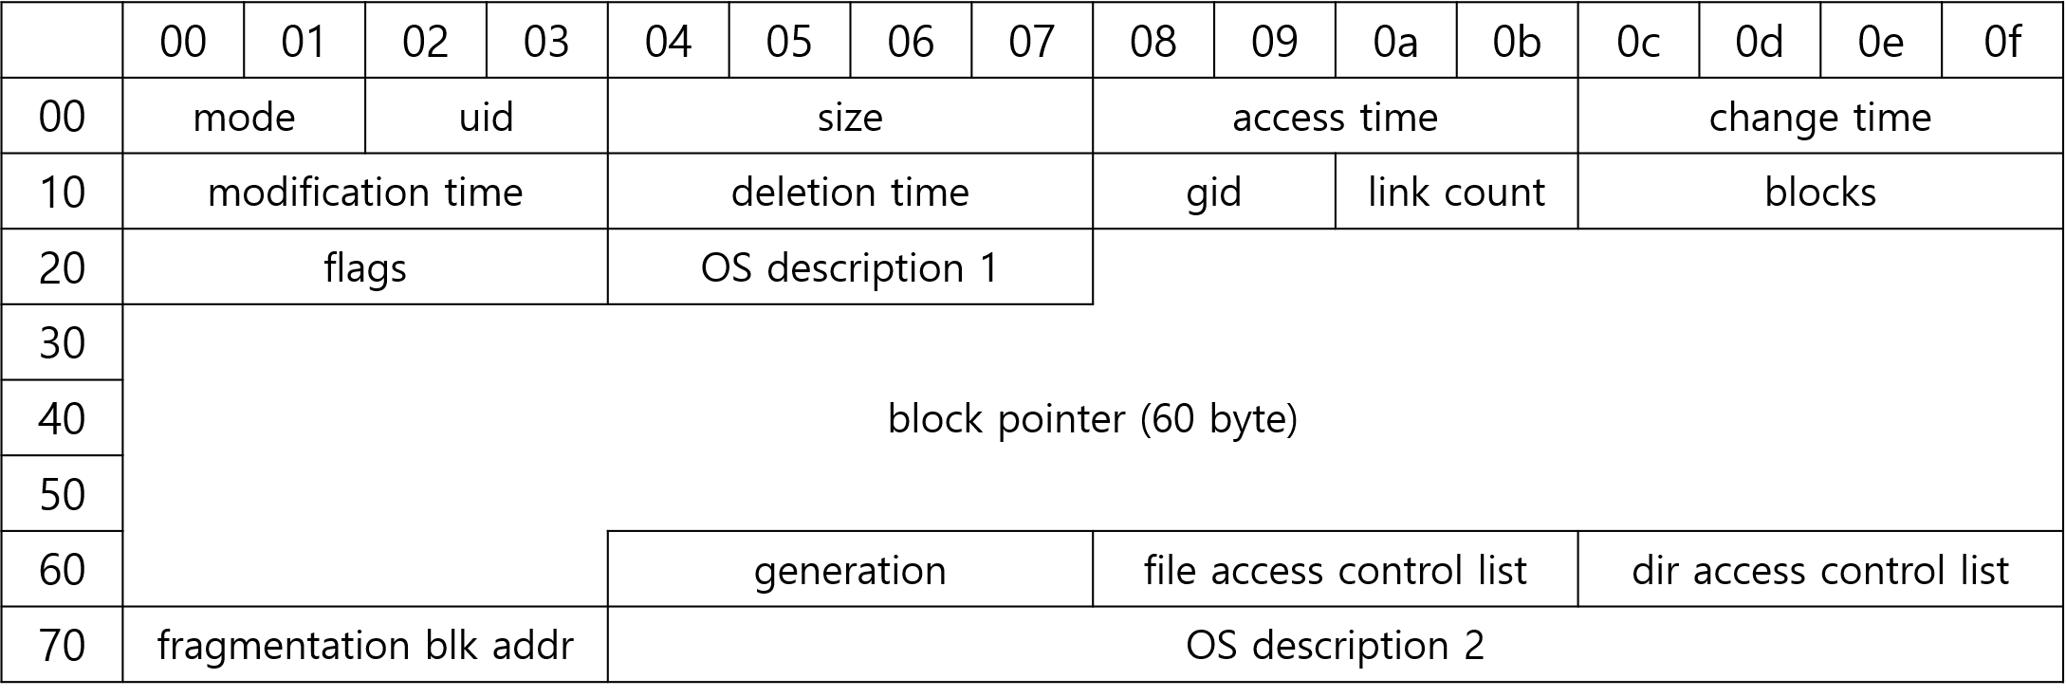
Appendix 1: Lab3 details
Key structures
https://drive.google.com/file/d/1Cg9HJNeYNSZOvYaIxqPv4aQOxreu4zA5/view
(layout)
(group descriptor table)
(inode)
(superblock)
(directory entry)
33

Slide 34
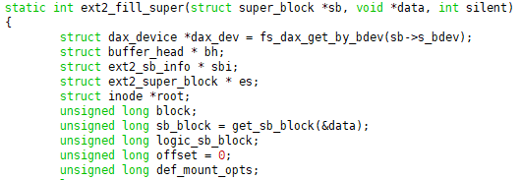
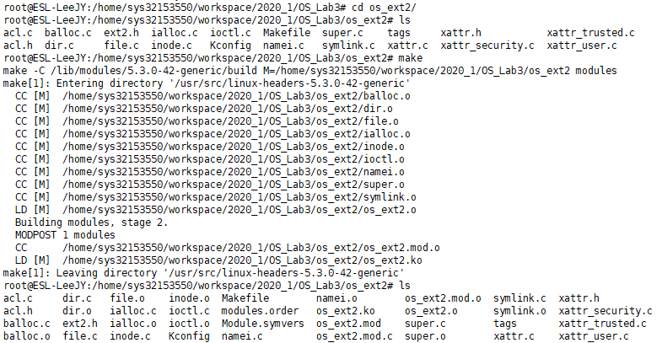
Appendix 1: Lab3 details
Bonus
https://drive.google.com/file/d/1Cg9HJNeYNSZOvYaIxqPv4aQOxreu4zA5/view
(insmod: os_ext2)
(modify ext2 source: just add your name)
(mkfs and mount)
(confirm your name which is printed out
at the kernel level NOT at the user level!!)
(make module: kernel loadable module)
34

Slide 35
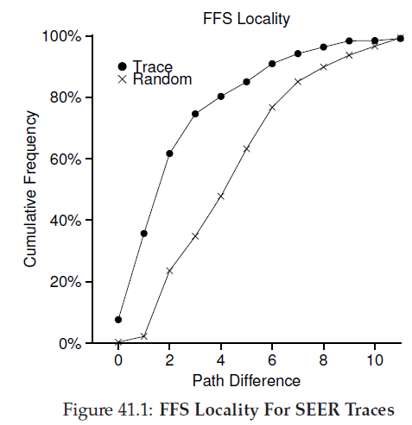
Appendix 2
41.5 Measuring File Locality: FFS relies on Common Sense (What CS stands for ^^)
Files in a directory are often accessed together (namespace locality)
Measurement: Fig. 41.1
Using real trance called SEER traces
Path difference: how far up the directory tree you have to travel to find the common ancestor btw the consecutive opens in the trace
E.g.) same file: 0, /a/b and /a/c: 1, /a/b/e and /a/d/f: 2, …
Observation: 60% of opens in the trace ➔ less than 2.
E.g.) OSproject/src/a.c, OSproject/include/a.h, OSproject/obj/a.o, …
35

Slide 36
Appendix 2
42.3 Solution #2: Journaling (or WAL): Revoke record in journal: for block reuse handling
Scenario: 1) there is a directory called foo, 2) a user adds an entry to foo (create a file), 3) foo’s contents are written to block 1000, 4) log are like the following figure (note that directory is metadata, which is also logged)
5) The user deletes the foo (and its subfiles), 6) The user creates another file (say foobar), which uses the block 1000, 7) Writes for foobar are logged (note that file contents themselves are not logged)
8) At this point, a crash occurs. 9) recovery performs “redo” from the beginning of the log. 10) overwrites the user data of the file foobar with the old directory contents.
Solution
Ext3 adds a new type of record, a revoke record, for the deleted file or directory. When do replaying, any revoked records are not redo
36

