Slide 1
PebblesDB: Building Key-Value Stores using Fragmented Log-Structured Merge Trees
Raju, P., Kadekodi, R., Chidambaram, V., & Abraham, I. (2017, October). In Proceedings of the 26th Symposium on Operating Systems Principles (pp. 497-514). ACM.
2021. 03. 10
이 광 희

Slide 2
Introduction
Background
Key-Value Store
LSM-tree
Issue
FLSM(Fragmented LSM)
Evaluation

Slide 3
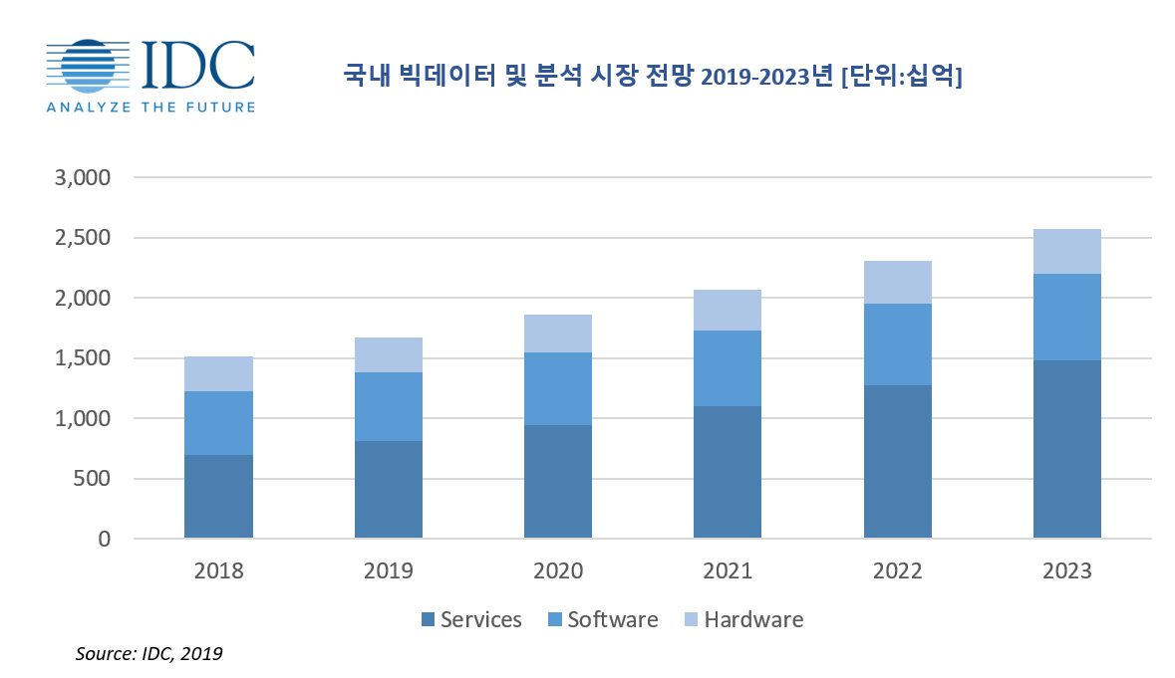
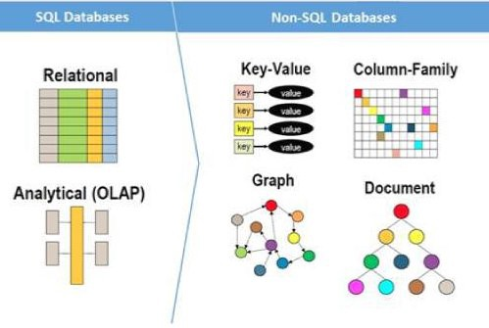
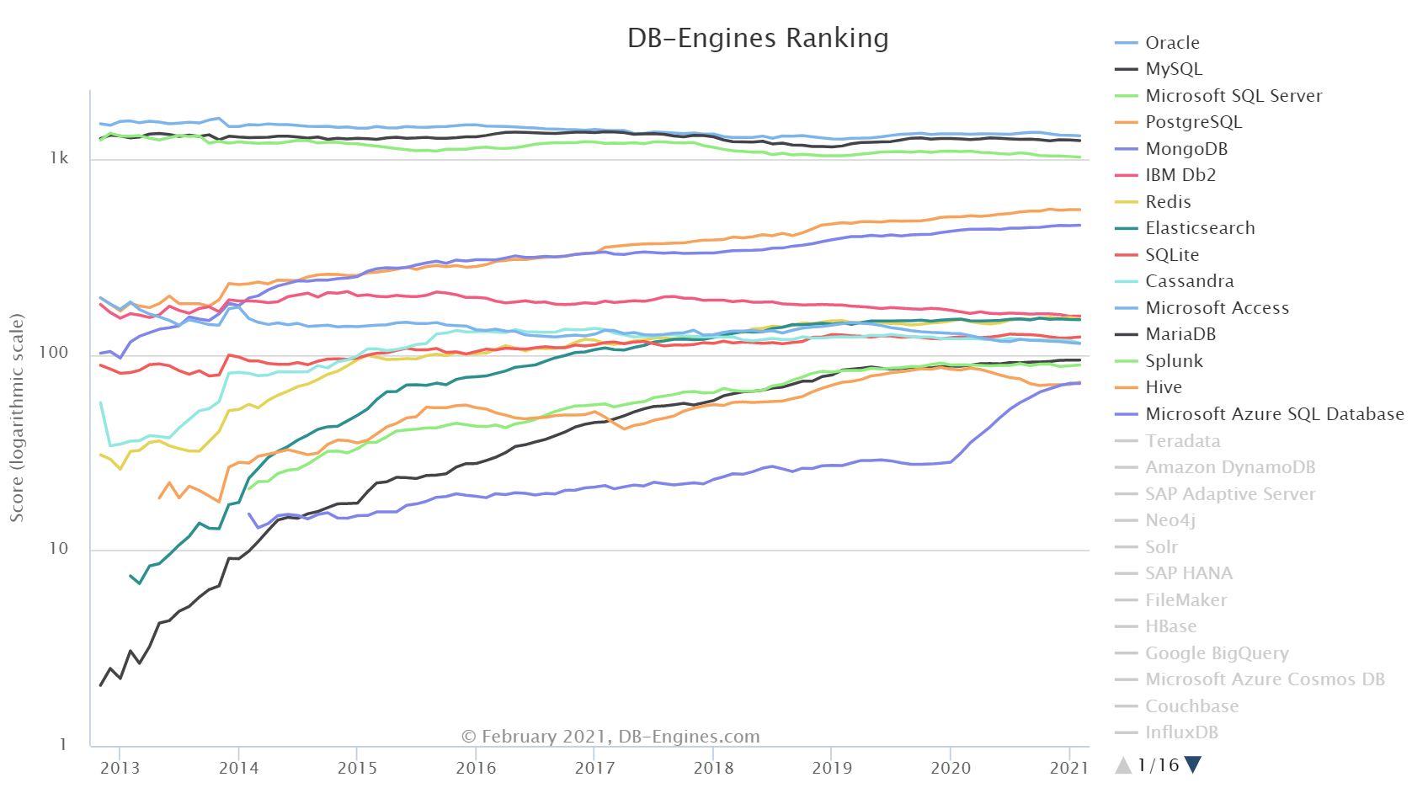
1. Introduction

Slide 4
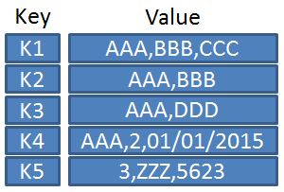
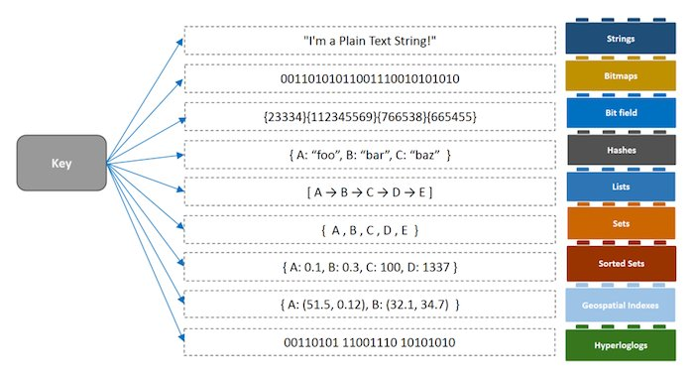
2. Background – Key-Value Store

Slide 5
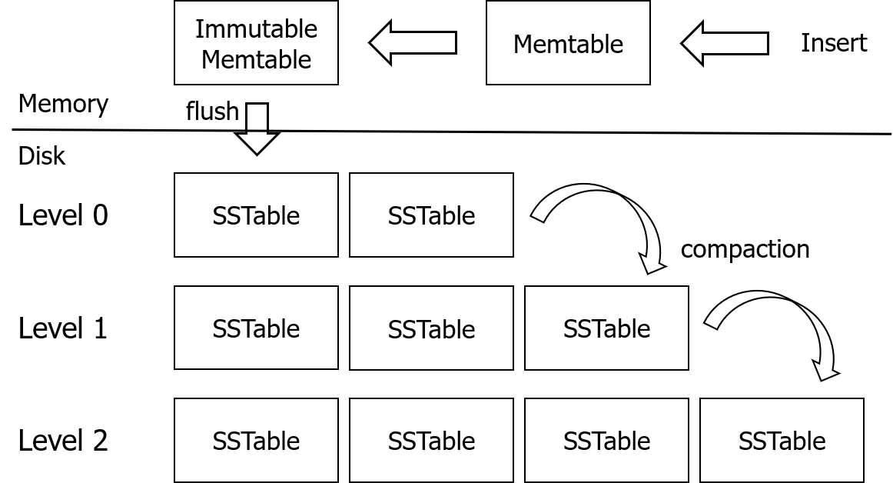
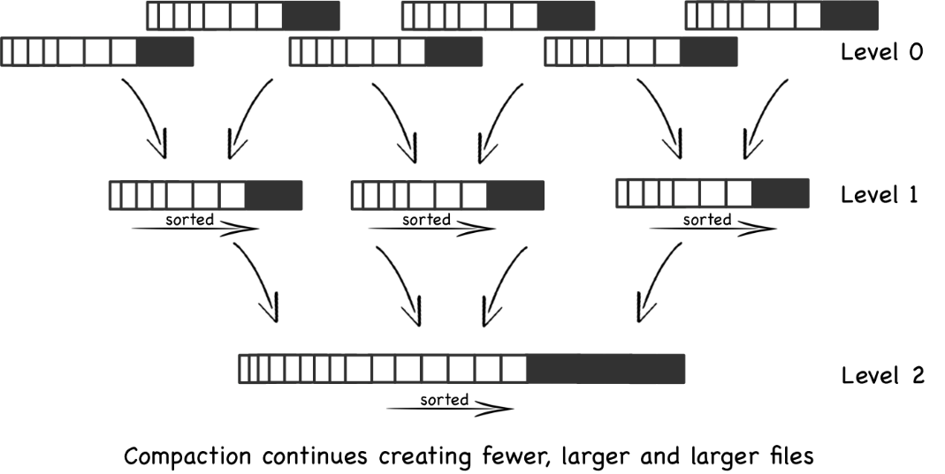
2. Background – LSM-tree

Slide 6
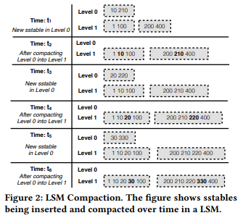
2. Background – LSM-tree

Slide 7
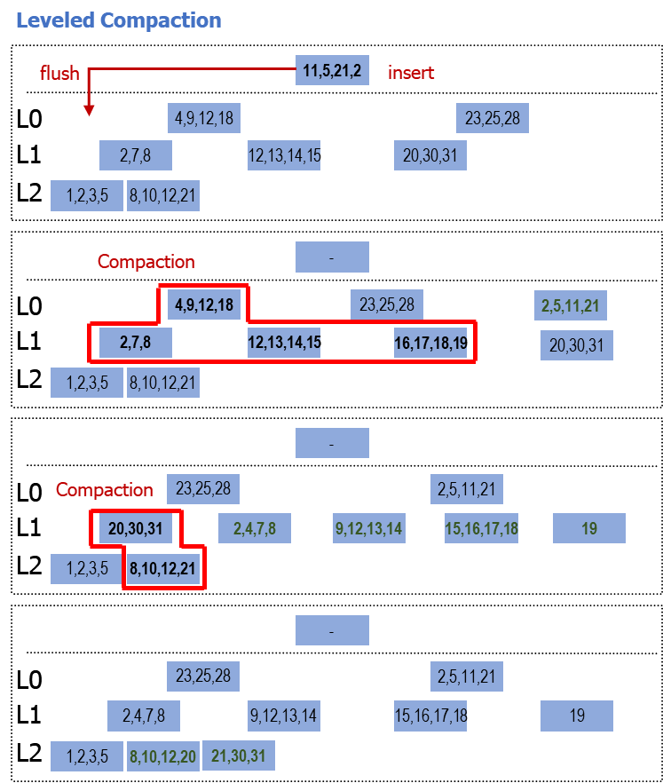
2. Background – LSM-tree

Slide 8
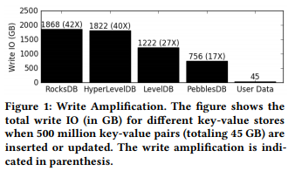
3. Issue
Compaction Overhead
1 회의 Compaction이 발생할 때 추가적인 Read/Write 횟수
Read Performance
Data를 찾기 위해 모든 Level Scan
Compaction Overhead
1 회의 Compaction이 발생할 때 추가적인 Read/Write 횟수
Read Performance
Data를 찾기 위해 모든 Level Scan

Slide 9
3. Issue
Compaction Overhead
1 회의 Compaction이 발생할 때 추가적인 Read/Write 횟수
Read Performance
Data를 찾기 위해 모든 Level Scan
Compaction Overhead
1 회의 Compaction이 발생할 때 추가적인 Read/Write 횟수
Read Performance
Data를 찾기 위해 모든 Level Scan

Slide 10
4. FLSM(Fragmented Log-Structured Merge Trees)
Key Idea
Key 중복을 통해 Compaction을 지연
Guards 도입
Skiplist
[150]
222
57
[40]
5
10
115
315
28

Slide 11
4. FLSM(Fragmented Log-Structured Merge Trees)
Skiplist
계층의 개수 - P – ½, ¼ / 시간복잡도: O(logN)

Slide 12
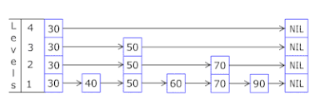
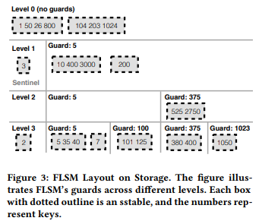
4. FLSM(Fragmented Log-Structured Merge Trees)
FLSM – Guards Selecting
Worstfit
1 Guard – All SSTable
Guard Probability
1/10
Level / Guard = Probability up
Guard Maximum Number SSTable
max_sstables_per_guard
= 1 ( LSM-tree )

Slide 13
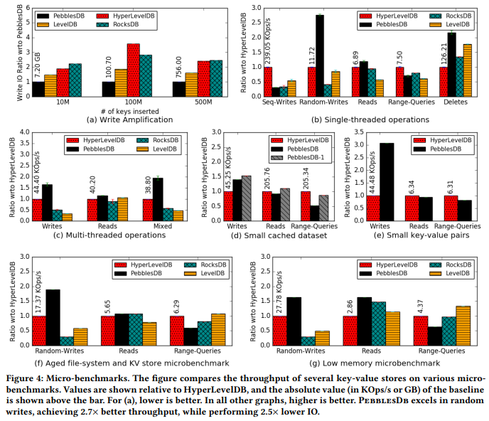
4. Evaluation

Slide 14
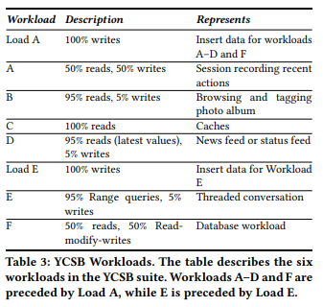
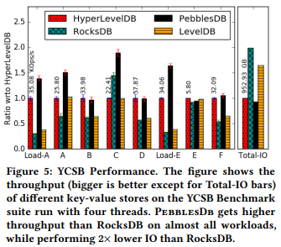
4. Evaluation

Slide 15
4. Conclusion
Compaction Overhead
1 회의 Compaction이 발생할 때 추가적인 Read/Write 횟수
Read Performance
Data를 찾기 위해 모든 Level Scan
Key Idea
Key 중복을 통해 Compaction을 지연
Guards 도입
Skiplist

Slide 16
Thank You!
2021. 03. 10
이 광 희
Notes:
Thank you.

