Slide 1
WiscKey Separating Keys from Values in SSD-conscious Storage
Lanyue Lu, Thanumalayan Sankaranarayana Pillai et al.
Usenix ’16, FAST, 2016
2021. 03. 10
Presentation by Shin Hojin
ghwls03s@gmail.com or hj03s@naver.com

Slide 2
Content
Introduction
Background
Motivation
Wisckey
Evaluation
Conclusion

Slide 3
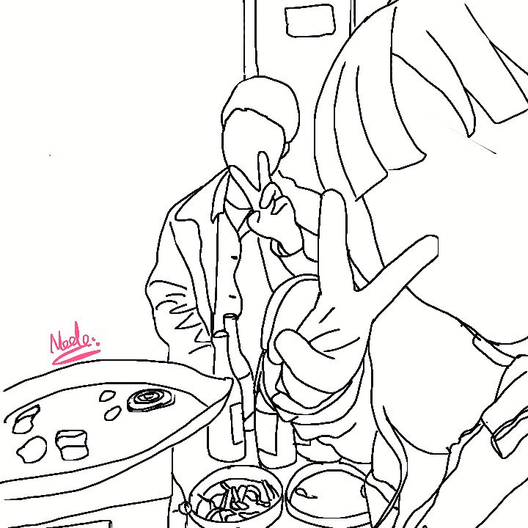
1. Introduction

Slide 4
1. Introduction
What to use for Data Management

Slide 5
1. Introduction
What to use for Data Management

Slide 6
1. Introduction
What to use for Data Management

Slide 7
1. Introduction
What to use for Data Management

Slide 8
1. Introduction
What to use for Data Management

Slide 9
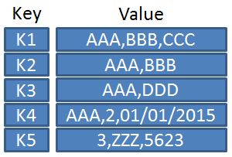
1. Introduction
Key-Value Stores
Web indexing, e-commerce, social networks
Various key-values stores
Hash table, b-tree
Log-structured merge trees (LSM-trees)

Slide 10
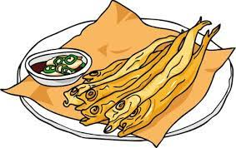
2. Background

Slide 11
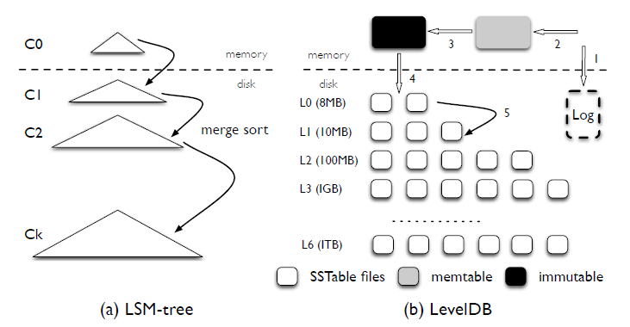
2. Background
What is the LSM-tree
Log structured merge tree
Provides efficient indexing for a key-value store with a high rate of inserts and deletes
Provide better write performance than traditional B-tree

Slide 12
2. Background
How LSM-tree(LevelDB) works - write

Slide 13
2. Background
Request
How LSM-tree(LevelDB) works - write
Key
Value

Slide 14
2. Background
Request
How LSM-tree(LevelDB) works - write
Key
Value
Disk Flush

Slide 15
2. Background
Request
How LSM-tree(LevelDB) works - write
Key
Value
Memtable
K
V
K
V

Slide 16
2. Background
Request
How LSM-tree(LevelDB) works - write
Key
Value
Immutable
Memtable
K
V
K
V

Slide 17
2. Background
Request
How LSM-tree(LevelDB) works
Key
Value
K
V
Disk Flush
K
V
Sorted Key-value Pair

Slide 18
2. Background
Request
How LSM-tree(LevelDB) works - write
Key
Value
Compaction
K
V
K
V
K
V

Slide 19
2. Background
Request
How LSM-tree(LevelDB) works - read
Key
Compaction
… …

Slide 20
3. Motivation

Slide 21
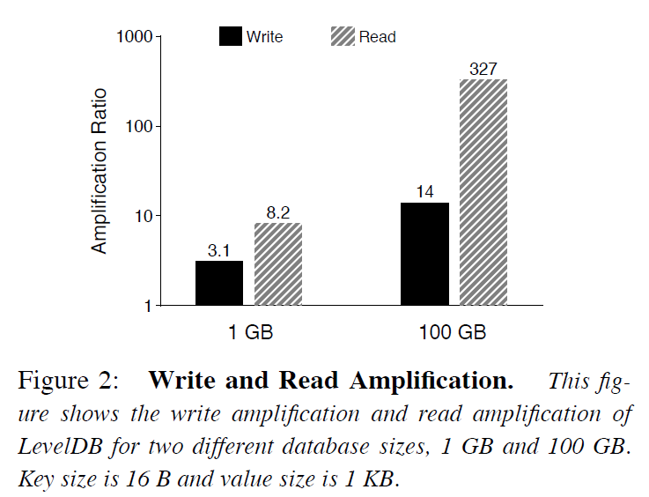
3. Motivation
What is the Problem for LSM-tree(LevelDB)
Write and read amplification
Write
Because of compaction
When compaction doing, read SST file from multiple level and write back these files to high level
It caused high write amplification
Read
Because of multiple metadata blocks
(index block + bloom filter block + data block)
It cause high read amplification
The more data is written, the higher amplification through more compaction and reads

Slide 22
4. Wisckey

Slide 23
4. Wisckey
Four critical ideas
Separates keys from values – key to LSM-tree, value to log
Uses parallel random-read characteristic of SSD dev
Utilizes unique crash-consistency and garbage collection techniques to efficiently manage the value log
Optimizes performance by removing the LSM-tree log without sacrificing consistency

Slide 24
4. Wisckey
Separates keys from values
Compaction is the main factor of high amplification
Compaction only needs to sort keys
LSM-tree = key (sorted)
vLog = value (append)
Size of LSM-tree of Wisckey is much smaller than LevelDB
Can reduce write amplification, because size of written back is small
Can reduce read amplification, because size of LSM-tree is small -> improve lookup performance
Key
Value
Key
addr
Value
Value
Value
LSM-tree
vLog

Slide 25
4. Wisckey
Separates keys from values
Compaction is the main factor of high amplification
Compaction only needs to sort keys
LSM-tree = key (sorted)
vLog = value (append)
Size of LSM-tree of Wisckey is much smaller than LevelDB
Can reduce write amplification, because size of written back is small
Can reduce read amplification, because size of LSM-tree is small -> improve lookup performance
Key
Value
Key
addr
Value
Value
Value
LSM-tree
vLog

Slide 26
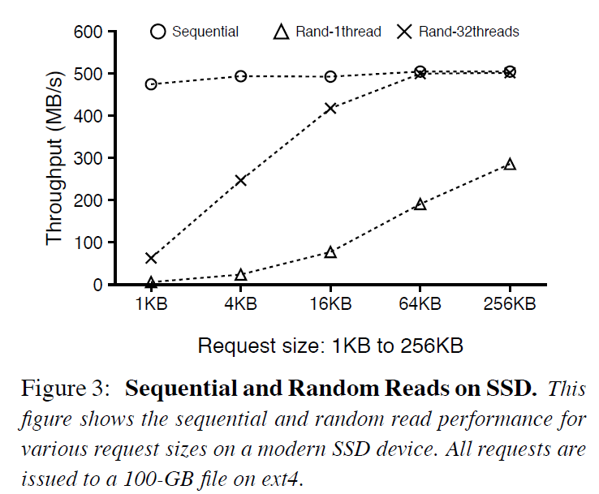
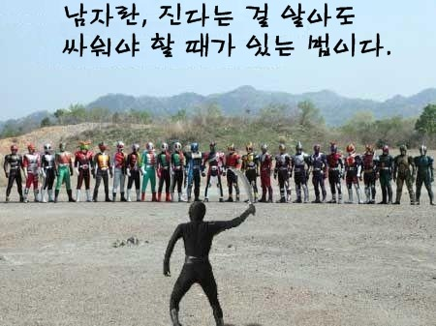
4. Wisckey
Parallel Range Query
Range query = allowing user to scan a range of key-value pairs
Wisckey separate key-value, require random reads -> not efficient
Use SSD character = parallel random reads
Reading key and corresponding address into a queue
Multiple threads will fetch addresses(from the queue) from the vLog concurrently in the background
Wisckey with Multi-thread
Wisckey with Single-thread

Slide 27
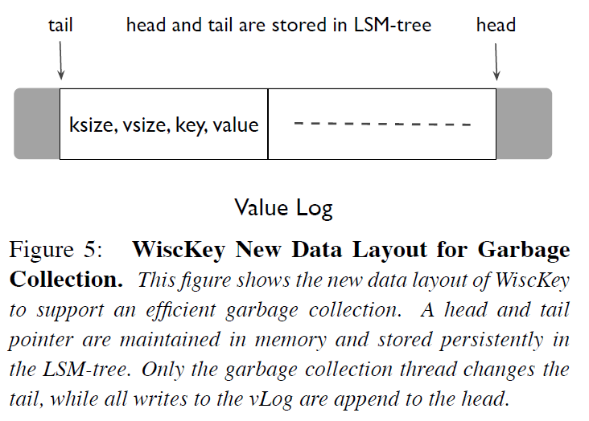
4. Wisckey
Garbage Collection
Standard LSM-tree reclaim key-value
Wisckey reclaim only key by the compaction
Special garbage collector to reclaim free space in the vLog
New data layout = (ksize, vsize, key, value)
New values appended
End of the vLog

Slide 28
4. Wisckey
Garbage Collection
Standard LSM-tree reclaim key-value
Wisckey reclaim only key by the compaction
Special garbage collector to reclaim free space in the vLog
New data layout = (ksize, vsize, key, value)
New values appended
End of the vLog
Garbage collection start

Slide 29
4. Wisckey
Garbage Collection
Standard LSM-tree reclaim key-value
Wisckey reclaim only key by the compaction
Special garbage collector to reclaim free space in the vLog
New data layout = (ksize, vsize, key, value)
Contains valid value
Searched during lookup

Slide 30
4. Wisckey
Crash Consistency
Using a property of modern file systems - prefix
Lookup
Key
addr
Value
Value
Value
Value will be garbage collected after
Lookup
Key
addr
Value
Value
Value
Found value corresponding key
Deletes the key from the LSM-tree

Slide 31
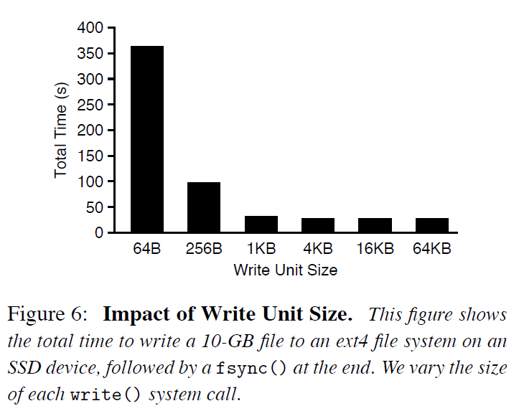
4. Wisckey
Optimizations
Value-Log Write Buffer
Buffers values in a userspace buffer
flushes the buffer only when the buffer size exceeds a threshold
when the user requests a synchronous insertion
Optimizing the LSM-tree Log
Can be recovered by scanning the vLog
Can remove lsm-tree log for key

Slide 32
5. Evaluation

Slide 33
5. Evaluation
Evaluation Enviornment
CPU | Intel Xeon CPU E5-2667 v2 @ 3.30GHz processros
Memory | 64 GB memory
OS | 64-bit Linux 3.14
Filesystem | Ext4 filesystem
Device | 500GB Samsung 840 EVO SSD
Device Performance | 500MB/s seq-read, 400MB/s seq-write

Slide 34
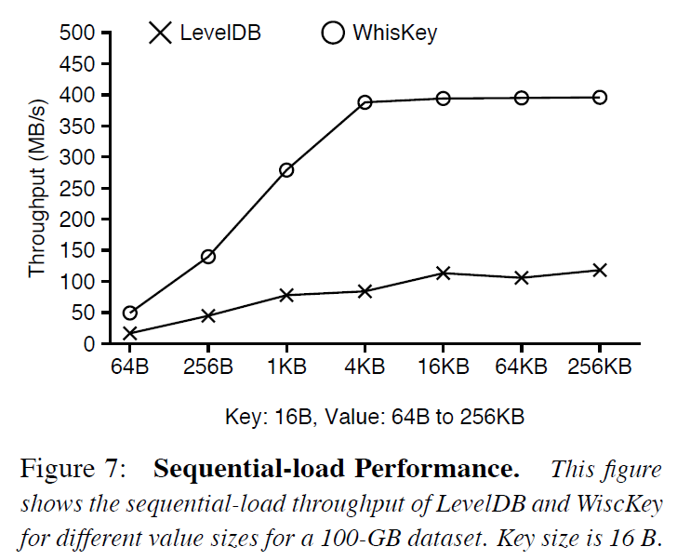
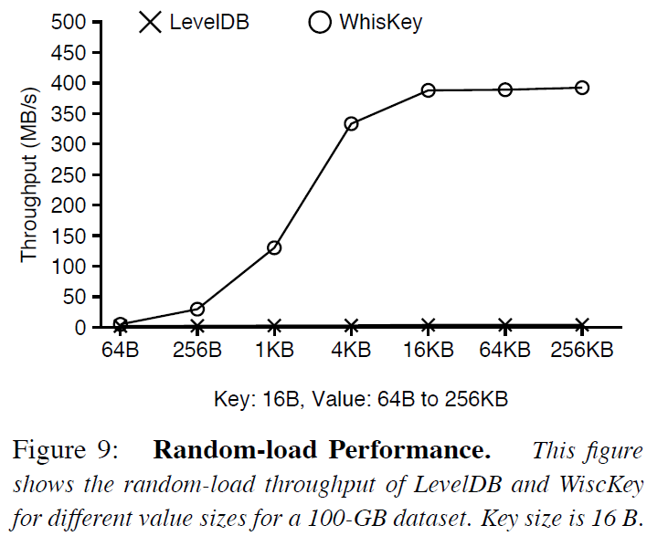
5. Evaluation
Load Performance
WAF Opt
Compaction Opt

Slide 35
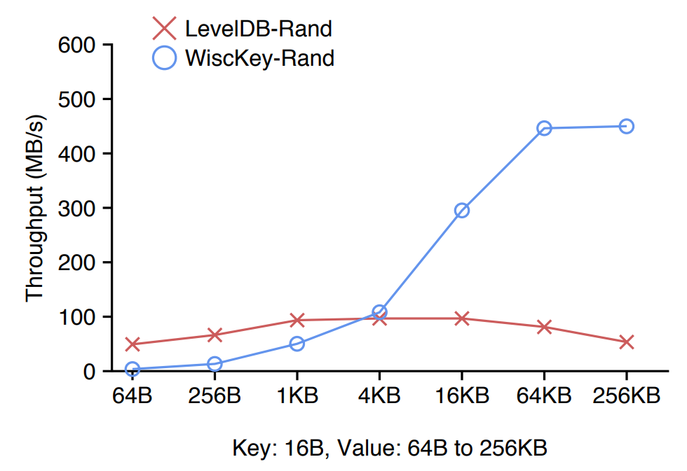
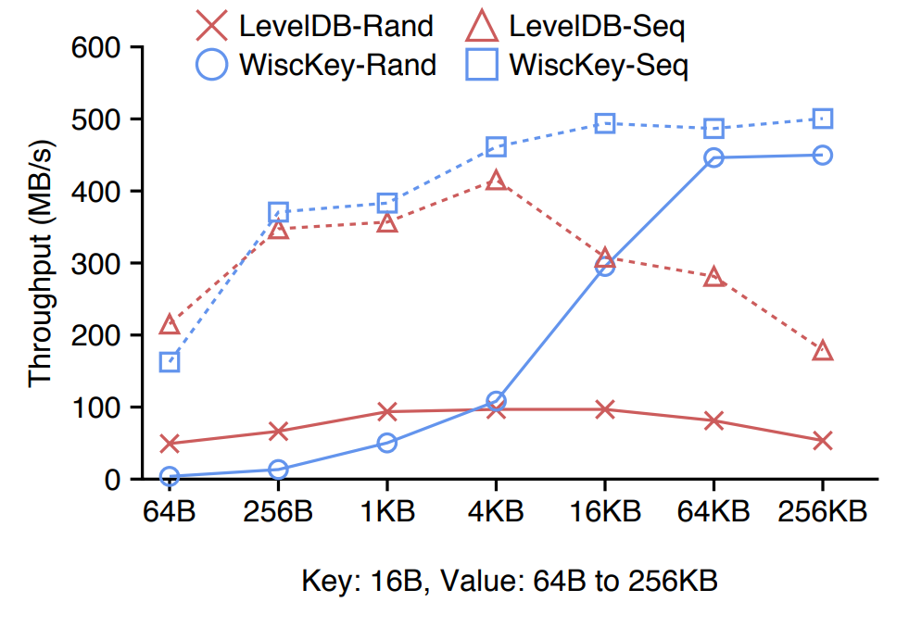
5. Evaluation
Query Performance
SSD Parallel Random Read

Slide 36
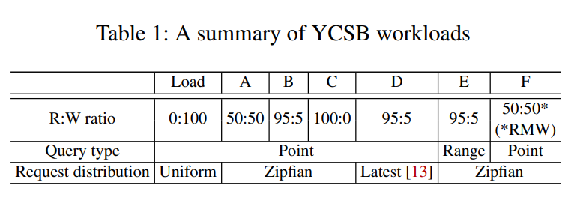
5. Evaluation
YCSB Benchmarks

Slide 37
6. Conclusion

Slide 38
6. Conclusion
Wisckey: a LSM-tree based key value store
Decouple sorting and garbage collection by separating keys from values
SSD-conscious designs
Significant performance gain
Transition to new storage hardware
Understand and leverage existing software
Explore new designs to utilize the new hardware

Slide 39
WiscKey Separating Keys from Values in SSD-conscious Storage
Lanyue Lu, Thanumalayan Sankaranarayana Pillai et al.
Usenix ’16, FAST, 2016
Thank You!
2021. 03. 10
Presentation by Shin Hojin
ghwls03s@gmail.com or hj03s@naver.com

