Slide 1
High Velocity Kernel File System with Bento
Samantha Miller, Kaiyuan Zhang, Mengqi Chen, Ryan Jennings, Ang Chen**, Danyang Zhuo*, Thomas Anderson
University of Washington, *Duke University, **Rice University
In 2020 USENIX Symposium on Operating Systems Design and Implementation
2021. 03. 16
Presentation by Inho, Song
inhoinno@dankook.ac.kr

Slide 2
Introduction
Motivation
Architecture of Bento
Design Goal
“Rust”
Evaluation
Conclusion
Notes:
This is the outline on my talk.
First, I will describe garbage Collection overhead in SSDs and Multi-Streamed SSD
Then, the details of PCStream design and analysis results are presented.
Finally, I will conclude my talk.

Slide 3
1. Introduction
Fast , Smart Storage
+
Traditional File System?
SSD
NVMe
Optane
Notes:
결국 커널에서 개발을 할 수 밖에 없습니다.

Slide 4
1. Introduction
How to develop in “Kernel” space?

Slide 5
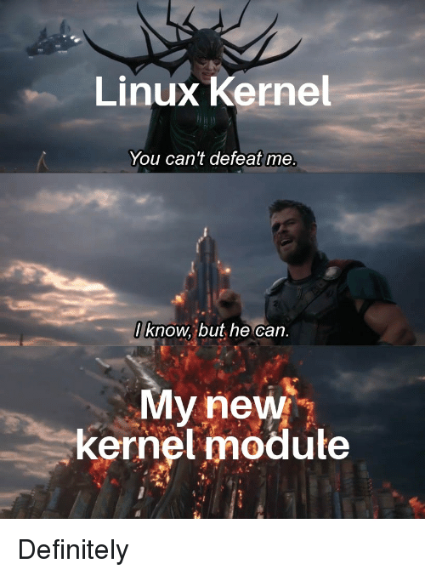
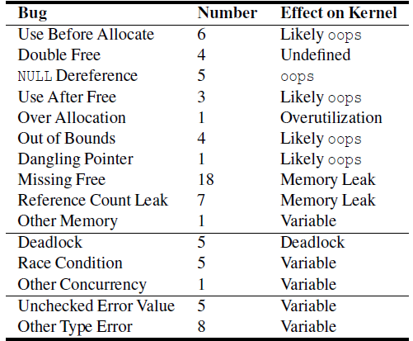
1. Introduction
Kernel modifications are notoriously difficult to get right.
Memory bugs
Concurrency bugs
Type errors
Low-level bugs in released versions of OverlayFS, AppArmor,
and Open vSwitch Datapath between 2014-2018
Notes:
왼쪽

Slide 6
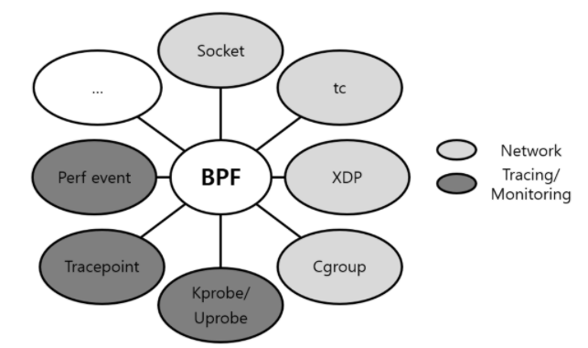
1. Introduction
Existing alternatives for higher velocity file systems
sacrificing …
1) Performance
2) Generality
Performance between FUSE and EXT4 on Filebench
eBPF Program Type
But the restrictions placed on eBPF make it very difficult to implement larger or more complex pieces of functionality
Notes:
1)
FUSE : 앞서 발표했듯, File system을 user level로 끌어 올려 개발을 쉽고 빠르게, 특히 디버그를 쉽게 할 수 있는 장점이 있는가 하면,
결국 Kernel FS로 가기위한 일종의 stub일 뿐이라서 성능적으로 inferio합니다.
2)
eBPF, extended BerKely Packed Filter, an in-kernel virtual machine
that allows code to be dynamically loaded and executed in the kernel at predefinded points defined by the kernel

Slide 7
2. Motivation
Higher velocity file systems
“without” sacrificing
Performance and Generality

Slide 8
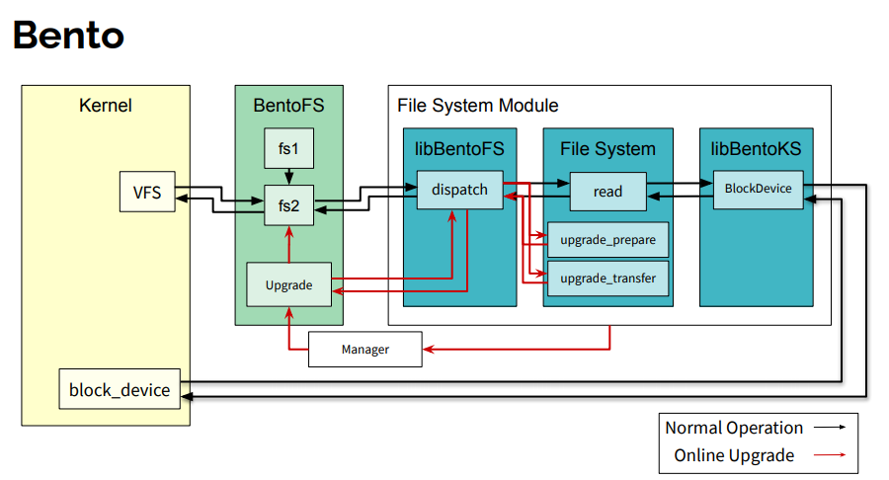
3. Architecture of Bento
Language : C
Language : Rust

Slide 9
3. Architecture of Bento
Safety
Generality
Performance
Comaptibility
Live upgrades
User-level debugging
Notes:
취사선택 해서 발표?

Slide 10
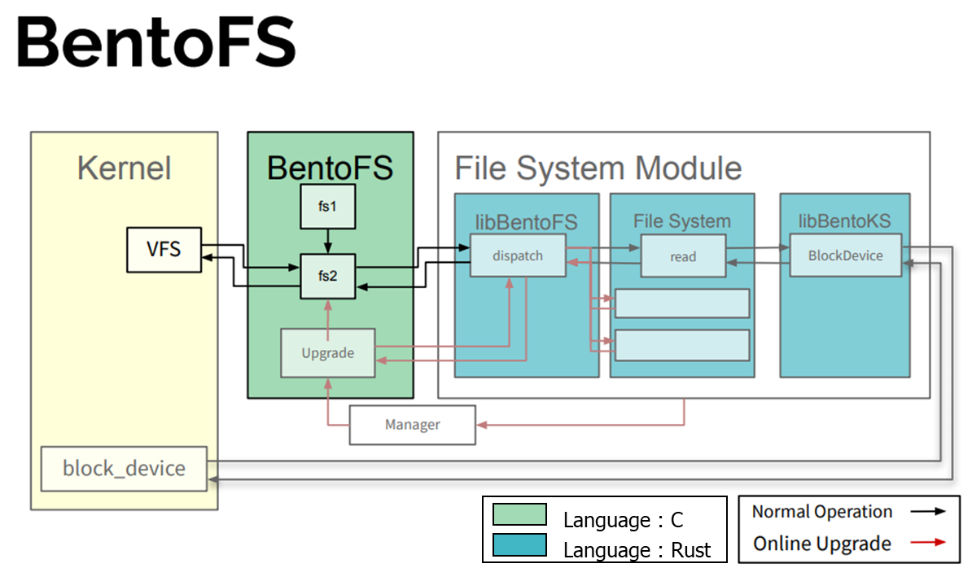
3. Architecture of Bento
Standalone C kernel module that hooks into VFS
Maintains an active list of file systems
Translates VFS calls to FUSE low-level API
Forwards calls to the correct file system
Contains the file system and two Rust libraries: libBentoFS and libBentoKS

Slide 11
3. Architecture of Bento
provides safe API for FS to access kernel service
such as Block IO
translate unsafe calls
Complied as a Rust static library includes
libBentoFS, libBentoKS

Slide 12
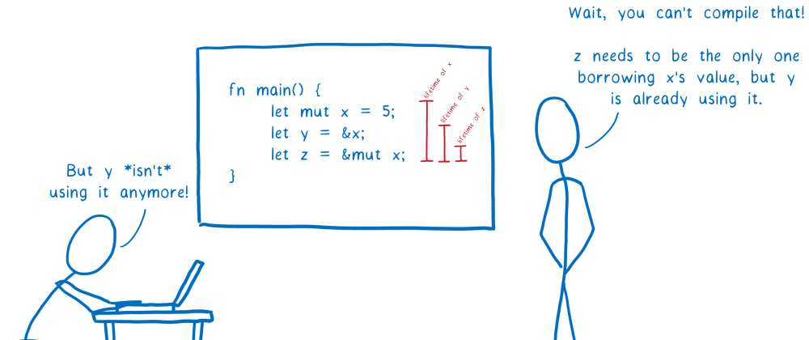
3. Architecture of Bento
1. How to develop a “Safe” Linux file system?
Rust : a multi-paradigm programming language design for performance, and safety
Official Rust Logo
bento/bento/rust/src/fuse/rely.rs
Syntactically similar to C++, but Rust guarantee memory safety
No runtime Garbage Collector(GC in Compile time)
Notes:
이쯤되면 이런 생각이 듭니다.
??? : “참 건방지네? 그래서 얼마나 좋아졌는데? 또 어떻게 설계를 했는데?”
라는 생각이 드는데요,
간단하게 얼마나 좋아졌고, 그뒤에 이사람들이 어떻게 설계했는지 알아보겠습니다.

Slide 13
3. Architecture of Bento
1. How to develop a “Safe” Linux file system?
Rust : a multi-paradigm programming language design for performance, and safety
2. How to make Bento with “Generality”?
Generality : Bento should not limit the types of file systems that can be developed.
3. How to make Bento with “Performance”?
Performance of Bento should be similar to that of the same functionality implemented using VFS.
Bento-fs
+
=
+
Rust
Performance

Slide 14
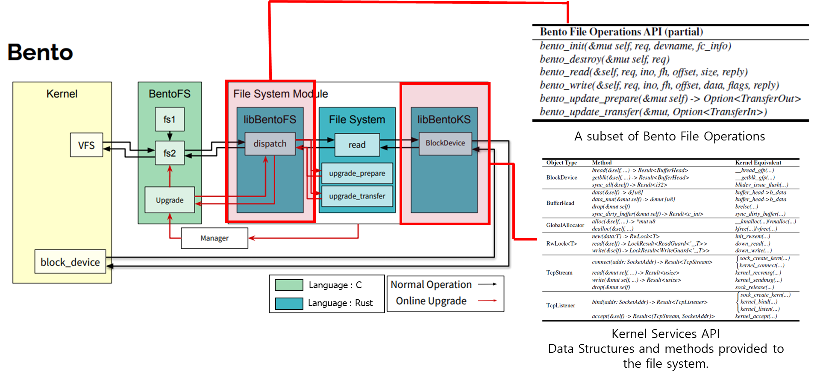
3. Architecture of Bento
4. How to make Bento with “Compatibility”?
Generality : Bento should not limit the types of file systems that can be developed.
Bento avoids directly using the Linux VFS interfaces
Instead, Bento introduces a message-passing based API for file systems
Also, Bento introduces a different API to enable safe access to C-language kernel services (C → Rust)
translate unsafe calls
translate unsafe calls

Slide 15
3. Architecture of Bento
5. Bento framework should support “Live upgrades”
The framework should support dynamic upgrades to running file system code, except for a small delay.
Language : C
Language : Rust

Slide 16
3. Architecture of Bento
5. Bento framework should support “Live upgrades”
Long-lived
File System
Updated
File System
Update
Constraints
Constraints
Semantics
Semantics
Disk request
File system journals
Bento quiesces the file system by pausing new calls into long-lived file system
A constraints on the old file system is that it must be able to transfer its semantic state to the new file system
TCP connection

Slide 17
3. Architecture of Bento
5. Bento framework should support “Live upgrades”
BentoFS
File System
FS1
Operation
FS2
RWLock
passed
by old file system
returned
when File system
removed
Upgrade
A constraints on the old file system is that it must be able to transfer its semantic state to the new file system
→ Each FS defines two data structure
Bento quiesces the file system by pausing new calls into long-lived file system
→ Read Lock on operations

Slide 18
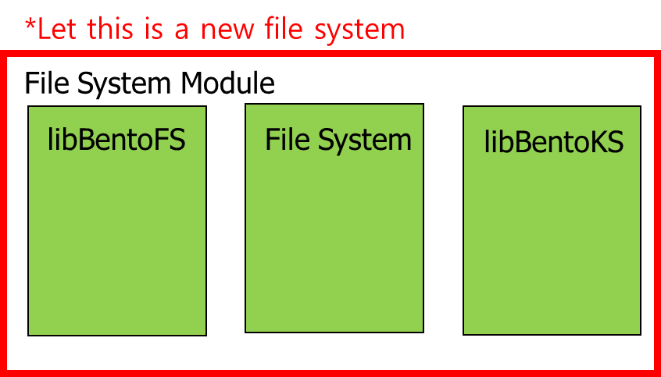
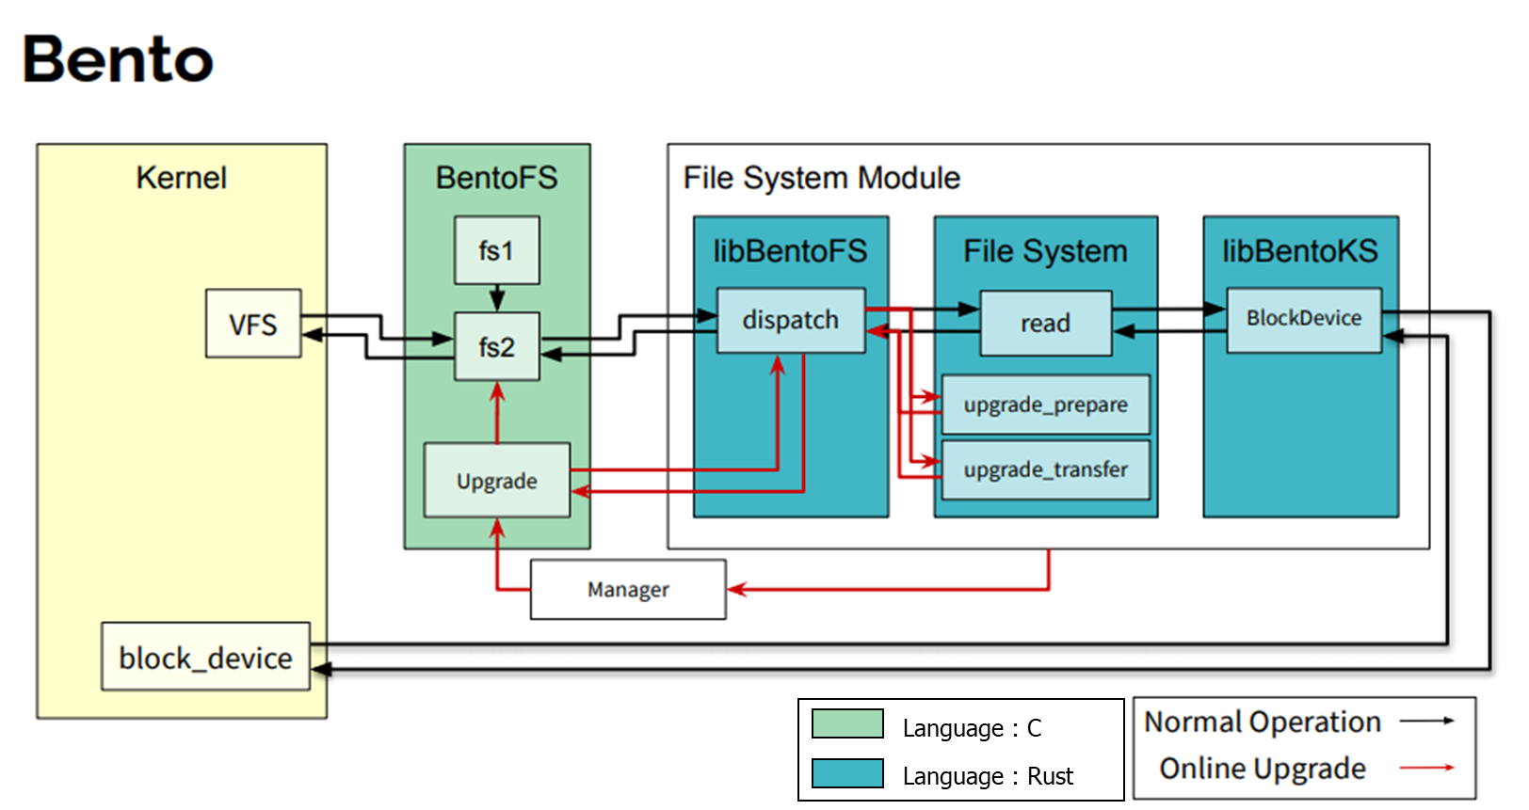
3. Architecture of Bento
5. Bento framework should support “Live upgrades”
*Let this is an old file system need to be upgraded
Kernel
BentoFS
File System Module
libBentoFS
File System
libBentoKS
VFS
fs 1
Upgrade
Component
Module
Manager
*Let this is a new file system
File System Module
libBentoFS
File System
libBentoKS

Slide 19
3. Architecture of Bento
5. Bento framework should support “Live upgrades”
*Let this is an old file system need to be upgraded
Kernel
BentoFS
File System Module
Read Lock
libBentoFS
File System
libBentoKS
VFS
fs 1
Dispatch
upgrade_prepare
Upgrade
Component
Module
Manager
*Let this is a new file system
File System Module
libBentoFS
File System
libBentoKS

Slide 20
3. Architecture of Bento
5. Bento framework should support “Live upgrades”
*Let this is an old file system need to be upgraded
Kernel
BentoFS
File System Module
Read Lock
libBentoFS
File System
libBentoKS
VFS
fs 1
Dispatch
upgrade_prepare
Upgrade
Component
Module
Manager
*Let this is a new file system
File System Module
libBentoFS
File System
libBentoKS

Slide 21
3. Architecture of Bento
5. Bento framework should support “Live upgrades”
*Let this is a new file system
Kernel
BentoFS
File System Module
Read Lock
libBentoFS
File System
libBentoKS
VFS
fs 1
Dispatch
upgrade_prepare
Upgrade
Component
upgrade_transfer
Now, the new file system instance initialized
*Let this is a new file system
File System Module
libBentoFS
File System
libBentoKS

Slide 22
3. Architecture of Bento
5. Bento framework should support “Live upgrades”
*Let this is a new file system
Kernel
BentoFS
File System Module
libBentoFS
File System
libBentoKS
VFS
fs 2
Dispatch
Upgrade
Component
Block Device
Now, the new file system instance initialized
*Let this is a new file system
File System Module
libBentoFS
File System
libBentoKS

Slide 23
3. Architecture of Bento
6. File system code should be easily migrated. “User-level debugging”
Userspace Execution : File system can be compiled to run in userspace using a build flag
File system can be compiled to run in user space using a build flags
File System Module
libBentoFS
File System
libBentoKS
User ver.
User ver.
Debugged code can be dropped back into kernel without any modification.

Slide 24
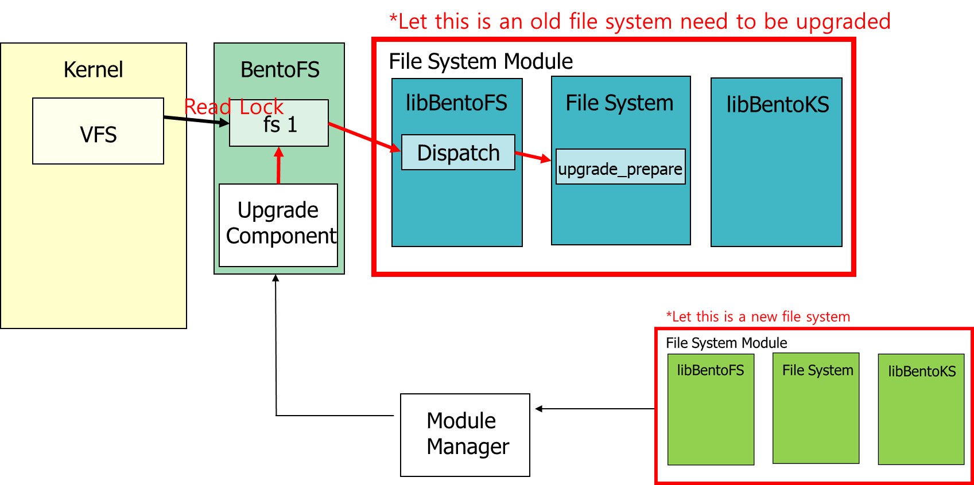
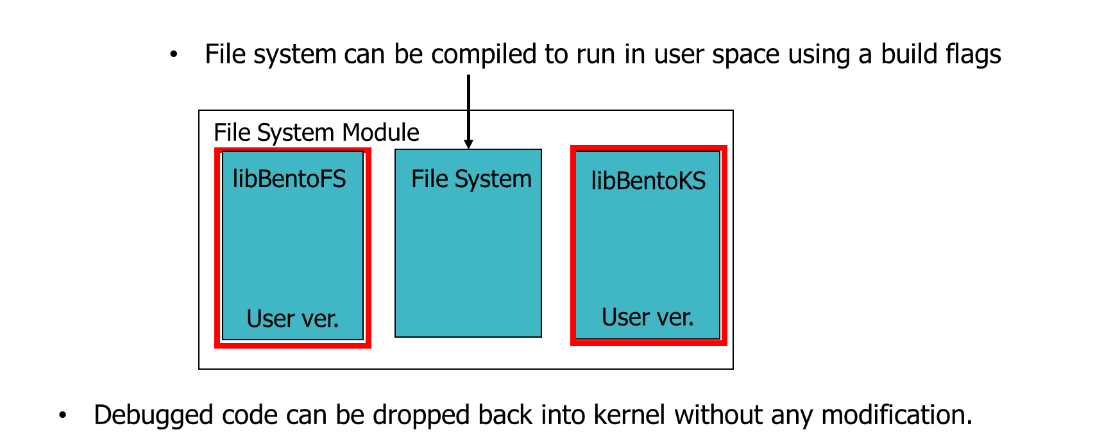
3. Architecture of Bento
Safety!
Generality
Performance?
Comaptibility!
Live upgrades
User-level debugging
Notes:
취사선택 해서 발표?

Slide 25
4. Evaluation
Bento-fs
: An optimized xv6 written in Rust. Implement similar to ext4 behavior & performance (4. Implementation)
Environment
Machine setup
Intel Xeon Gold 6138 CPU using 40 hyperthreads
96 GB DDR4 RAM
Intel Optane 900P Series NVMe SSD with 2.5 GB/s read speed and 2 GB/s write speed
Baselines
Ext4 with data journaling (data=journal)
Ext4 with default metadata journaling (data=ordered
Bento-prov
: Bento-fs + provenance feature
provenance : ability to record the history of data and its place of origin
Bento-user
: Bento-fs running in user space
Notes:
먼저
CrossFS ioctl인데,
자신들이 말한 3메인 Bottleneck을 피하고, disjoint블록에 대해서 접근을 허용해주었더니
12GB파일에 대해서 4개의 writer가 존재할 때 Reader 의 읽기 througput을 살펴보았더니
혼자 더 많이 좋아지는, 마치 사기치는것(?)과 같은 그래프를 보였습니다.

Slide 26
4. Evaluation
Live upgrade
: How does live upgrade impact availability?
Benchmarks: Pairs of creates and deletes and synced writes with 10 threads
the number of operations / 5ms interval = Througput

Slide 27
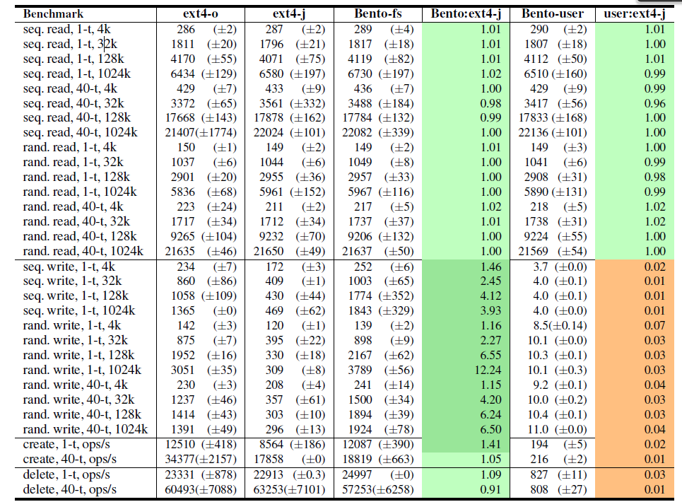
4. Evaluation
Microbenchmarks
: Can Bento support competitive performance?(compare to ext4)
Due to
Implementation
difference
MB/s
ext-j :
logs blocks to the journal on the write() syscall path
Bento-fs :
use writeback cahce(async)
Notes:
먼저
CrossFS ioctl인데,
자신들이 말한 3메인 Bottleneck을 피하고, disjoint블록에 대해서 접근을 허용해주었더니
12GB파일에 대해서 4개의 writer가 존재할 때 Reader 의 읽기 througput을 살펴보았더니
혼자 더 많이 좋아지는, 마치 사기치는것(?)과 같은 그래프를 보였습니다.

Slide 28
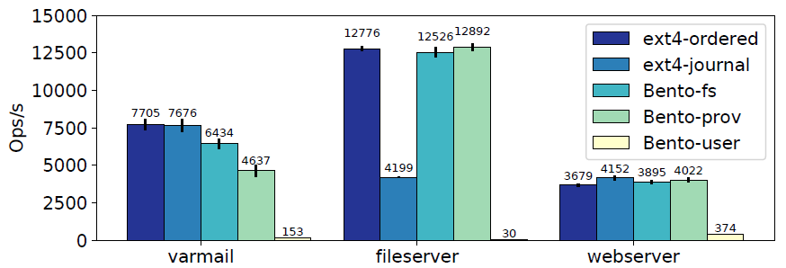
4. Evaluation
Application : Filebench
: Can Bento support competitive performance?(compare to ext4)
Filebench ‘fileserver’ executes many sequences of create-write-delete operations,
but it does not sync the file before the file is deleted.

Slide 29
4. Evaluation
Application : ‘tar’, ‘untar’, ‘grep’, ‘git clone’
: Can Bento support competitive performance?(compare to ext4)
Too many Kernel Crossing!
Too many Block I/O issues!

Slide 30
4. Evaluation
Key-Value Store
: Can Bento support competitive performance?(compare to ext4)
Redis
RocksDB

Slide 31
5. Conclusion
Bento
Safety, Performance, Generality
- FS implementation by Rust
Live update supports
- Using Bento, FS upgrade can be complete with 15ms
Easy Debugging
- Expose identical interface to kernel and userspace

Slide 32
High Velocity Kernel File System with Bento
Samantha Miller, Kaiyuan Zhang, Mengqi Chen, Ryan Jennings, Ang Chen**, Danyang Zhuo*, Thomas Anderson
University of Washington, *Duke University, **Rice University
In 2020 USENIX Symposium on Operating Systems Design and Implementation
Thank You!
2021. 03. 16
Presentation by Inho, Song
inhoinno@dankook.ac.kr

Slide 33
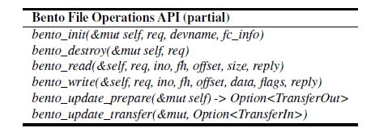
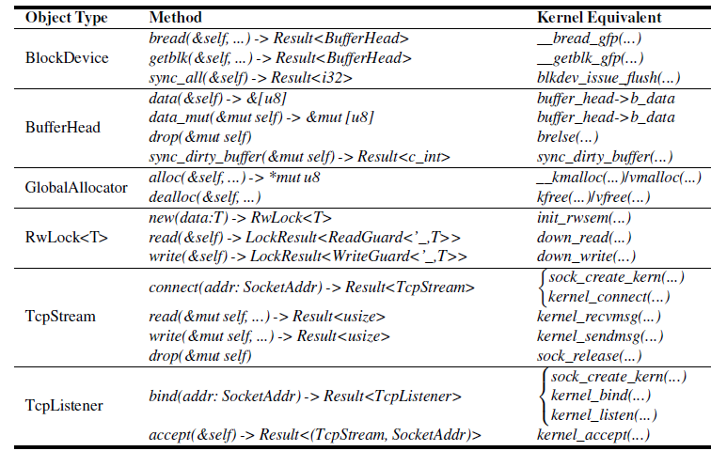
3. Architecture of Bento
1. How to develop a “Safe” Linux file system?
A subset of Bento File Operations
Language : C
Language : Rust
Kernel Services API
Data Structures and methods provided to the file system.

