Slide 1
A Reconfigurable FTL (Flash Translation Layer) Architecture for NAND Flash-Based Applications
C. Park et al.
2021. 03. 24
Presentation by Lee, Sounghyoun
leesh812@dankook.ac.kr

Slide 2
Introduction
Background
Related Work
Flexible Group Mapping
Performance Model and Analysis
Conclusion

Slide 3
1. Introduction
NAND Flash memory become more common in many mobile devices
It is nonvolatile, reliable, more resistant to physical shocks and uses less power
NAND flash memory is characterized by its erase-before-write operation
This necessitates FTL(Flash Translation Layer)
ex) MP3 players, MMC cards, cellular phones, and PDAs
Google Finance

Slide 4
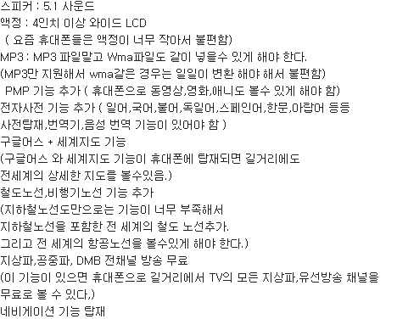
1. Introduction
NAND Flash memory become more common in many mobile devices
It is nonvolatile, reliable, more resistant to physical shocks and uses less power
NAND flash memory is characterized by its erase-before-write operation
This necessitates FTL(Flash Translation Layer)
ex) MP3 players, MMC cards, cellular phones, and PDAs
Google Finance

Slide 5
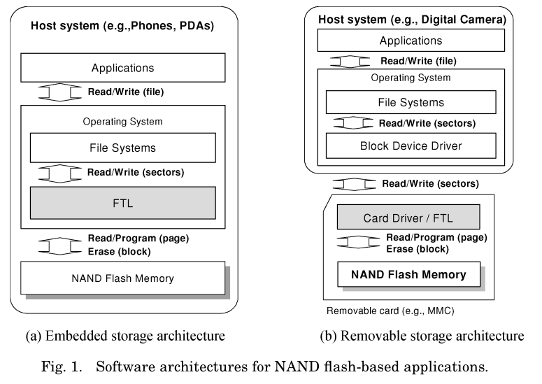
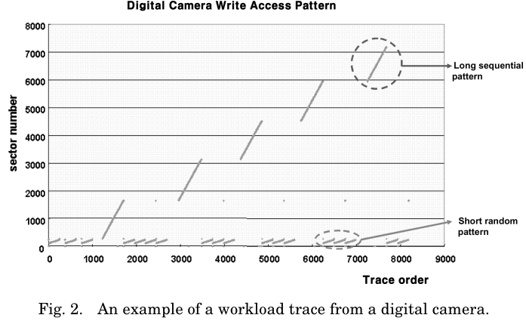
1. Introduction
Important Factors that affects FTL design
Hiding the technological detail
Maximizing the performance and lifetime
Access patterns of applications
Google Finance

Slide 6
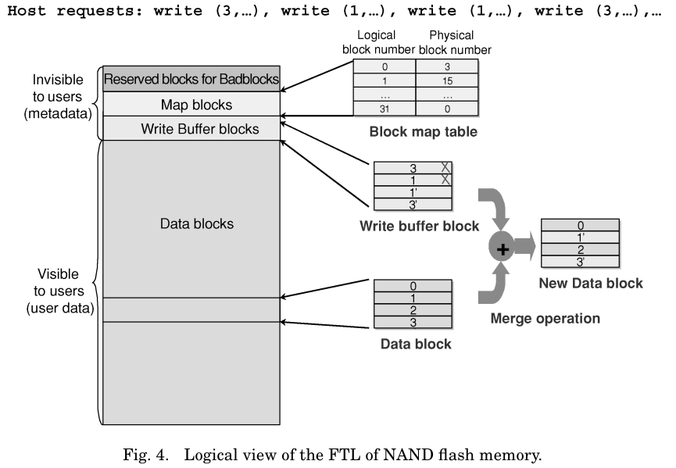
2. Background
Page-write requests
four page-read operations
four page program operations
two block-erase operations
Google Finance
Reducing the numbers of merge operations

Slide 7
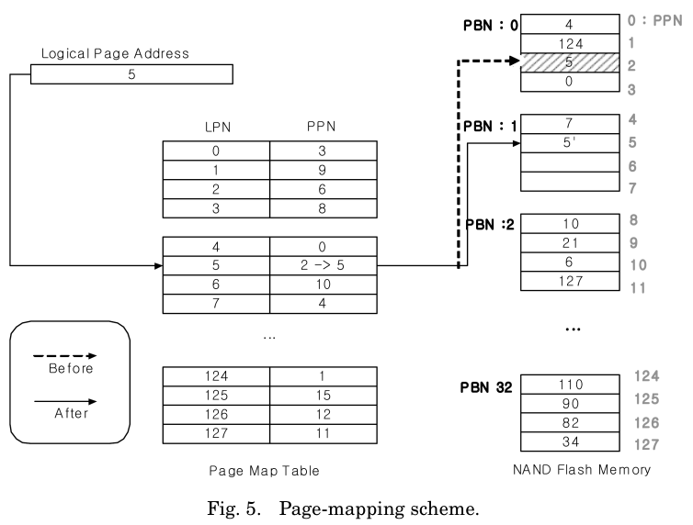
3. Related Work
Page Mapping
LPN : Logical Page Number
PPN : Physical Page Number
An efficient “garbage collection”
It requires a very large amount of memory space for the map table
Google Finance

Slide 8
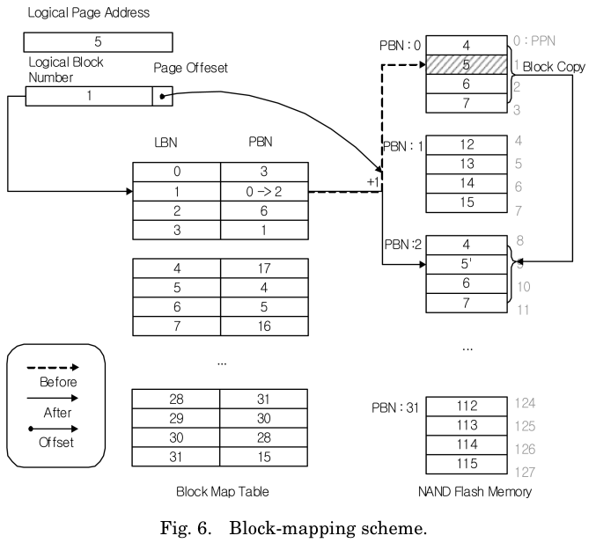
3. Related Work
Block Mapping
LBN : Logical Block Number
PBN : Physical Block Number
Considerable performance degradation over random-access patterns
Google Finance

Slide 9
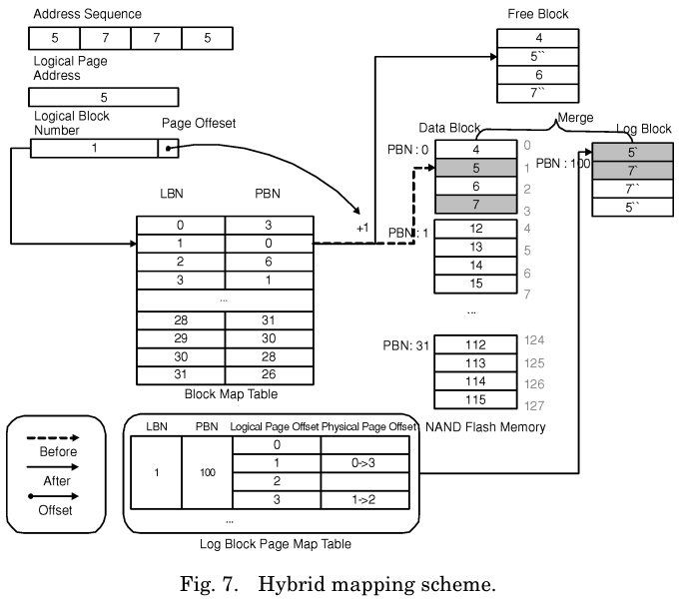
3. Related Work
Hybrid Mapping
Compromises between page mapping and block mapping
many hybrid mapping schemes reduce the mapping table size and the block copy overhead
Google Finance

Slide 10
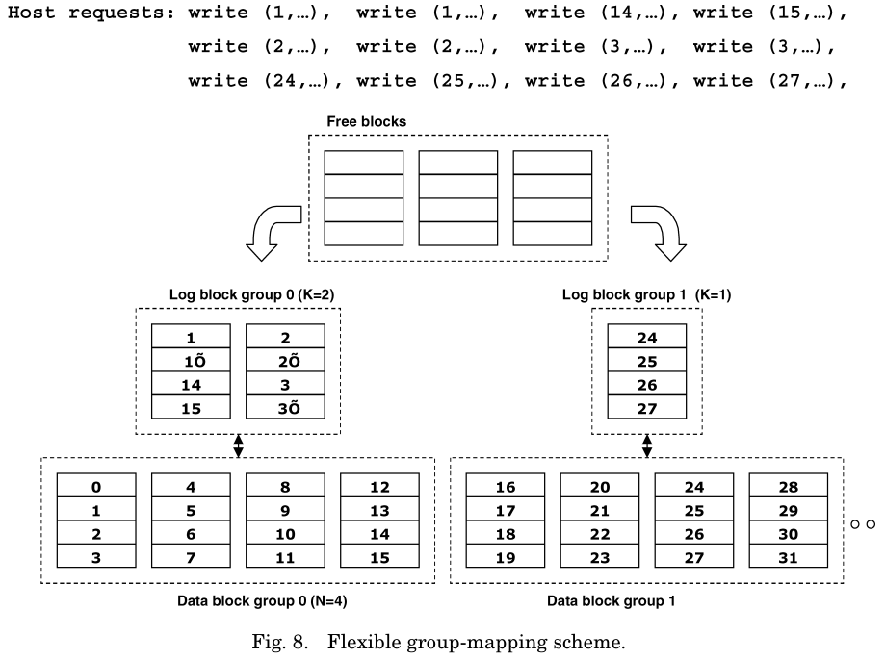
4. Flexible Group Mapping
Flexible Group Mapping
Based on the log block scheme
Configures the degree of sharing of log blocks among data blocks
Manages the degree of the allocation of log blocks for the frequently updated data blocks
Google Finance

Slide 11
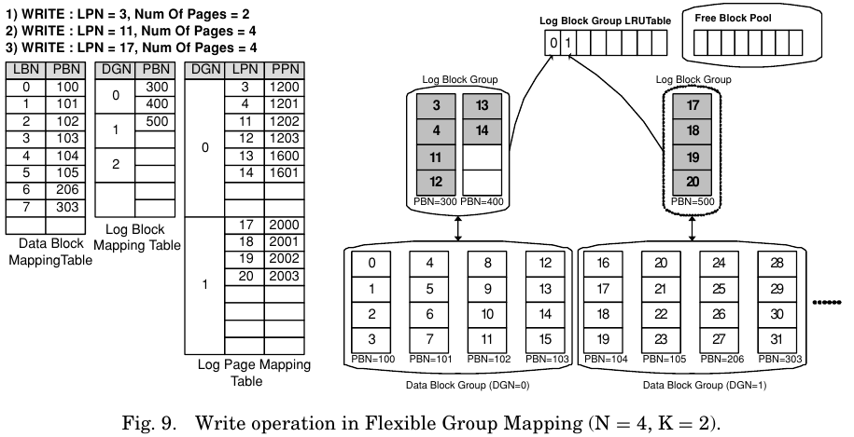
4. Flexible Group Mapping
Flexible Group Mapping – Write Scheme
DBMT : the data-block-mapping table
LBMT : the log-block-mapping table
LPMT : the log-page-mapping table
DGN : the data-block-group number
Google Finance

Slide 12
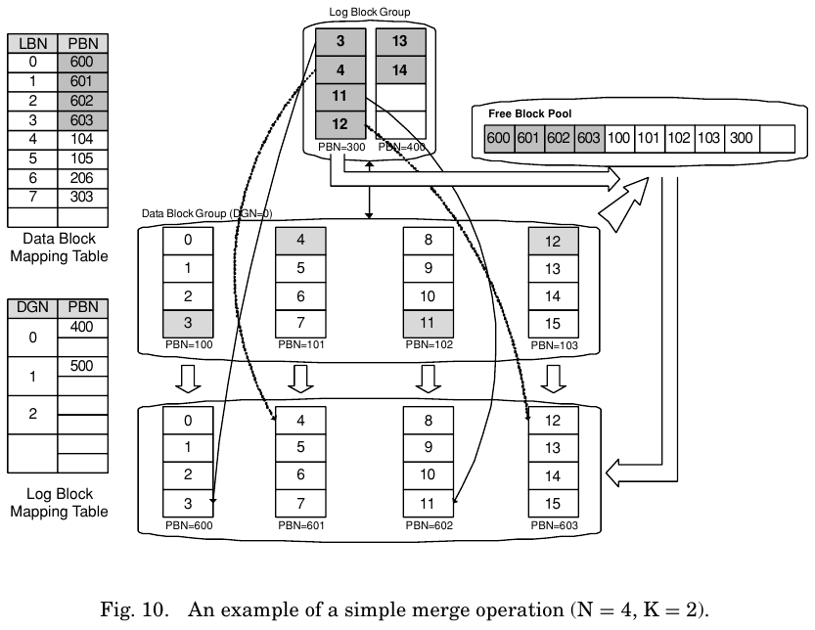
4. Flexible Group Mapping
Flexible Group Mapping – Merge Scheme
Simple merge operation
Swap merge operation
Copy merge operation
Google Finance

Slide 13
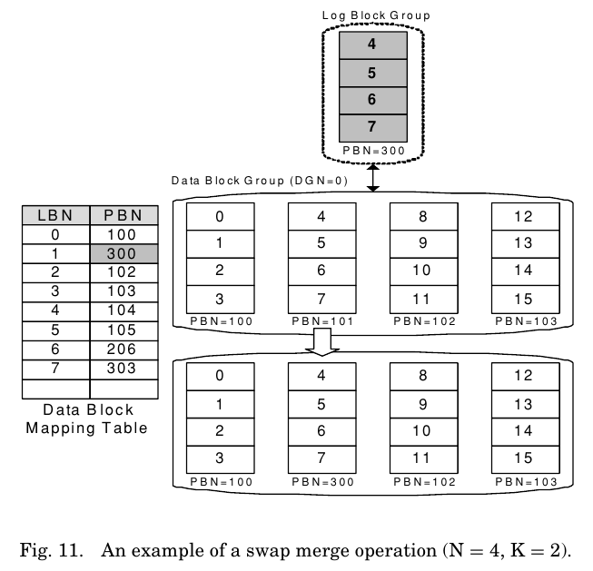
4. Flexible Group Mapping
Flexible Group Mapping – Merge Scheme
Simple merge operation
Swap merge operation
Copy merge operation
Google Finance

Slide 14
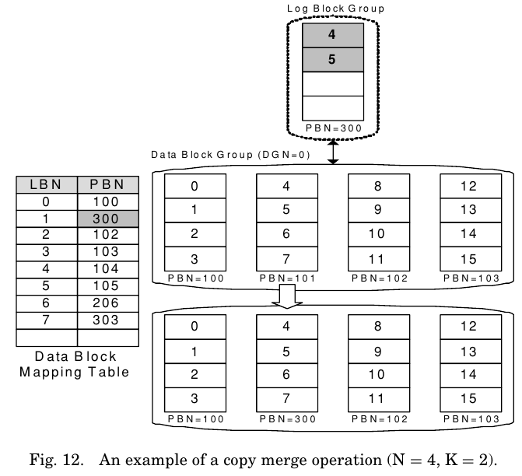
4. Flexible Group Mapping
Flexible Group Mapping – Merge Scheme
Simple merge operation
Swap merge operation
Copy merge operation
Google Finance

Slide 15
5. Performance Model and Analysis
Workload Analysis
$R_{k}$ denotes the $k$th write request
$$R=\left(R_{0},R_{1}, …,R_{M−1}\right), (0≤k<M)$$
The request density
$$RD_{i,j}= C_{i,j}/\left|W\right|$$
Google Finance

Slide 16
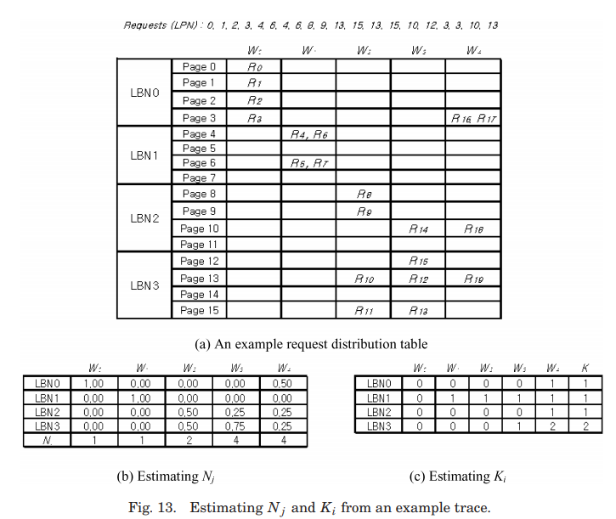
5. Performance Model and Analysis
Workload Analysis
Google Finance

Slide 17
5. Performance Model and Analysis
Performance Analysis
$A_{k}$ : the active data block accessed by $R_{k}$
${AG}_{k}$ : the active data block group accessed by $R_{k}$
$SA(W_{j})$ and $SAG(W_{j})$ : the set of active blocks and the set of active block groups
$L\left(AG_{k}\right)$ : the number of log blocks associated with ${AG}_{k}$
Memory Requirement Analysis
Google Finance

Slide 18
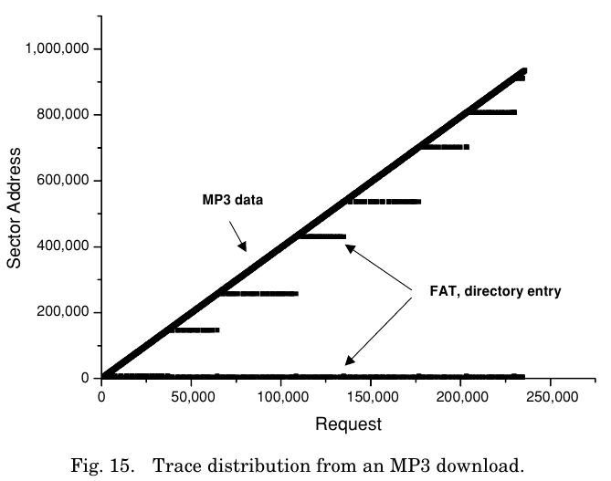
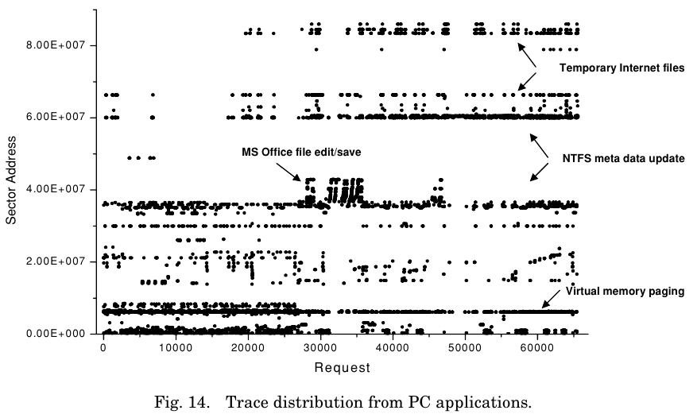
6. Experimental Results
Experiment
Google Finance

Slide 19
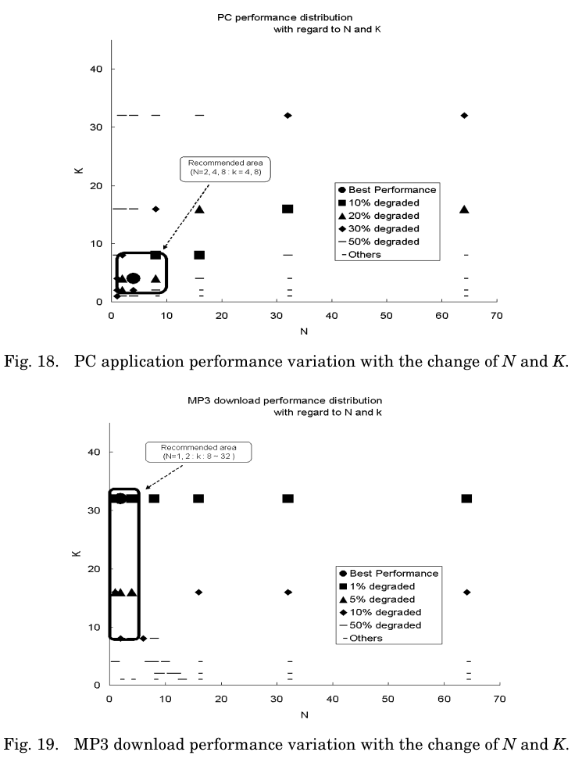
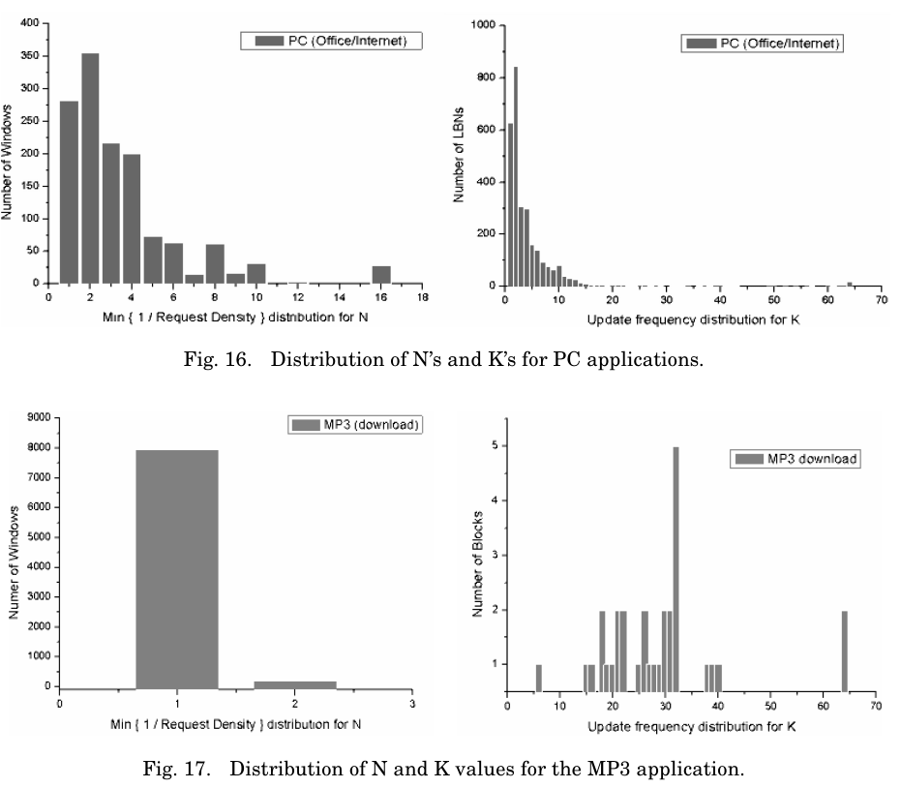
6. Experimental Results
Experiment
Google Finance

Slide 20
6. Conclusion
Conclusion
The proposed reconfigurable FTL architecture efficiently handles diverse NAND flash applications ranging from MP3 to SSD for a PC
In order to efficiently explore the design space, a workload analysis method based on the density distribution of given requests and the update frequency is proposed
The experimental results show
the proposed architecture can be reconfigured to a given workload ranging from MP3 to PC applications
the proposed analysis method can efficiently find the optimal N and K values within a reasonable amount of time
Google Finance

Slide 21
A Reconfigurable FTL (Flash Translation Layer) Architecture for NAND Flash-Based Applications
C. Park et al.
Thank you!
2021. 03. 24
Presentation by Lee, Sounghyoun
leesh812@dankook.ac.kr

