Slide 1
MLPerf Inference Benchmark
72200118 최동빈

Slide 2
Contents
Introduction
Prior Art In AI/ML Benchmarking
Inference-Benchmarking Challenges
Benchmark Design
Inference Submission System
Submission-System Evaluation
Benchmark Assessment
Lessons Learned
Conclusion

Slide 3
Impression on this paper

Slide 4
Introduction

Slide 5
Introduction
Representative workloads for reproducibility and accessibility
Scenarios for realistic evaluation
Prescribe target qualities and tail-latency bounds in accordance with real-world use cases
Rules that allow users to show both hardware and software capabilities.
Inference-benchmarking method that allows the models to change frequently while preserving the aforementioned contributions.

Slide 6
2. Prior Art In AI/ML Benchmarking
AI Benchmark.
EEMBC MLMark.
Fathom.
AI Matrix.
DeepBench.
TBD (Training Benchmarks for DNNs).
DAWNBench.

Slide 7
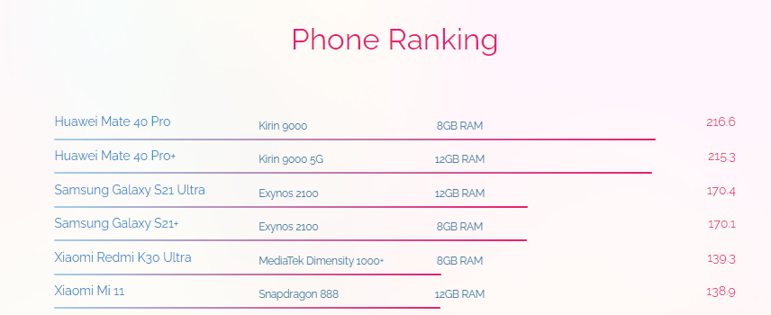
2. Prior Art In AI/ML Benchmarking

Slide 8
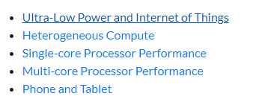
2. Prior Art In AI/ML Benchmarking
Categories
The EEMBC MLMark® benchmark is a machine-learning (ML) benchmark designed to measure the performance and accuracy of embedded inference.
Notes:
, but it lacks use-case scenarios.

Slide 9
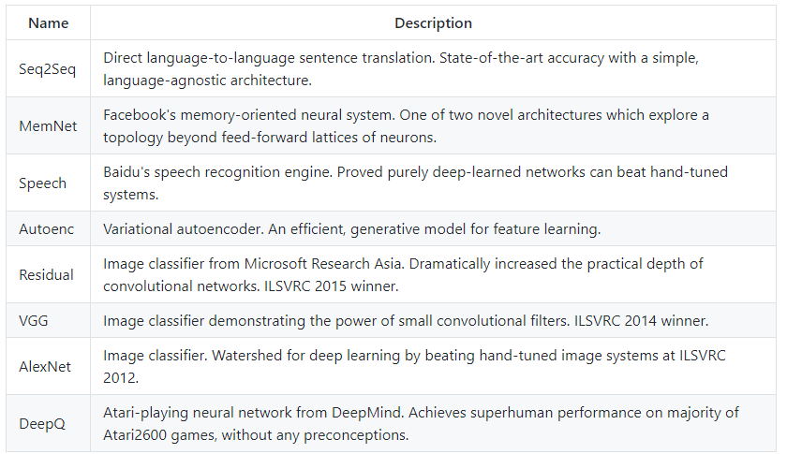
2. Prior Art In AI/ML Benchmarking
Notes:
Tensorflow 만 지원

Slide 10
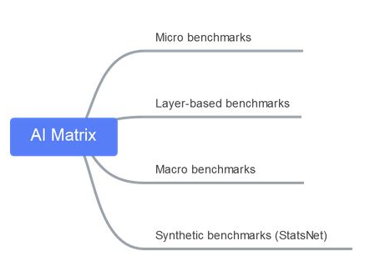
2. Prior Art In AI/ML Benchmarking
Notes:
It uses microbenchmarks to cover basic operators such as matrix multiplication and convolution, it measures performance for fully connected and other common layers, it includes full models that closely track internal applications, and it offers a synthetic benchmark to match the characteristics of real workloads. MLPerf has a smaller model collection and focuses on simulating scenarios using the LoadGen.

Slide 11
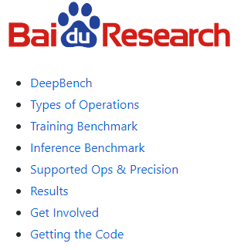
2. Prior Art In AI/ML Benchmarking
Notes:
measure the library implementation of kernel-level operations (e.g., 5,124×700×2,048 GEMM) that are important for performance in production models. They are useful for efficient development but fail to address the complexity of full models.

Slide 12
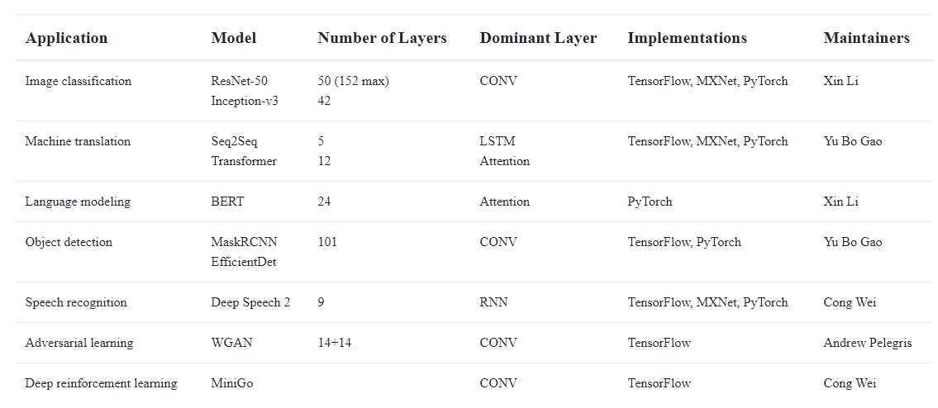
2. Prior Art In AI/ML Benchmarking
Notes:
It focuses on evaluating GPU performance

Slide 13
2. Prior Art In AI/ML Benchmarking
Notes:
It focuses on evaluating GPU performance

Slide 14
2. Prior Art In AI/ML Benchmarking
Notes:
but we offer more tasks, models, and scenarios.

Slide 15
3. Inference-Benchmarking Challenges
Diversity of models

Slide 16
3. Inference-Benchmarking Challenges
Deployment-Scenario Diversity

Slide 17
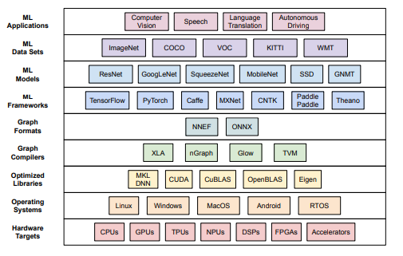
3. Inference-Benchmarking Challenges
Inference-System Diversity

Slide 18
4. Benchmark Design
Representative, Broadly Accessible Workloads & Robust Quality Targets

Slide 19
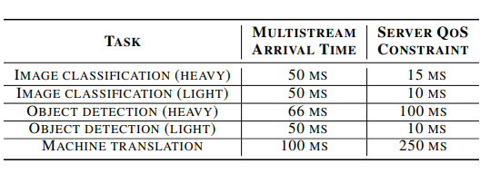
4. Benchmark Design
Realistic End-User Scenarios

Slide 20
4. Benchmark Design
Statistically Confident Tail-Latency Bounds

Slide 21
5. Inference Submission System
Allowed techniques.
Prohibited techniques.

Slide 22
5. Inference Submission System

Slide 23
6. Submission-System Evaluation
Divisions
Closed
Open
Categories
Available
Preview
Research, Development, and Other systems (RDO).

Slide 24
6. Submission-System Evaluation
Result Review
Accuracy verification
On-the-fly caching detection
Alternate-random-seed testing
Custom data sets
Result Reporting
MLPerf Inference provides no “summary score.”

Slide 25
7. Benchmark Assessment
Task Coverage

Slide 26
7. Benchmark Assessment
Scenario Usage

Slide 27
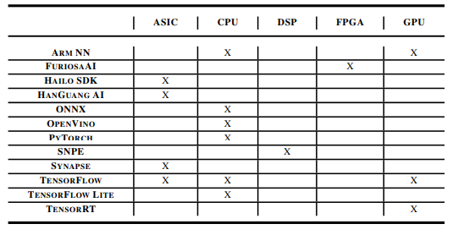
7. Benchmark Assessment
Processor Types and Software Frameworks

Slide 28
7. Benchmark Assessment
System Diversity

Slide 29
7. Benchmark Assessment
Open Division
Encouraging the industry to push system limits.
Notes:
v0.5 Results | MLCommons

Slide 30
8. Lessons Learned
Models: Breadth vs. Use-Case Depth
Metrics: Latency vs. Throughput
Data Sets: Public vs. Private
Performance: Modeled vs. Measured
Process: Audits and Auditability

Slide 31
9. Conclusion
Performance metrics.
Accuracy/performance tradeoff.
Evaluation of AI inference accelerators.

Slide 32
Additional – v0.7

Slide 33
Additional – v0.7

Slide 34
Additional – v0.7

Slide 35
Thank You

