Slide 1
SpanDB : A Fast, Cost-Effective LSM-tree Based KV store on Hybrid Storage
Hao Chen, Chaoyi Ruan, Cheng Li, Xiaosong Ma, Yinlog Xu
FAST, 2021
2021. 06. 02
Presentation by Shin, Hojin
hojin03s@dankook.ac.kr

Slide 2
Introduction
Reference
Background
SpanDB
Evaluation
Conclusion

Slide 3
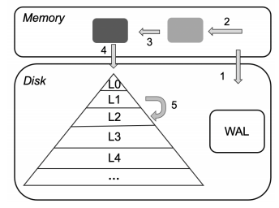
1. Introduction
Rise of Key-Value Stores
Persistent key-value stores popular and important
Storing semi-structured data for enterprise services – LevelDB by Google, RocksDB by Facebook
Being backend storage engine – Ceph, MyRocks TiDB, Cassandra
LSM-tree based KV stores are popular
LSM-tree based KV store

Slide 4
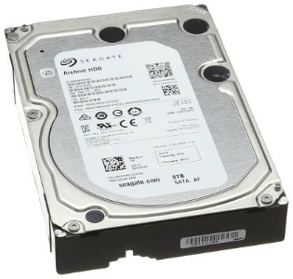
1. Introduction
Storage devices come faster
HDD
SATA SSD
NVMe SSD
Optane SSD
(~ms, 100MB/s)
(~us, 2000MB/s)
Faster

Slide 5
2. Reference

Slide 6
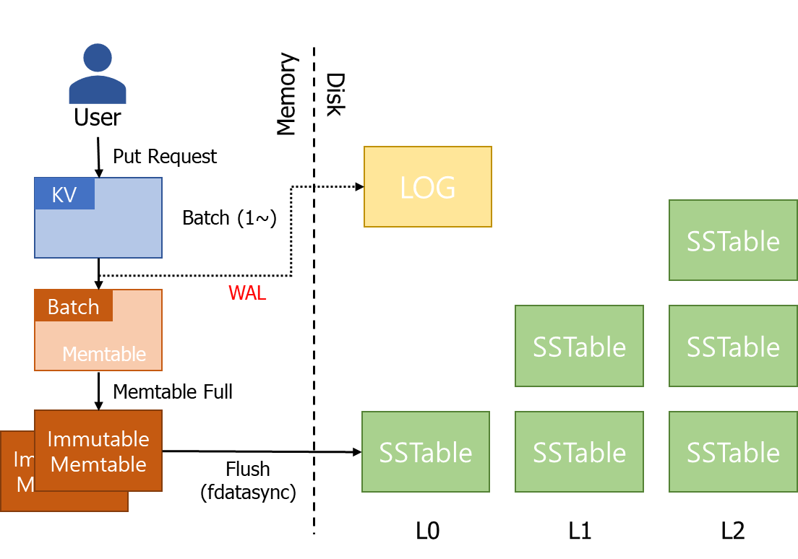
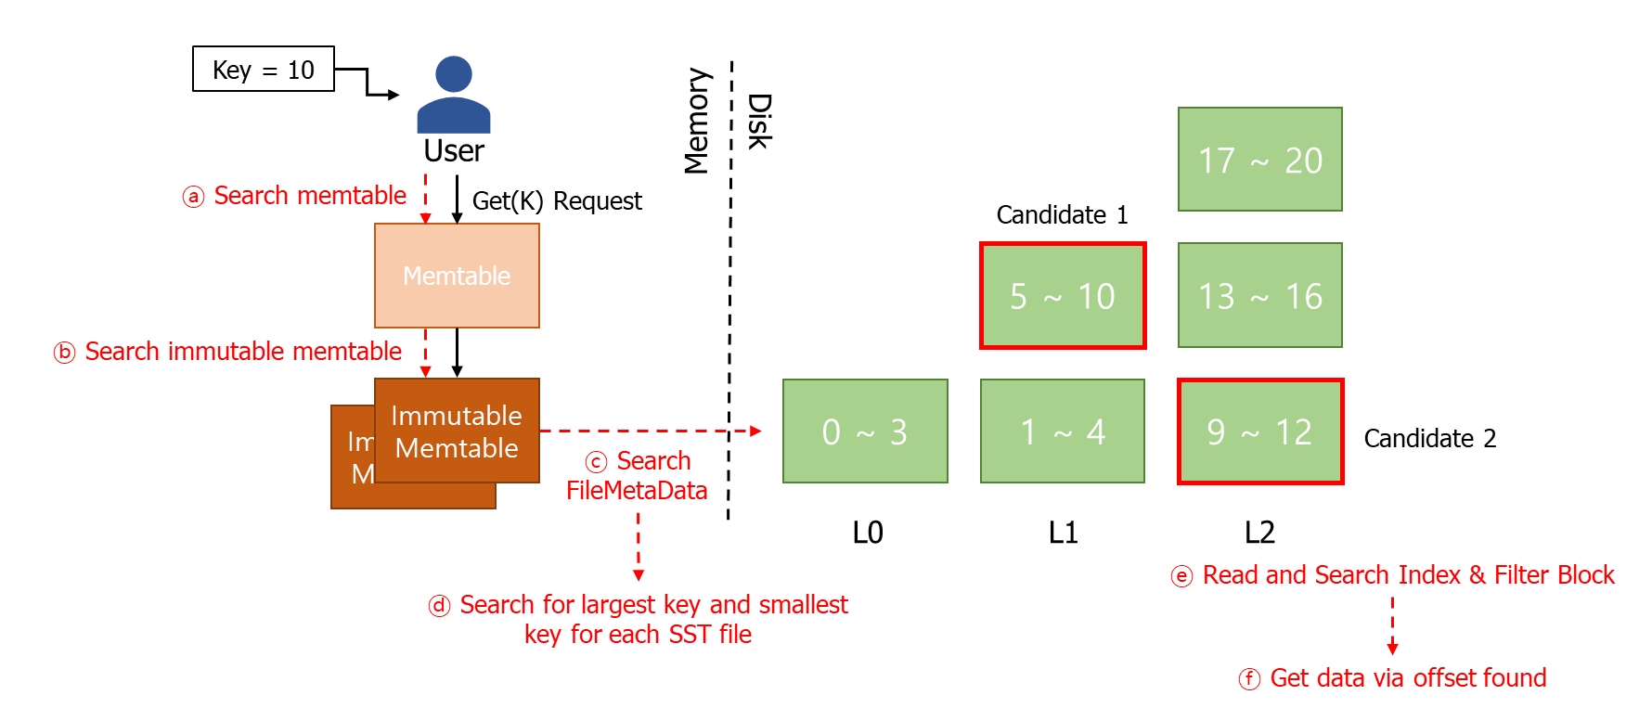
3. Background
RocksDB Data Structure
Foreground Thread
Compaction
Background Thread

Slide 7
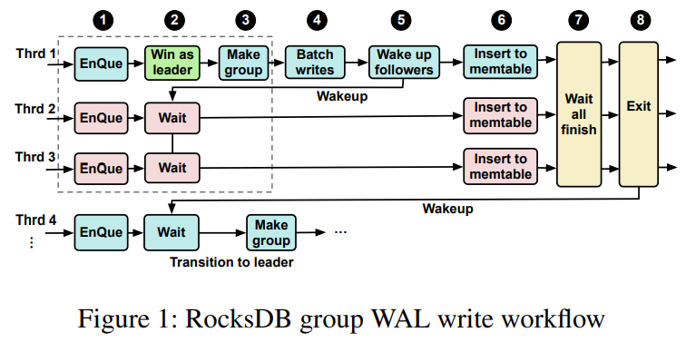
3. Background
RocksDB group WAL write workflow

Slide 8
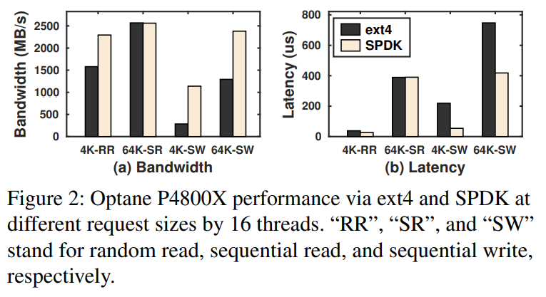
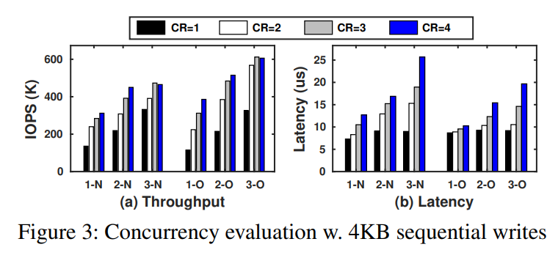
3. Background
SSD performance and Filesystem Effect
N = Intel P4610
O = Intel Optane
CR n = each thread issuing up to n requests
n – N = n threads writing to SSD N

Slide 9
4. SpanDB
Preview SpanDB

Slide 10
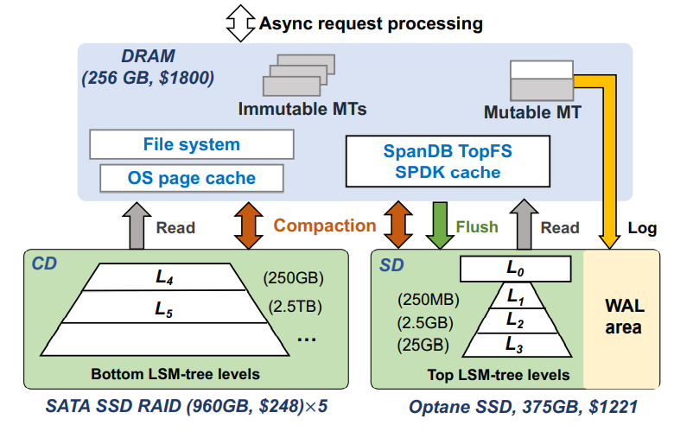
4. SpanDB
SpanDB Storage Overview
High-performance, cost-effective LSM-tree based KC store using heterogeneous storage devices
Capacity Disk(CD), Speed Disk(SD)
No modifications to RocksDB’s KV data structures, algorithms, or operation semantics
Implements TopFS, a lightweight file system, which allows easy and dynamic level relocation

Slide 11
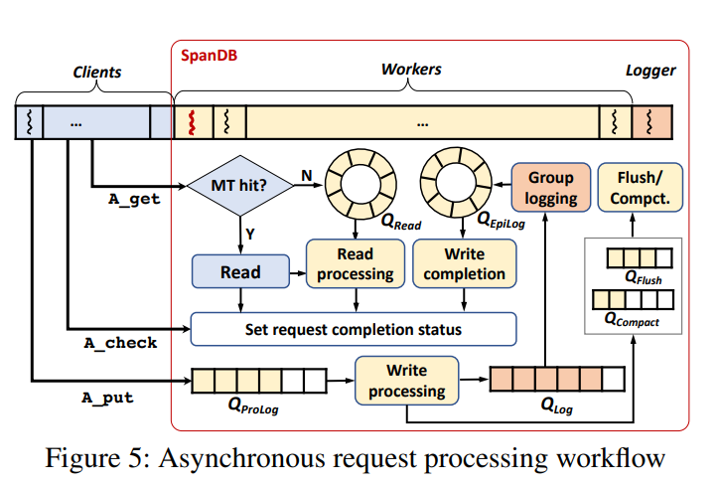
4. SpanDB
Asynchronous request processing workflow
Internal server threads – loggers and workers
Loggers – dedicated to WAL writes
Worker – handle both background processing and non-IO tasks
Asynchronous APIs
A_get, A_check, A_put
Task Queue
Q_flush, Q_compact = RocksDB
Q_read(Read), Q_prolog, Q_log, Q_Epilog(Write)

Slide 12
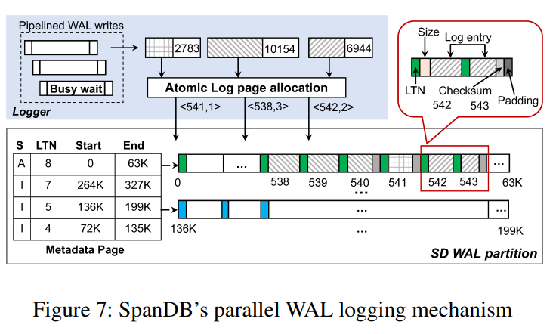
4. SpanDB
High-Speed Logging via SPDK
SpanDB uses SPDK to flush log entries to raw NVMe SSD devices, by passing the filesystem and Linux IO Stack
Performs pipelining by stealing the SPDK busy-wait time for one request to prepare/check others
Log Data Management
LPN(Log Page Number), LTN(Log Tag Number)
The only synchronization point is log page allocation
SpanDB needs to know which pages of the current log group have been overwritten
Reuse the per-Memtable LTN as a log page ‘color’

Slide 13
4. SpanDB
Offloading LSM-tree Levels to SD
Data area storage organization
SpanDB implements TopFS, providing familiar file interface wrappers on top of SPDK IO
TopFS does guarantee data persistence upon file close
Metadata management : hash table, indexed by file name, stores the files’ start and end LPNs
SpanDB SPDK Cache
Bypasses the OS page cache
All data buffers passed must be allocated in pinned memory
Manages the cache using another hash table, again with the RocksDB SST file name as key

Slide 14
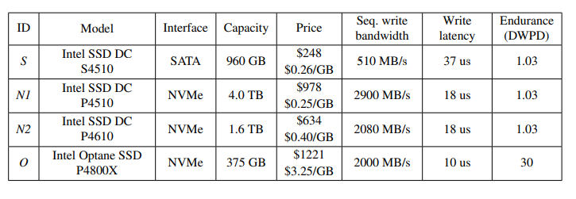
5. Evaluation
Experimental Setup
2 20-core Xeon Gold 6248 processors / 256GB DRAM / CentOS 7.7
SATA SSDs (4+1 RAIDS)

Slide 15
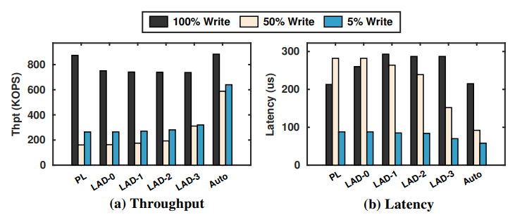
5. Evaluation
Impact of data placement in SpanDB
PL = Pure Logging
LAD-n = the top n levels of the LSM-tree is placed on the SD(speed disk)
Auto = Adapative Setting

Slide 16
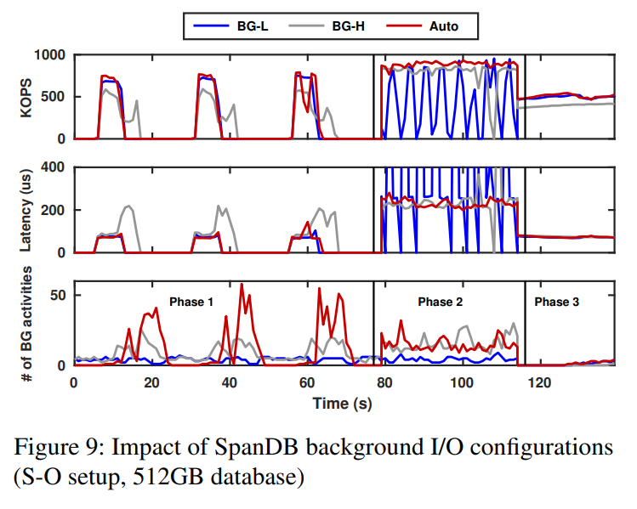
5. Evaluation
Background IO configurations
BG-L = RocksDB default, one thread each for compaction and flush
BG-H = 6 compactions and 2 flush threads

Slide 17
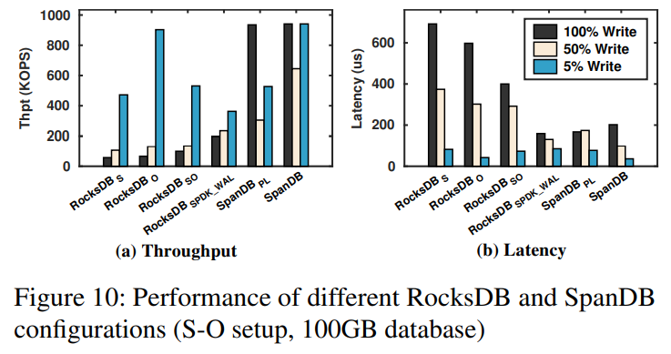
5. Evaluation
Performance of different RocksDB and SpanDB configurations
RocksDB use the SD (O)
RocksDB use the CD (S)
Only with WAL writes via SPDK instead of ext4 (SPDK_WAL)

Slide 18
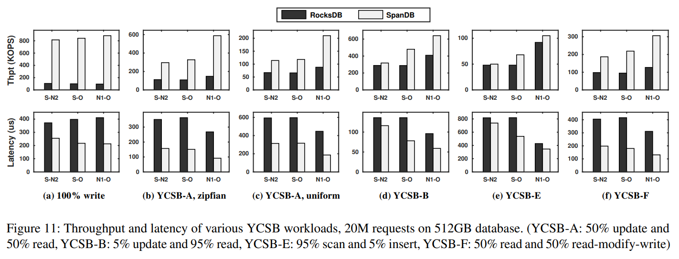
5. Evaluation
YCSB benchmark

Slide 19
5. Conclusion
Conclusion
Deploy a small and expensive high-speed SSD at the most-needed locations of a KV store
With leaving the majority of data on larger, cheaper, and slower device
Reveal that the mainstream LSM-tree based design can be significantly improved to take advantage of such partial hardware upgrade

Slide 20
SpanDB : A Fast, Cost-Effective LSM-tree Based KV store on Hybrid Storage
Hao Chen, Chaoyi Ruan, Cheng Li, Xiaosong Ma, Yinlog Xu
FAST, 2021
Thank you !
2021. 06. 02
Presentation by Shin, Hojin
hojin03s@dankook.ac.kr

