Slide 1
Serving DNNs like Clockwork: Performance Predictability from the Bottom Up
Arpan Gujarati et al., UT Austin
OSDI 2020
72210294@dankook.ac.kr
Shin Minjae

Slide 2
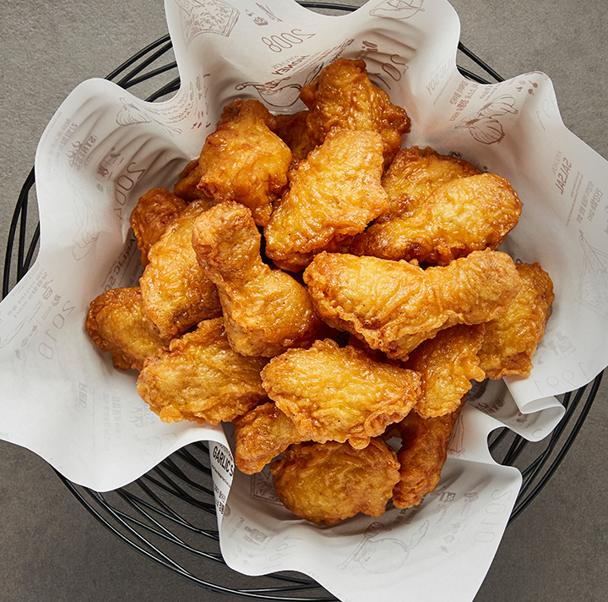
DNN Nowadays
Model Serving System
200,000,000,000,000 +
“교촌 허니콤보”

Slide 3
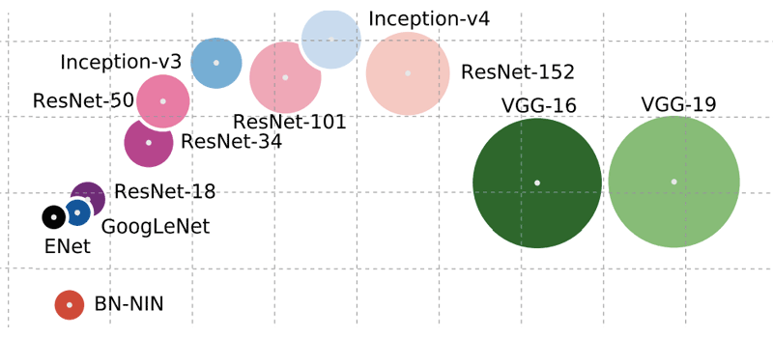
Influences of Latency
request
request
request
request
request
request
request
lot of requests
many different models
restricted GPU

Slide 4
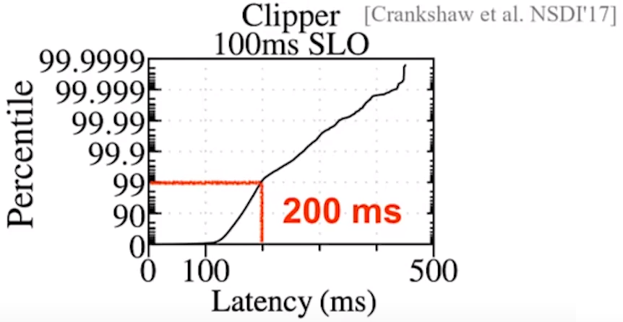
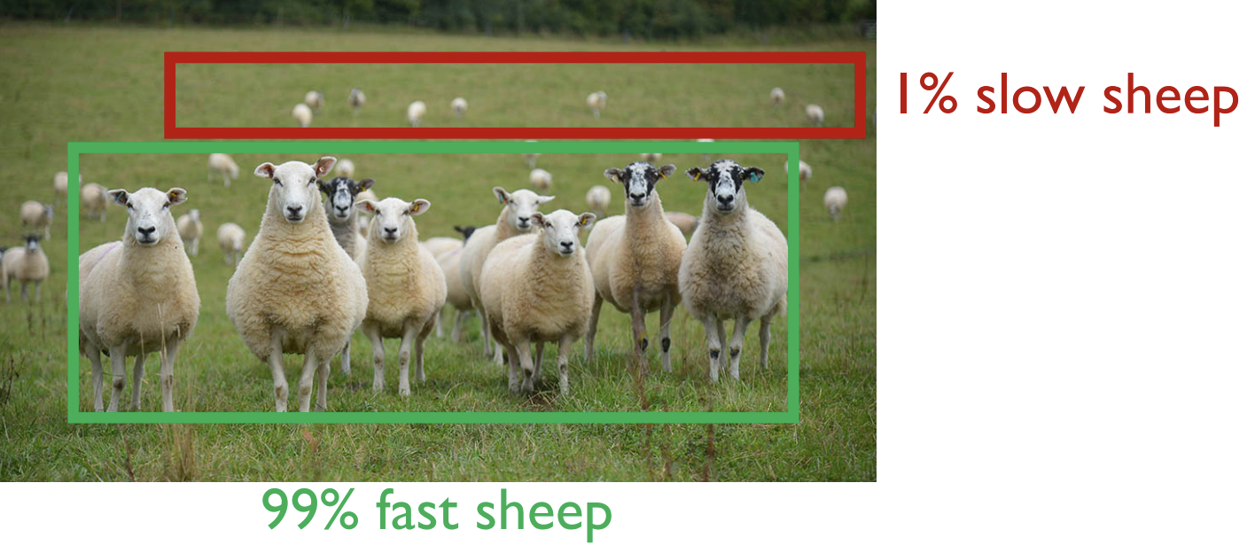
Tail Latency

Slide 5
Service-level Objectives (SLO)
wasted work
8:00
9:00
10:00
SLO
deadline
request

Slide 7
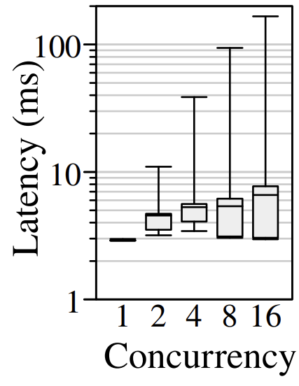
Predictable Latency
Executing a single DNN inference at a time,
the latency is extremely predictable
16 Concurrent inferences
Throughput: 1.25x
Latency: 100x
Clockwork aims to preserve predictability

Slide 8
Design Clockwork
1. Predictable worker with no choices
2. Consolidating choices at a central controller
3. Deadline-aware scheduler for SLO compliance

Slide 9
1. Predictable Worker with No Choices
DRAM
Inference( )
Inference( )
GPU RAM
GPU Execution

Slide 10
1. Predictable Worker with No Choices
DRAM
GPU RAM
GPU Execution

Slide 11
1. Predictable Worker with No Choices
Workers do not decide when to load model into GPU memory
Instead, they simply use deadline-driven queues
Load/Unload
Inference

Slide 12
2. Consolidating Choices at a Central Controller
inference
load
infer
Controller
Workers
load
infer

Slide 13
3. Deadline-aware Scheduler for SLO Compliance
Controller
load
infer
time
now
dead
line
free

Slide 14
3. Deadline-aware Scheduler for SLO Compliance
Controller
load
infer
time
now
free
dead
line

Slide 15
C++ 26,000 lines

Slide 16
Evaluation
How Does Clockwork Compare?
How Low Can Clockwork Go?
Can Clockwork Isolate Performance?
Are Realistic Workloads Predictable?
Can Clockwork Scale?

Slide 17
How Does Clockwork Compare?

Slide 18
How Low Can Clockwork Go?

Slide 19
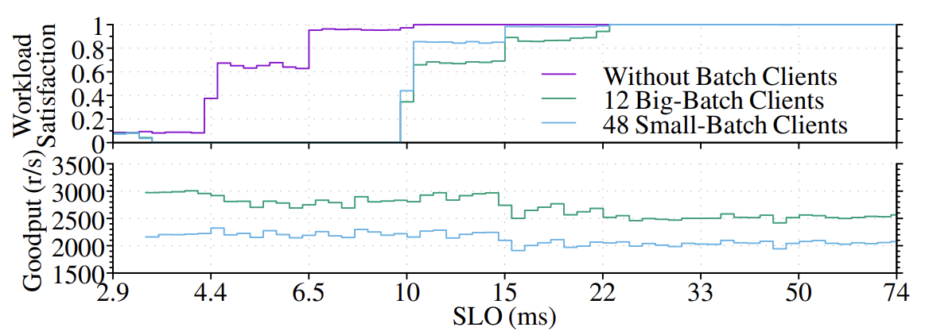
Can Clockwork Isolate Performance?

Slide 20
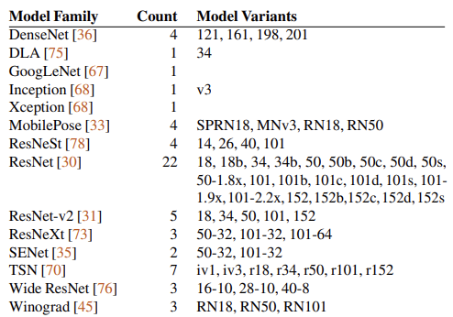
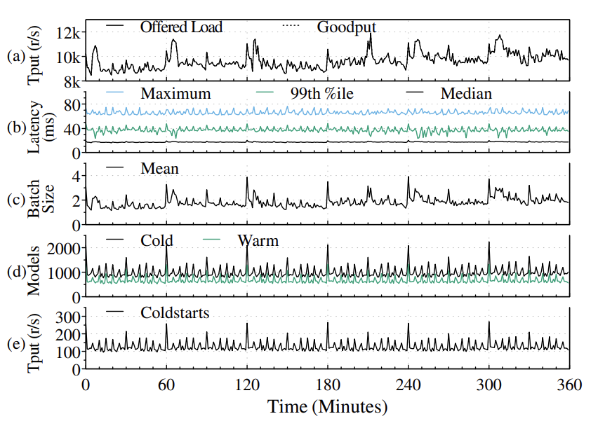
Are Realistic Workloads Predictable?

Slide 21
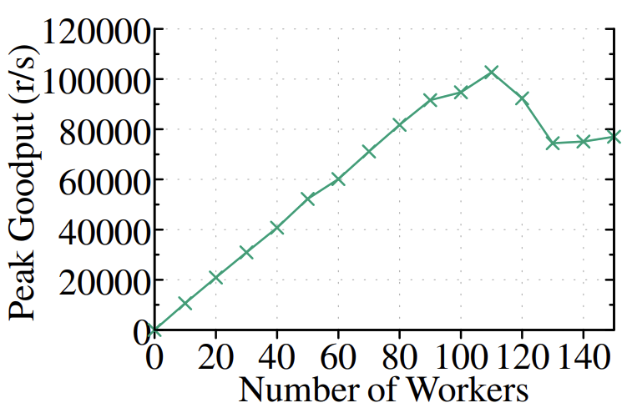
Can Clockwork Scale?

Slide 22
Conclusion
As DNN inferences become increasingly central to interactive applications, the requirements for fast response tighten, the volume of requests expands, and the number of models grows.
The model serving system, Clockwork, meets these challenges.

