Slide 1
IT 응용 II (IT Applications II)
Dept. of Computer Science and Engineering
Dankook University
March 3, 2021
Jongmoo Choi
choijm@dankook.ac.kr
http://embedded.dankook.ac.kr/~choijm

Slide 2
Course Objective
Understanding recent IT applications especially focusing on Bigdata SW, Next-generation storage and Machine-learning
Bigdata framework, Key-value store, Distributed system, Cloud, …
Flash memory, SSD, NVM, ISP (In-Storage Processing), …
ML-based resource management, Scheduling for DL, …
Get accustomed to papers written in English
Find out the general structure of a paper
How to review a paper?
Enhance presentation skill
How to make a successful presentation
How to discuss or argue?
Make our own paper
How to write a good paper?
Submit to a conference/journal (or mandatory?)
AI
Bigdata
Cloud
IoT

Slide 3
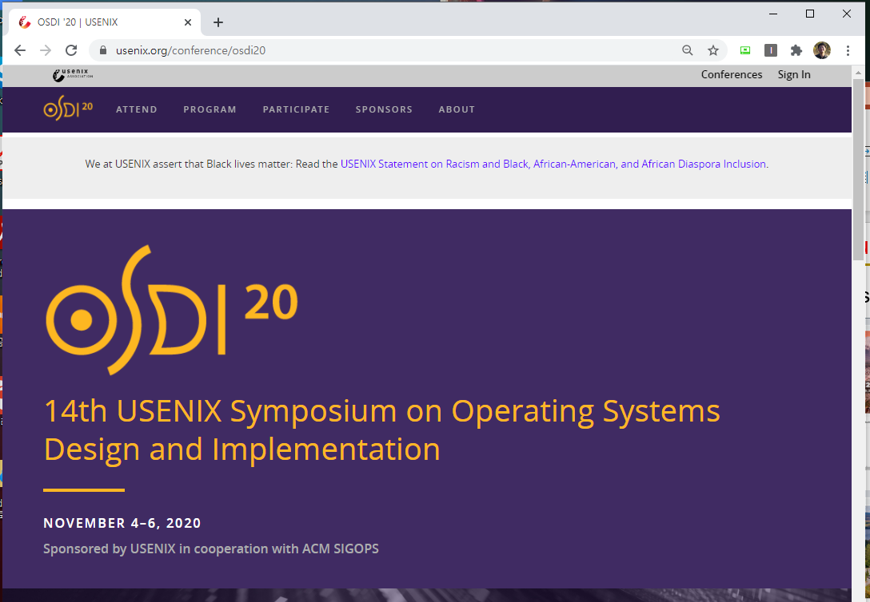
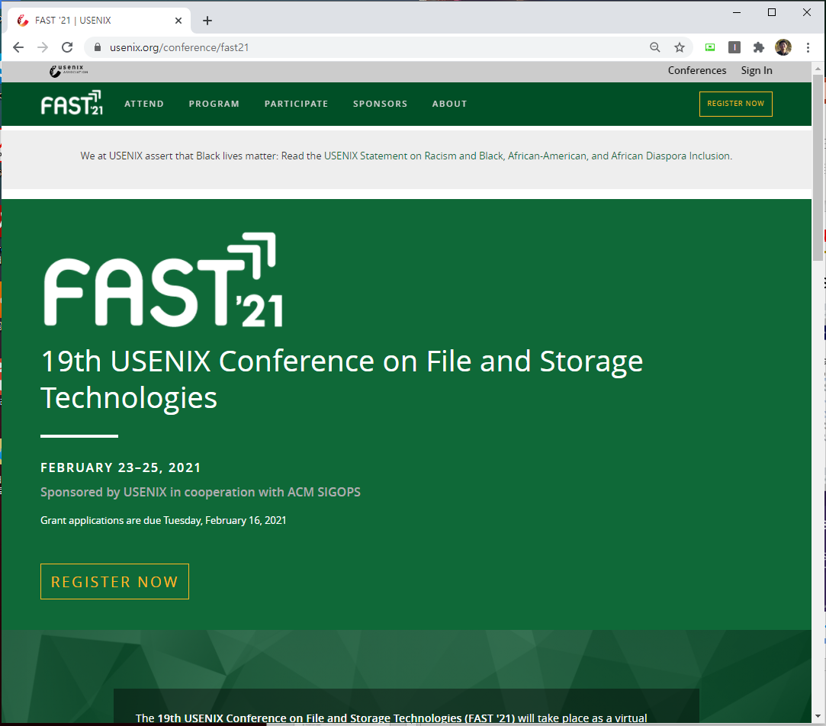
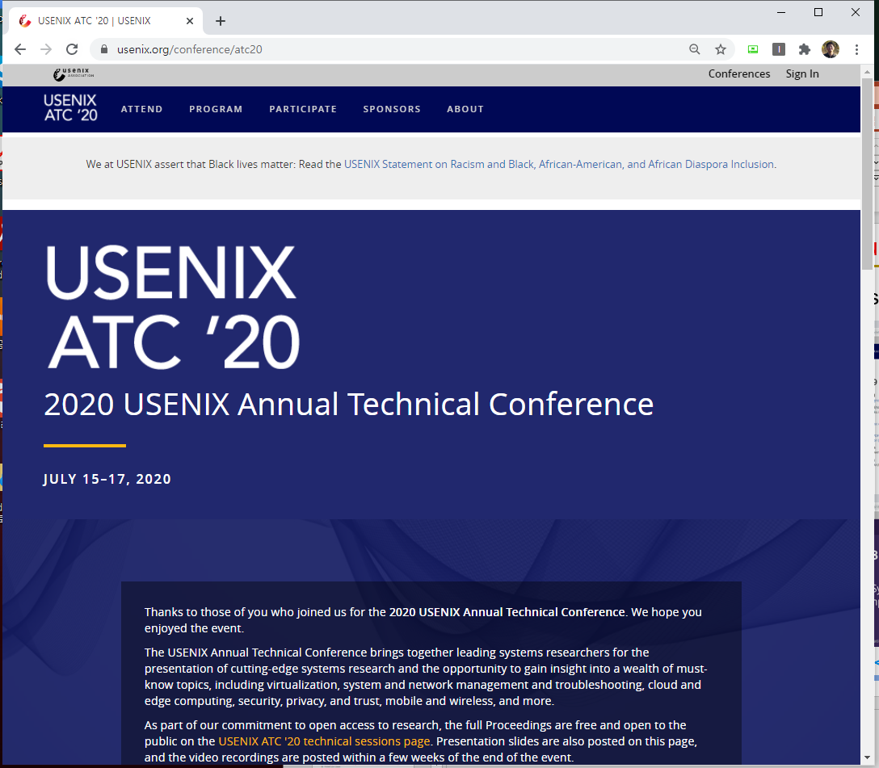
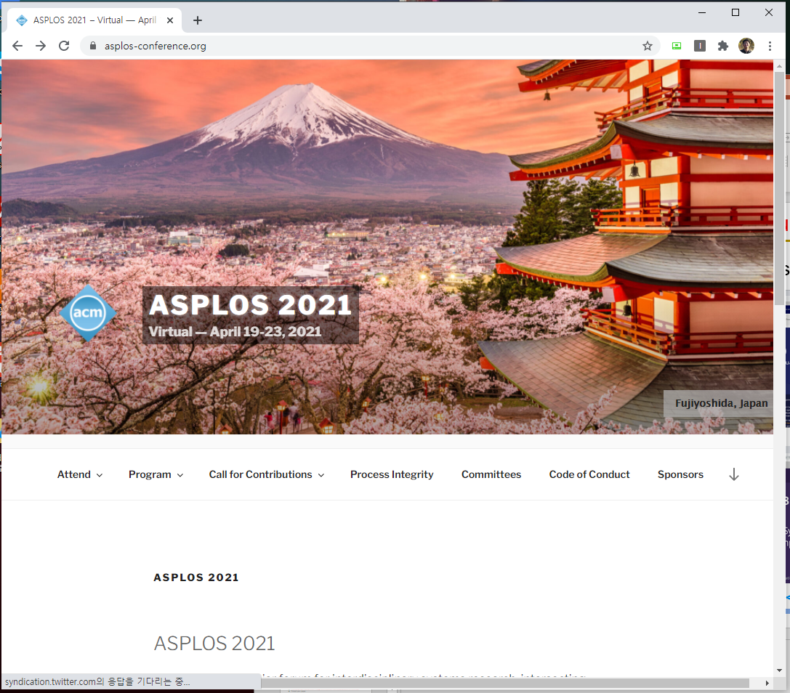
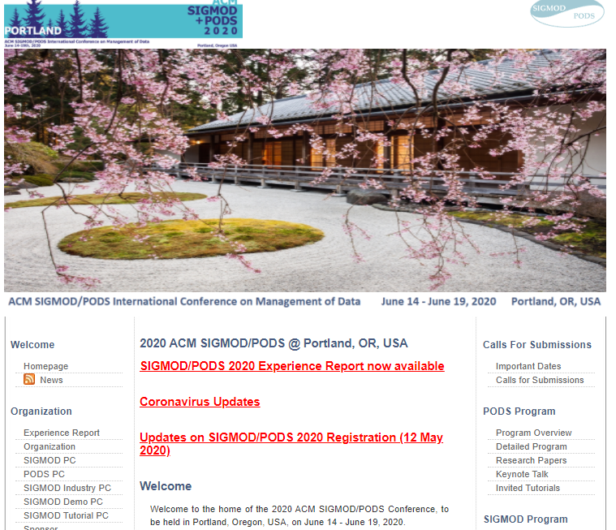
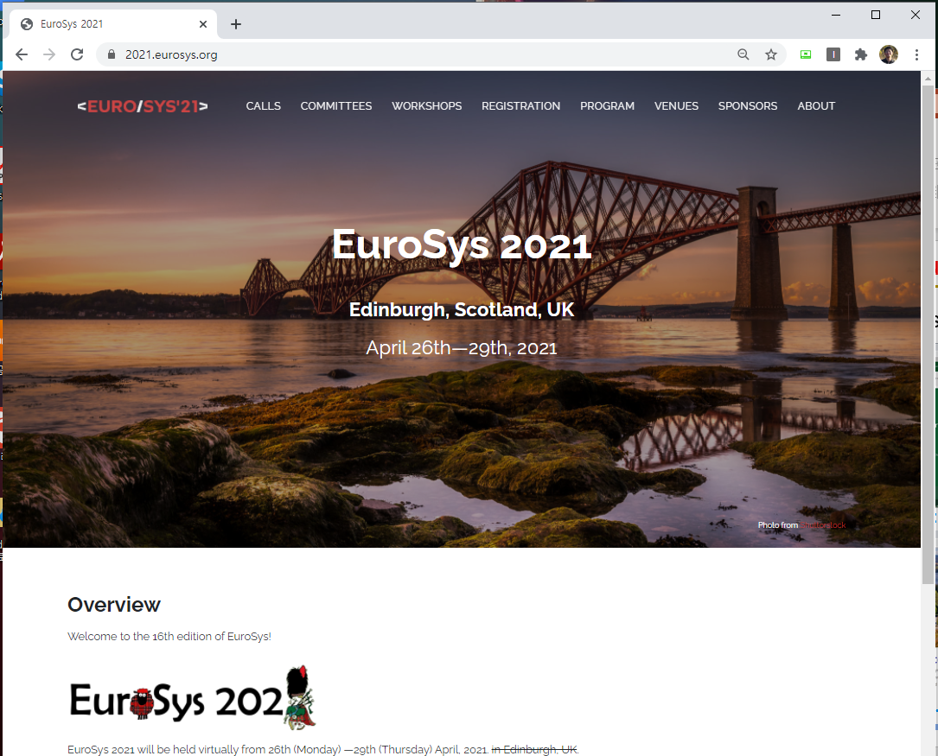
Course text
Where can you find papers?
<OSDI>
<FAST>
<ATC>
<ASPLOS>
<SIGMOD>
<Eurosys>

Slide 4
Paper lists (Suggested)
Week 1 (3/3): Introduction
Course introduction
Paper selection (3 papers per person)
Week 2 (3/10): KVS basic
L. Lu et al., “WiscKey: Separating Keys from Values in SSD-conscious Storage”, FAST’16. ➔ 신호진
P. Raju et al., “PebblesDB: Building Key-Value Stores using Fragmented Log-Structured Merge Trees”, SOSP’17. ➔ 이광희
Week 3 (3/17): FS basic
B. Vangoor et al., “To FUSE or Not to FUSE: Performance of User-Space File Systems”, FAST’17. ➔ 한예진
S. Miller et al., “High Velocity Kernel File Systems with Bento”, FAST’21. ➔ 송인호
Week 4 (3/24): FTL basic
C. Park et al., “A Reconfigurable FTL (Flash Translation Layer) Architecture for NAND Flash-Based Applications”, ACM ToECS’08. ➔ 이성현
F. Chen et al., “CAFTL: A Content-Aware Flash Translation Layer Enhancing the Lifespan of Flash Memory based Solid State Drives”, FAST’11. ➔ 이제연
S. R. Dulloor et al., “System Software for Persistent Memory”, Eurosys’14. ➔ 이고은
Week 5 (3/31): NVM basic + Personal Project
V. Gogte et al., “Software Wear Management for Persistent Memories”, FAST’19. ➔ 송인호
T. Yao et al., “MatrixKV: Reducing Write Stalls and Write Amplification in LSM-tree Based KV Stores with a Matrix Container in NVM”, ATC’20. ➔ 양문총
Brainstorming (Key Ideas) (5 minutes per person, 2~3 ppt)

Slide 5
Paper lists (Suggested)
Week 6 (4/7): Machine Learning for Resource Management
V. Reddi et al., “MLPerf Inference Benchmark”, ISCA’20. ➔ 최동빈
D. Narayanan et al., “Heterogeneity-Aware Cluster Scheduling Policies for Deep Learning Workloads”, OSDI’20. ➔ 이승균
M. Hao et al., “LinnOS: Predictability on Unpredictable Flash Storage with a Light Neural Network”, OSDI’20. ➔ 이성현
Week 7 (4/14): Indexing
T. Kraska et al., “The Case for Learned Index Structures”, SIGMOD’18. ➔ 아궁
Y. Dai et al., “From WiscKey to Bourbon: A Learned Index for Log-Structured Merge Trees”, OSDI’20. ➔ 신호진
K. Bonawitz et al., “Toward Federated Learning at Scale: System Design”, SysML, 2019. ➔ 쏭치아펑
Week 8 (4/21): System support for Deep Learning
Z. Bai et al., PipeSwitch: Fast Pipelined Context Switching for Deep Learning Applications”, OSDI’20. ➔ 이고은
J. Mohan et al., “CheckFreq: Frequent, Fine-Grained DNN Checkpointing”, FAST’21. ➔ 신민재
Week 9 (4/28): In Storage Processing
J. Im et al., “PinK: High-speed In-storage Key-value Store with Bounded Tails”, ATC’20. ➔ 이광희
S. Liang et al., “Cognitive SSD: A Deep Learning Engine for In-Storage Data Retrieval”, ATC’19. ➔ 쏭치아펑
M. Wilkening el al., “RecSSD: Near Data Processing for Solid State Drive Based Recommendation Inference“, ASPLOS’21. ➔ 이성현
Week 10 (5/12): Caching + Personal Project
J. Yang et al., “A large scale analysis of hundreds of in-memory cache clusters at Twitter”, OSDI’20. ➔ 아궁
Related paper survey (10 minutes per person) + preliminary results if possible

Slide 6
Paper lists (Suggested)
Week 11 (5/19): Distributed system
A. Aghayev et al., “File Systems Unfit as Distributed Storage Backends: Lessons from 10 Years of Ceph Evolution”, SOSP’19. ➔ 피치
L. Bindschaedler et al., “Hailstorm: Disaggregated Compute and Storage for Distributed LSM-based Databases”, ASPLOS’20. ➔ 이승균
W. Zhong et al., “REMIX: Efficient Range Query for LSM-trees”, FAST’21. ➔ 양문총
Week 12 (5/26): Transactions
S. Lee et al., “Application-Managed Flash”, FAST’17. ➔ 한예진
Y. Hu et al., “TxFS: Leveraging File-System Crash Consistency to Provide ACID Transactions”, ATC’18. ➔ 이제연
Week 13 (6/2): SLO (Service Level Objective)
L. Zheng et al., “Ansor: Generating High-Performance Tensor Programs for Deep Learning”, OSDI’20. ➔ 최동빈
A. Gujarati et al., “Serving DNNs like Clockwork: Performance Predictability from the Bottom Up”, OSDI’20. ➔ 신민재
M. Hao et al., “MittOS: Supporting Millisecond Tail Tolerance with Fast Rejecting SLO-Aware OS Interface”, SOSP’17. ➔ 피치
Week 14 (6/9): Others.
H. Chen et al, “SpanDB: A Fast, Cost-Effective LSM-tree Based KV Store on Hybrid Storage”, FAST’21. ➔ 신호진
S. Dong et al., “Evolution of Development Priorities in Key-value Stores Serving Large-scale Applications: The RocksDB Experience”, FAST’21. ➔ 이광희
D. Korolija et al., “Do OS abstractions make sense on FPGAs?”, OSDI’20. ➔ 이제연
Week 15 (6/16): Personal Project
Final (Key idea, Related work, Design and Evaluation result) presentation (15 minutes)
Submit your paper

Slide 7
Paper lists (Candidates)
Recommended for reading
Butler W. Lampson, “Hints for Computer System Design,” SOSP’83.
R. L. site, “Benchmarking Hello World“, http://web.Stanford.edu/class/cs240/readings/p10-sites.pdf.
San Disk, “Flash 101 and Flash Management”, https://documents.westerndigital.com/content/dam/doc-library/en_us/assets/public/western-digital/collateral/white-paper/white-paper-sandisk-flash101-management.pdf
M. Rosenblum et al., “The Design and Implementation of a Log-Structured FS”, ACM ToCS’92.
N. Agrawal et al., “Design Tradeoffs for SSD Performance”, ATC’08.
T. Anderson, “Assise: Performance and Availability via Client-local NVM in a Distributed File System”, OSDI’20.
V. Prabhakaran et al., “Transactional Flash”, OSDI’08.
M. Maas et al., “Learning-based Memory Allocation for C++ Server Workloads”, ASPLOS’20.
X. Wei et al., “Fast RDMA-based Ordered Key-Value Store using Remote Learned Cache”, OSDI’20.
C. Delimitrou and C. Kozyrakis, “Quasar: Resource-Efficient and QoS-Aware Cluster Management”, ASPLOS,14.
J. Dean and S. Ghemawat, “MapReduce: Simplified Data Processing on Large Clusters”, OSDI’04.
Sanjay Ghemawat et al., “The Google File System,” SOSP’03.
G. DeCandia et al., “Dynamo: Amazon’s Highly Available Key-value Store”, SOSP’07.
C. Writght et al., “Extending ACID semantics to the file system”, ACM ToS’07.
Y. Ren et al., “CrossFS: A Cross-layered Direct-Access File System”, OSDI’20.
Z. Cao et al., “Characterizing, Modeling, and Benchmarking RocksDB Key-Value Workloads at Facebook”, FAST’20.
O. Balmau et al, “SILK: Preventing Latency Spikes in Log-Structured Merge Key-Value Stores”, ATC’19.
Please let me know if you want to present other papers (after 2019)

Slide 8
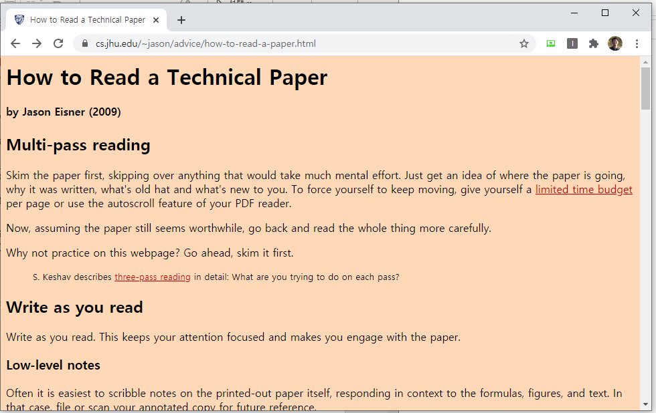
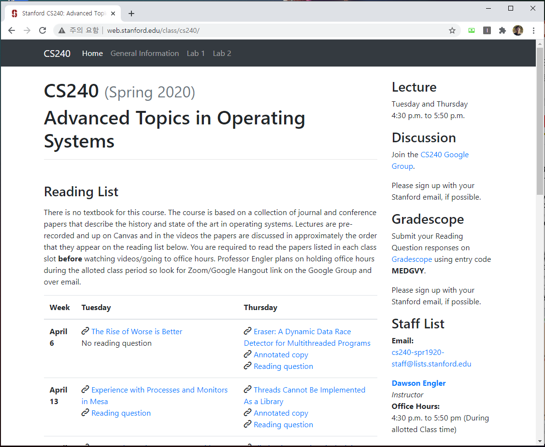
Papers about how to read/write a paper?
How to read a paper.
J. Eisner, “How to Read a Technical Paper”, https://www.cs.jhu.edu/~jason/advice/how-to-read-a-paper.html
Roy Levin and David D. Redell, “How (and How Not) to Write a Good Systems Paper”, ACM Operating Systems Review, 1983.
J. Maletic, “How to Read and Evaluate Technical Papers”, http://www.cs.kent.edu/~jmaletic/howtoread.html
S. Keshav, “How to read a paper”, https://web.stanford.edu/class/ee384m/Handouts/HowtoReadPaper.pdf
Papers used in other universities
http://web.stanford.edu/class/cs240/
https://www.seltzer.com/margo/teaching/CS508.19/syllabus.html
http://pages.cs.wisc.edu/~dusseau/Classes/CS736/CS736-F13/papers.html
https://www3.nd.edu/~cpoellab/teaching/cse60641/links.html
https://www.cs.utexas.edu/~vijay/cs380l/schedule.htm

Slide 9
Lecture details
Presentation (roughly 2~3 times per person)
Less than 25 minutes
Q & A are quite important
Paper Review
Personal project
Write a paper
No examination

Slide 10
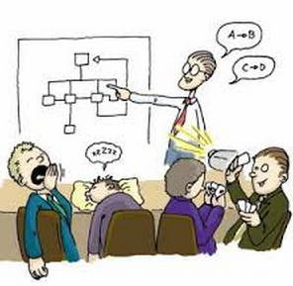
How to present
Presentation
Time
Presentation: 25 min, Q&A: 10 min
Slide
Less than 15 lines per each page
More than half pages must contain figures
Must include humor slides (if not, less points)
Must include references (if not, less points)
Each slide must be put in the lecture site (send it to choijm@dankook.ac.kr until the previous day of presentation)
Audience
Obligation of audience: at least one question per person a day
Without questions, you can not get a good grade.
Count the number of questions

Slide 11
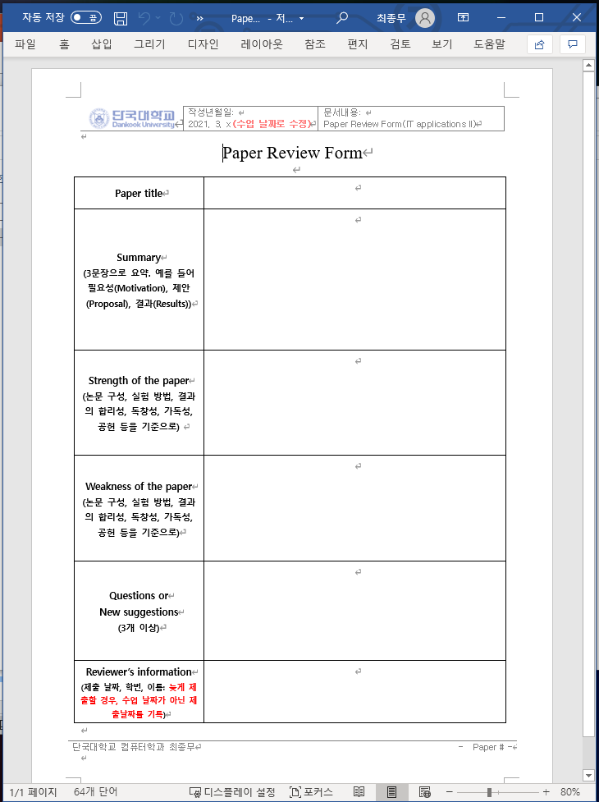
How to review a paper
Paper Review
All student must submit reviews about papers assigned to the corresponding week.
Format
Summary
3 sentences
Motivation, Proposal, Evaluation
Strength
What are positive things in this paper?
Weakness
What are the down sides of this paper?
Questions or Suggestions
At least 3

Slide 12
How to make a proposal
Personal project
1. Idea presentation (5 minutes)
Personnel introduction, Ice break
Research idea, Brainstorming
2. Survey presentation and initial design (10 minutes)
Idea proposal
Related papers (prepare references in advance)
Related industrial trends
3. Final presentation (15 minutes)
Idea, Related work, Design, Evaluation results
Enhance the idea obtained form your presentation
1) presentation (ppt), 2) paper (tex, hwp, word)
I strongly recommend to submit KCC or KSC or any conferences/workshops

Slide 13
Evaluation
Evaluation
Presentation(30%)
Questions and Answers (20%)
Paper review (30%)
Final proposal (20%)
Choose papers in the suggested list and send your choices to me via email (choijm@dankook.ac.kr) until next Monday (8th, March).
Need volunteers for next week (KVS papers).

Slide 14
Discussion

Slide 15
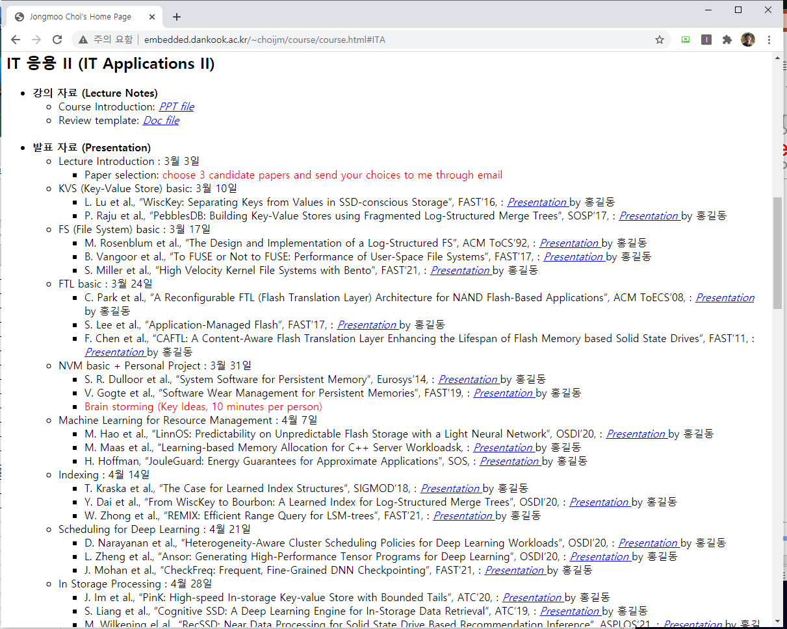
Appendix
Lecture site

