Slide 1
The Design and Implementation of a Log-Structured File System
Mendel Rosenblum and John K. Ousterhout
lectrical Engineering and Computer Sciences, Computer Science Division University of California Berkeley, CA 94720
2022. 3. 15
Presentation by Jeoung Won Lee
gardenlee960828@gmail.com

Slide 2
Background
Motive
Design
Evaluation
Notes:
int 1
back 4
bolt 8
evaul 5
con 1

Slide 3
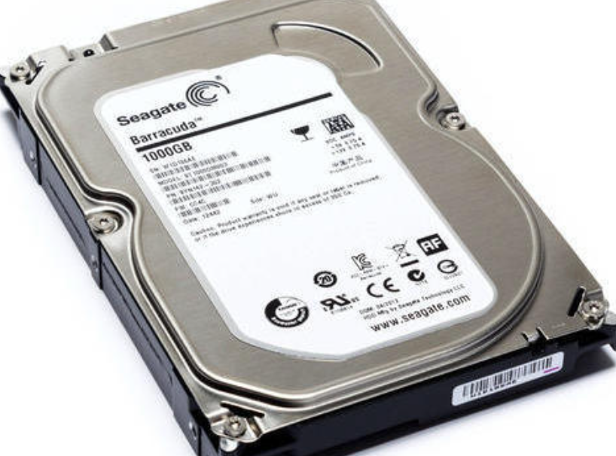
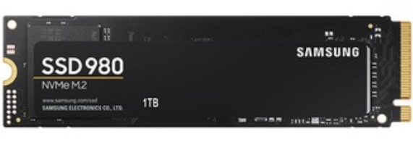
1, Background
Hard disk
SSD(Solid State Driver)
3

Slide 4
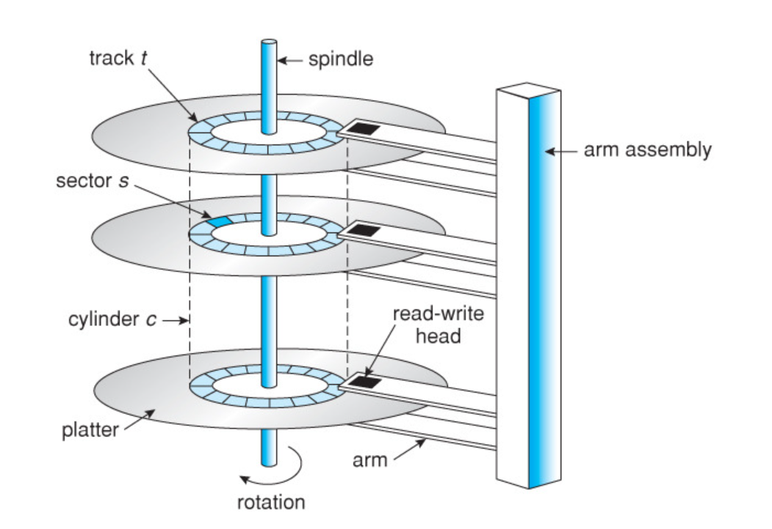
1, Background
Hard disk
Rotation time, Seek time

Slide 5
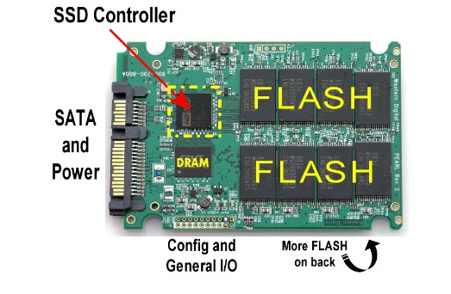
1, Background
SSD(Solid state driver)
In-place update
Out-of-place update
Overwrite

Slide 6
1, Background
Disk Block
Abstract SSD(page) or Hard disk(sector)
0
1
2
3
4
5
6
7
8
9
…

Slide 7
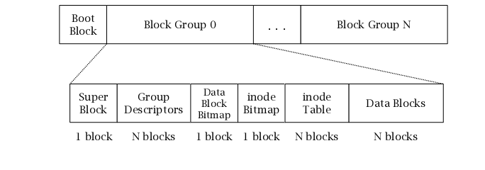
1, Background
File System
Manage disk block

Slide 8
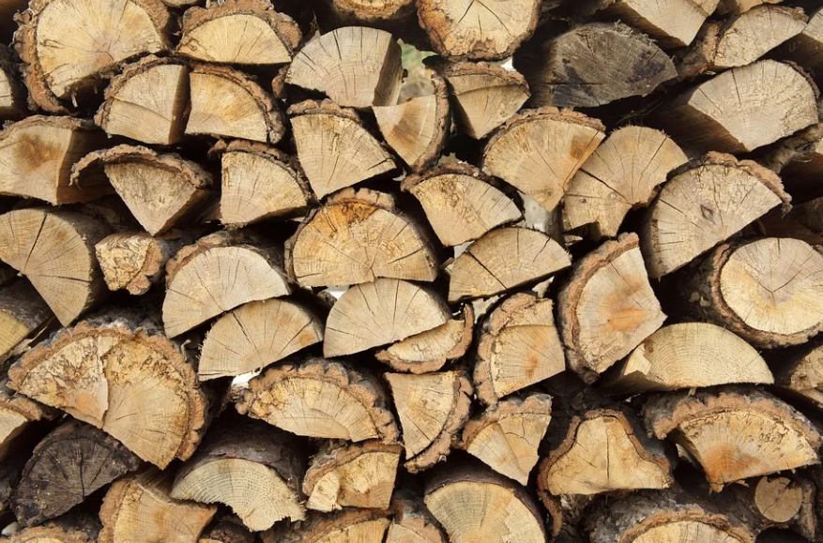
What is log?
Sailors write their trip in Log

Slide 9
2, Motive
Current File System issue
1, So Many Disk I/O
1, Find Directory entry
Super Block
Bit map
Inode Table
Data[0]
Data[1]
…
2, Find Data

Slide 10
2, Motive
Current File System issue
2, Meta data write synchronously to disk
Super Block, Bitmap, Inode…
Synchronously write
Only out-of-place update?

Slide 11
3, Design
Write
1, Request write save in buffer until full bandwidth
2, Write to disk like LOG
DATA
Asynchronously write
Like log
DATA
Disk

Slide 12
3, Design
Read
1, look up inode map address in check point(fixed location)
2, inode map load to memory(log location)
3, find data address
1, find inode map
Like log
Check
point
Inode map
Check
point
DATA
Disk
2, find data

Slide 13
3, Design
Segment
Log divide into fixed size
Management solution
Thread log(cold data)
Copy and compact(hot data)

Slide 14
3, Design
Segment Cleaning
Execute background or only when disk space is nearly exhausted
Store version in segment summary block & inode table, segment cleaner match this version
Grouping method
Same directories store same segment
Last modified and group blocks store same segment(age sort)
Check
if(inode table version != segment summary version)
Background
Clean
Grouping and store in log

Slide 15
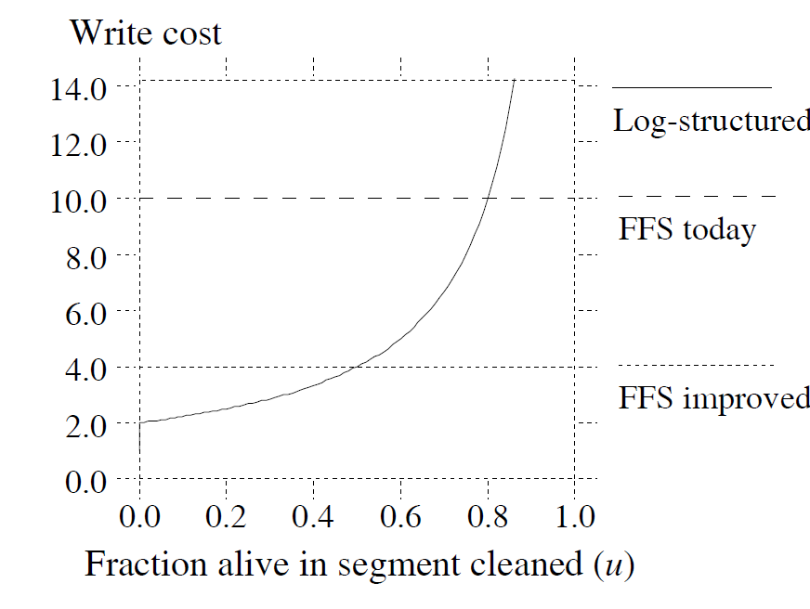
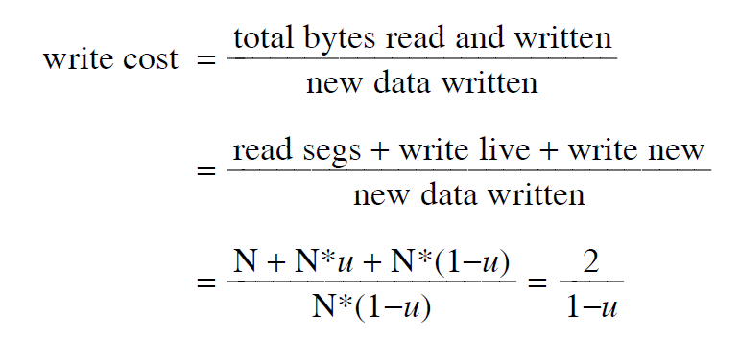
3, Design
Segment Cleaning
Start drop threshold value & clean until another threshold value
Write cost
Trade off
High utilization, High performance, High cost
Low utilization, Low cost, Low performance

Slide 16
3, Design
Segment grouping method
Uniform cleaning– each file has eauql likehood of bing selected
Hot & Cold cleaning
Hot – group have 10%, high utilization, high performance, high cost
Cold – group have 90%, low utilization, low performance, low cost

Slide 17
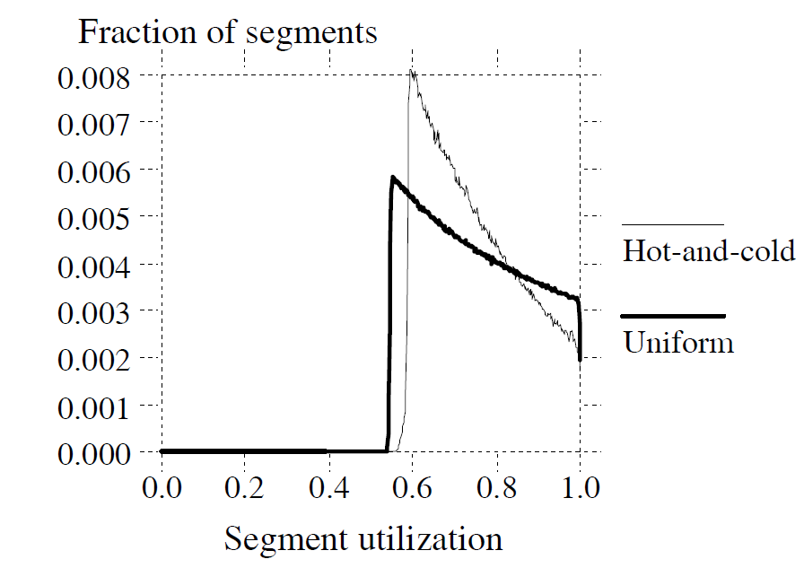
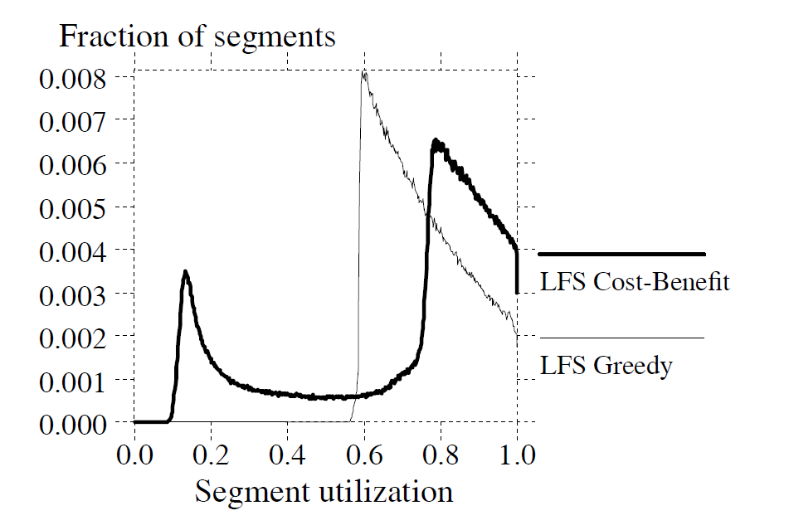
3, Design
Segment grouping method
Greedy policy
don’t clean until some segment utilization
Cost-benefit policy
Greedy
Cost-benefit

Slide 18
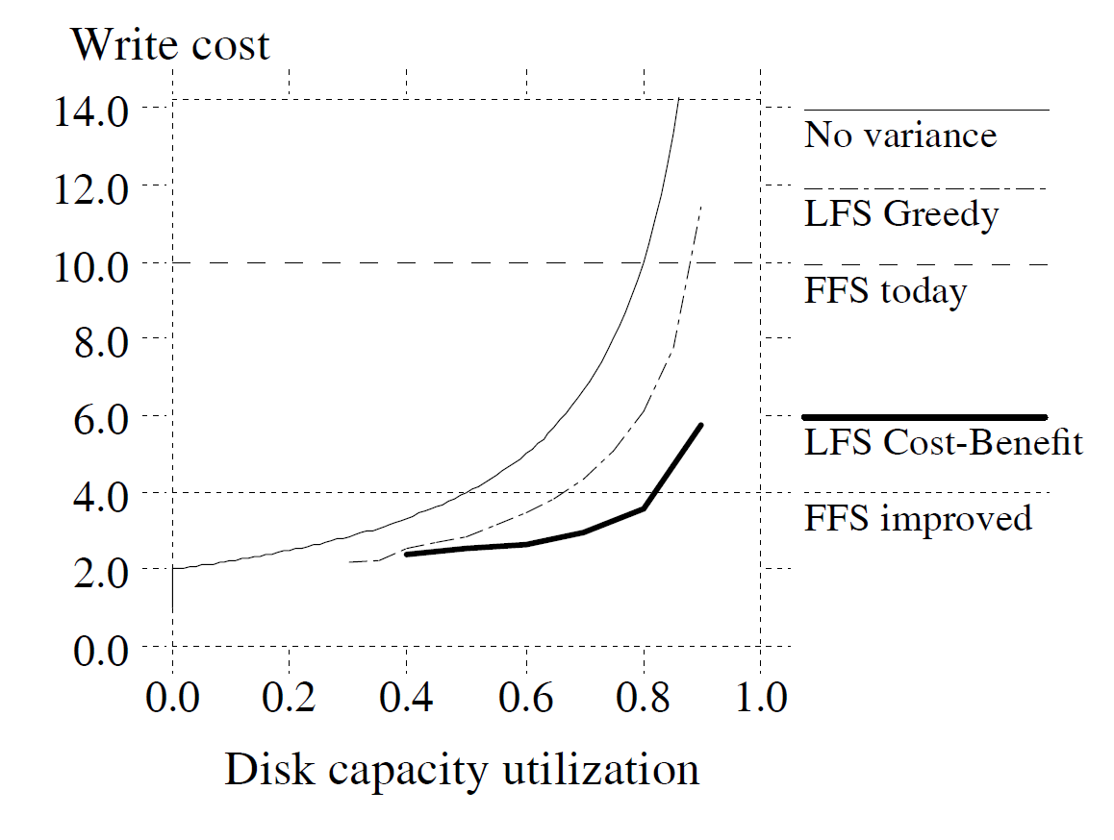
3, Design
Segment grouping method
Greedy policy VS Cost-benefit policy
segment usage table -> choose clean target

Slide 19
3, Design
Crash recovery
Checkpoint
Checkpoint store Log location(data, inode, inode map, segment usage table…)
Check points is two in first & end, alternatively use
If Log have crash, the system reads the latest checkpoint
Roll forward
It recovery data after the last checkpoint
When a summary block indicates a new inode, the system adjust every meta data
If data block is detected with no- inode, the system ignores
During checkpoint, the system doesn’t action so it stores directory operation log

Slide 20
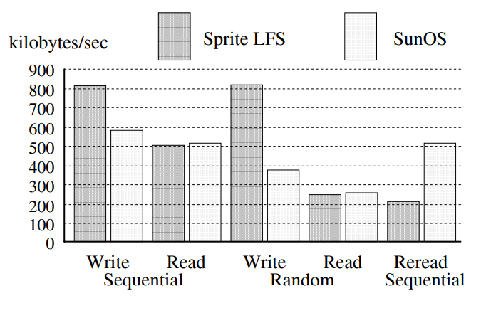
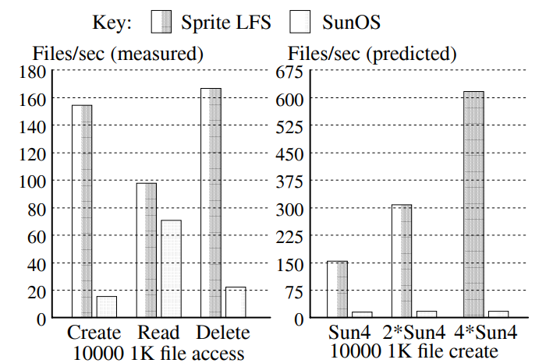
4, Evaluation

Slide 21
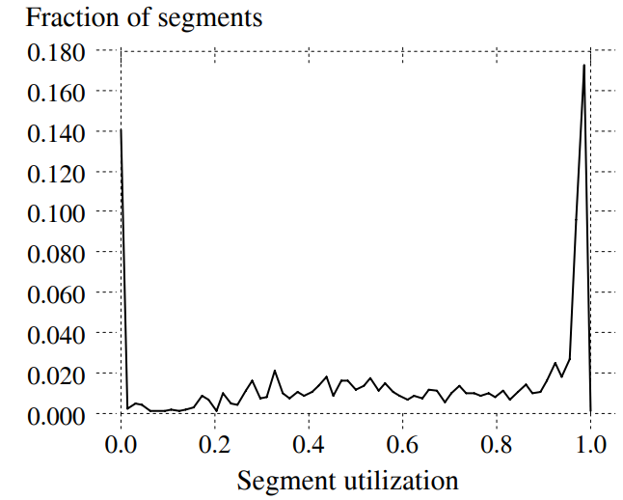
4, Evaluation
Cleaning overhead

Slide 22
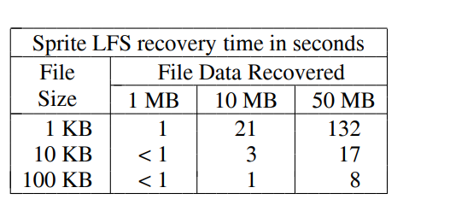
4, Evaluation
Cleaning overhead

Slide 23
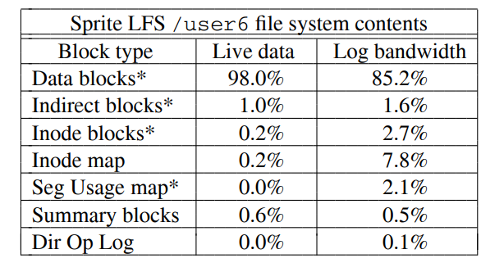
4, Evaluation
\
Other overheads in LFS

Slide 24
The Design and Implementation of a Log-Structured File System
Thank You!
2022. 2. 15
Presentation by Jeoung Won Lee
gardenlee960828@gmail.com

