Slide 1
The Linux Scheduler: a Decade of Watsed Cores
Jean-Pierre Lozi, Baptiste Lepers, Justin Funston, Fabien Gaud, Vivien Quema, Alexandra Fedorova
EuroSys 16’
2022. 03. 15
Presentation by Shin, Hojin
hojin03s@dankook.ac.kr

Slide 2
Introduction
Reference
The Linux Scheduler
No biggie, But biggie, The Bugs
Not new, But new, Tools
Conclusion

Slide 3
1. Introduction
The Linux Scheduler
Classical scheduling problem ➔ Setting the length of the scheduling quantum (Minimizing context switch overhead)
When faced with this problem, realize that we have to take on a challenge ➔ NUMA (Non-Uniform Memory Allocator)
The bugs are two types: (1) Short-term (2) Long-term

Slide 4
1. Introduction
The Linux Scheduler
Classical scheduling problem ➔ Setting the length of the scheduling quantum (Minimizing context switch overhead)
When faced with this problem, realize that we have to take on a challenge ➔ NUMA (Non-Uniform Memory Allocator)
The bugs are two types: (1) Short-term (2) Long-term
Short-term
Long-term

Slide 5
1. Introduction
The Linux Scheduler
Classical scheduling problem ➔ Setting the length of the scheduling quantum (Minimizing context switch overhead)
When faced with this problem, realize that we have to take on a challenge ➔ NUMA (Non-Uniform Memory Allocator)
The bugs are two types: (1) Short-term (2) Long-term
Short-term: thread exits, blocks, created, unblocked … etc
Long-term: not an expected behavior

Slide 6
1. Introduction
The Linux Scheduler
Classical scheduling problem ➔ Setting the length of the scheduling quantum (Minimizing context switch overhead)
When faced with this problem, realize that we have to take on a challenge ➔ NUMA (Non-Uniform Memory Allocator)
The bugs are two types: (1) Short-term (2) Long-term
Short-term: thread exits, blocks, created, unblocked … etc
Long-term: not an expected behavior
Tools
➔ difficult to discover: many asynchronous events in the scheduler
➔ too short to dectect with tools like below
Ex) htop, sar, perf … etc

Slide 7
1. Introduction
The Linux Scheduler
Classical scheduling problem ➔ Setting the length of the scheduling quantum (Minimizing context switch overhead)
When faced with this problem, realize that we have to take on a challenge ➔ NUMA (Non-Uniform Memory Allocator)
The bugs are two types: (1) Short-term (2) Long-term
Short-term: thread exits, blocks, created, unblocked … etc
Long-term: not an expected behavior
Tools
➔ difficult to discover: many asynchronous events in the scheduler
➔ too short to dectect with tools like below
Ex) htop, sar, perf … etc

Slide 8
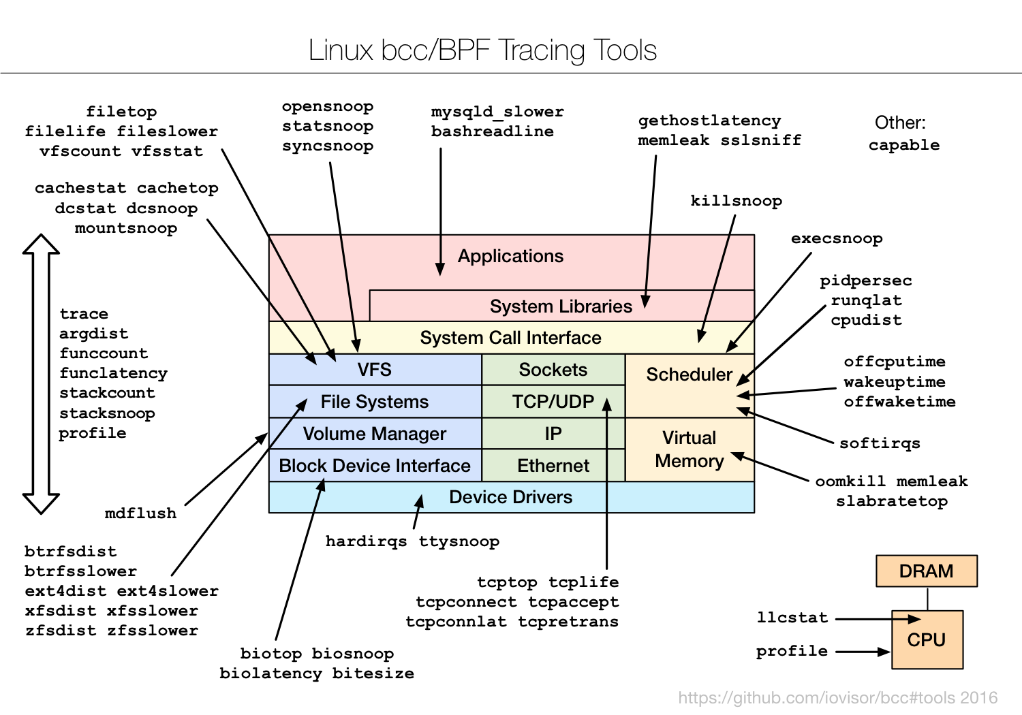
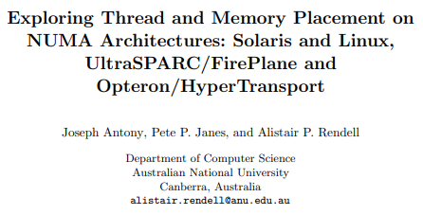
2. Reference

Slide 9
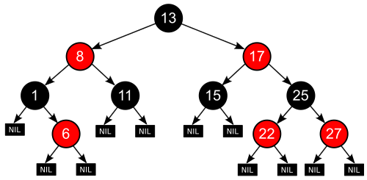
3. The Linux Scheduler
Linux’s Completely Fair Scheduling (CFS)
Algorithm ➔ WFQ (Weighted Fair Queuing)
Divied among threads in proportion to their weights (priority, niceness)
Using RB-tree (Red Black Tree)
Red-Black Tree

Slide 10
3. The Linux Scheduler
Linux’s Completely Fair Scheduling (CFS)
Algorithm ➔ WFQ (Weighted Fair Queuing)
Divied among threads in proportion to their weights (priority, niceness)
Using RB-tree (Red Black Tree)
On Multi-core ➔ context switch
Runqueues must be kept balanced
Preiodically run a load-balancing algorithm
Placement of newly created or newly awoken threads
Red-Black Tree

Slide 11
3. The Linux Scheduler
Linux’s Completely Fair Scheduling (CFS)
Algorithm ➔ WFQ (Weighted Fair Queuing)
Divied among threads in proportion to their weights (priority, niceness)
Using RB-tree (Red Black Tree)
On Multi-core ➔ context switch
Runqueues must be kept balanced
Preiodically run a load-balancing algorithm
Placement of newly created or newly awoken threads
Red-Black Tree
RQ
Single-Core
Multi-Cores
Thread A
RQ
Thread A
Weight: 10
Weight: 5
A
CPU A
Thread B
B
Thread B
Weight: 1
A
CPU
Weight: 5
RQ
Thread C
New Created
B
CPU B

Slide 12
3. The Linux Scheduler
Load Balancing Algorithm
Metric that the CFS scheduler uses to track load
Balancing the load based solely on thread weights is not sufficient either

Slide 13
3. The Linux Scheduler
Load Balancing Algorithm
Metric that the CFS scheduler uses to track load
Balancing the load based solely on thread weights is not sufficient either
Thread A
RQ
Thread A
RQ
Short sleep
High priority
Short sleep
High priority
Thread B
B
Thread B
Low priority
A
CPU
B
CPU
Low priority
Thread A wake
Thread A
RQ
Thread A
RQ
Short sleep
High priority
Short sleep
High priority
Thread B
B
Thread B
Low priority
A
CPU
Low priority
B
CPU

Slide 14
3. The Linux Scheduler
Load Balancing Algorithm
Metric that the CFS scheduler uses to track load
Balancing the load based solely on thread weights is not sufficient either
➔ Core would have to be frequently steal work form the other core’s runqueue
Metric called load ➔ thread’s weight and its average CPU utilization

Slide 15
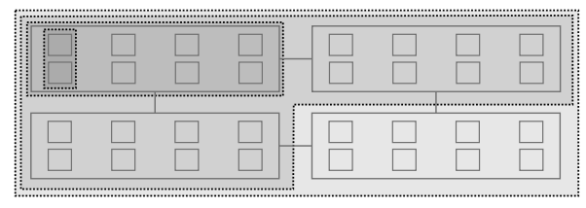
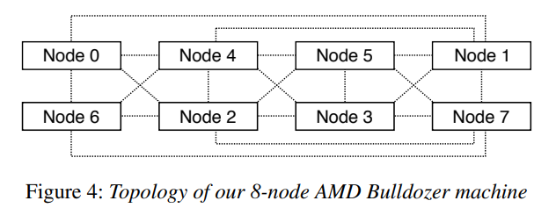
3. The Linux Scheduler
Load Balancing Algorithm
Metric that the CFS scheduler uses to track load
Balancing the load based solely on thread weights is not sufficient either
➔ Core would have to be frequently steal work form the other core’s runqueue
Metric called load ➔ thread’s weight and its average CPU utilization
Scheduling domain ➔ Each level of the hierarchy
Load Balacne, Not between individual cores of the NUMA node
Scheduling Groups ➔ In a Scheduling domain, the set of cores among which the load balancing is performed

Slide 16
3. The Linux Scheduler
Load Balancing Algorithm
Optimizations
Running the load-balancing algorithm only on the designated core for the given scheduling domain
Checks whether it is the lowest-numbered core in the domain (if all cores are busy)
Checks whether if it is the lowest-numbered idle core (if any core is idle)
Problem ➔ idle cores were always awoken on every clock tick
Tickless idle state ➔ Reduce their energy use
The only way for a core in this state to get work when another core is overloaded is to be awoken by another core

Slide 17
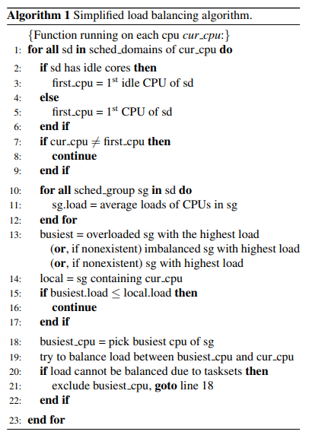
3. The Linux Scheduler

Slide 18
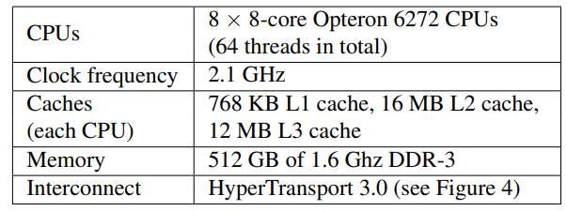
4. No biggie, But biggie, The Bugs
The Group Imbalance Bug
Problem ➔ Situation: Perform kernel compilation and data analysis using R machine learning package ➔ Did not use all available cores for highly-threaded computations Corwding all threads on a few nodes

Slide 19
4. No biggie, But biggie, The Bugs
The Group Imbalance Bug
Problem ➔ Situation: Perform kernel compilation and data analysis using R machine learning package ➔ Did not use all available cores for highly-threaded computations Corwding all threads on a few nodes

Slide 20
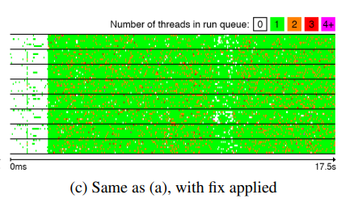
4. No biggie, But biggie, The Bugs
The Group Imbalance Bug
Problem ➔ Situation: Perform kernel compilation and data analysis using R machine learning package ➔ Did not use all available cores for highly-threaded computations Corwding all threads on a few nodes
Cause ➔ When a core attempts to steal work form another node ➔ it only looks at the group’s average load, not per core
Fix ➔ Instead of comparing the average load, ➔ Compare the minimum loads

Slide 21
4. No biggie, But biggie, The Bugs
The Scheduling Group Constructing Bug
Problem ➔ Occurs when an application is pinned on nodes that are two hops apart ➔ The bug will prevent the load balancing from migrating threads between these two nodes

Slide 22
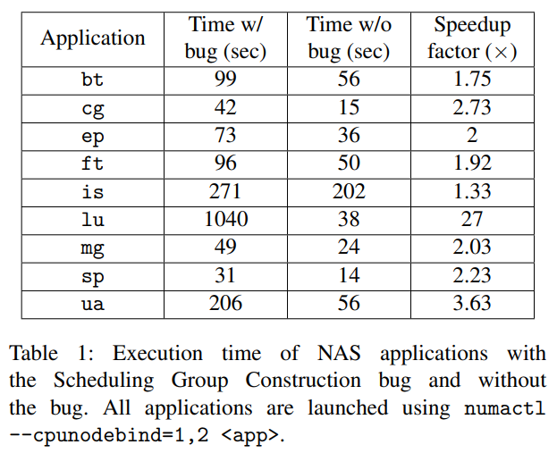
4. No biggie, But biggie, The Bugs
The Scheduling Group Constructing Bug
Problem ➔ Occurs when an application is pinned on nodes that are two hops apart ➔ The bug will prevent the load balancing from migrating threads between these two nodes
Fix ➔ Modified the construction of scheduling groups ➔ Constructed from its perspective ➔ Able to detect an imbalance and to steal work

Slide 23
4. No biggie, But biggie, The Bugs
The Overload-on-Wakeup Bug
Problem ➔ thread that was asleep may wake up on an overloaded core while other cores in the system are idle
Can lead to a significant under utilization of the machine

Slide 24
4. No biggie, But biggie, The Bugs
The Overload-on-Wakeup Bug
Problem ➔ thread that was asleep may wake up on an overloaded core while other cores in the system are idle
Can lead to a significant under utilization of the machine
Cause ➔ Scheduler attempts to place the woken up thread physically close to the waker thread

Slide 25
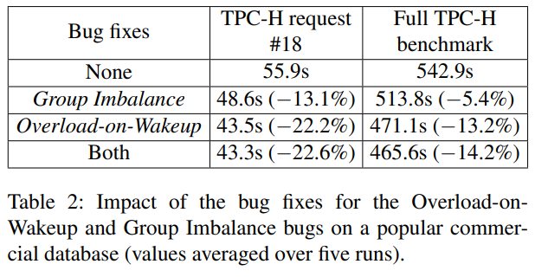
4. No biggie, But biggie, The Bugs
The Overload-on-Wakeup Bug
Problem ➔ thread that was asleep may wake up on an overloaded core while other cores in the system are idle
Can lead to a significant under utilization of the machine
Cause ➔ Scheduler attempts to place the woken up thread physically close to the waker thread
Fix ➔ Alter the code that is executed when a thread wakes up ➔ Wake up the thread on the core that has been idle for the longest amount of time

Slide 26
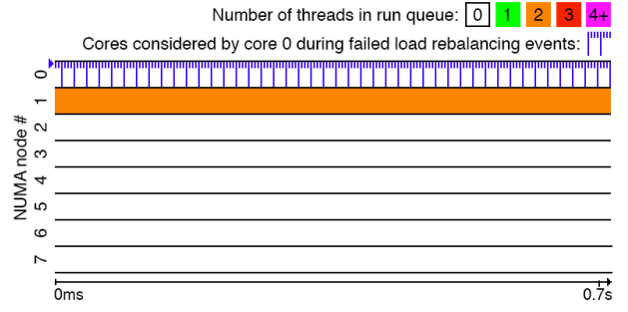
4. No biggie, But biggie, The Bugs
The Missing Scheduling Domains Bug
Problem ➔ Incorrect update of a global variable representing the number of scheduling domains in the machine

Slide 27
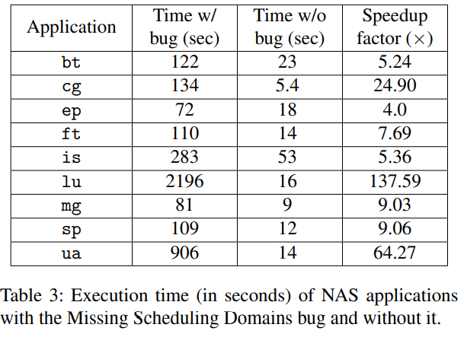
4. No biggie, But biggie, The Bugs
The Missing Scheduling Domains Bug
Problem ➔ Incorrect update of a global variable representing the number of scheduling domains in the machine
Fix ➔ Regenerates the machine’s scheduling domains (Code) ➔ Two-steps: Regenerates domains inside NUMA nodes, and then across NUMA nodes

Slide 28
4. No biggie, But biggie, The Bugs
Discussion for the Bugs
Conventional testing techniques and debuging tools were not helpful to us
Either confirming the bugs, after we initially suspected them
Or understanding their root causes
Our experience motivated us to build new tools
Using which we could productively confirm the bugs and understand why they occur

Slide 29
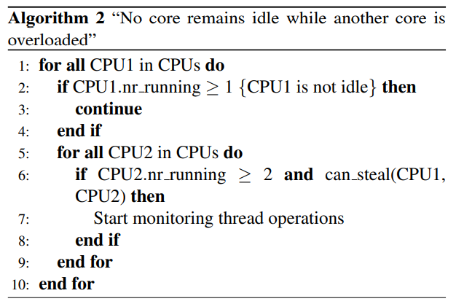
5. Not new, But new, Tools
Online Sanity Checker
Verifies that no core is idle while another core’s runqueue has waiting threads
Minimize the chance of bugs in the sanity checker itself
Scheduler Visualization tool
(1) the size of run queues add_nr_running and sub_nr_running
(2) the total load of run queues account_entity_enqueue and account_entity_dequeue
(3) the cores that were considered during periodic load balancing and thread wakeups select_idle_sibling, update_sg_lb_stats, find_busiest_queue, find_idlest_group

Slide 30
6. Conclusion
Conclusion
Simple scheduling policy resulted in a vary complex bug-prone implementation
Scheduling waiting threads onto idle cores
Application performance may degrade many fold
Bugs makes it difficult to detect them with conventional tools
Make catching and fixing these bugs substantially easier

Slide 31
The Linux Scheduler: a Decade of Watsed Cores
Jean-Pierre Lozi, Baptiste Lepers, Justin Funston, Fabien Gaud, Vivien Quema, Alexandra Fedorova
EuroSys 16’
Thank you !
2022. 03. 15
Presentation by Shin, Hojin
hojin03s@dankook.ac.kr

