Slide 1
Cuckoo Trie: Exploiting Memory-Level Parallelism for Effificent DRAM Indexing
Adar Zeitak, Adam Morrison
SOSP 2021’
2022. 04. 05
Presentation by Shin, Hojin
hojin03s@dankook.ac.kr

Slide 2
Introduction
Reference
Background
The need for MLP in index designs
The Cuckoo Trie
Evaluation
Conclusion

Slide 3
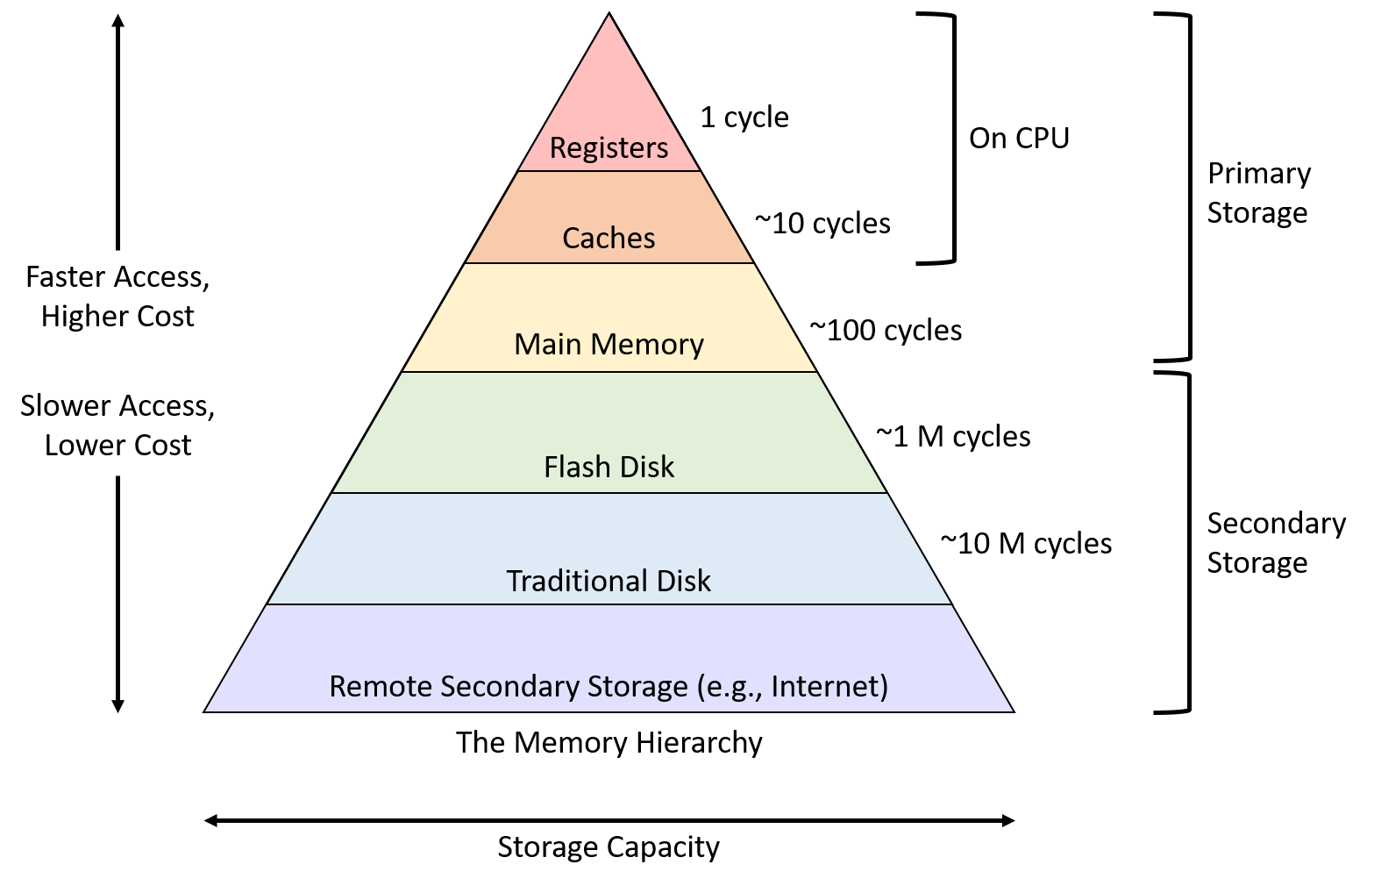
1. Introduction
Modern Database System
Modern enterprise and Clound System rely on in-memory database
Store the entire dataset in main memory ➔ Avoiding overhead (Storage media)
Ordered indexes to accelerate query processing
Query Execution Time
Database Memory Consumption
Representative DB
(In-Memory)
Memory Hierarchy

Slide 4
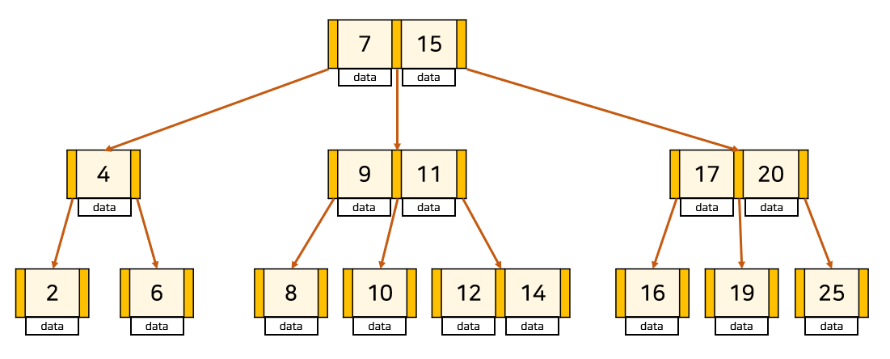
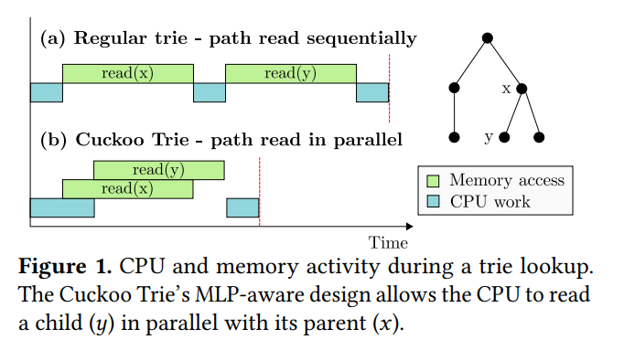
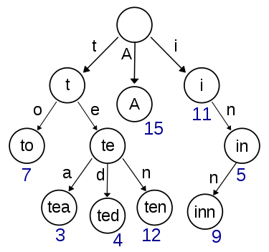
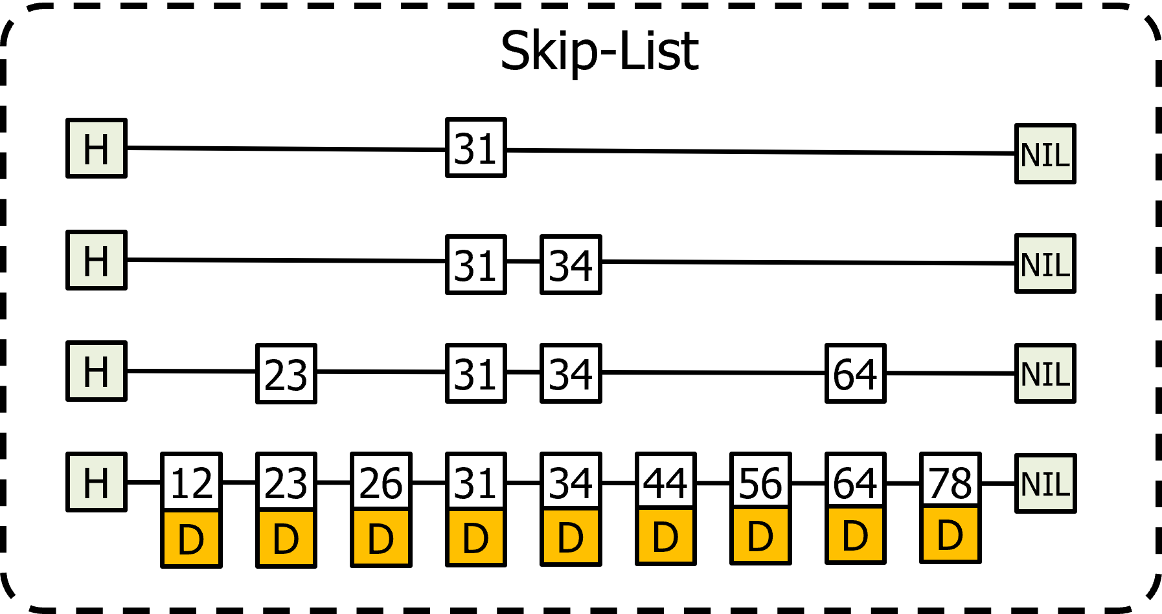
1. Introduction
Classical Indexes
Focus on shortening the searched paths to reduce memory access
Ex) B-tree, Trie, Skiplist …
Processor Idle
B-tree
Trie
Skiplist
Classical Indexes

Slide 5
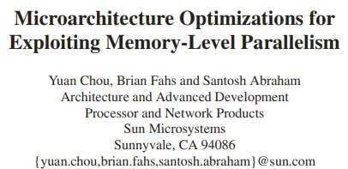
2. Reference

Slide 6
3. Background
Indexes
An ordered Index is a dictionary structure that support point and range operations
Three types : Comparison-based, Tries, hybrids
(1) Comparison-based: B-tree, Skiplist / $O(\log_{B}{N})$ / B = branching factor, N = number of keys
(2) Tries: $O(L)$ / L = key length
Bucketized Cuckoo Hashing
Each key can be stored in one of two possible table cells
Advantage: Fast, Constant-time lookup
6 | 7 (B) | 8
3 (C) | 4 | 5
0 | 1 (A) | 2
$$h_{1}\left(K\right)$$
0
1
2
3
4
5
6
7
8
Primary Bucket
Hash Function
After Relocate
Key K
6 | 7 (K) | 8 (B)
3 (C) | 4 | 5
0 | 1 (A) | 2
$$h_{2}\left(K\right)$$
Alternate Bucket

Slide 7
4. The need for MLP in index design
Memory Level Parallelism
Main topic : Out-of-order Execution
It can be hide the latency of cache misses
Last-level cache (LLC) or DRAM: Take dozens to hundreds of clock cycles
C programming example
// c = *mem1(A) + *mem2(B)
Memory operation
READ A from mem1
READ B from mem2
ADD c, A, B
Memory
CPU
read B
read A
Overlapping
ADD
Time

Slide 8
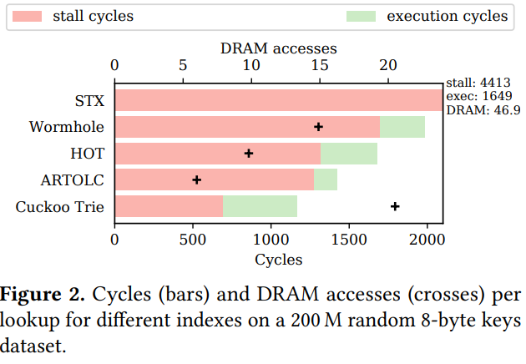
4. The need for MLP in index design
Index Bottlenecks: Lack of MLP
Classical index: Do not use MLP characteristics
The steps of traversing a search path cannot be overlapping
Execution cycle: one or more instructions are executed
Stall cycle: the core just waits for DRAM access to complete

Slide 9
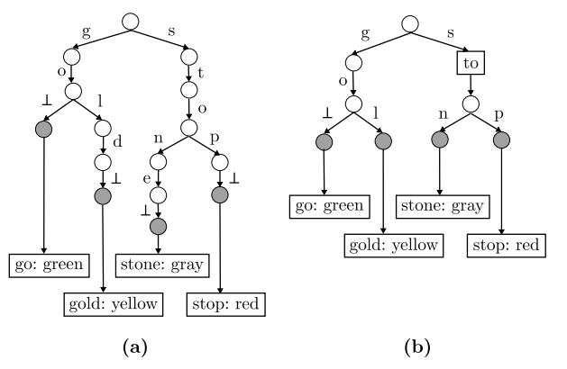
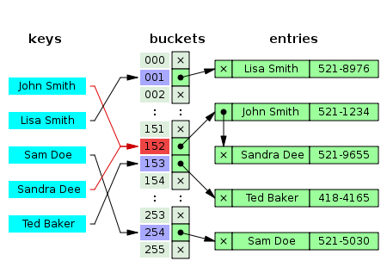
5. The Cuckoo Trie
Based Info
Cuckoo trie is a Path-compressed trie
For space efficiency, it stores unique key prefixes
Key design is Eliminate key storage (direct or indirect)
Key Storage
Direct
Indirect
Cuckoo Trie vs Regular Trie
Classical Hash Table

Slide 10
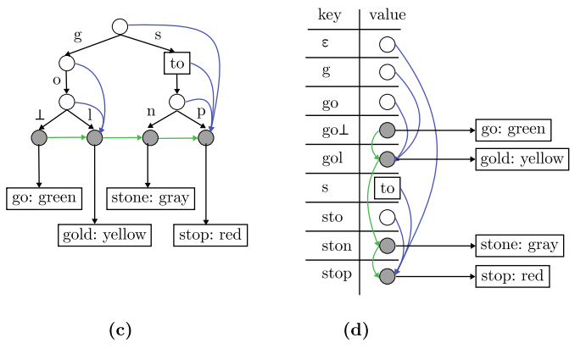
5. The Cuckoo Trie
Cuckoo Trie
Store trie nodes in a bucketized Cuckoo hash table
No memory access dependencies between the hash table lookups of nodes ➔ Using Prefix
Search Algorithm, you can see in paper …
Ex) Data = Stop
read p
read to
read s
Time
Ex) Data = Stock
Not found
Longest prefix: Sto
read to
read k
read s
read c
Time

Slide 11
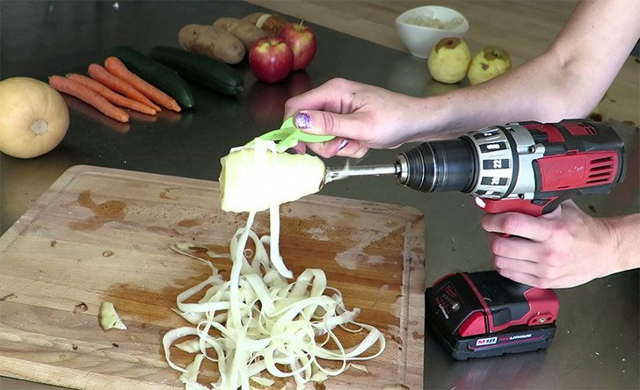
5. The Cuckoo Trie
Cuckoo Trie
The tag: small integer, determines h(k) and in turn, the alternate bucket
last_symbol: The last symbol of the key k stored in entry
color: A small integer chosen on key insertion such that it is unique
parent_color: The color of the entry that contains the key k[:#k-1] (parent node)
Using a peelable hash function
Ex) Data = Operating System
Peelable hash function $P_{h}\left(h\left(x∙c\right),c\right)=h(x)$
Ph(Operating System, O)
Ph(Operating System, p)
Ph(Operating System, e)
Ph(Operating System, r)
Ph(Operating System, a)
… do until end

Slide 12
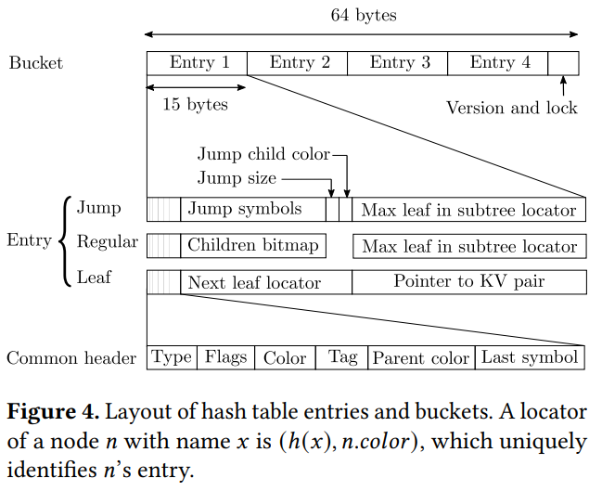
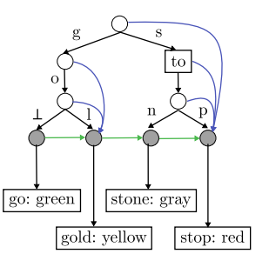
5. The Cuckoo Trie
Cuckoo Trie Layout
Jump
Regular
subtree-max
Leaf
next-leaf

Slide 13
5. The Cuckoo Trie
Cuckoo Trie Layout
Point
Lookup
Range Query

Slide 14
5. The Cuckoo Trie
Limitations
Path compression only saves space, not DRAM access
Attempts to read all prefixes of a key up front ➔ not optimize for DRAM access
Keys with long common prefixes
Less competitive on such data sets ➔ long common prefixes
Superfluous memory accesses
Making the DRAM accesses independent of each other ➔ Result superfluous DRAM accesses
(1) the leaf corresponding to the searched key’s unique prefix is located ➔ prefetches in flight for subsequent symbols
(2) Both buckets in which it might reside are fetched
(3) Fetches of buckets associated with symbols that are compressed into a jump node

Slide 15
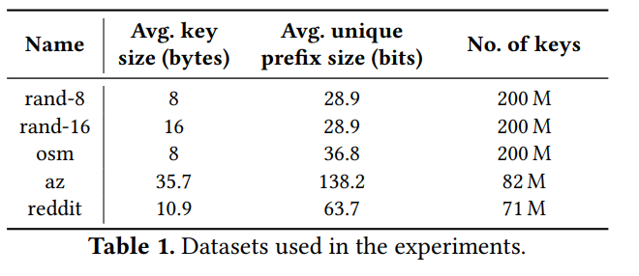
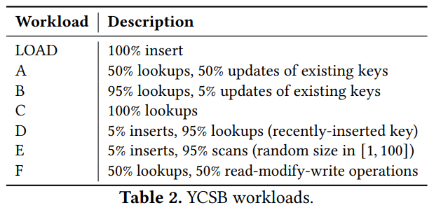
6. Evaluation
Experimental setup
HOT: The Height Optimized Trie keeps the trie shallow and balanced by considering a variable number of key bits in each node
Wormhole: A combined and optimized B-tree achieving O(LogL)
ARTOLC: Thread-safe implementation of the Adaptive Radix Tree using optimistic lock coupling
STX: An optimized in-memory B-tree
MlpIndex: An MLP-aware index using a basic hashed trie representation

Slide 16
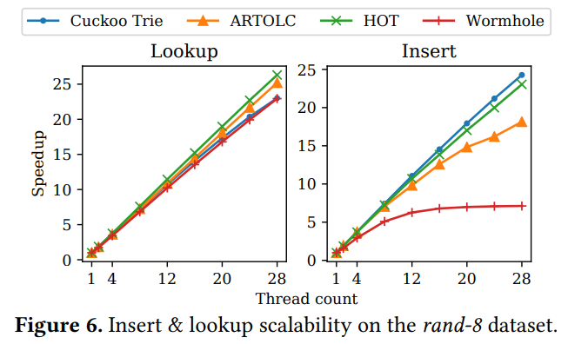
6. Evaluation
Insert & Lookup scalability on the rand-8 dataset
Lookup for YCSB-C workload
Insert for YCSB-Load workload

Slide 17
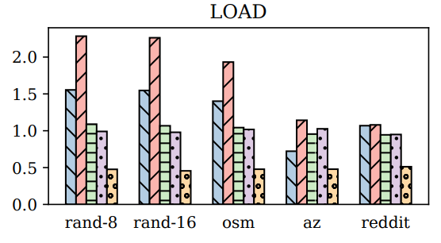
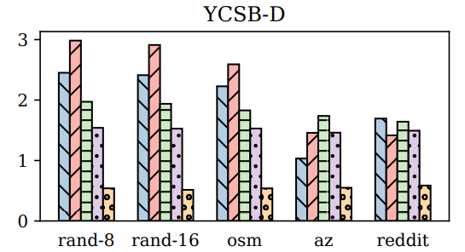
6. Evaluation
Single-threaded throughput of YCSB point-operation workloads

Slide 18
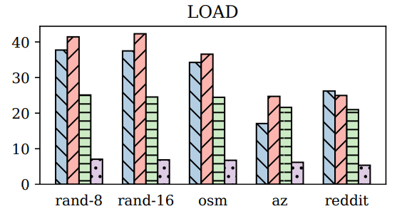
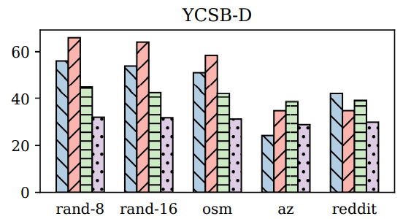
6. Evaluation
Multi-threaded throughput of YCSB point-operation workloads

Slide 19
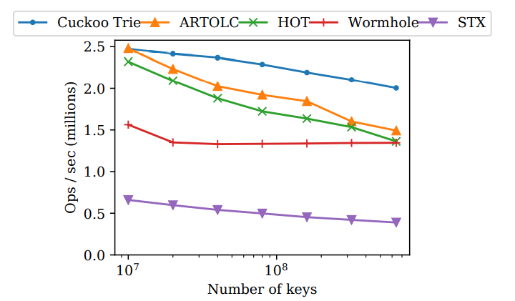
6. Evaluation
Single-threaded throughput as a function of dataset size (rand-8)

Slide 20
6. Evaluation
Scan(Range query) heavy YCSB-E workload

Slide 21
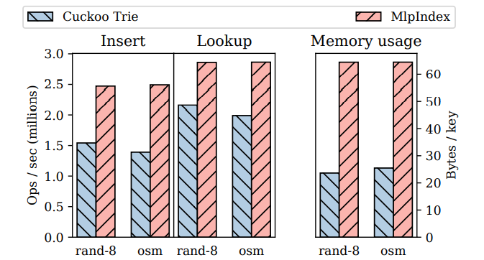
6. Evaluation
Comparison of the Cuckoo Trie and MlpIndex

Slide 22
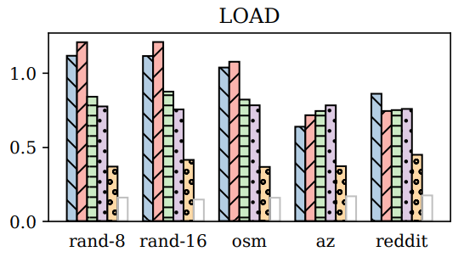
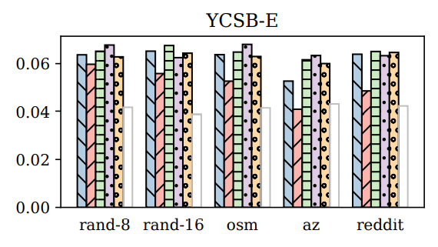
6. Evaluation
Redis throughput with different sorted-set implementations

Slide 23
7. Conclusion
Conclusion
Cuckoo Trie: Fast, memory-efficient ordered index designed with MLP
MLP makes the Cuckoo Trie faster than current indexes
Using novel key-eliminating hash table design
It is Open-Source Project

Slide 24
Cuckoo Trie: Exploiting Memory-Level Parallelism for Effificent DRAM Indexing
Adar Zeitak, Adam Morrison
SOSP 2021’
Thank you !
2022. 04. 05
Presentation by Shin, Hojin
hojin03s@dankook.ac.kr

