Slide 1
The Demikernel Datapath OS Architecture for Microsecond-scale Datacenter Systems
2022 Advanced Operating System
Zhang, I., Raybuck, A., Patel, P., Olynyk, K., Nelson, J., Leija, O. S. N., ... & Badam, A. (2021, October). The Demikernel Datapath OS Architecture for Microsecond-scale Datacenter Systems. In Proceedings of the ACM SIGOPS 28th Symposium on Operating Systems Principles (pp. 195-211).
2022. 05. 03
Presentation by Choi, Gunhee
choi_gunhee@dankook.ac.kr

Slide 2
Datacenter Trends
Kernel Bypass
Demikernal Datapath OS Requirements
Demikernel Datapath Library OS Design
Demikernel Library OS Implementations
Evaluation

Slide 3
1. Datacenter Trends
Datacenter Trends

Slide 4
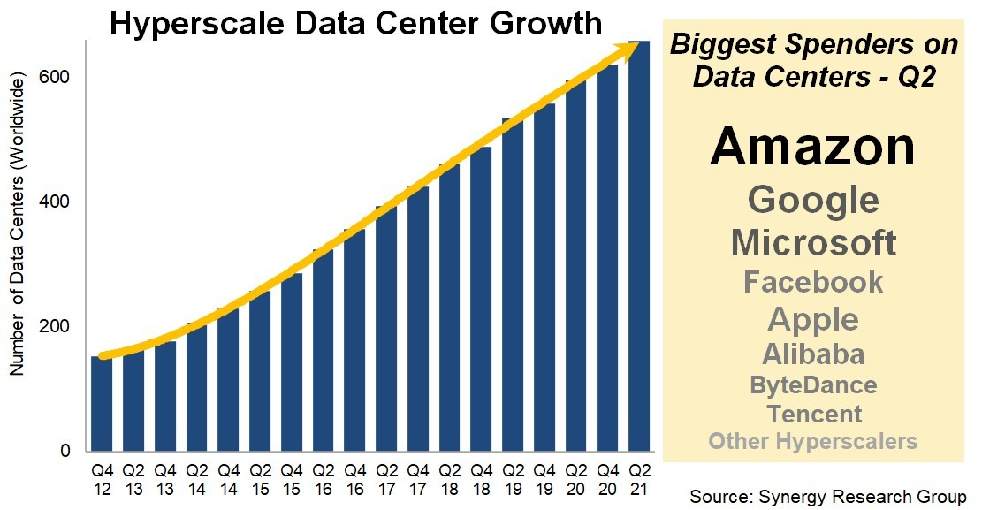
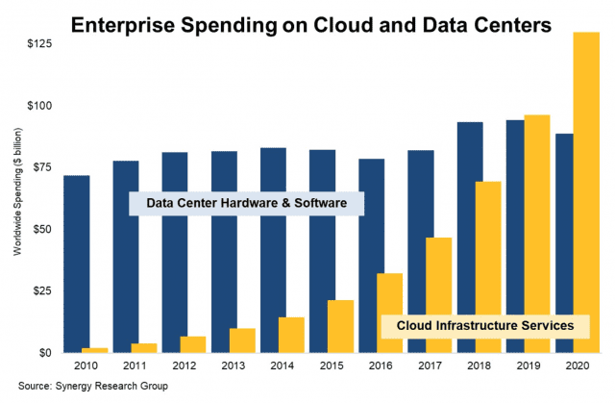
1. Datacenter Trends
https://www.ciokorea.com/news/208242

Slide 5
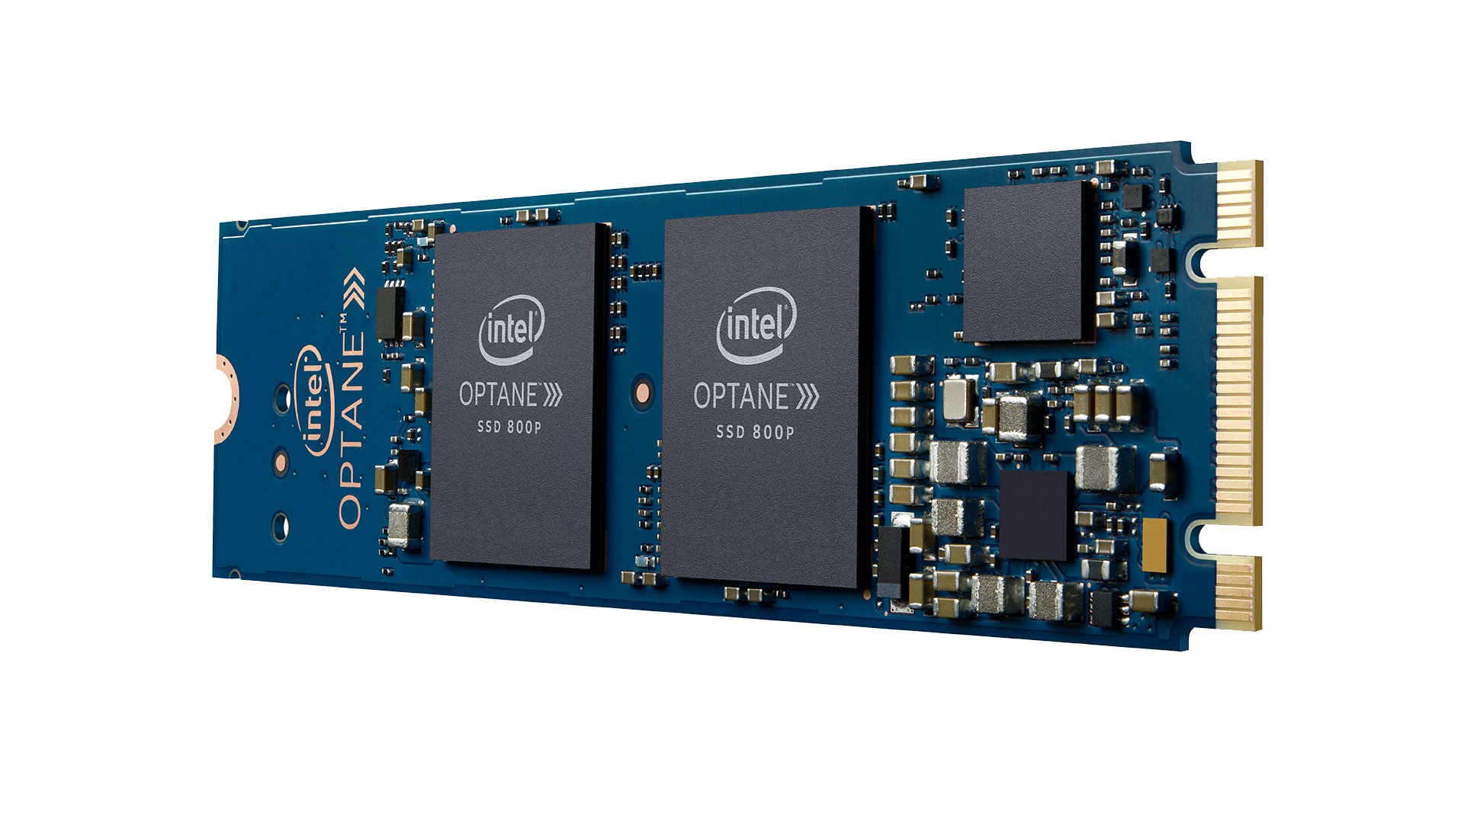
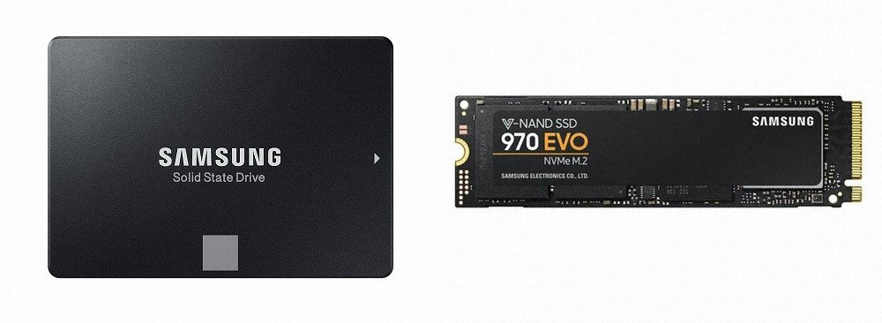
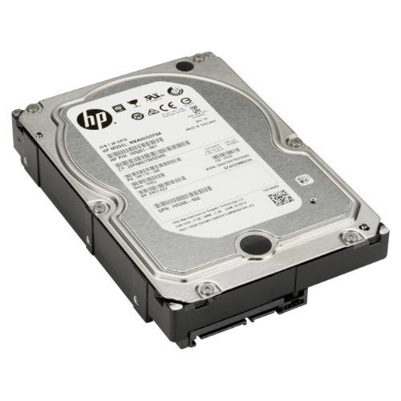
1. Datacenter Trends
Datacenter I/O devices and systems are increasingly us-scale
Achieve single-digit microsecond latencies.

Slide 6
1. Datacenter Trends
Datacenter I/O devices and systems are increasingly us-scale
Achieve single-digit microsecond latencies.

Slide 7
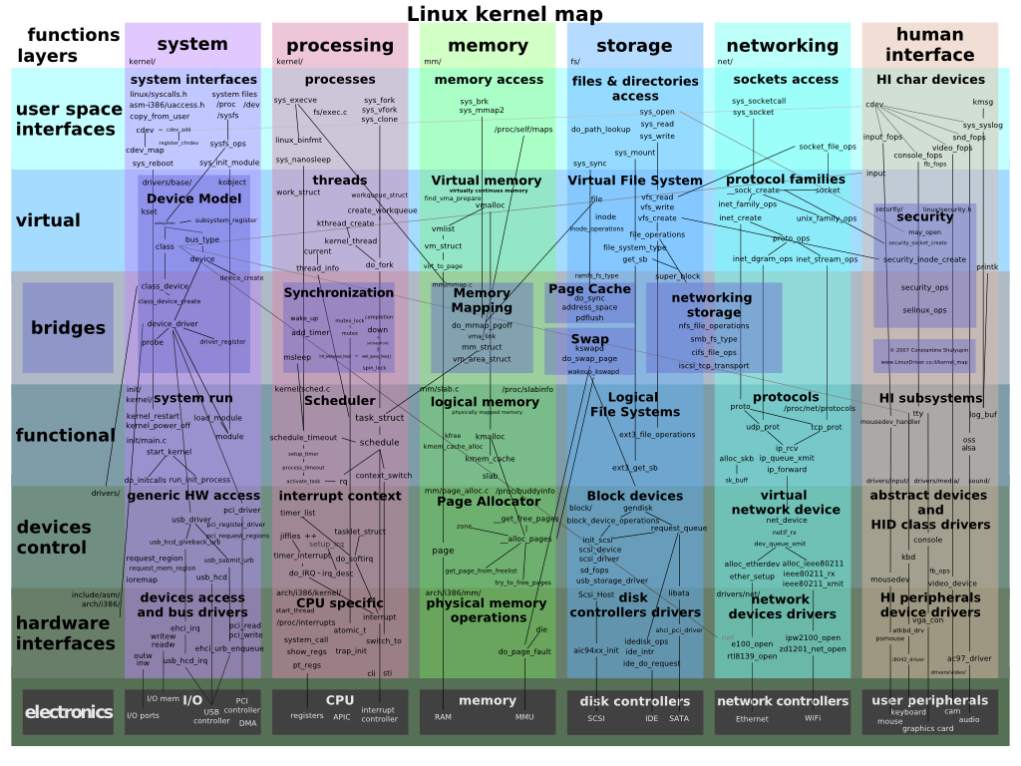
1. Datacenter Trends
https://ko.wikipedia.org/wiki/%EB%A6%AC%EB%88%85%EC%8A%A4_%EC%BB%A4%EB%84%90#/media/%ED%8C%8C%EC%9D%BC:Linux_kernel_map.png

Slide 8
2. Kernel Bypass
The Solution
is
Kernel Bypass

Slide 9
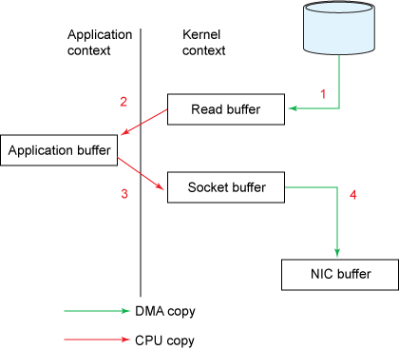
2. Kernel Bypass
https://onecellboy.tistory.com/128

Slide 10
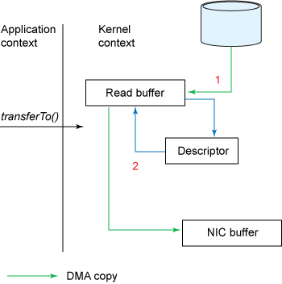
2. Kernel Bypass
Zero-copy
https://onecellboy.tistory.com/128

Slide 11
2. Kernel Bypass
Zero-copy
hardware
https://onecellboy.tistory.com/128

Slide 12
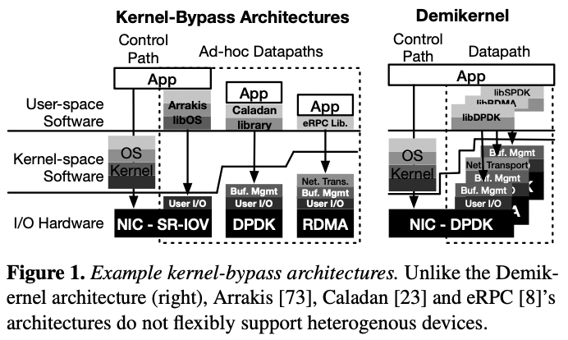
3. Demikernal Datapath OS Requirements
Support Heterogenous OS Offloads
Coordinate Zero-copy Memory Access
Multiplx and Schedule the CPU at us-scale

Slide 13
3. Demikernal Datapath OS Requirements
Support Heterogenous OS Offloads
Coordinate Zero-copy Memory Access
Multiplx and Schedule the CPU at us-scale
Goal
Simplify μs-scale kernel-bypass system development
Offer portability across heterogenous devices
Achieve nanosecond-scale latency overheads

Slide 14
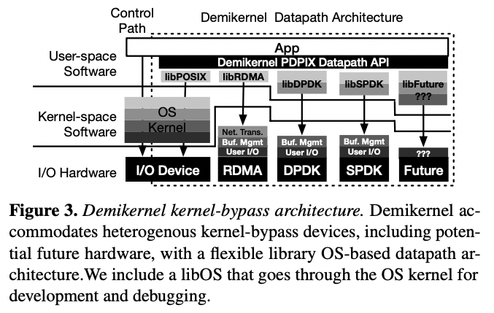
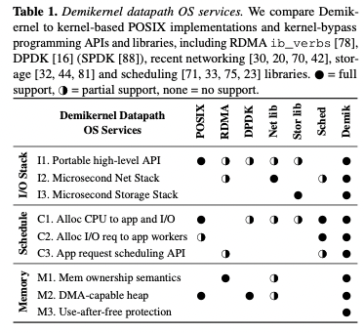
4. Demikernel Datapath Library OS Design

Slide 15
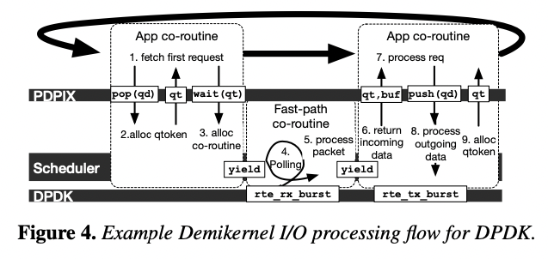
4. Demikernel Datapath Library OS Design

Slide 16
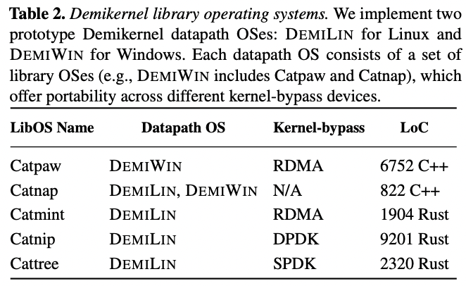
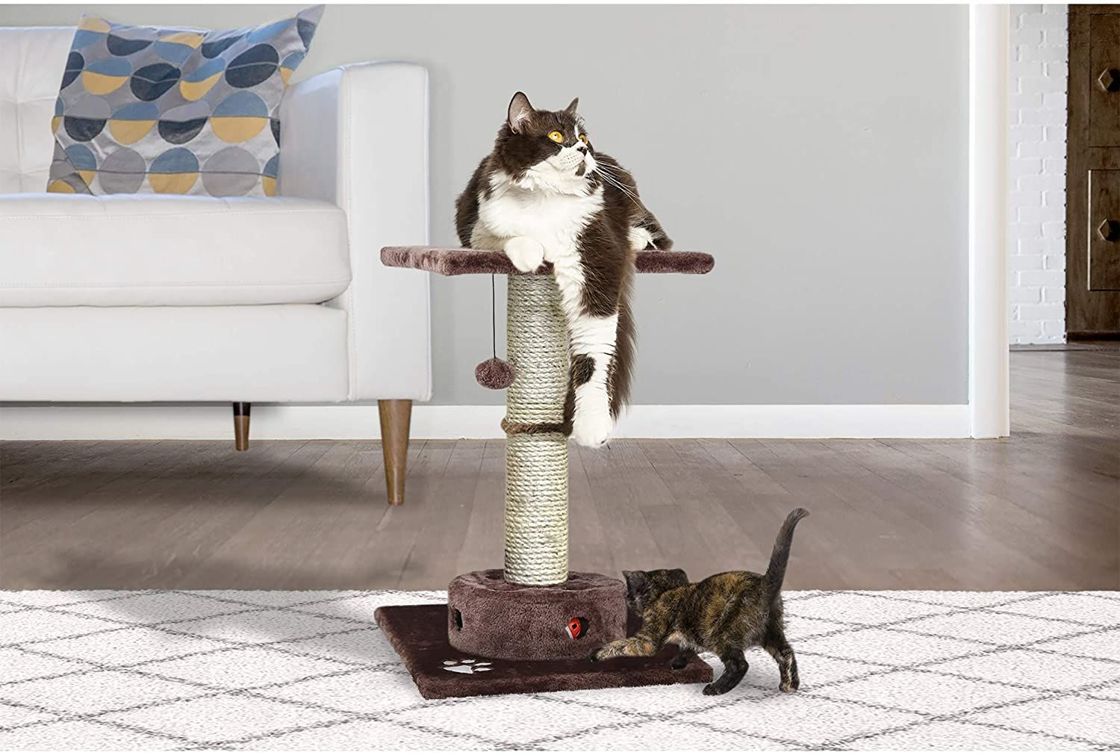
5. Demikernel Library OS Implementations
Catnap
Test and develop
Demikernel applications
without hardware
Catmint
Catnip
UDP
TCP
RDMA
Cattree
SPDK

Slide 17
5. Demikernel Library OS Implementations
Catnap
Test and develop
Demikernel applications
without hardware
Catmint
Catnip
UDP
TCP
RDMA
Cattree
SPDK

Slide 18
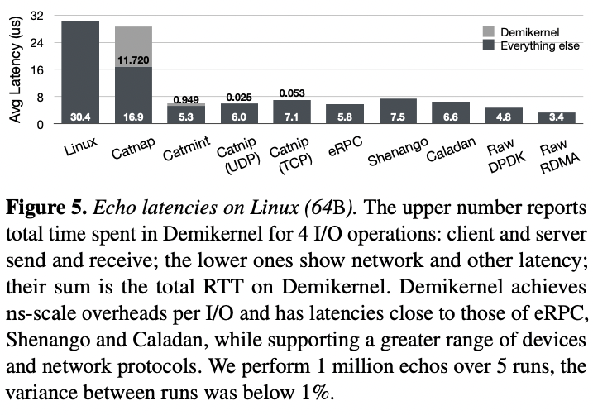
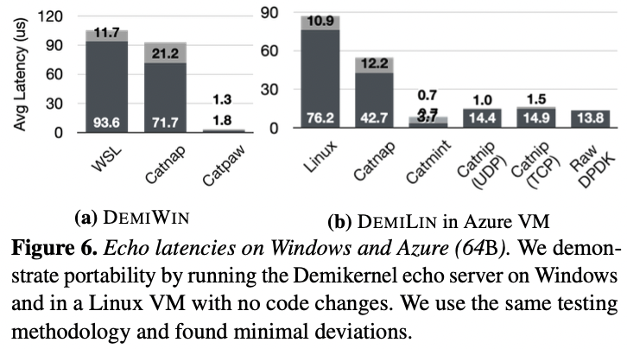
6. Evaluation
Experimental Setup
- CPU 20 core, using 5 2.2GHz servers
- Intel Optane 800P NVMe SSD
- For Windows, use a separate cluster of 14 core 2.6GHz servers
- On Linux, hugepage(2MB) is used as 2GB
Proven competitive performance
without sacrificing portability

Slide 19
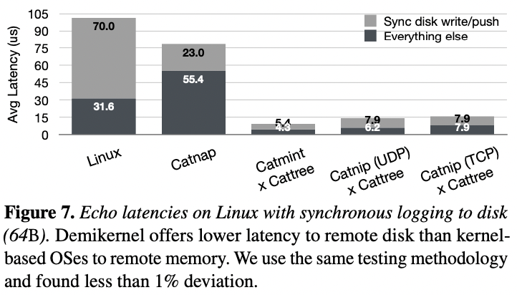
6. Evaluation
Experimental Setup
- CPU 20 core, using 5 2.2GHz servers
- Intel Optane 800P NVMe SSD
- For Windows, use a separate cluster of 14 core 2.6GHz servers
- On Linux, hugepage(2MB) is used as 2GB
Implement zero-copy
with high performance
without losing portability

Slide 20
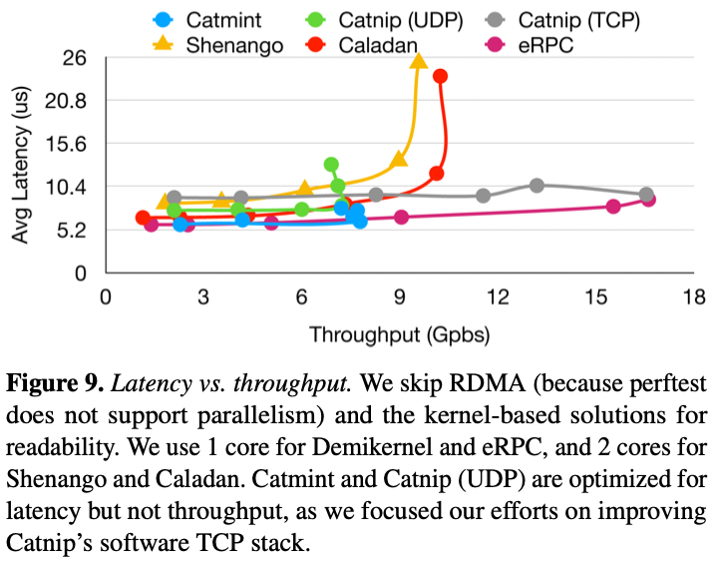
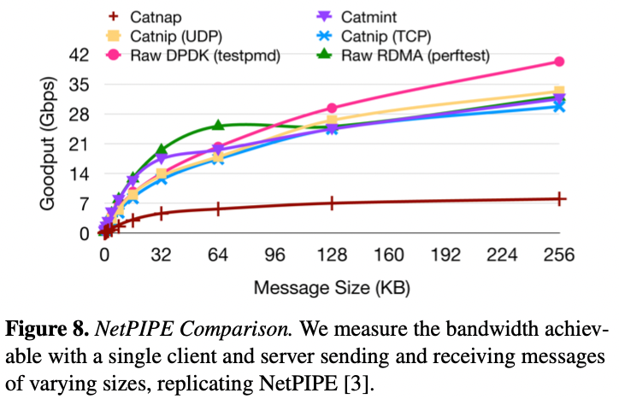
6. Evaluation
Experimental Setup
OS management service is provided at a reasonable cost.
You don't have to spend a lot of money on high-level APIs and OS features.
- CPU 20 core, using 5 2.2GHz servers
- Intel Optane 800P NVMe SSD
- For Windows, use a separate cluster of 14 core 2.6GHz servers
- On Linux, hugepage(2MB) is used as 2GB

Slide 21
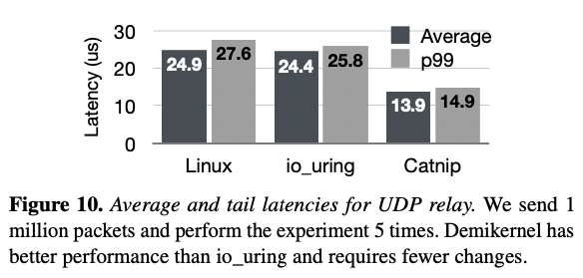
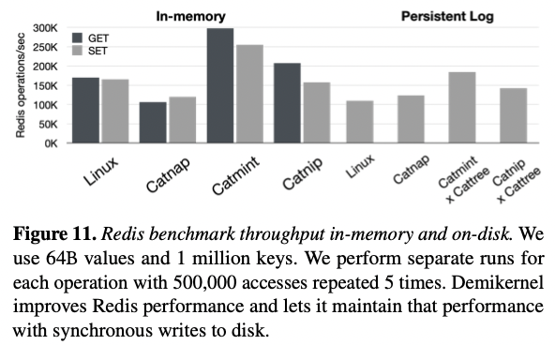
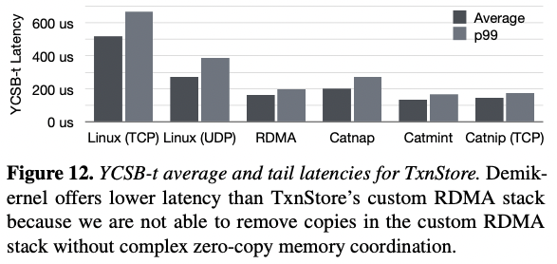
6. Evaluation
Experimental Setup
- CPU 20 core, using 5 2.2GHz servers
- Intel Optane 800P NVMe SSD
- For Windows, use a separate cluster of 14 core 2.6GHz servers
- On Linux, hugepage(2MB) is used as 2GB
UDP Relay Server
Redis
- In-memory distributed cache
TxnStore
- Distributed transactional storage
Performance is good in real applications.

Slide 22
7. Conclusion
Demikernel is a first step towards datapath OSes for μs-scale kernel-bypass applications.
It did not delve deeply into research areas
such as storage stack, memory resource management, and insight into memory access patterns.
However, Demikernel is a promising direction for further research
without losing portability and versatility.
we hope that Demikernel is the first of many datapath OSes for μs-scale datacenter applications.

Slide 23
The Demikernel Datapath OS Architecture for Microsecond-scale Datacenter Systems
2022 Advanced Operating System
Zhang, I., Raybuck, A., Patel, P., Olynyk, K., Nelson, J., Leija, O. S. N., ... & Badam, A. (2021, October). The Demikernel Datapath OS Architecture for Microsecond-scale Datacenter Systems. In Proceedings of the ACM SIGOPS 28th Symposium on Operating Systems Principles (pp. 195-211).
Thank You!
2022. 05. 03
Presentation by Choi, Gunhee
choi_gunhee@dankook.ac.kr

