Slide 1
Rethinking File Mapping for Persistent Memory
Ian Neal, Gefei Zuo, Eric Shiple, Tanvir Ahmed Khan,
Youngjin Kwon, Simon Peter, Baris Kasikci,
USENIX FAST ‘19.
2022. 06. 07
Presented by Jeyeon Lee
2reenact@dankook.ac.kr

Slide 2
Persistent Main Memory
Bridges the gap between SSD and DRAM
Traditionally-slow storage device
Fast, volatile random-access memory
Only 2-3$×$ higher latency than DRAM
File mapping comprises up to 70% of the I/O path
<Jumper>, 2008

Slide 3
File Mapping Challenges
Fragmentation
Causes mapping structure larger
Reduction in sequential access
Locality of reference
Mapping structure size
Concurrency
Isolation is simpler in per-file mapping structures
Mapping structure resizing occurs within a critical section

Slide 4
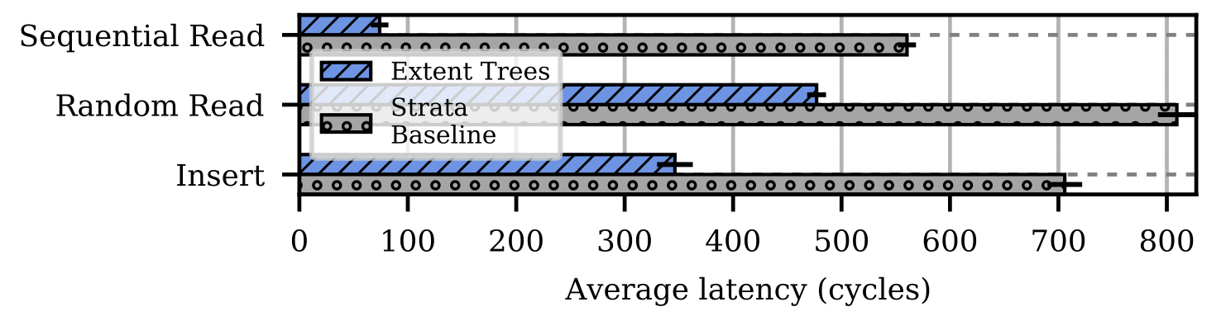
File Mapping Non-Challenges
Crash Consistency
File systems generally employ some form of journaling
PM data structures are designed to provide consistency itself
Page Caching
File systems read data and metadata into a page cache in DRAM
Batches updates using this page cache and write back dirty pages
Reduce the overhead of reading directly from a block device
For PM, OS-managed page cache may no longer be required for file mapping

Slide 5
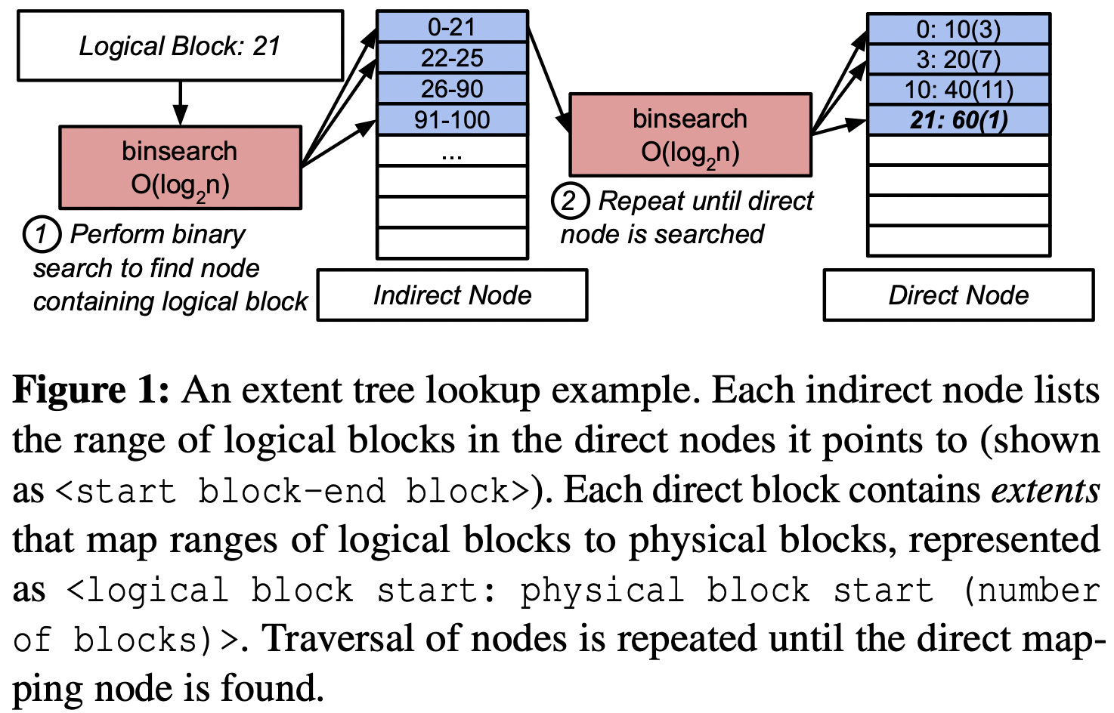
Traditional, Per-File Mapping : Extent Trees
Still used in modern PM-optimized file system
Youngjin Kwon et al., Strata(SOSP ‘17)
B-trees that contain extents
Small structure size
Require many memory accesses

Slide 6
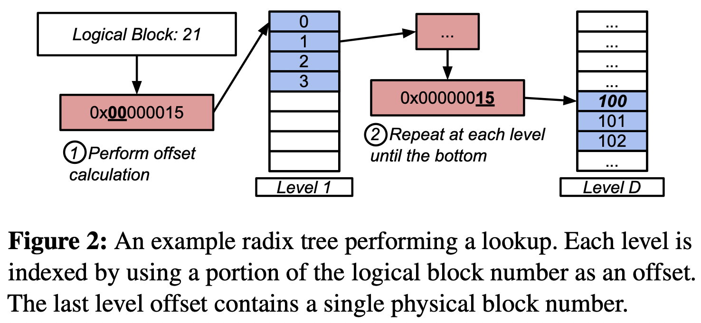
Traditional, Per-File Mapping : Radix Trees
Computationally simplest mapping operations
Tree traversal take longer, since radix tree grow faster
Less compact than extent trees
Require more indirection

Slide 7
PM-specific Global File Mapping
Hash Table
Leverage the small number of memory accesses
Avoid the complexity of resizing per-file mapping structure
Not affected by fragmentation as they do not use a compact layout
Employ a fixed-size translation cache in DRAM
Caches logical to physical block translations to accelerate lookups
Ameliorates accesses in randomly distributed mappings

Slide 8
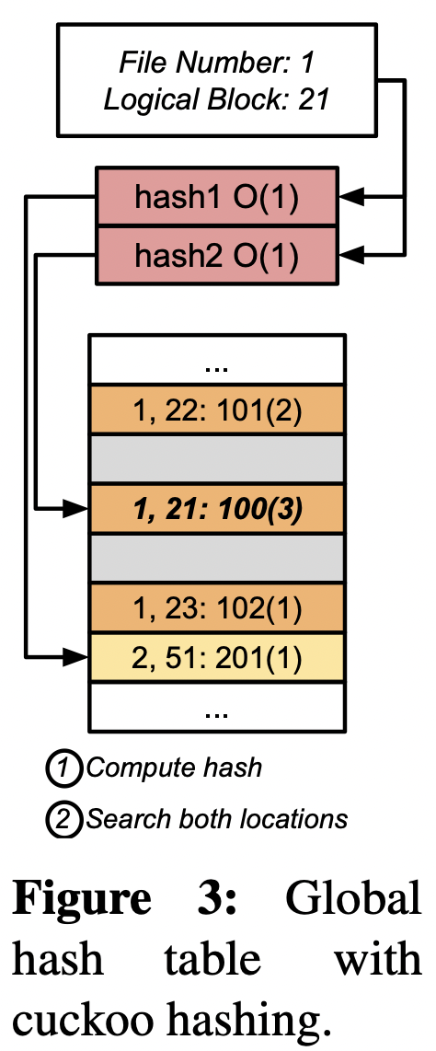
Global Cuckoo Hash Table
Cuckoo Hashing
Using two different hash function
Set up as a continuous array, statically allocated
Each entries maps
<inum>, <logical block>:<physical block>(<# of blocks>)
Maintain # of blocks to map continuous blocks

Slide 9
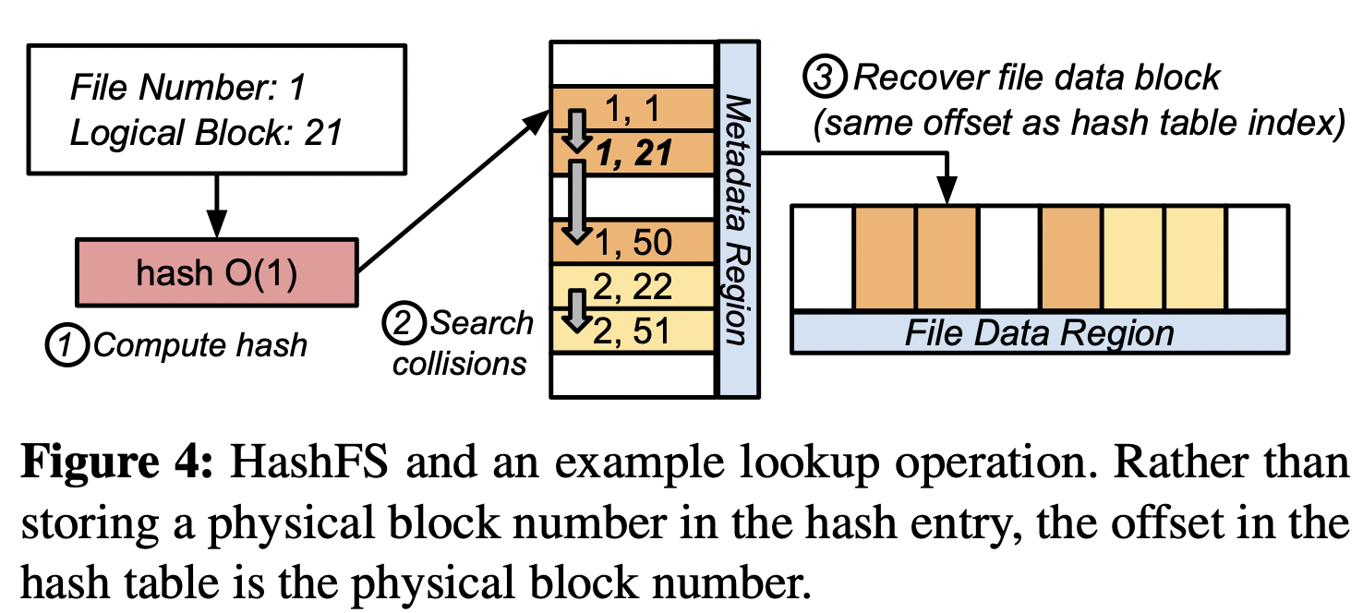
Hash FS
Block allocation with single hash table
Split into a metadata region and file data region
Uses constant 8bytes per 4KB data block
Improves sequential access by prefetching via SIMD parallelism

Slide 10
Experimental Setup
Server
Intel Cascade Lake-SP
4$×$ 128GB Intel Optane DC PM modules
Strata file system
Configured to only use PM
Mapping structured are not page cached

Slide 11
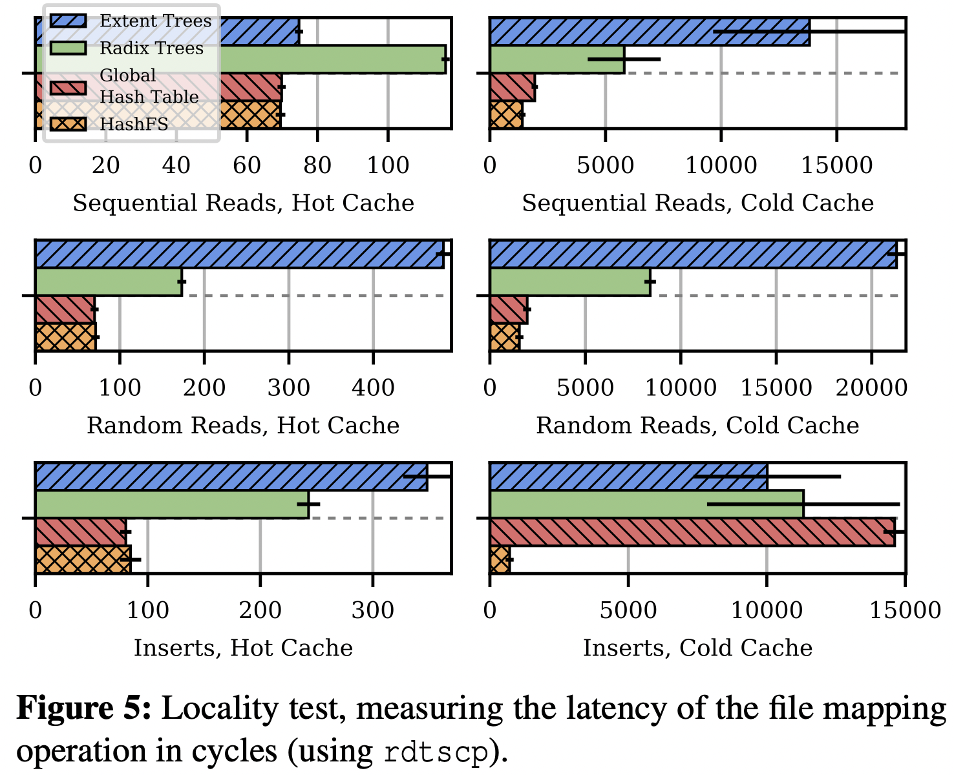
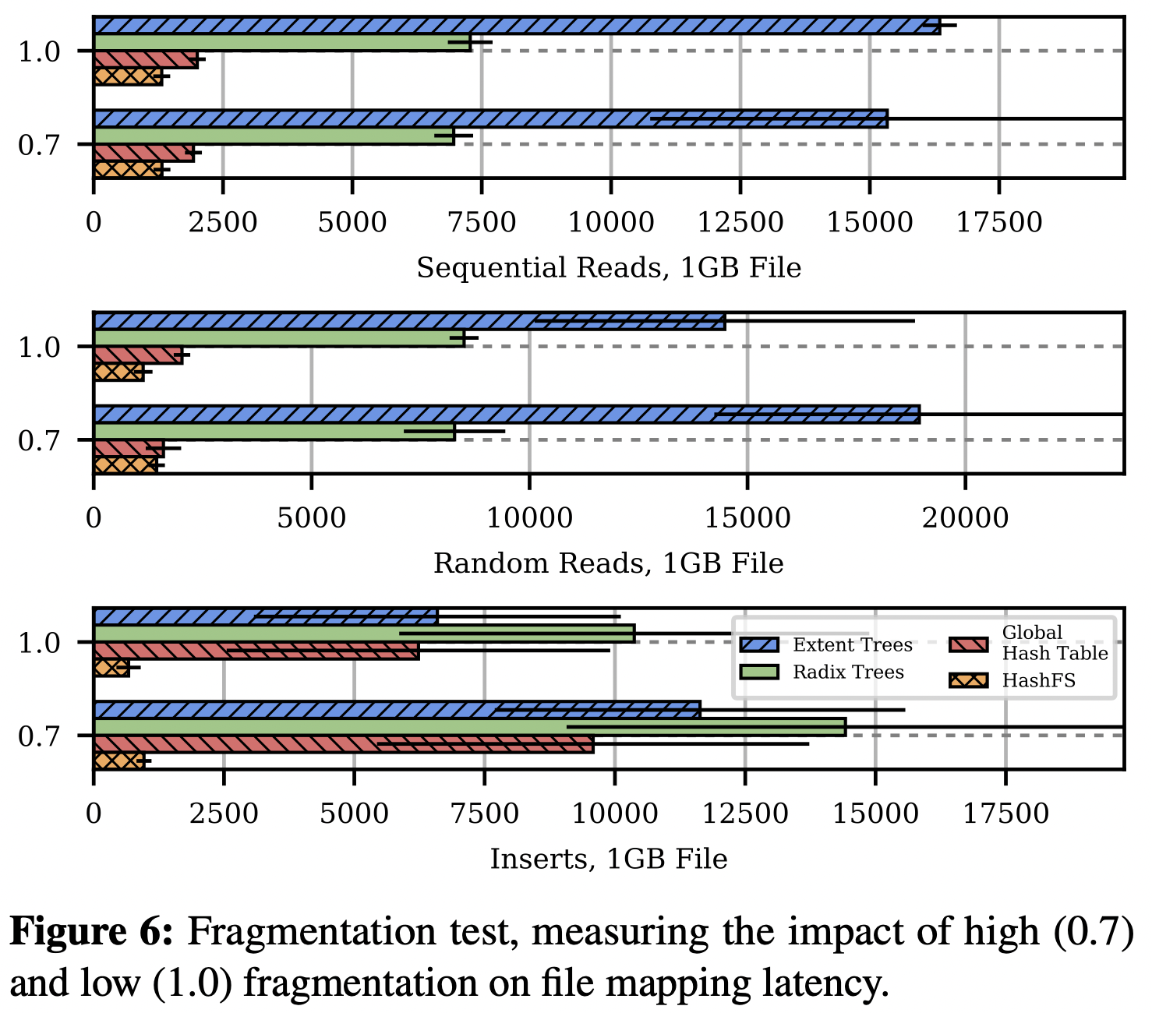
Evaluation
Locality test
Fragmentation

Slide 12
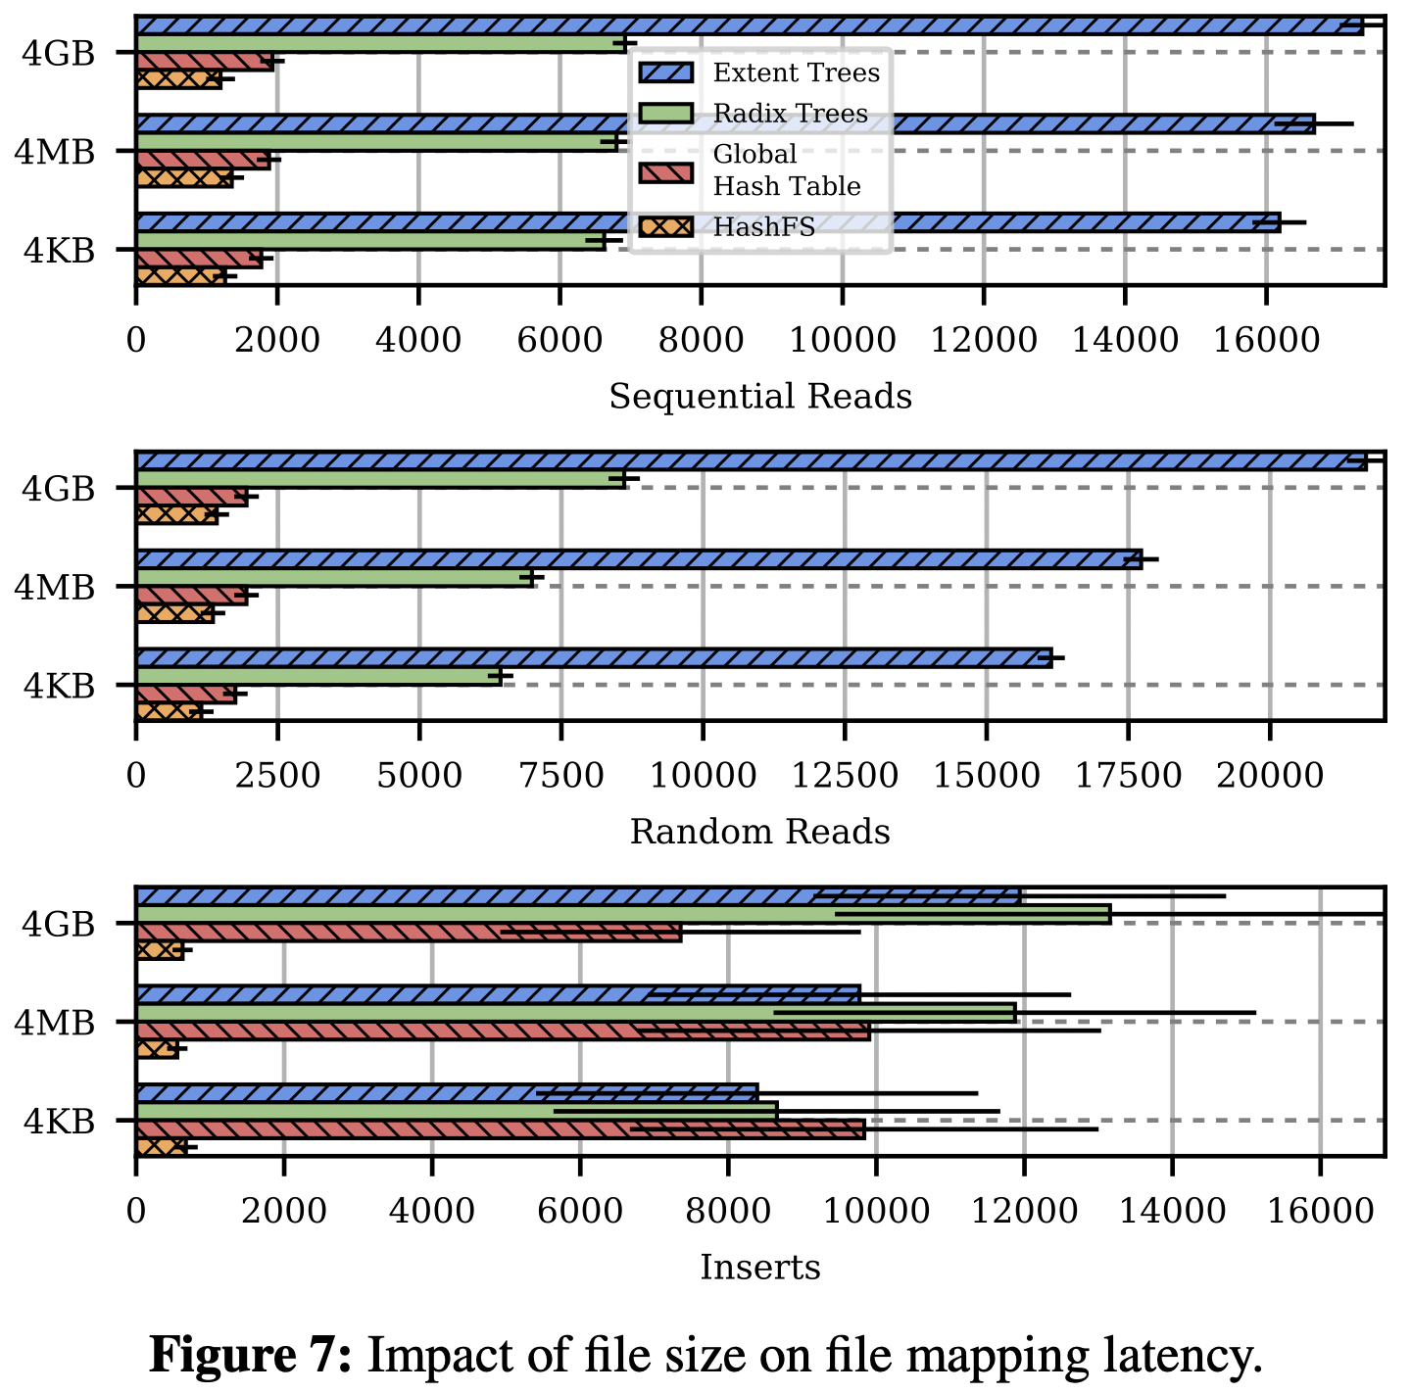
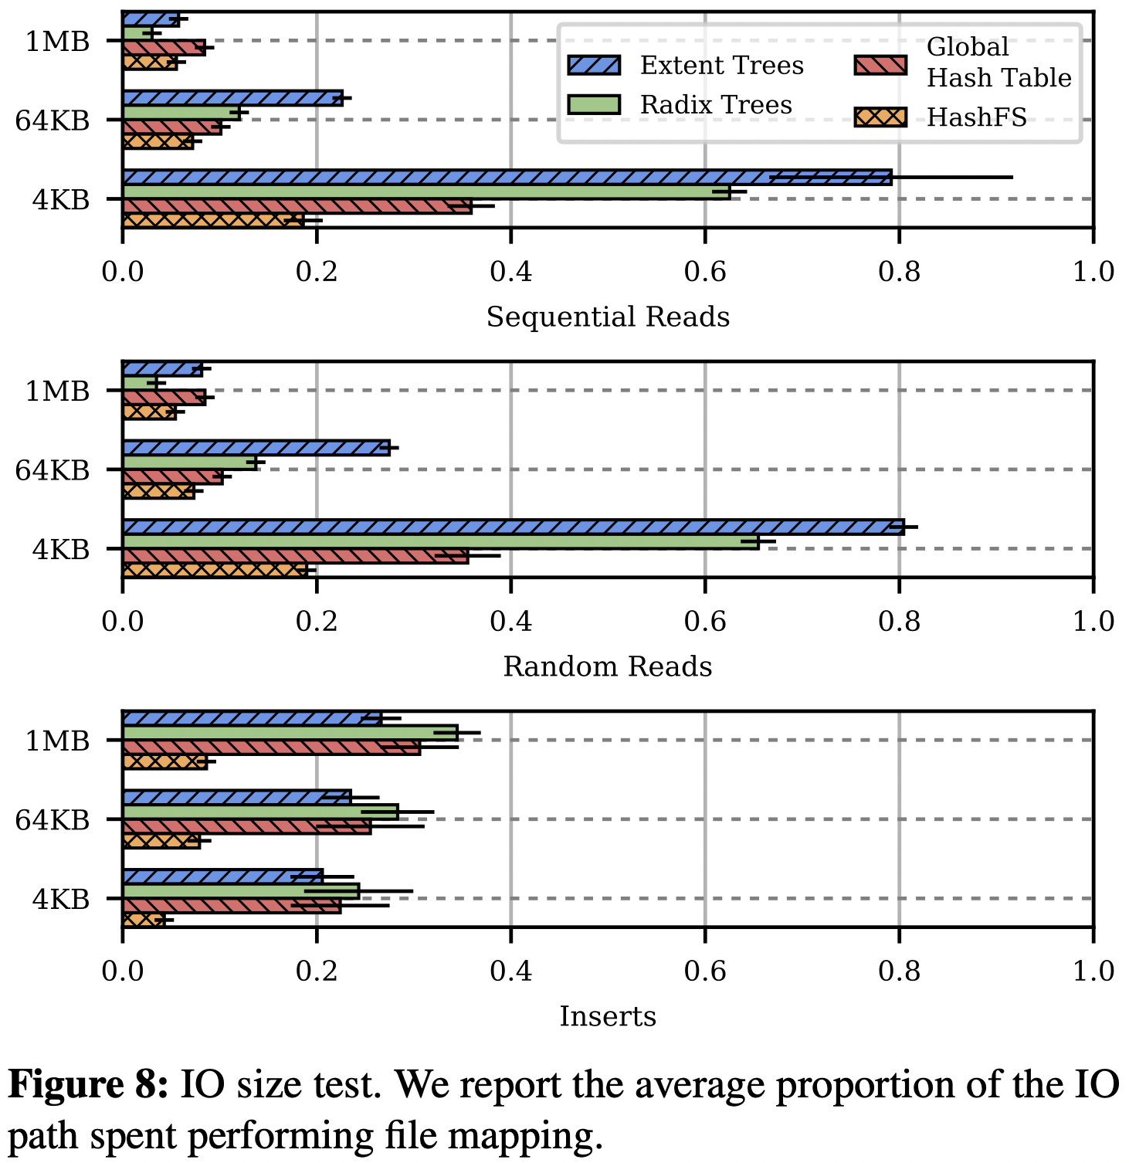
Evaluation
Impact of File Size and
IO Size

Slide 13
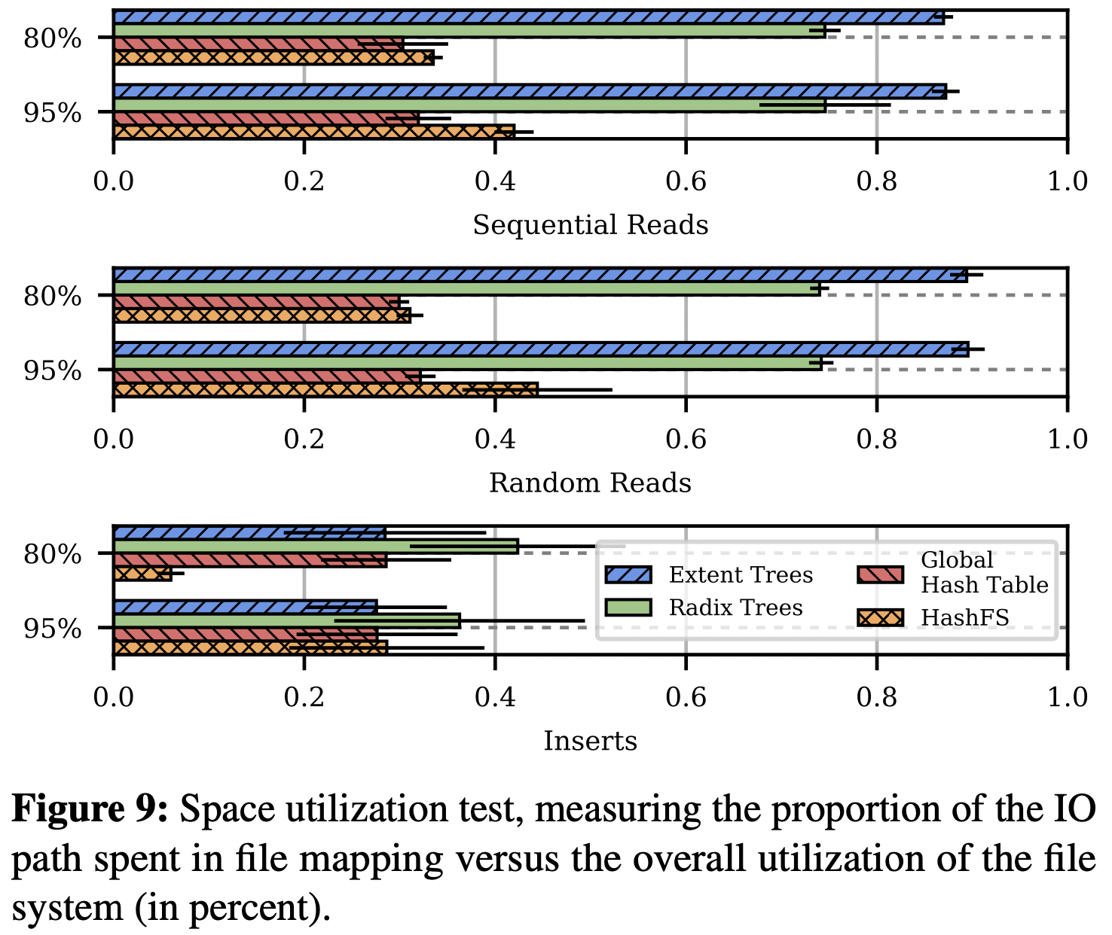
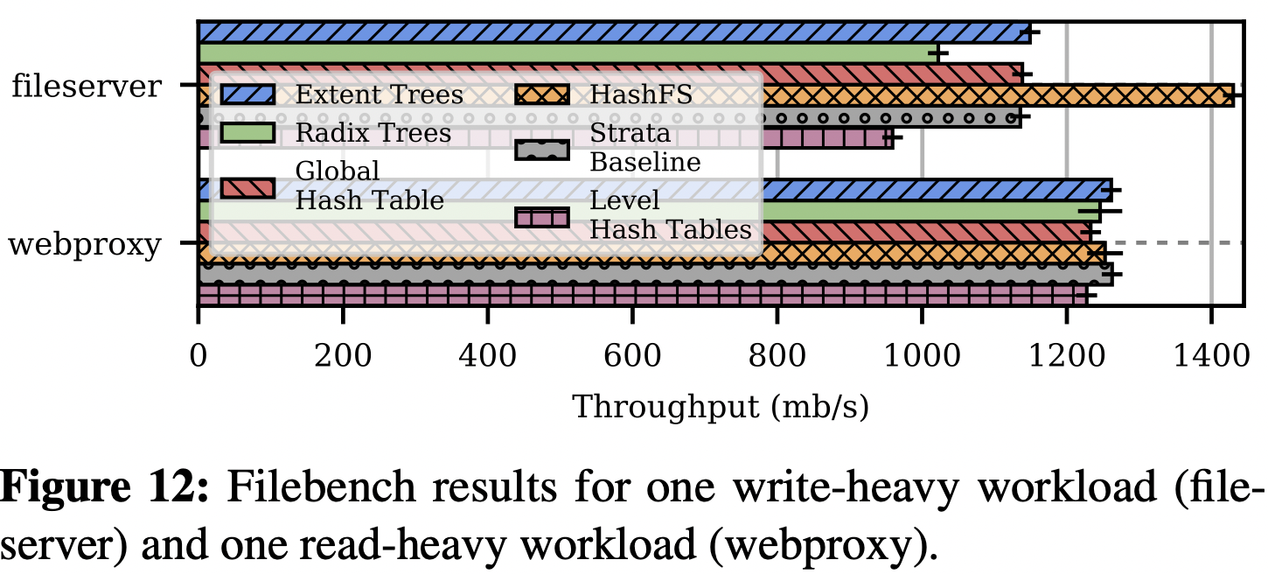
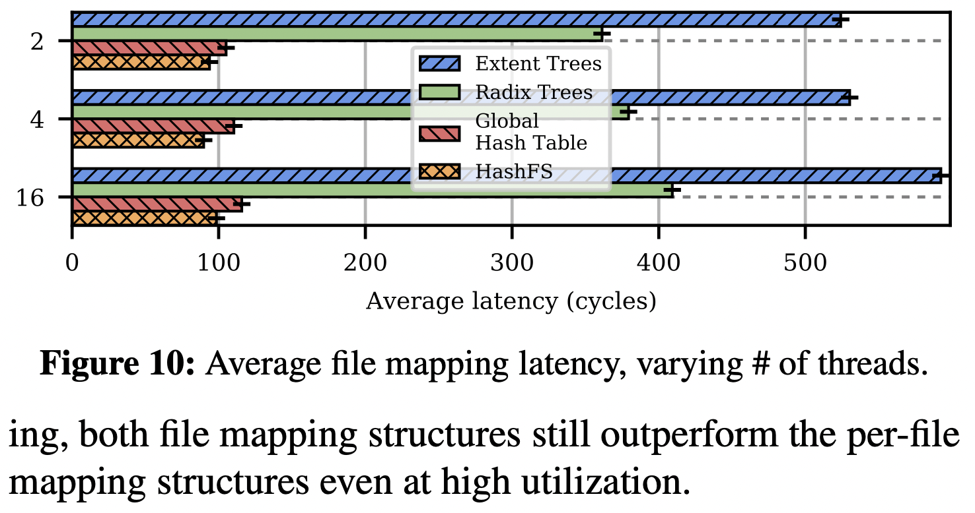
Evaluation
Space Utilization
File Bench
Concurrency

Slide 14
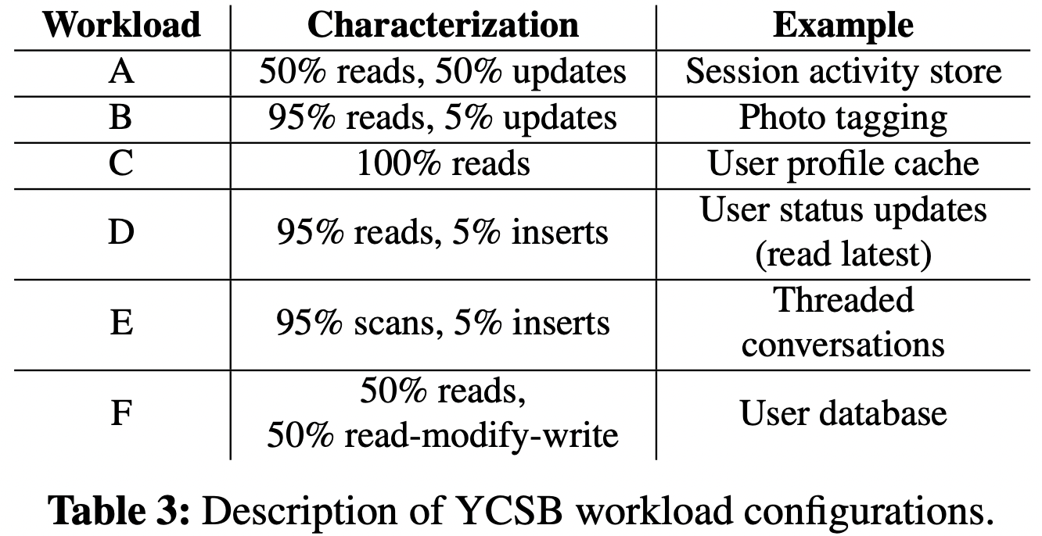
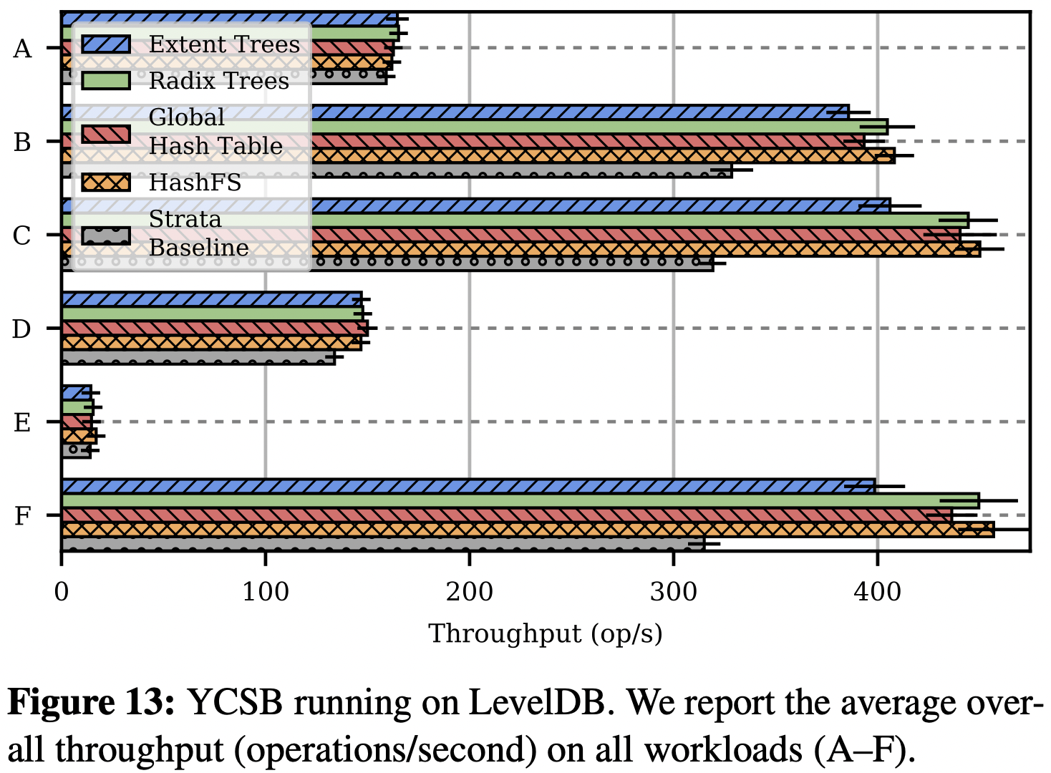
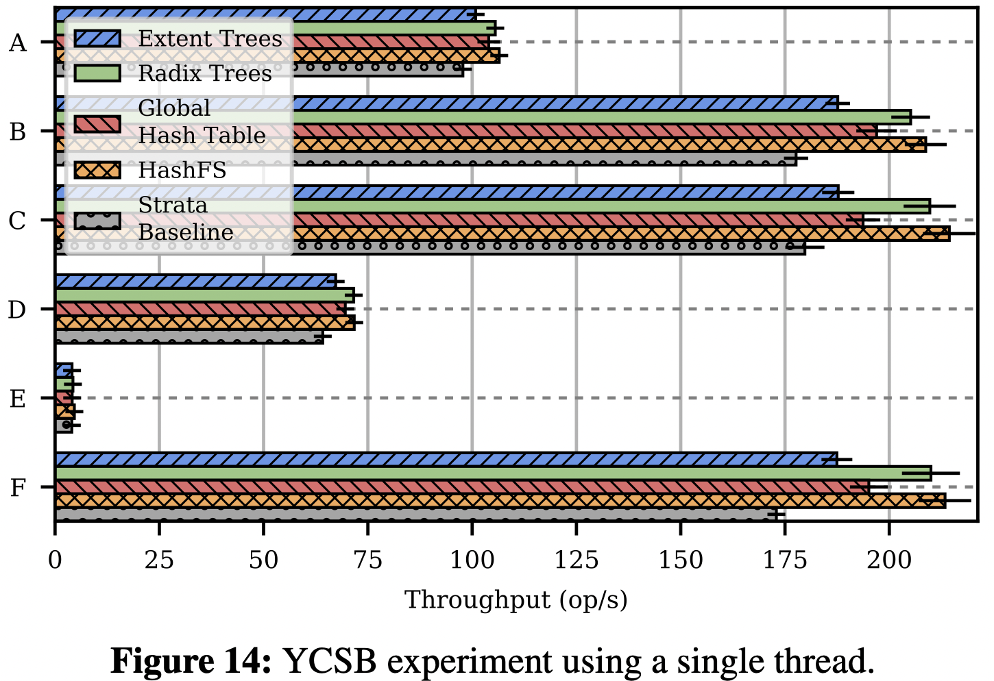
Evaluation
YCSB

Slide 15
Conclusion
File mapping is now a significant overhead on PM system
Page cache no longer mitigates overheads
Designed 4 different PM-optimized mapping structures
Extent trees, Radix trees
Cuckoo hash table, Hash FS
HashFS performs best on average
Providing up to 45% improvement on real application workload

Slide 16
Rethinking File Mapping for Persistent Memory
Ian Neal, Gefei Zuo, Eric Shiple, Tanvir Ahmed Khan,
Youngjin Kwon, Simon Peter, Baris Kasikci,
USENIX FAST ‘19.
Thank You !
2022. 06. 07
Presented by Jeyeon Lee
2reenact@dankook.ac.kr

