Slide 1
The Linux Scheduler: a Decade of Wasted Cores
Jean-Pierre Lozi, Baptiste Lepers, Justin Funston, Fabien Gaud, Vivien Quéma, Alexandra Fedorova
EuroSys '16: Proceedings of the Eleventh European Conference on Computer Systems
April 2016, London, United Kingdom
2023. 09. 12
Presented by Charles D. Jaranilla
charlzdieljaranilla@gmail.com

Slide 2
Introduction
The Linux Scheduler
Bugs
Tools
Conclusion

Slide 3
Introduction
“A decade of wasted cores”…
2004 marked the end of Dennard scaling
2005 onwards saw the increased use of multicores to improve CPU performance
Did Linux effectively take advantage of this multicore architecture?
Notes:
(Dennard scaling)
Before 2004, CPU manufacturers increase CPU performance by reducing transistor size = lower power consumption = improved CPU frequency = improved CPU performance

Slide 4
Introduction
Contributions
Discovery of 4 performance bugs in the Linux scheduler
Short-term occurrence
Long-term occurrence
Provide fixes to the bugs
Sanity checker
Trace visualization
Notes:
Challenging properties of modern hardware
NUMA
high costs of cache coherency and synchronization
diverging cpu and memory latencies
= complex implementation of the scheduler
Short-term: thread exits, blocks, created, unblocked … etc
Long-term: not an expected behavior

Slide 5
The Linux Scheduler
“The Linux scheduler is a multi-queue scheduler, which means that for each of the logical host CPUs, there is a run queue of processes waiting for this CPU. Each virtual CPU waits for its execution in one of these run queues.” ~ IBM
Load balance evenly on CPU cores to maximize resources
Don’t let CPU cores to go idle if some cores have waiting threads
“And you have to realize that there are not very many things that have aged as well as the scheduler. Which is just another proof that scheduling is easy.”
~ Linus Torvalds, 2001
Notes:
IBM definition taken from: https://www.ibm.com/docs/vi/linux-on-systems?topic=management-linux-scheduling
Certain cores, ideally, should not have more work than other cores
…

Slide 6
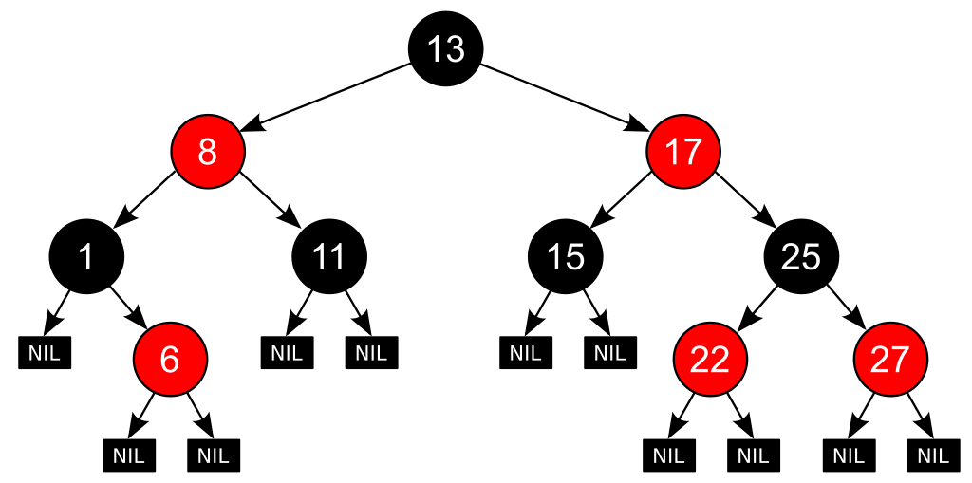
The Linux Scheduler
Completely Fair Scheduling (CFS)
On a single-CPU system, simple
Weighted Fair Queueing (WFQ) scheduling algorithm
Fixed time interval - divided among threads proportionally to their weights = timeslice
Threads are organized in a runqueue, implemented as a
Red Black Tree
Thread
A | Weight: 10
B | Weight: 1
runqueue
CPU
Notes:
Available CPU cycles are divided among threads in proportion to their weights. CFS time-slices the CPU among the running threads.
The scheduler defines a fixed time interval during which each thread in the system must run at least once. The interval is divided among threads proportionally to their weights. A thread’s weight is essentially its priority, or niceness
Threads are organized in a runqueue, implemented as a red-black tree, in which the threads are sorted in the increasing order of their vruntime. When a CPU looks for a new thread to run it picks the leftmost node in the red-black tree, which contains the thread with the smallest vruntime.

Slide 7
The Linux Scheduler
Completely Fair Scheduling (CFS)
On multi-core systems, complex
Per-core runqueues - context switch
Periodically run the load-balancing algorithm
Placement of newly created or awaken threads
Thread
A | Weight: 5
B | Weight: 5
C | Newly Created
runqueue
?
CPU 1
runqueue
CPU 2
Notes:
Context switches are on a critical path, so they must be fast

Slide 8
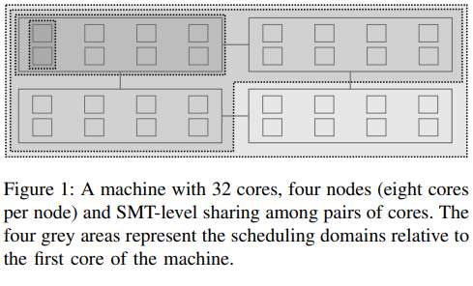
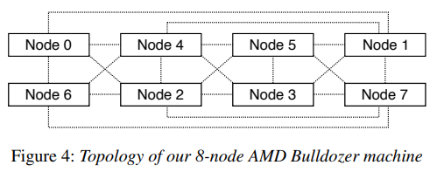
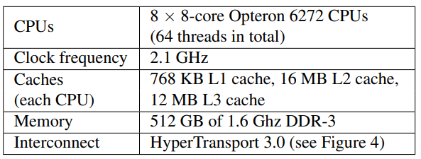
The Linux Scheduler
The Load Balancing Algorithm (LBA)
Used by CFS to track load
However, balancing the load based only on thread weights is insufficient
load - thread’s weight and average CPU utilization
Scheduling Domain (SD) – each level of the hierarchy (relative connectivity of cores)
Scheduling Groups (SG) – comprised of CPU cores
Notes:
INSUFFICIENT: Cores need to be able to freely steal work from other core’s runqueue

Slide 9
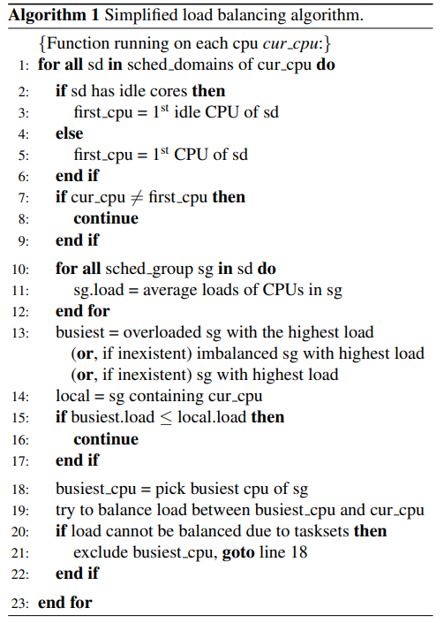
The Linux Scheduler
The Load Balancing Algorithm (LBA)
Pseudocode of the LBA
1 For each SD, from lowest to the highest hierarchy
2 Select designated core in SD to run the algorithm
(first idle core or core 0)
11 Compute average loads of all SG in SD
13 Select SG with the highest average load
15 If load of other SG > current SG
balance load (steal work from other SG)

Slide 10
Bugs
Bug 1: The Group Imbalance Bug
Cause: When a core tries to steal work from another SG, it compares the average load of the SG instead of looking at each core’s average load.
Effect: Load is only transferred if average load of target SG is greater than the average load of current SG
* Average doesn’t account for spread

Slide 11
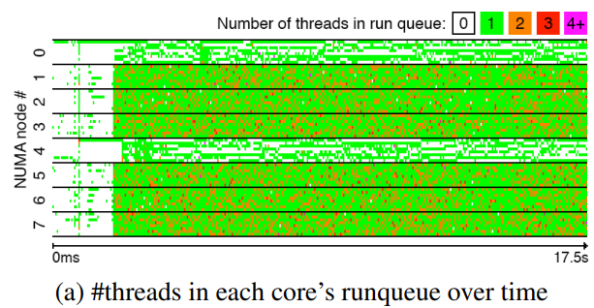
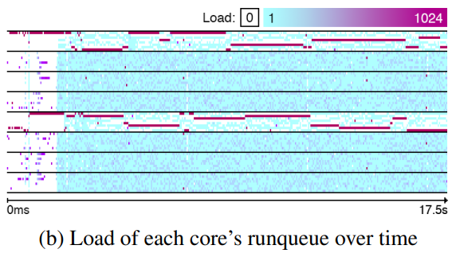
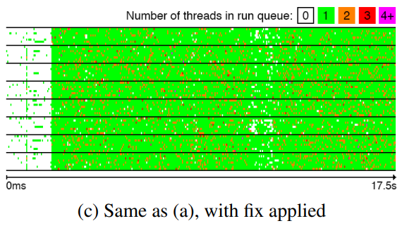
Bugs
Bug 1: The Group Imbalance Bug
Cause: When a core tries to steal work from another SG, it compares the average load of the SG instead of looking at each core’s average load.
Effect: Load is only transferred if average load of target SG is greater than the average load of current SG
* Average doesn’t account for spread
Fix: Instead of comparing average loads, compare the minimum loads
Result: Distribution of load is more balanced among the nodes
Notes:
In the time period shown in the figure, the machine was executing a compilation of the kernel (make with 64 threads), running two R processes (each with one thread). The make and the two R processes were launched from 3 different ssh connections.
The chart shows that there are two nodes whose cores run either only one thread or no threads at all, while the rest of the nodes are overloaded, with many of the cores having two threads in their runqueue.
Discrepancies between threads’ loads are illustrated in Figure 2b, which shows the combined load of threads in each core’s runqueue: a darker colour corresponds to a higher load. Nodes 0 and 4, the ones running the R processes, each have one core with a very high load.
After we fixed the bug, the completion time of the make job, in the make/R workload described earlier in this section, decreased by 13%. And as seen on the figure (c) the distribution of load is more balanced among the nodes

Slide 12
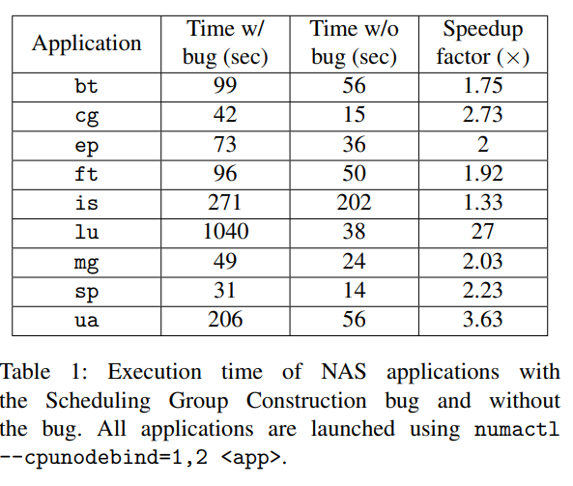
Bugs
Bug 2: The Scheduling Group Construction Bug
Cause: An application is pinned on nodes that are two hops apart
Effect: Prevents the load balancing from migrating threads between these two nodes
Fix: Modified the construction of scheduling groups by constructing them from their own perspective.
First SG: constructed by picking a node and directly connected nodes
Second SG: constructed by picking the first node not covered in the first SG
Result: SGs are able to detect imbalance and steal work
X
Notes:
Suppose that an application is pinned on Nodes 1 and 2 and that all of its threads are being created on Node 1 (Linux spawns threads on the same core as their parent thread; when an application spawns multiple threads during its initialization phase, they are likely to be created on the same core – so this is what typically happens). Eventually we would like the load to be balanced between Nodes 1 and 2. However, when a core on Node 2 looks for work to steal, it will compare the load between the two scheduling groups shown earlier. Since each scheduling group contains both Nodes 1 and 2, the average loads will be the same, so Node 2 will not steal any work!
After the fix, when cores of Node 1 and 2 try to steal tasks at the level of the machine, Nodes 1 and 2 are no longer included in all scheduling groups. The cores are thus able to detect an imbalance and to steal work.

Slide 13
Bugs
Scenario:
Thread A running on Node X
Thread A sleeps in a core in Node X
Node X gets busy
Thread A wakes up
Scheduler wakes Thread A up in the same core even when other cores are idle
Bug 3: The Overload-on-Wakeup Bug
Cause: A thread that was asleep may wake up on an overloaded core while other cores may be idle
Effect: Machine underutilization

Slide 14
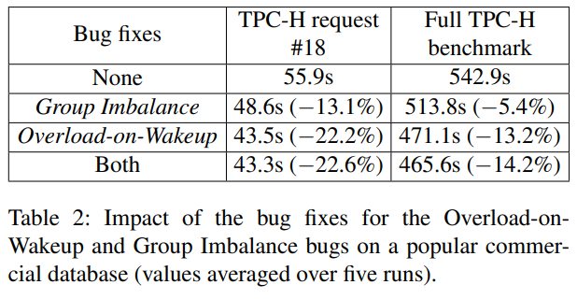
Bugs
Scenario:
Thread A running on Node X
Thread A sleeps in a core in Node X
Node X gets busy
Thread A wakes up
Scheduler wakes Thread A up in the same core even when other cores are idle
Bug 3: The Overload-on-Wakeup Bug
Cause: A thread that was asleep may wake up on an overloaded core while other cores may be idle
Effect: Machine underutilization
Fix: Wake thread up on an idle core for the longest time
Result: Woken up thread doesn’t need to wait for its original but now overloaded core

Slide 15
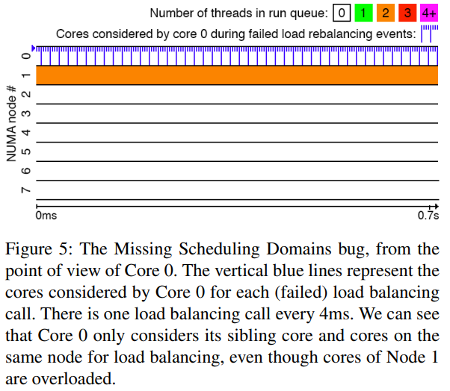
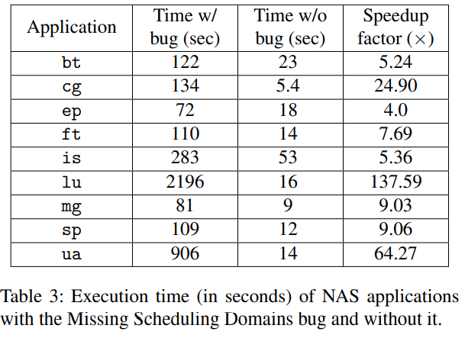
Bugs
Bug 4: The Missing Scheduling Domains Bug
Cause: Incorrect update of a global variable representing the number of scheduling domains in the machine
Effect: Threads can only run on the node on which they ran before the core had been disabled
*The call to the function generating domains across
NUMA nodes was dropped by Linux developers during code refactoring.
Fix: Added the code back
Result: Generate domains across NUMA nodes
Notes:
When a core is disabled, this variable is set to the number of domains inside a NUMA node. As a consequence, the main scheduling loop (line 1 of Algorithm 1) exits earlier than expected
We traced the root cause of the bug to the code that regenerates the machine’s scheduling domains. Linux regenerates scheduling domains every time a core is disabled. Regenerating the scheduling domains is a two-step process: the kernel regenerates domains inside NUMA nodes, and then across NUMA nodes.

Slide 16
Bugs
Discussion
Conventional testing and debugging tools were not helpful.
Understand root causes of bugs and build new tools to detect and visualize them.
Confirm the bugs and the reasons why they occur.

Slide 17
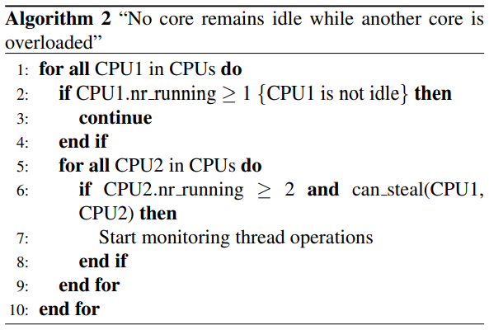
Tools
Online Sanity Checker
A mechanism for periodically checking an invariant that must be maintained
Code kept simple, minimize chance of bugs within the tool itself
Scheduler Visualization Tool
Illustrates salient scheduling activity over time
Profile and plot
the size of run queues
the total load of run queues
the cores that were considered during periodic load balancing and thread wakeups

Slide 18
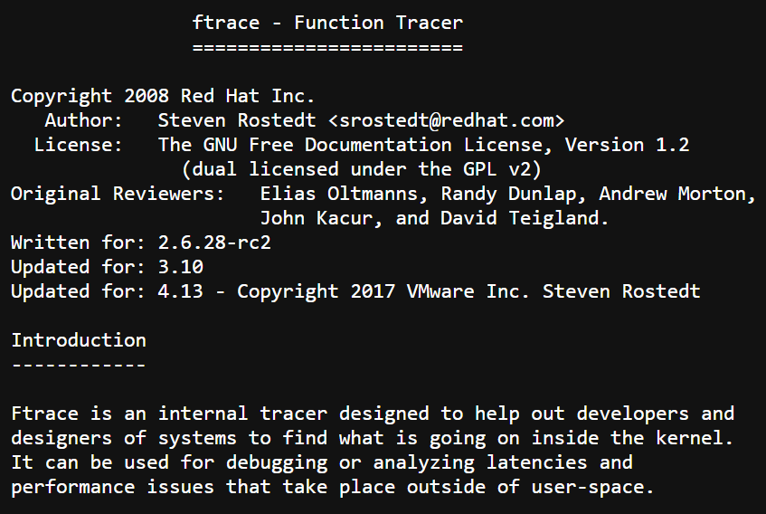
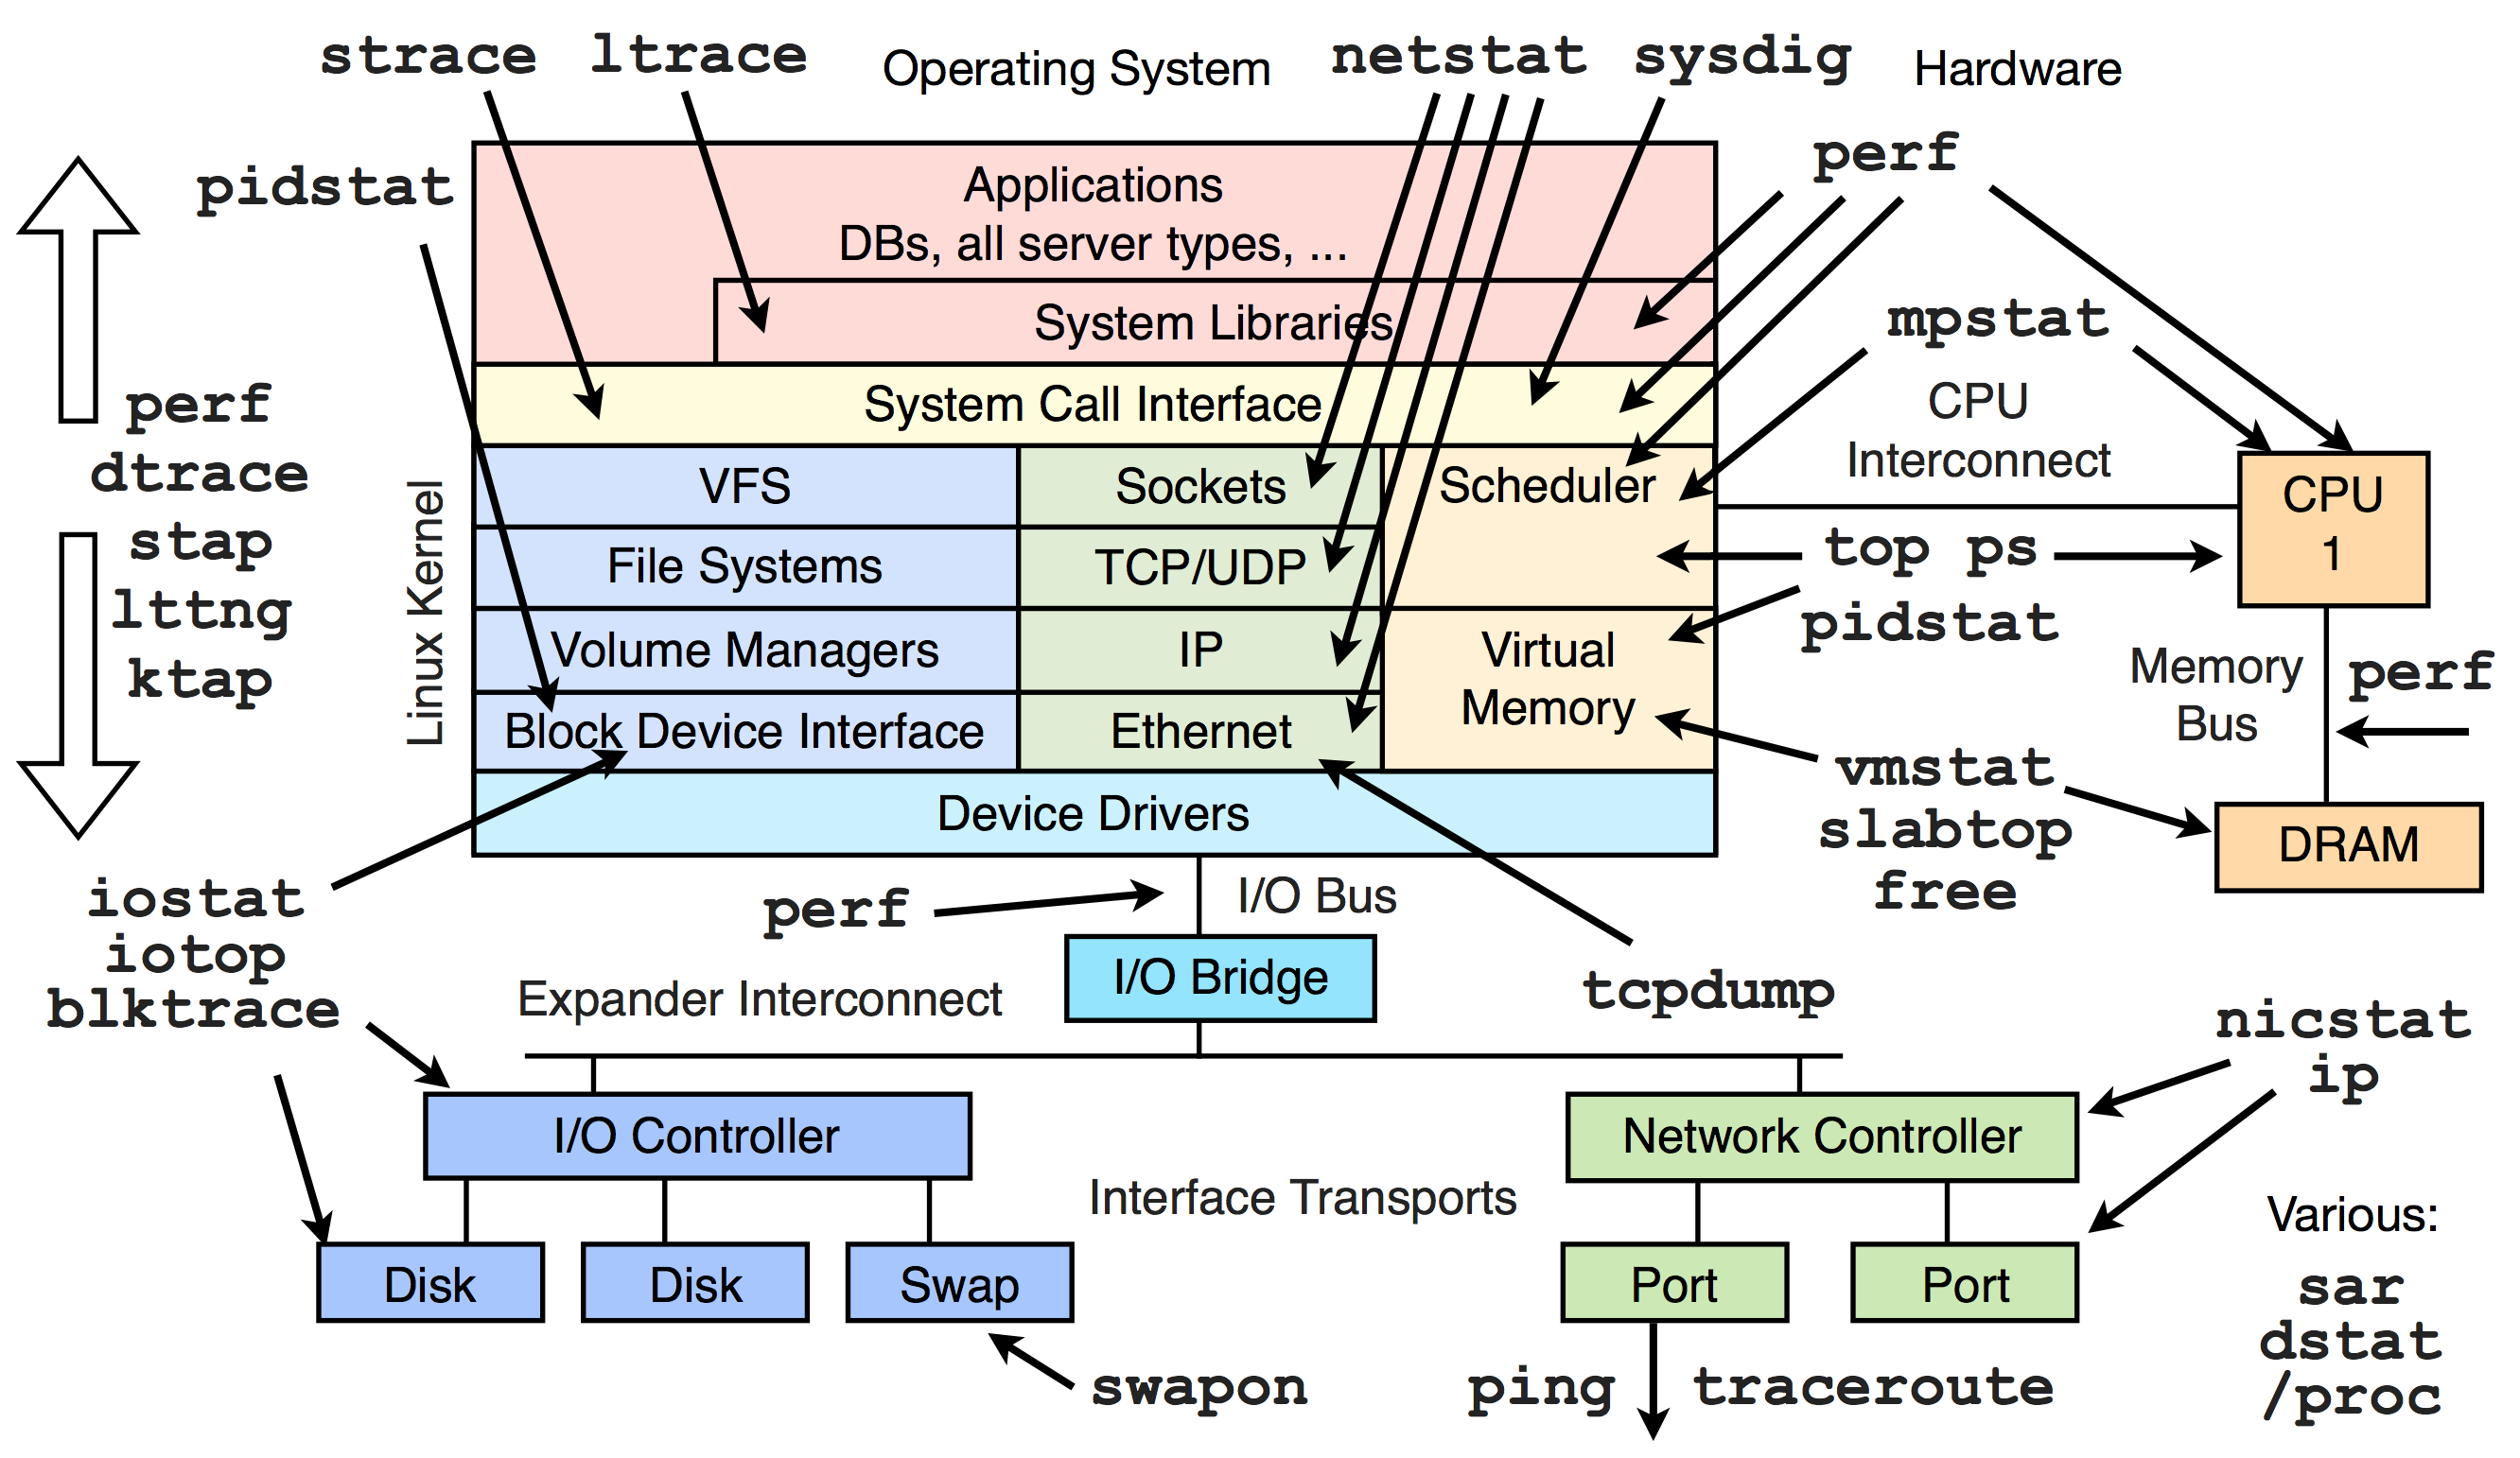
References
Image from: http://www.brendangregg.com/Perf/linuxperftools.png

Slide 19
Conclusion
Catering to complexities of modern hardware, a simple scheduling policy resulted in a very complex bug-prone implementation.
Runnable threads may be stuck in runqueues for seconds while there are idle cores in the system; application performance may degrade manyfold.
The nature of these bugs makes it difficult to detect them with conventional tools.
Present tools, which make catching and fixing these bugs substantially easier.
Tools available at http://git.io/vaGOW
“Nobody actually creates perfect code the first time around, except me. But there’s only one of me.”
~ Linus Torvalds, 2007
Notes:
the Linux scheduler violates a basic work-conserving invariant: scheduling waiting threads onto idle cores.

Slide 20
THANK YOU!

