Slide 1
Lottery Scheduling: Flexible Proportional-Share Resource Management
Carl A. Waldspurger, William E. Weihl OSDI‘ 94
2023. 09. 12
Presented by Suhwan Shin
shshin@dankook.ac.kr

Slide 2
Content
Introduction
- Scheduling
Lottery Scheduling
- Ticket Transfers, Inflation, Currencies
- Compensation Ticket
Evaluation
Improved Scheduling
- Stride scheduling
Conclusion

Slide 3
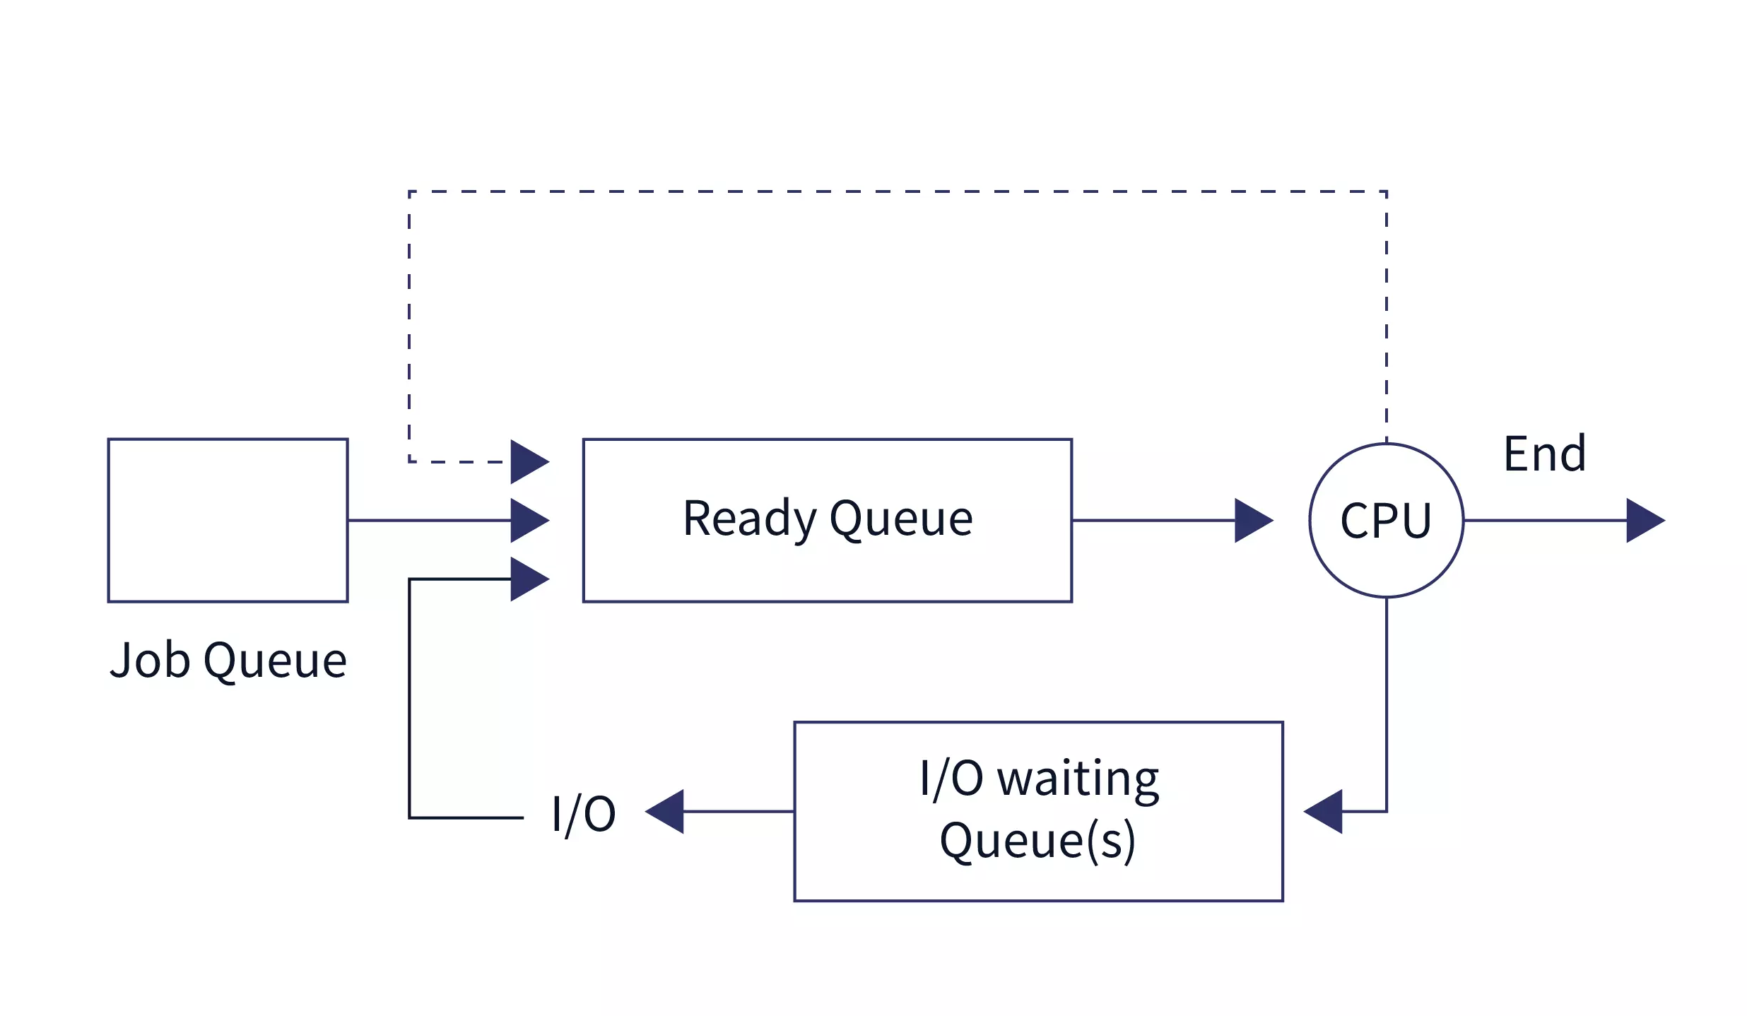
Introduction - Scheduling
Algorithm for sequencing processes
What is good scheduling?
FIFO?
SJF?
RR?
MLFQ?
https://www.scaler.com/topics/operating-system/cpu-scheduling/
Are those fair and efficient?

Slide 4
Lottery Scheduling
Lottery Scheduling is a proportional share algorithm
Draw which process to run with Ticket
More Tickets = More frequency
Like roulette!!
A(80T)
B(20T)
Selection rate A:B = 8:2

Slide 5
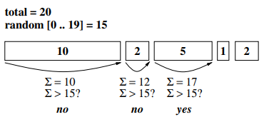
Lottery Scheduling
Lottery Scheduling search operation
O(n) to O(lg n) using trees
O(n)
Default
Move to front
(less searches)

Slide 6
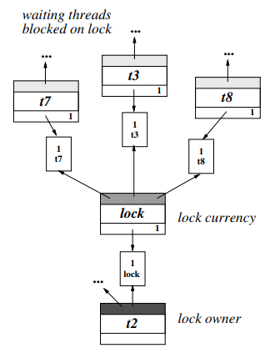
Ticket Transfers
Explicit transfers of tickets from one client to another
Useful when a task blocks for any reason
RPC: Redirects resource rights from a blocked client to the server computing on its behalf
Prevent priority inversion

Slide 7
Ticket Inflation
Expand resource authority by generating more lottery tickets
Conditions for being useful: trusting relationships
Create new tickets
Not explicit Communications
if) Not trust

Slide 8
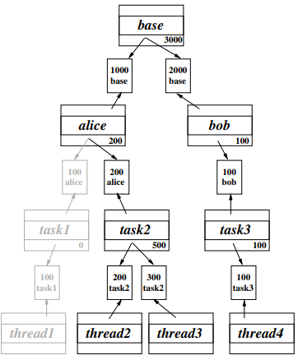
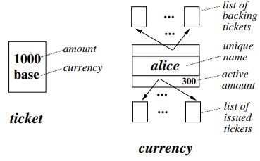
Ticket Currencies
Allows one to freely allocate lottery tickets to their own monetary value
thread2 = 400, thread3 = 600, thread4 = 2000
Notes:
사용자가 추첨권을 자신의 화폐 가치로 추첨권을 자유롭게 할당할 수 있도록 허용

Slide 9
Compensation Ticket
Compensation for spending less time
Time quantum: Minimum unit of execution time (Execution time for one allocation)
Using quantum rate: f
Compensation rate: 1/f
A: f = 1, 1/f = 1
B: f = 1/5, 1/f = 5
A(100)
B(20)
B has 5 times the ticket of A
= B wins the processor scheduler 5 times more often than A
If A and B start with 400T, B gets an additional 1,600T (Finally, A: 400, B: 2000)

Slide 10
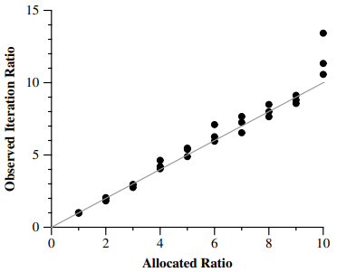
Evaluation – Fairness
Relative Rate Accuracy
X-axis: Ticket allocated ratio (ex. 1:1, 2:1, ~, 10:1)
Y-axis: Observed allocation ratio (over 60s)
Lottery Scheduling can control the distribution of allocated resoureces

Slide 11
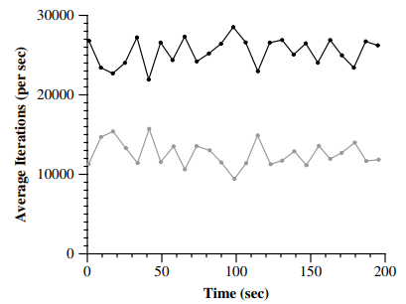
Evaluation – Fairness
Fairness Over Time
Two threads with 2:1 Ticket allocation (8 sec window)
Average
25478 : 12619 = 2.01 : 1

Slide 12
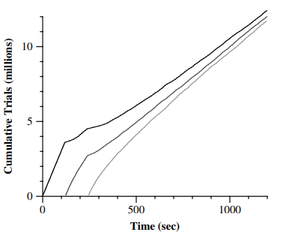
Evaluation – Flexible Control
Dynamic Execution Rates
Three tasks with Monte-Carlo simulation
Tasks periodically changes their ticket allocation to be proportional to their error

Slide 13
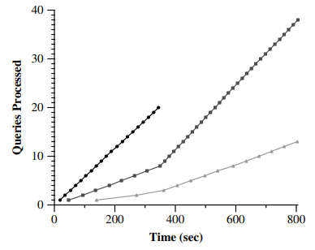
Evaluation – Ticket transfers
Query Processing Rates (Client-Server Computation)
8:3:1 allocation for clients
38(3)
20(8)
13(1)

Slide 14
Evaluation – Ticket Currencies
Currencies insulate loads
5 tasks executing the Dhrystone benchmark
Currencies A,B funded equally
A1: A2 = 1: 2, B1: B2: B3 = 1: 2: 3
A and B operate independently

Slide 15
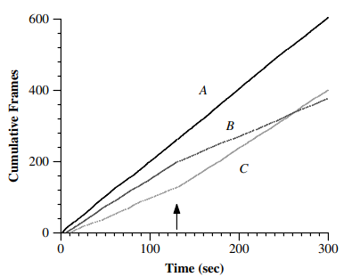
Evaluation – Multimedia Applications
Controlling Video Rates
Three video viewers
Initial allocation A: B: C = 3: 2: 1
Change starting from the arrow A: B: C: = 3: 1: 2

Slide 16
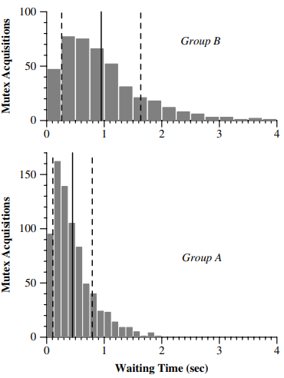
Evaluation – Lock Scheduling
Mutex Waiting Times
Using a synthetic multithreaded application where n threads compete for the same mutex (n:1)
n: Number of threads
h: Hold mutex 50ms
t: Computes for 50ms
A: B = 2: 1 allocation
A: B = 1: 2.11 waiting times (avg)
A: B = 1.80: 1 mutex acquisition rate

Slide 17
Limitations
How should the lottery tickets be distributed to the workers?
Non-deterministic method
Exact ratio cannot be guaranteed
Especially, if it is only run for a short period of time

Slide 18
Improved Scheduling – Stride Scheduling
Deterministic method
Each operation has stride instead ticket, Stride is inversely proportional to the ticket
Example (Ticket to Stride)
A_Tic: 100, B_Tic: 50, C_Tic: 250
A_Str: 100, B_Str: 200, C_Str: 40

Slide 19
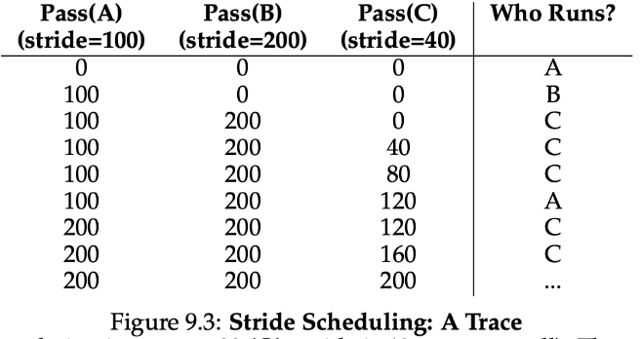
Improved Scheduling – Stride Scheduling
It is guaranteed that each task occupies a certain percentage of the CPU
Rule
Initially, Pass is 0 and the task with the smallest Pass value is executed
Problem
Maintain a specific state value
Especially, When a new process is added
The processing of pass values consumes about 5% of total CPU usage

Slide 20
Conclusion
Proportional scheduling: Scheduler guarantees each task a certain percentage of the CPU
Lottery Scheduling
Non-deterministic, Using randomness to ensure that tasks with many lottery tickets have a high probability of being executed
Flexible & Fair, Simple design, Dynamic allocation
But, How should the lottery tickets be distributed? → Not solved
Stride Scheduling
Improved Lottery Scheduling
Deterministic
But, Overhead of maintaining state and calculating Pass values
Notes:
ZNS SSD에 F2FS LFS 모드를 사용하여 F2FS의 디스크 레이아웃을 식별하고,
높은 디스크 활용도에서의 과프로비저닝과 GC 성능 간의 트레이드오프를 탐구했습니다.
우리는 새로운 프리 세그먼트 finding 스킴을 사용하여 더 나은 저장 공간 활용을 위해 낮은 경험적 과프로비저닝 공간을 설정했습니다.
결과적으로 우리의 연구는 과프로비저닝 공간을 고려해야 하며, 특히 쓰기 중심 워크로드에 대한 ZNS 기반 시스템의 설계에 중요한 역할을 해야 함을 보여주었습니다.

Slide 21
Lottery Scheduling: Flexible Proportional-Share Resource Management
Thank You !
Carl A. Waldspurger, William E. Weihl OSDI‘ 94
2023. 09. 12
Presented by Suhwan Shin
shshin@dankook.ac.kr

