Slide 1
ARC: A Self-Tuning, Low Overhead Replacement Cache
Nimrod Megiddo et al.
2023. 09. 19
Presented by Ramadhan Agung Rahmat
agung@dankook.ac.kr

Slide 2
Introduction
Caches
Motivation
ARC Design
Experiments
Conclusions
Related New Caches

Slide 3
Introduction: Memory Hierarchy
Source: https://techdifferences.com/difference-between-cache-memory-and-main-memory.html

Slide 4
Introduction: Cache Memory Diagram
Source: https://techdifferences.com/difference-between-cache-memory-and-main-memory.html

Slide 5
Introduction: Cache Speed
Source: https://techdifferences.com/difference-between-cache-memory-and-main-memory.html

Slide 6
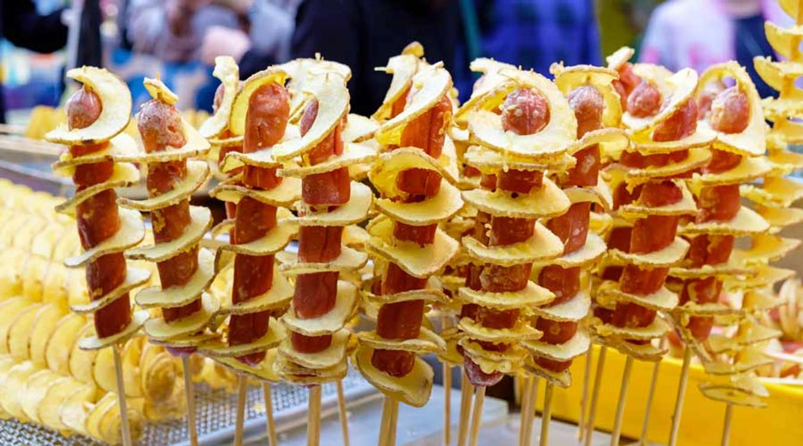
Illustration: Want to buy street food
I have no cash (cache)
Walk to Bank / ATM
Get some cash (cache)
Pay the street food
Source: https://st.depositphotos.com/1008070/1662/i/450/depositphotos_16627315-stock-photo-empty-pockets-man.jpg
https://res.heraldm.com/content/image/2018/01/11/20180111000990_0.jpg

Slide 7
Illustration: Want to buy street food
I have cash (cache)
Pay the street food
Source: https://st.depositphotos.com/1008070/1662/i/450/depositphotos_16627315-stock-photo-empty-pockets-man.jpg
https://res.heraldm.com/content/image/2018/01/11/20180111000990_0.jpg

Slide 8
Most Recently Used
Evicts most recently referred block
Works well with cyclic patterns
Block Requests: 1, 2, 3, 4, 5, 1, 2, 3, 4, 1, 2
0
1
2
3

Slide 9
Most Recently Used
Evicts most recently referred block
Works well with cyclic patterns
Block Requests: 1, 2, 3, 4, 5, 1, 2, 3, 4, 1, 2
0 | b₁
1
2
3

Slide 10
Most Recently Used
Evicts most recently referred block
Works well with cyclic patterns
Block Requests: 1, 2, 3, 4, 5, 1, 2, 3, 4, 1, 2
0 | b₁
1 | b₂
2
3

Slide 11
Most Recently Used
Evicts most recently referred block
Works well with cyclic patterns
Block Requests: 1, 2, 3, 4, 5, 1, 2, 3, 4, 1, 2
0 | b₁
1 | b₂
2 | b₃
3 | b₄

Slide 12
Most Recently Used
Evicts most recently referred block
Works well with cyclic patterns
Block Requests: 1, 2, 3, 4, 5, 1, 2, 3, 4, 1, 2
0 | b₁
1 | b₂
2 | b₃
3 | b₄

Slide 13
Most Recently Used
Evicts most recently referred block
Works well with cyclic patterns
Block Requests: 1, 2, 3, 4, 5, 1, 2, 3, 4, 1, 2
0 | b₁
1 | b₂
2 | b₃
3 | b₄ b₅

Slide 14
Most Recently Used
Evicts most recently referred block
Works well with cyclic patterns
Block Requests: 1, 2, 3, 4, 5, 1, 2, 3, 4, 1, 2
0 | b₁
1 | b₂
2 | b₃
3 | b₄ b₅

Slide 15
Most Recently Used
Evicts most recently referred block
Works well with cyclic patterns
Block Requests: 1, 2, 3, 4, 5, 1, 2, 3, 4, 1, 2
0 | b₁
1 | b₂
2 | b₃
3 | b₄ b₅

Slide 16
Most Recently Used
Evicts most recently referred block
Works well with cyclic patterns
Block Requests: 1, 2, 3, 4, 5, 1, 2, 3, 4, 1, 2
0 | b₁
1 | b₂
2 | b₃
3 | b₄ b₅

Slide 17
Most Recently Used
Evicts most recently referred block
Works well with cyclic patterns
Block Requests: 1, 2, 3, 4, 5, 1, 2, 3, 4, 1, 2
0 | b₁
1 | b₂
2 | b₃ b₄
3 | b₄ b₅

Slide 18
Most Recently Used
Evicts most recently referred block
Works well with cyclic patterns
Block Requests: 1, 2, 3, 4, 5, 1, 2, 3, 4, 1, 2
0 | b₁
1 | b₂
2 | b₃ b₄
3 | b₄ b₅

Slide 19
Most Recently Used
Evicts most recently referred block
Works well with cyclic patterns
Block Requests: 1, 2, 3, 4, 5, 1, 2, 3, 4, 1, 2
0 | b₁
1 | b₂
2 | b₃ b₄
3 | b₄ b₅

Slide 20
Most Recently Used
Evicts most recently referred block
Works well with cyclic patterns
Block Requests: 1, 2, 3, 4, 5, 1, 2, 3, 4, 1, 2
0 | b₁
1 | b₂
2 | b₃ b₄
3 | b₄ b₅

Slide 21
Most Recently Used
Evicts most recently referred block
Works well with cyclic patterns
Block Requests: 1, 2, 3, 4, 5, 1, 2, 3, 4, 1, 2
0 | b₁
1 | b₂
2 | b₃ b₄
3 | b₄ b₅
No Frequency Concerned

Slide 22
Least Recently Used
Exploits Temporal Locality
Evicts least recently referred block
Block Requests: 0, 1, 2, 3, 4, 2, 3, 1, 5, 6
0
1
2
3

Slide 23
Least Recently Used
Exploits Temporal Locality
Evicts least recently referred block
Block Requests: 0, 1, 2, 3, 4, 2, 3, 1, 5, 6
LRU
0 | b₀
1
2
3
b₀
MRU

Slide 24
Least Recently Used
Exploits Temporal Locality
Evicts least recently referred block
Block Requests: 0, 1, 2, 3, 4, 2, 3, 1, 5, 6
LRU
0 | b₀
1 | b₁
2
3
b₀
b₁
MRU

Slide 25
Least Recently Used
Exploits Temporal Locality
Evicts least recently referred block
Block Requests: 0, 1, 2, 3, 4, 2, 3, 1, 5, 6
LRU
0 | b₀
1 | b₁
2 | b₂
3
b₀
b₁
b₂
MRU

Slide 26
Least Recently Used
Exploits Temporal Locality
Evicts least recently referred block
Block Requests: 0, 1, 2, 3, 4, 2, 3, 1, 5, 6
LRU
0 | b₀
1 | b₁
2 | b₂
3 | b₃
b₀
b₁
b₂
b₃
MRU

Slide 27
Least Recently Used
Exploits Temporal Locality
Evicts least recently referred block
Block Requests: 0, 1, 2, 3, 4, 2, 3, 1, 5, 6
LRU
0 | b₀
1 | b₁
2 | b₂
3 | b₃
b₀
b₁
b₂
b₃
MRU

Slide 28
Least Recently Used
Exploits Temporal Locality
Evicts least recently referred block
Block Requests: 0, 1, 2, 3, 4, 2, 3, 1, 5, 6
LRU
0 | b₀
1 | b₁
2 | b₂
3 | b₃
b₀
b₁
b₂
b₃
MRU

Slide 29
Least Recently Used
Exploits Temporal Locality
Evicts least recently referred block
Block Requests: 0, 1, 2, 3, 4, 2, 3, 1, 5, 6
LRU
0 | b₄
1 | b₁
2 | b₂
3 | b₃
b₁
b₂
b₃
b₄
MRU

Slide 30
Least Recently Used
Exploits Temporal Locality
Evicts least recently referred block
Block Requests: 0, 1, 2, 3, 4, 2, 3, 1, 5, 6
LRU
0 | b₄
1 | b₁
2 | b₂
3 | b₃
b₁
b₃
b₄
b₂
MRU

Slide 31
Least Recently Used
Exploits Temporal Locality
Evicts least recently referred block
Block Requests: 0, 1, 2, 3, 4, 2, 3, 1, 5, 6
LRU
0 | b₄
1 | b₁
2 | b₂
3 | b₃
b₁
b₄
b₂
b₃
MRU

Slide 32
Least Recently Used
Exploits Temporal Locality
Evicts least recently referred block
Block Requests: 0, 1, 2, 3, 4, 2, 3, 1, 5, 6
LRU
0 | b₄
1 | b₁
2 | b₂
3 | b₃
b₄
b₂
b₃
b₁
MRU

Slide 33
Least Recently Used
Exploits Temporal Locality
Evicts least recently referred block
Block Requests: 0, 1, 2, 3, 4, 2, 3, 1, 5, 6
LRU
0 | b₄
1 | b₁
2 | b₂
3 | b₃
b₄
b₂
b₃
b₁
MRU

Slide 34
Least Recently Used
Exploits Temporal Locality
Evicts least recently referred block
Block Requests: 0, 1, 2, 3, 4, 2, 3, 1, 5, 6
LRU
0 | b₅
1 | b₁
2 | b₂
3 | b₃
b₂
b₃
b₁
b₅
MRU

Slide 35
Least Recently Used
Exploits Temporal Locality
Evicts least recently referred block
Block Requests: 0, 1, 2, 3, 4, 2, 3, 1, 5, 6
LRU
0 | b₅
1 | b₁
2 | b₂
3 | b₃
b₂
b₃
b₁
b₅
MRU

Slide 36
Least Recently Used
Exploits Temporal Locality
Evicts least recently referred block
Block Requests: 0, 1, 2, 3, 4, 2, 3, 1, 5, 6
LRU
0 | b₅
1 | b₁
2 | b₆
3 | b₃
b₃
b₁
b₅
b₆
MRU

Slide 37
Least Frequently Used
Evicts least frequently referred block
Frequency is recorded for all blocks present in Cache
Block Requests: 0, 1, 2, 3, 4, 2, 3, 1, 5, 6
0
1
2
3

Slide 38
Least Frequently Used
Evicts least frequently referred block
Frequency is recorded for all blocks present in Cache
Block Requests: 0, 1, 2, 3, 4, 2, 3, 1, 5, 6
Frequency
0 | b₀
1
2
3
b₀ = 1

Slide 39
Least Frequently Used
Evicts least frequently referred block
Frequency is recorded for all blocks present in Cache
Block Requests: 0, 1, 2, 3, 4, 2, 3, 1, 5, 6
Frequency
0 | b₀
1 | b₁
2
3
b₀ = 1
b₁ = 1

Slide 40
Least Frequently Used
Evicts least frequently referred block
Frequency is recorded for all blocks present in Cache
Block Requests: 0, 1, 2, 3, 4, 2, 3, 1, 5, 6
Frequency
0 | b₀
1 | b₁
2 | b₂
3 | b₃
b₀ = 1
b₁ = 1
b₂ = 1
b₃ = 1

Slide 41
Least Frequently Used
Evicts least frequently referred block
Frequency is recorded for all blocks present in Cache
Block Requests: 0, 1, 2, 3, 4, 2, 3, 1, 5, 6
Frequency
0 | b₀
1 | b₁
2 | b₂
3 | b₃
b₀ = 1
b₁ = 1
b₂ = 1
b₃ = 1

Slide 42
Least Frequently Used
Evicts least frequently referred block
Frequency is recorded for all blocks present in Cache
Block Requests: 0, 1, 2, 3, 4, 2, 3, 1, 5, 6
Frequency
0 | b₄
1 | b₁
2 | b₂
3 | b₃
b₄ = 1
b₁ = 1
b₂ = 1
b₃ = 1

Slide 43
Least Frequently Used
Evicts least frequently referred block
Frequency is recorded for all blocks present in Cache
Block Requests: 0, 1, 2, 3, 4, 2, 3, 1, 5, 6
Frequency
0 | b₄
1 | b₁
2 | b₂
3 | b₃
b₄ = 1
b₁ = 1
b₂ = 2
b₃ = 1

Slide 44
Least Frequently Used
Evicts least frequently referred block
Frequency is recorded for all blocks present in Cache
Block Requests: 0, 1, 2, 3, 4, 2, 3, 1, 5, 6
Frequency
0 | b₄
1 | b₁
2 | b₂
3 | b₃
b₄ = 1
b₁ = 1
b₂ = 2
b₃ = 2

Slide 45
Least Frequently Used
Evicts least frequently referred block
Frequency is recorded for all blocks present in Cache
Block Requests: 0, 1, 2, 3, 4, 2, 3, 1, 5, 6
Frequency
0 | b₄
1 | b₁
2 | b₂
3 | b₃
b₄ = 1
b₁ = 2
b₂ = 2
b₃ = 2

Slide 46
Least Frequently Used
Evicts least frequently referred block
Frequency is recorded for all blocks present in Cache
Block Requests: 0, 1, 2, 3, 4, 2, 3, 1, 5, 6
Frequency
0 | b₄
1 | b₁
2 | b₂
3 | b₃
b₄ = 1
b₁ = 2
b₂ = 2
b₃ = 2

Slide 47
Least Frequently Used
Evicts least frequently referred block
Frequency is recorded for all blocks present in Cache
Block Requests: 0, 1, 2, 3, 4, 2, 3, 1, 5, 6
Frequency
0 | b₅
1 | b₁
2 | b₂
3 | b₃
b₅ = 1
b₁ = 2
b₂ = 2
b₃ = 2

Slide 48
Least Frequently Used
Evicts least frequently referred block
Frequency is recorded for all blocks present in Cache
Block Requests: 0, 1, 2, 3, 4, 2, 3, 1, 5, 6
Frequency
0 | b₅
1 | b₁
2 | b₂
3 | b₃
b₅ = 1
b₁ = 2
b₂ = 2
b₃ = 2

Slide 49
Least Frequently Used
Evicts least frequently referred block
Frequency is recorded for all blocks present in Cache
Block Requests: 0, 1, 2, 3, 4, 2, 3, 1, 5, 6
Frequency
0 | b₆
1 | b₁
2 | b₂
3 | b₃
b₆ = 1
b₁ = 2
b₂ = 2
b₃ = 2
No Recency Concerned

Slide 50
Drawbacks of LFU
Logarithmic complexity in cache size
High frequently used page is hard to paged out
Even if it is no longer useful

Slide 51
LRU-K
Eleminates a weakness of LRU
Eviction based on the last k references of a page
Uses backward distance bt(p,k) to the k-th most recent reference to the page

Slide 52
LRU-K
LRU-1
Req. Page | 1 | 2 | 1 | 3 | 4
Buffer ( s=3 ) | 1 , _ , _ | 1 , 2 , _ | 1 , 2 , _ | 1 , 2 , 3
bt(p,1) | 0 , _ , _ | 1 , 0 , _ | 0 , 1 , _ | 1 , 2 , 0
Hit | x | x | ✔ | x
LRU-2
Req. Page | 1 | 2 | 1 | 3 | 4
Buffer ( s=3 ) | 1 , _ , _ | 1 , 2 , _ | 1 , 2 , _ | 1 , 2 , 3
bt(p,2) | ∞, _ , _ | ∞,∞, _ | 2,∞, _ | 3,∞,∞
Hit | x | x | ✔ | x
Source: https://www.youtube.com/watch?v=H7LhLdJS5fY

Slide 53
LRU-K
CIP (Correlated Information Period)
How far we consider 2 pages are related?
LRU-1
Req. Page | 1 | 2 | 1 | 3 | 4 | 5 | 1 | 6 | 2
Buffer ( s=3 ) | 1 , _ , _ | 1 , 2 , _ | 1 , 2 , _ | 1 , 2 , 3 | 1 , 4 , 3 | 5 , 4 , 3 | 5 , 4 , 1 | 5 , 6 , 1 | 2 , 6 , 1
bt(p,1) | 0 , _ , _ | 1 , 0 , _ | 0 , 1 , _ | 1 , 2 , 0 | 2 , 0 , 1 | 0 , 1 , 2 | 1 , 2 , 0 | 2 , 0 , 1 | 0 , 1 , 2
Hit | x | x | ✔ | x | x | x | x | x | x
LRU-2
Req. Page | 1 | 2 | 1 | 3 | 4 | 5 | 1 | 6 | 2
Buffer ( s=3 ) | 1 , _ , _ | 1 , 2 , _ | 1 , 2 , _ | 1 , 2 , 3 | 1 , 4 , 3 | 1 , 4 , 5 | 1 , 4 , 5 | 1 , 6 , 5 | 1 , 6 , 2
bt(p,2) | ∞, _ , _ | ∞,∞, _ | 2,∞, _ | 3,∞,∞ | 4,∞,∞ | 5,∞,∞ | 4,∞,∞ | 5,∞,∞ | 6,∞,7
Hit | x | x | ✔ | x | x | x | ✔ | x | x
Source: https://www.youtube.com/watch?v=H7LhLdJS5fY

Slide 54
LRFU
Eviction based on both their recency and frequency of access.
Removal of less frequently used items (LFU) and the preservation of recently accessed items (LRU) to optimize cache efficiency.
Req. Page | 1 | 2 | 3 | 4 | 1 | 5 | 6 | 5 | 1
Buffer ( s=3 ) | 1 , _ , _ | 1 , 2 , _ | 1 , 2 , 3 | 2 , 3 , 4 | 3 , 4 , 1 | 4 , 1 , 5 | 1 , 5 , 6 | 1 , 5 , 6 | 1 , 5 , 6
Frequency | 1 , _ , _ | 1 , 1 , _ | 1 , 1 , 1 | 1 , 1 , 1 | 1 , 1 , 1 | 1 , 1 , 1 | 1 , 1 , 1 | 1 , 2 , 1 | 2 , 2 , 1
Recency | 1 , _ , _ | 2, 1 , _ | 3 , 2 , 1 | 3 , 2 , 1 | 3 , 2 , 1 | 3 , 2 , 1 | 3 , 2 , 1 | 3, 1 , 2 | 1 , 2 , 3
Hit | x | x | x | x | x | x | x | ✔ | ✔

Slide 55
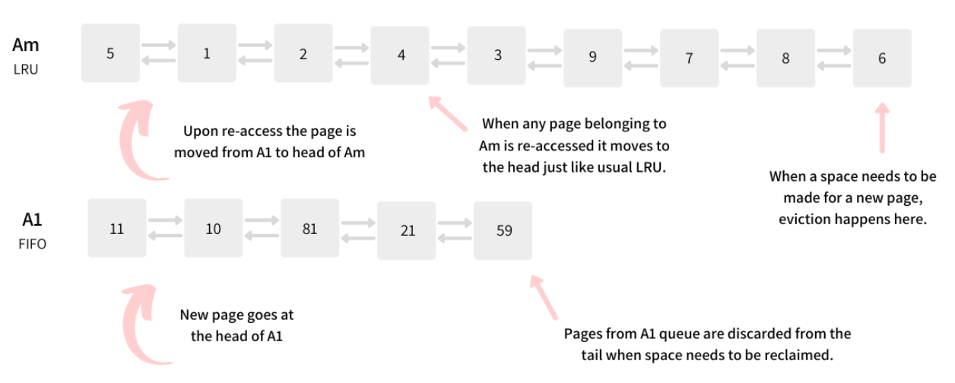
2Q (modified LRU-2)
Uses simple LRU list instead of the priority queue.
Main Buffer :
2ndary Buffer :
Source: https://arpitbhayani.me/blogs/2q-cache/

Slide 56
LIRS (Low Inter-reference Recency Set)
Maintains 2 LRU stacks of different size.
L_{lirs} maintains LRU page at least twice recently seen.
L_{hirs} maintains LRU page only once recently seen.
Works well for IRM, but not for SDD

Slide 57
LIRS (Low Inter-reference Recency Set)
Input Sequence : 1, 4, 2, 3, 2, 1, 4, 1, 5
L_{lirs} + L_{hirs} = c
L_{lirs} = 0.001c
5
4
3
2
1
c = 3
Lhirs = 1
Llirs = 2
5
Need to tune parameters
LIRS stack
HIRS stack
Source: http://csl.snu.ac.kr/courses/4190.568/2019-1/23-ARC.pdf

Slide 58
FBR (Frequency-Base Replacement)
Divide LRU list into 3 sections;
New
Reference count in new section is not incremented
Middle
Old
Replaces page in old section with smallest reference count.

Slide 59
FBR
Input Sequence : 0, 5, 1, 1
New
Middle
Old
Partition ratio of 3 Sections
Amax(predetermined)
Cmax(predertermined)
2 (1) | 0 (1) | 1 (1) | 5 (1) | 4 (1) | 9 (2)
Need to tune parameters
Source: http://csl.snu.ac.kr/courses/4190.568/2019-1/23-ARC.pdf

Slide 60
MQ Multi Queue
Each Qi contains [2_{i}, 2_{i+I}) times seen pages
Each hit page is assigned lifetime
If page expired, it goes down to lower-level queue's MRU position
Qi
T = 3, lifeTime =5 =>expireTime = 8
Need to tune parameters
Overhead checking params
Qi-1
T = 8
Source: http://csl.snu.ac.kr/courses/4190.568/2019-1/23-ARC.pdf

Slide 61
Terms
∏(c) : Replacement Policies which manage c pages
𝐿₁ : Set of pages seen only once recently
𝐿₂ : Set of pages seen more than once recently
0 ≤ 𝐿₁ + 𝐿₂ ≤ 2𝑐, 0 ≤ 𝐿₁ ≤ 𝑐, 0 ≤ 𝐿₂≤ 2𝑐
Replace 𝐿₁ when 𝐿₁ is full, if not, replace 𝐿₂
-> make | 𝐿₁ | and | 𝐿₂| similar
Source: ARC: A Self-Tuning, Low Overhead Replacement Cache | USENIX

Slide 62
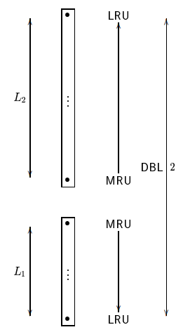
Class of RP : DBL(2c)
Cache hit : MRU update
Cache miss :
Case A : 𝐿₁ is full -> replace LRU of 𝐿₁
Case B : 𝐿₁ isn’t full
Case B-1 : 𝐿₁ + 𝐿₂ = 2𝑐 (cache full)
-> replace LRU of 𝐿₂
Case B-2 : 𝐿₁ + 𝐿₂ < 2𝑐 (cache isn’t full)
-> insert into 𝐿₁
Summary : Fill 𝐿₁ up to c
Source: ARC: A Self-Tuning, Low Overhead Replacement Cache | USENIX

Slide 63
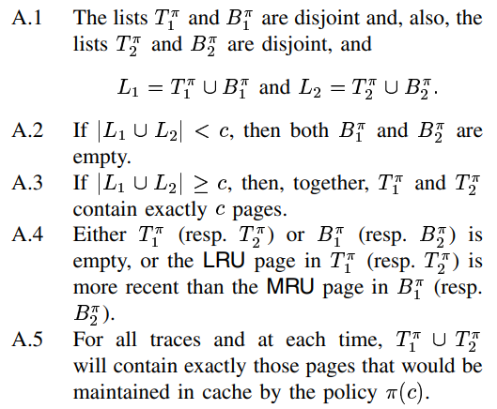
Class of RP : π(c)
Source: ARC: A Self-Tuning, Low Overhead Replacement Cache | USENIX

Slide 64
𝑭𝑹𝑪_{𝑷} 𝒄 (Fixed Replacement Cache)
𝑝 is tunable parameter (0 ≤ 𝑝 ≤ 𝑐)
Follows all properties of π(c)
Keeps 𝑇₁ = 𝑝, 𝑇₂ = 𝑐 − 𝑝
Replacement Policy
If 𝑇₁ > 𝑝 : Replace LRU of 𝑇₁
If 𝑇₁ < 𝑝 : Replace LRU of 𝑇₂
If 𝑇₁ = 𝑝 : (arbitrary)

Slide 65
ARC (Adaptive Replacement Cache
US Patent 20040098541
Assignee Name: IBM Corp.

Slide 66
Quick Summary
Motivation
Evolving and changing access patterns of memory
Various Workloads
Computation Overheads
Solution
ARC dynamically, adaptively, and continually balances between the recency and frequency components in an online and selftuning fashion.
The policy ARC uses a learning rule to adaptively and continually revise its assumptions about the workload
Evaluation
- LRU delivers a hit ratio of 9.19% while ARC achieves a hit ratio of 20%

Slide 67
Adaptive Replacement Cache
Accessed Again
Blocks in Cache
T₁ : Recent Cache Entries
T₂: Frequently-Used Blocks
Size of T1 adapts
“Ghost” Entries
B₁ : Evicted from T₁ (LRU)
B₂ : Evicted from T₂ (LFU)
How should the relative size of T₁ and T₂ be adjusted?

Slide 68
Adaptive Replacement Cache
Accessed Again
Blocks in Cache
T₁ : Recent Cache Entries
T₂: Frequently-Used Blocks
Size of T1 adapts
“Ghost” Entries
B₁ : Evicted from T₁ (LRU)
B₂ : Evicted from T₂ (LFU)
Hit in B₁: should increase size of T₁, drop entry from T₂ to B₂
Hit in B₂: should increase size of T₂, drop entry from T₁ to B₁

Slide 69
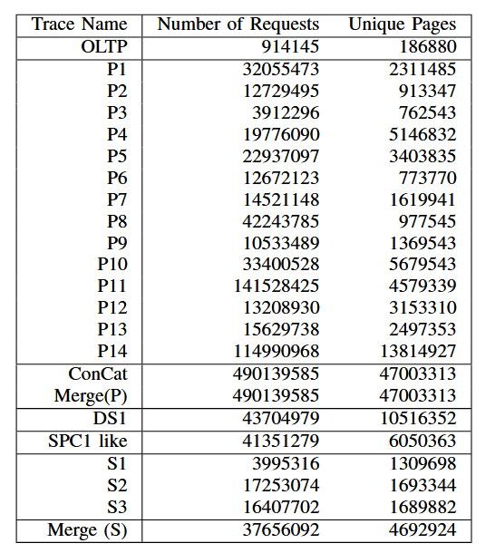
Experiment
Various traces used in this paper
Source: ARC: A Self-Tuning, Low Overhead Replacement Cache | USENIX

Slide 70
Experiment: Hit ratio of OLTP
ARC
Outperforms online parameter algorithm
Performs as well as offline parameter algorithms
Source: ARC: A Self-Tuning, Low Overhead Replacement Cache | USENIX

Slide 71
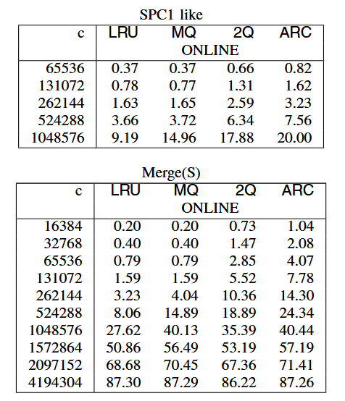
Experiment: Hit ratio (cont.)
MQ outperforms LRU, While ARC outperforms all
Source: ARC: A Self-Tuning, Low Overhead Replacement Cache | USENIX

Slide 72
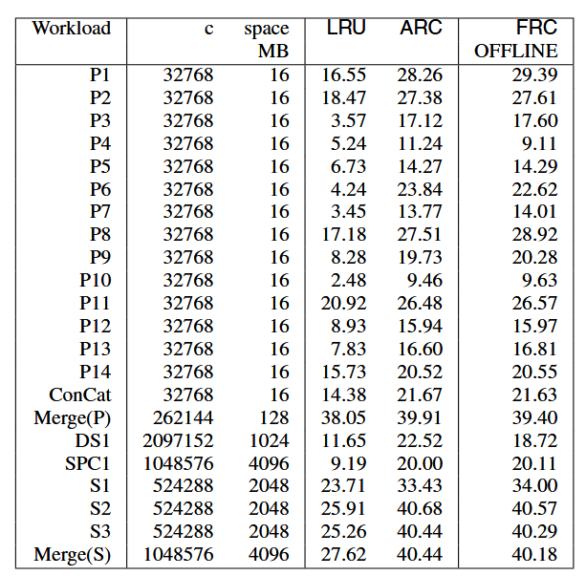
Experiment: Hit ratio (cont.)
Comparison for various workloads shows ARC outperforms.
Source: ARC: A Self-Tuning, Low Overhead Replacement Cache | USENIX

Slide 73
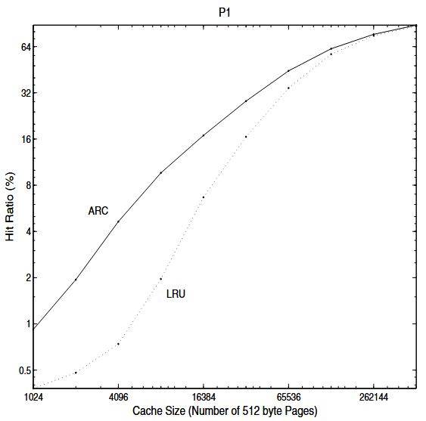
Experiment: Cache size of P1
ARC performs always better than LRU
Source: ARC: A Self-Tuning, Low Overhead Replacement Cache | USENIX

Slide 74
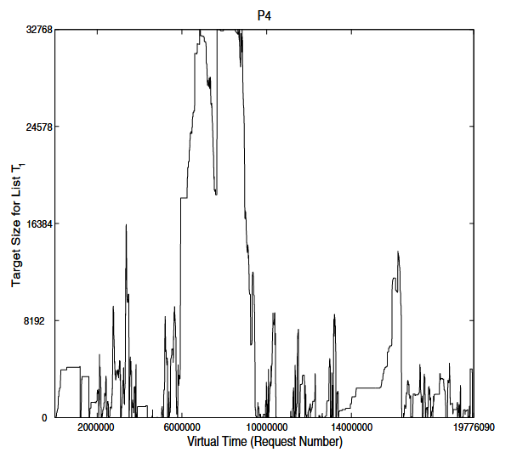
Experiment: parameter p
“Dances to the tune being played by workload.”
Source: ARC: A Self-Tuning, Low Overhead Replacement Cache | USENIX

Slide 75
Conclusion
LRU-2, 2Q, LRFU, LIRS algorithms
depends crucially on their respective tunable parameters.
no single universal rule
Computational overhead of LRU-2 and LRFU
makes them practically less attractive.
ARC that is online and self-tuning
ARC is robust for a wider range of workloads and has less overhead.
Source: ARC: A Self-Tuning, Low Overhead Replacement Cache | USENIX

Slide 76
Related New Papers

Slide 77
LIRS-2
Source: https://dl.acm.org/doi/pdf/10.1145/3456727.3463772

Slide 78
Source: https://dl.acm.org/doi/pdf/10.1145/3456727.3463772

Slide 80
CACHEUS Experiment
Source: https://www.usenix.org/conference/fast21/presentation/rodriguez

Slide 81
CACHEUS Experiment
Source: https://www.usenix.org/conference/fast21/presentation/rodriguez

Slide 83
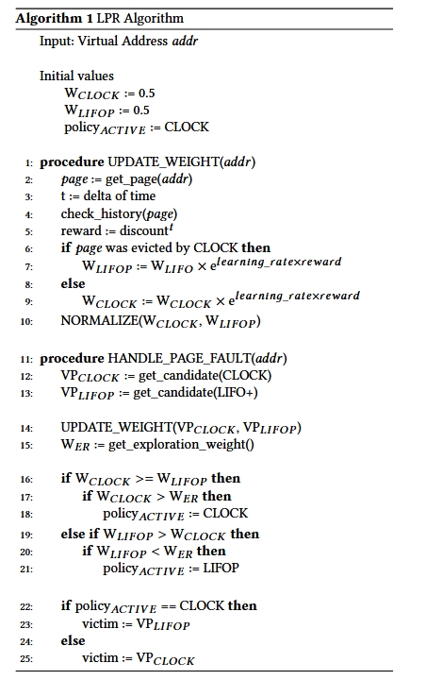
LPR: Learning-Based Page Replacement
Choose the best fit page replacement policy online
By learning the memory access patterns
Learn eviction history of LRU and MRU
Between CLOCK and LIFO+
Reward / Penalty based on prev. decission
Source: https://dl.acm.org/doi/abs/10.1145/3564695.3564777

Slide 84
CLOCK Page Replacement
Uses Circular List
Clock hand points to the oldest page
Reference bit : 0 (can be directly replaced), 1(set 0 and advance next pos)
A
L
B
K
C
J
D
I
E
H
F
G

Slide 85
CLOCK Page Replacement
Uses Circular List
Clock hand points to the oldest page
Reference bit : 0 (can be directly replaced), 1(set 0 and advance next pos)
A
R=0
L
B
R=1
K
C
R=1
J
D
R=0
I
E
H
F
G

Slide 86
CLOCK Page Replacement
Uses Circular List
Clock hand points to the oldest page
Reference bit : 0 (can be directly replaced), 1(set 0 and advance next pos)
A
R=0
Request :
L
B
M
R=1
K
C
R=1
J
D
R=0
I
E
H
F
G

Slide 87
CLOCK Page Replacement
Uses Circular List
Clock hand points to the oldest page
Reference bit : 0 (can be directly replaced), 1(set 0 and advance next pos)
A
R=1
Request :
L
M
N
R=1
K
C
R=1
J
D
R=0
I
E
H
F
G

Slide 88
CLOCK Page Replacement
Uses Circular List
Clock hand points to the oldest page
Reference bit : 0 (can be directly replaced), 1(set 0 and advance next pos)
A
R=1
Request :
L
M
N
R=0
K
C
R=1
J
D
R=0
I
E
H
F
G

Slide 89
CLOCK Page Replacement
Uses Circular List
Clock hand points to the oldest page
Reference bit : 0 (can be directly replaced), 1(set 0 and advance next pos)
A
R=1
Request :
L
M
N
R=0
K
C
R=0
J
D
R=0
I
E
H
F
G

Slide 90
CLOCK Page Replacement
Uses Circular List
Clock hand points to the oldest page
Reference bit : 0 (can be directly replaced), 1(set 0 and advance next pos)
A
R=1
Request :
L
M
N
R=0
K
C
R=0
J
D
R=0
I
E
H
F
G

Slide 91
CLOCK Page Replacement
Uses Circular List
Clock hand points to the oldest page
Reference bit : 0 (can be directly replaced), 1(set 0 and advance next pos)
A
R=1
Request :
L
M
R=0
K
C
R=0
J
D
R=1
I
N
H
F
G

Slide 92
CLOCK Page Replacement
Uses Circular List
Clock hand points to the oldest page
Reference bit : 0 (can be directly replaced), 1(set 0 and advance next pos)
A
R=1
Request :
L
M
R=1
K
C
R=1
J
D
R=0
I
E
H
F
G

Slide 93
LIFO+
Block Requests: 1, 2, 3, 4, 2, 3, 4, 5, 3, 4, 5, 6
 |  |  | 4 | 4 | 4 | 4 | 5 | 5 | 4 | 5 | 6
 |  | 3 | 3 | 3 | 3 | 3 | 3 | 3 | 3 | 3 | 3
 | 2 | 2 | 2 | 2 | 2 | 2 | 2 | 2 | 2 | 2 | 2
1 | 1 | 1 | 1 | 1 | 1 | 1 | 1 | 1 | 1 | 1 | 1
LIFO
Hit
Hit
Hit
Hit
 |  |  | 4 | 4 | 4 | 4 ® | 5 | 5 | 5 | 5 ® | 6
 |  | 3 | 3 | 3 | 3 ® | 3 ® | 4 | 4 | 4 ® | 4 ® | 5
 | 2 | 2 | 2 | 2 ® | 2 ® | 2 ® | 3 | 3 ® | 3 ® | 3 ® | 4
1 | 1 | 1 | 1 | 1 | 1 | 1 | 2 | 2 | 2 | 2 | 3
LIFO+
Hit
Hit
Hit
Hit
Hit
Hit

Slide 94
LPR Algorithm
UPDATE_WEIGHT (address)
W_{clock}= 0.5
W_{lifop}= 0.5
policy = Clock
HANDLE_PAGE_FAULT (address)
Get Page by address
Check History of the Page
Find Eviction Candidate both CLOCK and LIFO+
Page evicted by CLOCK
Update Weight (address)
Yes
No
W_{lifop} += Reward
W_{clock} += Reward
W_{clock} >=W_{lifop}
and
W_{clock >} W_{ER}
Yes
No
policy = CLOCK
victim = LIFO+
policy = LIFO+
victim = CLOCK

Slide 95
LPR Evaluation
Source: https://dl.acm.org/doi/abs/10.1145/3564695.3564777

Slide 96
Closing ARC: A Self-Tuning, Low Overhead Replacement Cache
Thank You !
2023. 09. 19
Presented by Ramadhan Agung Rahmat
agung@dankook.ac.kr

