Slide 1
Memory Resource Management in VMware ESX Server
C. Waldspurger
OSDI'02
2023. 09. 19
Presented by SeongHyeon Lee
leesh0812@dankook.ac.kr

Slide 2
Outline
Outline
ESX Server
Reclamation Mechanisms
Sharing Memory
Reallocation and Remapping
Conclusion

Slide 3
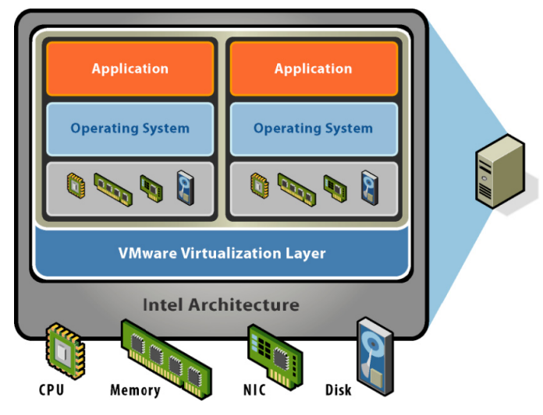
ESX Server
ESX Server
(Understanding Memory Resource Management in VMware ESX 4.1, ESX Vmware)

Slide 4
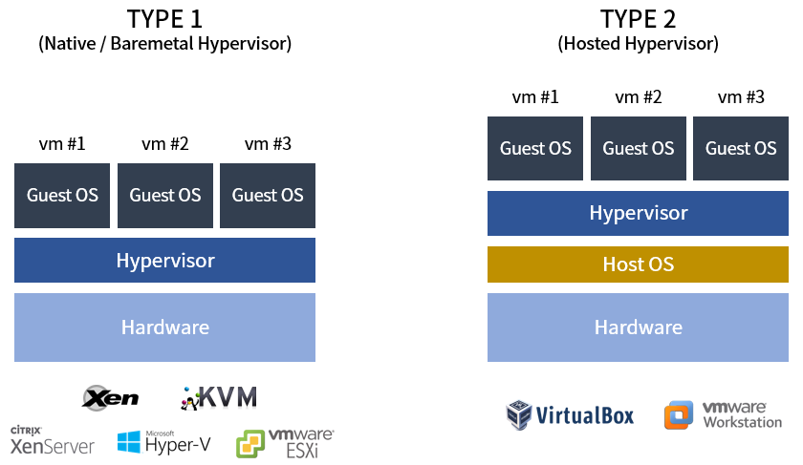
ESX Server
ESX Server
(하이퍼바이저와 가상화, “https://suyeon96.tistory.com/52” suyeon96)

Slide 5
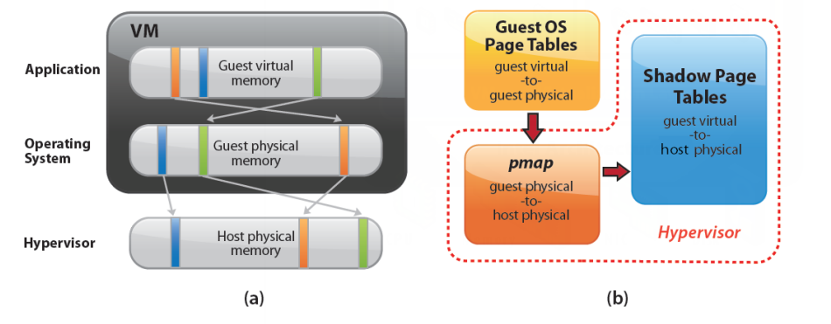
ESX Server
PPN : Physical Page Number -> VM Memory
MPN : Machine Page Number -> Real Hardware
Memory Virtualization
(Understanding Memory Resource Management in VMware ESX 4.1, ESX Vmware)
Notes:
\

Slide 6
ESX Server
Memory Virtualization
Hypervisor
Guest OS
Notes:
\

Slide 7
ESX Server
Memory overcommitment in ESX
(Understanding Memory Resource Management in VMware ESX 4.1, ESX Vmware)
But, it necessitates replacement policies and resource management decisions

Slide 8
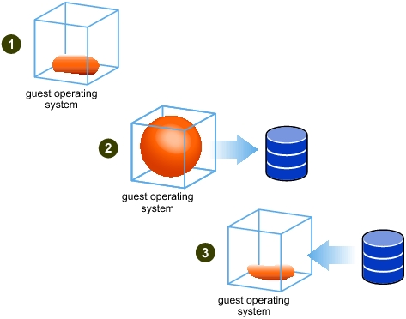
Reclamation Mechanisms
Ballooning
Dynamically adjusting and reclaiming less critical memory
Using balloon control to inflate memory within the guest OS (allocating memory from less important or free list).
Transmitting physical memory page information: The balloon driver transmits the physical page numbers (PPNs) of the allocated pages to the hypervisor.
Balloon deflation: As needed, the hypervisor instructs the balloon driver to release memory.
(“Memory Ballon Driver”, https://docs.vmware.com/en/VMware-vSphere/7.0/com.vmware.vsphere.resmgmt.doc/GUID-5B45CEFA-6CC6-49F4-A3C7-776AAA22C2A2.html, by Vmware Docs)

Slide 9
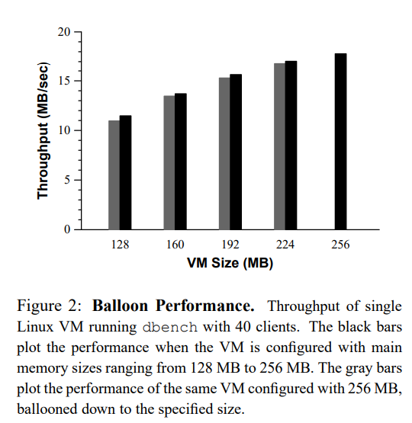
Reclamation Mechanisms
Ballooning

Slide 10
Reclamation Mechanisms
Ballooning
The balloon driver may be removed, deactivated, unavailable during guest OS boot, or unable to reclaim memory quickly enough.
Various guest OS limitations may set an upper bound on a reasonable balloon size.
In cases where the balloon mechanism is unavailable or insufficient, the system falls back on paging mechanisms.

Slide 11
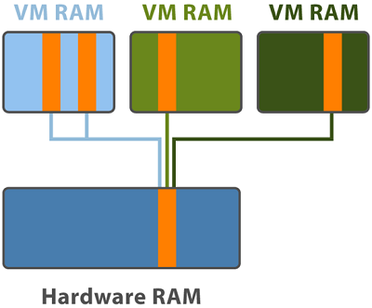
Sharing Memory
TPS(Transparent page Sharing)
Mapping identical pages within a VM's memory to the same physical page
dlls, exes, etc. that always run when using an app on the same OS
- Incurs a cost to find identical pages
- Finding by comparing every single page is highly inefficient and costly
(“Bye bye Transparent Page Sharing”, https://vinfrastructure.it/2014/10/bye-bye-transparent-page-sharing/, by Andrea Mauro)

Slide 12
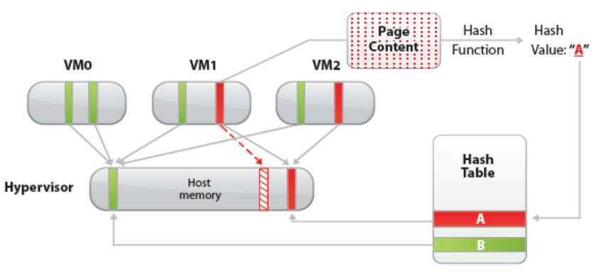
Sharing Memory
Content-based page sharing
Identifying duplicate pages by content
Pages with the same content can be shared, irrespective of when, where, or how they were created.
(Understanding Memory Resource Management in VMware ESX 4.1, ESX Vmware)

Slide 13
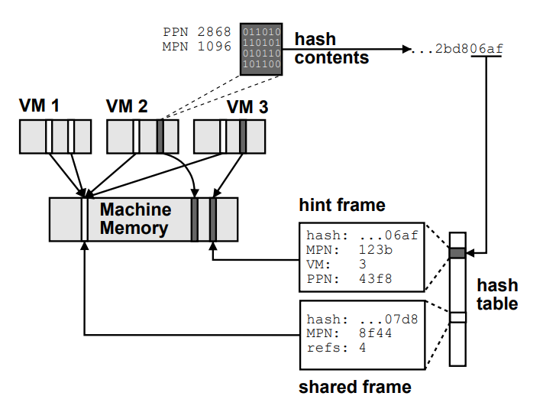
Sharing Memory
Content-based page sharing

Slide 14
Sharing Memory
Implementation
The total space overhead of the page sharing system is less than 0.5% of system memory
The level of sharing approaches 67% as the number of VMs increases, indicating that about two-thirds of all memory overlaps between VMs.
The CPU overhead due to page sharing was negligibly small.

Slide 15
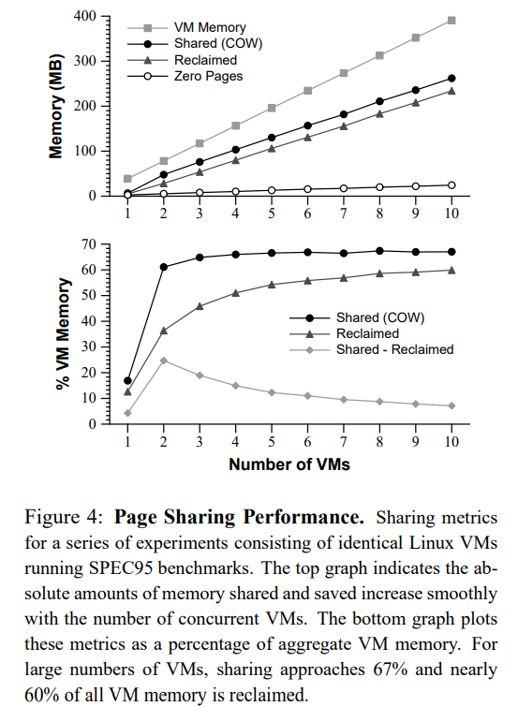
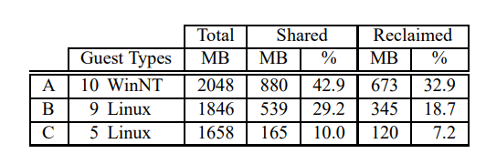
Sharing Memory
Content-based page sharing
Real-World Page Sharing
Page Sharing Performance

Slide 16
Sharing Memory
Shares vs. Working Set
Traditional operating systems improve performance by adjusting memory allocations
But, this conflicts with ensuring service quality proportionate to what's paid

Slide 17
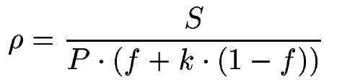
Sharing Memory
Reclaiming Idle Memory
Charging a client more for an idle page than for one it is actively using
The tax rate specifies the maximum fraction of idle pages that may be reclaimed from a client
If the client later starts using a larger portion of its allocated memory, its allocation will increase, up to its full share
$ρ$: adjusted shares-per-page ratio
S: total shares allocated to a client
P: total pages allocated to a client
f: fraction of active pages
k: coefficient reflecting the tax rate for idle memory
Notes:
유휴 메모리 크기만 가지고 동적으로 할당이 가능

Slide 18
Sharing Memory
Reclaiming Idle Memory
$τ$가 고정일때 $ρ는$ f에 따라 변동됨
$$ρ$$
f가 작아지는 것이므로 유휴 페이지 비율이 높아짐
reclaim을 적극적으로 진행
$$ρ$$
f가 커지는 것이므로 유휴 페이지 비율이 낮아짐
reclaim을 피함
$$τ$$
$$ρ$$
가 0에 가까워질수록 결국 가 커짐, 즉 reclaim을 피하게 됨
$$τ$$
$$ρ$$
가 1에 가까워질수록 결국 가 작아짐, 즉 reclaim을 적극적으로 진행
Notes:
유휴 메모리 크기만 가지고 동적으로 할당이 가능

Slide 19
Sharing Memory
Measuring Idle Memory
Statistical sampling (ESX Server samples 100 pages every 30-second period)
A small number of the virtual machine’s “physical” pages are selected randomly using a uniform distribution
Invalidating any cached mappings associated with its PPN
The system detects that access and restores the mappings, then it is in an active state

Slide 20
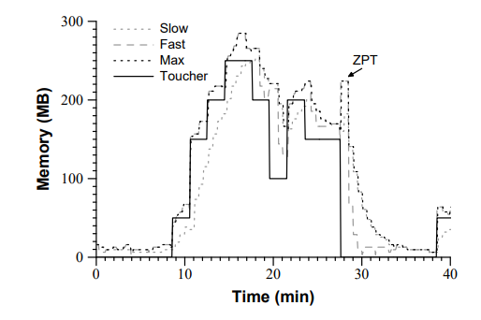
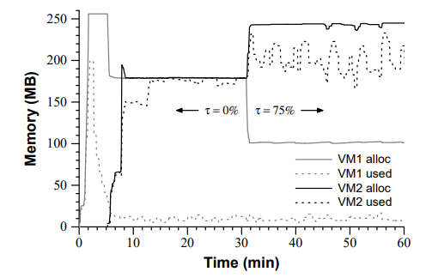
Sharing Memory
Slow : 과거 데이터에 더 많은 가중치를 부여
Fast : 최근 데이터에 더 많은 가중치를 부여
Sharing Memory
Active Memory Sampling
Idle Memory Tax

Slide 21
Sharing Memory
Reclaiming Idle Memory
When VM is allowed to power on
Ensure (sufficient memory + swap space)
Max - Min
Min+Overhead
VM Graphics Frame Buffer +
Virtualization Data Structures
Pmap Shadow, page tables
Notes:
유휴 메모리 크기만 가지고 동적으로 할당이 가능

Slide 22
Reallocation and Remapping
Dynamic Reallocation
ESX Server dynamically recomputes memory allocations in response to various events
ESX Server utilizes four thresholds: high, soft, hard, and low, which(6%, 4%, 2%, 1%)
Calculates the target allocations to maintain the aggregate amount of available space above the high threshold
I/O Page Remapping
Overcommitment may lead to problem that guest OS may address machine page that doesn't exist
Keep track of "hotness" of pages in high memory and when the I/O refernce count of such pages exceed certain threshold, they are remapped to low memory

Slide 23
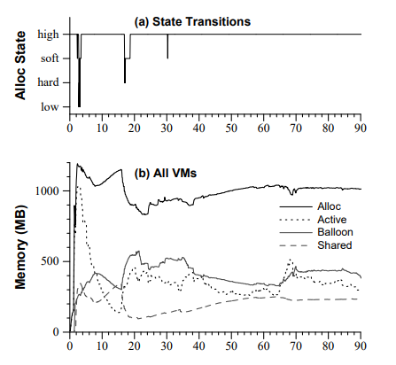
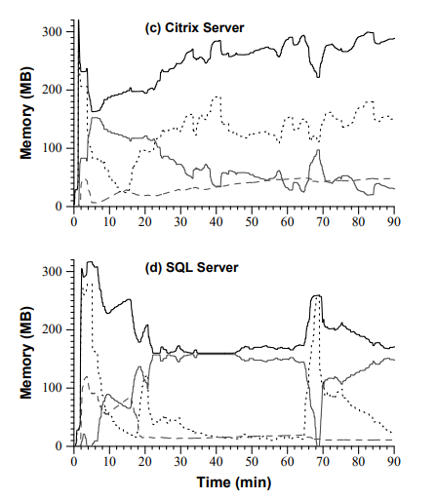
Reallocation and Remapping
Dynamic Reallocation
Dynamic Reallocation

Slide 24
Conclusion
Fundamental mechanisms and policies for memory management in ESX Serve
Ballooning – Reclamation Mechanisms
Content-based page Sharing – Sharing Memory
Idle memory tax – Sharing Memory
Hot I/O page remapping – Page Remapping
Currently underway on EXSi

Slide 25
Q&A
Q&A

