Slide 1
F2FS: A New File System for Flash Storage
Changman Lee, Dongho Sim, Joo-Young Hwang, and Sangyeun Cho, Samsung Electronics Co., Ltd FAST’ 15
2023. 09. 26
Presented by Suhwan Shin
shshin@dankook.ac.kr

Slide 2
Content
Introduction
F2FS Design
- Flash-friendly on-disk layout
- Cost-effective index structure
- Multi-head Logging
- Cleaning
- Adaptive Logging
- Fsync acceleration with roll-forward recovery
Evaluation
Conclusion

Slide 3
Introduction: LFS
We talked about LFS in the last class
Unix FS
superblock
inodes
data
LFS
log
inode
directory
file
Inode map

Slide 4
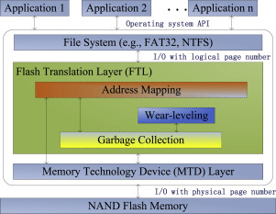
Introduction: Flash Memory
Flash memory is a non-volatile storage device that can be electrically erased and reprogrammed
Flash memory limitations
Erase before write
Erase unit: Block
Limited endurance → wear-leveling
Garbage Collection
FTL (Flash Translation Layer)
Built-in Flash memory controller
Provides a block device abstraction
Addressing the performance of NAND flash memory

Slide 5
Introduction: Flash Memory
Random writes
Frequent random writes in modern workloads
Significantly increased I/O latency (Free space fragmentation)
Lifetime reduction
(What do we do?)
Adopt Log-structured file system & Copy-on-write

Slide 6
Introduction: File Systems
File Systems
Optimized for disk storage
EXT 2~4
BTRFS
VFAT
Optimized for flash, but not aware of FTL
NILFS
…

Slide 7
Introduction: Problem
LFS
Propagation: Wandering tree problem
High cleaning(GC) overhead
Flash memory
Flash memory limitation
FTL
Random writes

Slide 8
Introduction: F2FS
Assumes presence of FTL
No effort to distribute writes
Random write area enlarged
Grouping blocks with similar life expectancies up to six in parallel
Data structures aligned to the units of FTL
Based on the log-structured design
Requires copy-on-write
Free space is managed in large regions which are written to sequentially
Some metadata, and occasionally some regular data is written via random single block writes
Support different garbage collection algorithms

Slide 9
F2FS Design

Slide 10
F2FS Design
Design Considerations
Flash-friendly on-disk layout
Cost-effective index structure
Multi-head Logging
Cleaning
Adaptive Logging
Checkpointing and Recovery

Slide 11
F2FS Design: On-disk layout
Flash awareness
All the file system metadata are located together for locality
Configurable units: Zone > Section(Cleaning unit) > segment
6 areas
SB, CP, SIT, NAT, SSA, Main Area
- Block: 4KB
- Segment: 2MB
- Section: consecutive segments
- Zone: set of sections
- Area: multiple sections
- Volume: six areas
(SB)

Slide 12
F2FS Design: On-disk layout
Superblock
Partition information
F2FS parameters (not changeable)
Exist two copies
Checkpoint
File system status
Bitmaps for valid NAT/SIT sets
Orphan inode list
Summary entries of active segment
Two checkpoint packs (last stable/intermediate Ver.)
Main Area : Block is typed to be node or data
Partition information
Node block stores inode or indices of data blocks (not data)
Data block contains directory or user file data
(SB)

Slide 13
F2FS Design: On-disk layout
Segment Information Table (SIT)
Valid segments and bitmap information in Main area
Used to select victim segments and identify valid blocks during cleaning process
Segment Summary Area (SSA)
Summary entries representing the owner information of all blocks in the Main area
Used to verify parent inode number and its node/data offset before moving valid blocks in cleaning process
Node Address Table (NAT)
Block address table to locate all the node blocks stored in Main area
(SB)

Slide 14
F2FS Design: Index Structure
LFS
Propagation
Wandering tree problem
F2FS
Node Address Translation
Containing the locations of all the node block
Restrain update propagation
SIT, SSA
CP
NAT
CP
Inode Map
Directory Inode
Directory Data
Directory Inode
Directory Data
File Inode
File Data
File Inode
File Data
File Data
Indirect Node
Referenced NAT lookup
Indirect Node
Direct Node
Direct Node

Slide 15
F2FS Design: Multi-head Logging
Six major log areas - Table 1: Separation of objects in multiple active segments
Object temperature
Node > Data
Direct node > Indirect node (more update in direct)
Directory > File
Default: F2FS sets six logs open for writing
If) 4 log is better: Hot & Cold
If) 2 log is better: Node & Data
Type | Update frequency (Temp) | Contained Objects
Node | Hot | Direct node blocks for directories
 | Warm | Direct node blocks for regular files
 | Cold | Indirect node blocks
Data | Hot | Directory entry blocks
 | Warm | Data blocks made by users
 | Cold | Data blocks moved by cleaning; Cold data blocks specified by users; Multimedia file data
NAT
Directory Inode
Directory Data
File Inode
File Data
File Data
Indirect Node
Direct Node

Slide 16
F2FS Design: Cleaning
Reclaim obsolete data scattered across the whole storage for new empty log space
Cleaning unit: section
Foreground Cleaning
Triggered when there are not enough free segments
Greedy policy: Select section with fewest valid blocks
Background Cleaning (kernel thread)
Triggered when the system is idle
Cost-benefit policy: Consideration of section utilization and age (Last modification time recorded in SIT)
F2FS loads the blocks into page cache and marks them as dirty (lazy migration)

Slide 17
F2FS Design: Cleaning
Cleaning Process
Select Victim section through SIT info
FG: Greedy
BG: Cost-benefit
Valid block identification and migration
Identify all valid blocks within a section (SIT bitmap)
Load parent index structures of there-in data identified from SSA
Move valid blocks to another empty log (Main area)
Post-cleaning process
Registration victim section as “pre-free” to become new empty sections
Pre-free sections are reallocated after checkpoint is created

Slide 18
F2FS Design: Adaptive Logging
F2FS dynamically switches between two logging policies to reduce cleaning costs at highly aged
Normal logging (Copy-and-Compaction)
Logging to clean segments (GC may be needed if no free segment)
Cause random read and sequential writes
Threaded logging
Logging to dirty segments (reuse invalid block) → No cleaning process
Cause random writes
k: Ratio of clean section (Default: Set to 5% of total section)
k > 5%: Normal logging
k < 5%: Threaded logging
Clean(free)
Dirty(invalid)

Slide 19
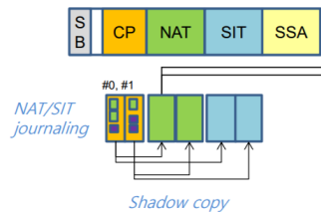
F2FS Design: Checkpointing & Recovery
Checkpoint and Rollback
Maintain shadow copy of checkpoint, NAT, SIT blocks
Recover the latest checkpoint (Roll-Back recovery)
Keep NAT/SIT journal in checkpoint to avoid NAT, SIT writes
Roll-forward recovery to recover fsync data

Slide 20
F2FS Evaluation

Slide 21
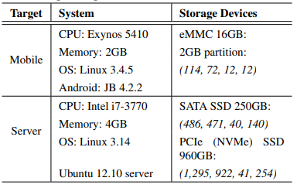
Evaluation
Experimental Setup
Mobile and Server systems
Compare EXT4, BTRFS, NILFS2, F2FS
Mobile System (Galaxy S4):
Storage:
eMMC - Sequential read/write: 110/16 MB/s, Random read/write: 3000/1500 IOPS
Server System (x86 Platform):
Storage Devices:
SATA SSD - Sequential read/write: 530/490 MB/s, Random read/write: 74,000/68,000 IOPS
SSD (Higher-speed) - Sequential read/write: 550/520 MB/s, Random read/write: 97,000/88,000 IOPS

Slide 22
Evaluation
Mobile system performance
A bar with a value greater than 1 indicates improved performance (normalization)
Reduces write amount per fsync by using roll-forward recovery
F2FS: RW → SW(90%) BTRFS: COW
F2FS: Roll-forward recovery BTRFS: Heavy index overhead
NLFS2:Sync write

Slide 23
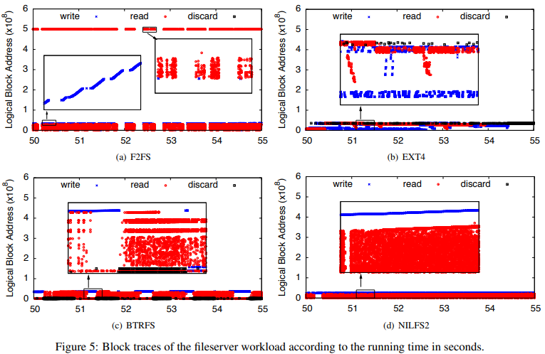
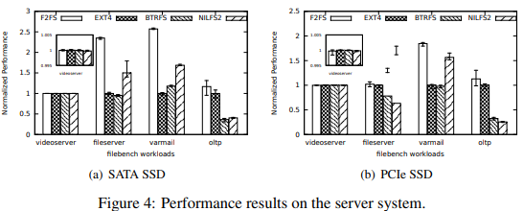
Evaluation
Server system performance
A bar with a value greater than 1 indicates improved performance (normalization)
Videoserver: mostly sequential reads and writes
Fileserver: Discard size matters in SATA SSD due to interface overhead (F2FS don’t have small discard - process unit: seg)
Varmail: Efficiency of fsync processing - many small writes with concurrent fsync
Oltp: Large number of random writes and fsync calls on a single database file (unlike varmail, many small files)
Write request size
- Large: Maximize disk bandwidth by converting to continuous disk operations
- Small: Disk operations are more distributed

Slide 24
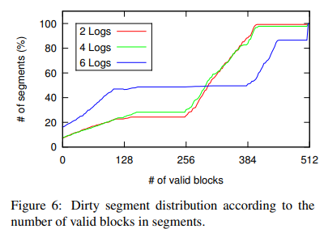
Evaluation
Multi-head Logging
Using more logs gives better hot and cold data separation (especially, 6 log)
- Dirty segments will have no valid blocks or will have a maximum number of valid blocks per segment (512) in the default configuration
Metric: Number of valid blocks within a given dirty segment before cleaning

Slide 25
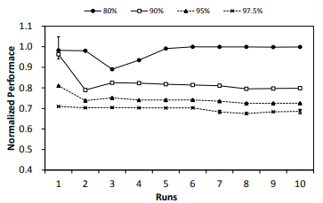
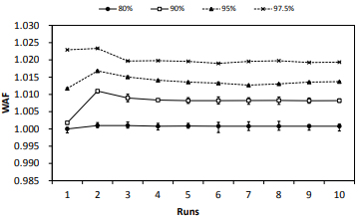
Evaluation
Cleaning Cost
As file system utilization increases, the WAF grows larger and performance decreases
F2FS does not dramatically increase WAF even at high utilization rates (Adaptive Logging)
ran out of free segments (normal → threaded Logging)

Slide 26
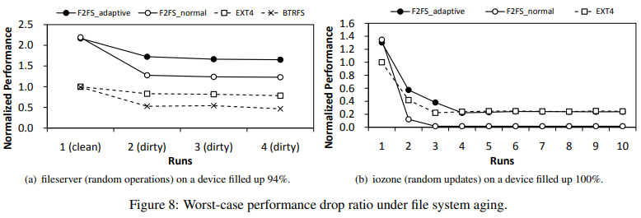
Evaluation
Adaptive Logging Performance
F2FS adaptive vs F2FS normal
Adaptive logging is important for F2FS to maintain performance at high storage utilization rates
Adaptive logging policies are effective in effectively limiting performance degradation due to fragmentation
fragmentation

Slide 27
Conclusion
F2FS is a file system optimized for flash storage devices, presenting technological innovations that improve performance and longevity
Experimental results show that F2FS shows superior performance in read and write operations compared to other file systems, and has particularly high efficiency in random read operations
These features highlight the usefulness of F2FS when considering file system selection and optimization on flash-based storage devices

Slide 28
F2FS: A New File System for Flash Storage
Changman Lee, Dongho Sim, Joo-Young Hwang, and Sangyeun Cho, Samsung Electronics Co., Ltd FAST’ 15
2023. 09. 26
Presented by Suhwan Shin
shshin@dankook.ac.kr
Thank You !

