Slide 1
The design and Implementation of a Log-Structured File System
Mendel Rosenblum and John K. Ousterhout, SOSP, 1991
2023. 09. 26
Presented by zhao
guangxun0621@gmail.com

Slide 2
Introduction
Design
Log-Structured File System
Recovery
Garbage Collection
Evaluation
Conclusion

Slide 3
Introduction
Back to the 90’s Technology trends
CPU
Processor’s speed is increasing at a nearly exponential rate
Disk Access
Cost & Capacity
Transfer bandwidth & Access time
Main Memory
Memory Size & Cache Size
Disk traffic dominated by writes
MEM

Slide 4
Introduction
File system workload
Worst case workload : Office and engineering applications
Small random disk I/O
Problems of other file systems
Widely spreading Information
Causes many small unit accesses (dir entry, inode, data block)
Unix FFS: disk I/O occurs at least 5 times
Notes:
매우 많은 작은 단위 access 유발
Seek
create a new file
file’s attributes
directory’s data
directory’s attributes

Slide 5
Introduction
Why Random Write is a problem?
Random Write:

Slide 6
Introduction
Why Random Write is a problem?
Random Write:

Slide 7
DESIGN
The basic idea of LSF system
Sprite LFS
Write Buffer
Memory
Disk

Slide 8
Design
The basic idea of LSF system
Sprite LFS
Two key issues
How to retrieve information from the log
How to manage the free space on disk
Write Buffer
sequential
Memory
LOG
Disk
Write Sequentially: never overwrite data
Notes:
Write buffe에 데이터가 어떻게 쓰이든 이를 sequential 로 disk에 쓰는 겁니다

Slide 9
Design 1
How to retrieve information from the log
inode structure
Direct block 10
Indirect block 1~
direct block 0
…
…
..
..
direct block 9
indirect block 0
…
inode
data

Slide 10
Design 1
How to retrieve information from the log
inode structure
inode map
Inode pointer
direct block 0
…
…
..
..
direct block 9
indirect block 0
…
inode map
inode
data

Slide 11
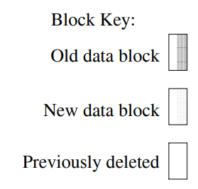
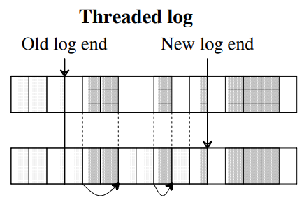
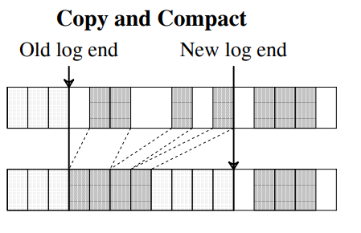
Design 2
2. How to manage the free space on disk
Threading and Copying
Sprite LFS uses Threading and Copying together

Slide 12
Design 2
2. How to manage the free space on disk
Segment : Unit for managing data on disk
Segment summary : Identifies contents of segment(file number and offset for each block)
Segment usage table: Counts live bytes still left in segments, stores last write time for data in segments
512 KB ~ 1024 KB
Checkpoint region
Segment 0 | Segment 1 | … | Segment n
Segment Summary | Data | Data | Data | inode | Data | inode | Inode map

Slide 13
Recovery
Checkpoint
Periodically or upon user request
Checkpoint settings are set if the data is valid up to that point.
Like Mario Game

Slide 14
Recovery
Checkpoint
Periodically or upon user request
Checkpoint settings are set if the data is valid up to that point.
Like Mario Game

Slide 15
Recovery
Checkpoint(Roll-forward)
Periodically or upon user request
Checkpoint settings are set if the data is valid up to that point.
Like Mario Game

Slide 16
Recovery
Checkpoint
Periodically or upon user request
Checkpoint settings are set if the data is valid up to that point.
Like Mario Game

Slide 17
Recovery
Roll forward
It recovery data after the last checkpoint
When a summary block indicates a new inode, the system adjust every meta data

Slide 18
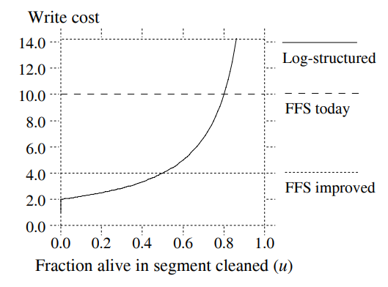
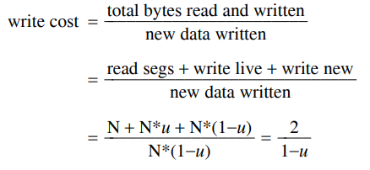
Garbage Collection
Segment Cleaning
Segment selection policy
Which segment will be cleaned is based on the space usage rate (effective data ratio) of the segment.
Block redistribution policy
Try to enhance the locality of future reads
Files in the same directory
Aging sort: Sort by last modification time
Utilization: live blocks in segments being cleaned

Slide 19
Evaluation
Simulator
Disk is filled with 4-KB files
Two random access patterns
Uniform
Random access patterns
Hot-and-cold
10% Hot data & 90% Cold data
Notes:
Each file has equal likelihood of being selected in each step.

Slide 20
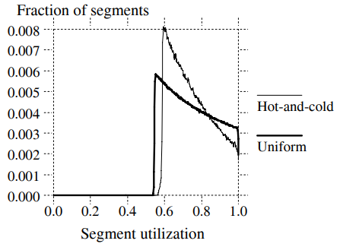
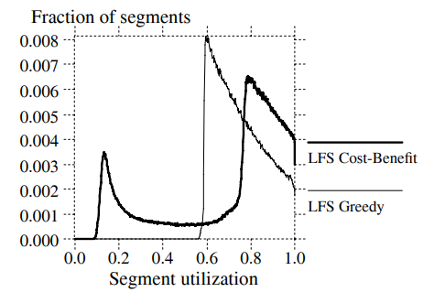
Evaluation
Segment utilization
Greedy policy
It always chose the least-utilized segments to clean
Cost-benefit policy
Greedy policy
Cost-benefit policy

Slide 21
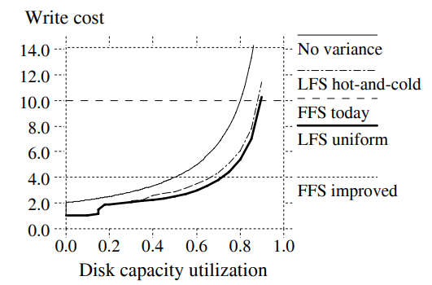
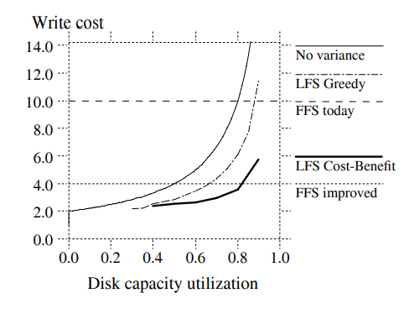
Evaluation
Disk capacity utilization
LFS uniform
LFS Cost-Benefit
LFS hot and cold
LFS Greedy
75%
Notes:
图7显示，成本-收益策略将写入成本降低了高达50%

Slide 22
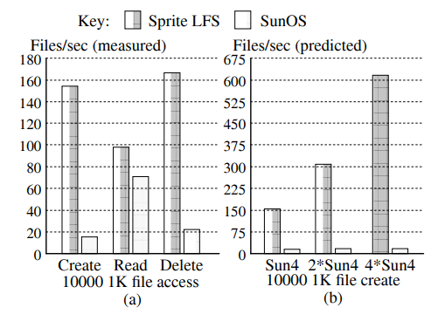
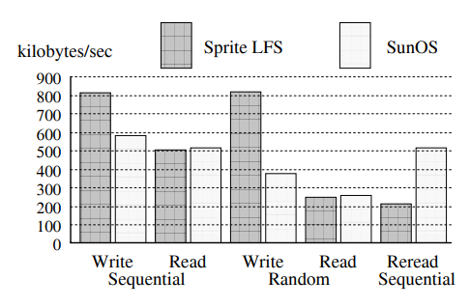
Evaluation
Small-file performance under Sprite LFS and SunOS
Estimates the performance of each system for creating files on faster processer
100-Mbyte
10X

Slide 23
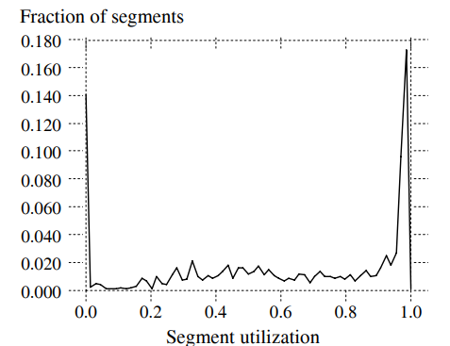
Evaluation
Large numbers of fully utilized segments and totally empty segments.
Notes:
\

Slide 24
Conclusion
Collect large amounts of new data in a file cache in main memory
Write the data to disk in a single large 1/0 that can use all of the disk’s bandwidth

Slide 25
Thank You !
Zhang, W., Zhao, X., Jiang, S., & Jiang, H .
Proceedings of the Sixteenth European Conference on Computer Systems. 2021.
2023. 06. 15
Presented by zhao
guangxun0621@gmail.com

Slide 26
Appendix
1 | 1 | 8 | 5 | 6 | 7 | 1 | 6
1 | 7 | 8
5 | 6 | 6

