Slide 1
Xen and the Art of Virtualization
Paul Barham, Boris Dragovic, Keir Fraser, Steven Hand, Tim Harris,
Alex Ho, Rolf Neugebauer, Ian Pratt, Andrew Warfield
SOSP '03: Proceedings of the 19th ACM Symposium on Operating Systems Principles
October 2003
Presented by Charles D. Jaranilla
charlzdieljaranilla@gmail.com

Slide 2
Contents
Why Virtualization?
Introduction
Xen: Approach and Overview
Design
Evaluation
Conclusion
Xen through the years

Slide 3
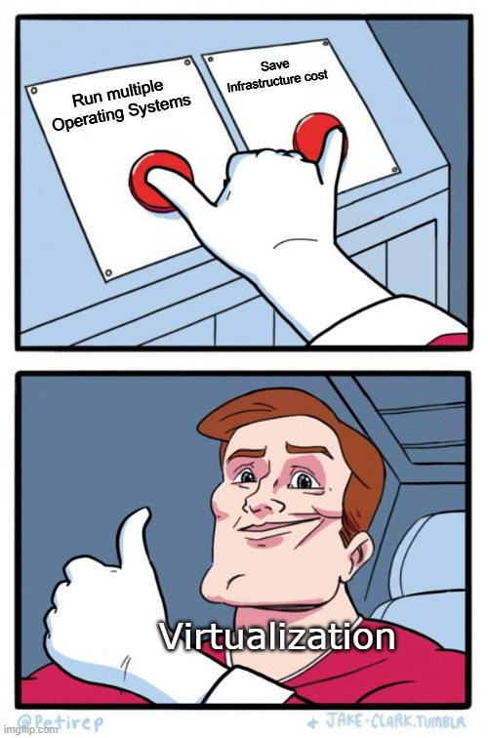
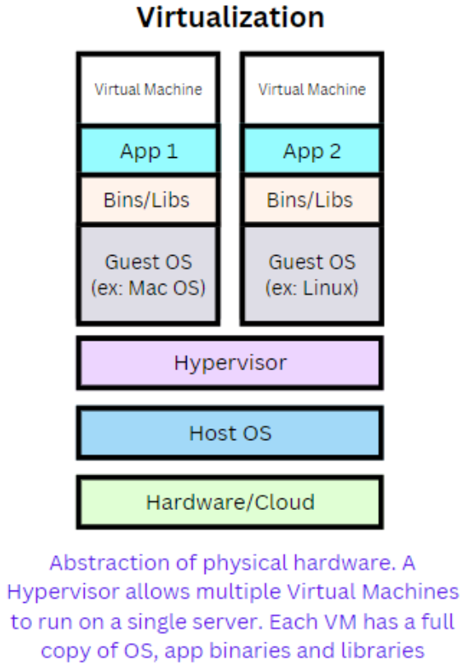
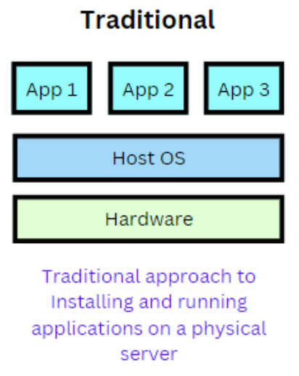
Why Virtualize?
Notes:
No isolation of resources
Overutilization by one app can crash the entire system
Scaling issues
Long downtimes
Expensive
Better utilization of resources than traditional methods
Applications are isolated
OS images are heavy and have slow bootup process
Applications are not portable
Not scalable
Can get expensive

Slide 4
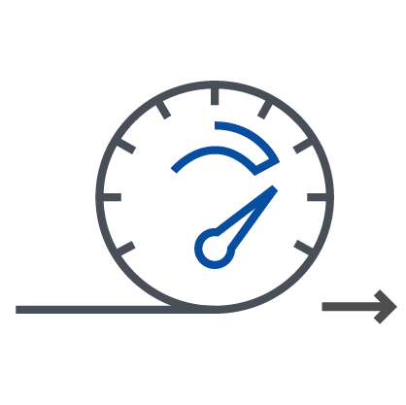
Why Virtualize?
Consolidation
Faster provisioning
Flexibility
Increased uptime
Enhanced security
Strong isolation
System partitioning
Secure I/O
New classes of threat detection
List taken from Lars Kurth’s presentation “An Introduction to Xen Project Virtualization” at the Root Linux Conference 2017
Notes:
Consolidation
Servers/Equipment, Cooling, Floor space
Single SoC / Maintainability , BoM
Faster provisioning
Flexibility
Less dependency on specific hardware / Co-existing OS environments
Increased uptime
Live migration, storage migration, fault tolerance, HA
Enhanced security
Strong isolation
Architecture provides strong isolation between VMs and Grant tables
System partitioning
Disaggregation: sandboxing parts of the system
Fine-grain control of VM capabilities
Enables multi-layered security approach
Secure I/O
Sandboxing disk, memory, etc. drivers
New classes of thread detection
Virtual machine introspection, alt2pm

Slide 5
Introduction
Full Virtualization
Allows unmodified OS to be hosted
Was not part of the x86 architecture
certain supervisor instructions must be handled by VMM
some fail silently instead of causing a convenient trap
can be fixed at the cost of complexity and performance
MMU is hard to virtualize efficiently
Other arguments:
In some cases, guest OSes don’t have access to accurate timers
RTT estimates
TCP timeouts
Notes:
Bottomline:
X86 is hard to virtualize
Even if it can be virtualized easily, there are cases that it is beneficial to the guest OS to access hardware resources

Slide 6
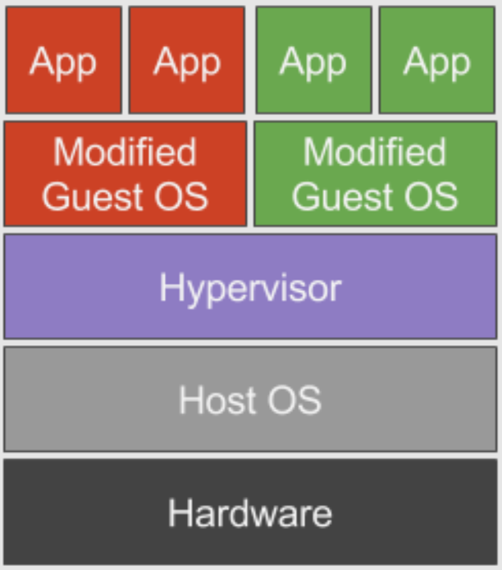
Xen: Approach and Overview
Paravirtualization
Design Principles
Support for unmodified application binaries.
Support full multi-application OS.
Obtain high performance and strong resource isolation on uncooperative machine architectures
Completely hiding effects of resource virtualization from guest OS risks correctness and performance.
Notes:
Paravirtualization: Trade off small changes to the guest OS for big improvements in performance and VMM simplicity

Slide 7
Xen: Approach and Overview
Xen vs Denali
Denali does not target existing ABIs, and so can elide certain architectural features from their VM interface.
The Denali implementation does not address the problem of supporting application multiplexing, nor multiple address spaces, within a single guest OS.
The Denali architecture the VMM performs all paging to and from disk.
Denali virtualizes the ‘namespaces’ of all machine resources, taking the view that no VM can access the resource allocations of another VM if it cannot name them.
Notes:
At the end of the previous year, 2002, the paper Scale and Performance in the Denali Isolation Kernel was published, and the authors made some justifications that Xen has different goals and underlying design choices than Denali.
For example, Denali does not fully support x86 segmentation although it is exported (and widely used) in the ABIs of NetBSD, Linux, and Windows XP
Applications are linked explicitly against an instance of the Ilwaco guest OS in a manner rather reminiscent of a libOS in the Exokernel [23]. Hence each virtual machine essentially hosts a single-user single-application unprotected “operating system”.
In Xen, by contrast, a single virtual machine hosts a real operating system which may itself securely multiplex thousands of unmodified user-level processes.
Perhaps related to the lack of memory management support at the virtualization layer. Paging within the VMM is contrary to our goal of performance isolation: malicious virtual machines can encourage thrashing behaviour, unfairly depriving others of CPU time and disk bandwidth.
In Xen we expect each guest OS to perform its own paging using its own guaranteed memory reservation and disk allocation
VMs have no knowledge of hardware addresses, only the virtual addresses created for them by Denali.
In contrast, we believe that secure access control within the hypervisor is sufficient to ensure protection; furthermore, as discussed previously, there are strong correctness and performance arguments for making physical resources directly visible to guest OSes

Slide 8
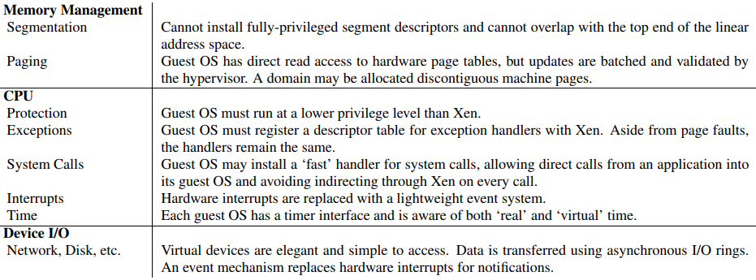
Xen: Approach and Overview
The Virtual Machine Interface
Notes:
O. In the following we address each machine subsystem in turn, and discuss how each is presented in our paravirtualized architecture.
Note that although certain parts of our implementation, such as memory management, are specific to the x86, many aspects (such as our virtual CPU and I/O devices) can be readily applied to other machine architectures.
Furthermore, x86 represents a worst case in the areas where it differs significantly from RISC-style processors — for example, efficiently virtualizing hardware page tables is more difficult than virtualizing a software managed TLB.

Slide 9
Xen: Approach and Overview
Memory Management
Limitations
x86 doesn’t have a software-managed TLB
TLB misses are serviced automatically by the processor by walking the page table structure in hardware
To achieve the best performance, all valid page translations for the current address space should be present in the hardware-accessible page table.
TLB is not tagged = address space typically require a complete TLB flush
Design decision
Guest OSes are responsible for allocating and managing the hardware page tables, with minimal involvement from Xen to ensure safety and isolation.
Xen exists in a 64 MB section at the top of every address space, avoiding a TLB flush when entering and leaving the hypervisor
Each guest OS can only map to memory it owns
Writes are validated by Xen
Notes:
TLB – Translation Lookaside Buffer - memory cache that stores the recent translations of virtual memory to physical memory.
Optimization (corresponds to the limitations item #1 on slide)
GuestOS is allowed to store virtual to physical translation. When there is a fault, the hypervisor can see all TLB misses, and can allow the guestOS to use a larger TLB than what is available
TLB supports an address space identifier which allows to avoid completely flushing the TLB every time a switch between guestOSes is done

Slide 10
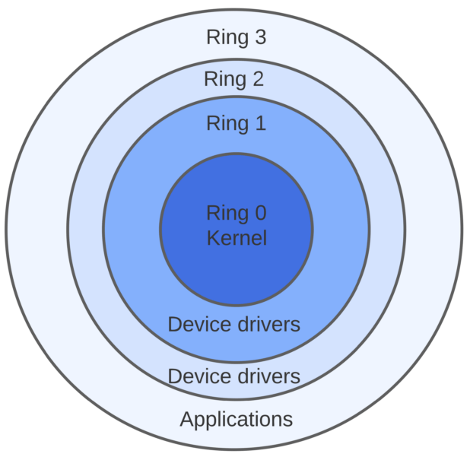
Xen: Approach and Overview
CPU
X86 supports 4 levels of privilege: 0 for OS, 3 for applications
Xen downgrades the privilege of guest OS onto Ring 1
System calls and page fault handlers are registered to Xen
“Fast handers” for most exceptions, Xen isn’t involved
Hypervisor
Guest OS
Notes:
Virtualizing the CPU has several implications for guest OSes. Principally, the insertion of a hypervisor below the operating system violates the usual assumption that the OS is the most privileged entity in the system. In order to protect the hypervisor from OS misbehavior (and domains from one another) guest OSes must be modified to run at a lower privilege level.
Efficient virtualization of privilege levels is possible on x86 because it supports four distinct privilege levels in hardware. The x86 privilege levels are generally described as rings and are numbered from zero (most privileged) to three (least privileged). OS code typically executes in ring 0 because no other ring can execute privileged instructions, while ring 3 is generally used for application code. Any OS which follows this common arrangement can be ported to Xen by modifying it to execute in ring 1. This prevents the guest OS from directly executing privileged instructions, yet it remains safely isolated from applications running in ring 3.
Privileged instructions are paravirtualized by requiring them to be validated and executed within Xen. Any guest OS attempt to directly execute a privileged instruction is failed by the processor, either silently or by taking a fault, since only Xen executes at a sufficiently privileged level.
Typically, only two types of exception occur frequently enough to affect system performance: system calls (which are usually implemented via a software exception), and page faults.

Slide 11
Xen: Approach and Overview
Device I/O
Xen exposes a set of simple device abstractions

Slide 12
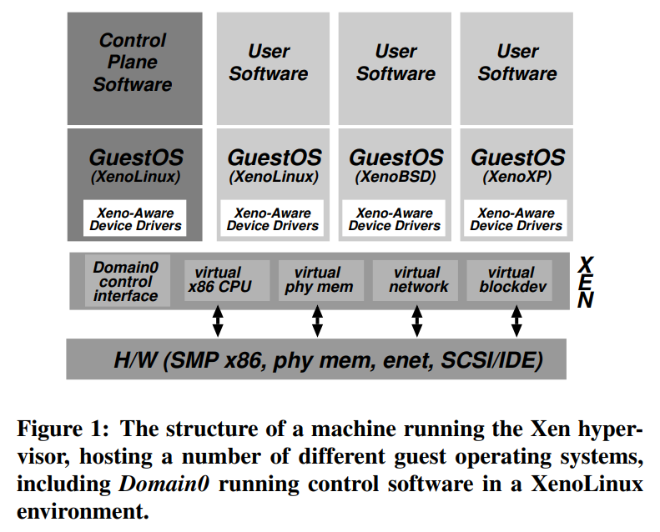
Xen: Approach and Overview
Control and Management
Separation of policy and mechanism
Domain0 hosts the application-level management software
Creation and deletion of virtual network interfaces and block devices
Notes:
Domain0 runs control software in Xen. This is a special privileged domain created at boot time that can subsequently create other domains to run operating systems.

Slide 13
Design
Control Transfer mechanisms: Hypercalls and Events
hypercall – synchronous calls from a domain to Xen
asynchronous events – notifications from Xen to domains
Notes:
Hypercall interface – allows a guestOS to request that Xen make a change to its page tables because Xen has write access to its memory
To improve performance, it can batch updates together
Communication from Xen to a domain is provided through an asynchronous event mechanism, which replaces the usual delivery mechanisms for device interrupts and allows lightweight notification of important events such as domain-termination requests.
For instance, events are used to indicate that new data has been received over the network, or that a virtual disk request has completed.
Pending events are stored in a per-domain bitmask which is updated by Xen before invoking an event-callback handler specified by the guest OS

Slide 14
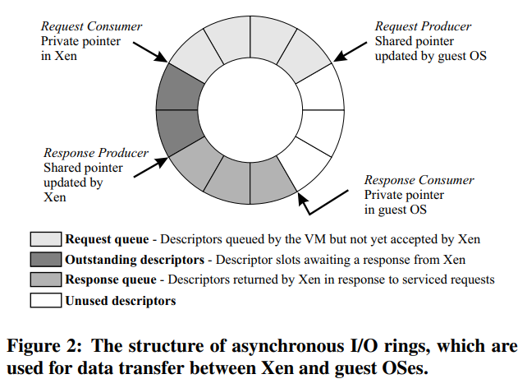
Design
Notes:
A ring is a circular queue of descriptors allocated by a domain but accessible from within Xen.
Descriptors do not directly contain I/O data; instead, I/O data buffers are allocated out-of-band by the guest OS and indirectly referenced by I/O descriptors.
Access to each ring is based around two pairs of producer-consumer pointers: domains place requests on a ring, advancing a request producer pointer, and Xen removes these requests for handling, advancing an associated request consumer pointer.
Responses are placed back on the ring similarly, save with Xen as the producer and the guest OS as the consumer.
There is no requirement that requests be processed in order: the guest OS associates a unique identifier with each request which is reproduced in the associated response.
This allows Xen to unambiguously reorder I/O operations due to scheduling or priority considerations.

Slide 15
Design
Subsytem Virtualization
CPU scheduling
schedules domains according to the Borrowed Virtual Time (BVT) scheduling algorithm
Time and timers
provides guest OSes with notions of real time, virtual time and wall-clock time
Virtual address translation
Physical memory
initial memory allocation, or reservation, for each domain is specified at the time of its creation; memory is thus statically partitioned between domains, providing strong isolation
Network
provides the abstraction of a virtual firewall-router (VFR), where each domain has one or more network interfaces (VIFs) logically attached to the VFR.
Disk
Only Domain0 has direct unchecked access to physical (IDE and SCSI) disks
Notes:
CPU: We chose this particular algorithms since it is both work-conserving and has a special mechanism for low-latency wake-up (or dispatch) of a domain when it receives an event. Fast dispatch is particularly important to minimize the effect of virtualization on OS subsystems that are designed to run in a timely fashion
Timer
Real time is expressed in nanoseconds passed since machine boot and is maintained to the accuracy of the processor’s cycle counter and can be frequency-locked to an external time source
A domain’s virtual time only advances while it is executing: this is typically used by the guest OS scheduler to ensure correct sharing of its timeslice between application processes.
wall-clock time is specified as an offset to be added to the current real time. This allows the wall-clock time to be adjusted without affecting the forward progress of real time.
Virtual Address Translation: As with other subsystems, Xen attempts to virtualize memory access with as little overhead as possible. (as discussed previously)
Physical memory: A maximum allowable reservation may also be specified: if memory pressure within a domain increases, it may then attempt to claim additional memory pages from Xen, up to this reservation limit. Conversely, if a domain wishes to save resources, perhaps to avoid incurring unnecessary costs, it can reduce its memory reservation by releasing memory pages back to Xen. XenoLinux implements a balloon driver [42], which adjusts a domain’s memory usage by passing memory pages back and forth between Xen and XenoLinux’s page allocator.
Network: Domain0 is responsible for inserting and removing rules. In typical cases, rules will be installed to prevent IP source address spoofing, and to ensure correct demultiplexing based on destination IP address and port. To transmit a packet, the guest OS simply enqueues a buffer descriptor onto the transmit ring. Xen copies the descriptor and, to ensure safety, then copies the packet header and executes any matching filter rules.
Disk: Allowing Domain0 to manage the VBDs keeps the mechanisms within Xen very simple and avoids more intricate solutions such as the UDFs used by the Exokernel
Xen maintains a shadow page table. Capability for domains to batch queue updates for page tables to minimize hypercalls.

Slide 16
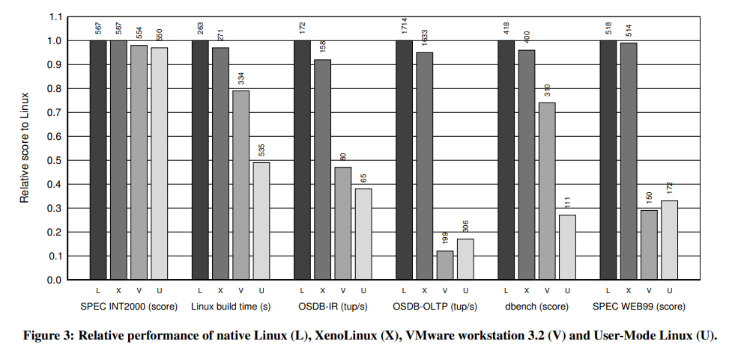
Evaluation
Notes:
The first cluster of bars in Figure 3 represents a relatively easy scenario for the VMMs. The SPEC CPU suite contains a series of long-running computationally-intensive applications intended to measure the performance of a system’s processor, memory system, and compiler quality. The suite performs little I/O and has little interaction with the OS. With almost all CPU time spent executing in user-space code, all three VMMs exhibit low overhead.
The next set of bars show the total elapsed time taken to build a default configuration of the Linux 2.4.21 kernel on a local ext3 file system with gcc 2.96. Native Linux spends about 7% of the CPU time in the OS, mainly performing file I/O, scheduling and memory management. In the case of the VMMs, this ‘system time’ is expanded to a greater or lesser degree: whereas Xen incurs a mere 3% overhead, the other VMMs experience a more significant slowdown.
Two experiments were performed using the PostgreSQL 7.1.3 database, exercised by the Open Source Database Benchmark suite (OSDB) in its default configuration. We present results for the multi-user Information Retrieval (IR) and On-Line Transaction Processing (OLTP) workloads, both measured in tuples per second. A small modification to the suite’s test harness was required to produce correct results, due to a UML bug which loses virtual-timer interrupts under high load. The benchmark drives the database via PostgreSQL’s native API (callable SQL) over a Unix domain socket. PostgreSQL places considerable load on the operating system, and this is reflected in the substantial virtualization overheads experienced by VMware and UML. In particular, the OLTP benchmark requires many synchronous disk operations, resulting in many protection domain transitions.
Bottomline: Figure 3 shows performance for different application-level benchmarks. Xen is close to native performance
Note that: Design goal of Xen was to avoid performance overhead

Slide 17
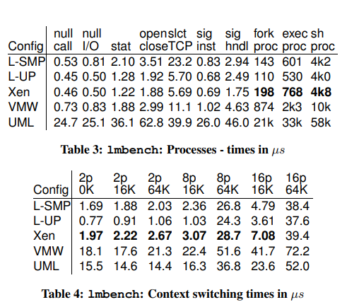
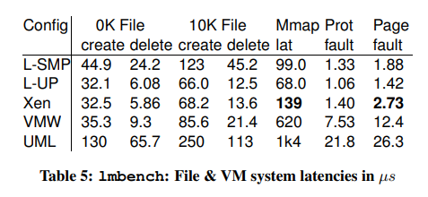
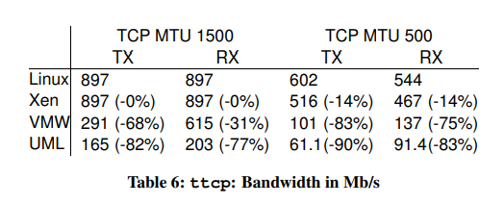
Evaluation

Slide 18
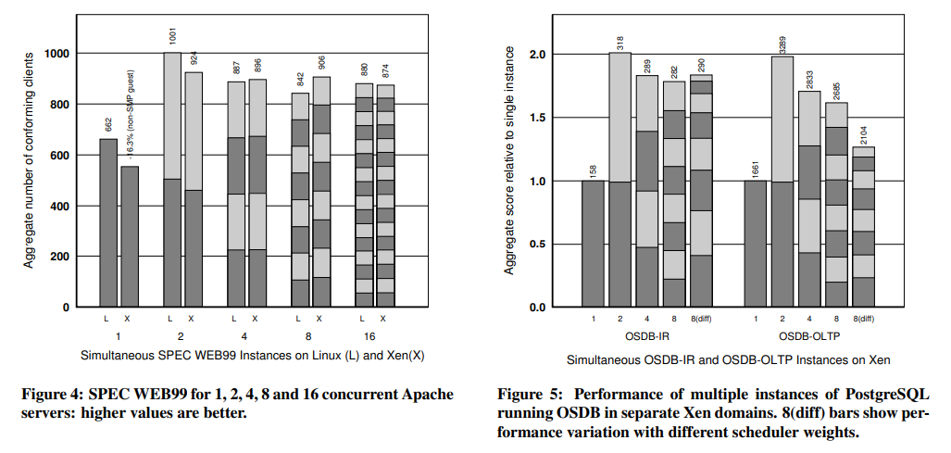
Evaluation

Slide 19
Conclusion
The x86 architecture does not support full virtualization
Xen is a high-performance virtual machine monitor which uses paravirtualization
It requires modification of the guest OS’s kernel code
Performance achievement near to that of the baseline Linux system

Slide 20
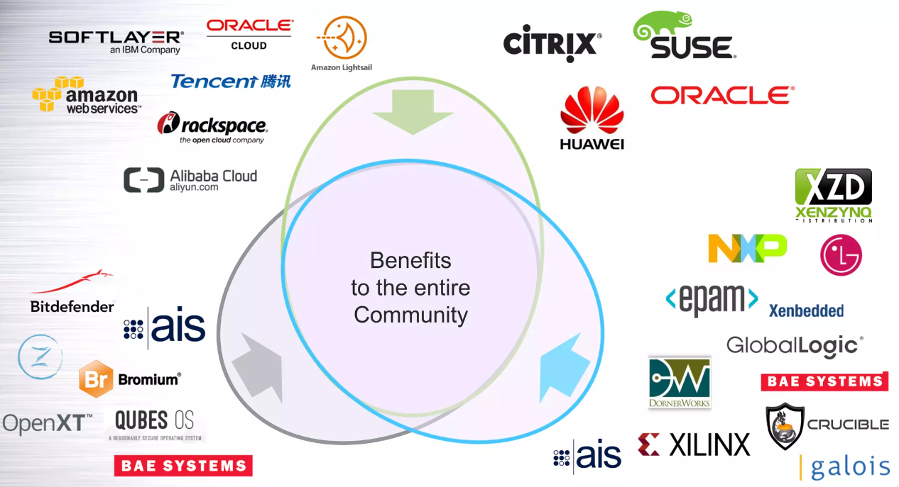
Xen through the years
Described in the paper “Xen and the Art of Virtualization” in SOSP 2003
Xen 1.0 was officially released in 2003
Xen 2.0 followed shortly
Xen Project was born, and the project went under The Linux Foundation in 2013
https://xenproject.org/users/virtualization/
Image taken from Lars Kurth’s presentation “An Introduction to Xen Project Virtualization” at the Root Linux Conference 2017

Slide 21
THANK YOU!

