Slide 1
Ceph: A Scalable, High-Performance Distributed File System
Sage A. Weil et al.
OSDI’06
2023. 10. 17
Agung Rahmat Ramadhan
agung@dankook.ac.kr

Slide 2
Introduction
Background
CEPH Design
Evaluation
Conclusion

Slide 3
Introduction
CLOUD SERVICES
COMPUTE
NETWORK
STORAGE

Slide 4
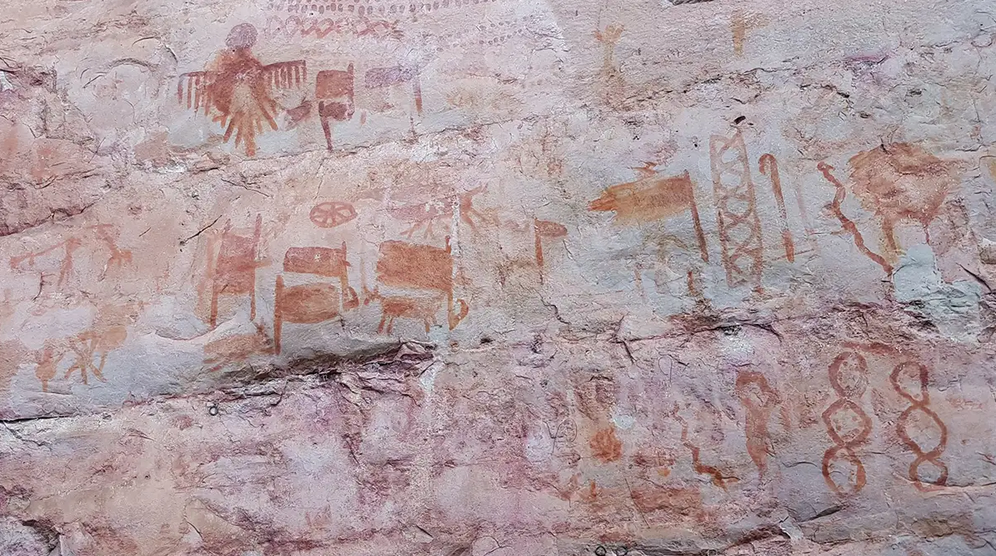
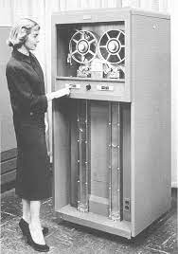
History of Storage
HUMAN
ROCK
INK
HUMAN
PAPER
HUMAN
COMPUTER
TAPE
Source:
https://upload.wikimedia.org/wikipedia/commons/c/ca/Quill_%28PSF%29.png
https://www.newscientist.com/article/2262013-ancient-rock-art-reveals-life-of-the-amazons-earliest-inhabitants/
http://www.columbia.edu/cu/computinghistory/701-tape.html
https://www.youtube.com/watch?v=7I9uxoEhUdY

Slide 5
Storage
HUMAN
COMPUTER
TAPE

Slide 6
Storage
YOU
TECHNOLOGY
YOUR DATA

Slide 7
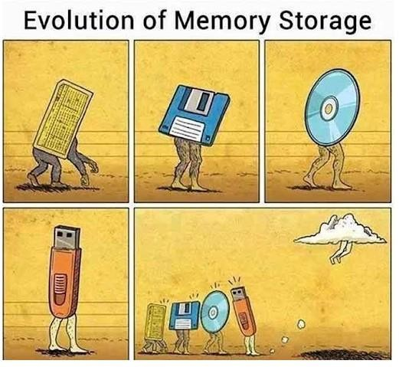
Storage
????????????
cloud computing
distributed storage
computer
paper
writing
carving

Slide 8
Storage
DISK
DISK
HUMAN
DISK
HUMAN
COMPUTER
DISK
DISK
HUMAN
DISK
DISK

Slide 9
Storage
DISK
HUMAN
HUMAN
DISK
HUMAN
DISK
HUMAN
HUMAN
DISK
COMPUTER
HUMAN
DISK
HUMAN
HUMAN
DISK
DISK
HUMAN
DISK
HUMAN
HUMAN
DISK
HUMAN
DISK
HUMAN
HUMAN
DISK
HUMAN
HUMAN
HUMAN
HUMAN

Slide 10
Storage Scaling
DISK
HUMAN
HUMAN
DISK
HUMAN
DISK
HUMAN
HUMAN
DISK
GIANT SPENDY COMPUTER
HUMAN
DISK
HUMAN
HUMAN
DISK
DISK
HUMAN
DISK
HUMAN
HUMAN
DISK
HUMAN
DISK
HUMAN
HUMAN
DISK
HUMAN
HUMAN
HUMAN
HUMAN

Slide 11
Storage
COMPUTER
DISK
COMPUTER
DISK
COMPUTER
DISK
HUMAN
COMPUTER
DISK
COMPUTER
DISK
HUMAN
COMPUTER
DISK
COMPUTER
DISK
HUMAN
COMPUTER
DISK
COMPUTER
DISK
COMPUTER
DISK
COMPUTER
DISK
COMPUTER
DISK

Slide 12
Storage
“STORAGE APPLIANCE”
COMPUTER
DISK
COMPUTER
DISK
COMPUTER
DISK
COMPUTER
DISK
COMPUTER
DISK
COMPUTER
DISK
COMPUTER
DISK

Slide 13
CEPH

Slide 14
In the Before
There was a distributed file system like:
NFS - Network File System
Single large server
Full POSIX support, in kernel
Slow with even a moderate number of client
Simple

Slide 15
In the Before
There was a distributed file system like:
Hadoop - Apache Project inspired by Google
Massive throughput
Througput scales with attached HDs
Have seen Very Large production clusters
Facebook, Yahoo
Doesn't even pretend to be POSIX

Slide 16
Motivation
Ceph is an emerging technology in the production clustered environment
Designed for:
Performance - Striped data over data servers
Reliability - No single point of failure
Scalability - Adaptable metadata cluster

Slide 17
Timeline
2006 - Ceph Paper written
2007 - Sage Weil earned PhD from Ceph
2007 - 2010 Development continued, primarily for DreamHost
March 2010 - Linus merged Ceph client into mainline 2.6.34 kernel
No more patches needed for clients

Slide 18
First Key Idea: Object-based Storage

Slide 19
Type of storage
Fixed-sized blocks with unique identifiers
Small data pieces with unique identifiers
Source: https://www.stackscale.com/wp-content/uploads/2023/06/types-storage-file-block-object-stackscale.jpg

Slide 20
Second Key Idea: Decoupled Data & Metadata

Slide 21
Ceph Overview
Decoupled data and metadata
IO directly with object servers
Dynamic distributed metadata management
Multiple metadata servers handling different directories (subtrees)
Reliable autonomic distribution storage
OSD's manage themselves by replicating and monitoring

Slide 22
Decoupled data and metadata
Increases performance by limiting interaction between clients and servers
Decoupling is common in distributed filesystem: Hadoop, etc
In contrast to other fs, CEPH uses a function to calculate the block location

Slide 23
Dynamic Distributed Metadata Management
Metadata is split among clusters of servers
The distribution of metadata changes as the number of requests loaded between metadata servers increases.
Metadata servers also can quickly recover from failures by taking over neighbors data

Slide 24
Reliable Autonomic Distributed Storage
Data storage servers act on events by themselves
Initiates replication
Improves performance by offloading decision making to the many data servers
Improves reliability by removing central control of the cluster (single point of failure)

Slide 25
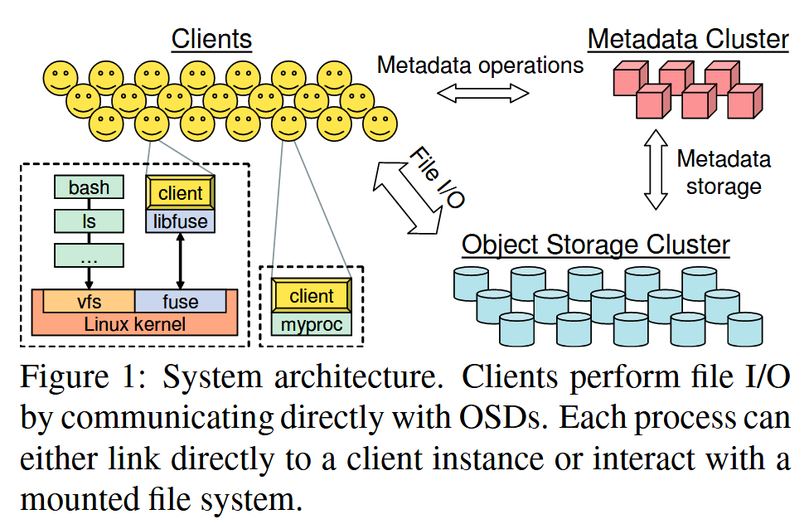
System Overview
1
2
3

Slide 26
Client Operation
Ceph interface
Nearly POSIX
Decoupled data and metadata operation
User space implementation
FUSE or directly linked
FUSE is a software allowing to implement a file system in a user space

Slide 27
Client Access Example
Client sends open request to MDS
MDS returns capability, file inode, file size and stripe information
Calculate data location with CRUSH
Read directly off storage nodes
Relinquishes capability, provides details to MDS
(1)
(2)
(5)
(3)
(4)
Capability = Read, Cache Reads, Write, and Buffer Write
Is the action(read/write) granted or not.

Slide 28
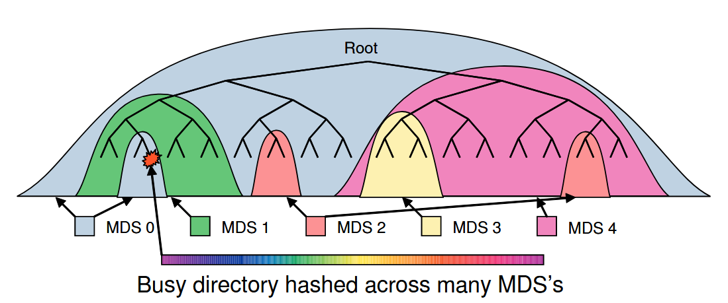
Dynamic Subtree Partitioning
Common to have 'hot' metadata that is needed by many clients
MDS will monitor frequency of queries using special counters
MDS will compare the counters each other and split the directory tree to evenly split the load
Busy directories (multiple creates/opens) will be hashed across multiple MDS's
Clients will read from random replica

Slide 29
Data Placement
Need a way to distribute data evenly among OSD
Problem: Don't want to keep data locations in the metadata servers
Requires lots of memory
Solution:
CRUSH
Crush is a pseudo-random function to find the location of data in a distributed fs
Summary: Take a little info, plug into hashing to find where the data is stored
Input data is:
inode number - From MDS
OSD Cluster Map (CRUSH map) - From OSD/Monitors

Slide 30
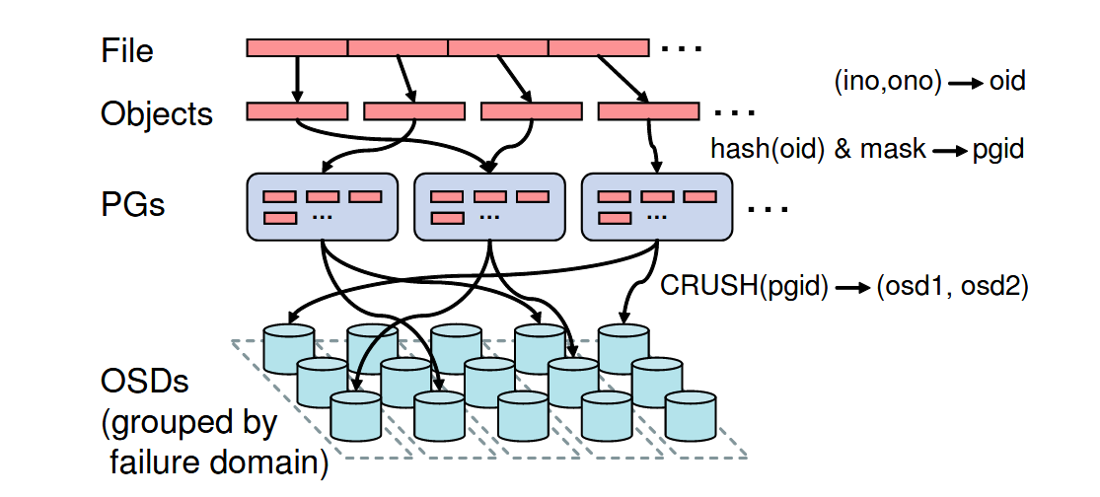
CRUSH
CRUSH maps a file to a list of servers that have the data

Slide 31
Placement Group
Sets of OSD
OSD's will have many PGs
PGs will have R OSD's where R is number of replicas
An OSD will either be a Primary / Replica
Primary is in charge of accepting modification
Clients will write to primary, read from random member of PG

Slide 32
CRUSH
Now we know where to write/read the data.
Then, how do we safely handle replication / server failures?

Slide 33
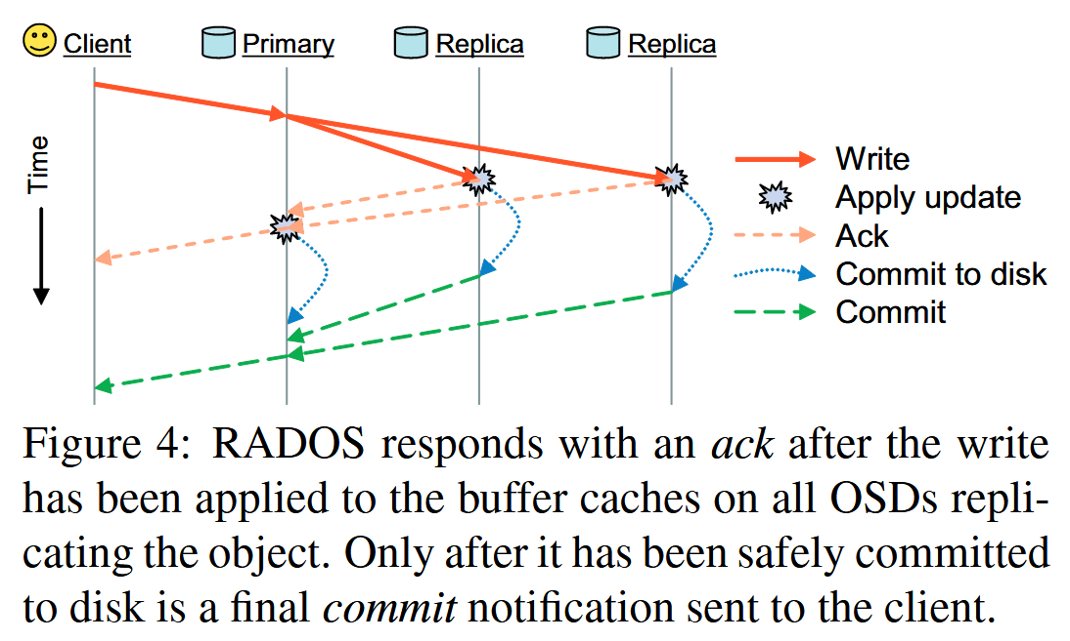
Replication
Objects are replicated on OSDs within same PG
Client is oblivious to replication
1
2

Slide 34
Failure Detection and Recovery
Down and Out
Down is when the node could come back
Out is when a node will not come back, data is re-replicated
Recovery & Update
Each object has a version number
Check the version number of the object to see if needs update

Slide 35
Object Storage
The underlying fs can make or break a distributed one
Filesystems have different characteristics:
Example: XFS good at REALLY big files
Ceph keeps a lot of attributes on the inodes, need a fs that can handle attributes
Ceph can run on normal file systems, but slow
XFS, ext3/4
Hugely recommended to run in BTRFS
Created own file system in order to handle special object of CEPH
EBOFS - Extent and B-Tree based Object File System

Slide 36
Object Storage - BTRFS
Fast Writes: Copy on write file system for Linux
Great Performance: Small files with fast lookup using B-Tree algorithm
Ceph Requirement: Support unlimited chaining of attributes
Integrated into kernel 2.6.29

Slide 37
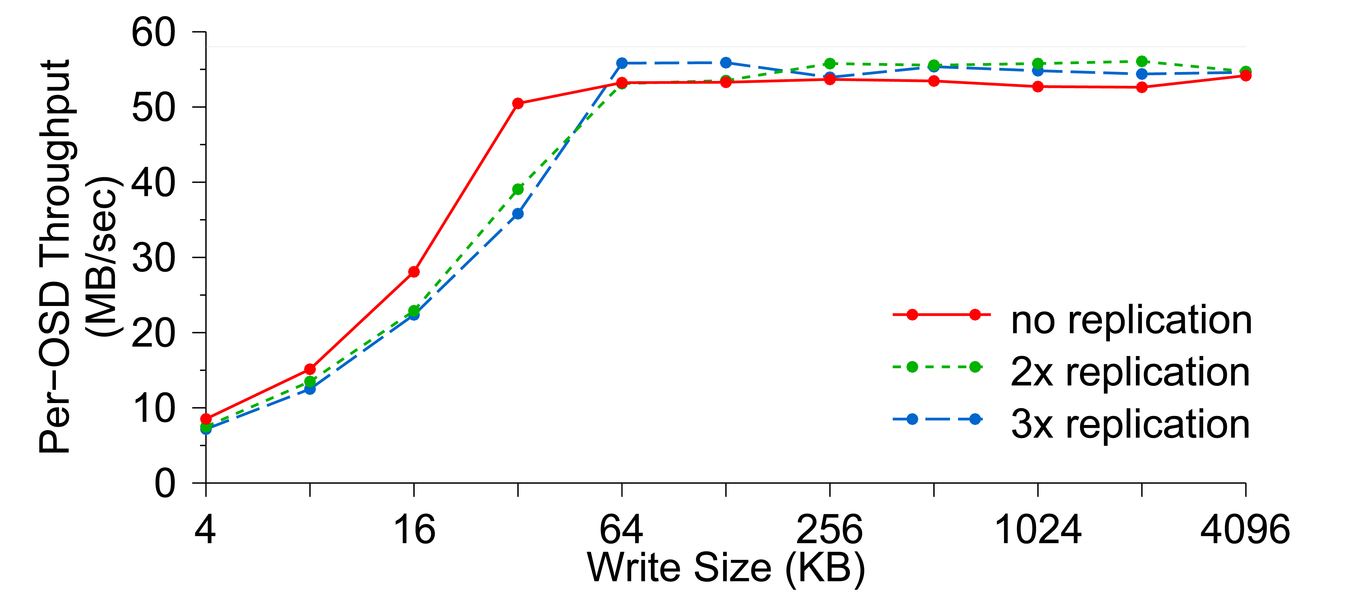
Per-OSD Write Performance
Replication has minimal impact on OSD throughput

Slide 38
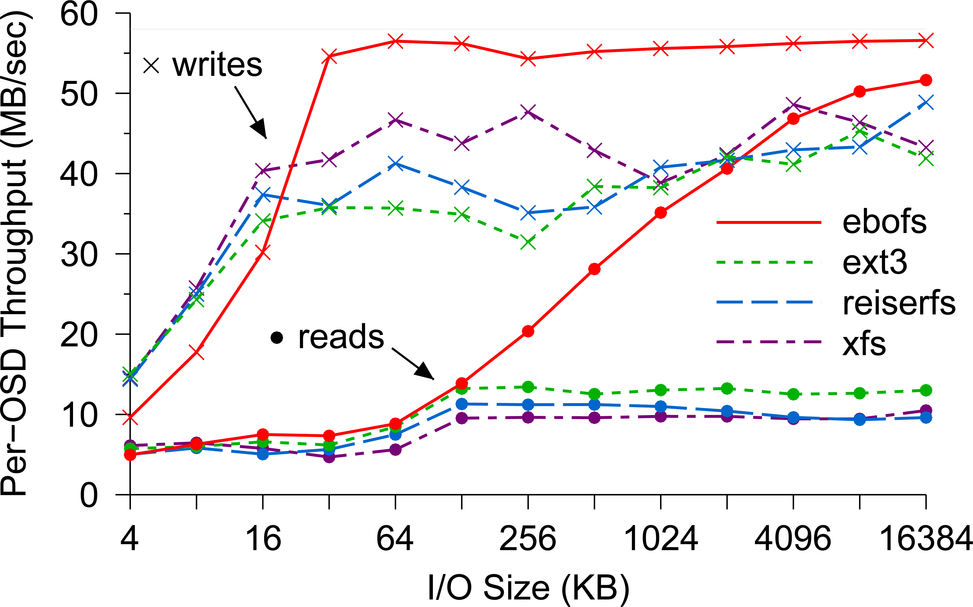
EBOFS Performance
Although small writes suffer from coarse locking in our prototype, EBOFS nearly saturates the disk for writes larger than 32 KB.
Since EBOFS lays out data in large extents when it is written in large increments, it has significantly better read performance.

Slide 39
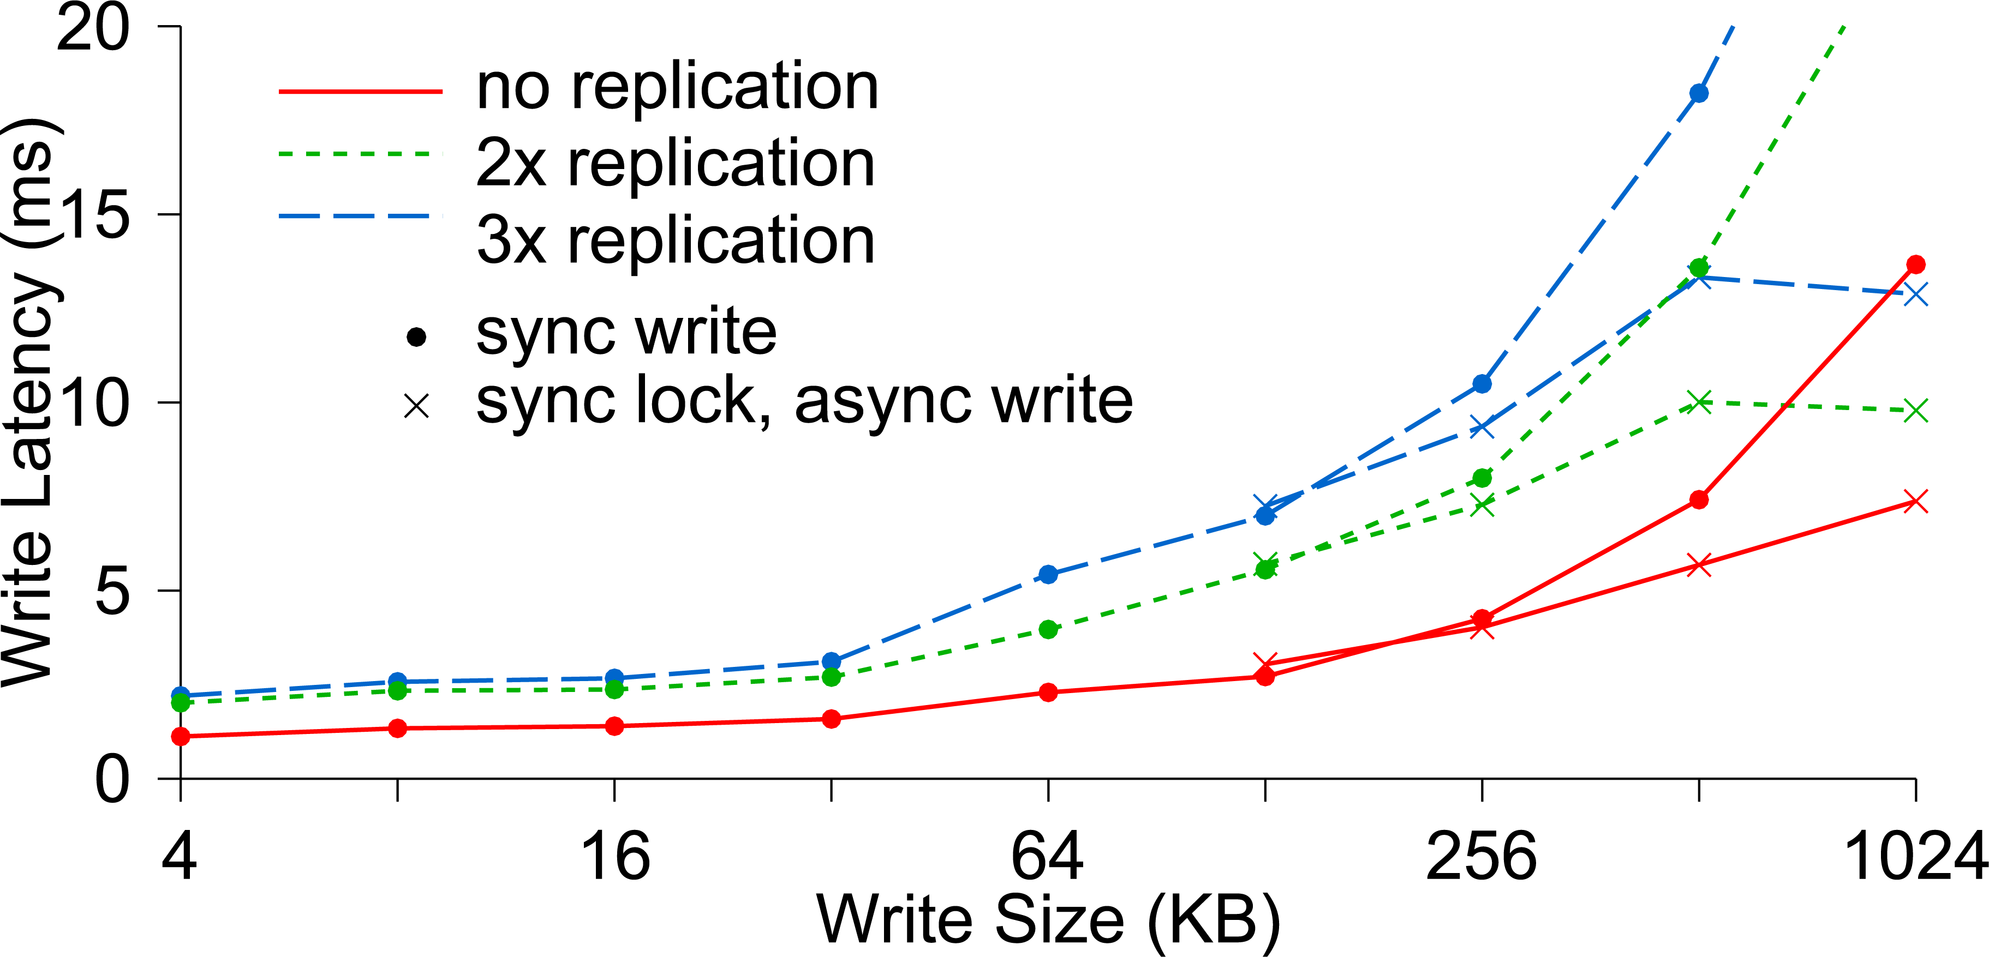
Write Latency
More than two replicas incur minimal additional costs for small writes because replicated updates occur concurrently.
For large synchronous writes, transmission times dominate. Clients partially mask that latency
for writes over 128 KB by acquiring exclusive locks and asynchronously flushing the data.

Slide 40
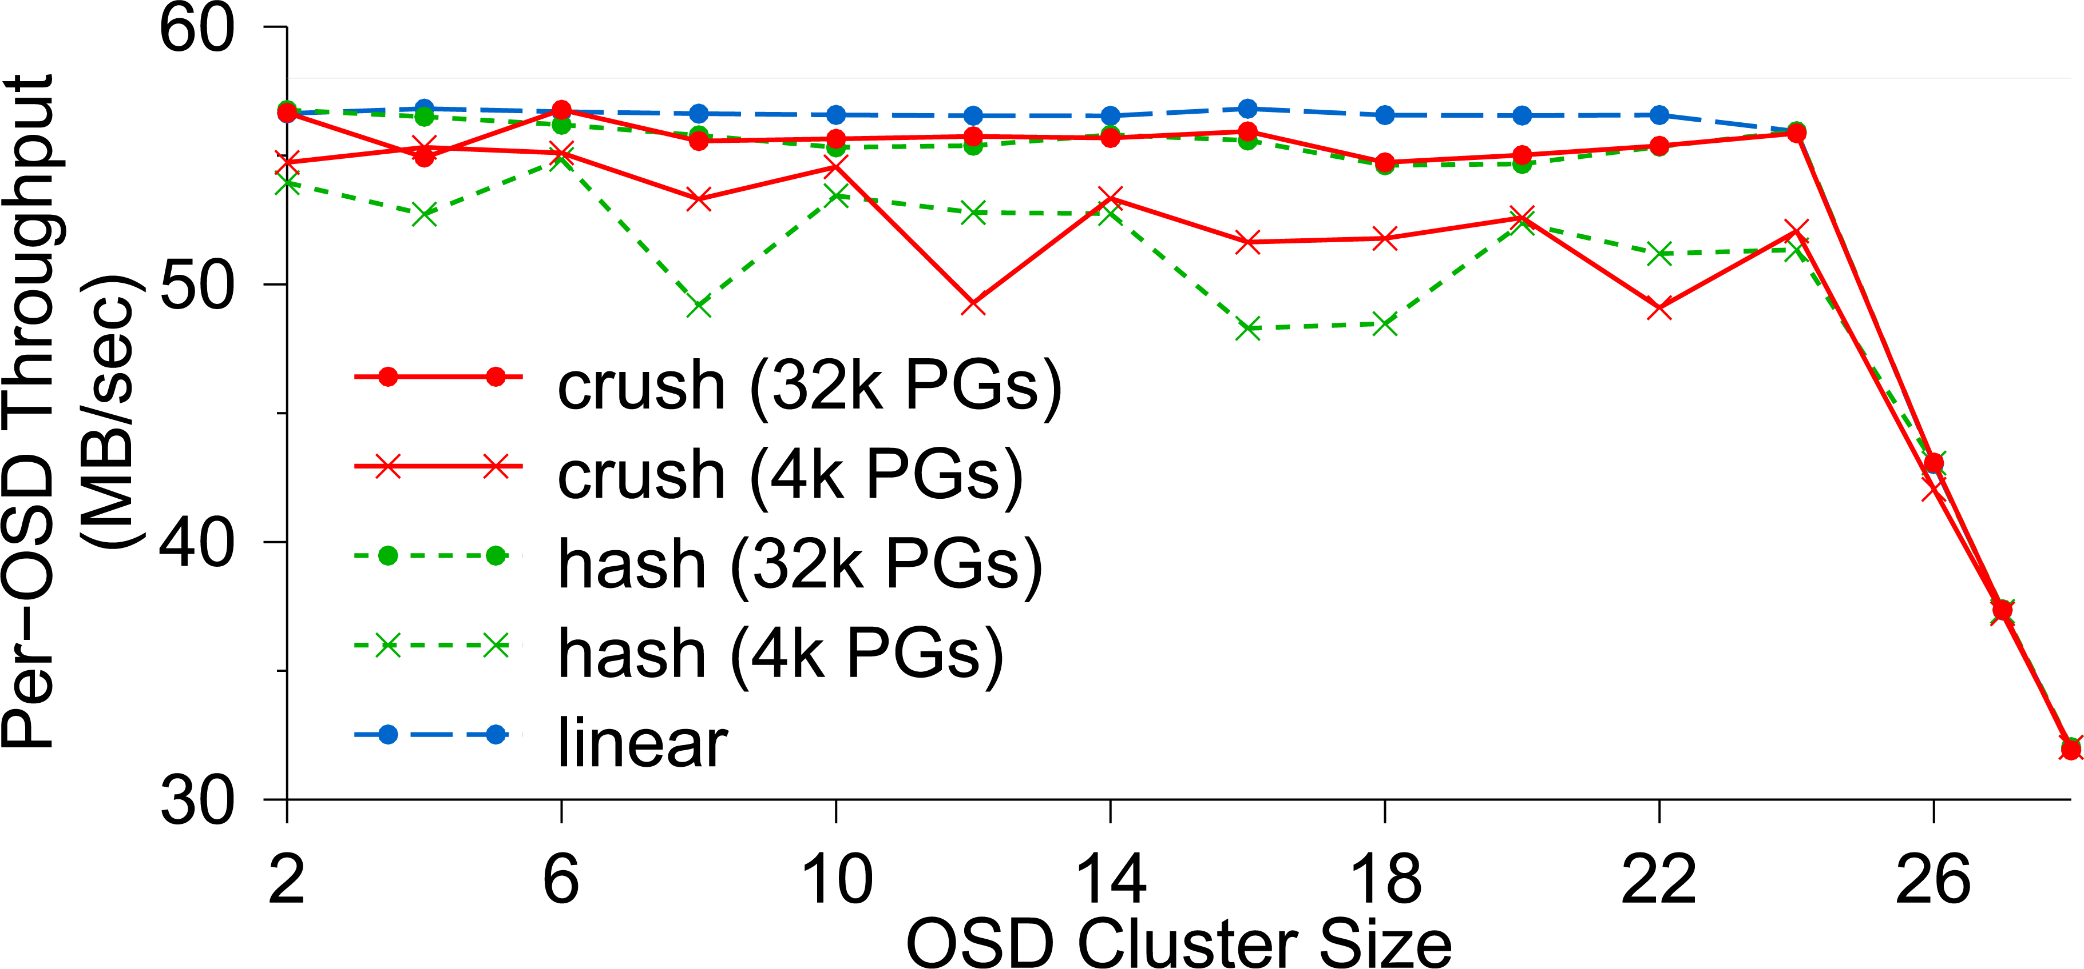
OSD Write Performance
OSD write performance scales linearly with the size of the OSD cluster until the switch is saturated at 24 OSDs.
CRUSH and hash performance improves when more PGs lower variance in OSD utilization

Slide 41
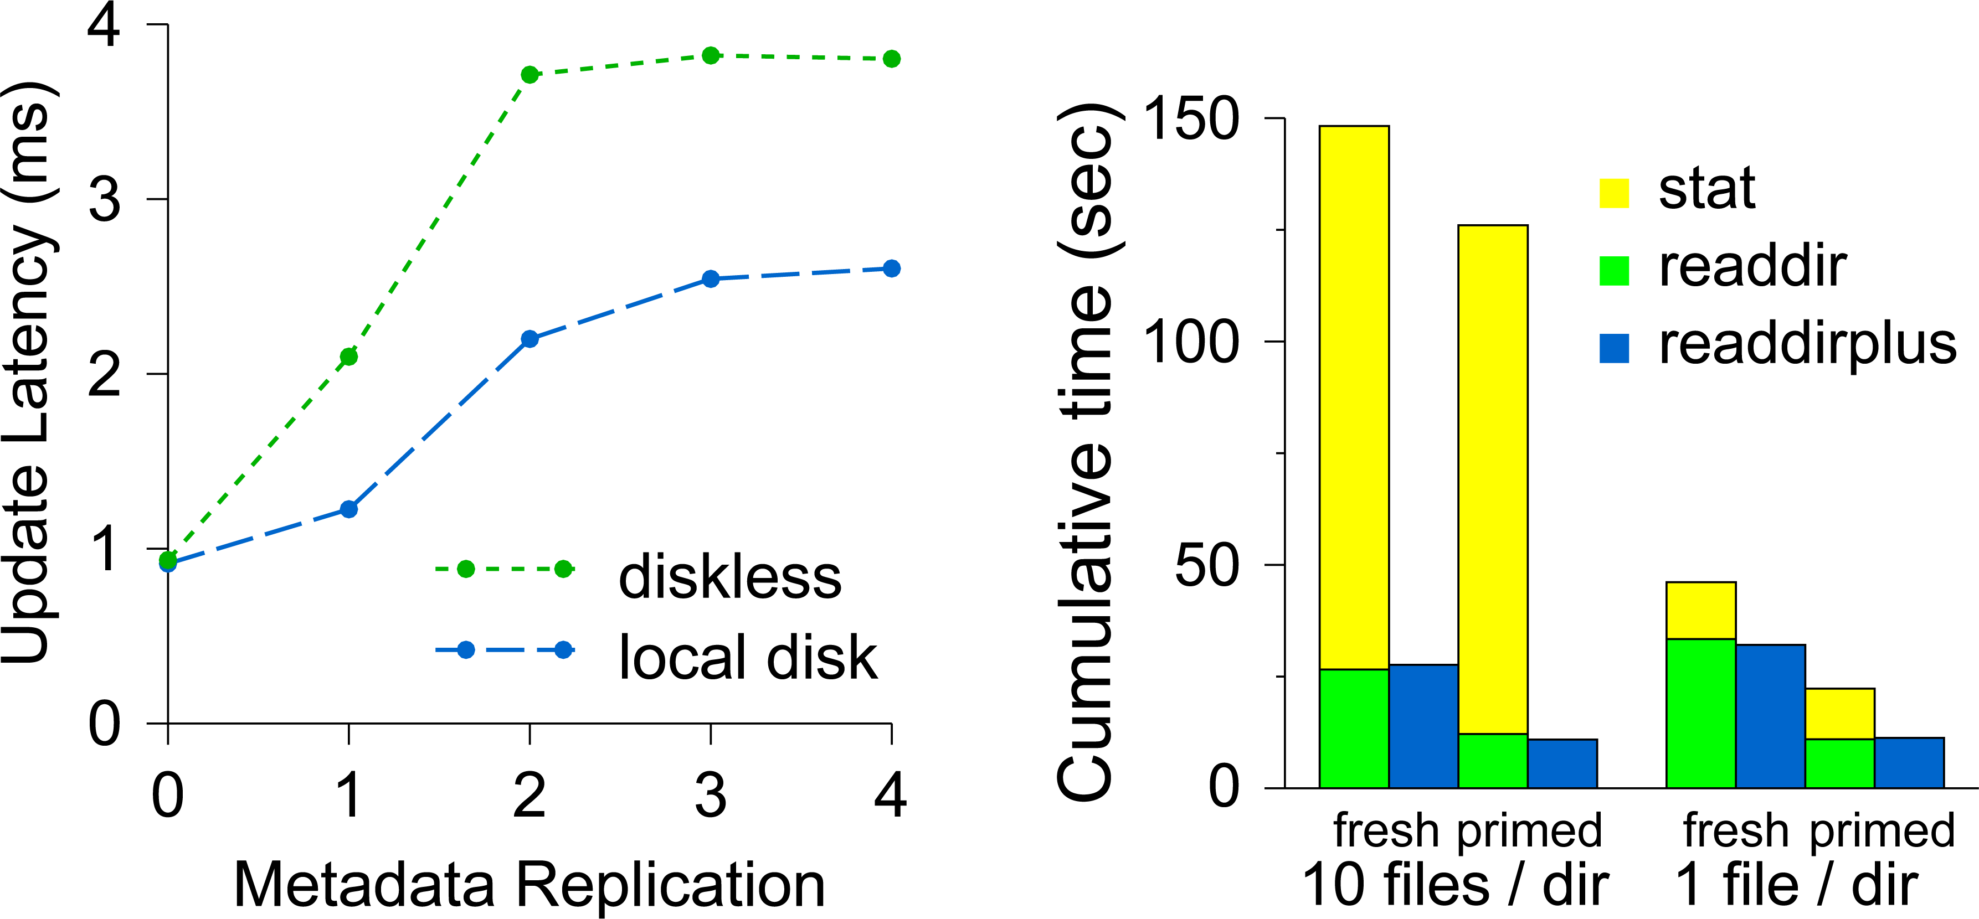
Diskless vs. Local Disk
Using a local disk lowers the write latency by avoiding the initial network round-trip.
Reads benefit from caching, while readdirplus or relaxed consistency eliminates MDS interaction for stats following readdir
Metadata update latency for an MDS with and without a local disk. Zero corresponds to no journaling.
Cumulative time consumed during a file system walk.

Slide 42
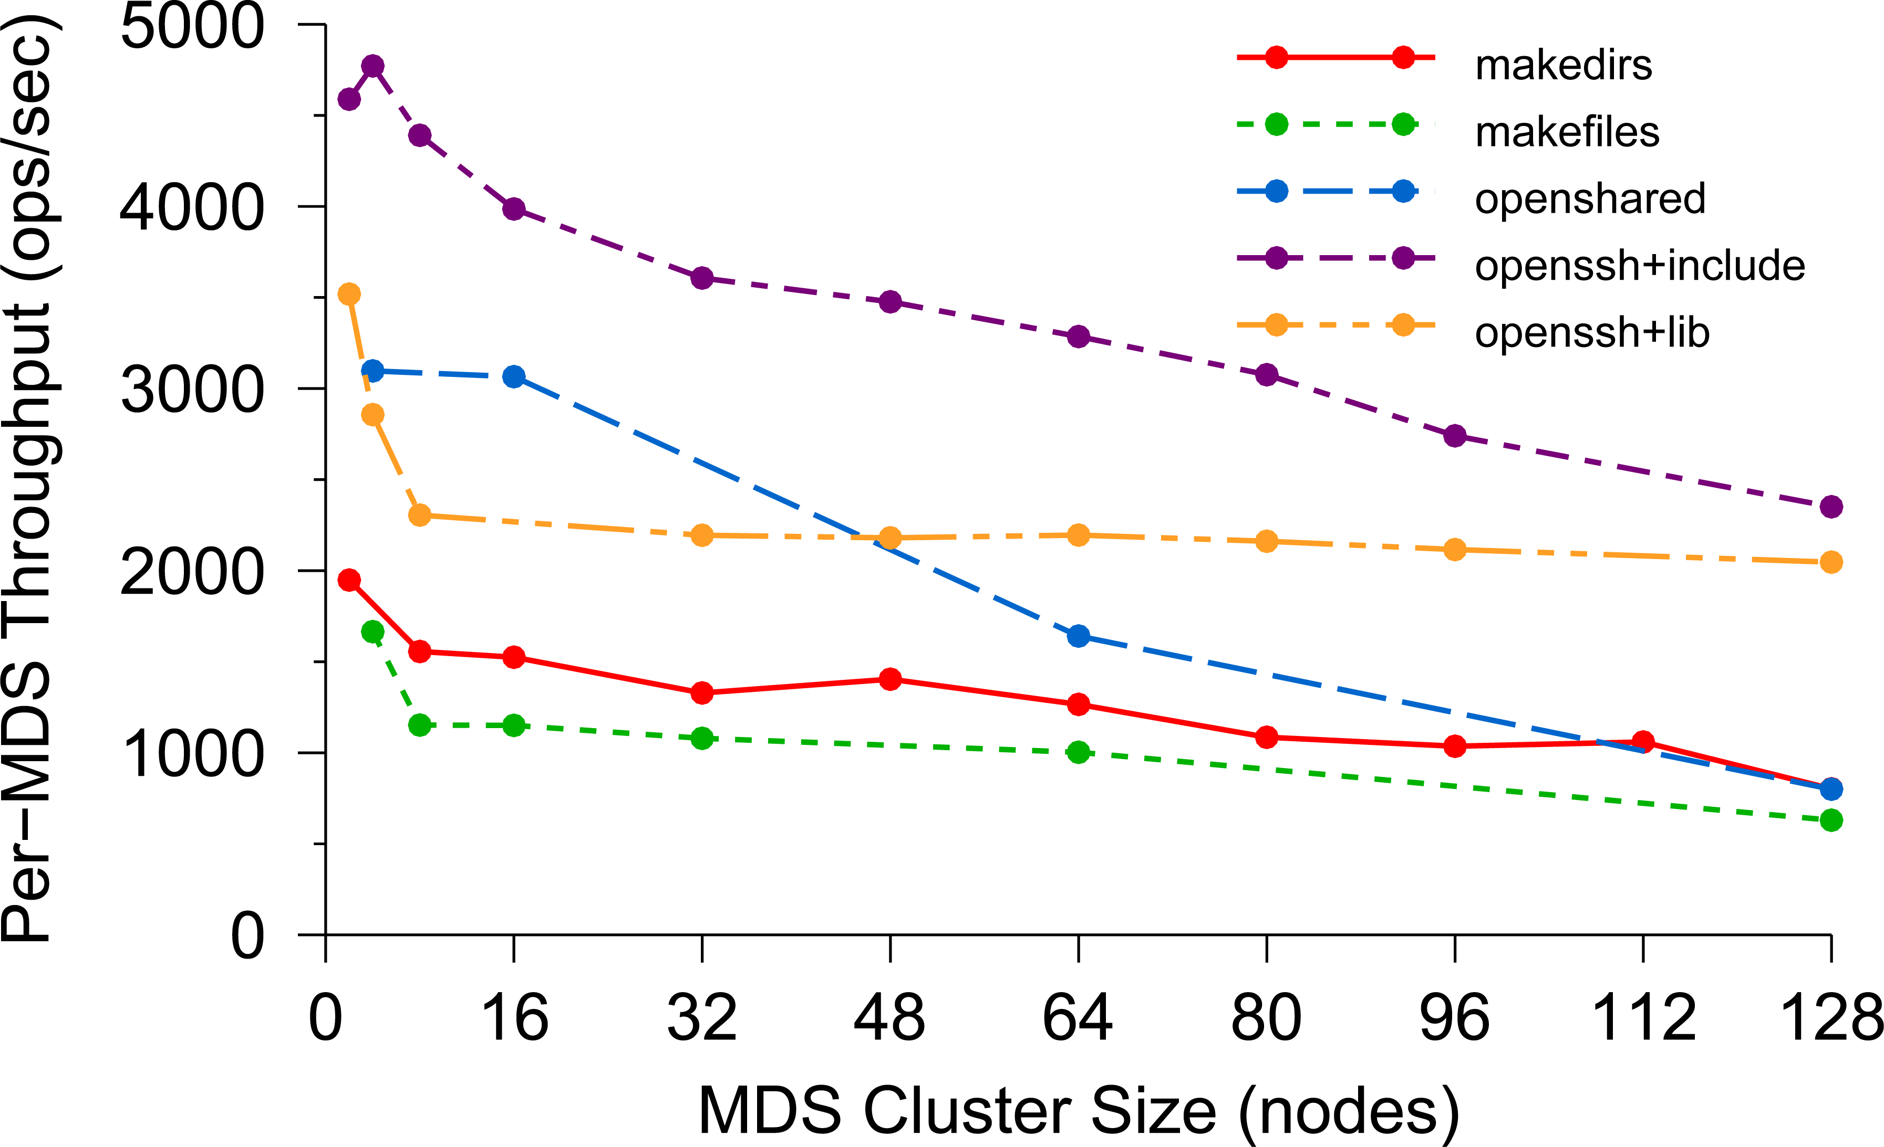
Per-MDS Throughput
As the cluster grows to 128 nodes, efficiency drops no more than 50% below perfect
linear (horizontal) scaling for most workloads, allowing
vastly improved performance over existing systems.

Slide 43
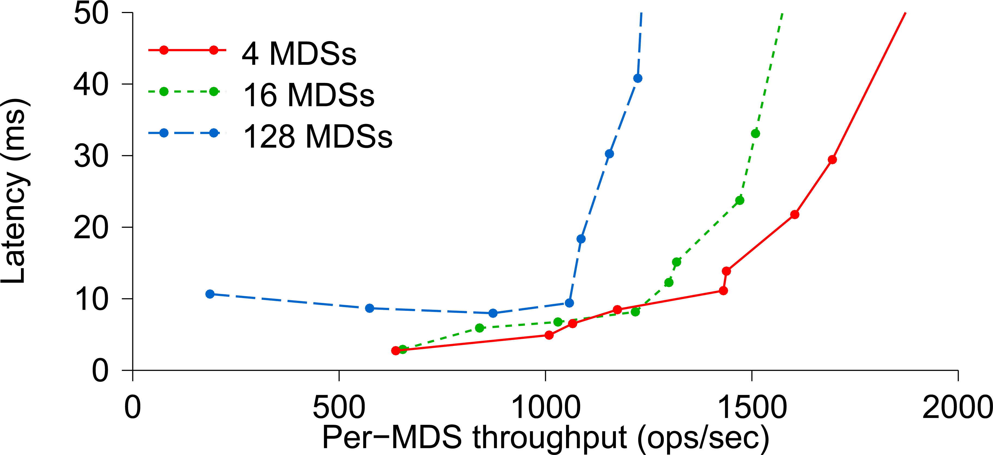
Average Latency
Larger clusters have imperfect
load distributions, resulting in lower average per-MDS
throughput and slightly higher latencies

Slide 44
Conclusions
Ceph addresses critical storage challenges: scalability, performance, and reliability.
It separates data from metadata, enabling independent scalability.
CRUSH ensures data distribution and efficient object location calculations.
RADOS manages data replication, failure recovery, and low-level operations without central servers.
EBOFS offers superior performance for specific workloads in Ceph.
Ceph's metadata management provides efficient, scalable support for a unified directory hierarchy with POSIX semantics.

Slide 45
Q&A Ceph: A Scalable, High-Performance Distributed File System
Thank You !
2023. 10. 17
Agung Rahmat Ramadhan
agung@dankook.ac.kr

